Slide 1
GitHub Tutorial
Presented by
AMS Graduate Student Chapter
Rachel Domagalski

Slide 2
This GitHub Workshop Will Cover
GitHub, what is it?
Creating a repository
Creating a branch
Perform operations
Pull Requests
Merge
Cloning & Forking
GitHub Desktop
Notes:
https://www.edureka.co/blog/how-to-use-github/

Slide 3
Version Control
Daily Workflow:
Create things
Save things
Edit things
Save again (the goal!)
When, why, how?
Track the history
Notes:
Example objectives
At the end of this lesson, you will be able to:
Save files to the team Web server.
Move files to different locations on the team Web server.
Share files on the team Web server.

Slide 4
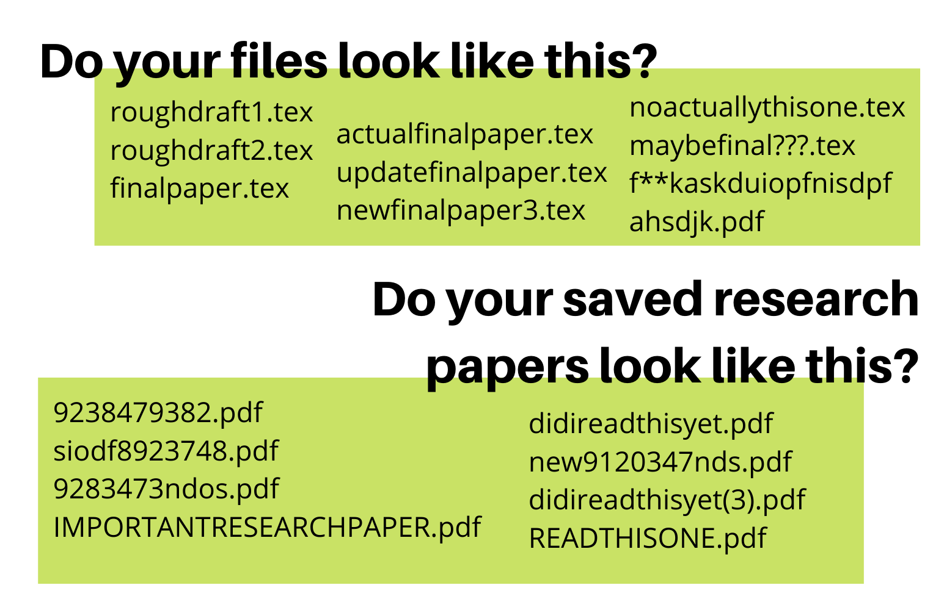
The Way of Inevitable Pain and Suffering
Notes:
Example objectives
At the end of this lesson, you will be able to:
Save files to the team Web server.
Move files to different locations on the team Web server.
Share files on the team Web server.

Slide 5
The Way of Inevitable Pain and Suffering
What if you could keep track of what each file is, what changes have been made, who made them, and be able to switch back and forth to any version you want?
Notes:
Example objectives
At the end of this lesson, you will be able to:
Save files to the team Web server.
Move files to different locations on the team Web server.
Share files on the team Web server.

Slide 6


























Version Control Perks
Notes:
Example objectives
At the end of this lesson, you will be able to:
Save files to the team Web server.
Move files to different locations on the team Web server.
Share files on the team Web server.

Slide 7












































Version Control Perks
Notes:
Example objectives
At the end of this lesson, you will be able to:
Save files to the team Web server.
Move files to different locations on the team Web server.
Share files on the team Web server.

Slide 8
















Version Control Perks
Notes:
Example objectives
At the end of this lesson, you will be able to:
Save files to the team Web server.
Move files to different locations on the team Web server.
Share files on the team Web server.

Slide 9
Version Control Perks
GIT LETS US DO ALL THESE THINGS
Notes:
Example objectives
At the end of this lesson, you will be able to:
Save files to the team Web server.
Move files to different locations on the team Web server.
Share files on the team Web server.

Slide 10
What is GitHub?
File & code sharing service
Access files both locally and remotely
Allows collaboration with multiple people
AT THE SAME TIME!!!
You can merge your files together
Version control
See what changes were made, when, and why
Notes:
Now, to GitHub, create an account

Slide 11
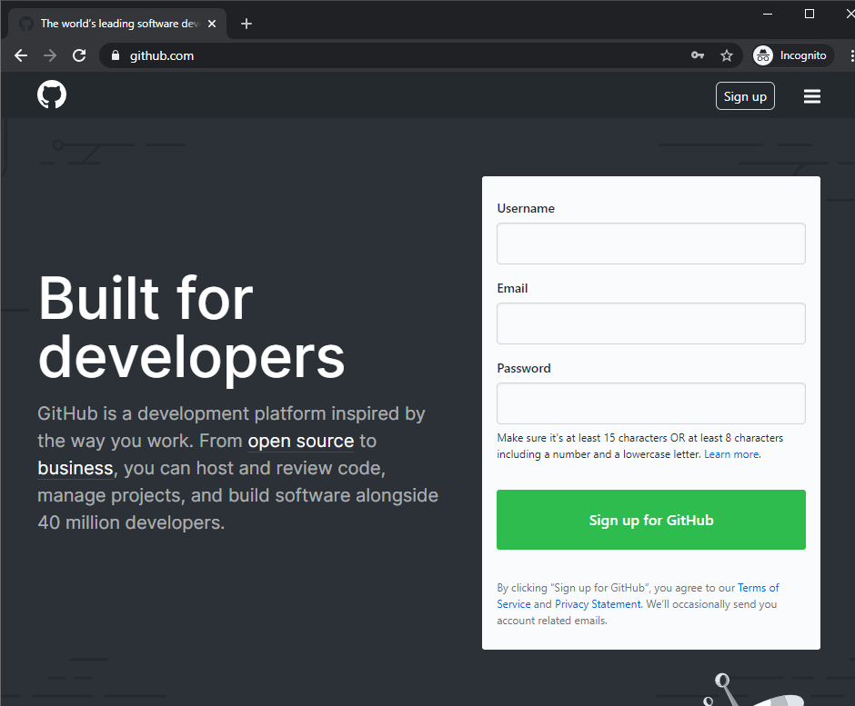
www.github.com
Sign Up (Or log in if you already have an account)

Slide 12
Create a Repository
A repository is a place to store your files
Store any type of file you want!
Local and remote repositories
GitHub repositories are remote, but they can sync to folders on your local computer
Keep different repositories for different projects

Slide 13
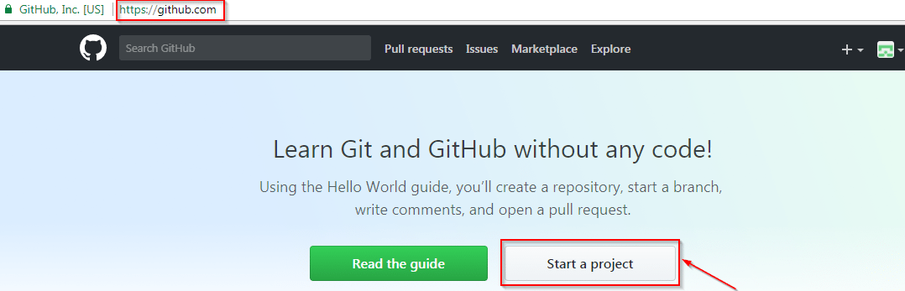
If this is your first-time logging into GitHub, you probably see a screen that looks like this.
Create your own repository by clicking on start a project!

Slide 14
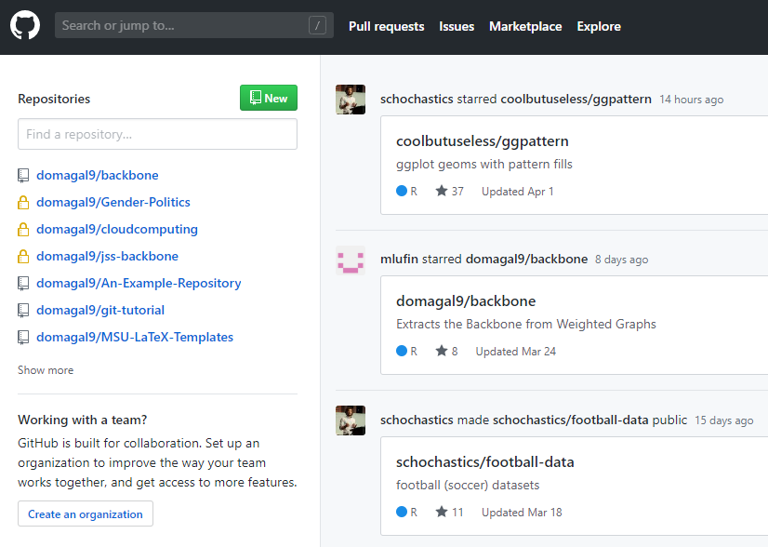
Here is my GitHub page when I log in
To the left are my existing repositories, one for each project
If you already have projects, click on “New” to create your own!

Slide 15
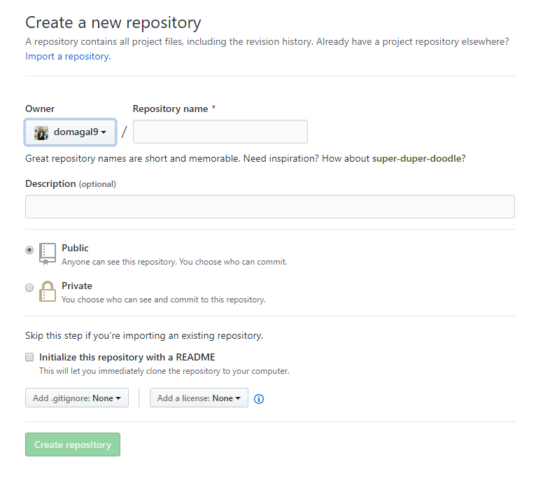
Add a project name
Public (you add student privileges to your account later and then have access to private, https://education.github.com/pack)
Click initialize with a README
In general, YES README if starting the project on GitHub, NO README if you already have the project on your computer

Slide 16
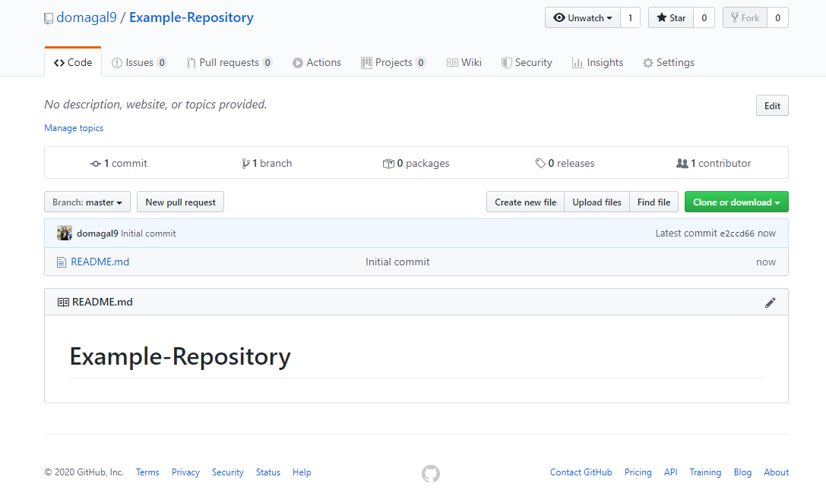
We now have a project and can see the files!
Let’s learn about branches.

Slide 17























Create a branch

Slide 18
Branches
Branches let you work on different versions of your project at the same time
They let you test out changes and decide to keep them or not
If you decide to keep it, you can easily merge it into your “master”, which is your official project files

Slide 19
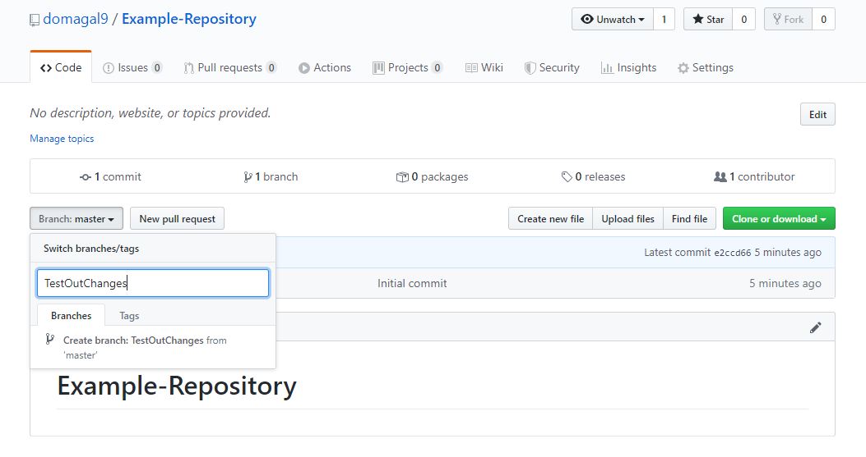

Slide 20





























Making Changes and Commits

Slide 21
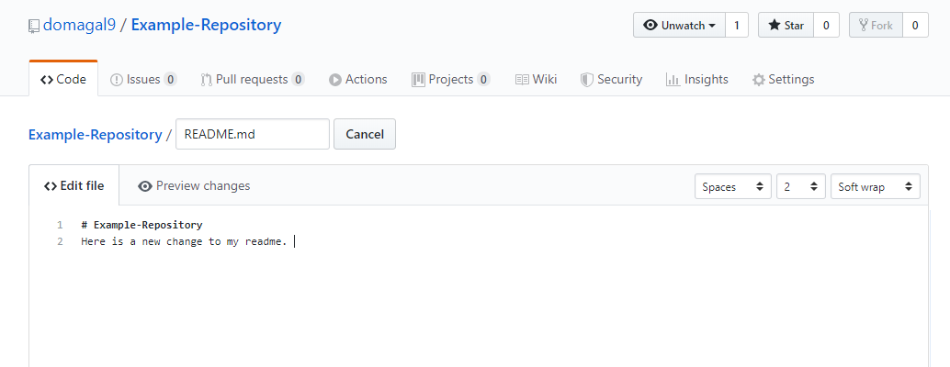
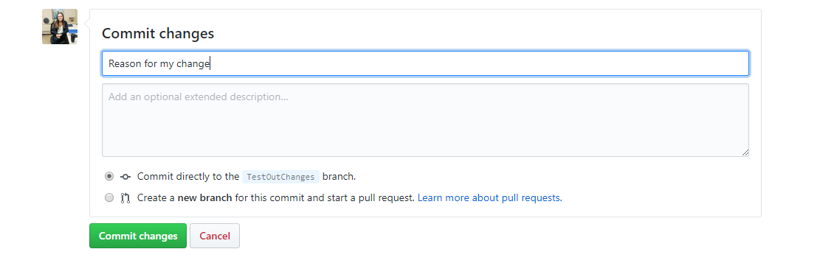

Slide 22
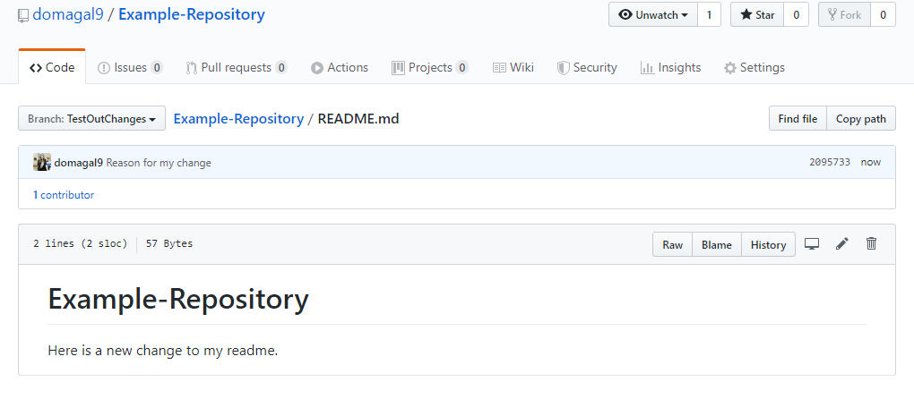
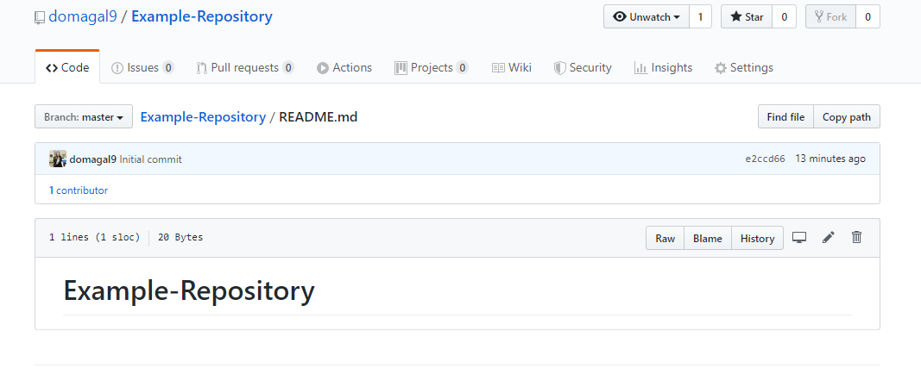

Slide 23
Like the change? Create a pull request!
When you’ve made a change on a branch, you submit a pull request to say “Hey! Check out my change! Add it to the main branch!”
All contributors get to see your changes line by line
Can have a discussion about changes

Slide 24
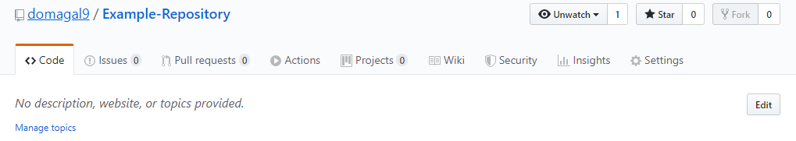
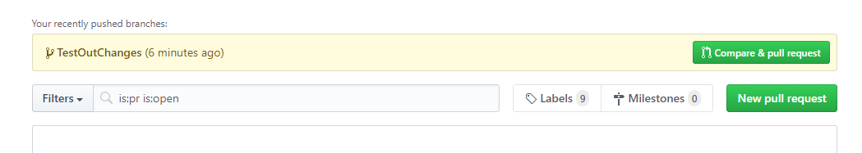

Slide 25
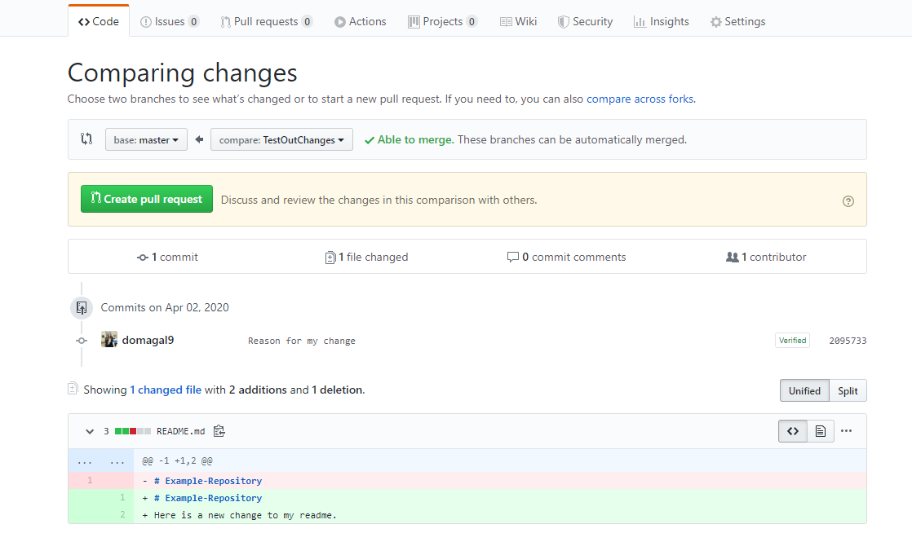

Slide 26
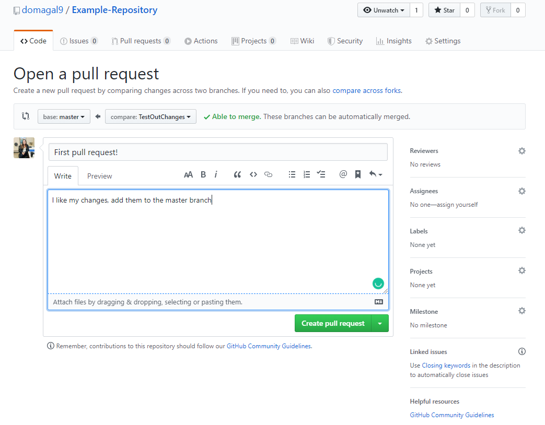

Slide 27
Merge
If you like the changes, you can MERGE them into your master branch
This adds your changes to your official file

Slide 28
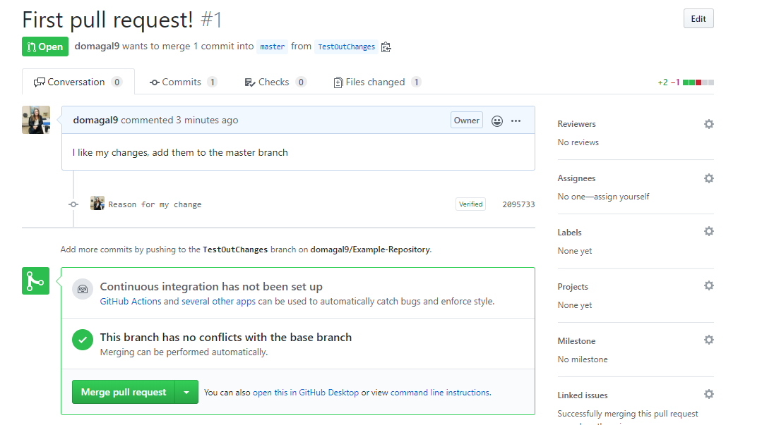

Slide 29
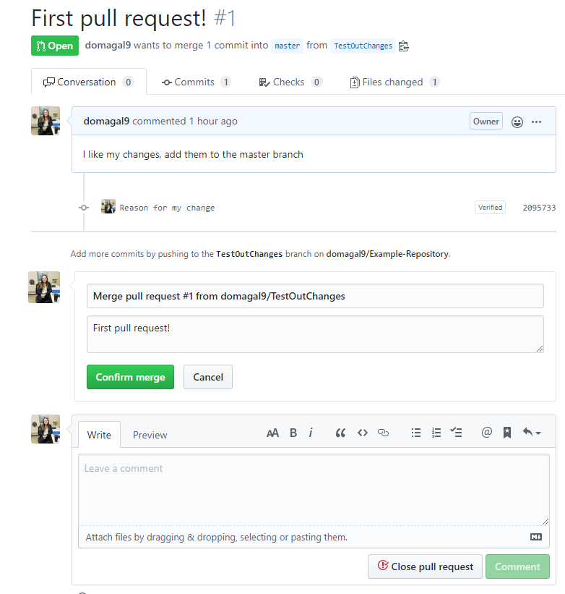

Slide 30
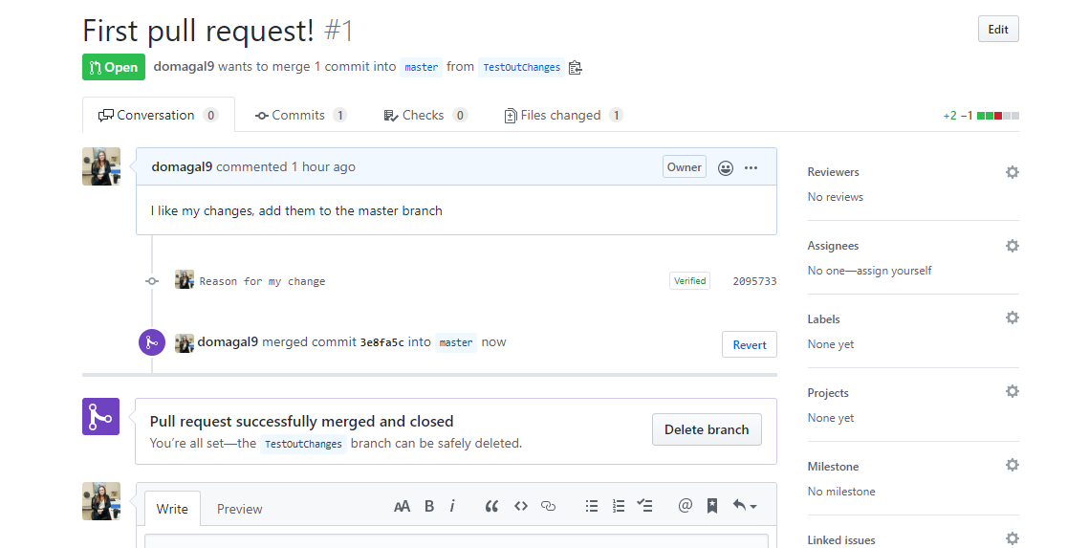

Slide 31
After you’ve merged
Your changes are now on master
You can delete the branch you were working on
Start a new branch for any other changes
TRY: Creating a new branch
Upload a .tex file
Edit it
Submit a pull request and merge

Slide 32
Cloning vs. Forking
A full copy of the original project
You can affect the original project if you have permission from the project owner
Basically lets you download someone’s project
A new copy of a repository that you can change without affecting the original project
Changes in the original WILL be reflected in the forked one
Use this to contribute to other people’s projects
Used to create pull requests, aka merging your changes into someone else’s project

Slide 33
Fork a project, make a change, submit a pull request
https://github.com/domagal9/Example-Repository/
Click on “Fork”
You should now see my repository under the list of your repositories
Open the README and add your name
Submit a pull request

Slide 34
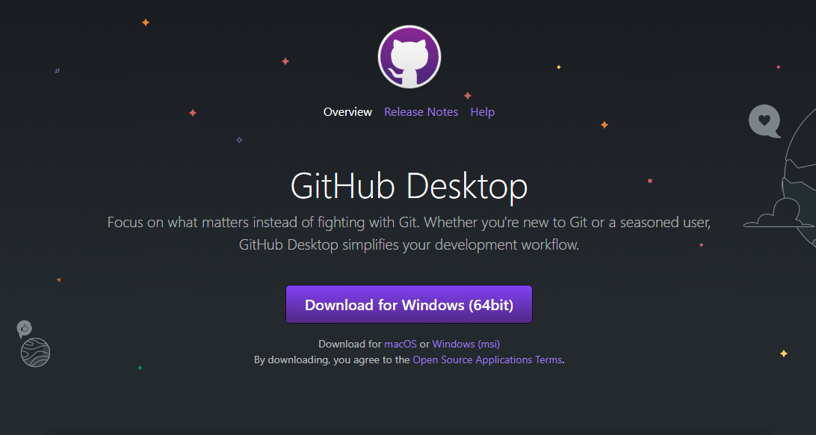
GitHub Desktop https://desktop.github.com/
Git can be confusing, especially if you’re not used to terminal / command line
GitHub Desktop is a GUI that makes everything simpler and easy to understand

Slide 35
https://help.github.com/en/desktop/getting-started-with-github-desktop/configuring-git-for-github-desktop
If you don’t already have Git installed (like from the previous workshop) you can configure it from within GitHub desktop.
This process will likely be slightly different for everyone depending on computer configurations

Slide 36
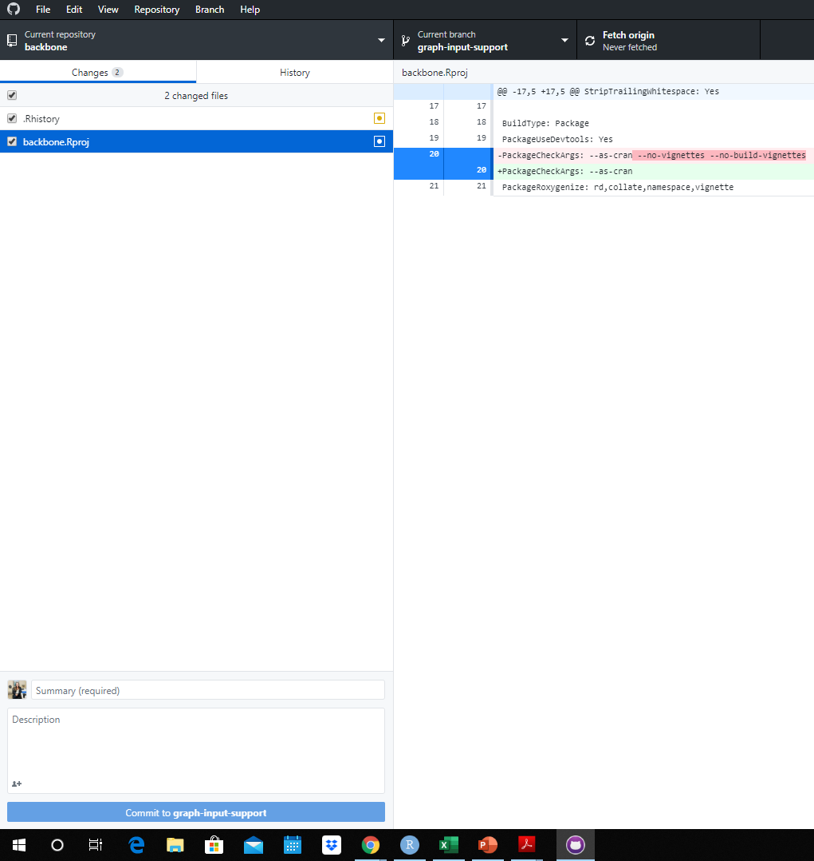

Slide 37
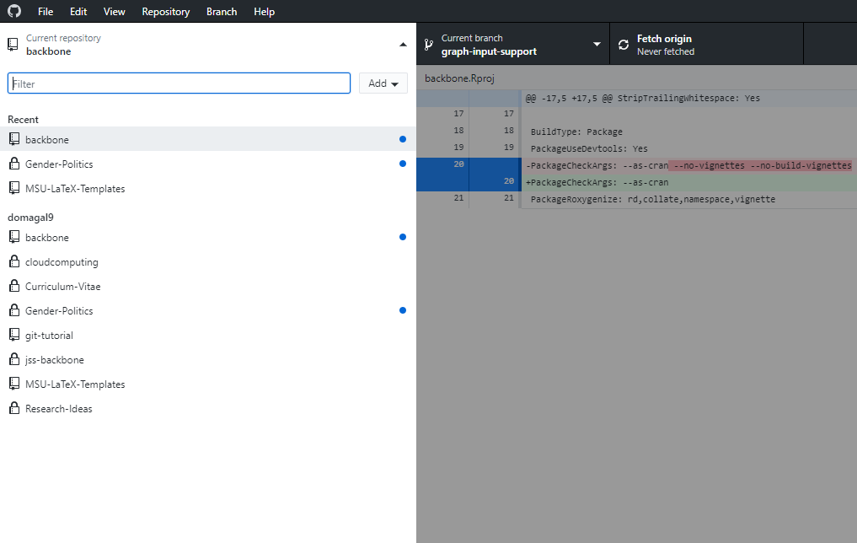
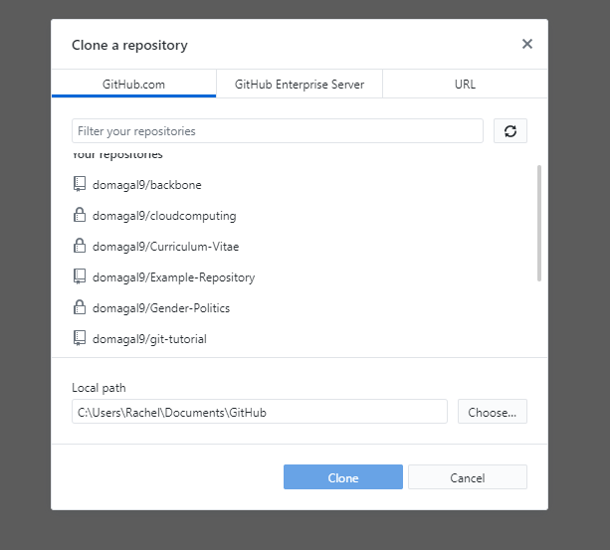

Slide 38
GitHub Desktop puts your GitHub files on your local computer
Find where they are saved
Make changes, upload, delete, etc.
Go back to GitHub Desktop
Commit your changes
PUSH - send them from your computer to the online version
Whenever you open GitHub Desktop, make sure to FETCH latest versions

Slide 39
Extras
Great for testing code in different branches
Keeping a record of files (CV, class notes, personal statements)
Allows collaboration of the same files at the same time
Don’t commit compiled files
Don’t mess with master unless it’s just you (make your changes on a branch in general)

Slide 40
References
https://help.github.com/en/desktop/getting-started-with-github-desktop/creating-your-first-repository-using-github-desktop
https://desktop.github.com/
https://medium.com/@george.seif94/a-full-tutorial-on-how-to-use-github-88466bac7d42
https://www.edureka.co/blog/how-to-use-github/
https://git-scm.com/book/en/v2/Getting-Started-About-Version-Control
https://github.github.com/training-kit/downloads/github-git-cheat-sheet.pdf
https://guides.github.com/introduction/git-handbook/
https://www.atlassian.com/git/tutorials/learn-git-with-bitbucket-cloud
https://thenewstack.io/getting-legit-with-git-and-github-your-first-pull-request/
https://try.github.io/
https://guides.github.com/activities/forking/
https://thenewstack.io/dont-mess-with-the-master-working-with-branches-in-git-and-github/

