Slide 1
Team: Egzepšn
Domagoj kopić
nikola majcen
ivan sušec
Mario tuđan

Slide 2
Technologies used
Frontend - Angular2
Backend - ASP.NET CORE
Mobile:
iOS native
Android native

Slide 3
Implemented features
Social Login
Moderator UI
Creating Quizzes
Creating teams and joining Via Mobile
Opening, Closing and Starting quizes via Web Interface
Generating questions

Slide 4
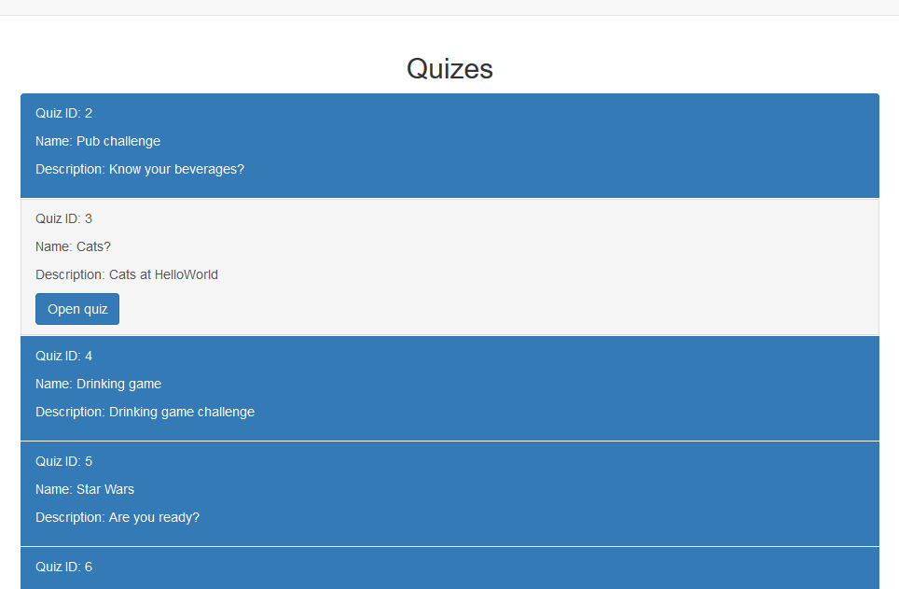
Web UI

Slide 5
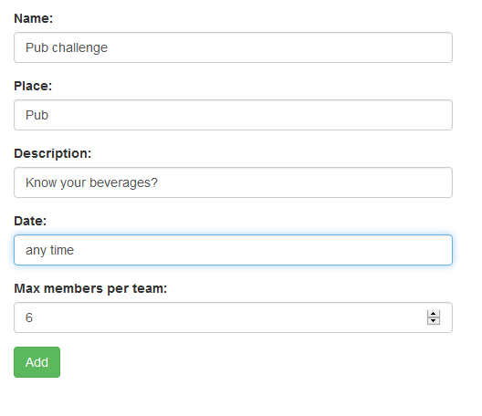

Slide 6
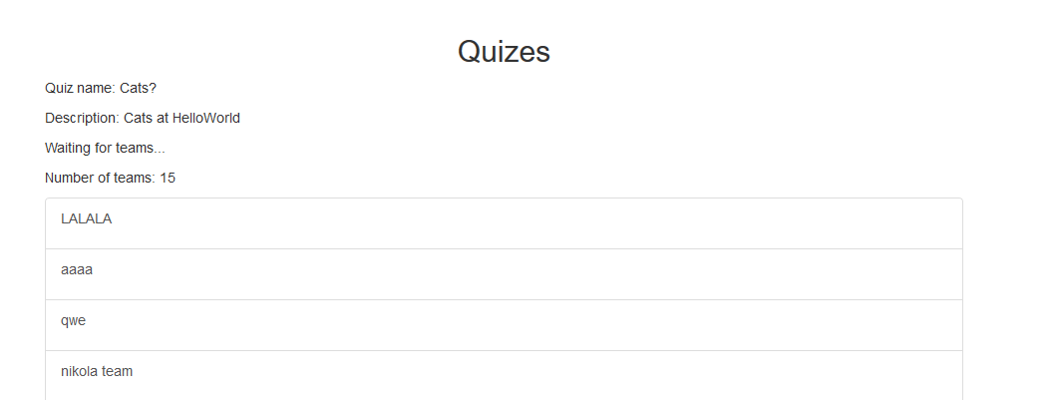

Slide 7
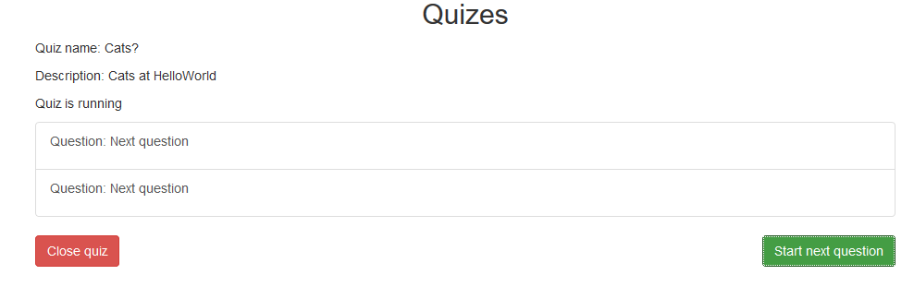

Slide 8
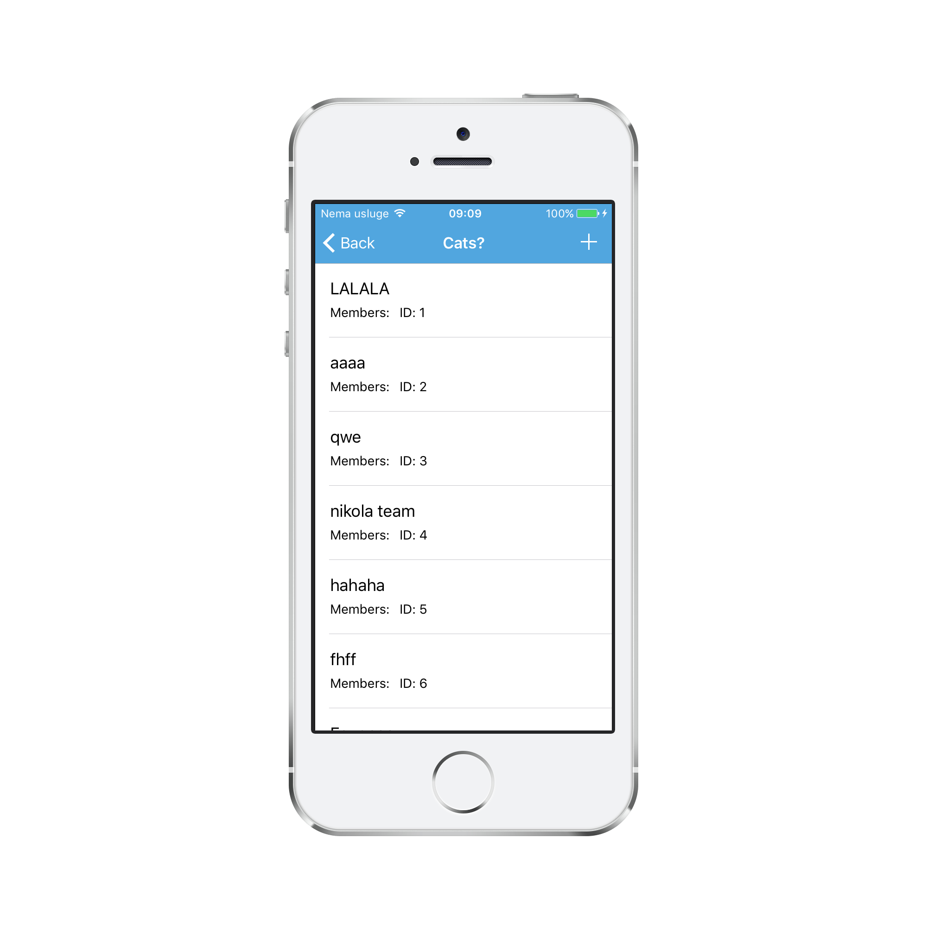
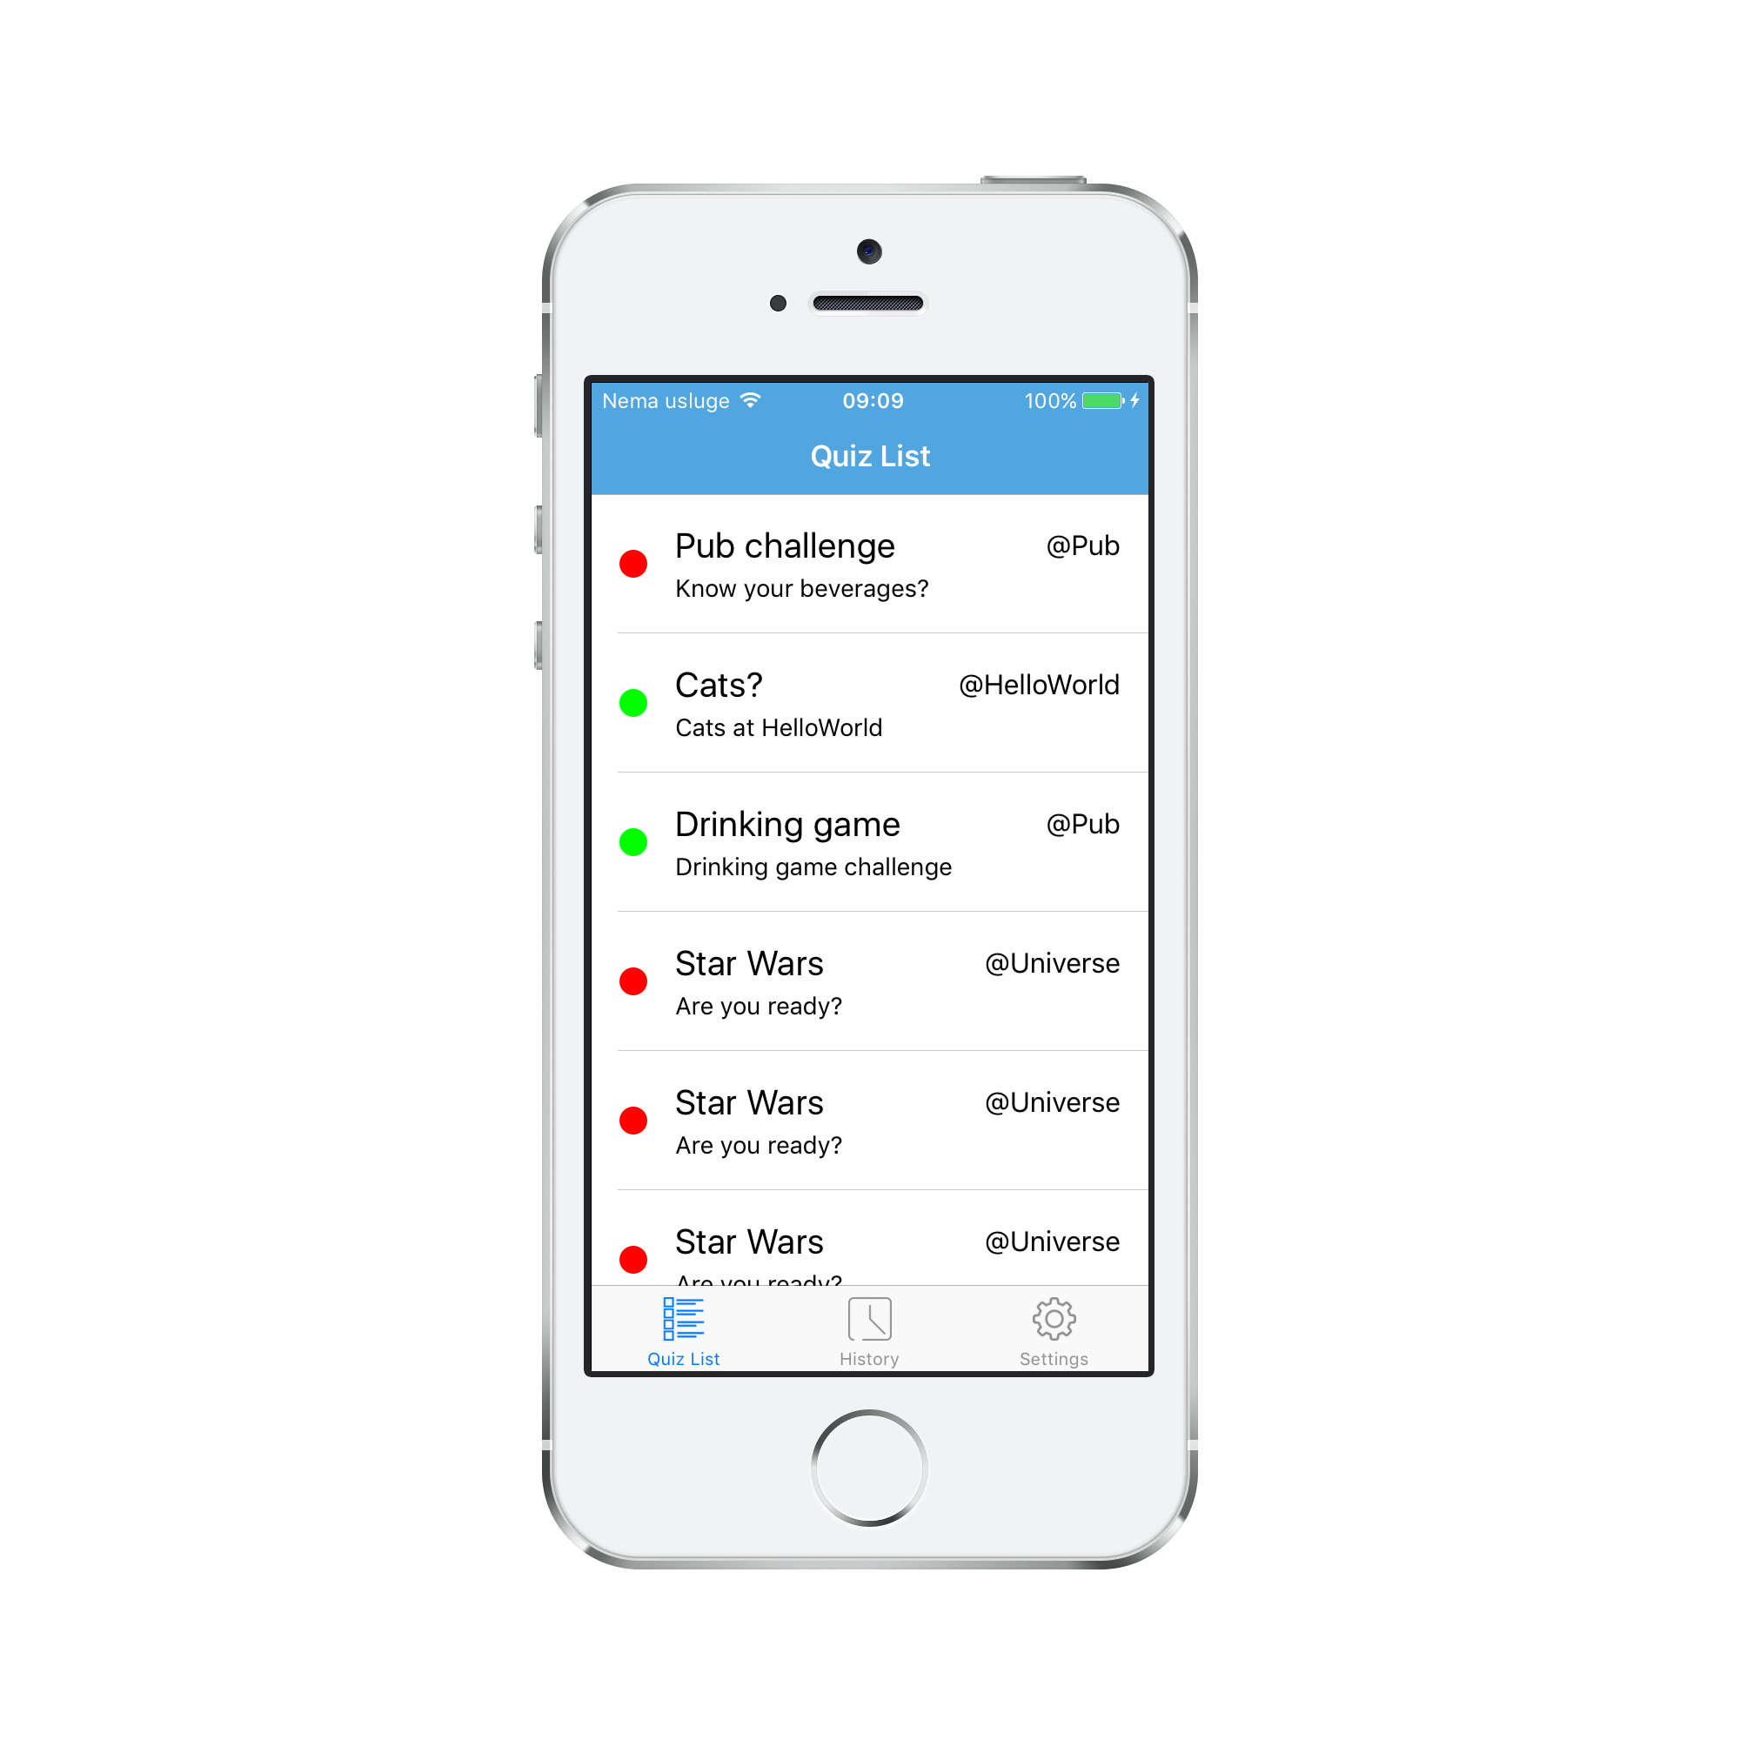
IOS

Slide 9
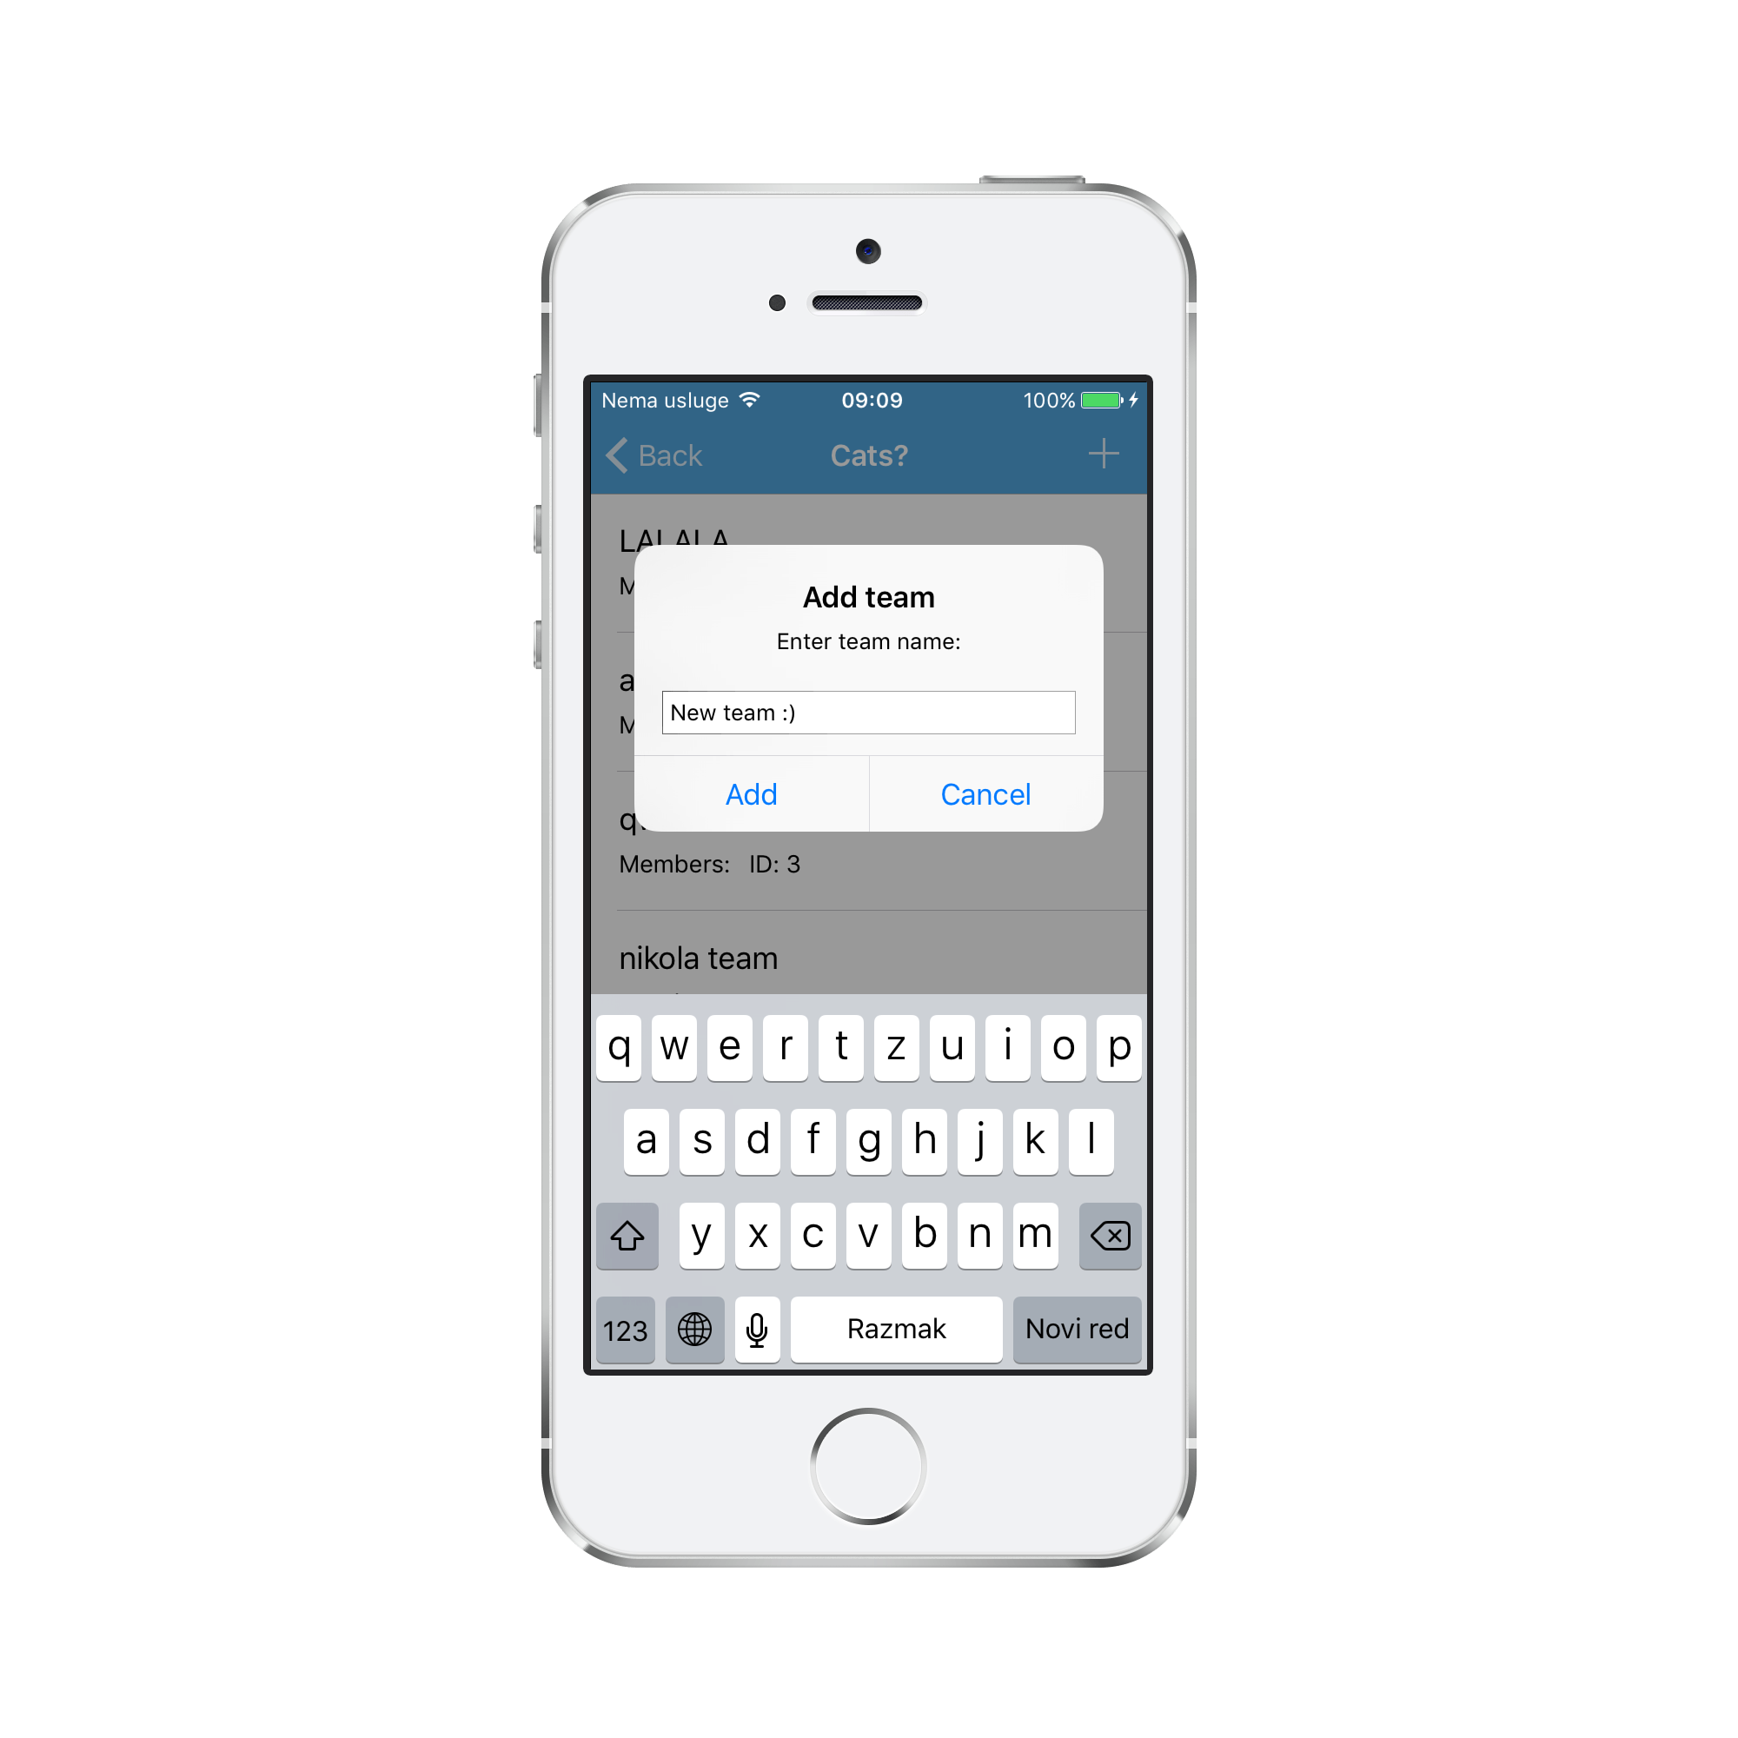
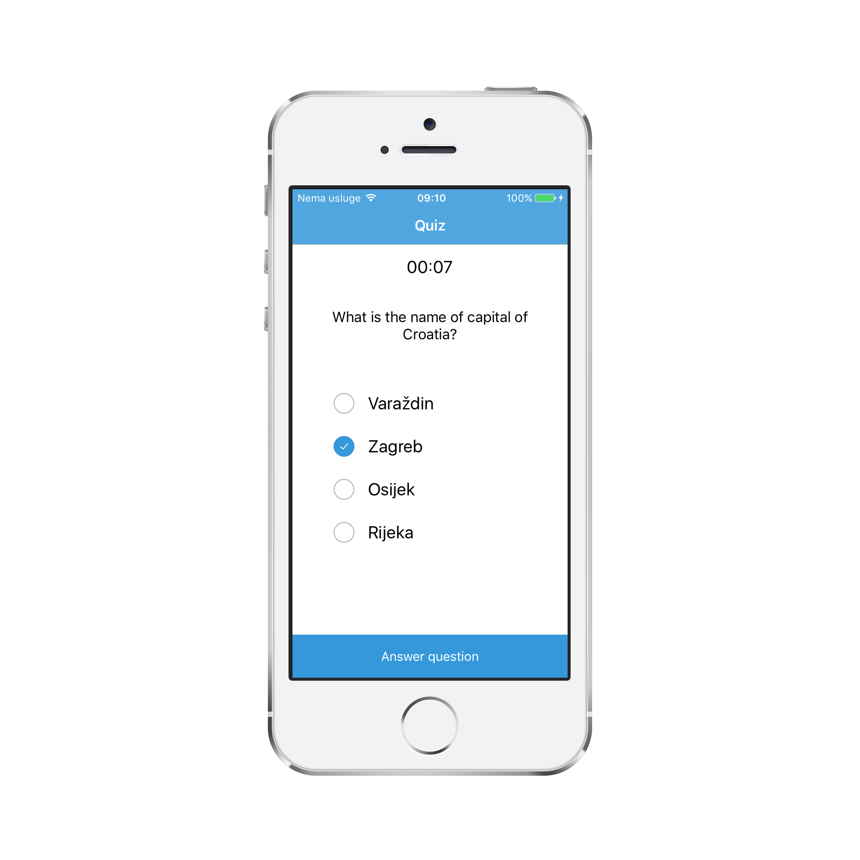

Slide 10
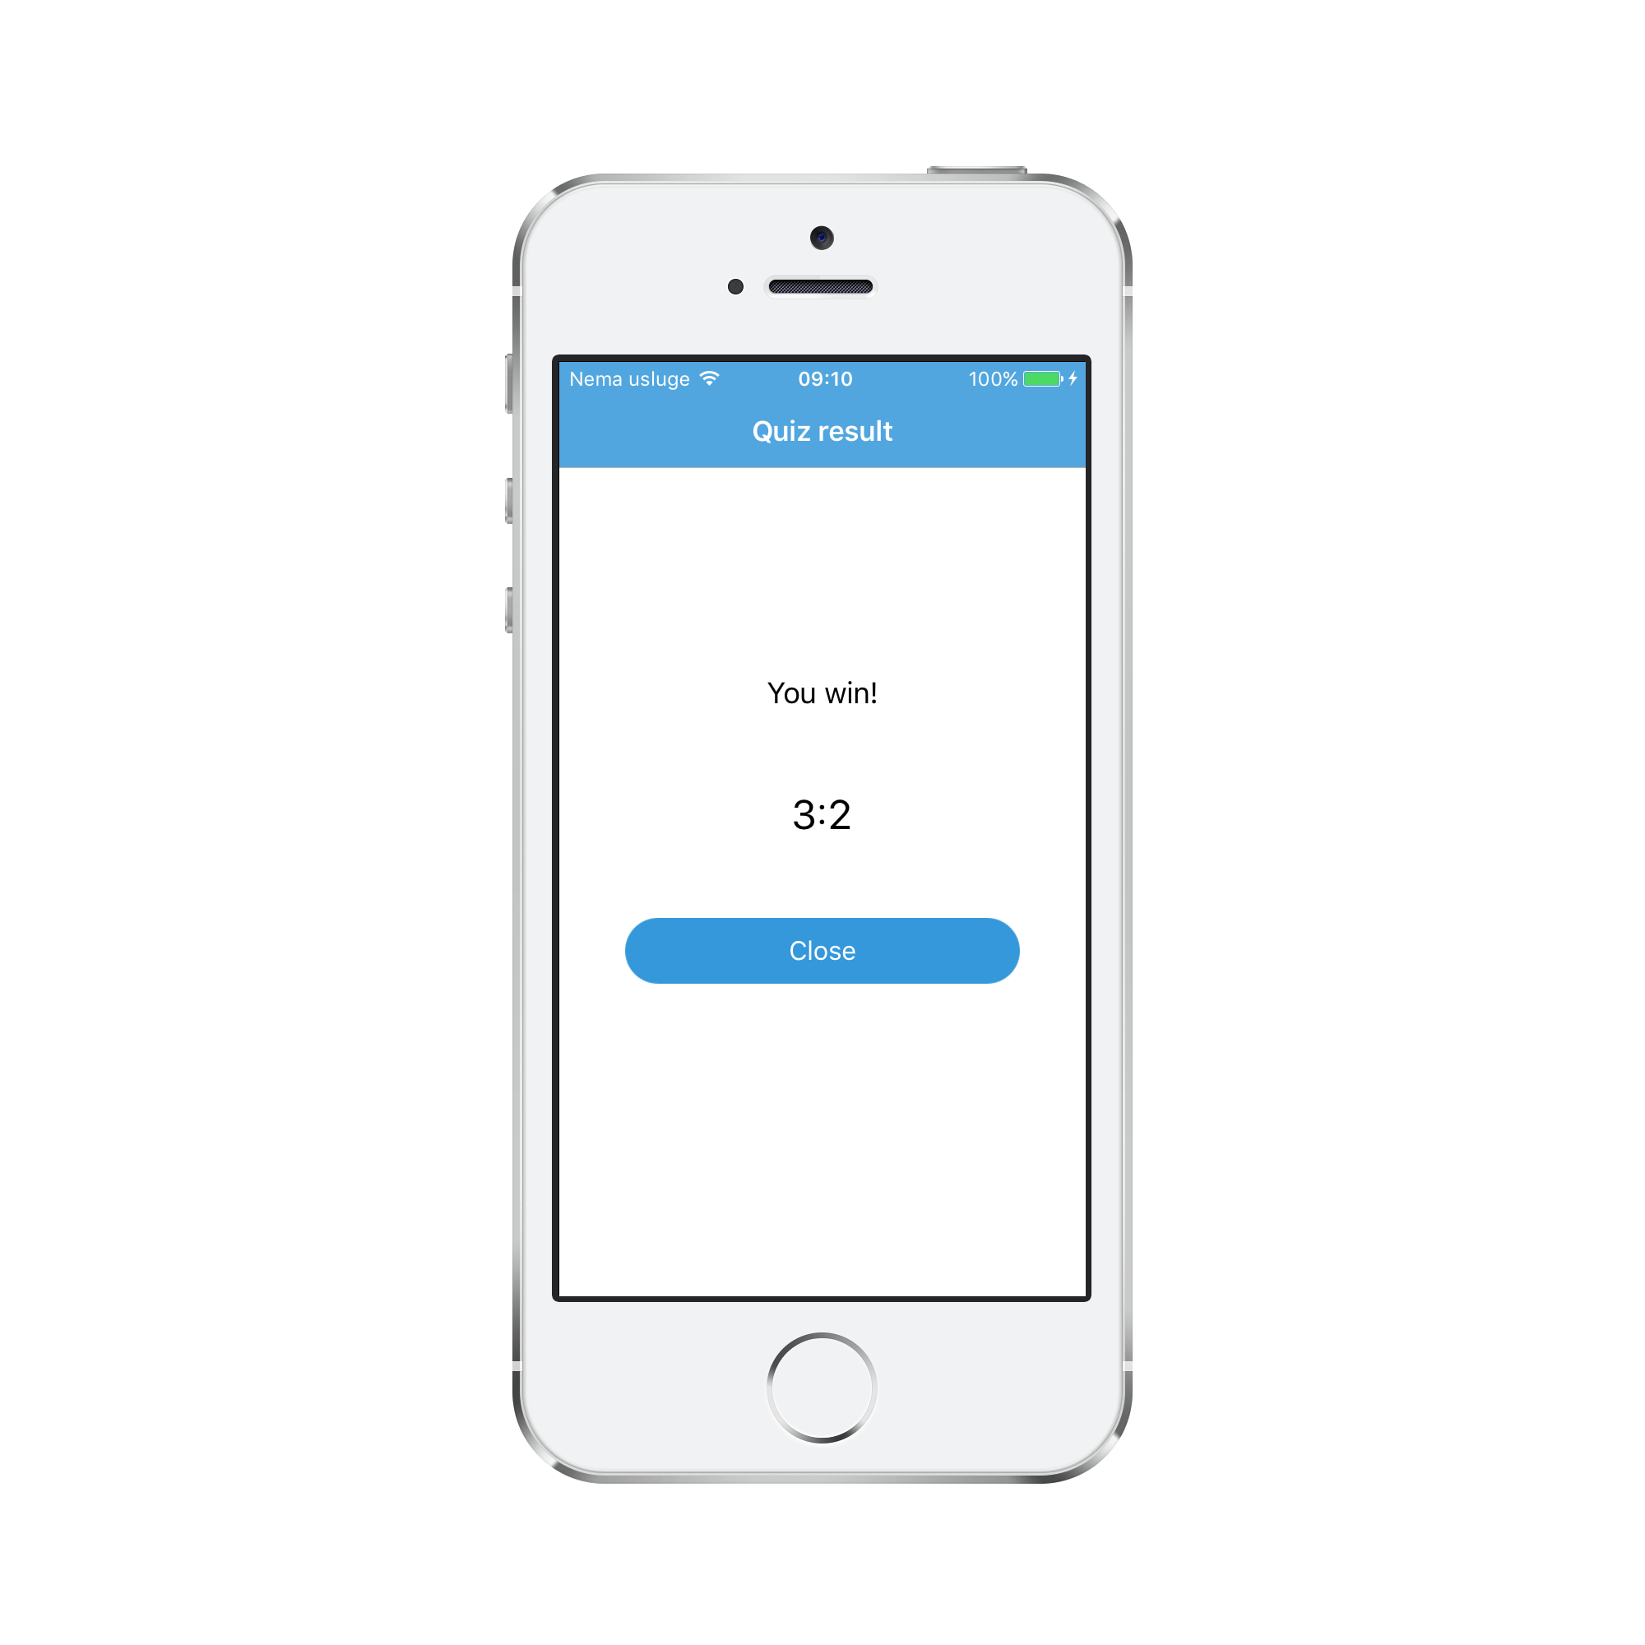
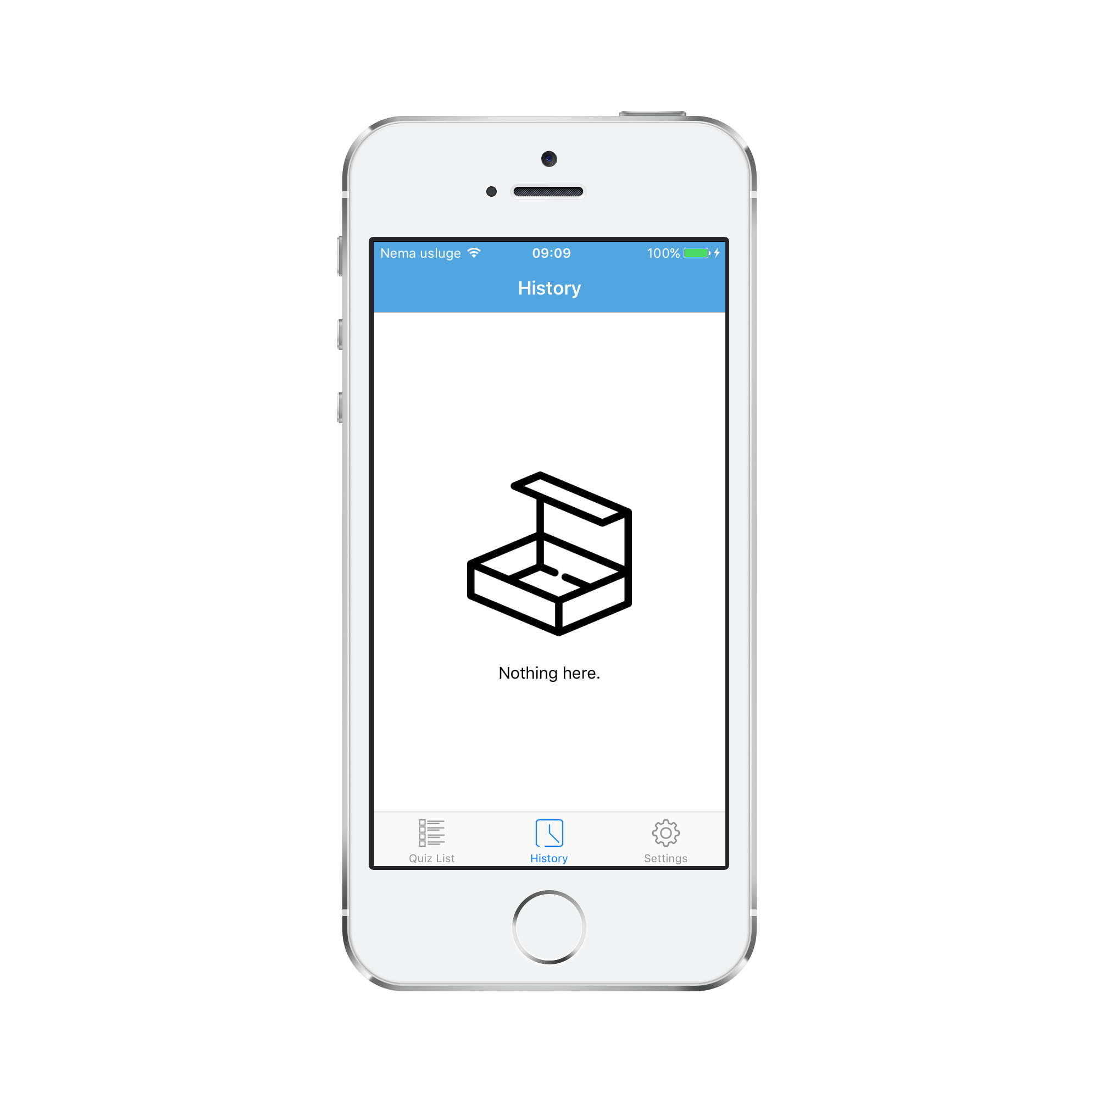

Slide 11
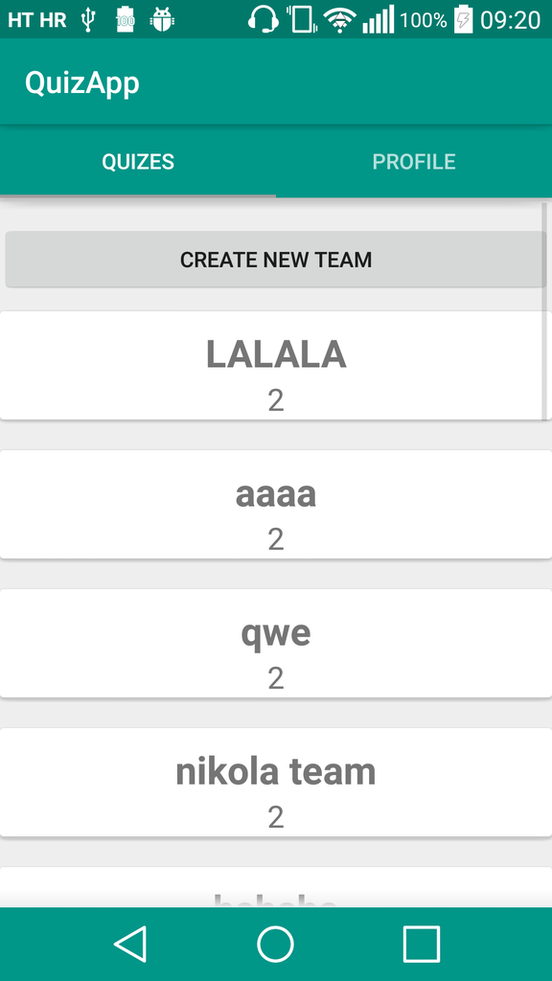
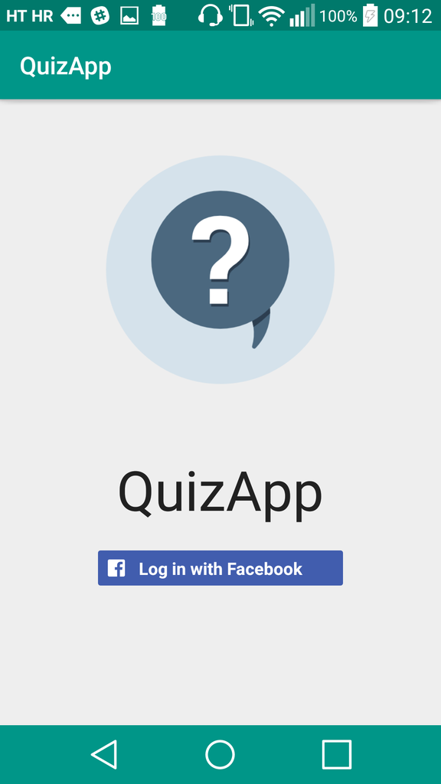
Android

Slide 12
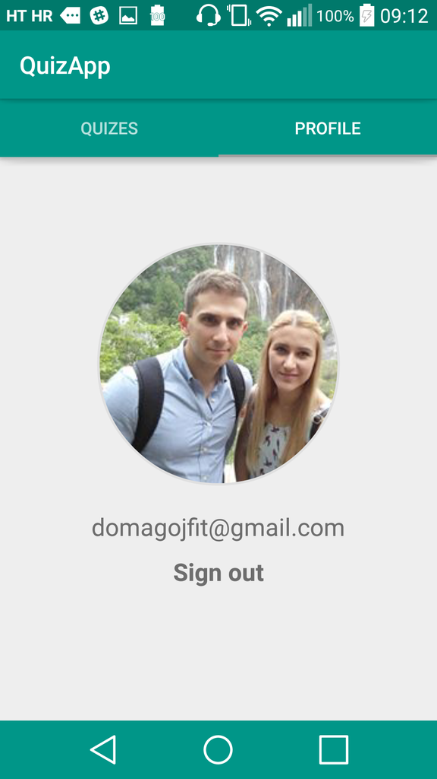
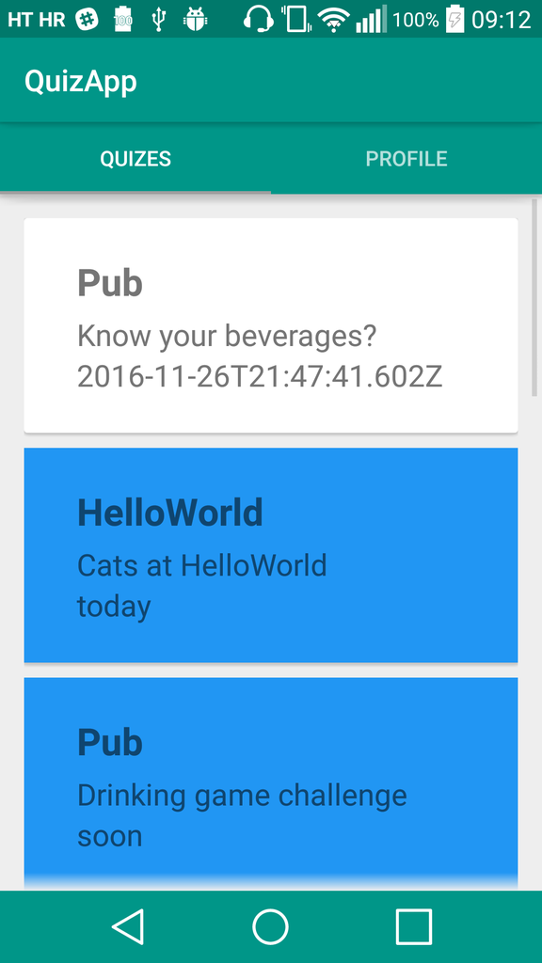

Slide 13
Thank you

