Slide 1
Introduction to Plotly

Slide 2
Why Plotly?
The focus for this section of the course is to build interactive visualizations for an audience.
The idea behind this skill is that you provide the customer/consumer/client with the ability to visualize complex data so that they can explore and draw their own conclusions from it.
This is a big trend in reproducible data science and data journalism.
Here is an article that has some explanation about this: https://medium.com/@FILWD/from-data-visualization-to-interactive-data-analysis-e24ae3751bf3

Slide 3
Why Plotly?
Communicate data insight and visualization to a wide audience using the browser.
More visually appealing than Matplotlib.
Offers interactivity.
Plotly and many similar visualization libraries use JavaScript.

Slide 4
Journey to JavaScript

Slide 5
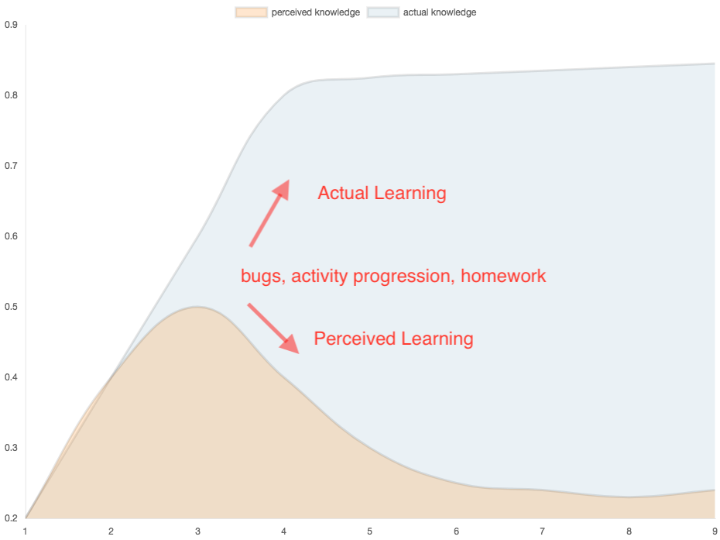
The Journey to JavaScript….

Slide 6
Learning Outcomes
By the end of this unit, you will be able to:
Create and annotate charts with labels, text, and hover information.
Create and annotate charts from API calls.
Create and annotate charts using advanced JavaScript methods and statistical functions.

Slide 7
Today’s Class

Slide 8
Class Objectives
By the end of the class you will:
Create basic plots in Plotly.
Use the JavaScript filter() method.
Use the JavaScript Math library
Use map() in creating Plotly charts.

Slide 9
Class Objectives
By the end of the class you will:
☑ Create basic plots in Plotly.
Use the JavaScript filter() method.
Use the JavaScript Math library
Use map() in creating Plotly charts.

Slide 10
Class Objectives
By the end of the class you will:
☑ Create basic plots in Plotly.
☑ Use the JavaScript filter() method.
Use the JavaScript Math library
Use map() in creating Plotly charts.

Slide 11
Class Objectives
By the end of the class you will:
☑ Create basic plots in Plotly.
☑ Use the JavaScript filter() method.
☑ Use the JavaScript Math library
Use map() in creating Plotly charts.

Slide 12
Class Objectives
By the end of the class you will:
☑ Create basic plots in Plotly.
☑ Use the JavaScript filter() method.
☑ Use the JavaScript Math library
☑ Use map() in creating Plotly charts.

