Slide 1
Florida Gun Violence incidents by city / county and income, unemployment and poverty statistics
Project 2 – Group 2 – ETL project
Ignacio Domaica, Jason Amaya, Andrés Sosa

Slide 2
AGENDA
Project description
Sources
EXTRACTION
TRANSFORMATION
LOAD
SQL Results
BONUS 1. TABLE 2 Florida_Gun_Violence_detail
BONUS 2. Plot_gmaps_with_main_incidents

Slide 3
Project Description
Perform an analysis of incidents of gun violence according to national official statistics throughout the country (239,677)
Filter them for the state of Florida (15,029)
Relate them geospatially (cities, towns and counties) to variables such as income, unemployment and poverty.

Slide 4
SOURCES (1)
Datasets used obtained from
Kaggle:
https://www.kaggle.com/gunviolencearchive/gun-violence-database
https://www.kaggle.com/ericking310/us-gun-violence
https://www.gunviolencearchive.org
US Census Bureau:
Median Household Income by Town: http://data.ctdata.org/dataset/median-household-income-by-town
U.S. DEPARTMENT OF AGRICULTURE, Economic Research Service:
Poverty Statistics:
https://www.ers.usda.gov/webdocs/DataFiles/48747/PovertyEstimates.xls?v=1975.4
https://www.ers.usda.gov/data-products/county-level-data-sets/download-data/
U.S. DEPARTMENT OF LABOR, Bureau of Labor Statistics
Unemployment Labor force data by county, 2019:
https://www.bls.gov/lau/
https://www.bls.gov/lau/#tables
https://www.ers.usda.gov/webdocs/DataFiles/48747/Unemployment.xls?v=1975.4

Slide 5
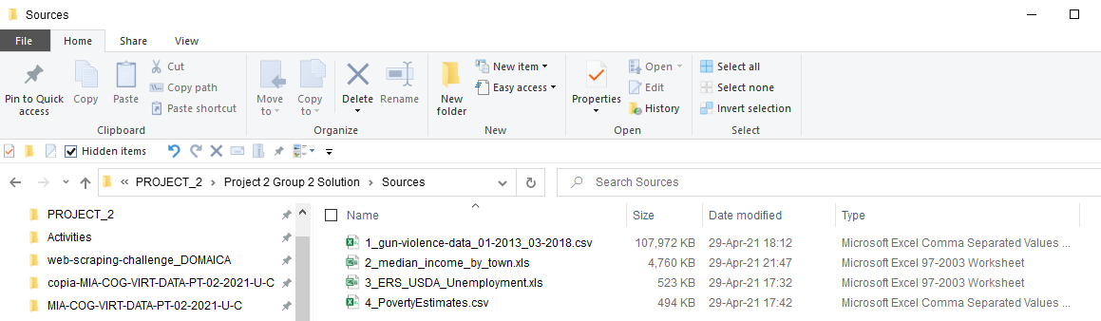
SOURCES (2). Final datasets used

Slide 6
AGENDA
Project description
Sources
EXTRACTION
TRANSFORMATION
LOAD
SQL Results
BONUS 1. TABLE 2 Florida_Gun_Violence_detail
BONUS 2. Plot_gmaps_with_main_incidents

Slide 7
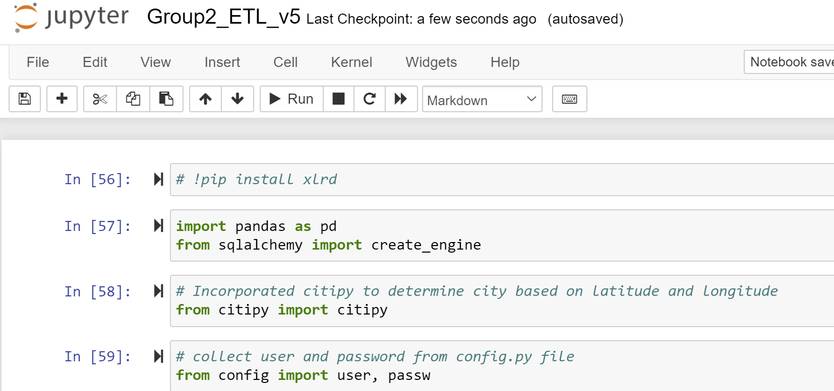
EXTRACTION
Instalation needed to later use:
pd.read_excel
Rest of dependencies

Slide 8
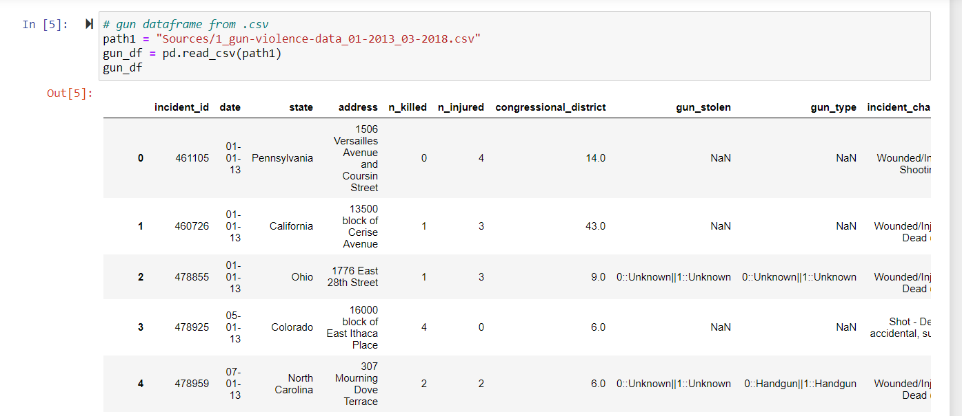
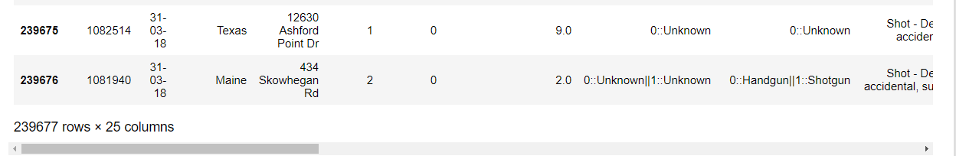
EXTRACTION 1st file. Gun violence data

Slide 9
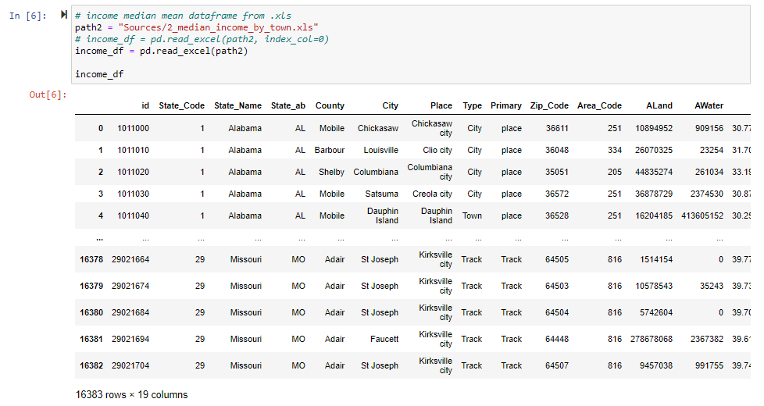
EXTRACTION 2nd file. Income data

Slide 10
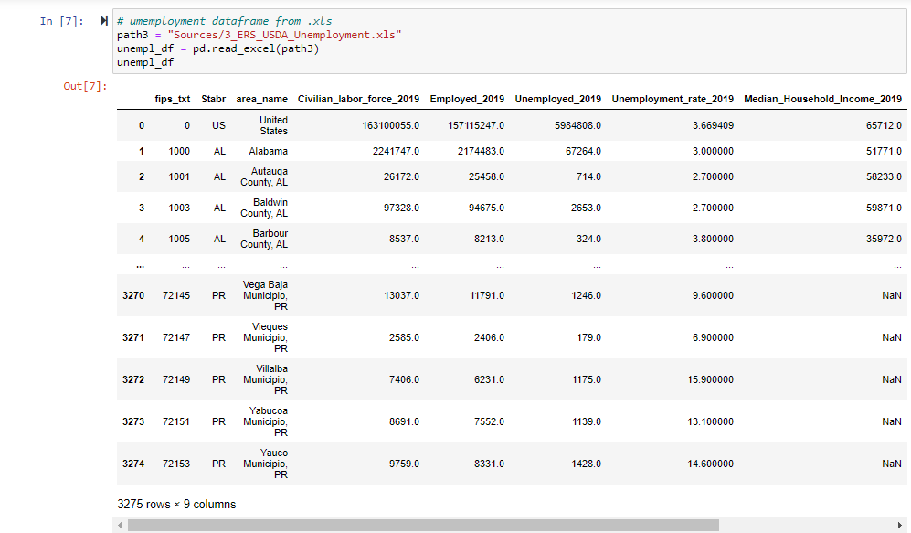
EXTRACTION 3rd file. Unemployment data

Slide 11
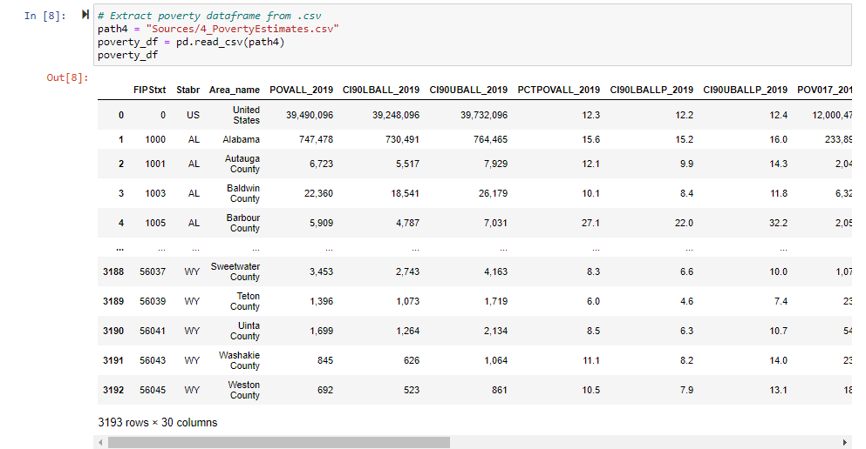
EXTRACTION 4th file. Poverty data

Slide 12
AGENDA
Project description
Sources
EXTRACTION
TRANSFORMATION
LOAD
SQL Results
BONUS 1. TABLE 2 Florida_Gun_Violence_detail
BONUS 2. Plot_gmaps_with_main_incidents

Slide 13
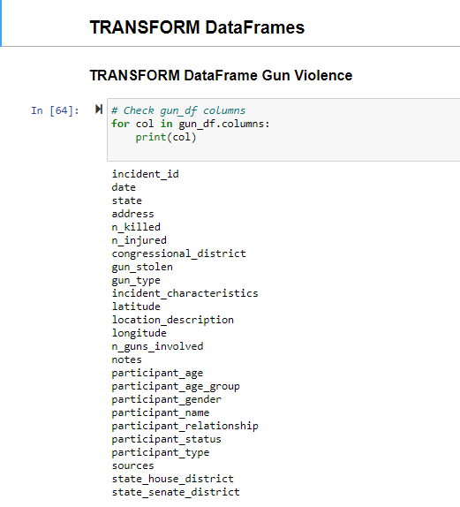
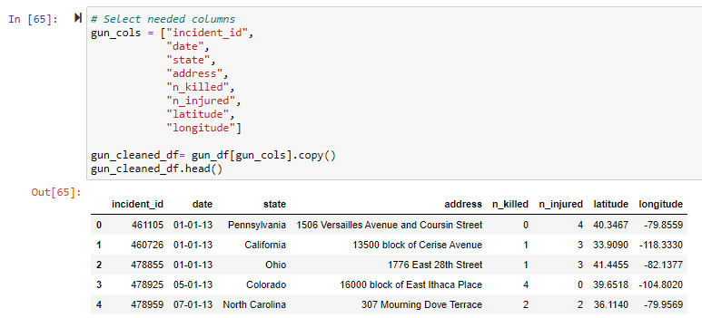
TRANSFORM. 1st dataframe. (1) Select required columns (8 out of 25)

Slide 14
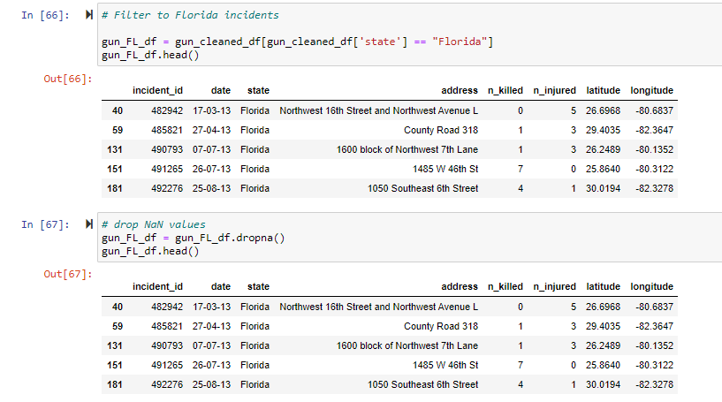
TRANSFORM. 1st dataframe. (2) Filter national to Florida / Drop NaN values

Slide 15
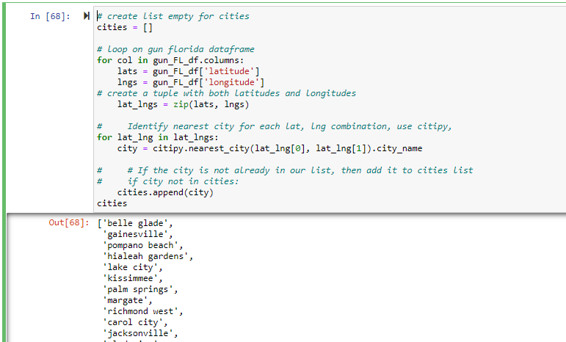
TRANSFORM. 1st dataframe. (3) Geolocate cities / towns of gun incidents using latitude and longitude with Citipy

Slide 16
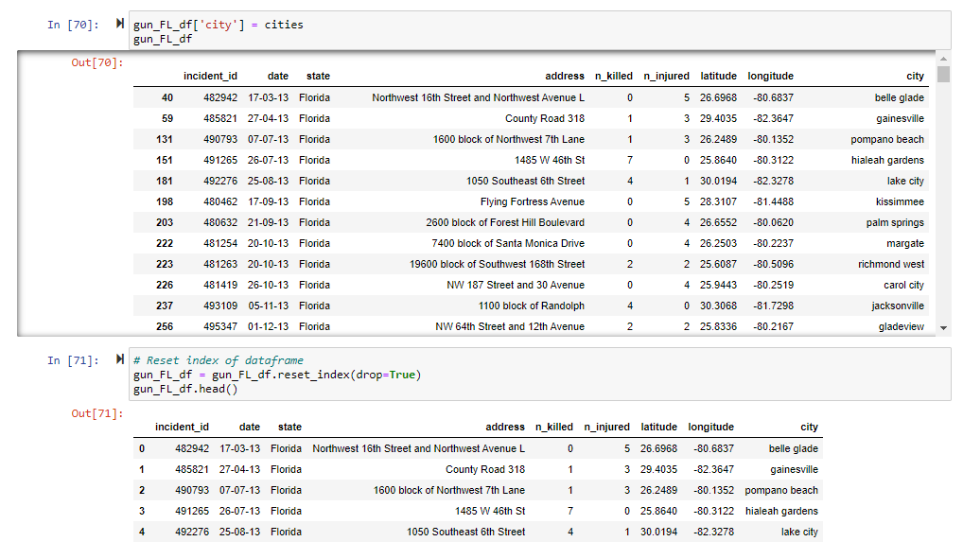
TRANSFORM. 1st dataframe. (4) Add new cities list as a new column in dataframe & reset index

Slide 17
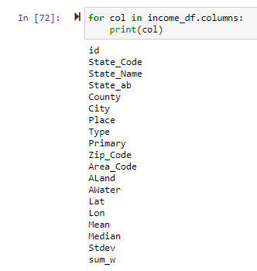
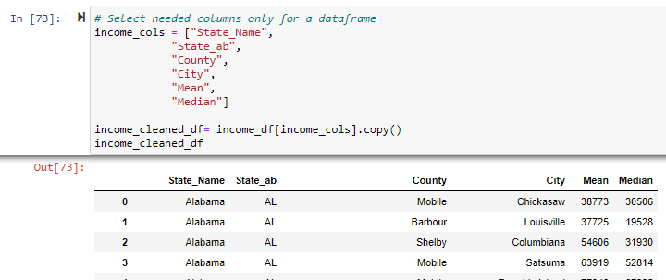
TRANSFORM. 2nd dataframe INCOME. (1) Select required columns (6 out of 19)

Slide 18
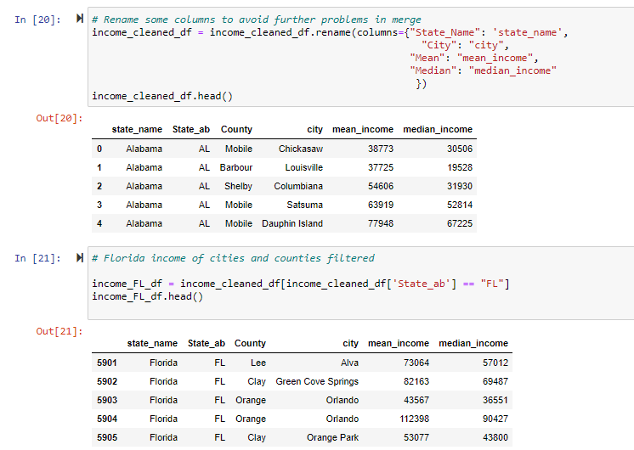
TRANSFORM. 2nd dataframe INCOME. (2) Rename columns & Filter national data to FL

Slide 19
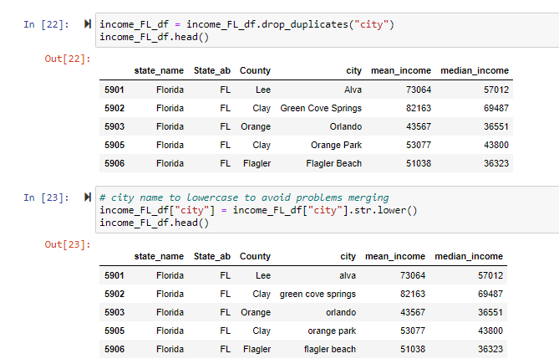
TRANSFORM. 2nd dataframe INCOME. (3) Drop duplicates & city name in lowercase

Slide 20
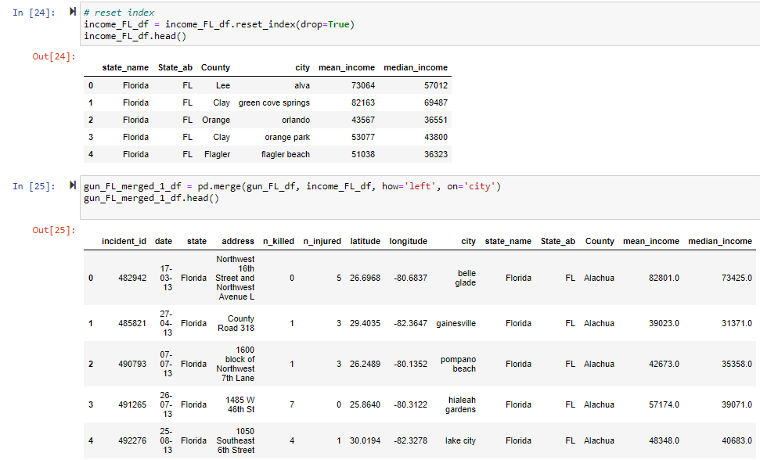

TRANSFORM. 2nd dataframe INCOME. (4) Reset index & Merge 1st gun dataset with income one

Slide 21
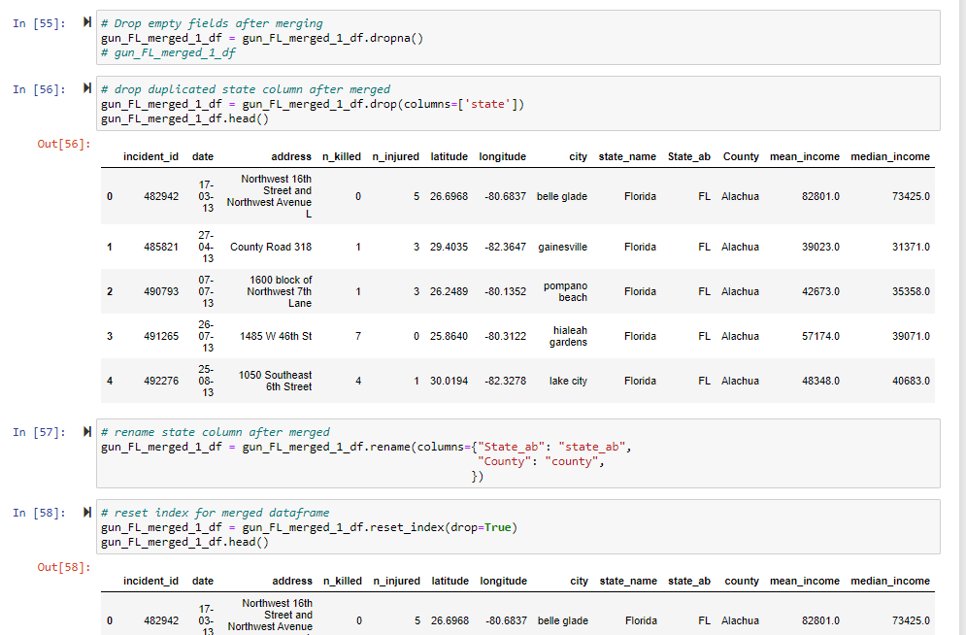
TRANSFORM. 2nd dataframe INCOME. (5) Dropna Drop duplicated columns after merging Rename columns Reset index

Slide 22
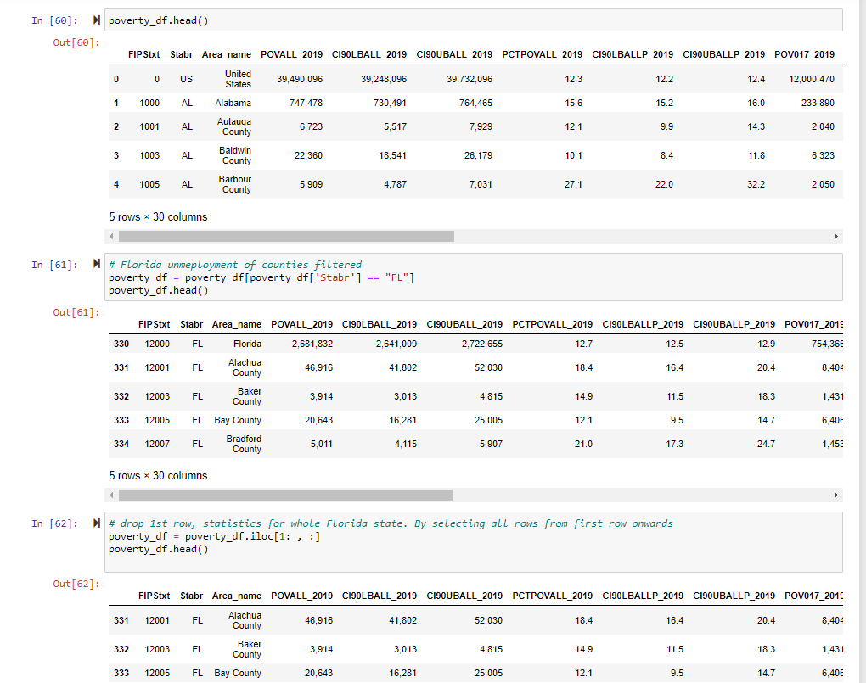
TRANSFORM. 3rd dataframe POVERTY. (1)
Filter national to state data
Delete 1st row with Florida aggregated data

Slide 23
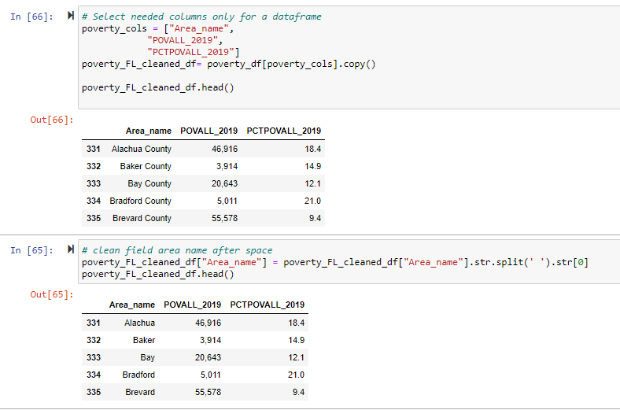
TRANSFORM. 3rd dataframe POVERTY. (2)
Select needed columns
Delete characters after first space to get county name exclusively

Slide 24
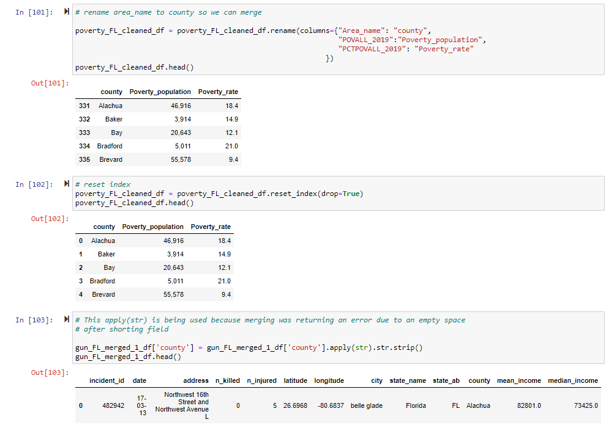
TRANSFORM. 3rd dataframe POVERTY. (3)
Rename
Reset index
Delete empty space after string so we can merge !!!!!!!

Slide 25
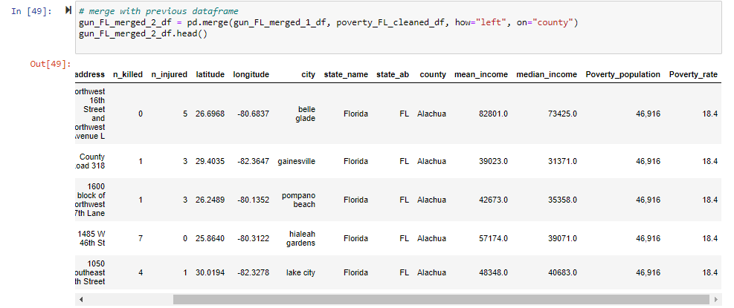
TRANSFORM. 3rd dataframe POVERTY. (4)
Merge gun dataset + income + poverty

Slide 26
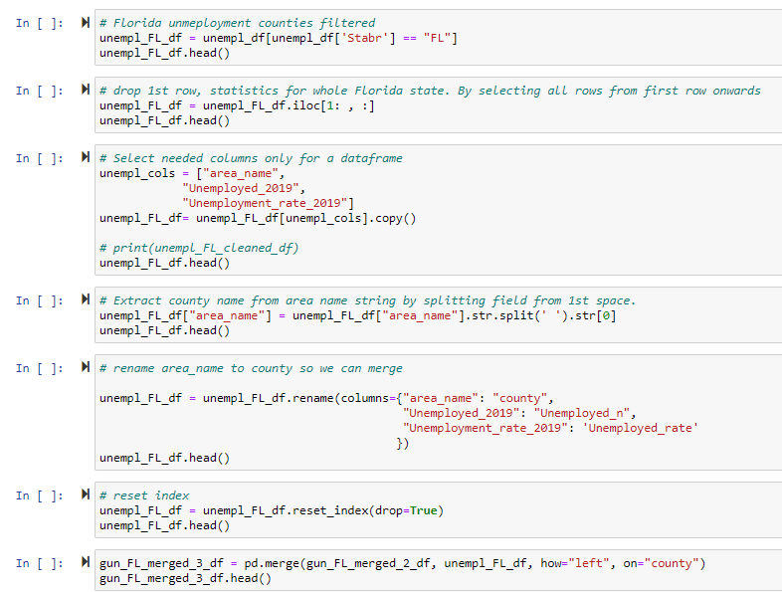
TRANSFORM. 4th dataframe UNEMPLOYMENT. (1) Pretty similar to poverty one. Synthesis
Filter to FL
Delete 1st row of aggregated data
Select columns. Drop rest
Delete characters after 1st space to get county name
Rename columns
Reset index
Merge

Slide 27
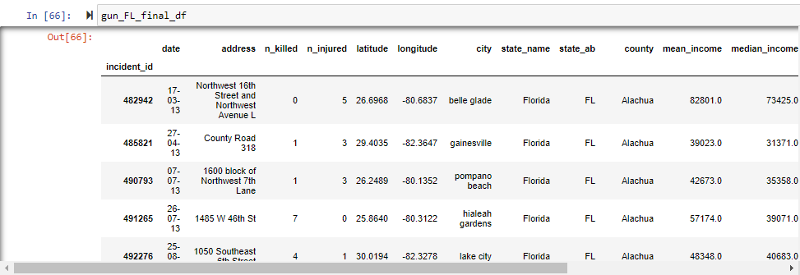
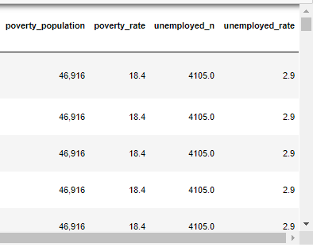
DEFINITIVE DATAFRAME READY TO BE LOADED AS SQL in Postgres

Slide 28
AGENDA
Project description
Sources
EXTRACTION
TRANSFORMATION
LOAD
SQL Results
BONUS 1. TABLE 2 Florida_Gun_Violence_detail
BONUS 2. Plot_gmaps_with_main_incidents

Slide 29
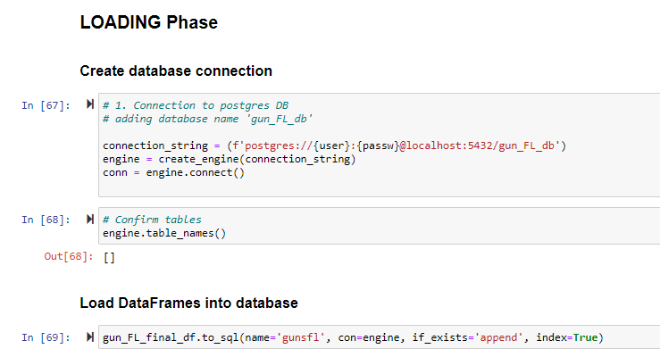

Slide 30
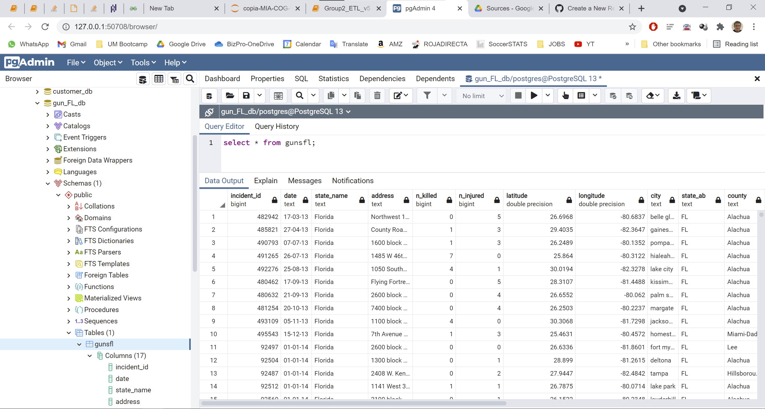
New table ‘gunsfl’ inside gun_FL_db database filled with our info from dataframe

Slide 31
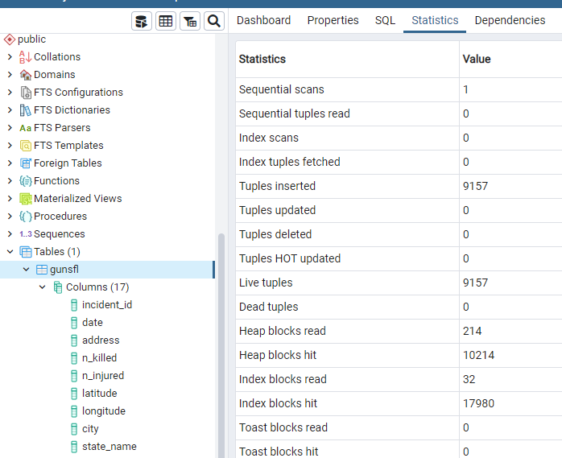

SQL table ‘gunsfl’ inside gun_FL_db database has same number of records than dataframe

Slide 32
Why chosen SQL Postgres over MongoDB in this project
Our raw data was mostly structured in tables already, not document oriented or complex unstructured data, etc
Easier to handle with GUI tools as pgAdmin
Data integrity is assured
Flexibility or scalability were not critical factors
Tables created in database ‘gun_FL_db’
Table / collection | Name in DB | Tables / Collections | Type of DB | Used | Reason
Florida_Gun_Violence_detail | gundetailfl | By incident | SQL | Postgres | Structured data
Florida_Gun_Violence | gunsfl | By county or city | SQL | Postgres | Structured data

Slide 33
AGENDA
Project description
Sources
EXTRACTION
TRANSFORMATION
LOAD
SQL Results
BONUS 1. TABLE 2 Florida_Gun_Violence_detail
BONUS 2. Plot_gmaps_with_main_incidents

Slide 34

BONUS 1. (1)
TABLE 2 Florida_Gun_Violence_detail.
Obtaining a second table and inserting it in the 'gun_FL_db' database with the following characteristics:
Got a source from "gunviolencearchive.org" with detail of every gun incident in USA.
Previous creation of an html page automatically converting a dataframe using the function: "df.to_html“
From that webpage we can access the details of each of the incidents on the page 'http://www.gunviolencearchive.org/incident/' and adding the respective incident number or "incident_id"- We finally update our SQL database with the dataframe. New table "gundetailfl".

Slide 35
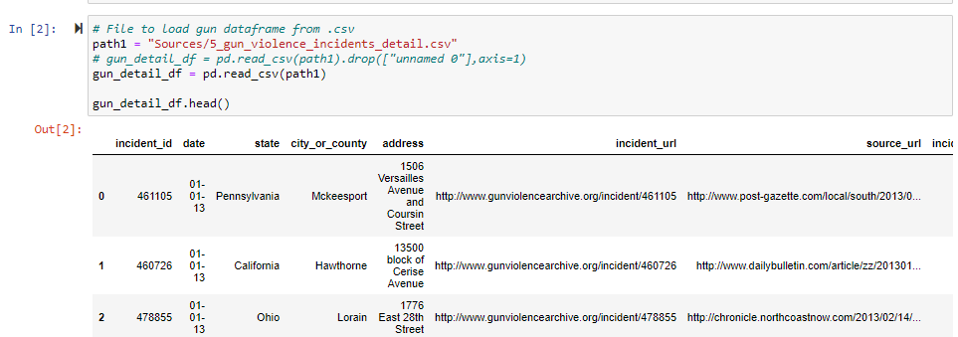
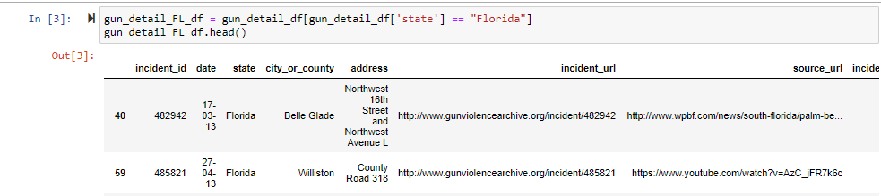
BONUS 1. (2) Jupyter detail
New source from ‘gunviolencearchive.org’
Filter national data to FL

Slide 36
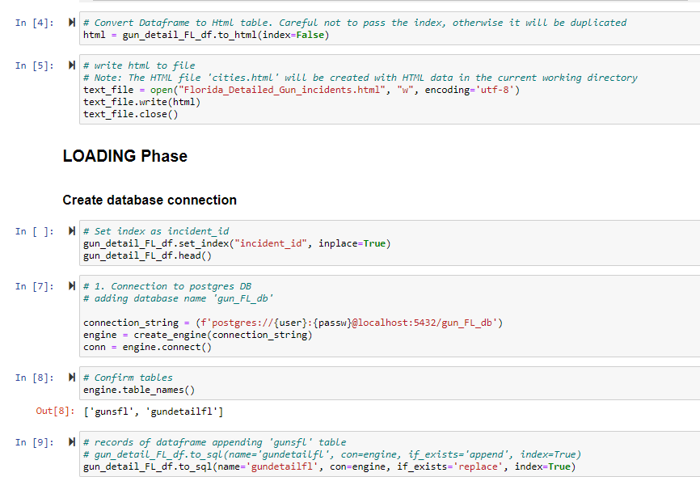
BONUS 1. (3) Jupyter detail
Dataframe to html created in current working directory
Tables in SQL database
df.to_sql

Slide 37
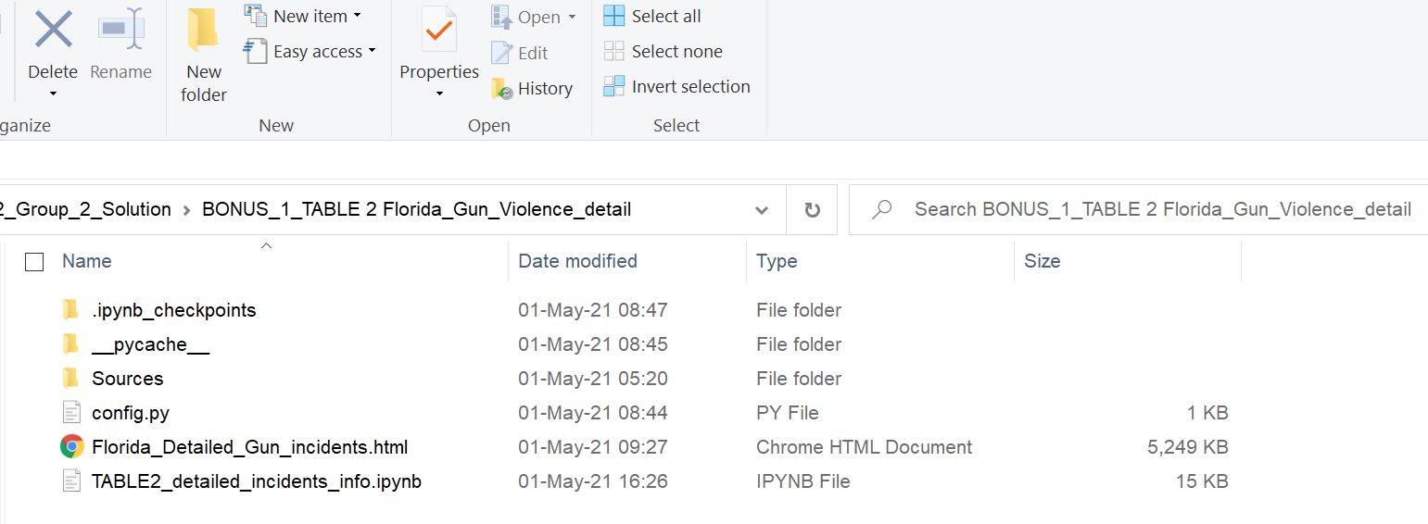
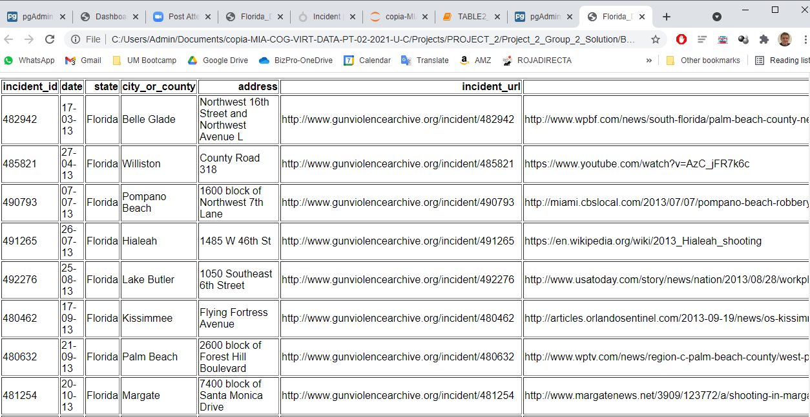
BONUS 1. (4) new html page created from dataframe and detail
New html
Page opened in browser detail with html table

Slide 38
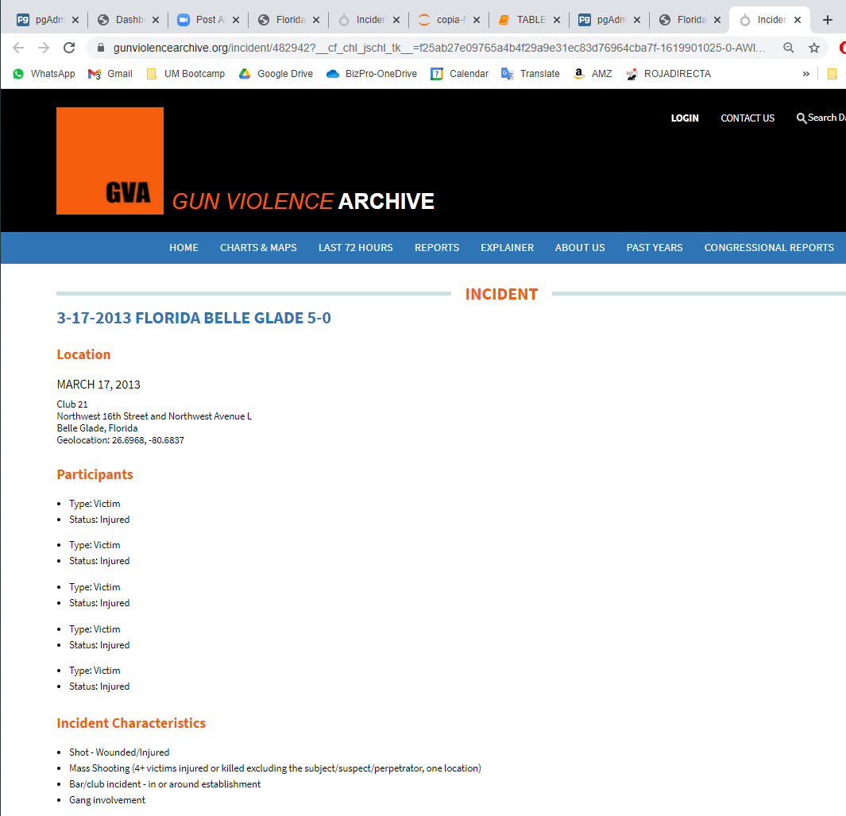
BONUS 1. (5) gun incident detail example opened

Slide 39
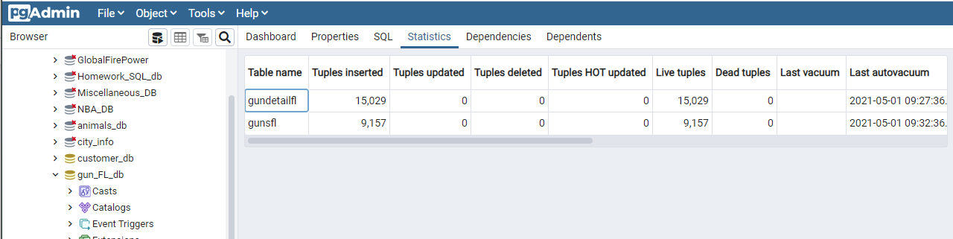
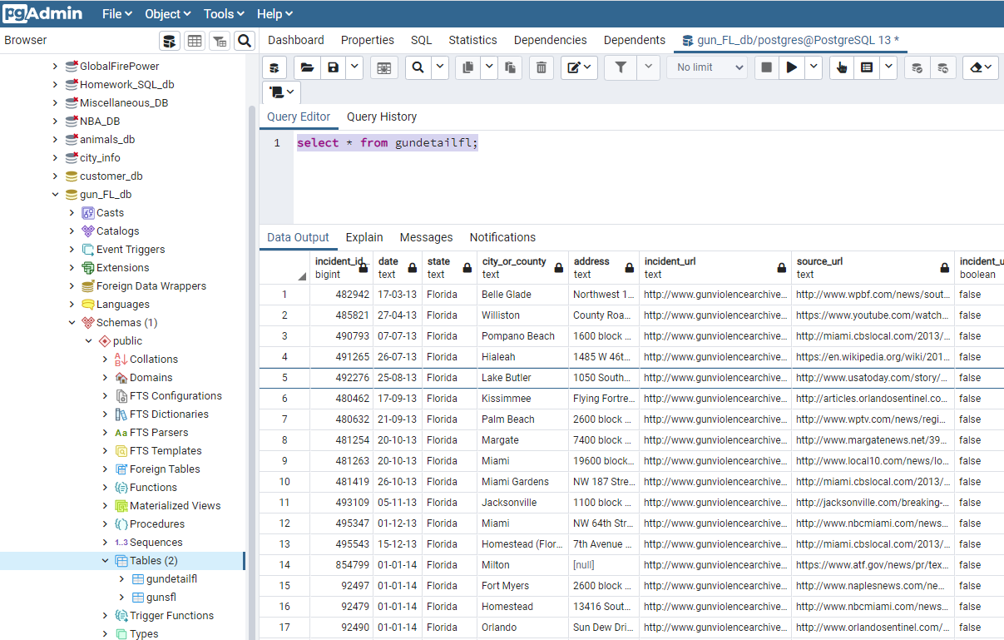
BONUS 1. (6) SQL detail of 2nd table ‘gundetailfl’
2 tables in SQL database ‘gun_FL_db’
Records shown with query tool

Slide 40
AGENDA
Project description
Sources
EXTRACTION
TRANSFORMATION
LOAD
SQL Results
BONUS 1. TABLE 2 Florida_Gun_Violence_detail
BONUS 2. Plot_gmaps_with_main_incidents

Slide 41
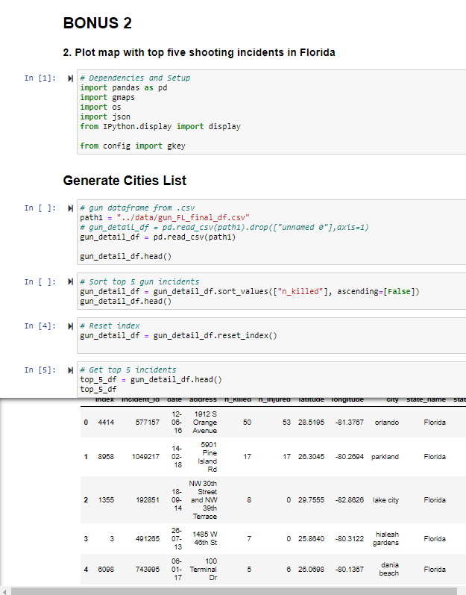
BONUS 2. (1)
Plot map with top five shooting incidents in Florida with GMAPS
Read .csv updated as result from our definitive dataframe of SQL table 1
Sort by number of people killed, descending
Reset index
Final dataframe before plotting
Top killing gun violence incidents in Florida

Slide 42
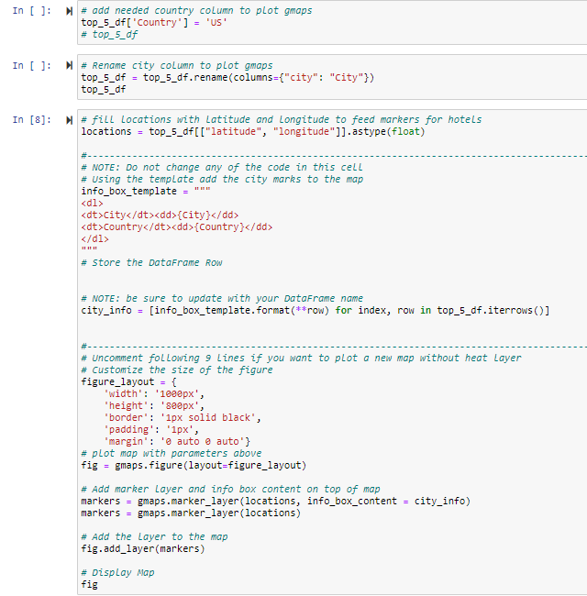
BONUS 2. (2)
Plot map with top five shooting incidents in Florida with GMAPS
Add needed column with country
Rename column
Pass variables to plot and make a marker layer

Slide 43
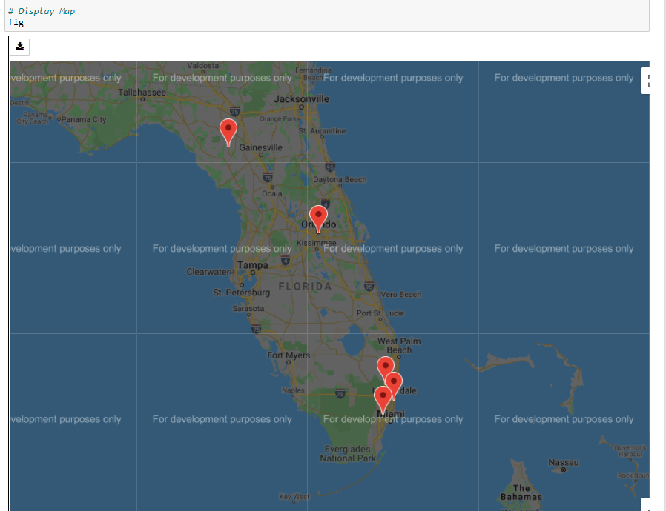
BONUS 2. (3)
Plot map with top five shooting incidents in Florida with GMAPS

