Slide 1
Natural Variables vs. Renewable Energy
Ignacio Domaica, Jason Amaya,
Gregory Gibbs

Slide 2
Motivation & Summary
Analysis of renewable power generation in random locations in USA.
What effect natural variables have on the output consumption of Renewable energy?

Slide 3
Data
Generation of Latitude and Longitude random sets with numpy python library
Use Citypy to look for nearest city with geo coordinates.
Perform API calls with Openweathermap to access json meteorologic data
Filter to get USA data
Sample size of US Cities (260-290). Around 10% of cities in USA over 500 unhabitants (28.700)
Data cleansing (records skipped, drop NaN values, duplicates, index resetting, etc)
Get elevation with reverse geocoding with google API maps, elevation. Obtain altitude (m)
Represent some maps with markers for USA cities, heat layers for wind and altitude
Get additional data like
state_id
State
timezone
Sun Radiation (h)
Precip_inch
Precip_mm
mean elevation feet
mean elevation meters
Hydro cons (BTU)
Solar cons (BTU)
Wind cons (BTU)
-
Elevation Data of those cities (Google elevation API)
-

Slide 4
Data Cleanup & Exploration
Display Graphs Here

Slide 5
Data Analysis
Matplotlib/Linear Regression?
Solar Radiation vs. Renewable
Avg. Wind Velocity vs. Renewable ?
Avg. Humidity vs. Renewable?
Elevation vs. Renewable ?

Slide 6
Discussion
Findings:
How close to hypothesis?

Slide 7
Post Mortem
Difficulties?
What would we do if given more time?

Slide 8
BACK UP

Slide 9
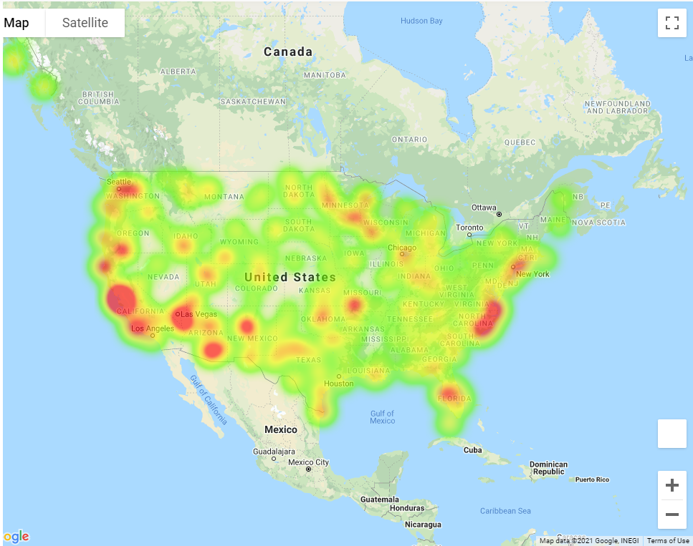

Slide 10
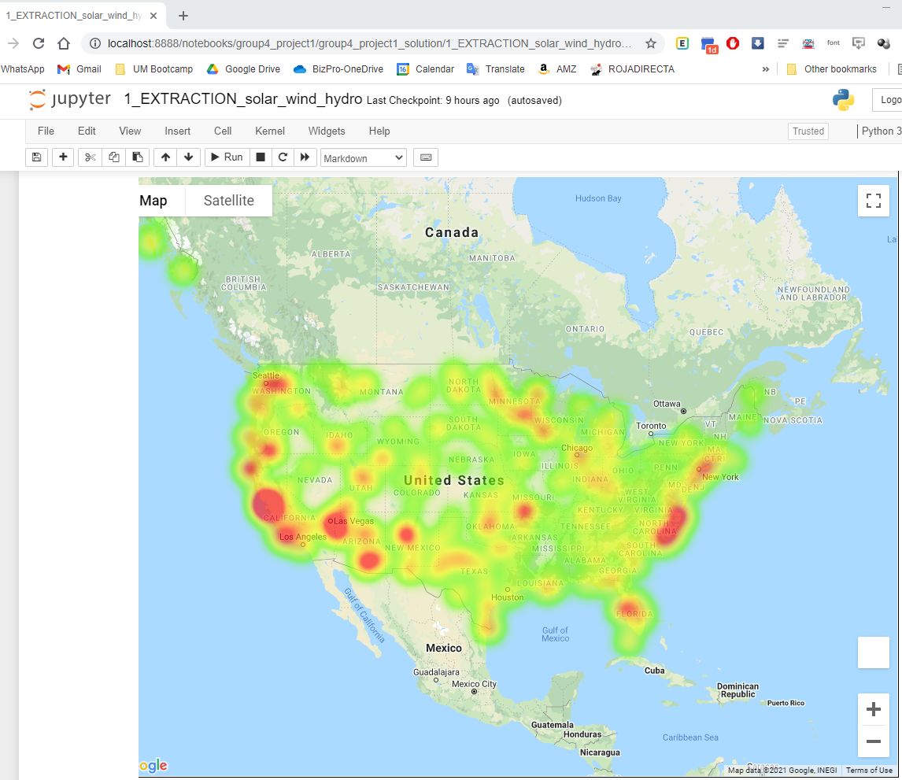

Slide 11
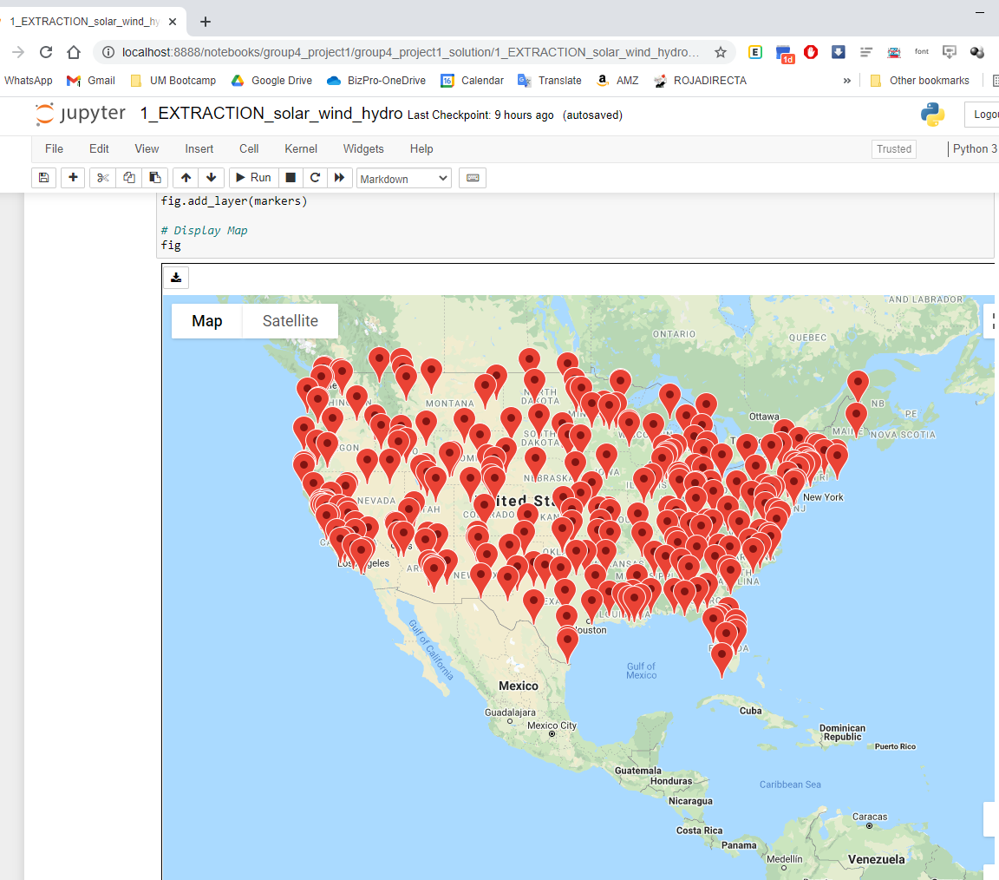

Slide 12
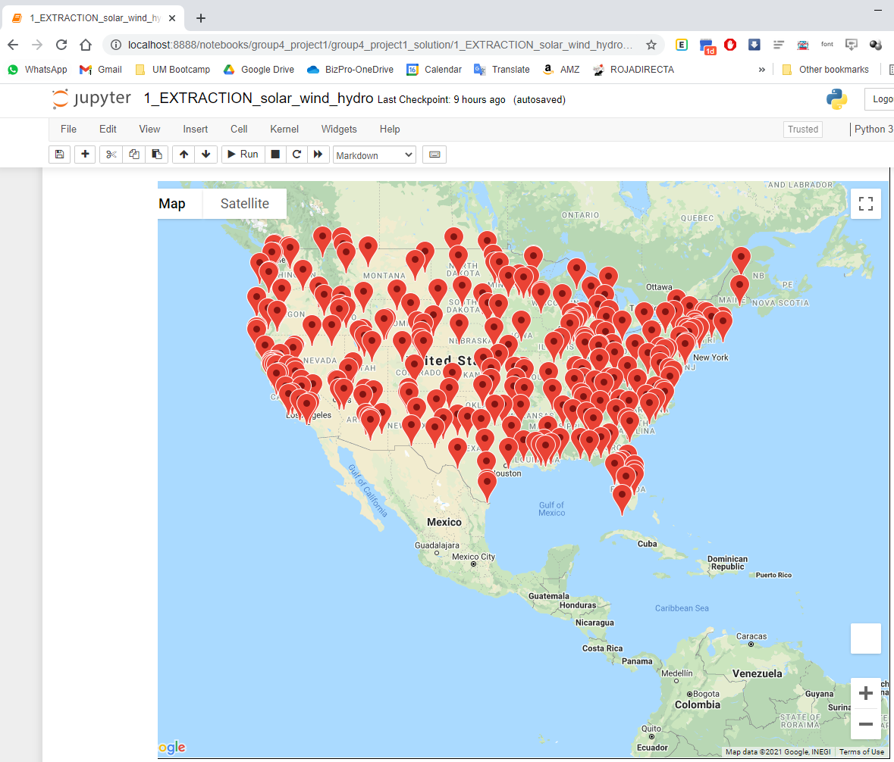

Slide 13
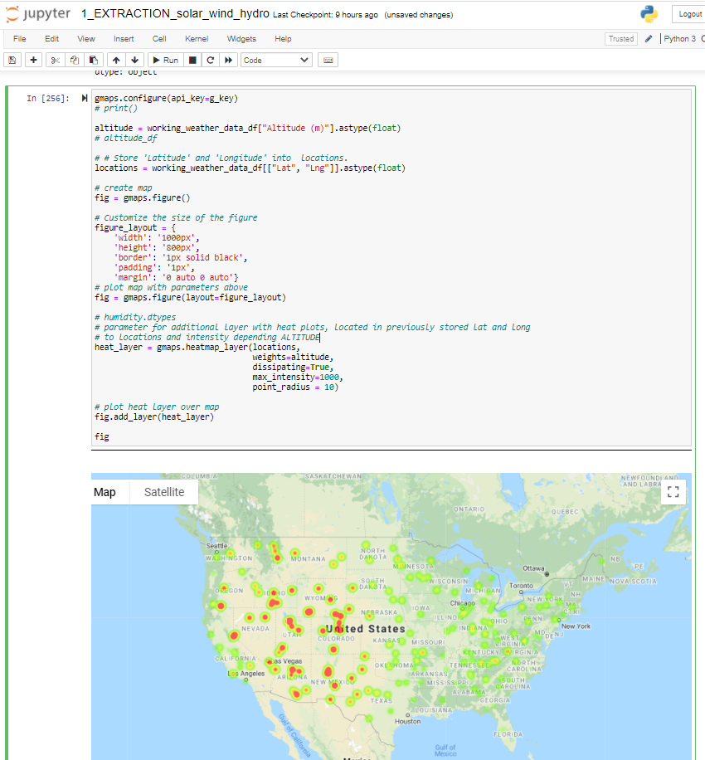

Slide 14
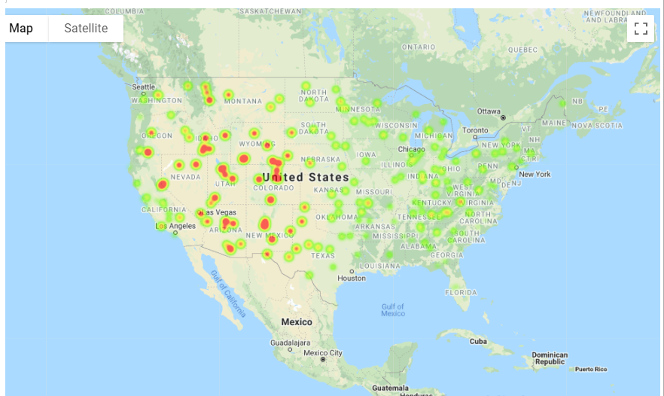

Slide 15
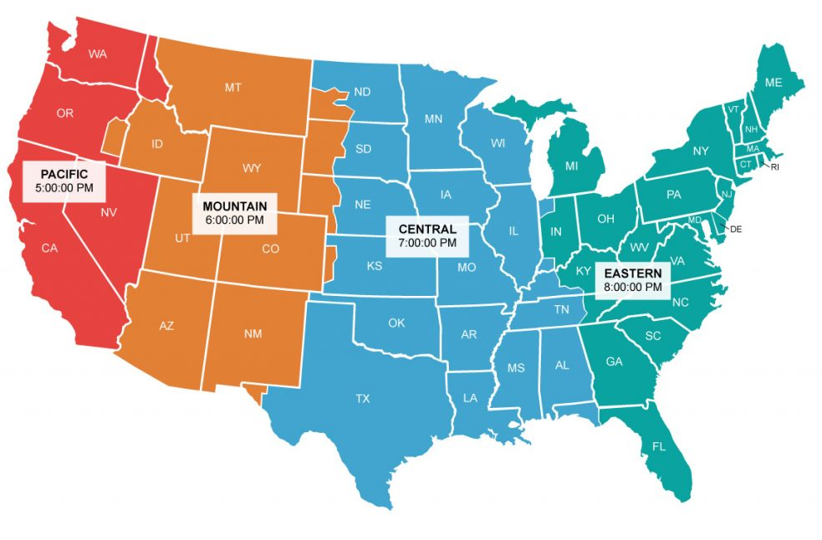

Slide 16
