Slide 1
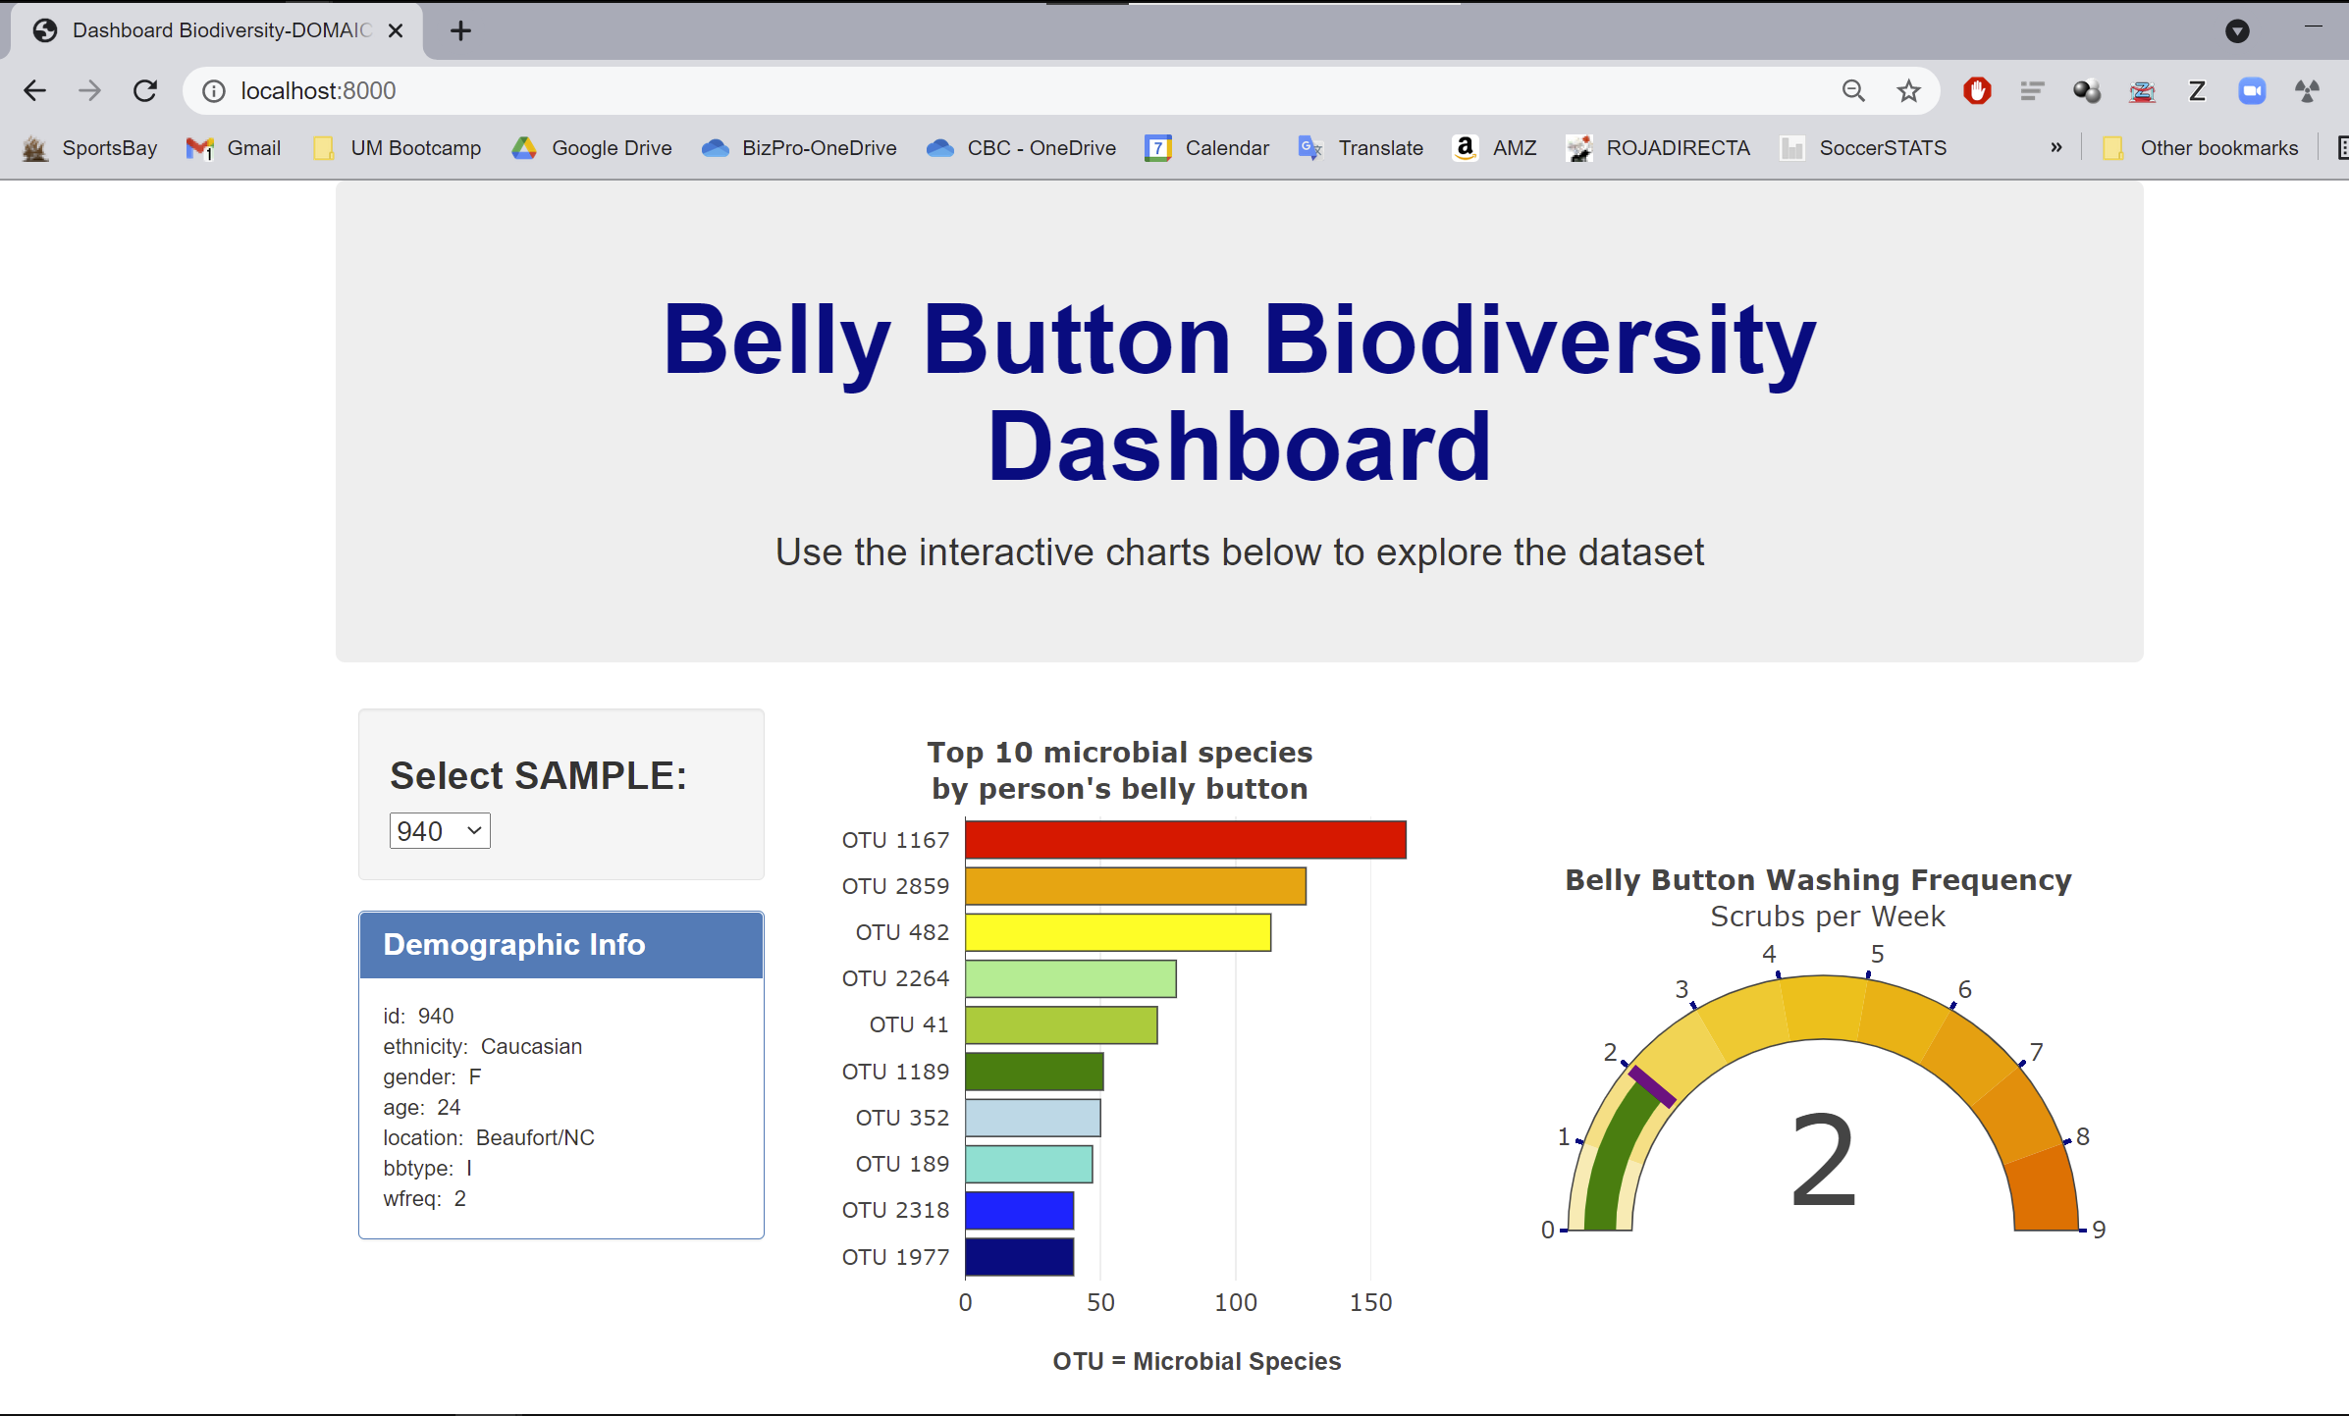
Index.html. Detail of index.html webpage

Slide 2
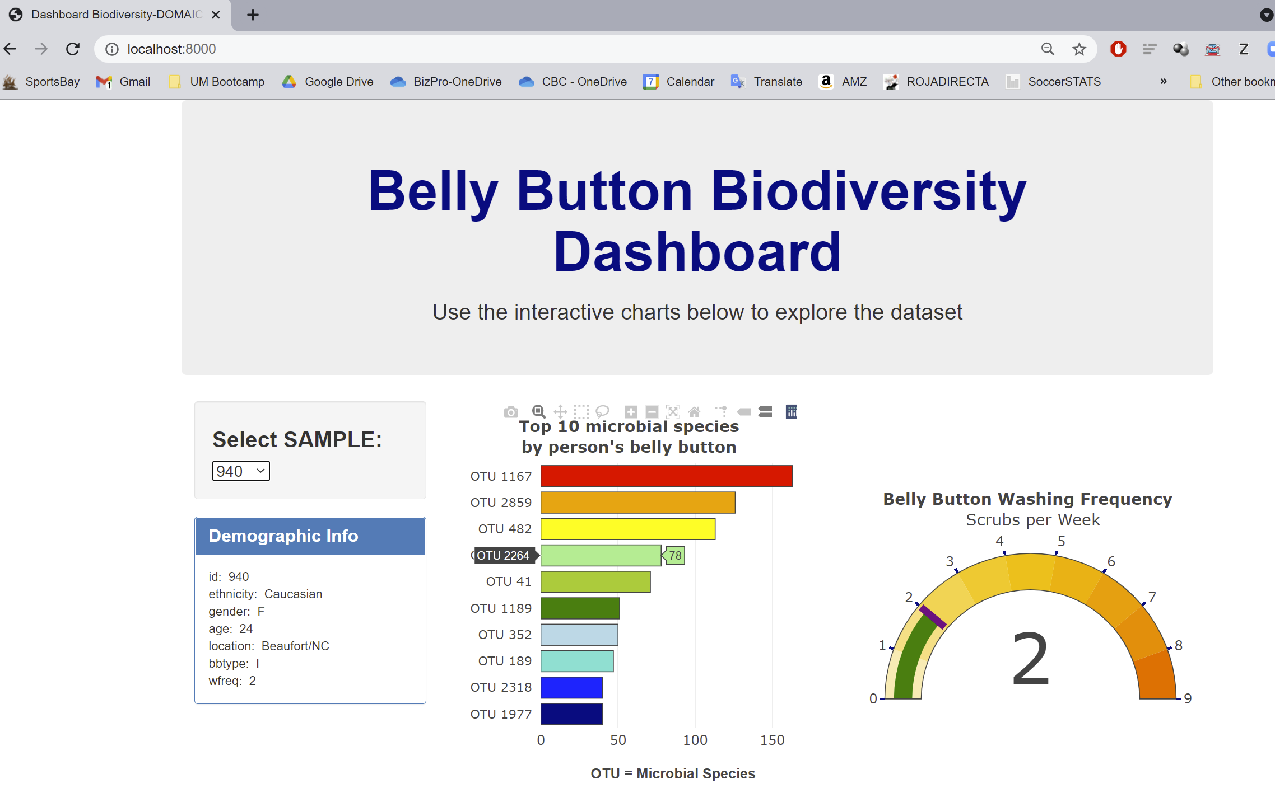
Detail of hovering over a bar chart content

Slide 3
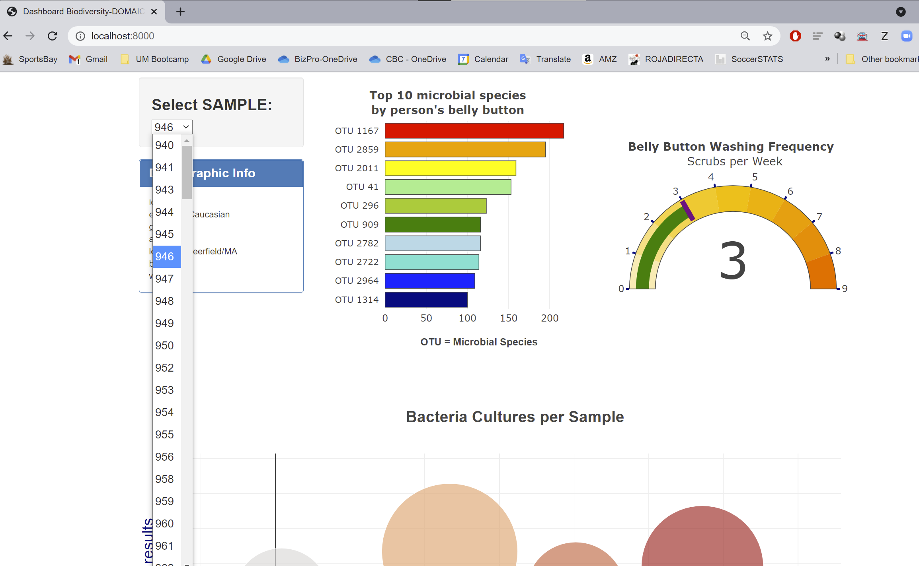
Dropdown selection to change input and selected data

Slide 4
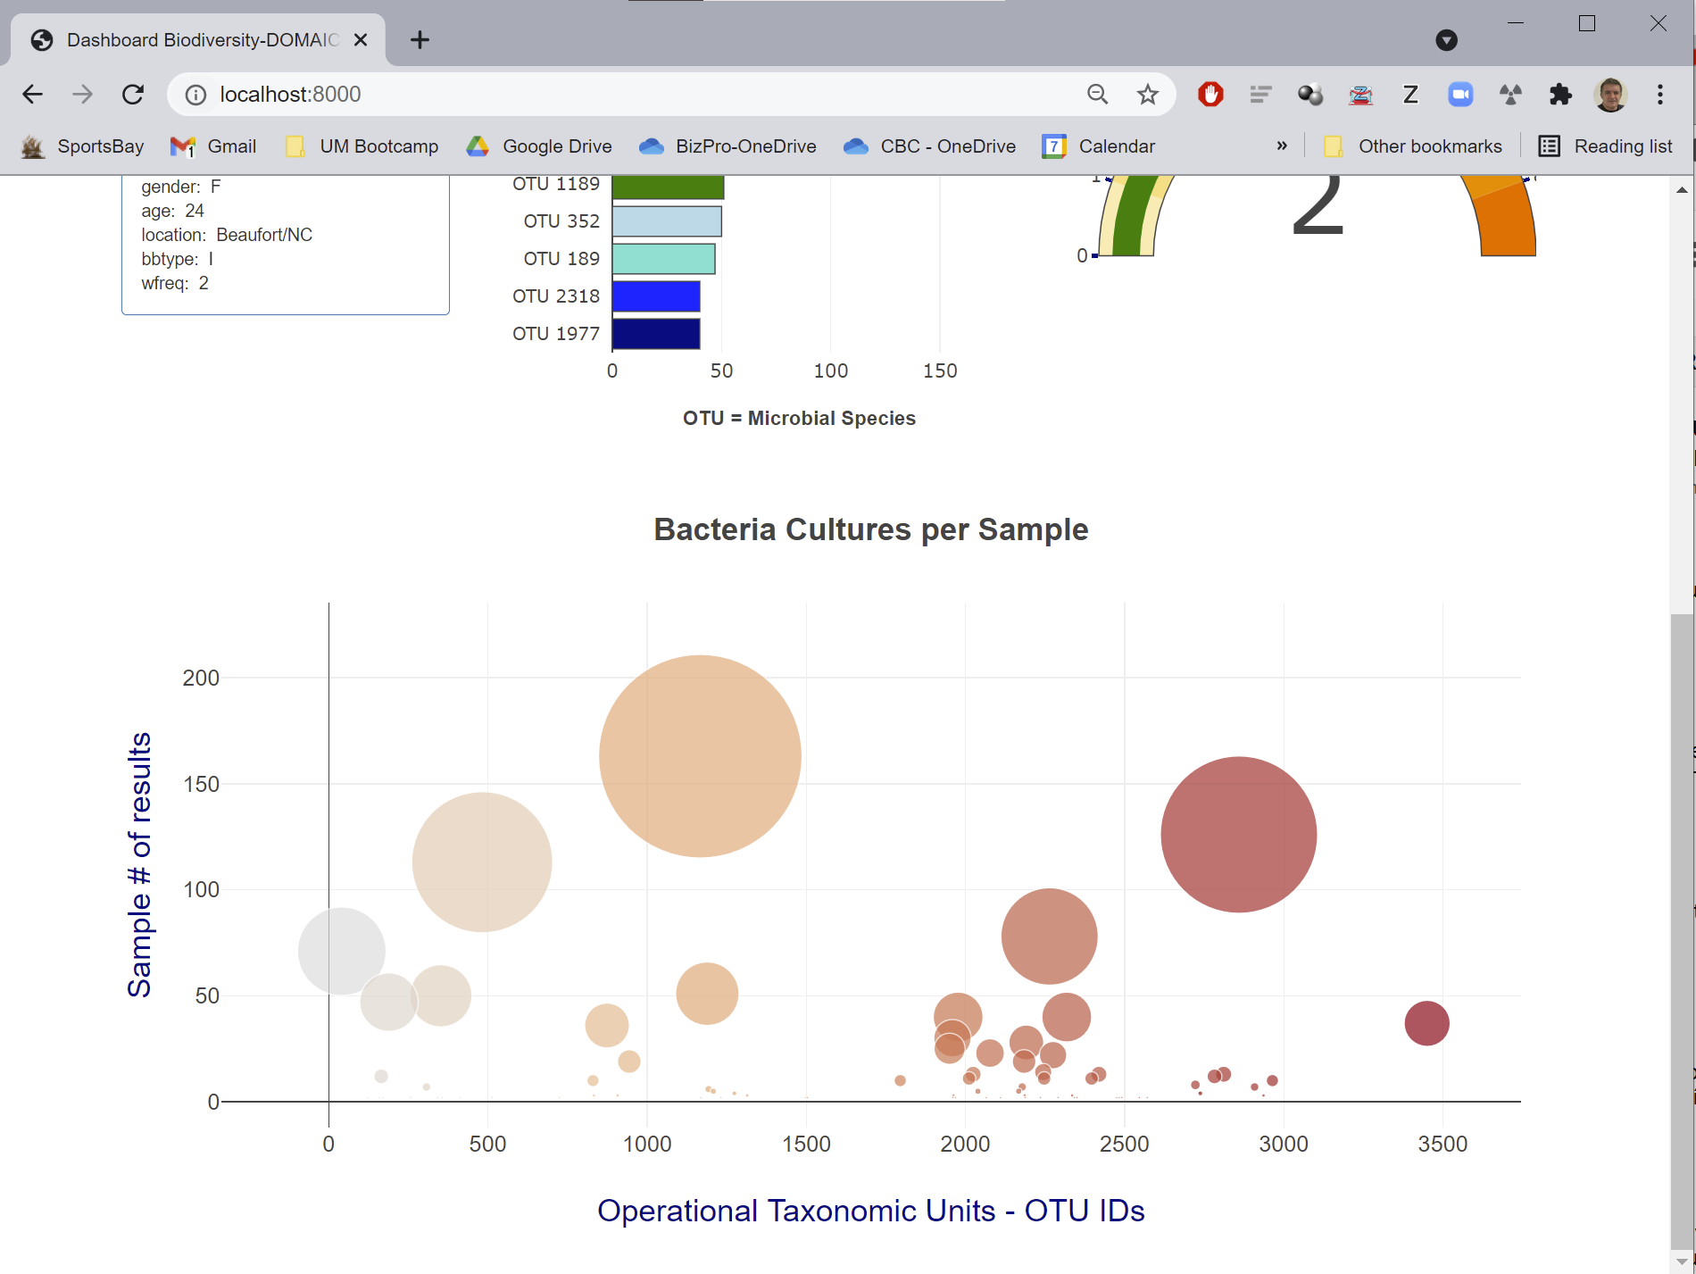
Index.html. Detail of lower part of webpage containing bubble chart

Slide 5
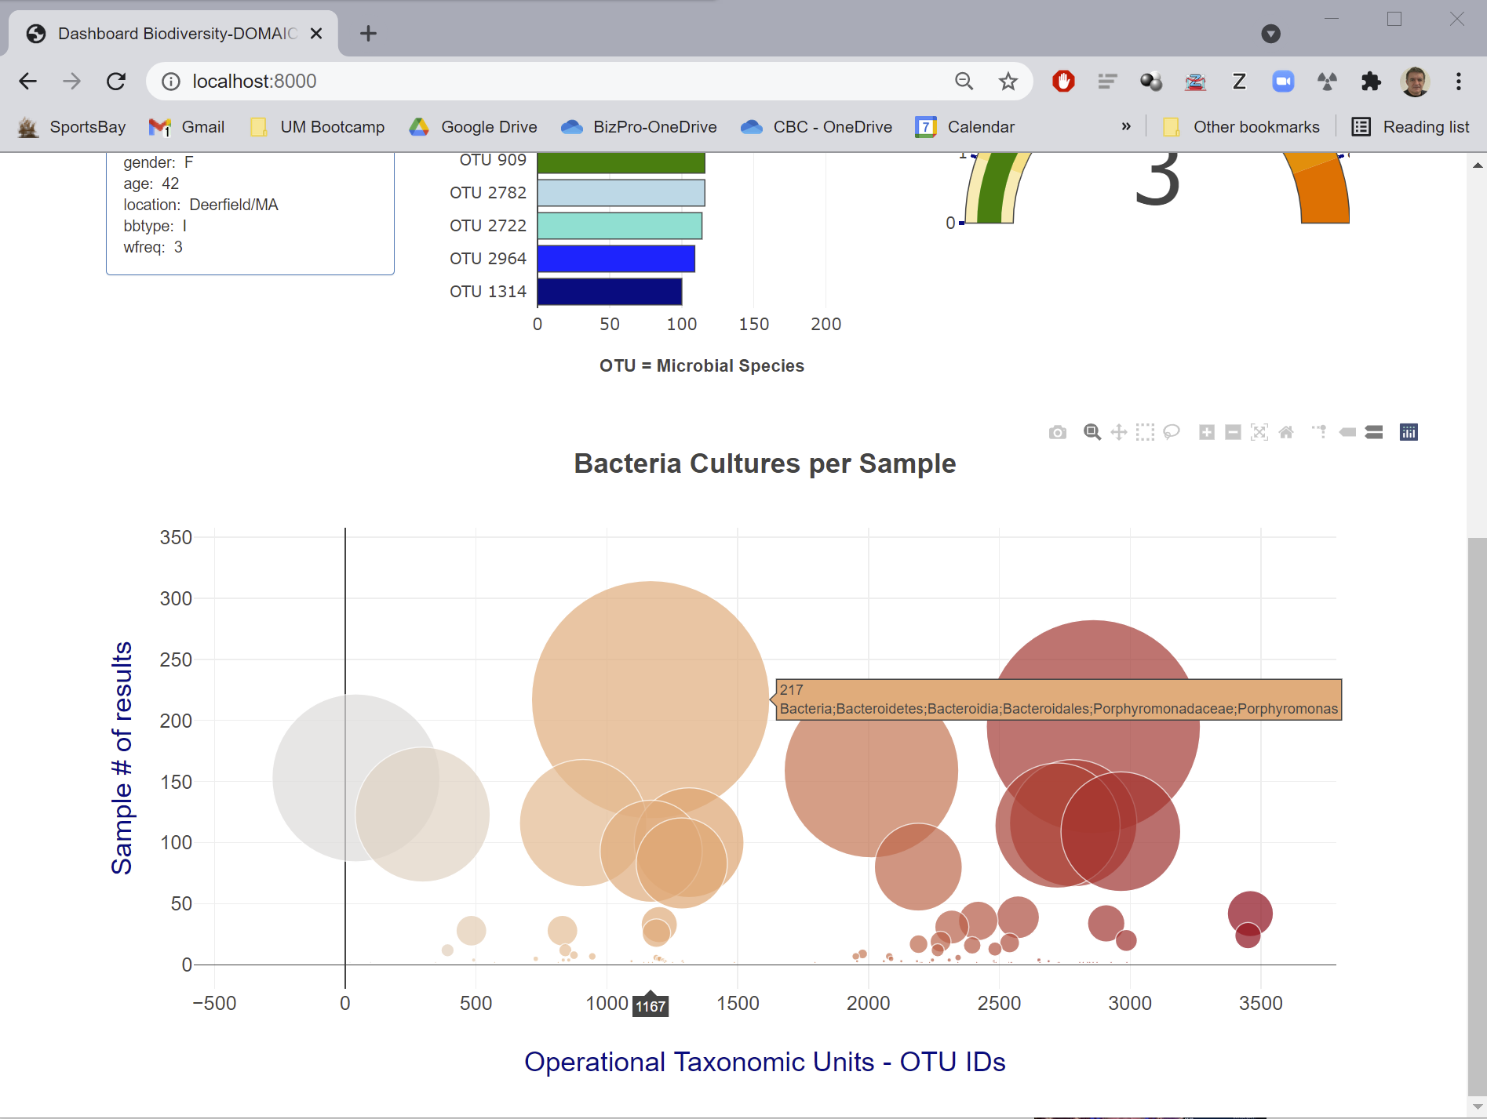
Index.html. Detail of hovering over bubble chart data

Slide 6
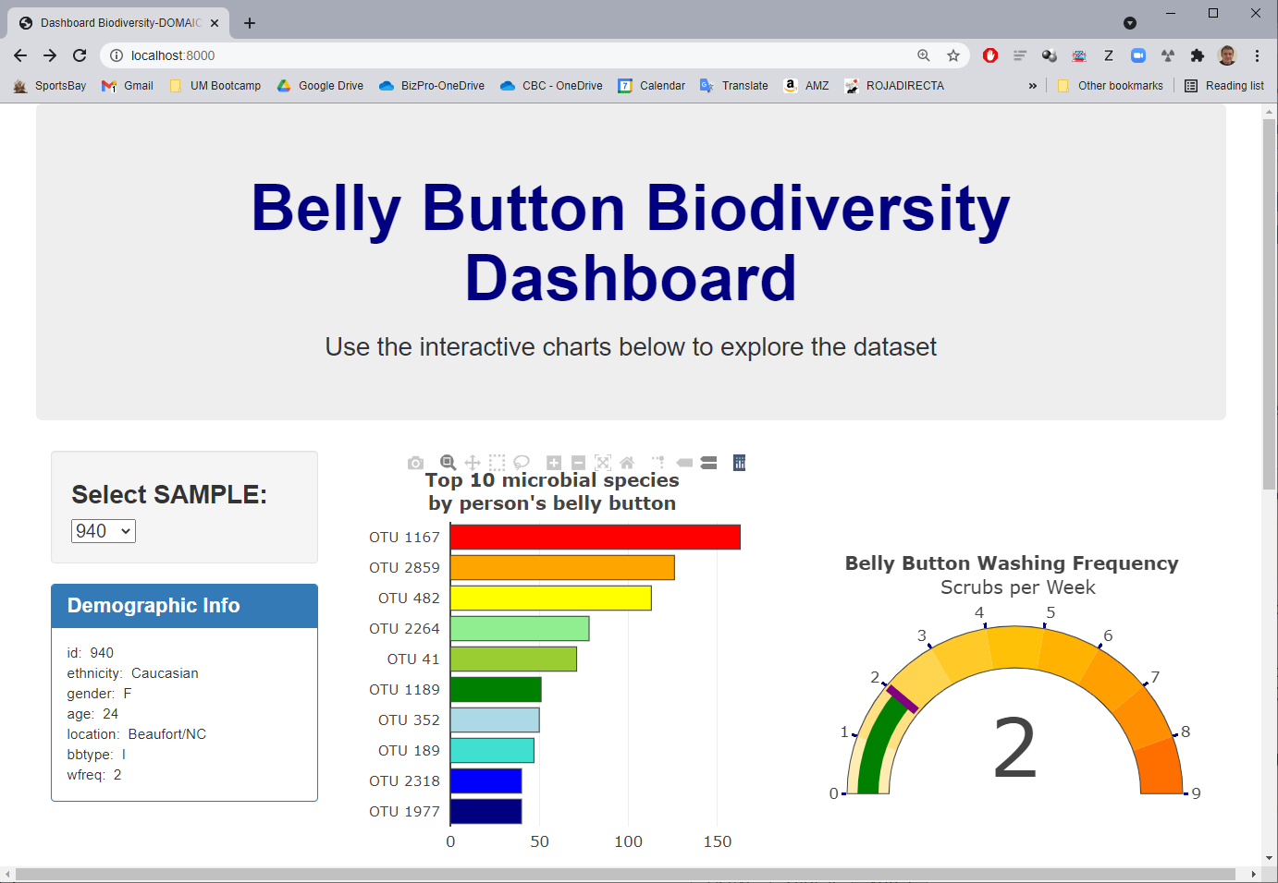
OPTIONAL Bonus gauge meter

Slide 7
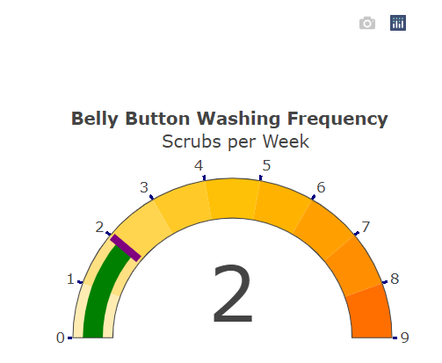
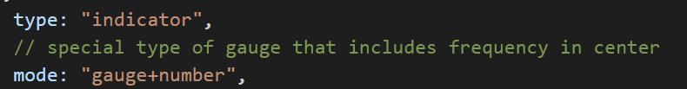
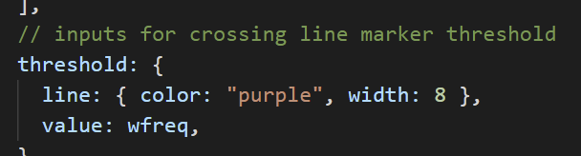
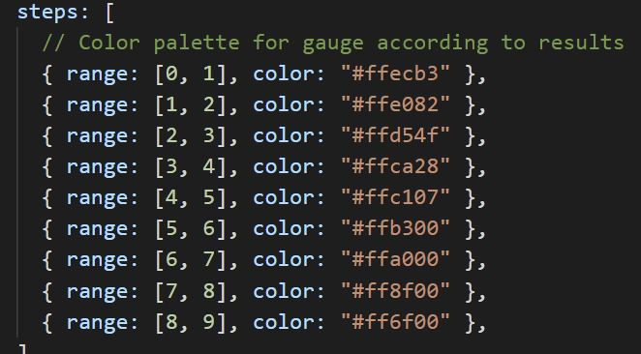
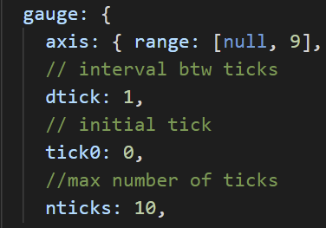
OPTIONAL Bonus gauge meter. Detail
Special type of gauge which contains frequency or measurement in center
Threshold marker color, width, value
Elaborated color palette
Intervals btw ticks
Number of ticks

