Slide 1
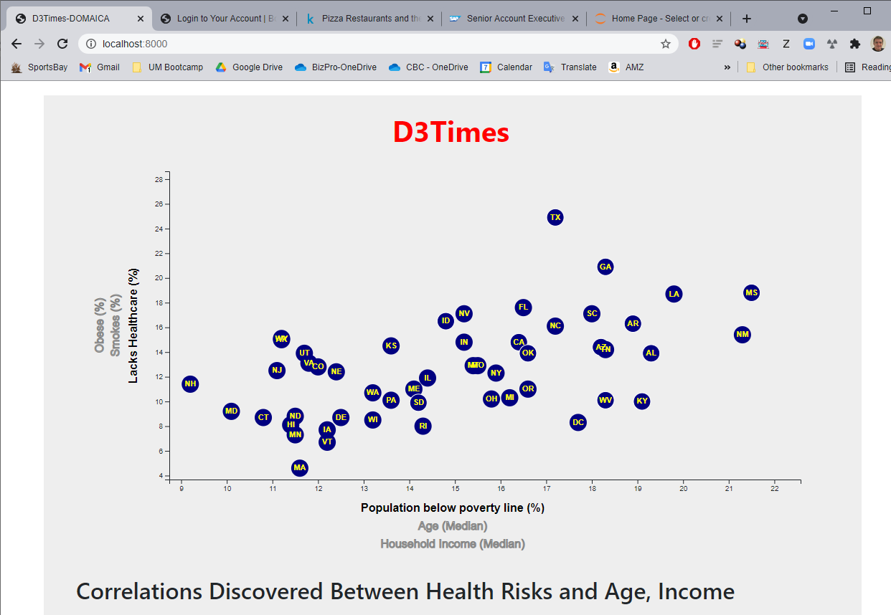
Index.html. Detail of index.html webpage

Slide 2
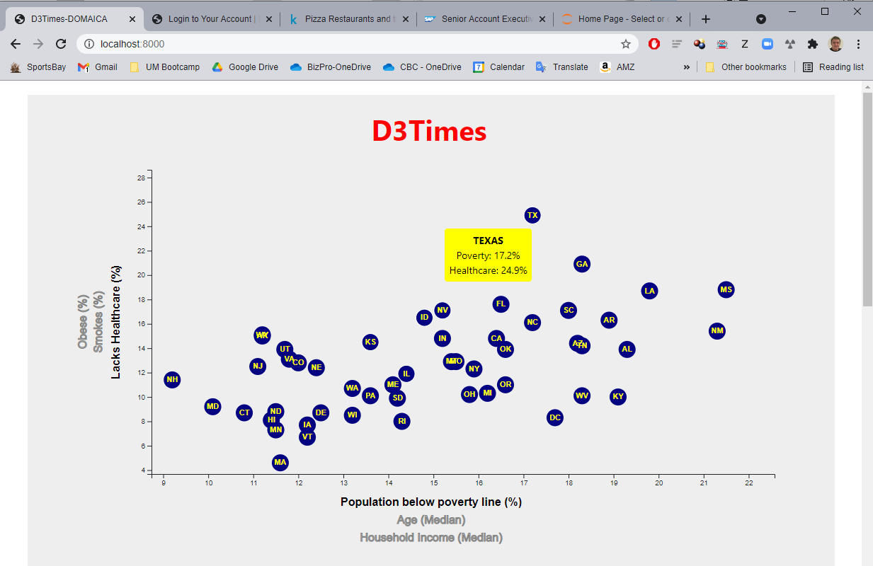
Detail of hovering over a circle marker

Slide 3
GIF showing input changes and plotting new data

Slide 4
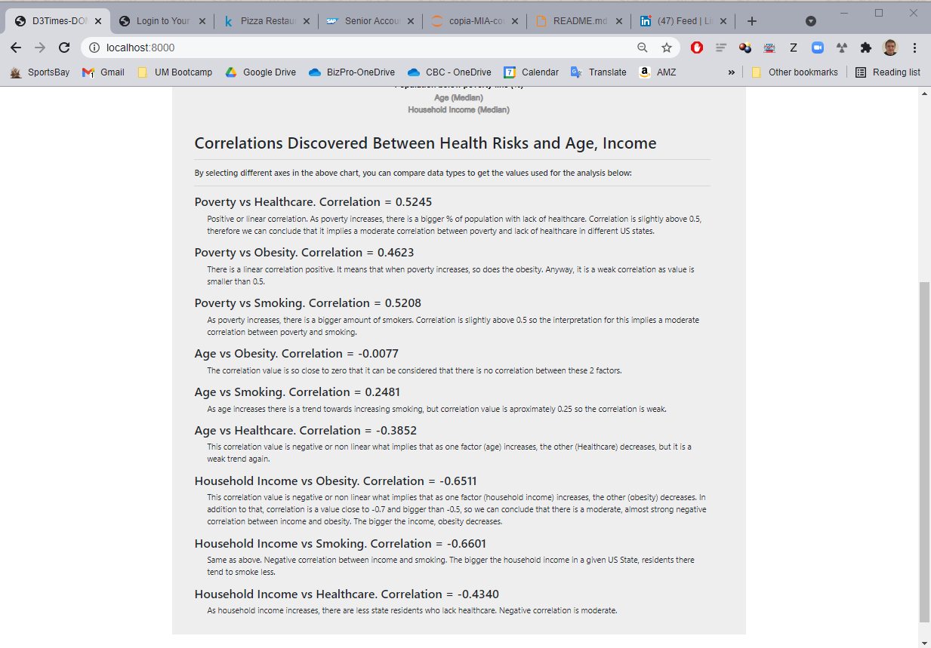
Index.html. Detail of lower part of webpage containing correlation analysis

Slide 5
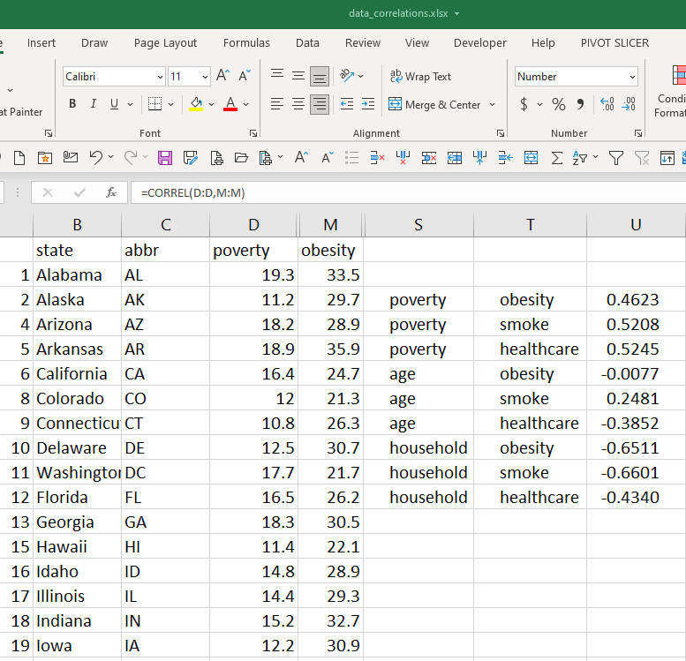
Index.html. Detail of correlation calculations. Used for analysis

