Slide 1
Compiler Design
Lecture 8
Syntax Analysis (6)
Constructing Precedence Table
and Syntax Tree

Slide 2
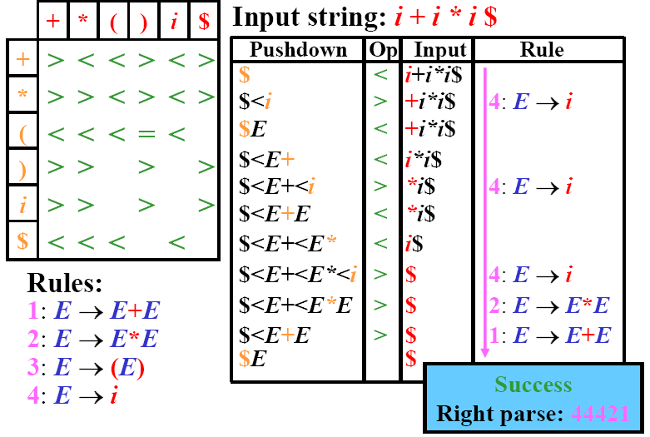
Operator-Precedence Parsing: Example

Slide 3
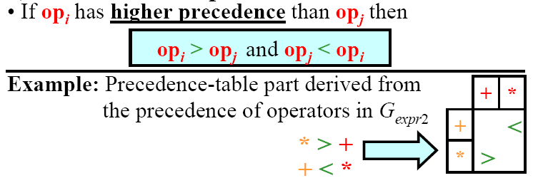
Construction of Precedence Table (1/5)
1) Using precedence of operators:
  For binary operators:

Slide 4


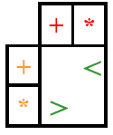

Construction of Precedence Table (1’/5)
1) Using precedence of operators:
  For unary operators:
    If op_{i} is unary prefix operator then
      For all other operators op_{j}
    If op_{i} has higher precedence than op_{j} then
    else
Example:
  If ! is a unary operator and & is binary operator, and ! Has higher precedence than & then
  a & ! b => a & (! b)
&
!
&
!
&
!
&
!

Slide 5
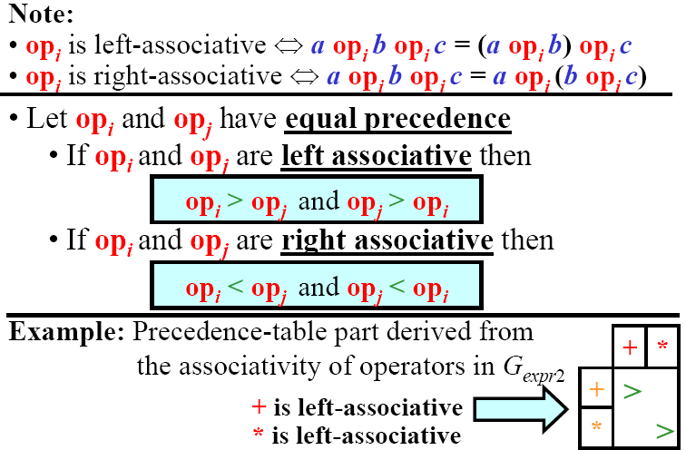
Construction of Precedence Table (2/5)
2) Using Associativity of operators:

Slide 6
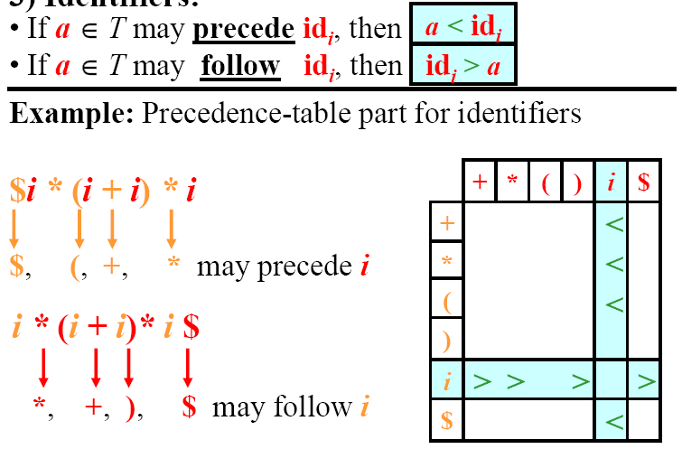
Construction of Precedence Table (3/5)
3) Identifiers:

Slide 7
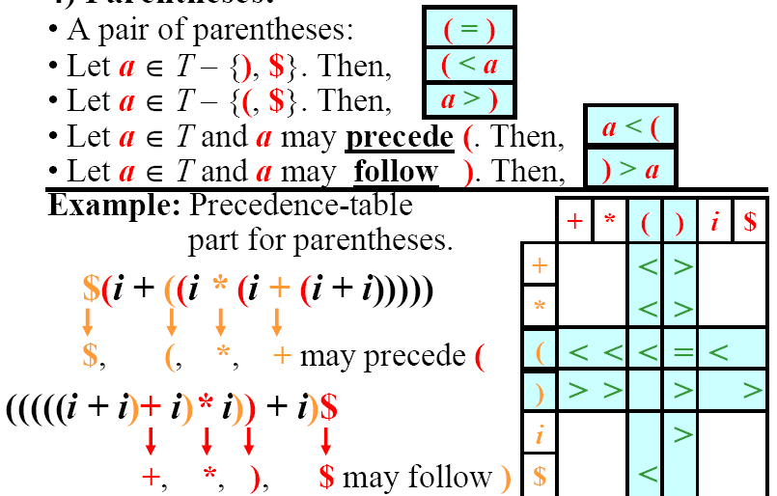
Construction of Precedence Table (4/5) (x * (y + z) (X * W))
4) Parentheses:

Slide 8
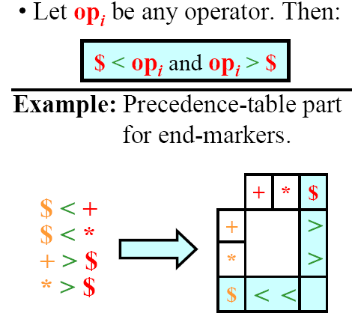
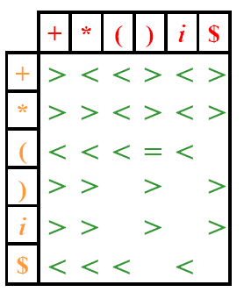
Construction of Precedence Table (5/5)
5) End Marker $:

Slide 9
Error Sources in Operator-Precedence Parsing
When a blank cell is found for the topmost stack terminal and current input terminal
If the detected handle does not match any RHS
  Example: the input $()+id$
  Error since the handle ()
  is not found as RHS of any
  production
Stack | Operator | Input
$ | < | ()+id$
$<( | = | )+id$
$<() | > | +id$

Slide 10
Combining Parsing Methods
Top-down and bottom-up parsers can be used in one compiler for the same language.
  Use top-down for the major constructs of the language
  Use bottom-up for expressions
Example:
    S ::= if E then S else S | while E do S | for (E;E;E) loop S | id = E
    E ::= E + E | ….
Use top-down for the whole grammar until E is found in the stack, then
Call bottom-up parser for E until input tokens for E is finished
  How to know end of E in the input tokens?
    loop <w ) loop ….
stack
input

Slide 11
Combining Parsing Methods (cont)
First idea: until t ∈ FOLLOW (E) is found
  Such as {then, do, ;}
  But: ) ∈ FOLLOW(E) and one E terminals also
    Any ideas?

Slide 12
Abstract Syntax Tree
Parse tree
  keeps a lot of parentheses and keywords for grouping purpose only
  Many grammar nonterminals are only used to:
    eliminate ambiguity
    Rewrite the grammar to be suitable for some parser
A parser typically generates an Abstract Syntax Tree (AST) or Syntax Tree for short
get next character
get token
source file
scanner
parser
AST
token

Slide 13
Abstract Syntax Tree (cont)
In a syntax tree, operators and keywords don’t appear in leaves as in parse tree, but appear as interior nodes
E
T + E
F T * E
id(x) F T
id(y) F
id(z)
+
Id(x)
*
Id(y)
Id(z)

Slide 14
AST Example
S ::= if E then S else S
If-then-else
S
E S S
If E then S else S

Slide 15
Symbol Table and Attributed Grammars

Slide 16
Type Checking
get next character
get token
source file
scanner
parser
AST
type checking
AST
token
symbol
table
type errors
Checking whether the use of names is consistent with their declaration in the program
    int x;
    x := x+1; correct use of x
    x.A := 1;
    x[0] := 0; type errors
Statically typed languages: done at compile time, not at run time
Need to remember declarations
  Symbol Table

Slide 17
Symbol Table
A compile-time data structure used to map names into declarations
It stores:
  for each type name, its type definition
    eg. for the C type declaration typedef int* mytype, it maps the name mytype to a data structure that represents the type int*
  for each variable name, its type
    if the variable is an array, it also stores dimension information
  for each constant name, its type and value
  for each function and procedure, its formal parameter list and its output type
    each formal parameter must have
      name
      type
      type of passing (by-reference, by-value, etc)

Slide 18
Using Symbol Tables
Collect information about names (identifiers) incrementally during analysis phases
  Lexical analyzer
    Create an entry as soon as it sees the characters that make up a lexeme.
  Parser
    Decides whether to use a previously created entry or create a new one for the identifier
  Semantic analyzer
    Later ….
Used by the synthesis phases to generate the target code

Slide 19
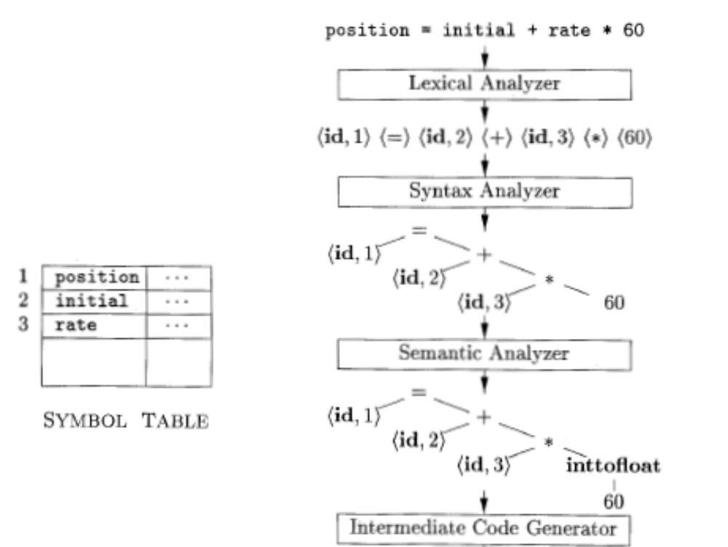
Translation of an assignment statement

Slide 20
Identifier Scope
Scope
  portion of a program that is the scope of one or more declarations
Most languages allow nested blocks
The “most-closely nested” rule for blocks
  an identifier x is in the scope of the most-closely nested declaration of x
  examine blocks inside-out, starting with the block in which x appears

Slide 21
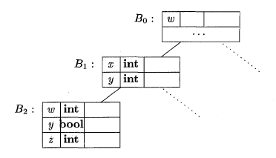
Symbol Table per Scope
int w;
{ int x; int y;
    { int w; bool y; int z;
        w ; x ; y ; z ;
    }
    w ; x ; y ;
}
  w ;
Chained Symbol Table

Slide 22
Semantic Analysis
Flow of control checks
  e.g. break must be within while, for, or switch
Uniqueness check:
  Identifier names must be unique within the same scope
  Switch cases must be distinct
  Enumerated names must be distinct
Name-related checks
  Some names must appears at begin and end of blocks: function xyz begin …….. End xyz
Type Checking
  A very important part in semantic analysis …. More later on

Slide 23
Attributes
Some compiler phases collect information about identifiers and other phases use these information
Where to store such information?
  As attributes in parse (or syntax) tree nodes
Two types of attributes:
  Synthesized attributes
    passed upwards from the leaves up to the root
  Inherited attributes
    passed downwards from root to leaves

Slide 24
Attributes
An attribute is said to be synthesized if its value at a parse-tree node N is determined from attribute values at the children of N and at N itself.
The "inherited" attributes have their value at a parse-tree node determined from attribute values at the node itself, its parent, and its siblings in the parse tree.

Slide 25
Syntax-directed translation
Syntax-directed translation engines that produce collections of routines for walking a parse tree and generating intermediate code.

Slide 26
Syntax-Directed Definition
A syntax-directed definition (SDD) is a context-free grammar together with, attributes and set of semantic rules (for computing the values of the attributes). Attributes are associated with grammar symbols and rules are associated with productions.
If X is a symbol and a is one of its attributes, then we write X.a to denote the value of a at a particular parse-tree node labeled X. If we implement the nodes of the parse tree by records or objects, then the attributes of X can be implemented by data fields in the records that represent the nodes for X.

Slide 27
Syntax-Directed Definition
A syntax-directed definition associates:
  With each grammar symbol, a set of attributes, and
  With each production, a set of semantic rules for computing the values of the attributes associated with the symbols appearing in the production

Slide 28
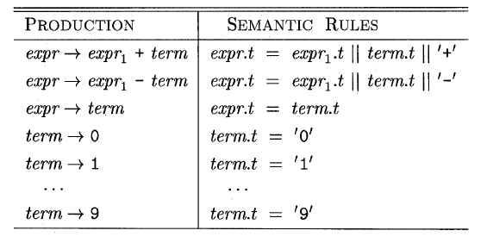
SDD Example
Syntax-directed definition for infix to postfix translation
The symbol || in the semantic rule is the operator for string concatenation

Slide 29
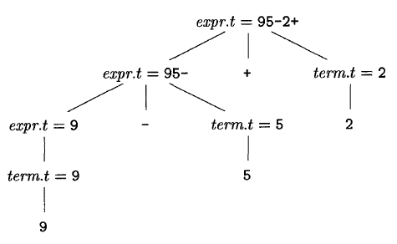
Synthesized Attribute Example
Parse tree for 9-5+2 with attribute t
annotated parse tree for 9-5+2
A parse tree, showing the value(s) of its attribute(s) is called an annotated parse tree.

Slide 30
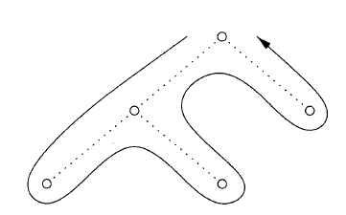
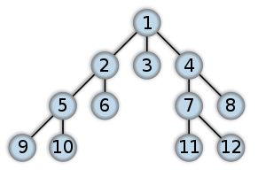
Tree Traversal
A traversal of a tree starts at the root and visits each node of the tree in some order
  Depth-first
  Breadth-first

Slide 31
Type Checking
Correct use of operators
  x + y check that both x and y are of equivalent types accepted by addition
    Integers
    Floats
    Integer and float
  Array subscript it used only with arrays
    Subscript index is integer
      A[2.5] → subscript error
      Int A; A[2]; → Error: A is not an array
  Pointer operator is used only with pointer variables
  etc
Correct function parameter passing
  The same number of arguments are passed to the function with compatible types

Slide 32
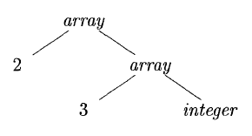
Type Expressions
Represents the structure of types
  Basic types, or
  Formed by applying type constructor to a type expression
Example: int a[2][3]
  array(2, array(3, integer))

Slide 33
Type Expressions (cont)
A basic type is a type expression
  boolean, char, integer, float, and void
A type name is a type expression
If t is type expression then
  array(size, t) is a type expression
If s and t are type expressions then
  s → t is a type expression for functions
  s x t (their Cartesian product) is type expression
    e.g. for function parameters
      int f(int, float, char) int x float x char → int
      Int f() void → int
      void f(int) int → void
record is a type constructor applied to record (struct) field names and their types
→ the type constructor for function types. Array record

Slide 34
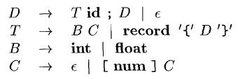
Declarations
Simple grammar for declarations

Slide 35
References
Compilers: Principles, Techniques and Tools, Alfred V. Aho, Monica S. Lam, Ravi Sethi, and Jeffrey D. Ullman. 2nd Edition, Addison-Wesley, 2007 (sections: 2.3, 2.7, 6.3)
Basics of Compiler Design, Torben Ægidius Mogensen. Published through lulu.com, 2008
Course notes of Leonidas Fegaras, University of Texas at Arlington, CSE, 2005

Slide 36
References
Compilers: Principles, Techniques and Tools, Alfred V. Aho, Ravi Sethi, and Jeffrey D. Ullman. 1st Edition, Addison-Wesley, 1986 (pages 203-208)
Teaching Materials of: Elements of Compiler Design, Alexander Meduna ,Taylor & Francis, New York, 2007
Course notes of Leonidas Fegaras, University of Texas at Arlington, CSE, 2005

