Slide 1
Data Visualisation
Prepared by Domas Belickas

Slide 2
INTRO
This data contains two datasets taken from different sources about nba players statistics and their shooting motion.
The first one is basic statistics overview of the regular 2020-2021 season, including the main metrics such as FG% (field goal percentage), FGA (field goals attemped), FG (field goals made), etc.
The second one of the motion of the shooting form, the data is split into 3 dimensions that describes the motion in dimension x,y and z.

Slide 3
Goal of the project
Adapt the statistic metrics to the shooting motions to be able to do a minor data analysis for questions such as which form is the optimal, is there any hidden motion, that could be used in order to gain advantage while shooting.
If possible - adapt nearal network or any other machine learning algorithm and try to contstruct ‘an optimal shooting motion’.

Slide 4
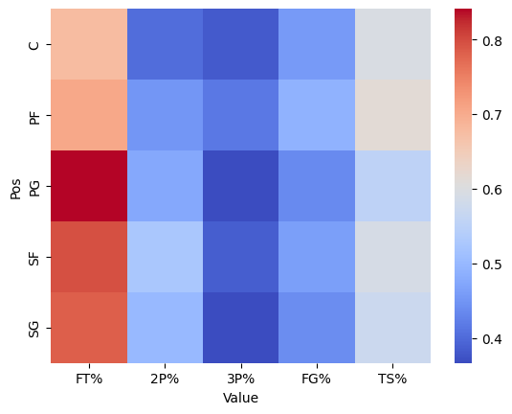
HEATMAP
This heatmap represents how each position compares to each other across different metrics.

Slide 5
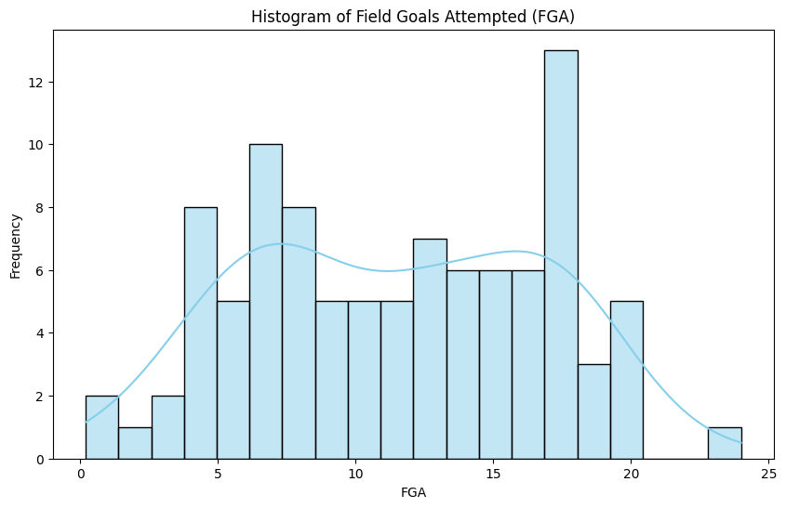
Histogram 1
Here we can see how many attempts are made by every player in the NBA.
What is important to note here, that we can see two normal distribution graphs merged, so it indicates that some clustering would be beneficial to retrieve a feature out of the data.

Slide 6
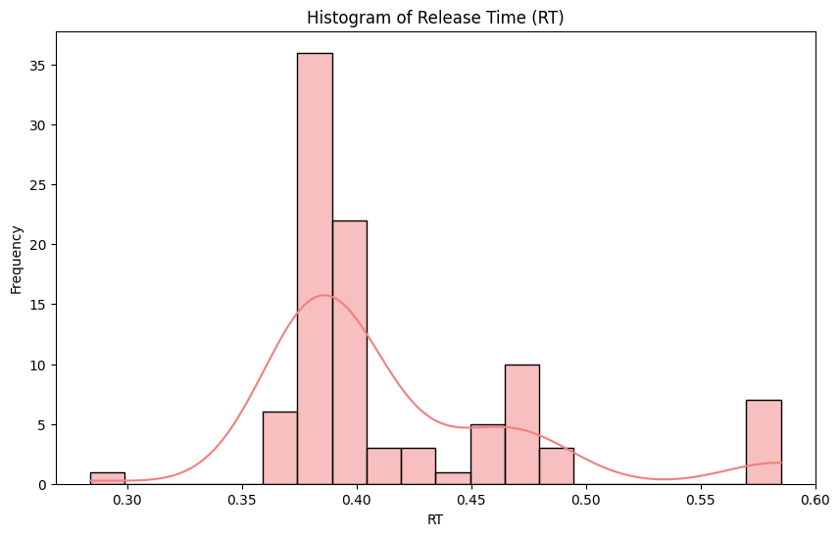
HISTORGAM 2
This is more near a normal distribution with only one peak, since the other one has way less players included.

Slide 7
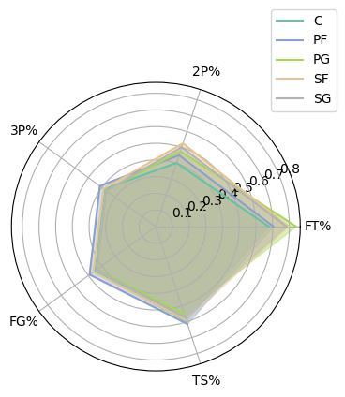
RADAR CHART
This has the exact same data used as the heatmap, but in a bit of a messy way.

Slide 8
Thanks for your attention

