Slide 1


Notes:
Template used for copy and pasting bc grouping

Slide 2
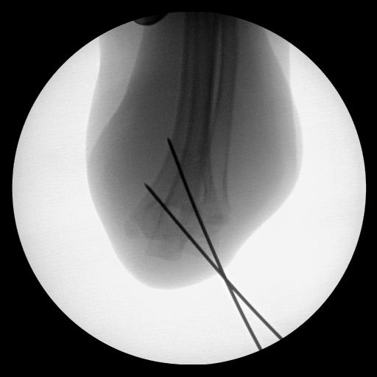

Notes:
20181025_1-034_221027

Slide 3
Notes:
20181025_1-034_221027

Slide 4
Notes:
20181025_1-034_221027

Slide 5
Notes:
034_221027

Slide 6
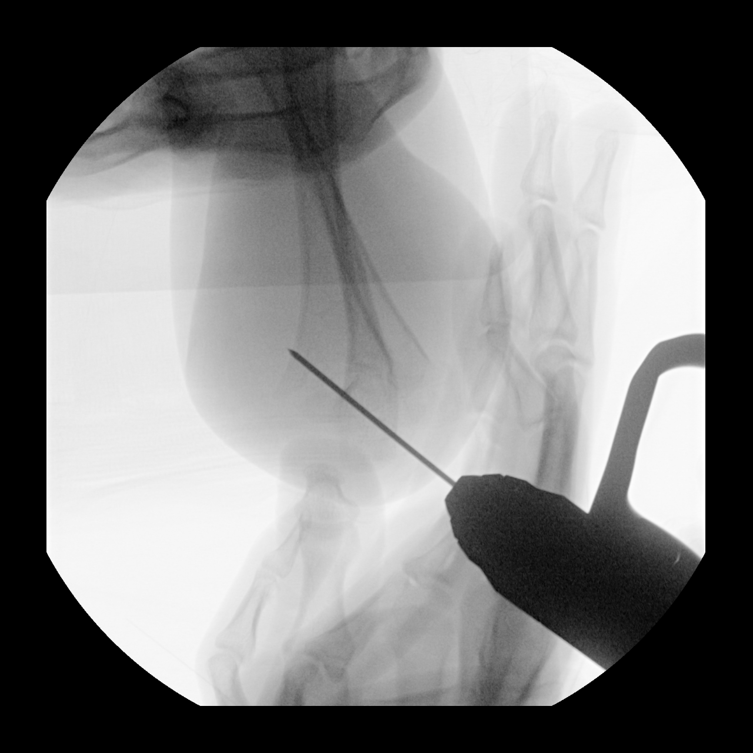
Notes:
20210924_1-024_110911

Slide 7
Notes:
20210924_1-024_110911

Slide 8
Notes:
20210924_1-024_110911

Slide 9
Notes:
20210924_1-024_110911

Slide 10
Notes:
201806201-007_050620

Slide 11
Notes:
201806201-007_050620

Slide 12
Notes:
201806201-007_050620

Slide 13
Notes:
201806201-007_050620

Slide 14
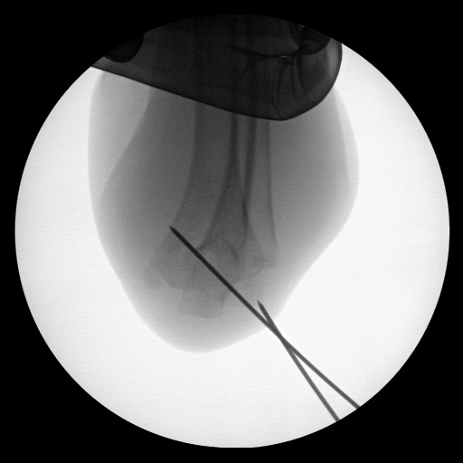
Notes:
20181025_1-021_221042

Slide 15
Notes:
20181025_1-021_221042

Slide 16
Notes:
20181025_1-021_221042

Slide 17
Notes:
20181025_1-021_221042

