Slide 1


Notes:
Template used for copy and pasting bc grouping

Slide 2
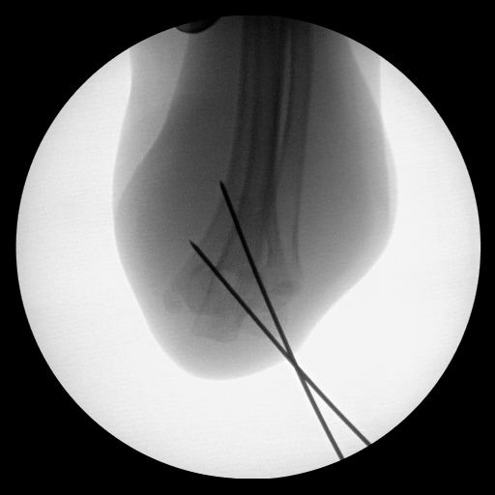

Notes:
20181025_1-034_221027

Slide 3
Notes:
20181025_1-034_221027

Slide 4
Notes:
20181025_1-034_221027

Slide 5
Notes:
20181025_1-034_221027

Slide 6
Notes:
20181025_1-034_221027

Slide 7
Notes:
20181025_1-034_221027

Slide 8
Notes:
20181025_1-034_221027

Slide 9
Notes:
20181025_1-034_221027

Slide 10
Notes:
20181025_1-034_221027

Slide 11
Notes:
20181025_1-034_221027

Slide 12
Notes:
20181025_1-034_221027

Slide 13
Notes:
20181025_1-034_221027

Slide 14
Notes:
20181025_1-034_221027

Slide 15
Notes:
034_221027

Slide 16
Notes:
034_221027

Slide 17
Notes:
034_221027

Slide 18
Notes:
034_221027

Slide 19
Notes:
034_221027

Slide 20
Notes:
034_221027

Slide 21
Notes:
034_221027

Slide 22
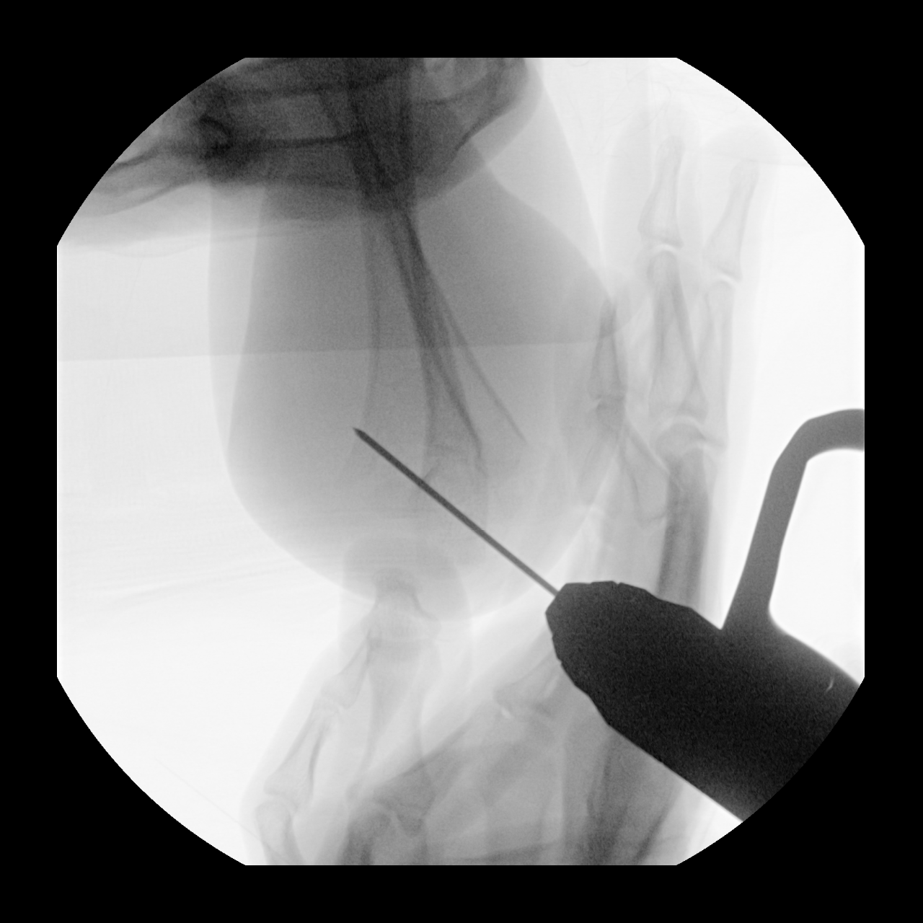
Notes:
20210924_1-024_110911

Slide 23
Notes:
20210924_1-024_110911

Slide 24
Notes:
20210924_1-024_110911

Slide 25
Notes:
20210924_1-024_110911

Slide 26
Notes:
201806201-007_050620

Slide 27
Notes:
201806201-007_050620

Slide 28
Notes:
201806201-007_050620

Slide 29
Notes:
201806201-007_050620

Slide 30
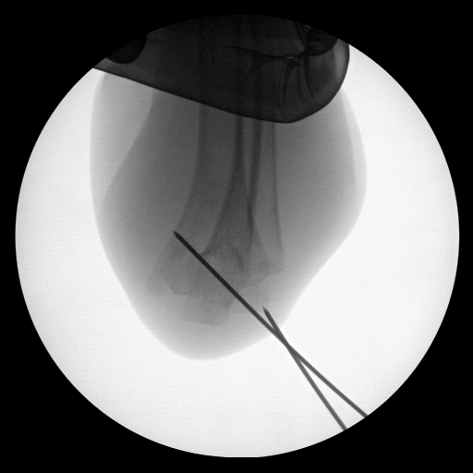
Notes:
20181025_1-021_221042

Slide 31
Notes:
20181025_1-021_221042

Slide 32
Notes:
20181025_1-021_221042

Slide 33
Notes:
20181025_1-021_221042

