Slide 1
Plant Database
Kevin Dombrosky, Brittany Purcell

Slide 2

Dataset
Plant Dataset
Maps plants to locations in United States/Canada
Plants
Listed using their scientific name
Locations
Abbreviations for different regions
There is a separate file which mapped the abbreviations to the regions
(http://archive.ics.uci.edu/ml/datasets/Plants)
Notes:
The dataset that we chose was a plant dataset. This dataset contained plant names (each one listed by its scientific name). Each plant name then had a list of all of the regions in the United States/Canada that the plant could be found in. The regions were all listed using abbreviations, and in order to know what the abbreviations stood for there was an additional file which contained all of the abbreviations and what they stood for.
The URL at the end is the link to the dataset that we used.

Slide 3
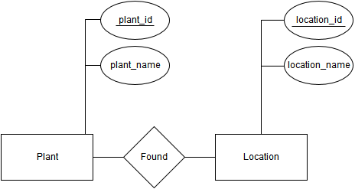
Creating the Database
Created a script in Java
Steps script took to upload data to database
Convert the abbreviations into the regions
Need full names for analysis
Created the tables for the database
The ER diagram (seen to right)
Uploaded the data to the database using load call.
3 tables of data
Notes:
In order to load the data effectively into the database, we needed to create a script. This script not only changed the abbreviations to stand for the full name of the regions, but it then took that information and neatly loaded it into the database, creating a unique ID for each plant and location, and creating a table that would link the ID’s together in order to a quick lookup using the ID’s.
This script was created using Java in Eclipse, and was run on the files that contained the data. The script would first create a new file which removed the abbreviations, and that is the file that was used to load the database.

Slide 4

Analysis
Created webpage visualization
Written in Jade Markup Language with CSS
Familiar language for the group
Map of United States/Canada
Search and substring-searching
Display information
Notes:
The analytic that we chose was a visualization. We chose to do a webpage that was written using Jade Markup Language and CSS. This was chosen because it was a familiar language with members of the group, and there would not need to be a new language to learn. The visualization has great support, and has a map that we were able to use. The map is a map of the united states/Canada since this is the information that is contained in the dataset that we have.
There are 2 ways that you can look up information using the webpage. The first is to select a location. If you do this, on the left a list of information will appear showing the plants that are available in that area. If you know the name of the plant that you are looking for you can also search for it, and when you select it the locations that it can be found in will turn green. Sub searching works as well, so if you search a part of a plant name, a list of the plants that contain that string will become available to select on the left hand side.
There is a screen shot image on the next slide that shows what the visualization looks like.

Slide 5
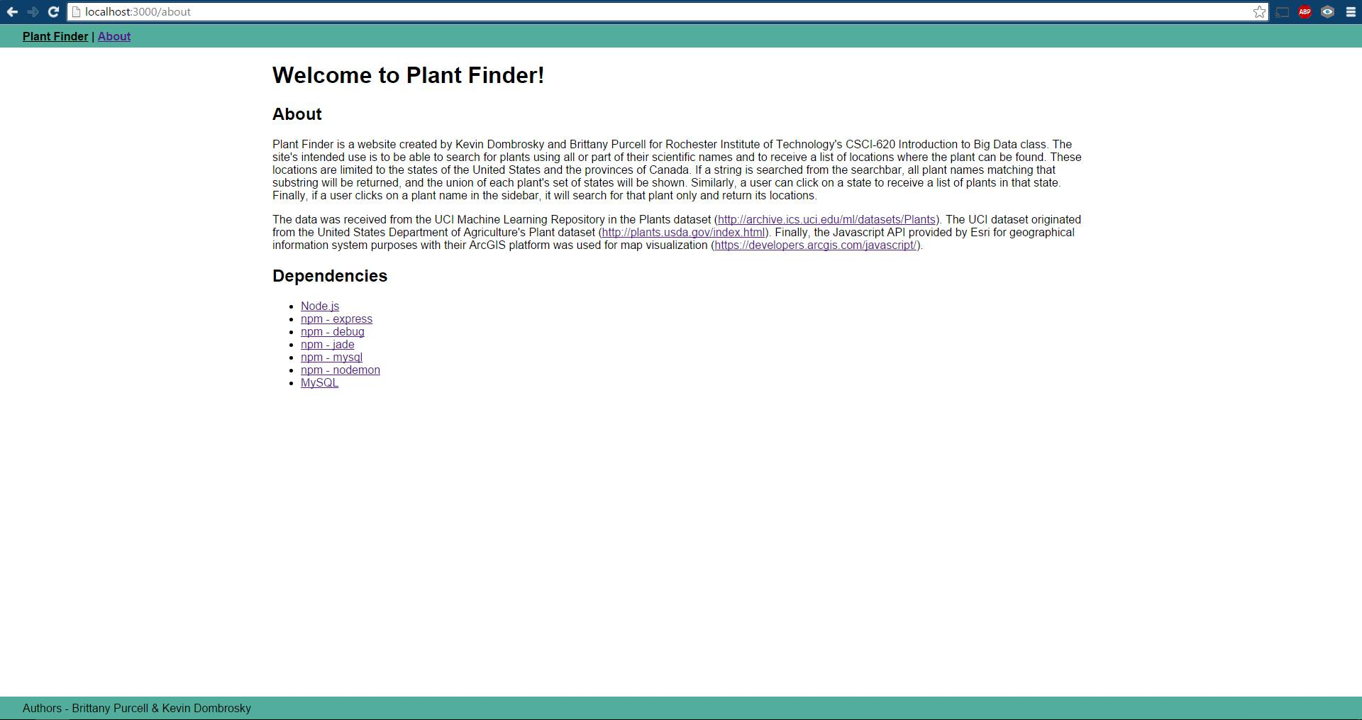
The Visualization
Notes:
This is the screenshot of the webpage. All of the regions are highlighted green, and you would be able to select any of the regions and on the left hand side the available plants in that area will appear. Also, at the top left is the search bar. This is how you can do any searching. As you search the plant name will appear on the left hand side, and it can be selected. This will then change the regions to only the regions where that particular plant is available.

Slide 6
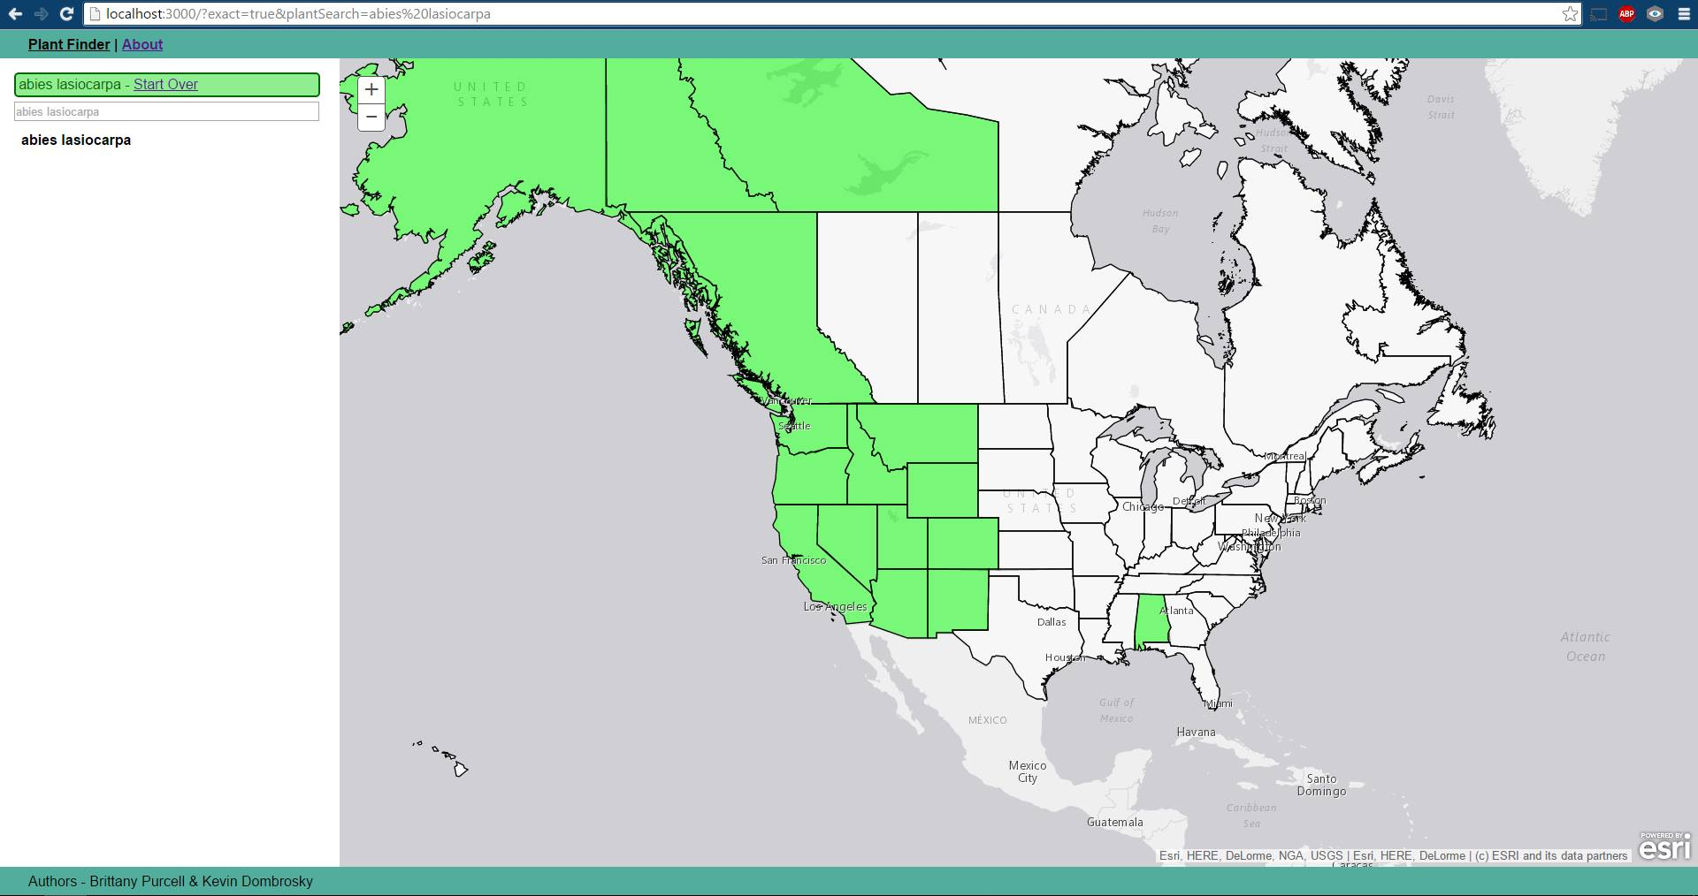
Exact Search
Notes:
This is what will appear if you search for a certain plant by its full name. See how only some of the regions are highlighted.

Slide 7
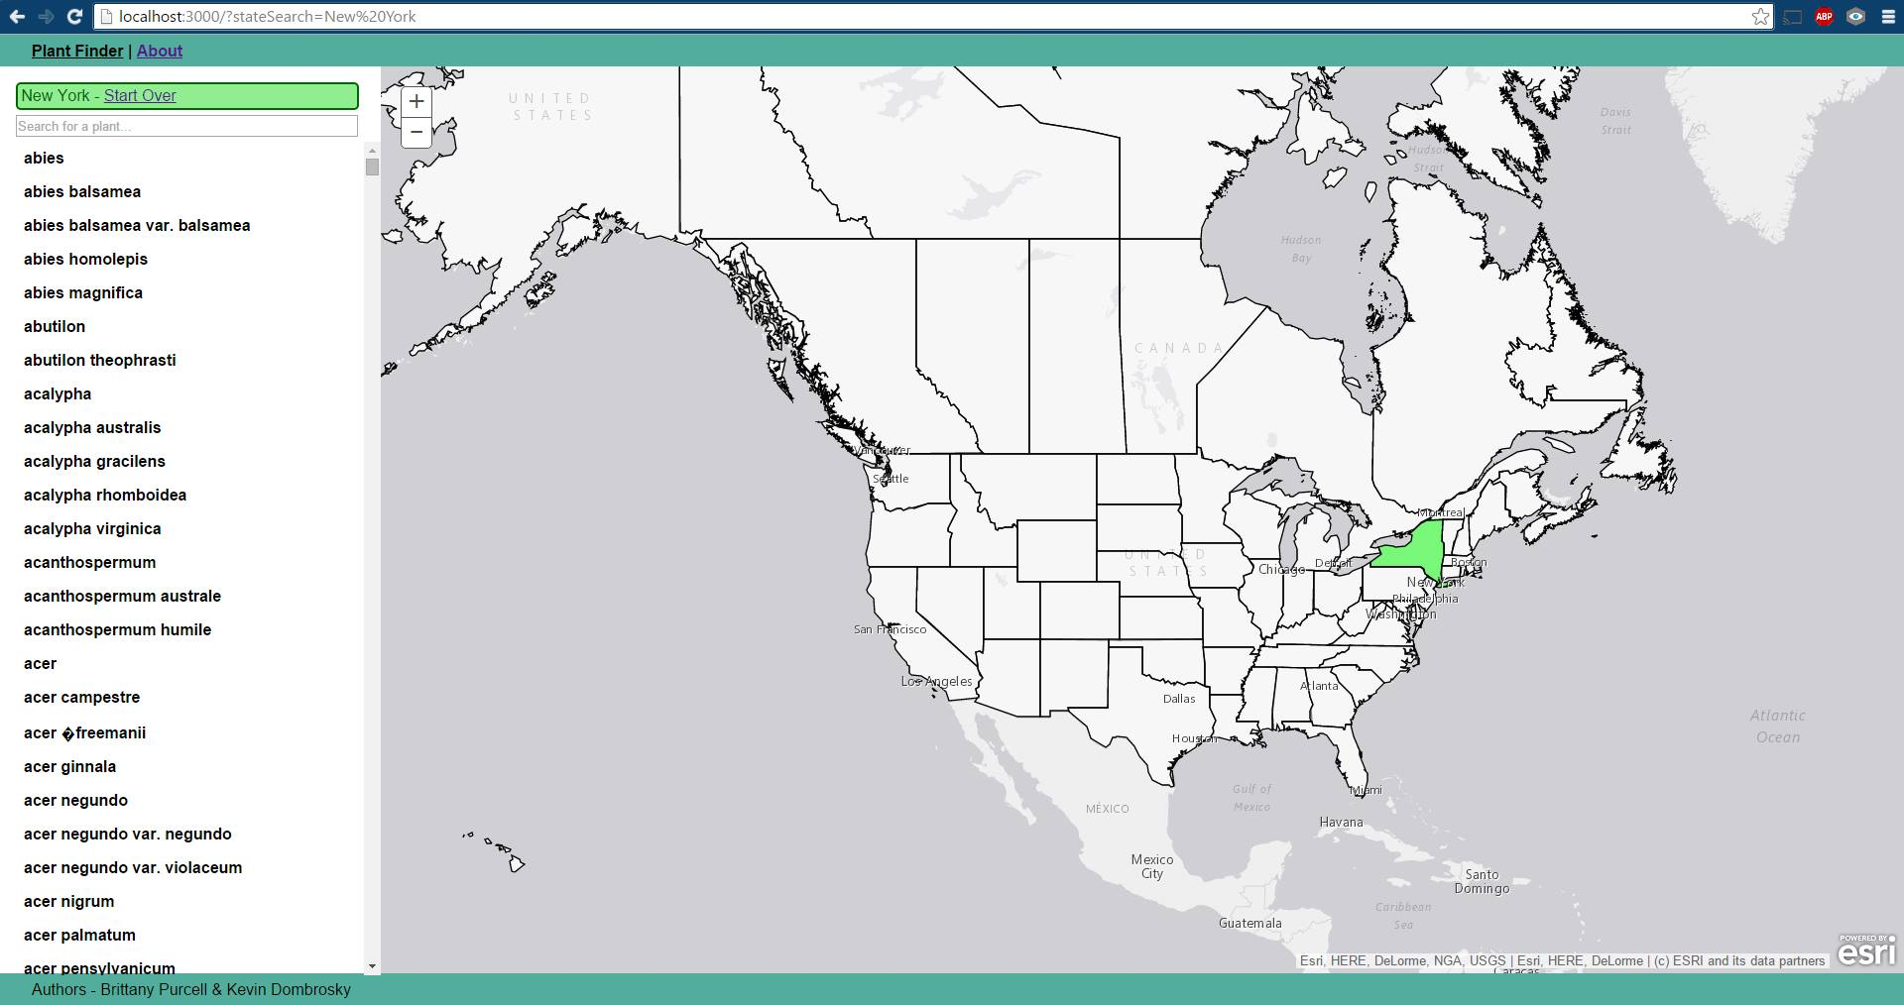
Selecting State
Notes:
Here the state of New York was selected, and on the left hand side is a list of all of the plants that can be found in that state.

Slide 8
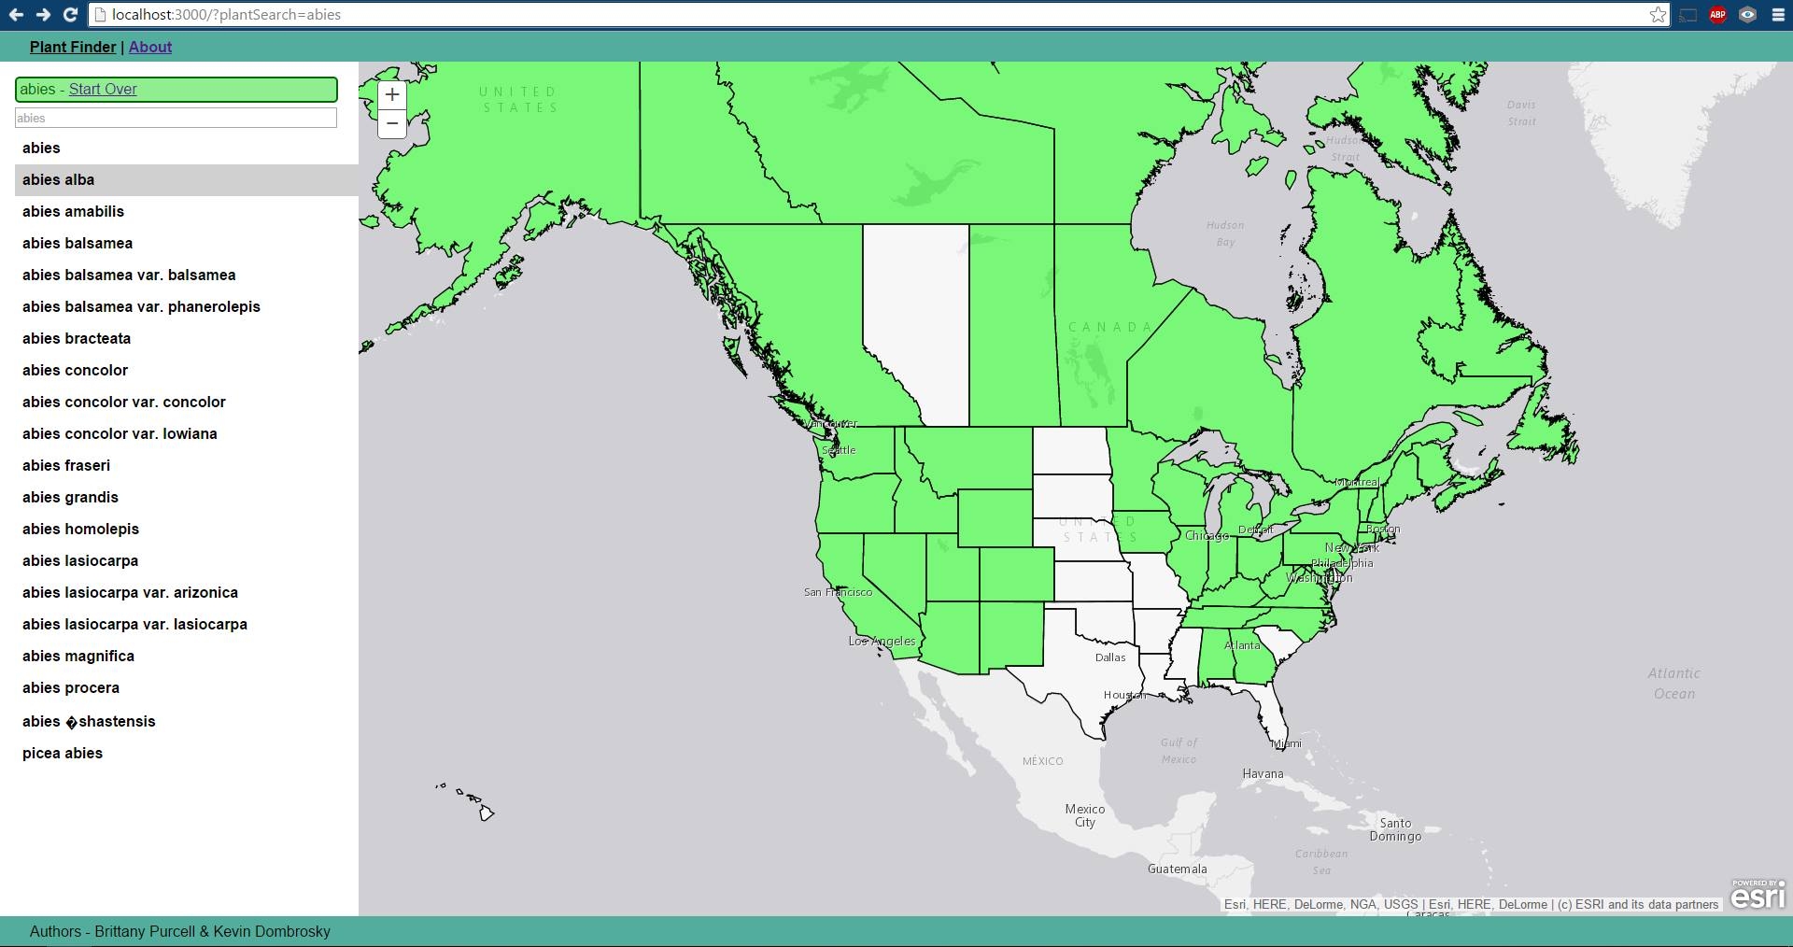
Partial Search
Notes:
Here a partial search was done, which will give a result with many plants that contain that substring in their name. Then, all of the regions where that plant exists will be highlighted on the map.

Slide 9

Connecting Database to Webpage
Node MySQL database
Node.js server
Protection
Use MySQL injection with escape command
MySQL packaging
Notes:
In order to connect the database and the webserver we needed to use a MySQL package, and put the database up on a server. The server we used was a Node.js server that was created locally on the computer. In order to protect the information, we used a MySQL injection with an escape command. Then it was as simple as pushing the database calls to the server, and the server relaying the results back to the webpage in order to be displayed in the visualization.

Slide 10

Work Arounds
Newfoundland and Labrador
2 places in database, 1 place on the map
At runtime either combine or split the information
Prince Edward Island, Greenland/Denmark, and St. Pierre and Miquelon.
In dataset
Not in ArcGIS map that was used
Were removed, “outside scope of project”
Notes:
There were a few areas where we needed to slightly adjust the dataset/information in order to get it to work with the map. The first is that Newfoundland and Labrador are the same place on the map in the webpage. For this reason, at runtime we either combine the information or make 2 different calls in order to get the needed information. If the regions is selected, it searched both Newfoundland and Labrador. If a plant is listed in either of these locations, it is combined to include them both.
Another change to the dataset we made was with Prince Edward Island, Greenland/Denmark, and St. Pierre Miquelon. This information was removed from our database because our map did not include these regions, which are not part of the United States/Canada. We figured that since the map we wanted was only US and Canada, there was no need to include any regions outside of that. So, we simple removed that information from the dataset.

Slide 11
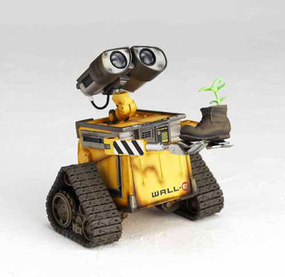
Future
Clustering
Try to determine trends
Climate
Locations
Notes:
In the future, we could attempt to cluster that data in order to find a trend with the type of plants that are found. Certain plants might grow together because of a certain climate. There might also be trends based on the locations for the plants.

Slide 12
References
http://res.freestockphotos.biz/pictures/16/16631-illustration-of-a-green-plant-pv.png
https://24.media.tumblr.com/9b699955b7a950954f6e6d7143d0bbb7/tumblr_mz0tlzrS2E1qeuvt8o1_500.png
http://therecycletimes.com/wp-content/uploads/2011/04/Replant.jpg
http://archive.ics.uci.edu/ml/datasets/Plants

