Slide 1

END-OF-YEAR INTERNSHIP REPORT
Synkro
Project board
Live
To Do
In Progress
In Review
Done
Design and development of a collaborative project
and task management platform
Prepared by
Adem Ouerhani
Professional supervisor
Mr. Mkaissi Khalil, Kernel Solution & Innovation
Institution
ISLAIB, Licence GLSI, 2025-2026
01 / 19

Slide 2

Agenda
What this presentation covers
01
03
05
Project context
The four sprints
Reflection & next steps
The host company, the market, and the problem Synkro addresses
Authentication, project & task management, real-time collaboration, admin
Skills gained, challenges, and where Synkro goes from here
02
04
Solution & methodology
Architecture & results
Objectives, actors, tech stack, and the Agile sprint plan
How it's built, and what the platform looks like today
02 / 19

Slide 3
1
Project context
Kernel Solution & Innovation
A digital agency in Hammam-Lif, Tunisia, with over seven years of experience turning client ideas into complete digital products: custom software, mobile apps, web design, and digital marketing.
1
Planning
Understand goals, define roadmap
2
Development
Build with modern technologies
This internship (PFA) was self-directed: full autonomy over the topic and the implementation, under the professional supervision of the agency's CEO, within its own Agile delivery culture.
3
Testing & QA
Validate quality before launch
4
Launch & support
Deliver and support ongoing use
03 / 19

Slide 4
1
Project context
A gap in existing project management tools
Small teams need simplicity, live collaboration, and fine-grained role control together, a combination the market rarely offers in one lightweight product.
Trello
Asana
Jira
ClickUp
Synkro
Ease of use
Very simple
Simple & fast
Steep learning curve
Steep learning curve
Simple & fast
Real-time collaboration
Limited
Moderate
Moderate
Moderate
True real-time
Role granularity
Basic roles
Moderate roles
Advanced roles
Advanced roles
4 granular roles
Simple tools sacrifice roles and real-time depth; complete tools become heavy. Synkro targets that gap.
04 / 19

Slide 5
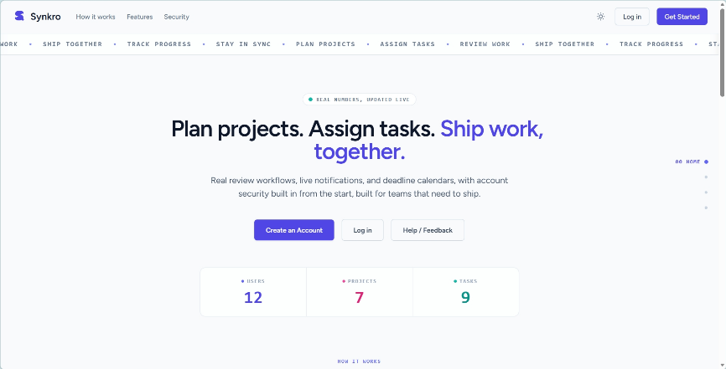
1
Project context
Introducing Synkro
A collaborative web platform where teams create projects, assign role-based responsibilities, move tasks through a clear status workflow, and stay instantly informed. All built solo in seven weeks.
Role-aware projects: Owner, Manager, Member, Tester
Full task lifecycle with checklists & deliverables
Real-time notifications powered by WebSockets
Administration, moderation & analytics layer
05 / 19

Slide 6
2
Solution & methodology
Objectives
Deliver a complete, usable platform within a seven-week internship
Fine-grained, role-based access control across every project
True real-time collaboration via WebSockets
Administration & moderation tooling for a healthy platform
Run the internship itself as an Agile, sprint-based process
06 / 19

Slide 7
2
Solution & methodology
Actors & roles
PROJECT LEVEL
Owner
Manager
Member
Tester
Full control, including deleting the project and role management
Creates and assigns tasks, manages members
Works on assigned tasks, checklists and deliverables
Validates submitted work, restricted permissions
PLATFORM LEVEL
User
Administrator
Superadmin
Any authenticated account by default: manages their own profile and projects
Moderates users, handles tickets and appeals
Promotes/demotes users, deletes accounts, edits user info
07 / 19

Slide 8
2
Solution & methodology
Requirements specification
Functional
Non-functional
Registration, e-mail verification, login & session management
Usability: clean, responsive UI on desktop & mobile
Profile, account settings & visual theme management
Performance: real-time updates with minimal latency
Project creation, invitations & role assignment
Security: every sensitive action behind role-based authorization
Task lifecycle: status, checklists & deliverables
Maintainability: MVC separation & a normalized data model
Comments, reviewer feedback & real-time notifications
Dark, light & custom colour themes for user comfort
Admin: user management, suspension appeals & analytics
08 / 19

Slide 9
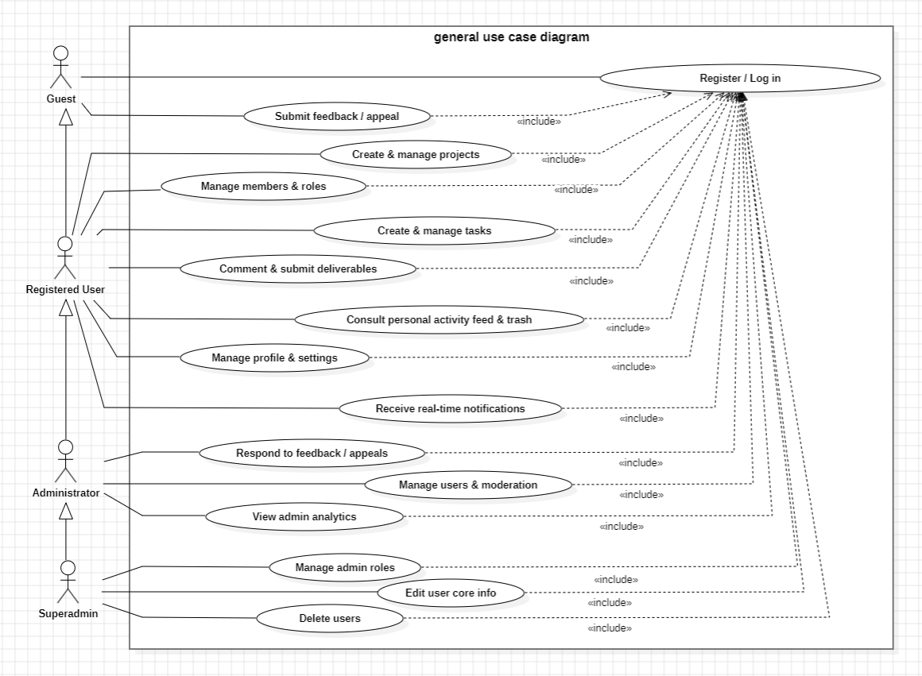
2
Solution & methodology
Methodology & tech stack
Agile, sprint-based delivery
As sole developer and de facto product owner, the internship followed a planning sprint (Sprint 0) plus four development sprints, each shipping a working, demonstrable increment, modeled beforehand with UML use case, sequence, and class diagrams.
Technology stack
Backend
Laravel 13
Frontend
React + Inertia.js
Real-time
Laravel Reverb
Styling
Tailwind CSS
Database
MySQL
Charts
Recharts
General use case diagram of Synkro
09 / 19

Slide 10
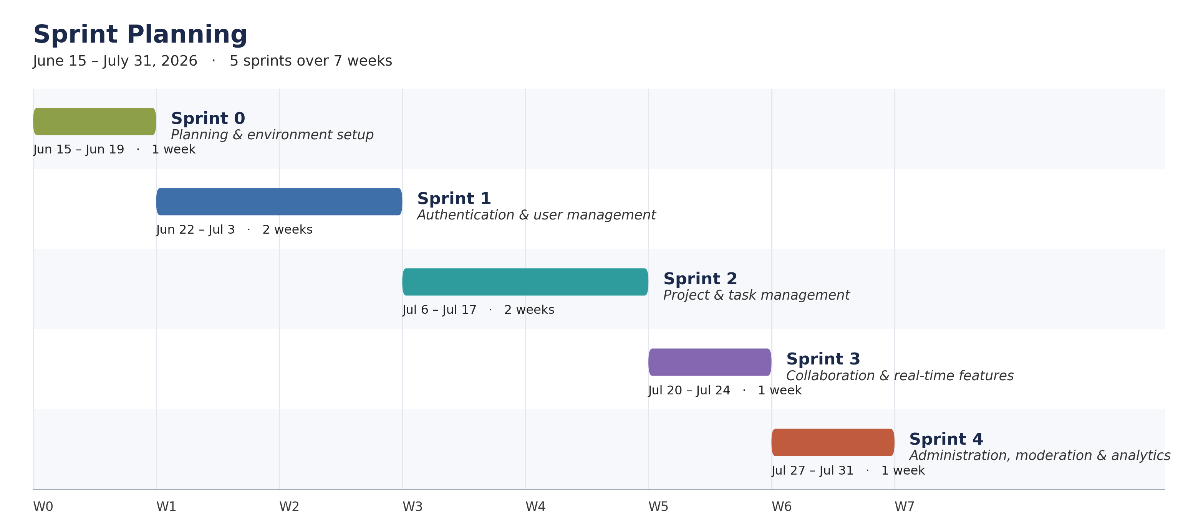
2
Solution & methodology
Sprint planning: June 15 to July 31, 2026
Seven full working weeks, split into one planning sprint and four development sprints: two weeks each for the functional core (auth, project & task management), one week each for the lighter, incremental features that follow.
10 / 19

Slide 11
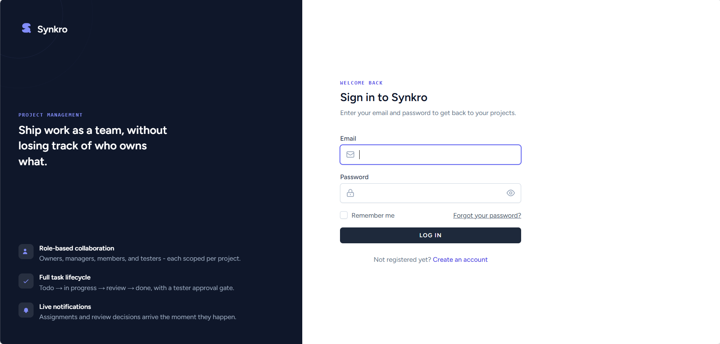
3
The four sprints
S1
Authentication & User Management
June 22 - July 3, 2026
Registration with e-mail verification, login & logout
Password reset and full profile management
Light, dark & black appearance themes
Live list of active sessions (“logged in devices”)
Account deactivation, reactivated automatically on next login
On-page restore prompt when a deleted account tries to log in
11 / 19

Slide 12
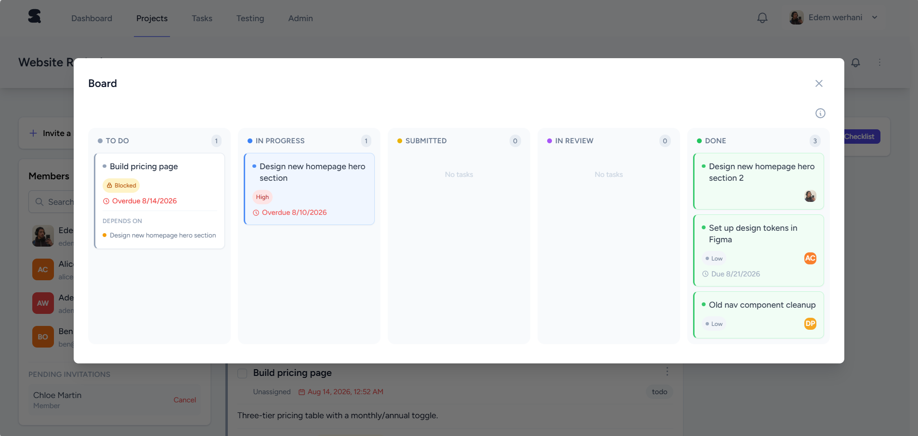
3
The four sprints
S2
Project & Task Management
July 6 - July 17, 2026
Project creation, invitations & role assignment
Full task lifecycle: To Do → In Progress → Submitted → In Review → Done
Checklists and file/link deliverables per task
Kanban-style board updating live for the whole team
Projects, My Tasks and Testing Queue views for finding your own work, plus bulk task actions for reviewers and managers
Pinning and archiving are user-side: any member can use them on their own view, regardless of role
12 / 19

Slide 13
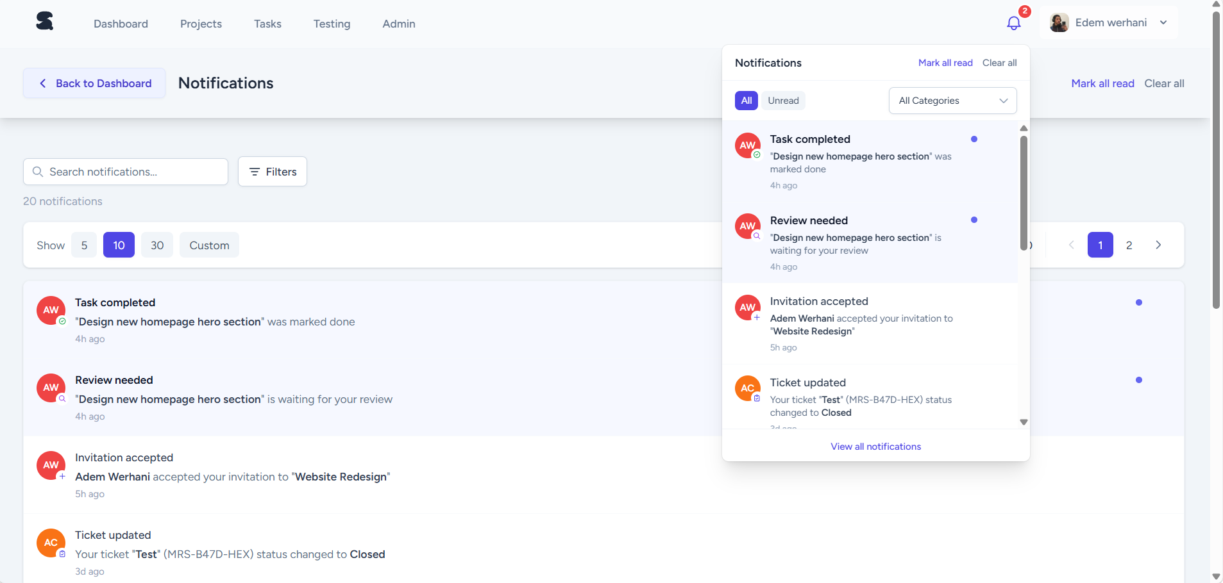
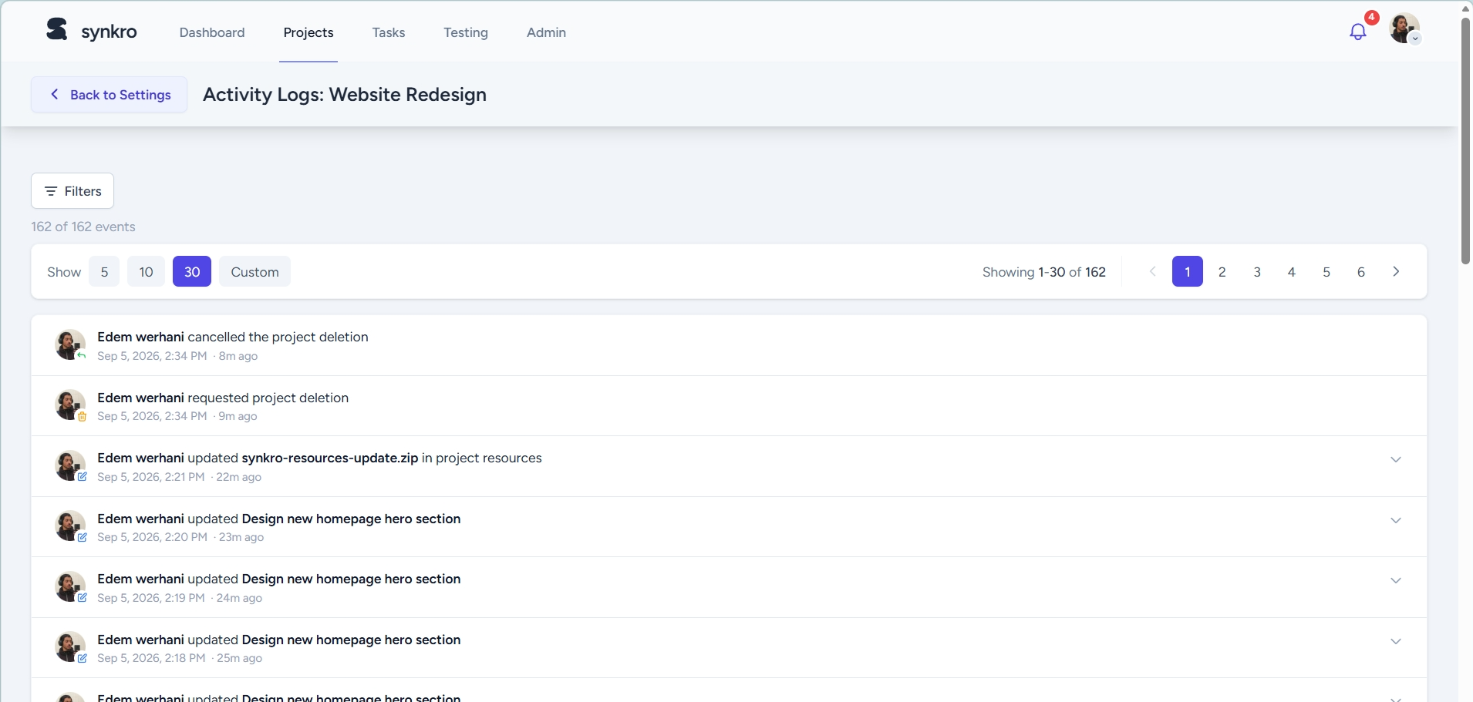
3
The four sprints
S3
Real-Time Collaboration
July 20 - July 24, 2026
Task comments & structured reviewer feedback
Instant notifications pushed over WebSockets
Personal notes and shared project resources
Project activity log for accountability
Per-project and per-task notification muting
Personal dashboard: activity charts, calendars & My Notes
Personal reminders and configurable per-task deadline alerts
Project activity log
13 / 19

Slide 14
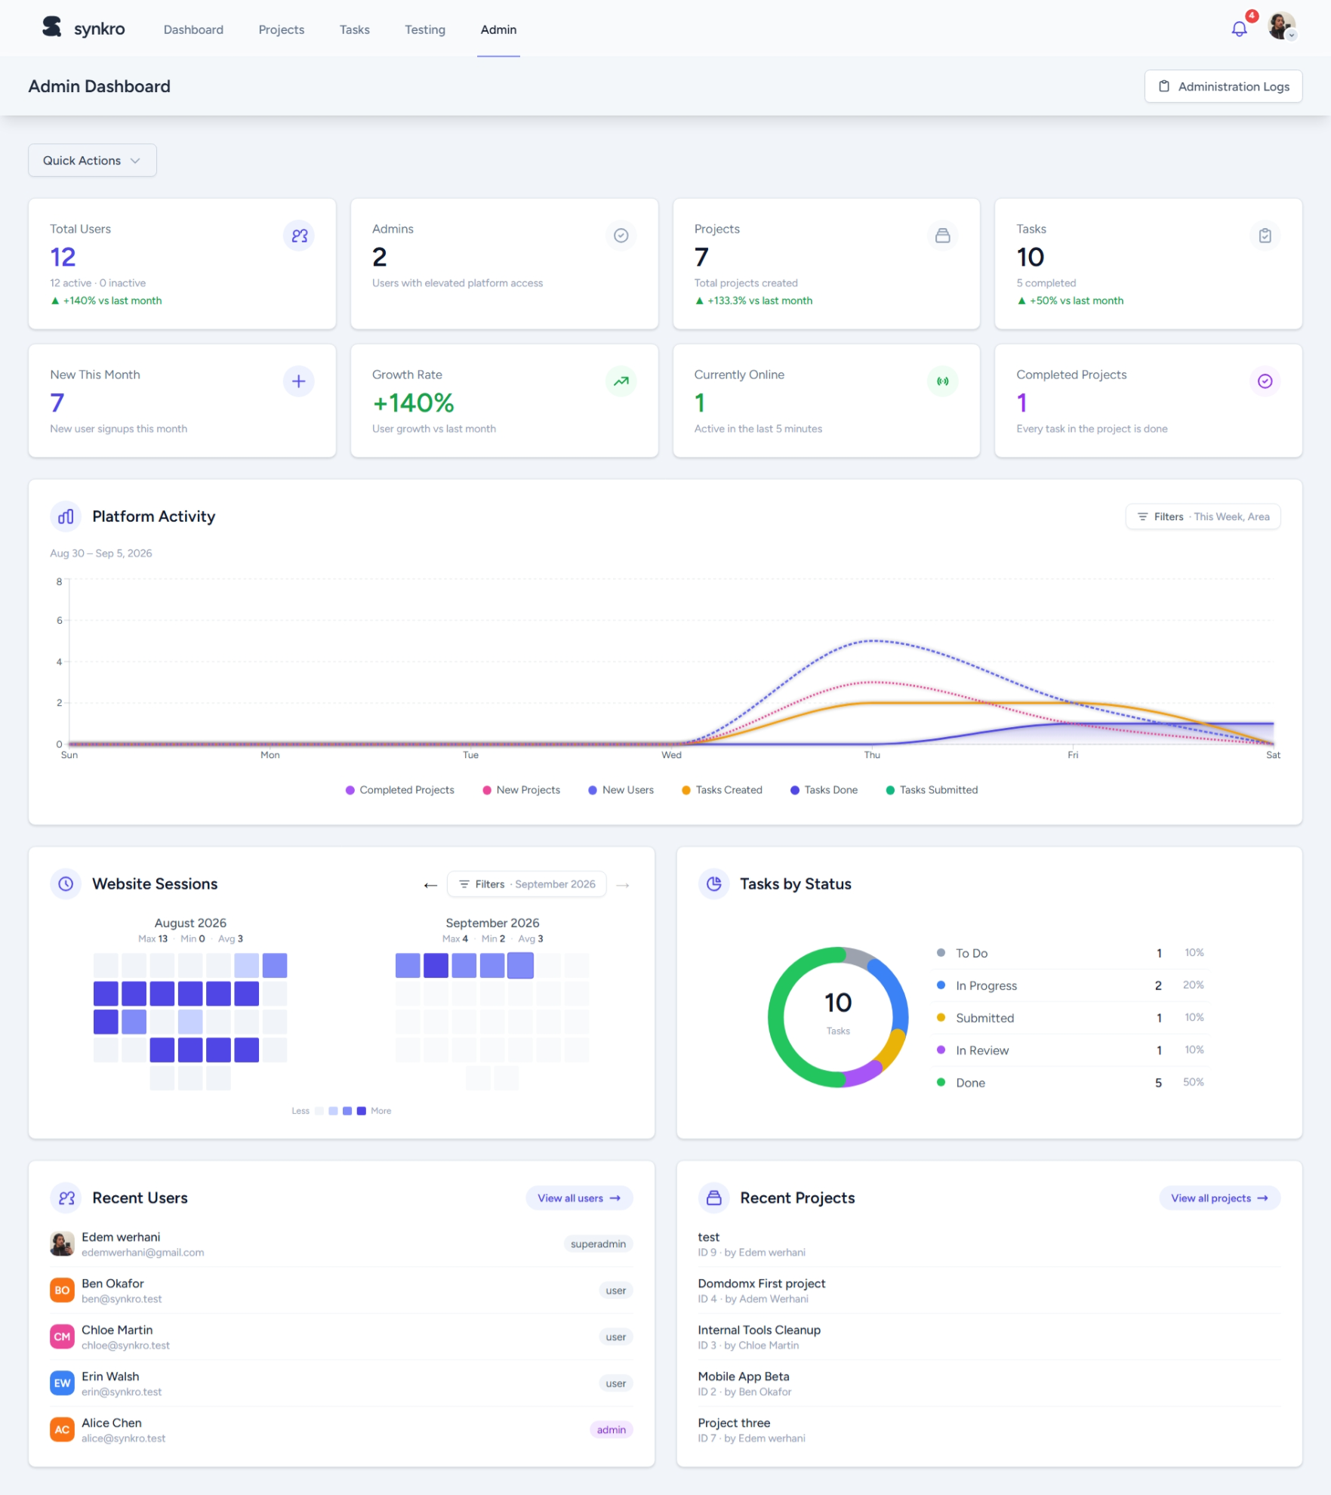
3
The four sprints
S4
Administration & Analytics
July 27 - July 31, 2026
User management with role promotion/demotion
Suspension workflow with a formal appeal process
Feedback / support ticket tracking
Platform-wide analytics dashboard for admins
Admin temporary passwords & configurable feedback categories
14 / 19

Slide 15
4
Architecture & results
Technical architecture
Client
Browser: React + Inertia.js
Tailwind CSS
Application
Laravel 13 controllers & policies
Services: notifications, logs, scheduler
Real-time
Laravel Reverb (WebSocket server)
Laravel Echo (client subscriber)
Persistence
Eloquent ORM → MySQL
Mail queue → notification e-mails
Requests flow top to bottom; broadcast events fan out sideways into either a live WebSocket push or a queued e-mail, depending on the recipient's notification preferences.
15 / 19

Slide 16
5
Reflection & next steps
Skills gained & challenges faced
Skills gained
Challenges faced
Full Laravel ecosystem: policies, jobs, scheduling
Coordinating real-time updates without duplication
React + Inertia.js without a separate REST layer
Designing a flexible yet simple RBAC model
Real-time systems with WebSockets
Prioritizing scope within a fixed seven-week window
Relational data modelling at platform scale
Running my own Agile process end to end
16 / 19

Slide 17
5
Reflection & next steps
Future perspectives
2FA / CAPTCHA and Google sign-in
Dedicated user profiles, separate from account settings
Messaging: direct, per-project, and admin broadcast
An in-app chatbot assistant
Graduated warnings before suspension
Global search across users, projects and tasks
Open-source projects, showcased on public profiles
Custom, configurable project roles
Superadmin system-wide announcement broadcasts
17 / 19

Slide 18

Conclusion
A complete platform, built solo, in seven weeks
Synkro meets every objective set out at the start of this internship: role-aware collaboration, real-time updates, and a full administration layer, delivered through a disciplined, sprint-based process from requirements to a working product.
This internship was a complete, hands-on exercise in software engineering: not just a product, but the judgment built while shipping it under real constraints.
18 / 19

Slide 19
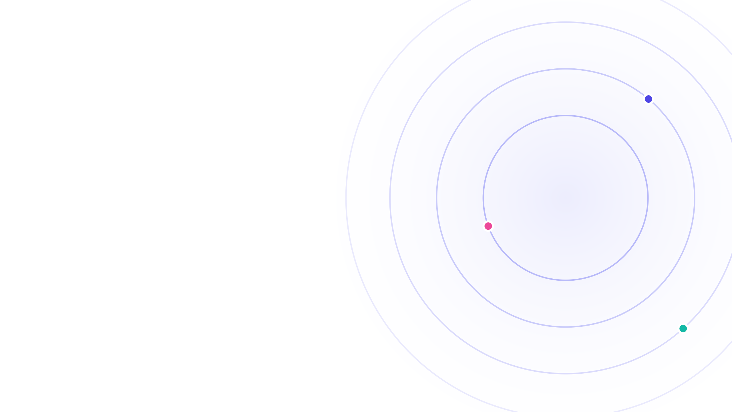
Thank you
Questions & discussion
Adem Ouerhani
Synkro, ISLAIB, Licence GLSI
19 / 19

