Slide 1
END-OF-YEAR INTERNSHIP REPORT (PFA)
Synkro
Design and Development of a Collaborative Project
and Task Management Platform
Prepared by Adem Ouerhani Professional Supervisor Mr. Mkaissi Khalil · Kernel Solution & Innovation Institution ISLAIB · Licence GLSI · Academic Year 2025-2026
01 / 20

Slide 2
AGENDA
What this presentation covers
01
Project context
The host company, the market, and the problem Synkro addresses
02
Solution & methodology
Objectives, actors, tech stack, and the Agile sprint plan
03
The four sprints
Authentication, project & task management, real-time collaboration, admin
04
Architecture & results
How it's built, and what the platform looks like today
05
Reflection & next steps
Skills gained, challenges, and where Synkro goes from here
02 / 20

Slide 3
01 · PROJECT CONTEXT
Kernel Solution & Innovation
A digital agency in Hammam-Lif, Tunisia, with over seven years of experience turning client ideas into complete digital products: custom software, mobile apps, web design, and digital marketing.
1
Planning
Understand goals, define roadmap
2
Development
This internship (PFA) was self-directed: full autonomy over the topic and the implementation, under the professional supervision of the agency's CEO, within its own Agile delivery culture.
Build with modern technologies
3
Testing & QA
Validate quality before launch
4
Launch & Support
Deliver and support ongoing use
03 / 20

Slide 4
01 · PROJECT CONTEXT
A gap in existing project management tools
Small teams need simplicity, live collaboration, and fine-grained role control together, a combination the market rarely offers in one lightweight product.
Trello
Asana
Jira
ClickUp
Synkro
• Very simple
• Easy to learn
• Steep learning curve
• Steep learning curve
• Simple & fast
• Limited real-time
• Moderate real-time
• Moderate real-time
• Moderate real-time
• True real-time (WS)
• Basic roles
• Moderate roles
• Advanced roles
• Advanced roles
• 4 granular roles
Observation: simple tools sacrifice roles and real-time depth; complete tools become heavy. Synkro targets that gap.
04 / 20

Slide 5
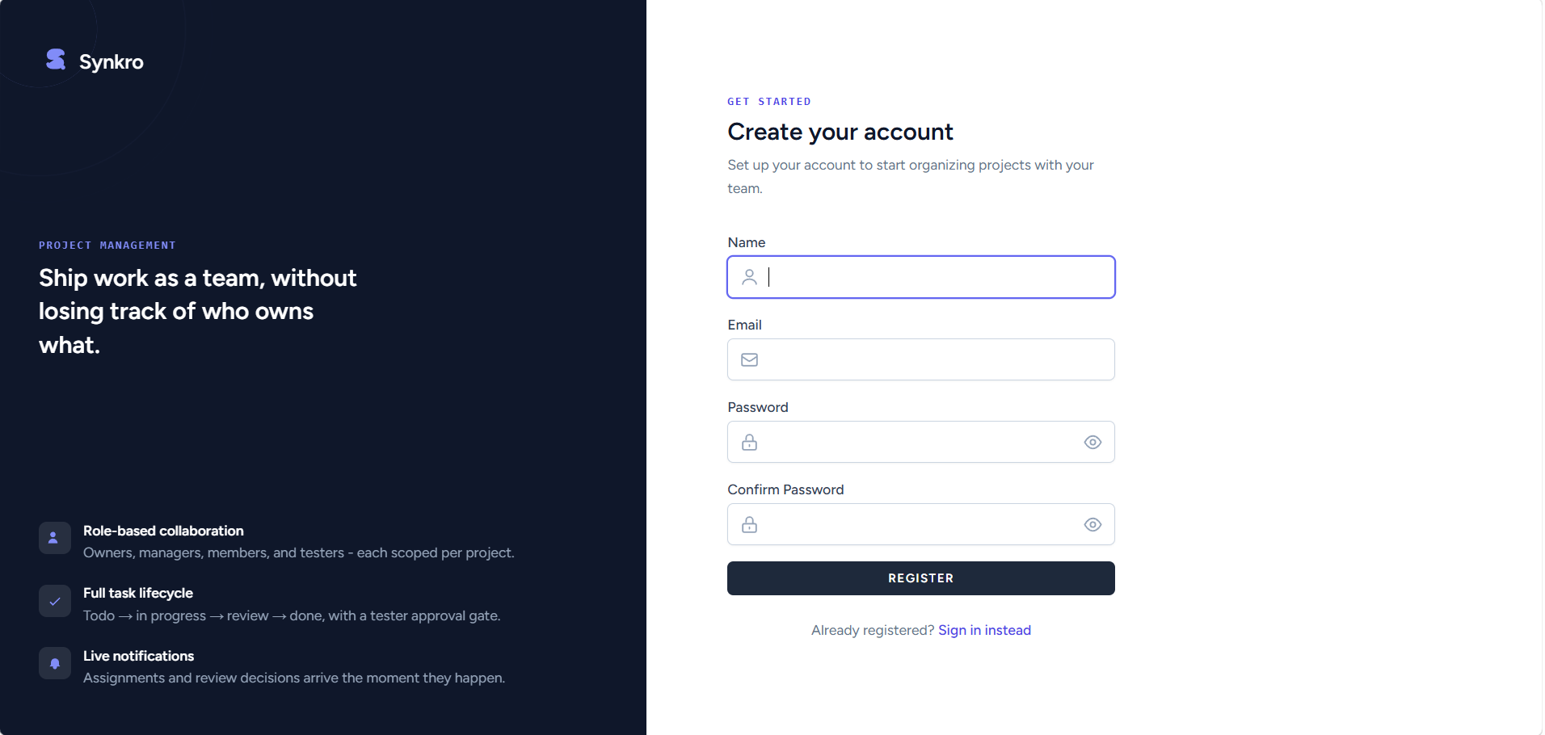
01 · PROJECT CONTEXT
Introducing Synkro
A collaborative web platform where teams create projects, assign role-based responsibilities, move tasks through a clear status workflow, and stay instantly informed. All built solo in seven weeks.
Role-aware projects: Owner, Manager, Member, Tester
Full task lifecycle with checklists & deliverables
Real-time notifications powered by WebSockets
Administration, moderation & analytics layer
05 / 20

Slide 6
02 · SOLUTION & METHODOLOGY
Objectives
1
Deliver a complete, usable platform within a seven-week internship
2
Fine-grained, role-based access control across every project
3
True real-time collaboration via WebSockets
4
Administration & moderation tooling for a healthy platform
5
Run the internship itself as an Agile, sprint-based process
06 / 20

Slide 7
02 · SOLUTION & METHODOLOGY
Actors & roles
Owner
Manager
Member
Full control of a project, including archiving and role management
Creates and assigns tasks; manages other members
Works on assigned tasks, checklists and deliverables
Tester
Administrator
Superadmin
Validates submitted work with restricted permissions
Moderates users, handles tickets and appeals
Promotes/demotes users, deletes accounts, edits user info
07 / 20

Slide 8
02 · SOLUTION & METHODOLOGY
Requirements specification
Functional requirements
Non-functional requirements
• Registration, e-mail verification, login & session management
• Usability: clean, responsive UI on desktop & mobile
• Profile, account settings & visual theme management
• Performance: real-time updates with minimal latency
• Project creation, invitations & role assignment
• Security: every sensitive action behind role-based authorization
• Task lifecycle: status, checklists & deliverables
• Maintainability: MVC separation & a normalized data model
• Comments, reviewer feedback & real-time notifications
• Dark, light & custom colour themes for user comfort
• Admin: user management, suspension appeals & analytics
08 / 20

Slide 9
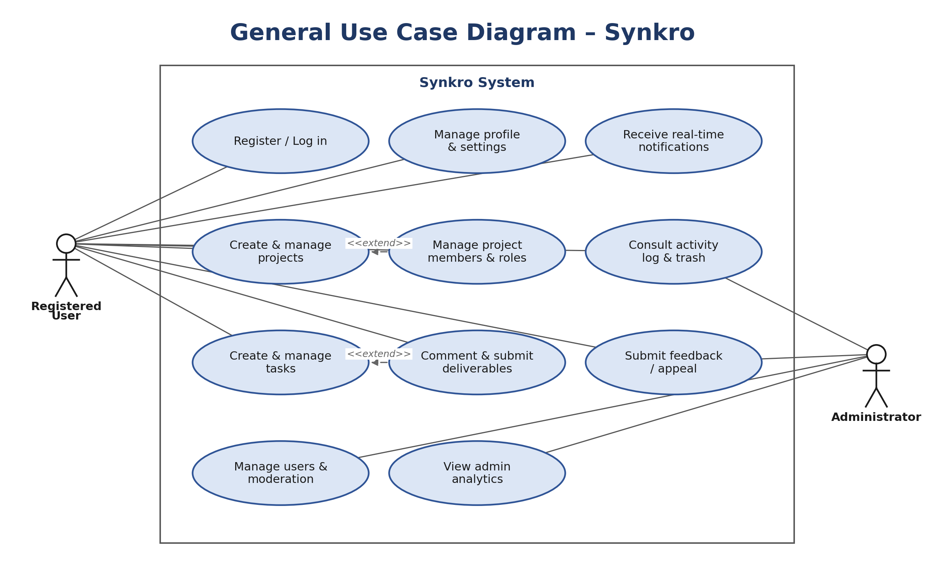
02 · SOLUTION & METHODOLOGY
Methodology & tech stack
Agile, sprint-based delivery
As sole developer and de facto product owner, the internship followed a planning sprint (Sprint 0) plus four development sprints, each shipping a working, demonstrable increment, modeled beforehand with UML use case, sequence, and class diagrams.
Technology stack
Laravel 13
React + Inertia.js
Laravel Reverb (WS)
MySQL
Tailwind CSS
Recharts
09 / 20

Slide 10
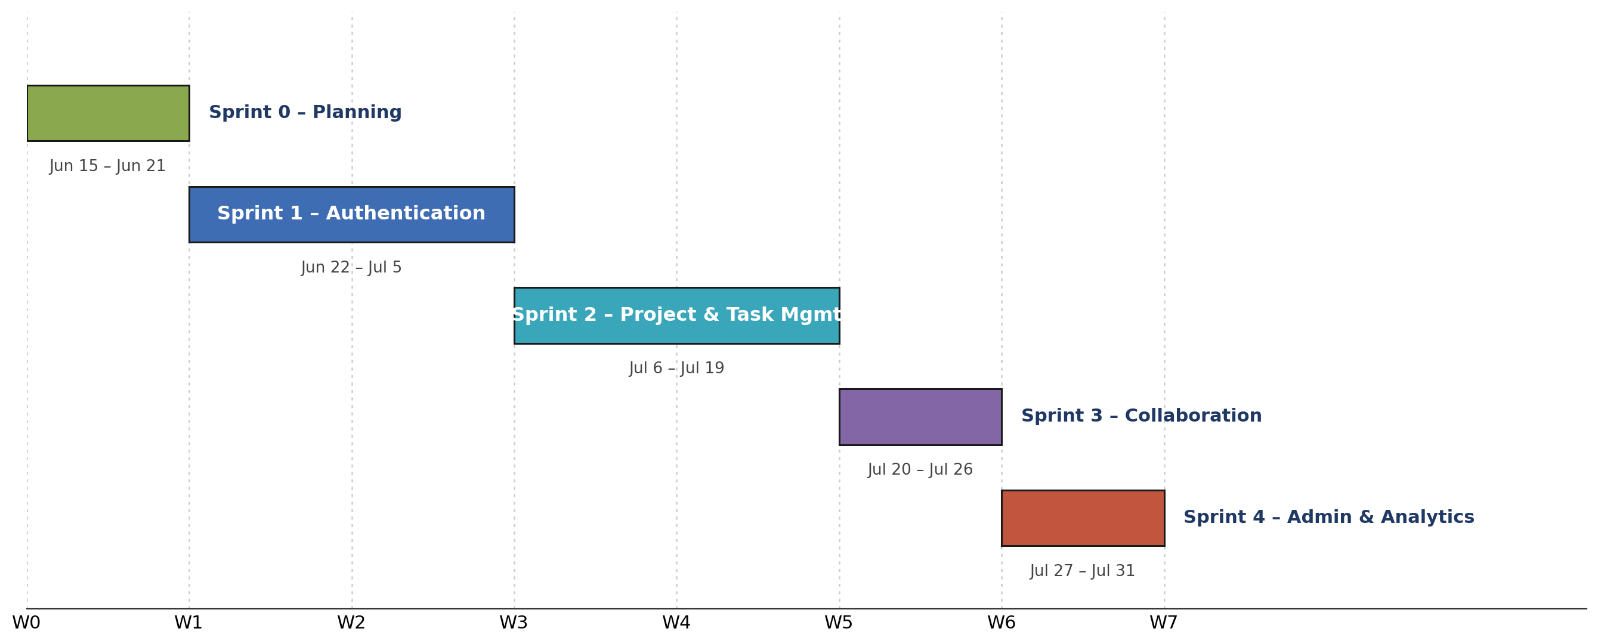
02 · SOLUTION & METHODOLOGY
Sprint planning: June 15 to July 31, 2026
Seven full working weeks, split into one planning sprint and four development sprints: two weeks each for the functional core (auth, project & task management), one week each for the lighter, incremental features that follow.
10 / 20

Slide 11
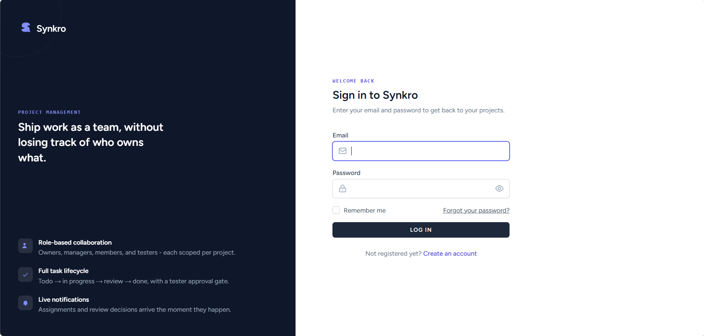
03 · THE FOUR SPRINTS
Sprint 1: Authentication & User Management
June 22 - July 3, 2026
Registration with e-mail verification, login & logout
Password reset and full profile management
Light, dark & black appearance themes
Live list of active sessions (“logged in devices”)
Account deactivation, reactivated automatically on next login
On-page restore prompt when a deleted account tries to log in
11 / 20

Slide 12
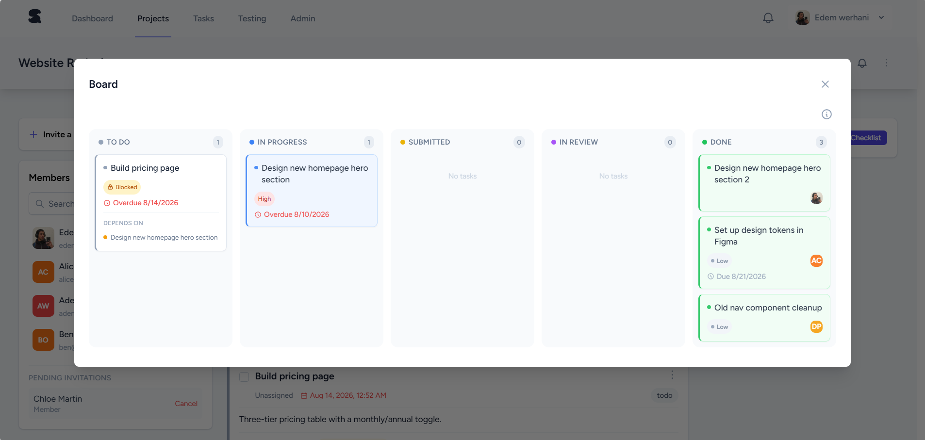
03 · THE FOUR SPRINTS
Sprint 2: Project & Task Management
July 6 - July 17, 2026
Project creation, invitations & role assignment
Full task lifecycle: To Do → In Progress → Submitted → In Review → Done
Checklists and file/link deliverables per task
Kanban-style board updating live for the whole team
Testing Queue, personal My Tasks list with pinning and archiving, and bulk task actions for reviewers and managers
12 / 20

Slide 13
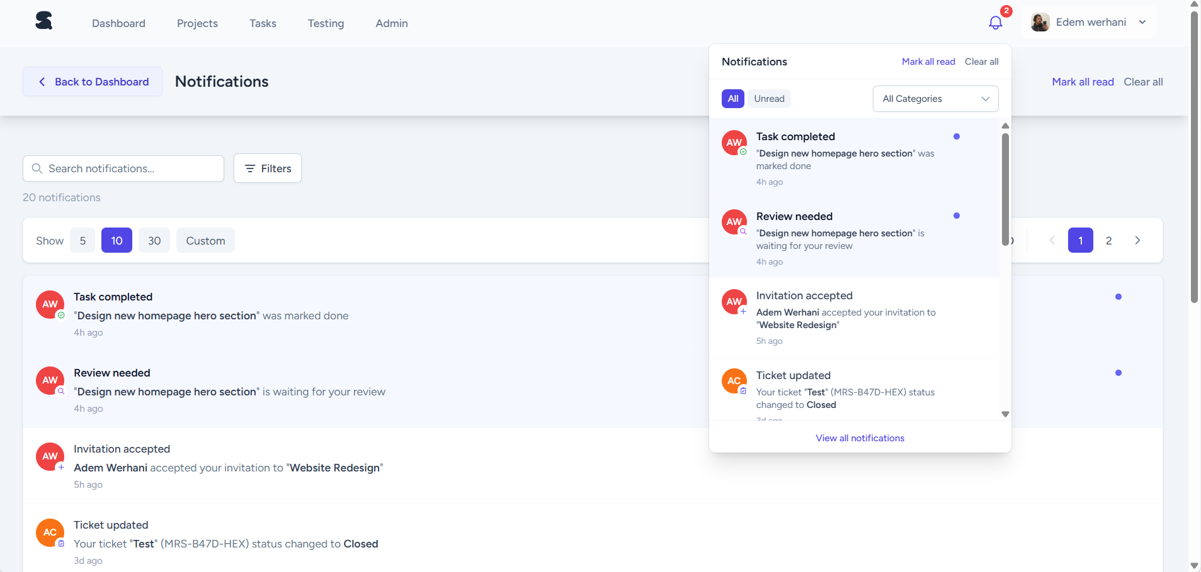
03 · THE FOUR SPRINTS
Sprint 3: Real-Time Collaboration
July 20 - July 24, 2026
Task comments & structured reviewer feedback
Instant notifications pushed over WebSockets
Personal notes and shared project resources
Full project activity log for accountability
Per-project and per-task notification muting
Personal dashboard: activity charts, calendars & My Notes
Personal reminders and configurable per-task deadline alerts
13 / 20

Slide 14
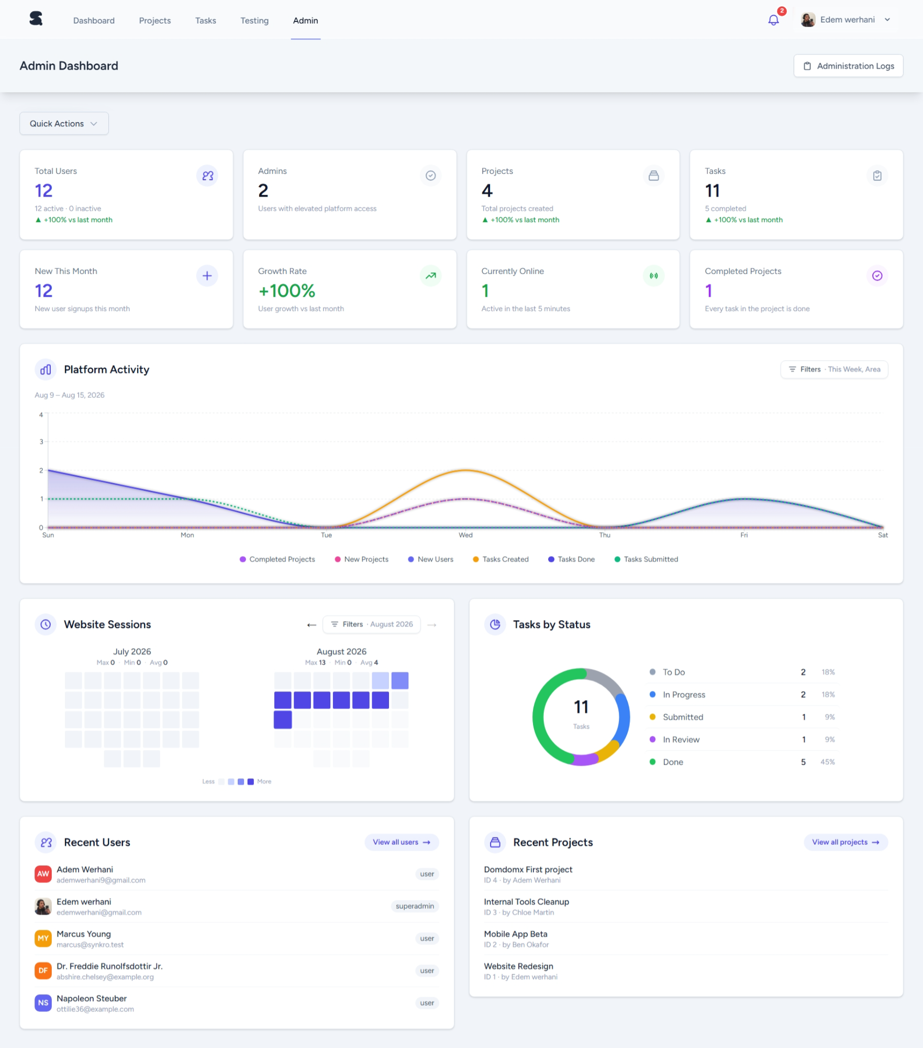
03 · THE FOUR SPRINTS
Sprint 4: Administration & Analytics
July 27 - July 31, 2026
User management with role promotion/demotion
Suspension workflow with a formal appeal process
Feedback / support ticket tracking
Platform-wide analytics dashboard for admins
Admin temporary passwords & configurable feedback categories
14 / 20

Slide 15
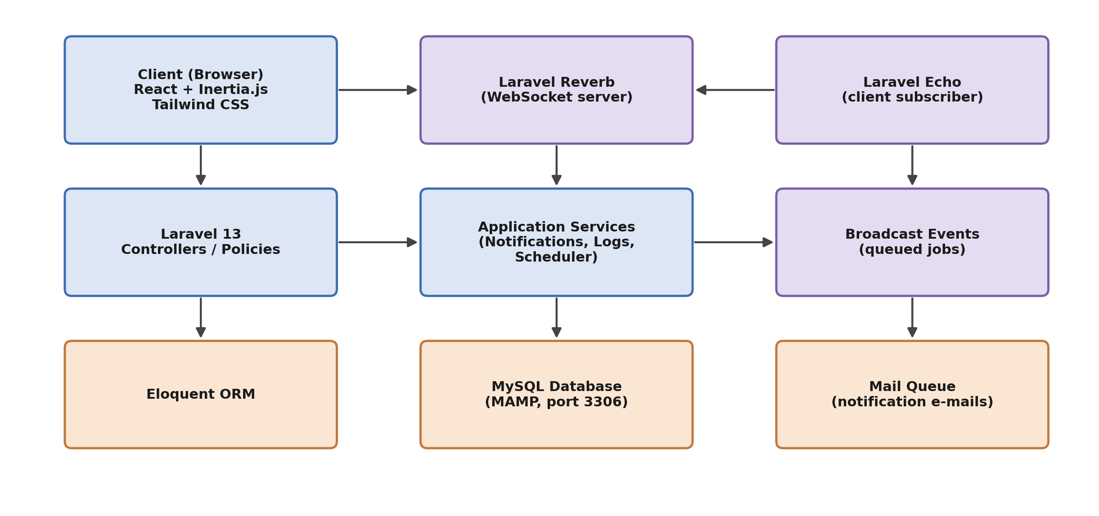
04 · ARCHITECTURE & RESULTS
Technical architecture
15 / 20

Slide 16
04 · ARCHITECTURE & RESULTS
The platform today, in numbers
12
4
11
+100%
registered users
active projects
tasks tracked
user growth this month
Live snapshot from the admin analytics dashboard (internal test data), built during Sprint 4.
16 / 20

Slide 17
05 · REFLECTION & NEXT STEPS
Skills gained & challenges faced
Skills gained
Challenges faced
• Full Laravel ecosystem: policies, jobs, scheduling
• Coordinating real-time updates without duplication
• React + Inertia.js without a separate REST layer
• Designing a flexible yet simple RBAC model
• Real-time systems with WebSockets
• Prioritizing scope within a fixed seven-week window
• Relational data modelling at platform scale
• Running my own Agile process end to end
17 / 20

Slide 18
05 · REFLECTION & NEXT STEPS
Future perspectives
2FA / CAPTCHA and Google sign-in
Dedicated user profiles, separate from account settings
→
→
Messaging: direct, per-project, and admin broadcast
An in-app chatbot assistant
→
→
Graduated warnings before suspension
Global search across users, projects and tasks
→
→
Open-source projects, showcased on public profiles
Custom, configurable project roles
→
→
18 / 20

Slide 19
CONCLUSION
A complete platform, built solo, in seven weeks
Synkro meets every objective set out at the start of this internship: role-aware collaboration, real-time updates, and a full administration layer, delivered through a disciplined, sprint-based process from requirements to a working product.
This internship was a complete, hands-on exercise in software engineering: not just a product, but the judgment built while shipping it under real constraints.
19 / 20

Slide 20
Thank you
Questions & discussion
Adem Ouerhani · Synkro · ISLAIB · Licence GLSI
20 / 20

