Slide 1
Aerospace Control Systems
Exam project AA 25/26
Robust multivariable control of the lateral/longitudinal dynamics of a multirotor UAV
26/05/26 – Giorgio Vedovi, Miguel Maria Barros Santos, Domenico Raffaele Acierno

Slide 2
Index
00
01
02
03
04
05
06
Problem definition
TASK 1
TASK 2
TASK 3
TASK 4
TASK 5
Project Infos
Quadrotor dynamics and coupling
Nominal plant modeling and control design
Modeling of uncertain plant
RS verification for the nominal controller designed
Robustness to lateral-longitudinal coupling
Monte Carlo Campaign and Conclusions
References
​

Slide 3
Problem Definition
00

Slide 4
Problem Definition
The ANT-X quadrotor is a small quadrotor drone designed for research and education.
Grey-box models of ANT-X have been identified from flight test data are are available for control law design
The project task is to design and verify a robust multivariable attitude control system for the ANT-X quadrotor
1. The problem

Slide 5

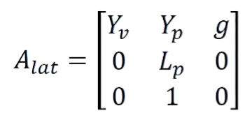
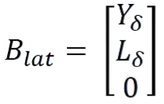
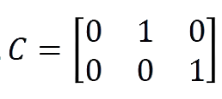

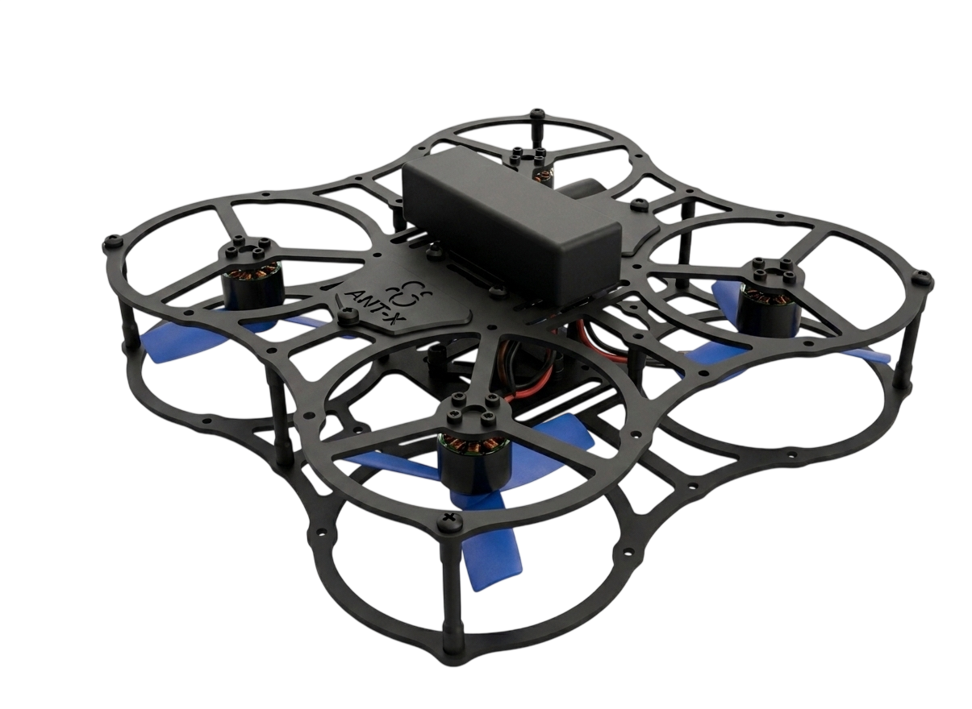
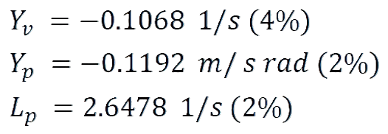
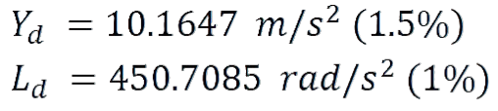






Problem Definition
Lateral Velocity
Roll Rate
Roll angle
Linearized lateral Dynamics:
State Vector:
Control Variable:
2. Lateral
Dynamics
Normalised rolling moment ([-1,1])
$$\hat{y}$$
Stability derivatives:
Control Derivatives:
Uncertainty is given in terms of standard deviations, assuming a Gaussian density for each parameter
$$\hat{p}$$
$$\hat{r}$$
$$φ$$
$$δ_{lat}$$
$$p$$

Slide 6
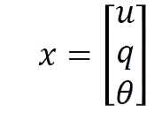
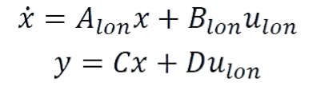

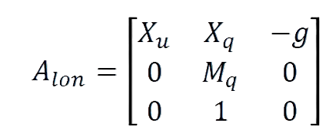
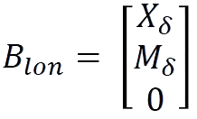
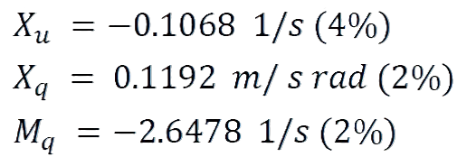
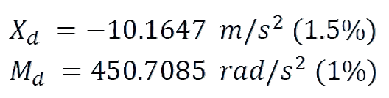





Problem Definition
Longitudinal Velocity
Pitch Rate
Pitch angle
Linearized lateral Dynamics:
State Vector:
Control Variable:
3. Longitudinal
Dynamics
3. Longitudinal
Dynamics
Normalised pitching moment ([-1,1])
$$\hat{y}$$
Stability derivatives:
Control Derivatives:
$$\hat{p}$$
$$p$$
Uncertainty is given in terms of standard deviations, assuming a Gaussian density for each parameter
$$δ_{lon}$$
$$φ$$
$$\hat{r}$$

Slide 7



4. Longitudinal/lateral coupling
Uncertain coupling between lateral and longitudinal dynamics
$$\left[\begin{matrix}u_{lon} \\ u_{lat}\end{matrix}\right]=\left[\begin{matrix}\cos\left(ψ\right) & \sin\left(ψ\right) \\ −\sin\left(ψ\right) & \cos\left(ψ\right)\end{matrix}\right]\left[\begin{matrix}δ_{lon} \\ δ_{lat}\end{matrix}\right]$$
where $φ∈[−15°,+15°]$.
$$\hat{y}$$
$$\hat{p}$$
$$p$$
$$δ_{lon}$$
$$φ$$
$$\hat{r}$$
$$φ$$
$$δ_{lat}$$
$$p$$

Slide 8
Nominal controller design for 1 dof dynamics
TASK
1

Slide 9
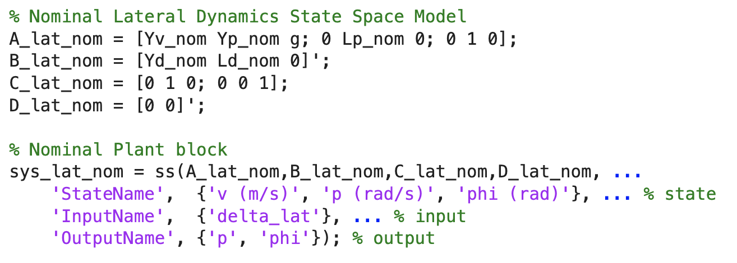
Nominal plant modeling for Lateral dynamics
Aerospace Control Systems - Exam project AA 25/26 - Robust multivariable control of the lateral/longitudinal dynamics of a multirotor UAV
1 DOF testbed (Courtesy of Antx.com)

Slide 10
Nominal plant modeling for Lateral dynamics
Aerospace Control Systems - Exam project AA 25/26 - Robust multivariable control of the lateral/longitudinal dynamics of a multirotor UAV
Plant model: (Evans) ${\overline{G}}_{lat}\left(s\right)=\left[\begin{matrix}{\overline{G}}_{p}(s) \\ {\overline{G}}_{φ}(s)\end{matrix}\right]=\left[\begin{matrix}\frac{450.7}{\text{s}\text{−}\text{2.648 }} \\ \frac{450.7}{\text{s}\text{(}\text{s}\text{−}\text{2.}\text{648}\text{)} }\end{matrix}\right]$
With a non-critical cancellation in -0.1068 in both $G_{p}(s)$ and $G_φ(s)$.

Slide 11
Nominal plant modeling for Lateral dynamics
Aerospace Control Systems - Exam project AA 25/26 - Robust multivariable control of the lateral/longitudinal dynamics of a multirotor UAV
Nominal Plant model ${\overline{G}}_{lat}\left(s\right)=\left[\begin{matrix}{\overline{G}}_{p}(s) \\ {\overline{G}}_{φ}(s)\end{matrix}\right]=\left[\begin{matrix}\frac{450.7}{\text{s}\text{−}\text{2.648 }} \\ \frac{450.7}{\text{s}\text{(}\text{s}\text{−}\text{2.648}\text{) }}\end{matrix}\right]$
With a non-critical cancellation in -0.1068 in both $G_{p}(s)$ and $G_φ(s)$.
$G_{φ}\left(s\right)=G_{p}(s)/s$
Unstable lateral dynamics

Slide 12
Nominal plant modeling for Lateral dynamics
Aerospace Control Systems - Exam project AA 25/26 - Robust multivariable control of the lateral/longitudinal dynamics of a multirotor UAV
$$G_{lat}\left(s\right)=\left[\begin{matrix}G_{p}(s) \\ G_{φ}(s)\end{matrix}\right]=\left[\begin{matrix}−\text{170.2}\frac{1}{\text{1−0.378 }\text{s}} \\ −\text{170.2}\frac{1}{\text{s}\text{(1−0.378 }\text{s}\text{)}}\end{matrix}\right]$$

Slide 13
Nominal controller design for Lateral dynamics
Aerospace Control Systems - Exam project AA 25/26 - Robust multivariable control of the lateral/longitudinal dynamics of a multirotor UAV
1) Assigned controller structure: PID-P cascade:
roll angle controller $R_{φ}\left(s\right)$ : P
roll rate controller $R_{p}(s)$ : PID
$R_{φ}\left(s\right)$ : $p_{0}=K_{φ}e_{φ}.$ $e_{φ}=φ_{0}−φ$
$R_{p}(s)$ : $δ_{lat}=K_{p,P}e_{p}+\frac{K_{p,I}}{s}e_{p}+\frac{K_{p,D}s}{1+sT_{p}}\left(−p\right).$ $T_{p}=0.02s, e_{p}=p_{0}−p$
2) Design methodology: $H_{∞}$ controller design via mixed-sensitivity synthesis
1 DOF testbed (Courtesy of Antx.com)

Slide 14
Nominal controller design for Lateral dynamics
Aerospace Control Systems - Exam project AA 25/26 - Robust multivariable control of the lateral/longitudinal dynamics of a multirotor UAV
MATLAB documentation
Tunable PID in MATLAB
$R_{φ}:$Tunable PID
$R_{p}:$Tunable PID2
Inputs: r= $p_{0}$, y = p ; parameters b=1, c=0

Slide 15
Nominal controller design for Lateral dynamics
Aerospace Control Systems - Exam project AA 25/26 - Robust multivariable control of the lateral/longitudinal dynamics of a multirotor UAV
1 DOF testbed (Courtesy of Antx.com)

Slide 16
Design requirements for Nominal controller design for Lateral dynamics
Aerospace Control Systems - Exam project AA 25/26 - Robust multivariable control of the lateral/longitudinal dynamics of a multirotor UAV
NOMINAL PERFORMANCE
Response of 𝜑 to variations in 𝜑0:
equivalent to a second-order response with:
$ω_{n}$ ≥ 10 𝑟𝑎𝑑/𝑠
𝜉 ≥ 0.9.
$$F_{2}\left(s\right)=\frac{ω_{n}^{2}}{s^{2}+2sξω_{n}+ω_{n}^{2}}$$
$$S_{2}\left(s\right)=1−F(s)$$
$$S_{2}\left(s\right):$$
DC gain: 0
Crossover frequency: $ω_{c}≃7.07$ rad/s
Peak: $max|S\left(jω)\right|=S\left(j 13.29rad/s\right)=$1.18

Slide 17
Design requirements for Nominal controller design for Lateral dynamics
Aerospace Control Systems - Exam project AA 25/26 - Robust multivariable control of the lateral/longitudinal dynamics of a multirotor UAV
Mapping of the dynamic performance requirements in terms of desired step response:

Slide 18
Design requirements for Nominal controller design for Lateral dynamics
Aerospace Control Systems - Exam project AA 25/26 - Robust multivariable control of the lateral/longitudinal dynamics of a multirotor UAV
Design of a performance weight $W_{p}(s)$ for $H_{∞}$ controller design s.t. $\left|\overline{S_{φ}}\left(jω\right)\right|<\frac{1}{|W_{p,lat }(s)|}$. Selected as n=1 order:
$$W_{p,lat}\left(s\right)=\frac{\frac{s}{M_{lat}}+ω_{b,lat}}{s+Aω_{b,lat}}$$
s.t. $1/W_{p,lat}(jω)$ has:
- DC gain : $A_{lat}={10}^{−3}$
- ${ ω}_{b,lat}=\text{7.070107}$ rad/s - obtained by sweeping method
HF gain: $M_{lat}=\text{1.657}$ - obtained by sweeping method
When imposing weight functions, makeweight allows for better
crossover frequency control

Slide 19
Design requirements for Nominal controller design for Lateral dynamics
Aerospace Control Systems - Exam project AA 25/26 - Robust multivariable control of the lateral/longitudinal dynamics of a multirotor UAV
Design of a performance weight $W_{p,lat}(s)$ for $H_{∞}$ controller design:
$W_{p,lat}(s)$ selection s.t.:
- DC gain : $A_{lat}={10}^{−3}$
- ${ ω}_{b,lat}=\text{7.070107}$ rad/s
HF gain: $M_{lat}=\text{1.657}$
Order n = 1

Slide 20
Design requirements for Nominal controller design for Lateral dynamics
Aerospace Control Systems - Exam project AA 25/26 - Robust multivariable control of the lateral/longitudinal dynamics of a multirotor UAV
CONTROL EFFORT LIMITATION
Control effort limitation: $|δ_{lat}|$ ≤ 0.05 for the doublet change in $φ_{0}$ with 10 ° amplitude given by (in deg):

Slide 21
Design requirements for Nominal controller design for Lateral dynamics
Aerospace Control Systems - Exam project AA 25/26 - Robust multivariable control of the lateral/longitudinal dynamics of a multirotor UAV
Design of a control sensitivity weight $W_{p}(s)$ for $H_{∞}$ controller design s.t. $\left|{\overline{Q}}_{lat}\left(jω\right)\right|<\frac{1}{|W_{Q,lat}(s)|} .$ Selected as n=1 order:
$$W_{Q,lat}\left(s\right)=α\frac{s+ω_{τ}⋅{10}^{−3}}{s+ω_{τ}}$$
Choice of $ω_{τ}:$ $ω_{τ}=$ 30 rad/s
Choice of $α:$ consider an equivalent step of magnitude A= 20° and consider peak control effort at t=0. For the IVT, then
$δ_{lat,0}=\lim_{t→0}{δ_{lat}(t)}=\lim_{s→∞}{s }⋅δ_{lat}\left(s\right)=\lim_{s→∞}{s }⋅Q\left(s\right)Y\left(s\right)=$ $=\lim_{s→∞}{s }⋅Q\left(s\right)⋅\frac{A}{s}=\lim_{s→∞}{ }Q\left(s\right) A=\frac{A}{α}.$
$α>A/{\left|δ_{lat}\right|}_{max}\left(\frac{20°π}{180°}\right)/0.05=$ 6.9813
relaxed control constraint: $α=\text{4.65421}$
$$\text{(}\text{obtained} \text{by} \text{sweeping} \text{method}\text{)}$$

Slide 22
Mixed-sensitivity synthesis
Aerospace Control Systems - Exam project AA 25/26 - Robust multivariable control of the lateral/longitudinal dynamics of a multirotor UAV
Mixed-sensitivity synthesis for Nominal controller design for Lateral dynamics
1) Augmented plant:
Define augmented plant
Optimization problem

Slide 23
Mixed-sensitivity synthesis
Aerospace Control Systems - Exam project AA 25/26 - Robust multivariable control of the lateral/longitudinal dynamics of a multirotor UAV
Mixed-sensitivity synthesis for Nominal controller design for Lateral dynamics
1) Augmented plant:
2) Optimization
${{\left\|\left[\begin{matrix}z_{1,lat}(s) \\ z_{2,lat}(s)\end{matrix}\right]\right\|}_{∞}= \left\|\left[\begin{matrix}\left|W_{p,lat}\left(s\right) \overline{F}\left(s\right)\right| \\ \left|W_{Q,lat}\left(s\right) \overline{Q}\left(s\right)\right|\end{matrix}\right]\right\|}_{∞}<γ_{min}$
With $γ_{min}<1,$ imposing Performance and control effort limitation; R.S. is checked a posteriori; R.P. will be verified via MC campaign (Task 5).
Define augmented plant
Optimization problem

Slide 24
Mixed-sensitivity synthesis
Aerospace Control Systems - Exam project AA 25/26 - Robust multivariable control of the lateral/longitudinal dynamics of a multirotor UAV
Mixed-sensitivity synthesis for Nominal controller design for Lateral dynamics
Define augmented plant
Optimization problem
MATLAB documentation

Slide 25
Analysis of the results
Aerospace Control Systems - Exam project AA 25/26 - Robust multivariable control of the lateral/longitudinal dynamics of a multirotor UAV
Analysis of results of $H_{∞}$ synthesis of a
Nominal controller design for Lateral dynamics
1) ${{\left\|\left[\begin{matrix}z_{1,lat}(s) \\ z_{2,lat}(s)\end{matrix}\right]\right\|}_{∞}= \left\|\left[\begin{matrix}\left|W_{p,lat}\left(s\right) \overline{F}\left(s\right)\right| \\ \left|W_{Q,lat}\left(s\right) \overline{Q}\left(s\right)\right|\end{matrix}\right]\right\|}_{∞}<γ_{min}$ = 0.9902 < 1
Peak gain 1-value limit satisfaction
Tuned controller
Nominal performance satisfaction
Nominal control effort limitation satisfaction
Reiterate?

Slide 26
Analysis of the results
Aerospace Control Systems - Exam project AA 25/26 - Robust multivariable control of the lateral/longitudinal dynamics of a multirotor UAV
Analysis of results of $H_{∞}$ synthesis of a
Nominal controller design for Lateral dynamics
${{\left\|\left[\begin{matrix}z_{1,lat}(s) \\ z_{2,lat}(s)\end{matrix}\right]\right\|}_{∞}= \left\|\left[\begin{matrix}\left|W_{p,lat}\left(s\right) \overline{F}\left(s\right)\right| \\ \left|W_{Q,lat}\left(s\right) \overline{Q}\left(s\right)\right|\end{matrix}\right]\right\|}_{∞}<γ_{min}$ = 0.9902 < 1.
The tuned controllers have:
Peak gain 1-value limit satisfaction and nominal CL stability
Tuned controller
Nominal performance satisfaction
Nominal control effort limitation satisfaction
Reiterate?

Slide 27
Analysis of the results
Options – All of these are of course related
a) fit a second order transfer function on the obtained F and compute its ξ X
b) compute the S peak and map its corresponding value into a corresponding ξ X
c) directly use the S peak as a measure of ξ OK
Given an obtained F(jw) and S(jw) how do we obtain the corresponding ξ ?
Options a and b are poor representations!
c allows us to understand what's happening. The damping is mapped into the S peak.

Slide 28
Analysis of the results
Aerospace Control Systems - Exam project AA 25/26 - Robust multivariable control of the lateral/longitudinal dynamics of a multirotor UAV
Analysis of results of $H_{∞}$ synthesis of a
Nominal controller design for Lateral dynamics
3) Nominal performance:
Imposed S Peak via relaxed
requirement (M_lat): 1.6573
Original function S Peak: 1.1838
Actual obtained S Peak: 1.2473
Peak gain 1-value limit satisfaction
Tuned controller
Nominal performance satisfaction
Nominal control effort limitation satisfaction
Reiterate?

Slide 29
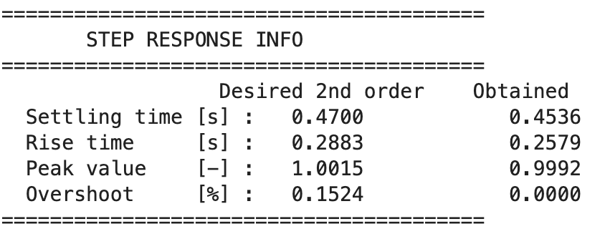
Analysis of the results
Aerospace Control Systems - Exam project AA 25/26 - Robust multivariable control of the lateral/longitudinal dynamics of a multirotor UAV
Analysis of results of $H_{∞}$ synthesis of a
Nominal controller design for Lateral dynamics
3) Dynamic performance
expressed in terms
of step response:
Peak gain 1-value limit satisfaction
Tuned controller
Nominal performance satisfaction
Nominal control effort limitation satisfaction
Reiterate?

Slide 30
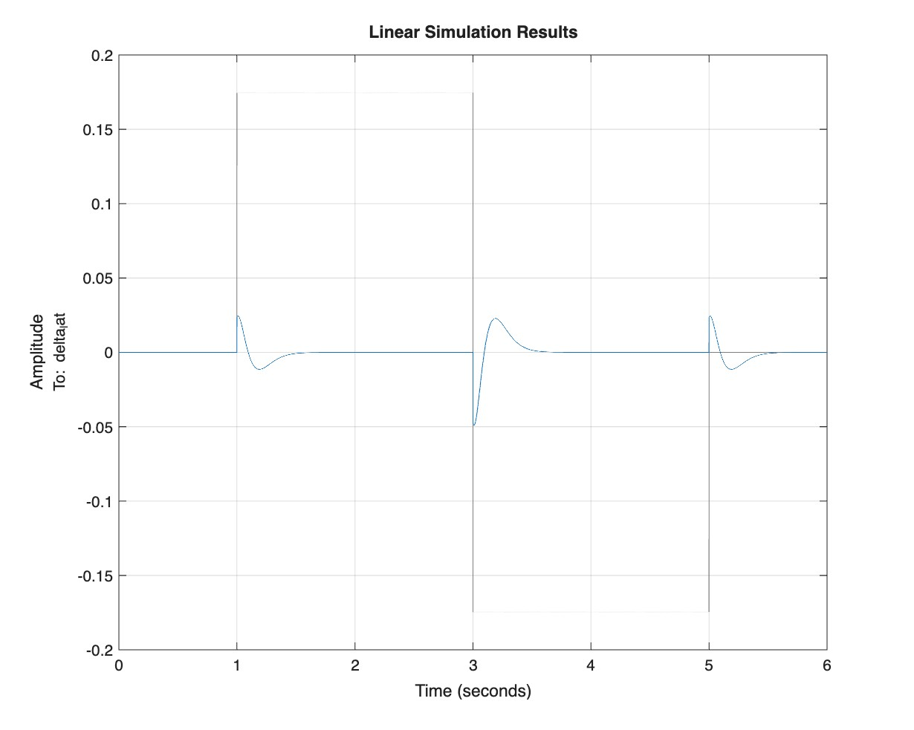
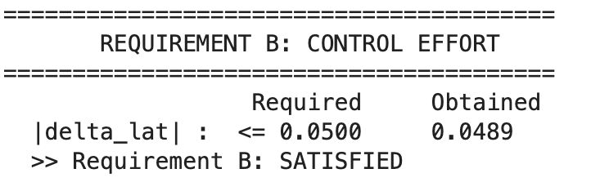
Analysis of the results
Aerospace Control Systems - Exam project AA 25/26 - Robust multivariable control of the lateral/longitudinal dynamics of a multirotor UAV
Analysis of results of $H_{∞}$ synthesis of a
Nominal controller design for Lateral dynamics
4) Control effort limitation in doublet response:
Peak gain 1-value limit satisfaction
Tuned controller
Nominal performance satisfaction
Nominal control effort limitation satisfaction
Reiterate?

Slide 31
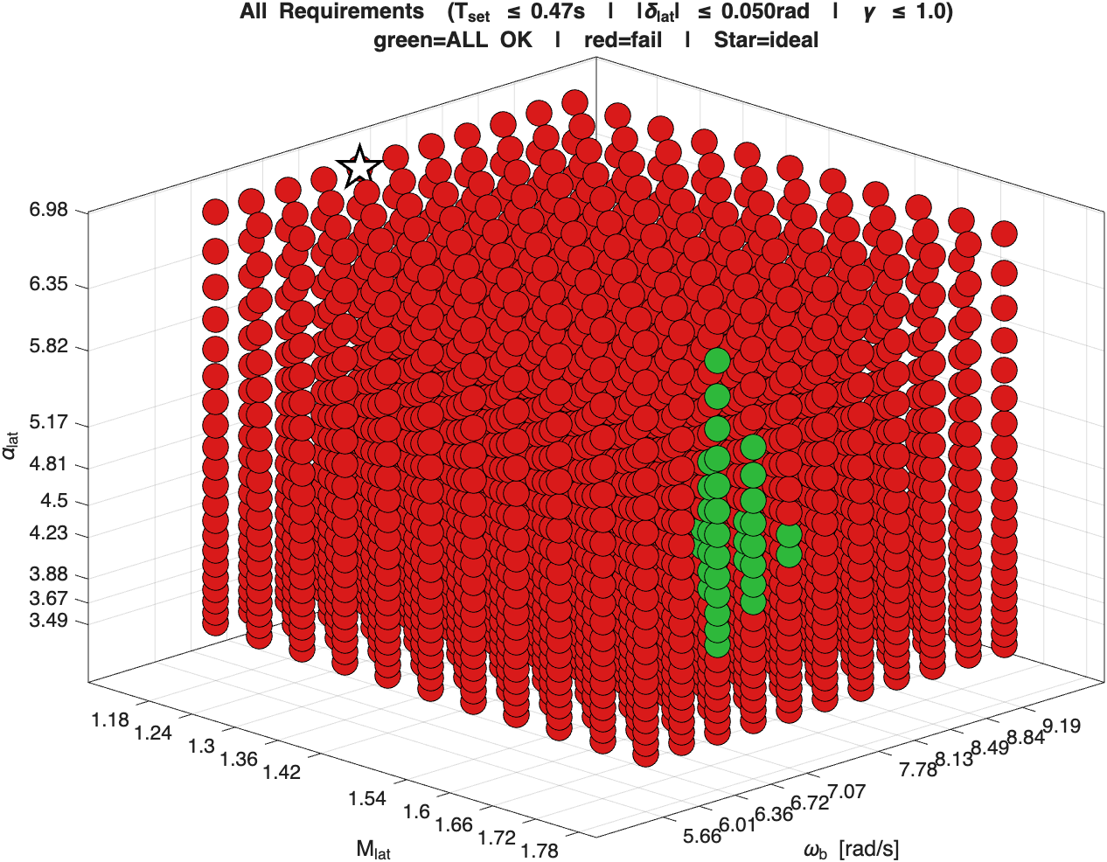
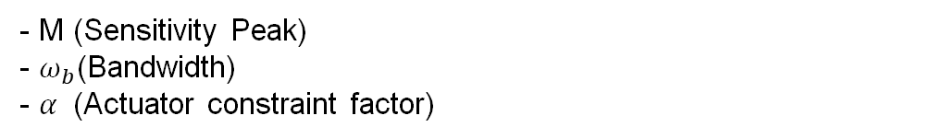

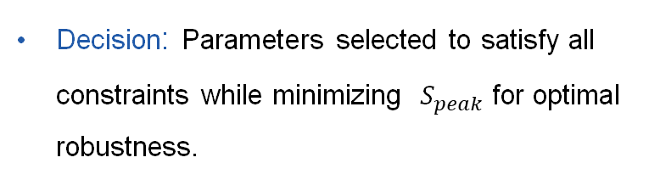
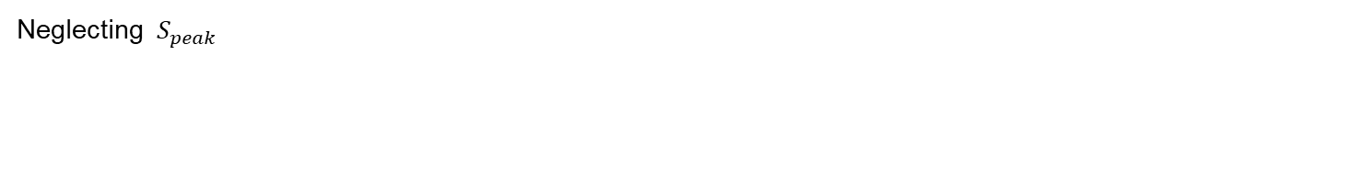
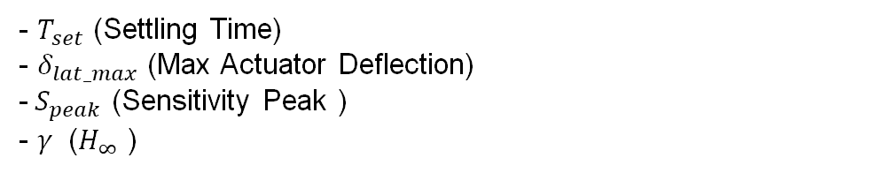
Analysis of the results
Aerospace Control Systems - Exam project AA 25/26 - Robust multivariable control of the lateral/longitudinal dynamics of a multirotor UAV
Motivation for the relaxation of requirements for $H_{∞}$ synthesis of the
Nominal controller design for Lateral dynamics
It is physically impossible to strictly satisfy all design requirements of the 2nd order function simultaneously, in terms of desired tranfer functions
3D Parameter Sweep Study:
Peak gain 1-value limit satisfaction
Tuned controller
Nominal performance satisfaction
Nominal control effort limitation satisfaction
Reiterate?
- Explored a grid of design weights:
- M (Sensitivity Peak)
- $ω_{b}$(Bandwidth)
- $α$ (Actuator constraint factor)
- Evaluated Metrics:
- $T_{set}$ (Settling Time)
- $δ_{lat_max}$ (Max Actuator Deflection)
-${ S}_{peak}$ (Sensitivity Peak )
- $γ$ ($H_{∞}$ )
Decision: Parameters selected to satisfy all constraints while minimizing ${ S}_{peak}$for optimal robustness.
Neglecting ${ S}_{peak}$

Slide 32
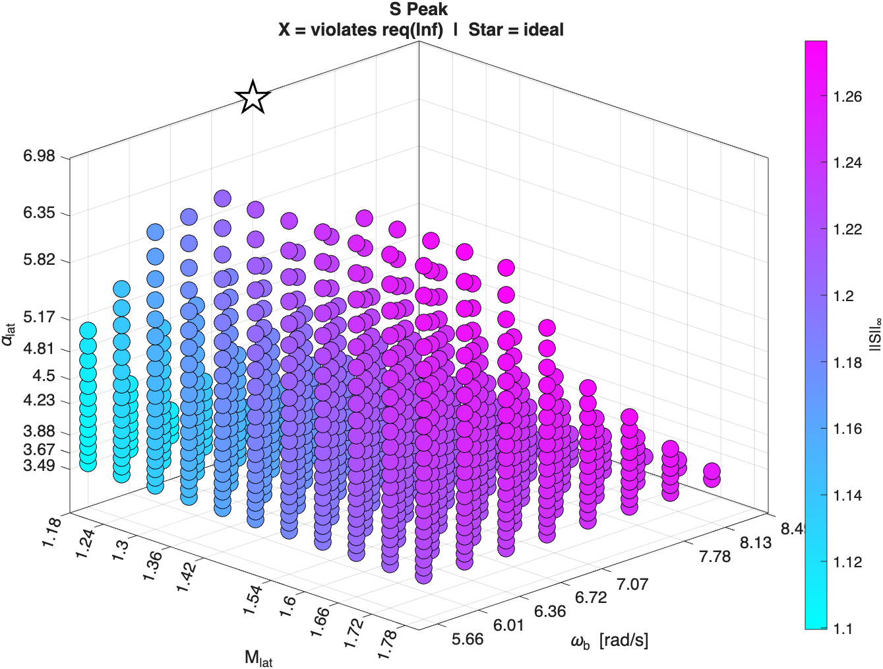
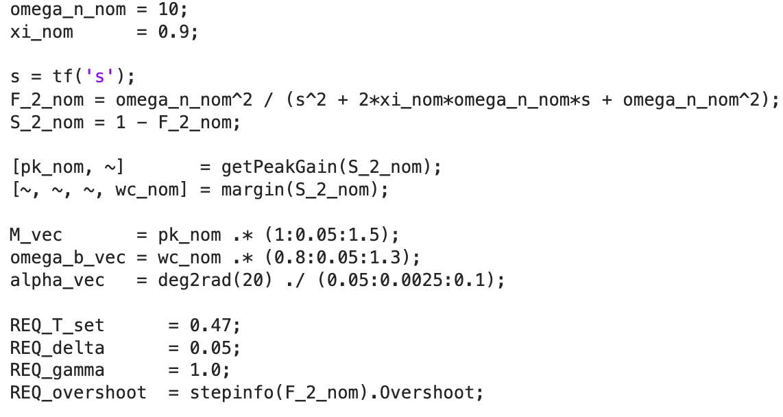
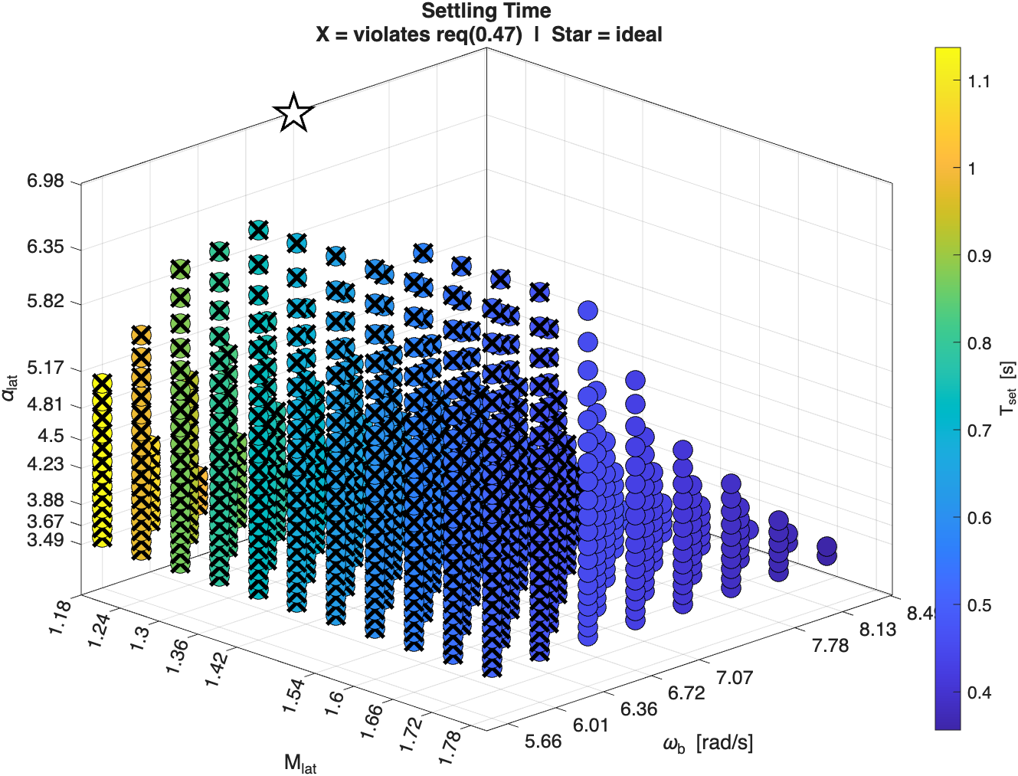
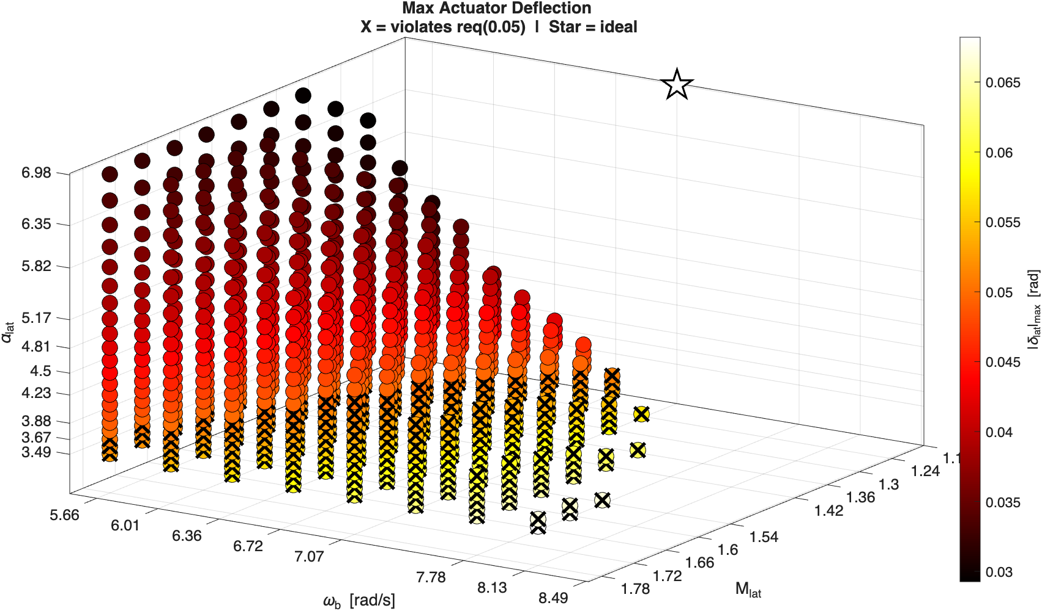
Analysis of the results
Aerospace Control Systems - Exam project AA 25/26 - Robust multivariable control of the lateral/longitudinal dynamics of a multirotor UAV
Motivation for the relaxation of requirements for $H_{∞}$ synthesis of the
Nominal controller design for Lateral dynamics
Peak gain 1-value limit satisfaction
Tuned controller
Nominal performance satisfaction
Nominal control effort limitation satisfaction
Reiterate?

Slide 33
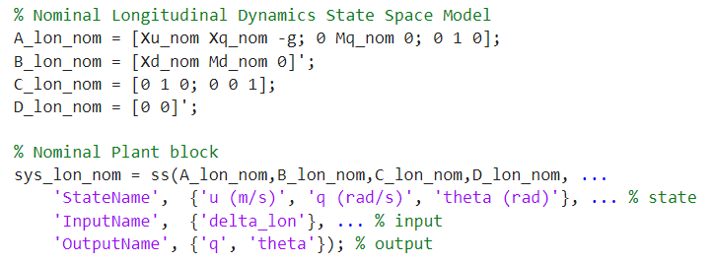
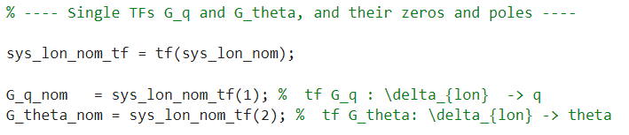
Nominal plant modeling for Longitudinal dynamics
Aerospace Control Systems - Exam project AA 25/26 - Robust multivariable control of the lateral/longitudinal dynamics of a multirotor UAV
1 DOF testbed (Courtesy of Antx.com)

Slide 34
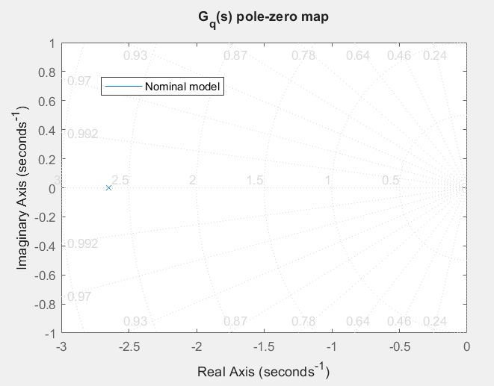
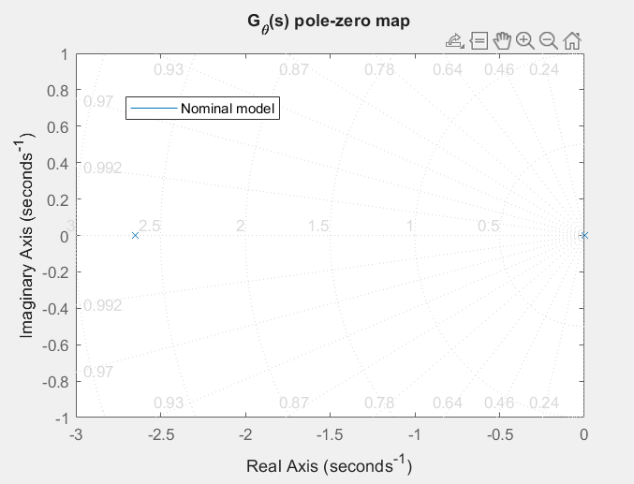
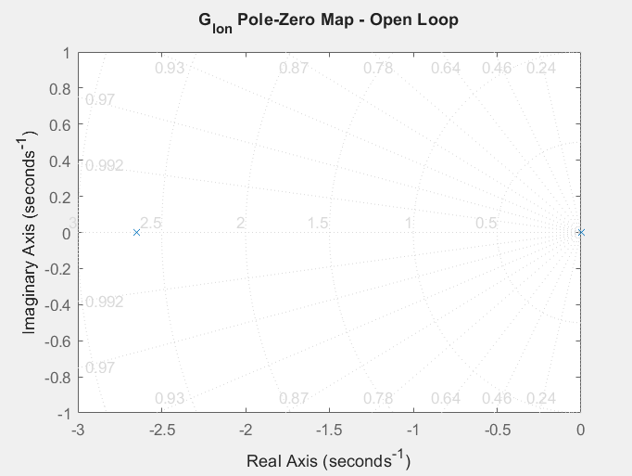
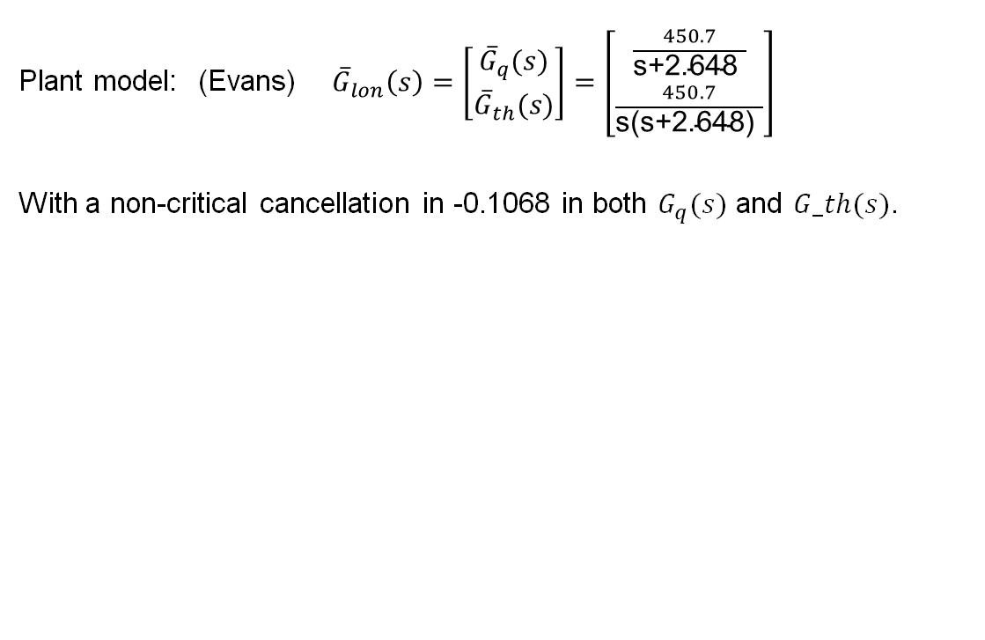
Nominal plant modeling for Longitudinal dynamics
Aerospace Control Systems - Exam project AA 25/26 - Robust multivariable control of the lateral/longitudinal dynamics of a multirotor UAV
Plant model: (Evans) ${\overline{G}}_{lon}\left(s\right)=\left[\begin{matrix}{\overline{G}}_{q}(s) \\ {\overline{G}}_{th}(s)\end{matrix}\right]=\left[\begin{matrix}\frac{450.7}{\text{s}\text{+}\text{2.648 }} \\ \frac{450.7}{\text{s}\text{(}\text{s}\text{+}\text{2.648}\text{)} }\end{matrix}\right]$
With a non-critical cancellation in -0.1068 in both $G_{q}(s)$ and $G_th(s)$.

Slide 35
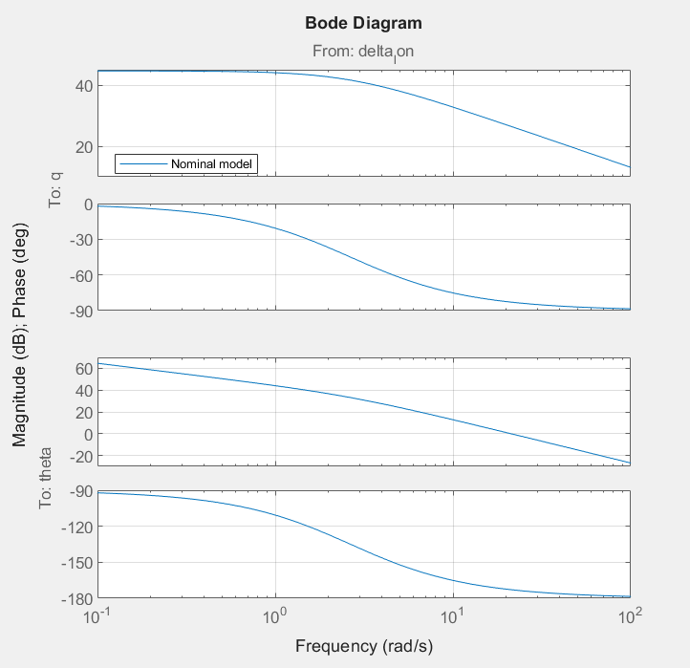
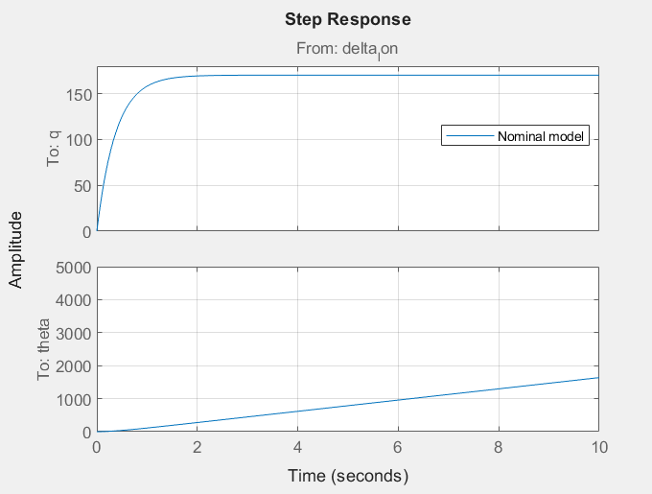
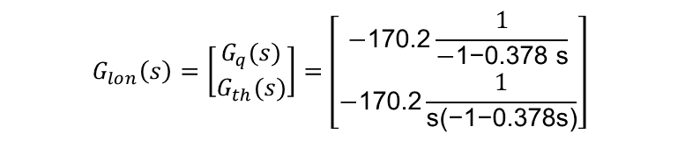
Nominal plant modeling for Longitudinal dynamics
Aerospace Control Systems - Exam project AA 25/26 - Robust multivariable control of the lateral/longitudinal dynamics of a multirotor UAV
$$G_{lon}\left(s\right)=\left[\begin{matrix}G_{q}(s) \\ G_{th}(s)\end{matrix}\right]=\left[\begin{matrix}−\text{170.2}\frac{1}{\text{−}\text{1}\text{−}\text{0.378 }\text{s}} \\ −\text{170.2}\frac{1}{\text{s}\text{(}\text{−}\text{1−0.378}\text{s}\text{)}}\end{matrix}\right]$$

Slide 36
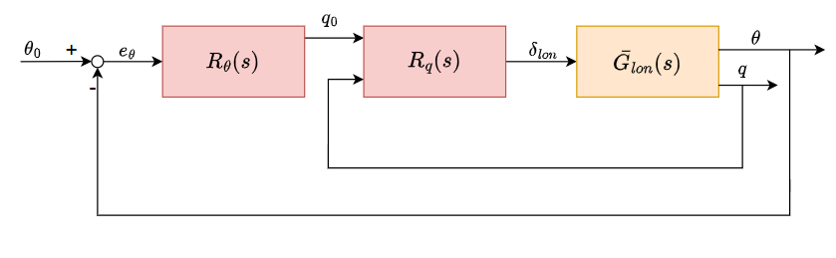
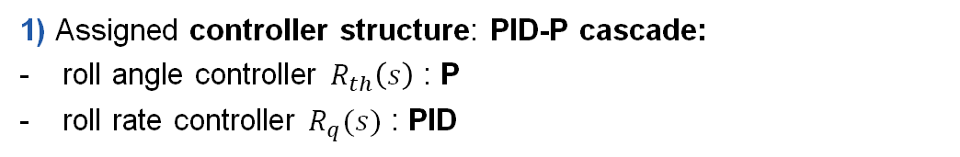
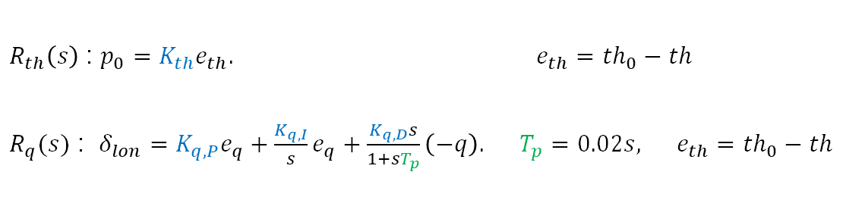
Nominal controller design for Longitudinal dynamics
Aerospace Control Systems - Exam project AA 25/26 - Robust multivariable control of the lateral/longitudinal dynamics of a multirotor UAV
1) Assigned controller structure: PID-P cascade:
roll angle controller $R_{th}\left(s\right)$ : P
roll rate controller $R_{q}(s)$ : PID
$R_{th}\left(s\right)$ : $p_{0}=K_{th}e_{th}.$ $e_{th}={th}_{0}−th$
$R_{q}(s)$ : $δ_{lon}=K_{q,P}e_{q}+\frac{K_{q,I}}{s}e_{q}+\frac{K_{q,D}s}{1+sT_{p}}\left(−q\right).$ $T_{p}=0.02s, e_{th}={th}_{0}−th$
2) Design methodology: $H_{∞}$ controller design via mixed-sensitivity synthesis
1 DOF testbed (Courtesy of Antx.com)

Slide 37
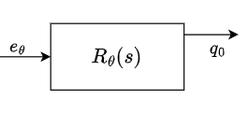
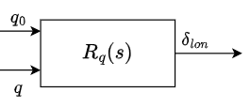
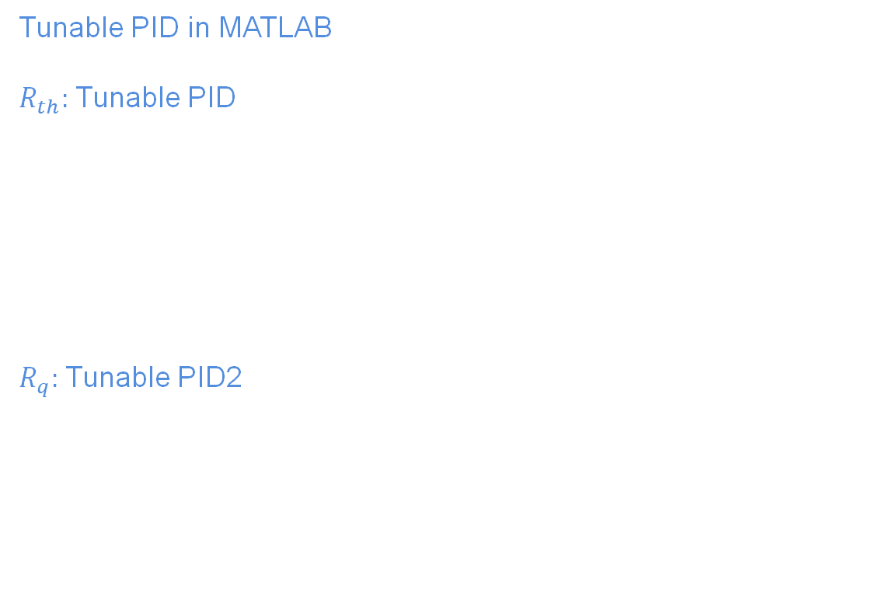
Nominal controller design for Longitudinal dynamics
Aerospace Control Systems - Exam project AA 25/26 - Robust multivariable control of the lateral/longitudinal dynamics of a multirotor UAV
MATLAB documentation
Tunable PID in MATLAB
$R_{th}:$Tunable PID
$R_{q}:$Tunable PID2
Inputs: r= $q_{0}$, y = q ; parameters b=1, c=0

Slide 38
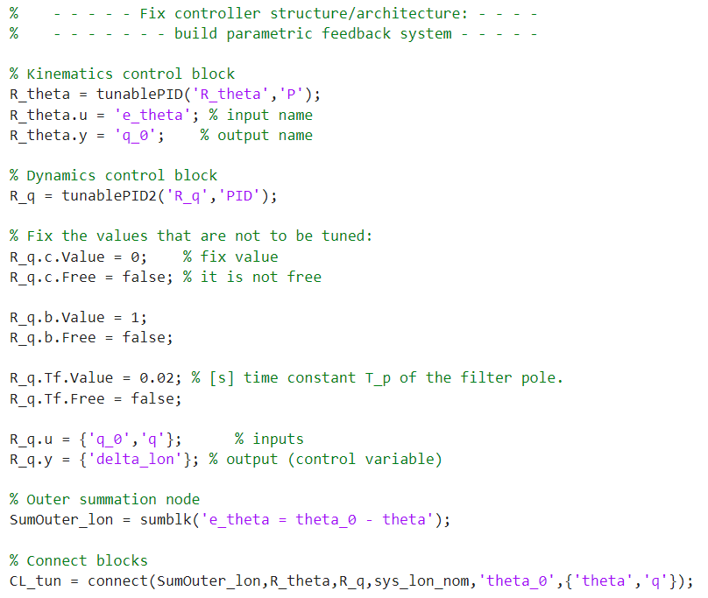
Nominal controller design for Longitudinal dynamics
Aerospace Control Systems - Exam project AA 25/26 - Robust multivariable control of the lateral/longitudinal dynamics of a multirotor UAV
1 DOF testbed (Courtesy of Antx.com)

Slide 39
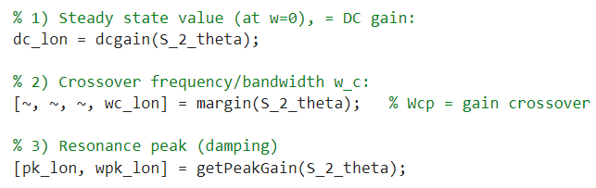
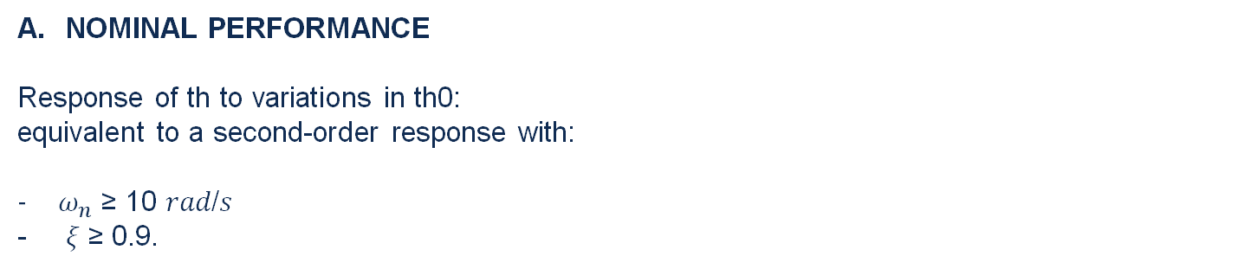
Design requirements for Nominal controller design for Longitudinal dynamics
Aerospace Control Systems - Exam project AA 25/26 - Robust multivariable control of the lateral/longitudinal dynamics of a multirotor UAV
NOMINAL PERFORMANCE
Response of th to variations in th0:
equivalent to a second-order response with:
$ω_{n}$ ≥ 10 𝑟𝑎𝑑/𝑠
𝜉 ≥ 0.9.
$$F_{2}\left(s\right)=\frac{ω_{n}^{2}}{s^{2}+2sξω_{n}+ω_{n}^{2}}$$
$$S_{2}\left(s\right)=1−F(s)$$
$$S_{2}\left(s\right):$$
DC gain: 0
Crossover frequency: $ω_{c}≃7.07$ rad/s
Peak: $max|S\left(jω)\right|=S\left(j 13.29rad/s\right)=$1.18

Slide 40

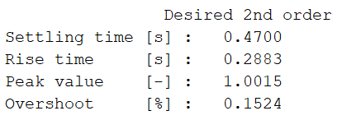
Design requirements for Nominal controller design for Longitudinal dynamics
Aerospace Control Systems - Exam project AA 25/26 - Robust multivariable control of the lateral/longitudinal dynamics of a multirotor UAV
Mapping of the dynamic performance requirements in terms of desired step response:

Slide 41
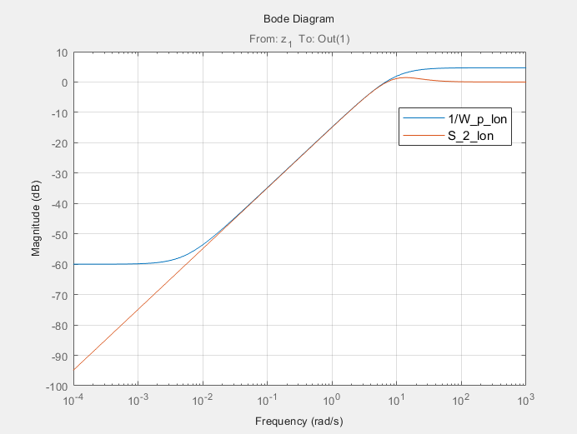

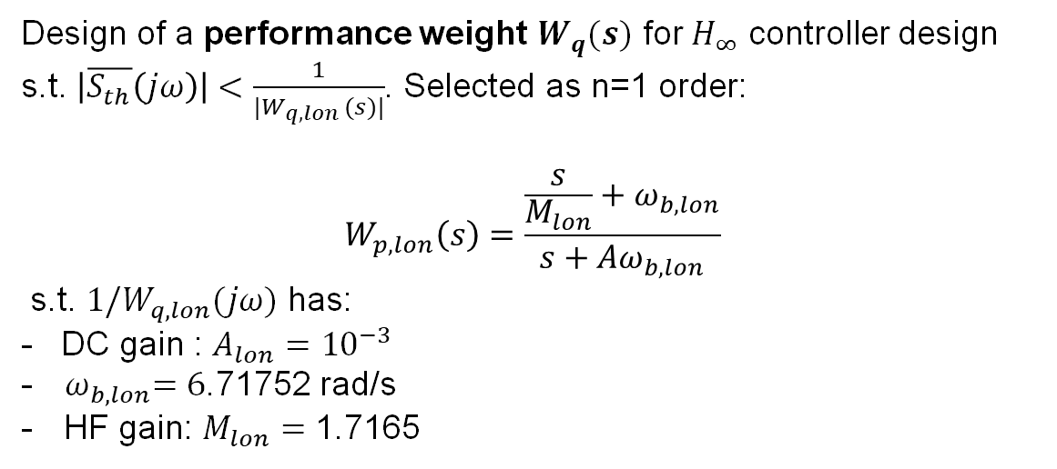
Design requirements for Nominal controller design for Longitudinal dynamics
Aerospace Control Systems - Exam project AA 25/26 - Robust multivariable control of the lateral/longitudinal dynamics of a multirotor UAV
Design of a performance weight $W_{q}(s)$ for $H_{∞}$ controller design s.t. $\left|\overline{S_{th}}\left(jω\right)\right|<\frac{1}{|W_{q,lon }(s)|}$. Selected as n=1 order:
$$W_{p,lon}\left(s\right)=\frac{\frac{s}{M_{lon}}+ω_{b,lon}}{s+Aω_{b,lon}}$$
s.t. $1/W_{q,lon}(jω)$ has:
- DC gain : $A_{lon}={10}^{−3}$
- ${ ω}_{b,lon}=\text{6}\text{.}\text{71752}$ rad/s
HF gain: $M_{lon}=\text{1.}\text{71}\text{65}$
When imposing weight functions, makeweight allows for better
crossover frequency control

Slide 42
Design requirements for Nominal controller design for Longitudinal dynamics
Aerospace Control Systems - Exam project AA 25/26 - Robust multivariable control of the lateral/longitudinal dynamics of a multirotor UAV
CONTROL EFFORT LIMITATION
Control effort limitation: $|δ_{lon}|$ ≤ 0.05 for the doublet change in ${th}_{0}$ with 10 ° amplitude given by (in deg):

Slide 43
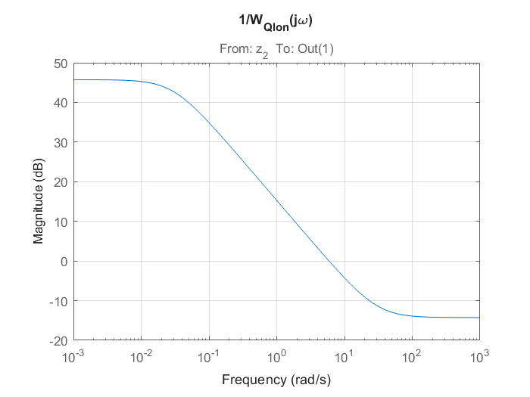
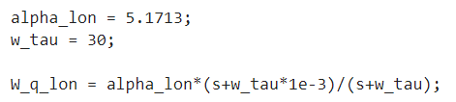
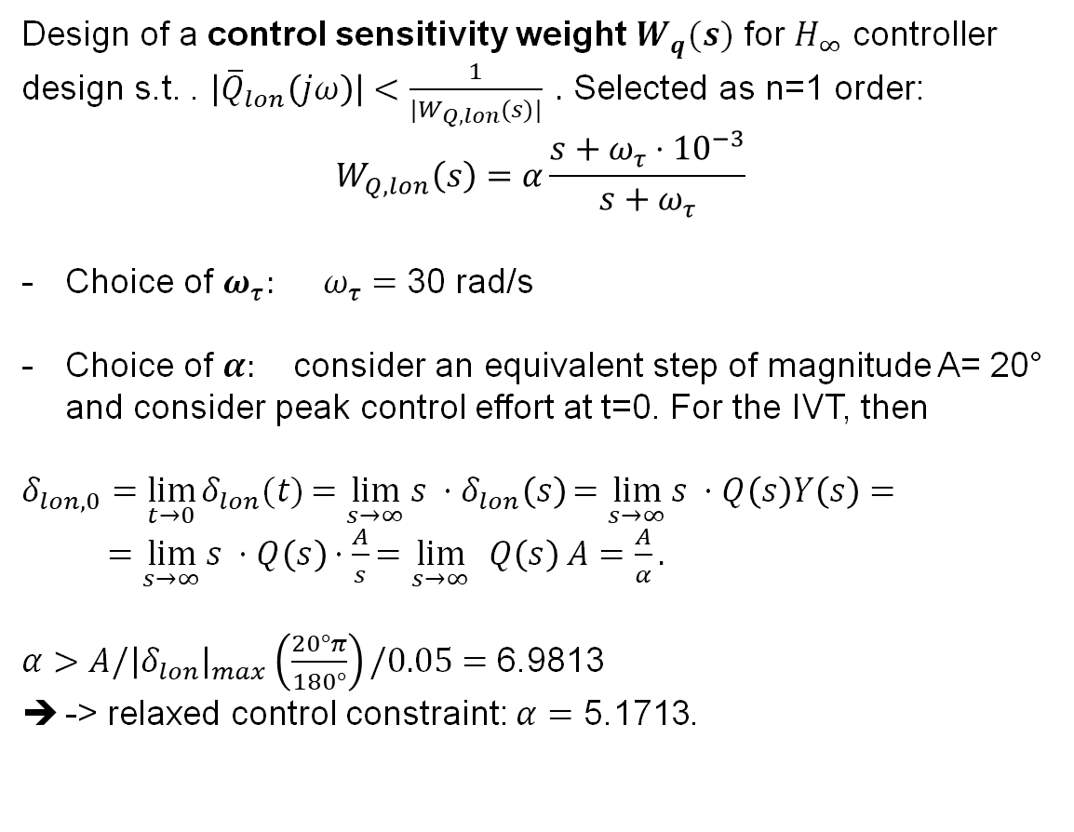
Design requirements for Nominal controller design for Longitudinal dynamics
Aerospace Control Systems - Exam project AA 25/26 - Robust multivariable control of the lateral/longitudinal dynamics of a multirotor UAV
Design of a control sensitivity weight $W_{q}(s)$ for $H_{∞}$ controller design s.t. . $\left|{\overline{Q}}_{lon}\left(jω\right)\right|<\frac{1}{|W_{Q,lon}(s)|} .$ Selected as n=1 order:
$$W_{Q,lon}\left(s\right)=α\frac{s+ω_{τ}⋅{10}^{−3}}{s+ω_{τ}}$$
Choice of $ω_{τ}:$ $ω_{τ}=$ 30 rad/s
Choice of $α:$ consider an equivalent step of magnitude A= 20° and consider peak control effort at t=0. For the IVT, then
$δ_{lon,0}=\lim_{t→0}{δ_{lon}(t)}=\lim_{s→∞}{s }⋅δ_{lon}\left(s\right)=\lim_{s→∞}{s }⋅Q\left(s\right)Y\left(s\right)=$ $=\lim_{s→∞}{s }⋅Q\left(s\right)⋅\frac{A}{s}=\lim_{s→∞}{ }Q\left(s\right) A=\frac{A}{α}.$
$α>A/{\left|δ_{lon}\right|}_{max}\left(\frac{20°π}{180°}\right)/0.05=$ 6.9813
-> relaxed control constraint: $α=\text{5.1713}$.

Slide 44
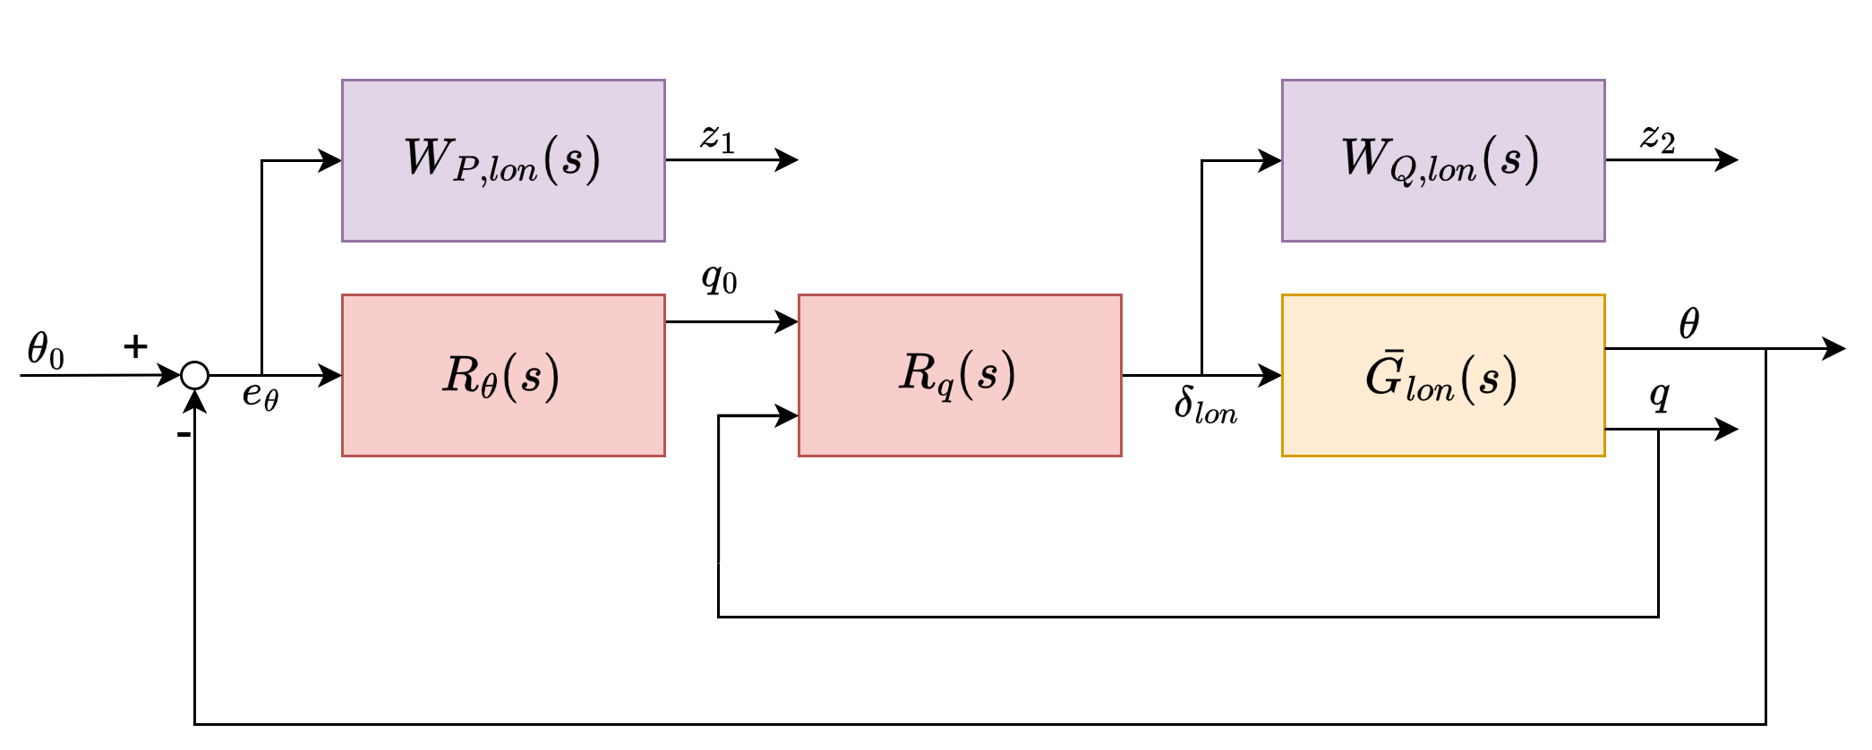
Mixed-sensitivity synthesis
Aerospace Control Systems - Exam project AA 25/26 - Robust multivariable control of the lateral/longitudinal dynamics of a multirotor UAV
Mixed-sensitivity synthesis for Nominal controller design for Longitudinal dynamics
1) Augmented plant:
Define augmented plant
Optimization problem

Slide 45

Mixed-sensitivity synthesis
Aerospace Control Systems - Exam project AA 25/26 - Robust multivariable control of the lateral/longitudinal dynamics of a multirotor UAV
Mixed-sensitivity synthesis for Nominal controller design for Longitudinal dynamics
1) Augmented plant:
2) Optimization
${{\left\|\left[\begin{matrix}z_{1,lon}(s) \\ z_{2,lon}(s)\end{matrix}\right]\right\|}_{∞}= \left\|\left[\begin{matrix}\left|W_{p,lon}\left(s\right) \overline{F}\left(s\right)\right| \\ \left|W_{Q,lon}\left(s\right) \overline{Q}\left(s\right)\right|\end{matrix}\right]\right\|}_{∞}<γ_{min}$
With $γ_{min}<1,$ imposing Performance and control effort limitation; R.S. is checked a posteriori; R.S. will be verified via MC campaign (Task 4).
Define augmented plant
Optimization problem

Slide 46


Mixed-sensitivity synthesis
Aerospace Control Systems - Exam project AA 25/26 - Robust multivariable control of the lateral/longitudinal dynamics of a multirotor UAV
Mixed-sensitivity synthesis for Nominal controller design for Longitudinal dynamics
Define augmented plant
Optimization problem
MATLAB documentation

Slide 47


Analysis of the results
Aerospace Control Systems - Exam project AA 25/26 - Robust multivariable control of the lateral/longitudinal dynamics of a multirotor UAV
Analysis of results of $H_{∞}$ synthesis of a
Nominal controller design for Longitudinal dynamics
1) ${{\left\|\left[\begin{matrix}z_{1,lon}(s) \\ z_{2,lon}(s)\end{matrix}\right]\right\|}_{∞}= \left\|\left[\begin{matrix}\left|W_{p,lon}\left(s\right) \overline{F}\left(s\right)\right| \\ \left|W_{Q,lon}\left(s\right) \overline{Q}\left(s\right)\right|\end{matrix}\right]\right\|}_{∞}<γ_{min}$ = 0.9787 < 1
Peak gain 1-value limit satisfaction
Tuned controller
Nominal performance satisfaction
Nominal control effort limitation satisfaction
Reiterate?

Slide 48



Analysis of the results
Aerospace Control Systems - Exam project AA 25/26 - Robust multivariable control of the lateral/longitudinal dynamics of a multirotor UAV
Analysis of results of $H_{∞}$ synthesis of a
Nominal controller design for Longitudinal dynamics
${{\left\|\left[\begin{matrix}z_{1,lon}(s) \\ z_{2,lon}(s)\end{matrix}\right]\right\|}_{∞}= \left\|\left[\begin{matrix}\left|W_{p,lon}\left(s\right) \overline{F}\left(s\right)\right| \\ \left|W_{Q,lon}\left(s\right) \overline{Q}\left(s\right)\right|\end{matrix}\right]\right\|}_{∞}<γ_{min}$ = 0.9787 < 1.
The tuned controllers have:
Peak gain 1-value limit satisfaction and nominal CL stability
Tuned controller
Nominal performance satisfaction
Nominal control effort limitation satisfaction
Reiterate?

Slide 49



Analysis of the results
Aerospace Control Systems - Exam project AA 25/26 - Robust multivariable control of the lateral/longitudinal dynamics of a multirotor UAV
Analysis of results of $H_{∞}$ synthesis of a
Nominal controller design for Longitudinal dynamics
3) Nominal performance:
Imposed S Peak via relaxed
requirement (M_lat): $\text{1.}\text{71}\text{65}$
Original function S Peak: 1.1838
Actual obtained S Peak: 1.2560
Peak gain 1-value limit satisfaction
Tuned controller
Nominal performance satisfaction
Nominal control effort limitation satisfaction
Reiterate?

Slide 50


Analysis of the results
Aerospace Control Systems - Exam project AA 25/26 - Robust multivariable control of the lateral/longitudinal dynamics of a multirotor UAV
Analysis of results of $H_{∞}$ synthesis of a
Nominal controller design for Longitudinal dynamics
3) Dynamic performance
expressed in terms
of step response:
Peak gain 1-value limit satisfaction
Tuned controller
Nominal performance satisfaction
Nominal control effort limitation satisfaction
Reiterate?

Slide 51


Analysis of the results
Aerospace Control Systems - Exam project AA 25/26 - Robust multivariable control of the lateral/longitudinal dynamics of a multirotor UAV
Analysis of results of $H_{∞}$ synthesis of a
Nominal controller design for Longitudinal dynamics
4) Control effort limitation in doublet response:
Peak gain 1-value limit satisfaction
Tuned controller
Nominal performance satisfaction
Nominal control effort limitation satisfaction
Reiterate?

Slide 52



Analysis of the results
Aerospace Control Systems - Exam project AA 25/26 - Robust multivariable control of the lateral/longitudinal dynamics of a multirotor UAV
Motivation for the relaxation of requirements for $H_{∞}$ synthesis of the
Nominal controller design for Longitudinal dynamics
It is physically impossible to strictly satisfy all design requirements of the 2nd order function simultaneously, in terms of desired tranfer functions
3D Parameter Sweep Study:
Peak gain 1-value limit satisfaction
Tuned controller
Nominal performance satisfaction
Nominal control effort limitation satisfaction
Reiterate?
- Explored a grid of design weights:
- M (Sensitivity Peak)
- $ω_{b}$(Bandwidth)
- $α$ (Actuator constraint factor)
- Evaluated Metrics:
- $T_{set}$ (Settling Time)
- $δ_{lon_max}$ (Max Actuator Deflection)
-${ S}_{peak}$ (Sensitivity Peak )
- $γ$ ($H_{∞}$ )
Decision: Parameters selected to satisfy all constraints while minimizing ${ S}_{peak}$for optimal robustness.
Neglecting ${ S}_{peak}$

Slide 53




Analysis of the results
Aerospace Control Systems - Exam project AA 25/26 - Robust multivariable control of the lateral/longitudinal dynamics of a multirotor UAV
Motivation for the relaxation of requirements for $H_{∞}$ synthesis of the
Nominal controller design for Longitudinal dynamics
Peak gain 1-value limit satisfaction
Tuned controller
Nominal performance satisfaction
Nominal control effort limitation satisfaction
Reiterate?

Slide 54
Uncertain modeling
TASK
2

Slide 55




Uncertain Modelling: Lateral
$$±3σ$$
Parametric Uncertainty: ranges as deterministic bounds

Slide 56




Uncertain Modelling: Lateral
Model Analysis: Poles and Zeros

Slide 57




Uncertain Modelling: Lateral
Model Analysis: Frequency Response Functions
$$G_{lat}\left(s\right)=\left[\begin{matrix}G_{p}(s) \\ G_{φ}(s)\end{matrix}\right]=\left[\begin{matrix}−\text{170.2}\frac{1}{\text{1−0.378 }\text{s}} \\ −\text{170.2}\frac{1}{\text{s}\text{(1−0.378 )}\text{s}}\end{matrix}\right]$$

Slide 58


Uncertain Modelling: Longitudinal
$$±3σ$$
Parametric Uncertainty: ranges as deterministic bounds

Slide 59




Uncertain Modelling: Longitudinal
Model Analysis: Poles and Zeros

Slide 60




Uncertain Modelling: Longitudinal
Longitudinal Step Response
Model Analysis: Frequency Response Functions
$$G_{lon}\left(s\right)=\left[\begin{matrix}G_{q}(s) \\ G_{th}(s)\end{matrix}\right]=\left[\begin{matrix}−\text{170.2}\frac{1}{\text{−}\text{1}\text{−}\text{0.378 }\text{s}} \\ −\text{170.2}\frac{1}{\text{s}\text{(}\text{−}\text{1−0.378 }\text{s}\text{)}}\end{matrix}\right]$$

Slide 61
Robust stability (R.S.) analysis
TASK
3

Slide 62


Task 3: RS
Aerospace Control Systems - Exam project AA 25/26 - Robust multivariable control of the lateral/longitudinal dynamics of a multirotor UAV
Robust stability for the uncertain Lateral dynamics
1) We define the tuned and uncertain system:
Define the uncertain system
Decompose in uncertainty from the known plant
Get P-$Δ$ form
Get N
Get M
Test R.S.

Slide 63


Task 3: RS
Aerospace Control Systems - Exam project AA 25/26 - Robust multivariable control of the lateral/longitudinal dynamics of a multirotor UAV
Robust stability for the uncertain Lateral dynamics
Define the uncertain system
Decompose in uncertainty from the known plant
Get P-$Δ$ form
Get N
Get M
Test R.S.
From Task 1
From Task 2

Slide 64



Task 3: RS
Aerospace Control Systems - Exam project AA 25/26 - Robust multivariable control of the lateral/longitudinal dynamics of a multirotor UAV
Robust stability for the uncertain Lateral dynamics
Define the uncertain system
Decompose uncertainty from known plant: $Δ$
Get P-$Δ$ form
Get N
Get M
Test R.S.

Slide 65

Task 3: RS
Aerospace Control Systems - Exam project AA 25/26 - Robust multivariable control of the lateral/longitudinal dynamics of a multirotor UAV
Robust stability for the uncertain Lateral dynamics
Motivation for P-$Δ$ form:
Considering 2 possible approaches to model multiple uncertainties (here 5 for each plant)
P-$Δ$ : exact, but requires (real) matrices. Becomes conservative if we need to account for non-linearities by considering more than one independent uncertain variables instead of 1 (not the case of Task3: here all linear)
Circular overbound : conservative, but 1 complex $Δ$(s). Can be used in the same way also when uncertainties appear in non-linear functions (not the case of Task3).
Define the uncertain system
Decompose uncertainty from known plant: $Δ$
Get P-$Δ$ form
Get N
Get M
Test R.S.

Slide 66

Task 3: RS
Aerospace Control Systems - Exam project AA 25/26 - Robust multivariable control of the lateral/longitudinal dynamics of a multirotor UAV
Robust stability for the uncertain Lateral dynamics
Motivation for P-$Δ$ form:
Considering 2 possible approaches to model multiple uncertainties (here 5 for each plant)
P-$Δ$ :exact, but requires (real) matrices. Becomes conservative if we need to account for non-linearities by considering more than one independent uncertain variables instead of 1 (not the case of Task3: here all linear). Numerically behaves well if low number of multiple uncertainties, such as here (5). -> ok.
Circular overbound : conservative, but 1 complex $Δ$(s). Can be used in the same way also when uncertainties appear in non-linear functions (not the case of Task3).->?
Define the uncertain system
Decompose uncertainty from known plant: $Δ$
Get P-$Δ$ form
Get N
Get M
Test R.S.

Slide 67


Task 3: RS
Aerospace Control Systems - Exam project AA 25/26 - Robust multivariable control of the lateral/longitudinal dynamics of a multirotor UAV
Robust stability for the uncertain Lateral dynamics
Circular overbound.
Plot uncertainty regions in polar plot to get a sense of the conservativeness it would introduce:
Define the uncertain system
Decompose uncertainty from known plant: $Δ$
Get P-$Δ$ form
Get N
Get M
Test R.S.
MATLAB documentation

Slide 68


Task 3: RS
Aerospace Control Systems - Exam project AA 25/26 - Robust multivariable control of the lateral/longitudinal dynamics of a multirotor UAV
Robust stability for the uncertain Lateral dynamics
Circular overbound.
Example $G_{p}(s)$
Define the uncertain system
Decompose uncertainty from known plant: $Δ$
Get P-$Δ$ form
Get N
Get M
Test R.S.

Slide 69


Task 3: RS
Aerospace Control Systems - Exam project AA 25/26 - Robust multivariable control of the lateral/longitudinal dynamics of a multirotor UAV
Robust stability for the uncertain Lateral dynamics
Circular overbound.
$$G_{p}(s)$$
Points move radially
~ gain uncertainty
Define the uncertain system
Decompose uncertainty from known plant: $Δ$
Get P-$Δ$ form
Get N
Get M
Test R.S.

Slide 70


Task 3: RS
Aerospace Control Systems - Exam project AA 25/26 - Robust multivariable control of the lateral/longitudinal dynamics of a multirotor UAV
Robust stability for the uncertain Lateral dynamics
Circular overbound.
$$G_{p}(s)$$
Conservativeness
increases at LF.
-> No
Define the uncertain system
Decompose uncertainty from known plant: $Δ$
Get P-$Δ$ form
Get N
Get M
Test R.S.

Slide 71




Task 3: RS
Aerospace Control Systems - Exam project AA 25/26 - Robust multivariable control of the lateral/longitudinal dynamics of a multirotor UAV
Robust stability for the uncertain Lateral dynamics
With the $Δ$ plant decomposition we obtain:
Define the uncertain system
Decompose in uncertainty from the known plant: $Δ$
Get P-$Δ$ form
Get N
Get M
Test R.S.
$$Δ:$$

Slide 72


Task 3: RS
Aerospace Control Systems - Exam project AA 25/26 - Robust multivariable control of the lateral/longitudinal dynamics of a multirotor UAV
Robust stability for the uncertain Lateral dynamics
We obtain:
Define the uncertain system
Decompose in uncertainty from the known plant: $Δ$
Get P-$Δ$ form
Get N
Get M
Test R.S.
$${\tilde{G}}_{lat}:$$

Slide 73

Task 3: RS
Aerospace Control Systems - Exam project AA 25/26 - Robust multivariable control of the lateral/longitudinal dynamics of a multirotor UAV
Robust stability for the uncertain Lateral dynamics
Define the uncertain system
Decompose in uncertainty from the known plant: $Δ$
Get P-$Δ$ form
Get N
Get M
Test R.S.

Slide 74




Task 3: RS
Aerospace Control Systems - Exam project AA 25/26 - Robust multivariable control of the lateral/longitudinal dynamics of a multirotor UAV
Robust stability for the uncertain Lateral dynamics
P-$Δ$ form
Define the uncertain system
Decompose in uncertainty from the known plant: $Δ$
Get P-$Δ$ form
Get N
Get M
Test R.S.
(Not reported for space reasons : dimensions 7x10)

Slide 75

Task 3: RS
Aerospace Control Systems - Exam project AA 25/26 - Robust multivariable control of the lateral/longitudinal dynamics of a multirotor UAV
Robust stability for the uncertain Lateral dynamics
P-$Δ$ form
Define the uncertain system
Decompose in uncertainty from the known plant: $Δ$
Get P-$Δ$ form
Get N
Get M
Test R.S.

Slide 76

Task 3: RS
Aerospace Control Systems - Exam project AA 25/26 - Robust multivariable control of the lateral/longitudinal dynamics of a multirotor UAV
Robust stability for the uncertain Lateral dynamics
P-$Δ$ form
Define the uncertain system
Decompose in uncertainty from the known plant: $Δ$
Get P-$Δ$ form
Get N
Get M
Test R.S.
(Notation $u_{lat}$is Skogestad’s. In our case $u_{lat}=δ_{lat})$

Slide 77





Task 3: RS
Aerospace Control Systems - Exam project AA 25/26 - Robust multivariable control of the lateral/longitudinal dynamics of a multirotor UAV
Robust stability for the uncertain Lateral dynamics
N-$Δ$ form
$N=F_{l}\left(P,K\right)≜P_{11}+P_{12}K{\left(I−P_{22}K\right)}^{−1}P_{21}$
linear fractional transformation (lft)
Define the uncertain system
Decompose in uncertainty from the known plant: $Δ$
Get P-$Δ$ form
Get N
Get M
Test R.S.

Slide 78

Task 3: RS
Aerospace Control Systems - Exam project AA 25/26 - Robust multivariable control of the lateral/longitudinal dynamics of a multirotor UAV
Robust stability for the uncertain Lateral dynamics
N-$Δ$ form
$N=F_{l}\left(P,K\right)≜P_{11}+P_{12}K{\left(I−P_{22}K\right)}^{−1}P_{21}$
linear fractional transformation (lft)
Define the uncertain system
Decompose in uncertainty from the known plant: $Δ$
Get P-$Δ$ form
Get N
Get M
Test R.S.

Slide 79

Task 3: RS
Aerospace Control Systems - Exam project AA 25/26 - Robust multivariable control of the lateral/longitudinal dynamics of a multirotor UAV
Robust stability for the uncertain Lateral dynamics
N-$Δ$ form
$N=F_{l}\left(P,K\right)≜P_{11}+P_{12}K{\left(I−P_{22}K\right)}^{−1}P_{21}$
linear fractional transformation (lft)
Define the uncertain system
Decompose in uncertainty from the known plant: $Δ$
Get P-$Δ$ form
Get N
Get M
Test R.S.

Slide 80

Task 3: RS
Aerospace Control Systems - Exam project AA 25/26 - Robust multivariable control of the lateral/longitudinal dynamics of a multirotor UAV
Robust stability for the uncertain Lateral dynamics
N-$Δ$ form
$N=F_{l}\left(P,K\right)≜P_{11}+P_{12}K{\left(I−P_{22}K\right)}^{−1}P_{21}$
linear fractional transformation (lft)
Define the uncertain system
Decompose in uncertainty from the known plant: $Δ$
Get P-$Δ$ form
Get N
Get M
Test R.S.

Slide 81



Task 3: RS
Aerospace Control Systems - Exam project AA 25/26 - Robust multivariable control of the lateral/longitudinal dynamics of a multirotor UAV
Robust stability for the uncertain Lateral dynamics
Define the uncertain system
Decompose in uncertainty from the known plant: $Δ$
Get P-$Δ$ form
Get N
Get M
Test R.S.

Slide 82




Task 3: RS
Aerospace Control Systems - Exam project AA 25/26 - Robust multivariable control of the lateral/longitudinal dynamics of a multirotor UAV
Robust stability for the uncertain Lateral dynamics
Theorem [RS for unstructured (“full”) perturbations]: Assuming $Δ(s)$ is full and complex s.t. $σ̅(Δ(jω))≤1 ∀ω$, then assuming $Δ(s)$ and M(s) are A.S., the feedback system is RS IFF
$$σ̅(M(jω))<1 ∀ω$$
Define the uncertain system
Decompose in uncertainty from the known plant: $Δ$
Get P-$Δ$ form
Get N
Get M
Test R.S.
-> in our case (structured and real uncertainty) it is only sufficient.
MATLAB documentation

Slide 83



Task 3: RS
Aerospace Control Systems - Exam project AA 25/26 - Robust multivariable control of the lateral/longitudinal dynamics of a multirotor UAV
Robust stability for the uncertain Lateral dynamics
Define the uncertain system
Decompose in uncertainty from the known plant: $Δ$
Get P-$Δ$ form
Get N
Get M
Test R.S.
Remark: the two methods give the same result, if not for numerical errors on null singular values.
Numerical errors: $σ\sim 0$

Slide 84

Task 3: RS
Aerospace Control Systems - Exam project AA 25/26 - Robust multivariable control of the lateral/longitudinal dynamics of a multirotor UAV
Robust stability for the uncertain Lateral dynamics
Define the uncertain system
Decompose in uncertainty from the known plant: $Δ$
Get P-$Δ$ form
Get N
Get M
Test R.S.
$σ̅$=-1.23 dB = 0.8680 < 1 -> RS -> No need to re-design the controller

Slide 85

Task 3: RS
Aerospace Control Systems - Exam project AA 25/26 - Robust multivariable control of the lateral/longitudinal dynamics of a multirotor UAV
Robust stability for the uncertain Longitudinal dynamics
The same approach is followed for the longitudinal feedback control, for which:
Define the uncertain system
Decompose in uncertainty from the known plant
Get P-$Δ$ form
Get N
Get M
Test R.S.
1
2
3
4
5

Slide 86

Task 3: RS
Aerospace Control Systems - Exam project AA 25/26 - Robust multivariable control of the lateral/longitudinal dynamics of a multirotor UAV
Robust stability for the uncertain Longitudinal dynamics
Theorem [RS for unstructured (“full”) perturbations]: Assuming $Δ(s)$ is full and complex s.t. $σ̅(Δ(jω))≤1 ∀ω$, then assuming $Δ(s)$ and M(s) are A.S., the feedback system is RS IFF
$$σ̅(M(jω))<1 ∀ω$$
Define the uncertain system
Decompose in uncertainty from the known plant: $Δ$
Get P-$Δ$ form
Get N
Get M
Test R.S.
-> in our case (structured and real uncertainty) it is only sufficient.

Slide 87


Task 3: RS
Aerospace Control Systems - Exam project AA 25/26 - Robust multivariable control of the lateral/longitudinal dynamics of a multirotor UAV
Robust stability for the uncertain Longitudinal dynamics
Define the uncertain system
Decompose in uncertainty from the known plant: $Δ$
Get P-$Δ$ form
Get N
Get M
Test R.S.
$σ̅$=-2.64 dB < 0dB -> RS -> No need to re-design the controller

Slide 88
Stability Robustness to pitch-roll dynamics uncertainty coupling
TASK
4

Slide 89


Stability Robustness to pitch-roll dynamics uncertainty coupling
Aerospace Control Systems - Exam project AA 25/26 - Robust multivariable control of the lateral/longitudinal dynamics of a multirotor UAV
Verify if the obtained control system satisfies the RS condition when taking into account the longitudinal/lateral coupling given by:
Uncertain longitudinal/ Lateral coupling
with $φ ε \left[−15°, 15°\right]$

Slide 90



Stability Robustness to pitch-roll dynamics uncertain coupling
Aerospace Control Systems - Exam project AA 25/26 - Robust multivariable control of the lateral/longitudinal dynamics of a multirotor UAV
We define the coupling matric C:
C ($ψ$)=$\left[\begin{matrix}cosψ & sinψ \\ −sinψ & cosψ\end{matrix}\right]$.
Remark: C($ψ̅=0$)=I : no coupling.
$ψ$ is argument of non-linear functions
$ψ ε \left[\text{−}\text{0.}\text{2618 }, \text{0.}\text{2618}\right]$
Choice of modeling model uncertainty, e.g.:

Slide 91

Stability Robustness to pitch-roll dynamics uncertain coupling
Aerospace Control Systems - Exam project AA 25/26 - Robust multivariable control of the lateral/longitudinal dynamics of a multirotor UAV
We define the coupling matric C:
C ($ψ$)=$\left[\begin{matrix}cosψ & sinψ \\ −sinψ & cosψ\end{matrix}\right]$.
Remark: C($ψ̅=0$)=I : no coupling.
$ψ$ is argument of non-linear functions
$ψ ε \left[\text{−}\text{0.}\text{2618 }, \text{0.}\text{2618}\right]$
Choice of modeling model uncertainty, e.g.:
OPTION 1: model two independent uncertainties c=cos$ψ$, s=sin$ψ$, both $∈[−1,1]$ -> Pull out the $Δ: P−Δ$ form. Most conservative

Slide 92

Stability Robustness to pitch-roll dynamics uncertain coupling
Aerospace Control Systems - Exam project AA 25/26 - Robust multivariable control of the lateral/longitudinal dynamics of a multirotor UAV
We define the coupling matric C:
C ($ψ$)=$\left[\begin{matrix}cosψ & sinψ \\ −sinψ & cosψ\end{matrix}\right]$.
Remark: C($ψ̅=0$)=I : no coupling.
$ψ$ is argument of non-linear functions
$ψ ε \left[\text{−}\text{0.}\text{2618 }, \text{0.}\text{2618}\right]$
Choice of modeling model uncertainty, e.g.:
OPTION 1: model two independent uncertainties c=cos$ψ$, s=sin$ψ$, both $∈[−1,1]$ -> Pull out the $Δ: P−Δ$ form. Most conservative
OPTION 2: 1st order Taylor to linearize $f_{i}(ψ)$ -> Pull out the $Δ: P−Δ$ form. Conservativeness?

Slide 93

Stability Robustness to pitch-roll dynamics uncertain coupling
Aerospace Control Systems - Exam project AA 25/26 - Robust multivariable control of the lateral/longitudinal dynamics of a multirotor UAV
We define the coupling matric C:
C ($ψ$)=$\left[\begin{matrix}cosψ & sinψ \\ −sinψ & cosψ\end{matrix}\right]$.
Remark: C($ψ̅=0$)=I : no coupling.
$ψ$ is argument of non-linear functions
$ψ ε \left[\text{−}\text{0.}\text{2618 }, \text{0.}\text{2618}\right]$
Choice of modeling model uncertainty, e.g.:
OPTION 1: model two independent uncertainties c=cos$ψ$, s=sin$ψ$, both $∈[−1,1]$ -> Pull out the $Δ: P−Δ$ form. Most conservative
OPTION 2: 1st order Taylor to linearize $f_{i}(ψ)$ -> Pull out the $Δ: P−Δ$ form. Conservativeness?
OPTION 3: circular overbound: it can describe the non-linearity, however its conservativeness has to be checked by polar plotting.

Slide 94

Stability Robustness to pitch-roll dynamics uncertain coupling
Aerospace Control Systems - Exam project AA 25/26 - Robust multivariable control of the lateral/longitudinal dynamics of a multirotor UAV
We define the coupling matric C:
C ($ψ$)=$\left[\begin{matrix}cosψ & sinψ \\ −sinψ & cosψ\end{matrix}\right]$.
Remark: C($ψ̅=0$)=I : no coupling.
$ψ$ is argument of non-linear functions
$ψ ε \left[\text{−}\text{0.}\text{2618 }, \text{0.}\text{2618}\right]$
Choice of modeling model uncertainty, e.g.:
OPTION 1: model two independent uncertainties c=cos$ψ$, s=sin$ψ$, both $∈[−1,1]$ -> Pull out the $Δ: P−Δ$ form. Most conservative
OPTION 2: 1st order Taylor to linearize $f_{i}(ψ)$ -> Pull out the $Δ: P−Δ$ form. Conservativeness?
OPTION 3: circular overbound: it can describe the non-linearity, however its conservativeness has to be checked by polar plotting.

Slide 95



Stability Robustness to pitch-roll dynamics uncertain coupling
Aerospace Control Systems - Exam project AA 25/26 - Robust multivariable control of the lateral/longitudinal dynamics of a multirotor UAV
We define the coupling matrix C:
C ($ψ$)=$\left[\begin{matrix}cosψ & sinψ \\ −sinψ & cosψ\end{matrix}\right]\underset{→}{ML}$ C $≃$ $\left[\begin{matrix}1 & ψ \\ −ψ & 1\end{matrix}\right]$
Conservativeness: for $ψ ∈$[-15°,+15°]:
  |1| >|cos $ψ$|
  |$ψ$|>|sin $ψ$|
  Therefore we do not loose possible values of the uncertain parameters, but only add conservativeness

Slide 96


Stability Robustness to pitch-roll dynamics. uncertain coupling
Aerospace Control Systems - Exam project AA 25/26 - Robust multivariable control of the lateral/longitudinal dynamics of a multirotor UAV
Model multiplicative scalar uncertainty:
Adimensionalize the uncertainty: $ψ=ψ_{max}δ_{ψ}$
With $ψ_{max}$=15°, $δ_{ψ} ∈$[-1,+1], s.t.:
$\underset{→}{ML}$ C $≃$ $\left[\begin{matrix}1 & ψ \\ −ψ & 1\end{matrix}\right]$= $\left[\begin{matrix}1 & 0 \\ 0 & 1\end{matrix}\right]$+ $\left[\begin{matrix}0 & ψ \\ −ψ & 0\end{matrix}\right] \text{= }\left[\begin{matrix}1 & 0 \\ 0 & 1\end{matrix}\right]\text{+ }\left[\begin{matrix}0 & ψ_{max} \\ −ψ_{max} & 0\end{matrix}\right]$ $δ_{ψ}$
= $\left[\begin{matrix}1 & 0 \\ 0 & 1\end{matrix}\right]\text{+ }\left[\begin{matrix}0 & ψ_{max} \\ −ψ_{max} & 0\end{matrix}\right]$ $\left[\begin{matrix}1 & 0 \\ 0 & 1\end{matrix}\right] δ_{ψ}$= $\left[\begin{matrix}1 & 0 \\ 0 & 1\end{matrix}\right]\text{+ }\left[\begin{matrix}0 & ψ_{max} \\ −ψ_{max} & 0\end{matrix}\right]$ $\left[\begin{matrix}δ_{ψ} & 0 \\ 0 & δ_{ψ}\end{matrix}\right]$= 1 + $W_{C}Δ_{C}$

Slide 97

Stability Robustness to pitch-roll dynamics. uncertain coupling
Aerospace Control Systems - Exam project AA 25/26 - Robust multivariable control of the lateral/longitudinal dynamics of a multirotor UAV

Slide 98

Stability Robustness to pitch-roll dynamics uncertain coupling
Aerospace Control Systems - Exam project AA 25/26 - Robust multivariable control of the lateral/longitudinal dynamics of a multirotor UAV
Define coupling blocks in their new multiplicative $Δ$ form:

Slide 99




Stability Robustness to pitch-roll dynamics uncertain coupling
Aerospace Control Systems - Exam project AA 25/26 - Robust multivariable control of the lateral/longitudinal dynamics of a multirotor UAV
Redefine inputs of the dynamics
Connect to build M for M-$Δ$ form:
12x12
$Δ$ is diagonal, real. -> structured real uncertainty

Slide 100

Task 4: RS
Aerospace Control Systems - Exam project AA 25/26 - Robust multivariable control of the lateral/longitudinal dynamics of a multirotor UAV
Stability Robustness to pitch-roll dynamics. uncertain coupling
Hierarchy of RS methods
Unstructured RS condition
Scalings
Structured singular values:$μ$-analysis.
$$μ_{Δ}(M(jω)) ≤\min_{D(s)}{σ̅(D(jω)}M(jω)D^{−1}(jω))≤σ̅(μ(jω)) ∀ ω$$

Slide 101

Task 4: RS
Aerospace Control Systems - Exam project AA 25/26 - Robust multivariable control of the lateral/longitudinal dynamics of a multirotor UAV
Stability Robustness to pitch-roll dynamics. uncertain coupling
Hierarchy of RS methods
Unstructured RS condition
Scalings
Structured singular values:$μ$-analysis.
$$μ_{Δ}(M(jω)) ≤\min_{D(s)}{σ̅(D(jω)}M(jω)D^{−1}(jω))≤σ̅(μ(jω)) ∀ ω$$
Theorem [RS for unstructured (“full”) perturbations]: Assuming $Δ(s)$ is full and complex s.t. $σ̅(Δ(jω))≤1 ∀ω$, then assuming $Δ(s)$ and M(s) are A.S., the feedback system is RS IFF
$$σ̅(M(jω))<1 ∀ω$$
-> in our case (structured and real uncertainty) it is only sufficient.

Slide 102

Task 4: RS
Aerospace Control Systems - Exam project AA 25/26 - Robust multivariable control of the lateral/longitudinal dynamics of a multirotor UAV
Stability Robustness to pitch-roll dynamics. uncertain coupling
Unstructured RS condition
Scalings
Structured singular values:$μ$-analysis.
$σ̅$ =70.5 = 37.0 dB > 0dB ->RS test inconclusive

Slide 103





Task 4: RS
Aerospace Control Systems - Exam project AA 25/26 - Robust multivariable control of the lateral/longitudinal dynamics of a multirotor UAV
Stability Robustness to pitch-roll dynamics. uncertain coupling
Hierarchy of RS methods
Unstructured RS condition
Scalings
Structured singular values:$μ$-analysis.
$$μ_{Δ}(M(jω)) ≤\min_{D(s)}{σ̅(D(jω)}M(jω)D^{−1}(jω))≤σ̅(μ(jω)) ∀ ω$$
$$Δ=diag(Δ_{i}) 12x12$$
$$D(s)=diag(d_{i}(s))$$
RS condition now is
$\min_{D(s)}{σ̅(D(jω)}M(jω)D^{−1}(jω))$<1

Slide 104




Task 4: RS
Aerospace Control Systems - Exam project AA 25/26 - Robust multivariable control of the lateral/longitudinal dynamics of a multirotor UAV
Stability Robustness to pitch-roll dynamics. uncertain coupling
Computation of the scalings $d_{i}(s):$
Step 0: Problem set-up
- select a discrete set of frequencies $ω_{k}$ and, so for each, we find $d_{i}(jω_{k})$ that
minimize $σ̅(D(jω_{k})M(jω_{k})D^{−1}(jω_{k}))$
$σ̅(D(jω_{k})M(jω_{k})D^{−1}(jω_{k}))$ depends only on the scalings ratios:
$\left[\begin{matrix}d_{1} & ⋯ & 0 \\ ⋮ & ⋱ & ⋮ \\ 0 & ⋯ & d_{12}\end{matrix}\right]\left[\begin{matrix}M_{1,1} & ⋯ & M_{1,12} \\ ⋮ & ⋱ & ⋮ \\ M_{12,1} & ⋯ & M_{12,12}\end{matrix}\right]\left[\begin{matrix}\frac{1}{d_{1}} & ⋯ & 0 \\ ⋮ & ⋱ & ⋮ \\ 0 & ⋯ & \frac{1}{d_{12}}\end{matrix}\right]=\left[\begin{matrix}d_{1} & ⋯ & 0 \\ ⋮ & ⋱ & ⋮ \\ 0 & ⋯ & d_{12}\end{matrix}\right]\left[\begin{matrix}\frac{M_{1,1}}{d_{1}} & ⋯ & \frac{M_{1,12}}{d_{12}} \\ ⋮ & ⋱ & ⋮ \\ \frac{M_{12,1}}{d_{1}} & ⋯ & \frac{M_{12,12}}{d_{12}}\end{matrix}\right]$= $\left[\begin{matrix}M_{1,1} & ⋯ & M_{1,12}\frac{d_{1}}{d_{12}} \\ ⋮ & ⋱ & ⋮ \\ M_{12,1}\frac{d_{12}}{d_{1}} & ⋯ & M_{12,12}\end{matrix}\right]$, indeed in element i,j
I’ll have $M_{i,j}\frac{d_{j}}{d_{i}}$, so the matrix only depends on the ratios of the scalings.
Unstructured RS condition
Scalings
  Step 0
  Step 1
  Step 2
Structured singular values:$μ$-analysis.

Slide 105


Task 4: RS
Aerospace Control Systems - Exam project AA 25/26 - Robust multivariable control of the lateral/longitudinal dynamics of a multirotor UAV
Stability Robustness to pitch-roll dynamics. uncertain coupling
Computation of the scalings $d_{i}(s):$
Unstructured RS condition
Scalings
  Step 0
  Step 1
  Step 2
Structured singular values:$μ$-analysis.
Step 0: Problem set-up
- select a discrete set of frequencies $ω_{k}$ and, so for each, we find $d_{i}(jω_{k})$ that
minimize $σ̅(D(jω_{k})M(jωω_{k})D^{−1}(jωω_{k}))$
$σ̅(D(jω_{k})M(jω_{k})D^{−1}(jω_{k})) \text{depends} \text{only} \text{on} \text{the} \text{scalings} \text{ratios}\text{:}$
E.g. 2x2 case:
$\left[\begin{matrix}d_{1} & 0 \\ 0 & d_{2}\end{matrix}\right]\left[\begin{matrix}m_{11} & m_{12} \\ m_{21} & m_{22}\end{matrix}\right]\left[\begin{matrix}1/{d_{1}} & 0 \\ 0 & 1/{d_{2}}\end{matrix}\right]=$ $\left[\begin{matrix}m_{11} & m_{12}\frac{d_{2}}{d_{1}} \\ m_{21}\frac{d_{1}}{d_{2}} & m_{22}\end{matrix}\right]= \left[\begin{matrix}m_{11} & m_{12}λ \\ m_{21}λ & m_{22}\end{matrix}\right]$. Only 1 dof.

Slide 106

Task 4: RS
Aerospace Control Systems - Exam project AA 25/26 - Robust multivariable control of the lateral/longitudinal dynamics of a multirotor UAV
Stability Robustness to pitch-roll dynamics. uncertain coupling
Computation of the scalings $d_{i}(s):$
Unstructured RS condition
Scalings
  Step 0
  Step 1
  Step 2
Structured singular values:$μ$-analysis.
Step 0: Problem set-up
- select a dscrete set of frequencies $ω_{k}$ and, so for each, we find $d_{i}(jω_{k})$ that
minimize $σ̅(D(jω_{k})M(jωω_{k})D^{−1}(jωω_{k}))$
$σ̅(D(jω_{k})M(jω_{k})D^{−1}(jω_{k})) \text{depends} \text{only} \text{on} \text{the} \text{scalings} \text{ratios}\text{.}$
→ Normalization: we can fix one scaling to 1:$d_{12}=1$. Minimization problem in 11 variables.

Slide 107

Task 4: RS
Aerospace Control Systems - Exam project AA 25/26 - Robust multivariable control of the lateral/longitudinal dynamics of a multirotor UAV
Stability Robustness to pitch-roll dynamics. uncertain coupling
Computation of the scalings $d_{i}(s):$
Unstructured RS condition
Scalings
  Step 0
  Step 1
  Step 2
Structured singular values:$μ$-analysis.
Step 0: Problem set-up
- select a discrete set of frequencies $ω_{k}$ and, so for each, we find $d_{i}(jω_{k})$ that
minimize $σ̅(D(jω_{k})M(jωω_{k})D^{−1}(jωω_{k}))$
$σ̅(D(jω_{k})M(jω_{k})D^{−1}(jω_{k})\text{)} \text{depends} \text{only} \text{on} \text{the} \text{scalings} \text{ratios}\text{.}$
→ Normalization: we can fix one scaling to 1:$d_{12}=1$. Minimization problem in 11 variables.
Look only for $d_{i}(jω_{k})$ >0 (s.t.to enable magnitude (>0) fitting of $d_{i}(s)$ ), but restricted to limited values (e.g. <100).
Change of variables: substitute$d_{i}=e^{x_{i}}$ for i = 1,…,11 and optimize for x $∈ℝ^{11}$via MATLAB fmincon: gives real optimum solution, s.t. then $d_{i}=e^{x_{i}} >0.$

Slide 108

Task 4: RS
Aerospace Control Systems - Exam project AA 25/26 - Robust multivariable control of the lateral/longitudinal dynamics of a multirotor UAV
Stability Robustness to pitch-roll dynamics. uncertain coupling
Computation of the scalings $d_{i}(s):$
Unstructured RS condition
Scalings
  Step 0
  Step 1
  Step 2
Structured singular values:$μ$-analysis.
Step 0: Problem set-up
-$\left[\begin{matrix}\begin{matrix}d_{1} & ⋯ & 0 \\ ⋮ & ⋱ & ⋮ \\ 0 & ⋯ & d_{11}\end{matrix} & 0 \\ 0 & 1\end{matrix}\right]$= $\left[\begin{matrix}\begin{matrix}e^{x_{1}^{⋯}} & ⋯ & 0 \\ ⋮ & ⋱ & ⋮ \\ 0 & ⋯ & e^{x_{11}^{⋯}}\end{matrix} & 0 \\ 0 & 1\end{matrix}\right].$
- Constraints on $d_{i}$ (<100)become constraints on x optimization

Slide 109


Task 4: RS
Aerospace Control Systems - Exam project AA 25/26 - Robust multivariable control of the lateral/longitudinal dynamics of a multirotor UAV
Stability Robustness to pitch-roll dynamics. uncertain coupling
Computation of the scalings $d_{i}(s):$
Unstructured RS condition
Scalings
  Step 0
  Step 1
  Step 2
Structured singular values:$μ$-analysis.
Step 1: Minimization via fmincon, frequency by frequency to find optimal $d_{i}(jω_{k}):$

Slide 110

Task 4: RS
Aerospace Control Systems - Exam project AA 25/26 - Robust multivariable control of the lateral/longitudinal dynamics of a multirotor UAV
Stability Robustness to pitch-roll dynamics. uncertain coupling
Unstructured RS condition
Scalings
  Step 0
  Step 1
  Step 2
Structured singular values:$μ$-analysis.

Slide 111



Task 4: RS
Aerospace Control Systems - Exam project AA 25/26 - Robust multivariable control of the lateral/longitudinal dynamics of a multirotor UAV
Stability Robustness to pitch-roll dynamics. uncertain coupling
Applying the scalings in
a discrete manner on M:
Unstructured RS condition
Scalings
  Step 0
  Step 1
  Step 2
Structured singular values:$μ$-analysis.
$σ̅$ =0.759 = --2.4dB< 0dB
Remark.: real, discrete scalings $d_{i,k}$are able to diminish $σ̅$.
Complex scalings s.t.
$$|d_{i}(jω_{k})|=d_{i,k}$$

Slide 112


Task 4: RS
Aerospace Control Systems - Exam project AA 25/26 - Robust multivariable control of the lateral/longitudinal dynamics of a multirotor UAV
Stability Robustness to pitch-roll dynamics. uncertain coupling
Computation of the scalings $d_{i}(s):$
Unstructured RS condition
Scalings
  Step 0
  Step 1
  Step 2
Structured singular values:$μ$-analysis.
Step 2: Fit frequency response magnitude data with stable (s.t. D has LHP poles), minimum-phase (s.t. D^-1 has LHP poles) order n transfer functions using log-Chebyshev magnitude design.
MATLAB documentation

Slide 113


Task 4: RS
Aerospace Control Systems - Exam project AA 25/26 - Robust multivariable control of the lateral/longitudinal dynamics of a multirotor UAV
Stability Robustness to pitch-roll dynamics. uncertain coupling
Unstructured RS condition
Scalings
  Step 0
  Step 1
  Step 2
Structured singular values:$μ$-analysis.
5th order Chebyshev – fitted scalings
e.g.

Slide 114



Task 4: RS
Aerospace Control Systems - Exam project AA 25/26 - Robust multivariable control of the lateral/longitudinal dynamics of a multirotor UAV
Stability Robustness to pitch-roll dynamics. uncertain coupling
Applying the complex
scalings on M:
Unstructured RS condition
Scalings
  Step 0
  Step 1
  Step 2
Structured singular values:$μ$-analysis.
$σ̅$ =1.04 =0.3 >0dB
-> RS test inconclusive
Remark 1.: slighlty more conservative than before due to
- Fitting of the magnitude with order n limited
- Complex fitting that doesn’t take into consideration the phase

Slide 115

Task 4: RS
Aerospace Control Systems - Exam project AA 25/26 - Robust multivariable control of the lateral/longitudinal dynamics of a multirotor UAV
Stability Robustness to pitch-roll dynamics. uncertain coupling
Applying the complex
scalings on M:
Unstructured RS condition
Scalings
  Step 0
  Step 1
  Step 2
Structured singular values:$μ$-analysis.
$σ̅$ =1.04 =0.3 >0dB
-> RS test inconclusive
Remark 2:- Lower orders n are unable to describe the magnitude variability; higher orders n are affected by ‘noise’ in the numerical solution.

Slide 116



Task 4: RS
Aerospace Control Systems - Exam project AA 25/26 - Robust multivariable control of the lateral/longitudinal dynamics of a multirotor UAV
Stability Robustness to pitch-roll dynamics. uncertain coupling
Hierarchy of RS methods
Unstructured RS condition
Scalings
Structured singular values:$μ$-analysis.
$$μ_{Δ}(M(jω)) ≤\min_{D(s)}{σ̅(D(jω)}M(jω)D^{−1}(jω))≤σ̅(μ(jω)) ∀ ω$$
Structured singular value (ssv):
$μ$-analysis (IFF condition)

Slide 117

Task 4: RS
Aerospace Control Systems - Exam project AA 25/26 - Robust multivariable control of the lateral/longitudinal dynamics of a multirotor UAV
Stability Robustness to pitch-roll dynamics. uncertain coupling
Unstructured RS condition
Scalings
Structured singular values:$μ$-analysis.
MATLAB documentation

Slide 118


Task 4: RS
Aerospace Control Systems - Exam project AA 25/26 - Robust multivariable control of the lateral/longitudinal dynamics of a multirotor UAV
Stability Robustness to pitch-roll dynamics. uncertain coupling
$μ_{Δ}<$ 0.3462 $<$1->RS : The system is robustly stable with respect to coupling.
Unstructured RS condition
Scalings
Structured singular values:$μ$-analysis.

Slide 119

Task 4: RS
Aerospace Control Systems - Exam project AA 25/26 - Robust multivariable control of the lateral/longitudinal dynamics of a multirotor UAV
Stability Robustness to pitch-roll dynamics. uncertain coupling
Hierarchy of
RS methods
$$μ_{Δ}(M(jω)) ≤\min_{D(s)}{σ̅(D(jω)}M(jω)D^{−1}(jω))≤σ̅(μ(jω)) ∀ ω$$
Unstructured RS condition
Scalings
Structured singular values:$μ$-analysis.

Slide 120
TASK 5: Monte Carlo Campaign
TASK
5

Slide 121







Task 5: MC
Aerospace Control Systems - Exam project AA 25/26 - Robust multivariable control of the lateral/longitudinal dynamics of a multirotor UAV
Monte Carlo Campaign
Robustness implementation and verifications worked assuming uniform distributions.
Now we exploit them to provide insight on the real robustness using statistical information about our uncertainty.
Additionally, after $μ$-analysis, this is the last resort for robustness testing.
Distribution of the 11 aleatory variables
Uncertain system
First iteration: standard deviations
Continue iteration: means convergence
Conclusions, e.g. on RP.
Lateral dynamics
Longitudinal dynamics
Stability derivatives
Stability derivatives
$Y_{v}$ ~ N(-0.1068 ,4%)
$Y_{P}$ ~ N(-0.1192,2%)
$L_{P}$ ~ N(2.6478, 2%)
$X_{u}$ ~ N(-0.1068, 4%)
$X_{q}$ ~ N(0.1192,2%)
$M_{P}$ ~ N(-2.6478, 2%)
Coupling
$ψ$~ U(-15°,15°)
Control derivatives
Control derivatives
$Y_{d}$ ~ N(10.1647,1.5%)
$L_{d}$ ~ N(450.7085,1%)
$X_{d}$ ~ N(-10.1647,1.5%)
$M_{d}$ ~ N(450.7085,1%)
- Second argument is not the
variance but standard deviation,
in terms of % of the mean;
- Units of measure are omitted

Slide 122


Task 5: MC
Aerospace Control Systems - Exam project AA 25/26 - Robust multivariable control of the lateral/longitudinal dynamics of a multirotor UAV
Monte Carlo Campaign
Note: the control action on the system
is now u, not $δ$ (which is the control effort)
Simulate entire system using:
- Uncertain system from task 2 ,
- Coupling from task 4 :
Distribution of the 11 aleatory variables
Uncertain system
First iteration: standard deviations
Continue iteration: means convergence
Conclusions, e.g. on RP.
All
blocks
are inherited

Slide 123


Task 5: MC
Aerospace Control Systems - Exam project AA 25/26 - Robust multivariable control of the lateral/longitudinal dynamics of a multirotor UAV
Monte Carlo Campaign
A. DYNAMIC PERFORMANCES
Performances defined in
task 1 (Weights)
Complementary sensitivities of total uncertain system :
Distribution of the 11 aleatory variables
Uncertain system
First iteration: standard deviations
Continue iteration: means convergence
Conclusions, e.g. on RP.

Slide 124


Task 5: MC
Aerospace Control Systems - Exam project AA 25/26 - Robust multivariable control of the lateral/longitudinal dynamics of a multirotor UAV
Monte Carlo Campaign
A. DYNAMIC PERFORMANCES
Distribution of the 11 aleatory variables
Uncertain system
First iteration: standard deviations
Continue iteration: means convergence
Conclusions, e.g. on RP.
F of the system will have components
of order $≠$ 2:
-> 2° order approximation to evaluate $ω_{c},ξ$ difference with respect to the nominal design performances

Slide 125


Task 5: MC
Aerospace Control Systems - Exam project AA 25/26 - Robust multivariable control of the lateral/longitudinal dynamics of a multirotor UAV
Monte Carlo Campaign
B. CONTROL EFFORT LIMITATION
Control limitations defined in
task 1 (Weights)
Control sensitivities of total uncertain system:
Distribution of the 11 aleatory variables
Uncertain system
First iteration: standard deviations
Continue iteration: means convergence
Conclusions, e.g. on RP.

Slide 126



Task 5: MC
Aerospace Control Systems - Exam project AA 25/26 - Robust multivariable control of the lateral/longitudinal dynamics of a multirotor UAV
Monte Carlo Campaign
Aleatory variables to monitor:
Distribution of the 11 aleatory variables
Uncertain system
First iteration: standard deviations
Continue iteration: means convergence
Conclusions, e.g. on RP.
$$ω_{c, ϕ}$$
$$ξ_{ϕ}$$
$$δ_{lat,doublet}$$
$$T_{settl,ϕ}$$
$${OS}_{\%,ϕ}$$
$$ω_{c, θ}$$
$$ξ_{θ}$$
$$δ_{lon,doublet}$$
$$T_{settl,θ}$$
$${OS}_{\%,θ}$$
Aleatory variables $X_{i}$, differently distributed

Slide 127

Task 5: MC
Aerospace Control Systems - Exam project AA 25/26 - Robust multivariable control of the lateral/longitudinal dynamics of a multirotor UAV
Monte Carlo Campaign
Number of iterations:
- k=500 seemingly way smaller than the one we will use in the actual MC:
Distribution of the 11 aleatory variables
Uncertain system
First iteration: standard deviations
Continue iteration: means convergence
Conclusions, e.g. on RP.
Generate random samples

Slide 128


Task 5: MC
Aerospace Control Systems - Exam project AA 25/26 - Robust multivariable control of the lateral/longitudinal dynamics of a multirotor UAV
Monte Carlo Campaign
For each iteration m out of k:
1) Initialize m-th plant $∈Π:$
Distribution of the 11 aleatory variables
Uncertain system
First iteration: standard deviations
Continue iteration: means convergence
Conclusions, e.g. on RP.

Slide 129

Task 5: MC
Aerospace Control Systems - Exam project AA 25/26 - Robust multivariable control of the lateral/longitudinal dynamics of a multirotor UAV
Monte Carlo Campaign
For each iteration m out of k:
Distribution of the 11 aleatory variables
Uncertain system
First iteration: standard deviations
Continue iteration: means convergence
Conclusions, e.g. on RP.
2) Compute and store variables realizations

Slide 130

Task 5: MC
Aerospace Control Systems - Exam project AA 25/26 - Robust multivariable control of the lateral/longitudinal dynamics of a multirotor UAV
Monte Carlo Campaign
For each iteration m out of k:
Distribution of the 11 aleatory variables
Uncertain system
First iteration: standard deviations
Continue iteration: means convergence
Conclusions, e.g. on RP.
3) Compute and store sample means and sample standard deviations using
m measurements

Slide 131

Task 5: MC
Aerospace Control Systems - Exam project AA 25/26 - Robust multivariable control of the lateral/longitudinal dynamics of a multirotor UAV
Monte Carlo Campaign
Distribution of the 11 aleatory variables
Uncertain system
First iteration: standard deviations
Continue iteration: means convergence
Conclusions, e.g. on RP.

Slide 132

Task 5: MC
Aerospace Control Systems - Exam project AA 25/26 - Robust multivariable control of the lateral/longitudinal dynamics of a multirotor UAV
Monte Carlo Campaign
We can therefore assume ${σ̂}_{i}$ convergence to $𝔼[{Σ̂}_{i}]( \underset{→}{∗}σ_{i}$ for k>>), therefore:
Distribution of the 11 aleatory variables
Uncertain system
First iteration: standard deviations
Continue iteration: means convergence
Conclusions, e.g. on RP.
in lack of exact formulations for the standard deviations or the means, due to the
non-linearities involved in the computations of the inspected quantities,
we assume
$$σ_{i}≃{σ̂}_{i,k}$$
*: ${Σ̂}_{i}$ is consistent in quadratic mean: $\lim_{n→∞}{\text{mse} ({Σ̂}_{i};σ)}≜\lim_{n→∞}𝔼[{{(Σ̂}_{i}−σ)}^{2}]$=0

Slide 133

Task 5: MC
Aerospace Control Systems - Exam project AA 25/26 - Robust multivariable control of the lateral/longitudinal dynamics of a multirotor UAV
Monte Carlo Campaign
C.I. for the expected value $μ$ of a large sample $X_{1},…,X_{n}$ (of any distribution)
- At each iteration/simulation I compute a realization of $x_{i}$
Distribution of the 11 aleatory variables
Uncertain system
First iteration: standard deviations
Continue iteration: means convergence
Conclusions, e.g. on RP.
After n iterations I can compute their average mean estimation ${x̅}_{i,n}=\frac{\sum_{in}{x_{i}}}{n}$, as estimate of $μ_{i}= 𝔼[X_{i}].$
How many n iterations do I need s.t. I know that ${x̅}_{i,n}$ well approximates $μ_{i}= 𝔼[X_{i}]$; and how well?
$P(μ ∈[ X̅−hw,X̅+hw] )≃1−α$, with hw= $z_{1−α/2}\frac{σ}{\sqrt{n}}$
Choice: we want an interval ${x̅}_{i}±{hw}_{i}$of values s.t. we have 90% confidence( $z_{1−α/2}≃$1.645) that the real mean $μ_{i}$is inside it. Also, ${hw}_{i}$ must be small (otherwise useless), depending on i-th quantity. We chose:
$[{hw}_{ω_{C}},{hw}_{ξ},{hw}_{u},{hw}_{T},{hw}_{OS\%}]=\text{[}\text{0.1,0.01,0.01,0.001,0.01}\text{]}\text{;}$ (in the corresponding units of measure)
Hw = Halfwidth of C.I.

Slide 134

Task 5: MC
Aerospace Control Systems - Exam project AA 25/26 - Robust multivariable control of the lateral/longitudinal dynamics of a multirotor UAV
Monte Carlo Campaign
C.I. for the expected value $μ$ of a large sample $X_{1},…,X_{n}$ (of any distribution)
Distribution of the 11 aleatory variables
Uncertain system
First iteration: standard deviations
Continue iteration: means convergence
Conclusions, e.g. on RP.
Therefore the number of total iterations n needed are dictated by the
highest $\frac{σ_{i}}{{hw}_{i}}$ ratio:
$n_{i}$= ${(1.645\frac{σ_{i}}{{hw}_{i}} )}^{2}$
For example (Different on every run code): We find n= 4374
So we still have to simulate r = n-k = 3874 times
After which we get…

Slide 135

Task 5: MC
Aerospace Control Systems - Exam project AA 25/26 - Robust multivariable control of the lateral/longitudinal dynamics of a multirotor UAV
Monte Carlo Campaign
Distribution of the 11 aleatory variables
Uncertain system
First iteration: standard deviations
Continue iteration: means convergence
Conclusions, e.g. on RP.

Slide 136

Task 5: MC
Aerospace Control Systems - Exam project AA 25/26 - Robust multivariable control of the lateral/longitudinal dynamics of a multirotor UAV
Monte Carlo Campaign
Uncoupled system:
Distribution of the 11 aleatory variables
Uncertain system
First iteration: standard deviations
Continue iteration: means convergence
Conclusions, e.g. on RP.

Slide 137

Task 5: MC
Aerospace Control Systems - Exam project AA 25/26 - Robust multivariable control of the lateral/longitudinal dynamics of a multirotor UAV
Monte Carlo Campaign
Coupled system:
Distribution of the 11 aleatory variables
Uncertain system
First iteration: standard deviations
Continue iteration: means convergence
Conclusions, e.g. on RP.

Slide 138

Task 5: MC
Aerospace Control Systems - Exam project AA 25/26 - Robust multivariable control of the lateral/longitudinal dynamics of a multirotor UAV
Monte Carlo Campaign
Distribution of the 11 aleatory variables
Uncertain system
First iteration: standard deviations
Continue iteration: means convergence
Conclusions, e.g. on RP.

Slide 139

Task 5: MC
Aerospace Control Systems - Exam project AA 25/26 - Robust multivariable control of the lateral/longitudinal dynamics of a multirotor UAV
Monte Carlo Campaign
Coupled system:
Distribution of the 11 aleatory variables
Uncertain system
First iteration: standard deviations
Continue iteration: means convergence
Conclusions, e.g. on RP.
Only 500 iterations are required for the uncoupled system, which means it has “less uncertainty” than the coupled one (sigmas are lower in formula of n)
Uncoupled system:

Slide 140


Task 5: MC
Aerospace Control Systems - Exam project AA 25/26 - Robust multivariable control of the lateral/longitudinal dynamics of a multirotor UAV
Monte Carlo Campaign (Coupled System) - Lateral
Distribution of the 11 aleatory variables
Uncertain system
First iteration: standard deviations
Continue iteration: means convergence
Conclusions, e.g. on RP.

Slide 141


Task 5: MC
Aerospace Control Systems - Exam project AA 25/26 - Robust multivariable control of the lateral/longitudinal dynamics of a multirotor UAV
Monte Carlo Campaign (Coupled System) - Longitudinal
Distribution of the 11 aleatory variables
Uncertain system
First iteration: standard deviations
Continue iteration: means convergence
Conclusions, e.g. on RP.

Slide 142







Task 5: MC
Aerospace Control Systems - Exam project AA 25/26 - Robust multivariable control of the lateral/longitudinal dynamics of a multirotor UAV
Monte Carlo Campaign
C.I. for the expected value $μ$ of a large sample $X_{1},…,X_{n}$ (of any distribution)
But we used n iterations also for the less deviated variables so:
Distribution of the 11 aleatory variables
Uncertain system
First iteration: standard deviations
Continue iteration: means convergence
Conclusions, e.g. on RP.
$$∀ variable: {hw}_{i}=z_{1−α_{i}/2}\frac{σ_{i}}{\sqrt{n}}≈z_{1−α_{i}/2}\frac{{\hat{σ}}_{n_{i}}}{\sqrt{n}}$$
Now we use a more precise estimation of real $σ$
$⇒$ $z_{1−α_{i}/2}≈ \frac{{hw}_{i}⋅\sqrt{n}}{{\hat{σ}}_{n_{i}}}$
$$Φ(z_{1−\frac{α_{i}}{2}})≈Φ\left(\frac{{hw}_{i}⋅\sqrt{n}}{{\hat{σ}}_{n_{i}}}\right)$$
$$1−\frac{α_{i}}{2} ≈Φ\left(\frac{{hw}_{i}⋅\sqrt{n}}{{\hat{σ}}_{n_{i}}}\right)$$
Confidence of variable i inside its C.I. ${\overline{X}}_{n}±{hw}_{i}$
$$α_{i}≈2\left(1−Φ\left(\frac{{hw}_{i}⋅\sqrt{n}}{{\hat{σ}}_{n_{i}}}\right)\right)$$

Slide 143
Task 5: MC
Aerospace Control Systems - Exam project AA 25/26 - Robust multivariable control of the lateral/longitudinal dynamics of a multirotor UAV
Monte Carlo Campaign
C.I. for the expected value $μ$ of a large sample $X_{1},…,X_{n}$ (of any distribution)
Distribution of the 11 aleatory variables
Uncertain system
First iteration: standard deviations
Continue iteration: means convergence
Conclusions, e.g. on RP.
The Confidence intervals (CI) are (for the coupled case):
Lateral dynamics
$μ_{wc_{φ}}∈$[5.529, 5.729] rad/s with a confidence higher than 99%
$μ_{ζ_{φ} }∈$[0.5883, 0.6083] with a confidence higher than 99%
$μ_{δ_{lat}}∈$[0.03892, 0.05892] with a confidence higher than 99%
$μ_{Tset_{φ}}∈$[0.4977, 0.4997]. with a confidence of 90%
$μ_{OS_{φ}}∈$[0.001612, 0.02161] with a confidence higher than 99%
Desired and nominal Values

Slide 144
Task 5: MC
Aerospace Control Systems - Exam project AA 25/26 - Robust multivariable control of the lateral/longitudinal dynamics of a multirotor UAV
Monte Carlo Campaign
C.I. for the expected value $μ$ of a large sample $X_{1},…,X_{n}$ (of any distribution)
Distribution of the 11 aleatory variables
Uncertain system
First iteration: standard deviations
Continue iteration: means convergence
Conclusions, e.g. on RP.
The Confidence intervals (CI) are(for the coupled case):
Longitudinal dynamics
$μ_{wc_{θ}}∈$[5.446, 5.646] rad/s with a confidence higher than 99%
$μ_{ζ_{θ} }∈$[0.5847, 0.6047] with a confidence higher than 99%
$μ_{δ_{lon}}∈$[0.03907, 0.05907] with a confidence higher than 99%
$μ_{Tset_{θ}}∈$[0.4977, 0.4997] with a confidence of 91.07%
$μ_{OS_{θ}}∈$[-0.008483, 0.01152] with a confidence higher than 99%
Desired and nominal Values

Slide 145
Task 5: MC
Aerospace Control Systems - Exam project AA 25/26 - Robust multivariable control of the lateral/longitudinal dynamics of a multirotor UAV
Monte Carlo Campaign
Distribution of the 11 aleatory variables
Uncertain system
First iteration: standard deviations
Continue iteration: means convergence
Conclusions, e.g. on RP.
Conclusions: MC-based RP analysis

Slide 146
Project Methodologies
Aerospace Control Systems - Exam project AA 25/26 - Robust multivariable control of the lateral/longitudinal dynamics of a multirotor UAV
06

Slide 147
References
Aerospace Control Systems Course 25/26, M. Lovera, Lecture slides
Aerospace Control Systems Course Lectures 25/26,M. Lovera, Lecture notes
Multivariable Feedback Control – Analysis and Design, Skogestad, Postlethwaite.
MatLab’s Robust Control Toolbox documentation : https://it.mathworks.com/help/robust/index.html
M. K. H. Fan, A. L. Tits, J. C. Doyle (1991) "Robustness in the presence of mixed parametric uncertainty and unmodeled dynamics" IEEE Transactions on Automatic Control, vol. 36, no. 1, pp. 25–38.
Ross, S. M. (2014). Introduzione alla statistica (2ª ed.). Maggioli Editore.
Images from ANT-X website: https://antx.it/educational-products-antx/dronelab-v2-antx/
Software
MATLAB 2025b :
Matlab Control System Toolbox,MATLAB Robust Control Toolbox, MATLAB Optimization Toolbox (for fmincon)
2) Geogebra

