Slide 1
“A Picture is Worth a Thousand Words”: Automatic Illustration of Text via Multimodal Interaction

Slide 2
Introduction
Motivation
Problem statement
Build the index
Select query terms
Obtain relevant results
Evaluate model
Contributions
Research questions
Given some context, how effectively can we extract the information need from that context?
Given the information need, how effectively can we retrieve the content of different modalities?

Slide 3
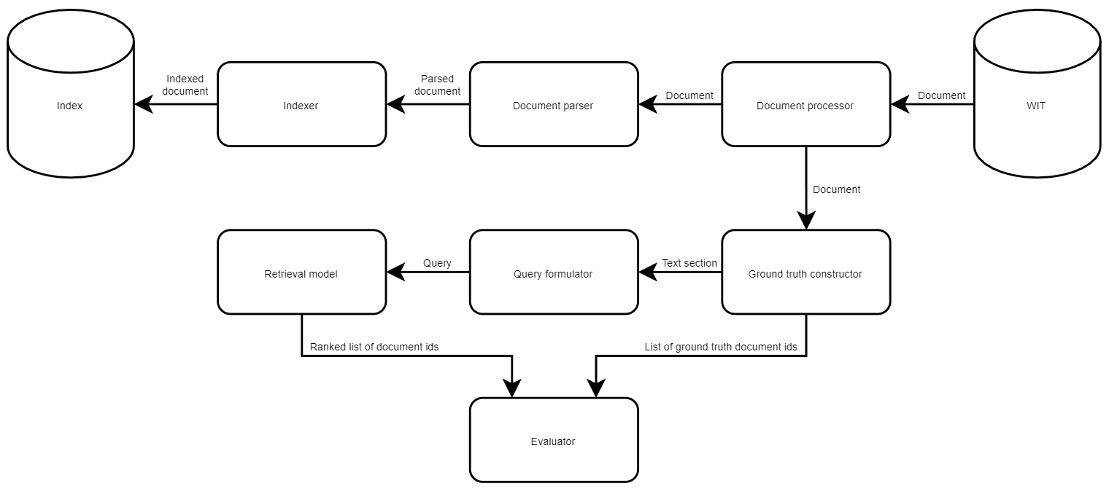
Methodology

Slide 4


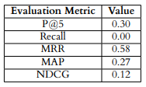
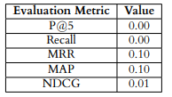
Experiments
A stairway, staircase, stairwell, flight of stairs, or simply stairs, is a construction designed to bridge a large vertical distance by dividing it into smaller vertical distances, called steps. Stairs may be straight, round, or may consist of two or more straight pieces connected at angles. Special types of stairs include escalators and ladders. Some alternatives to stairs are elevators, stairlifts and inclined moving walkways.
stair, straight, stairlift, vertic, distanc, stairwel, escal, stairwai, inclin, ladder

Slide 5
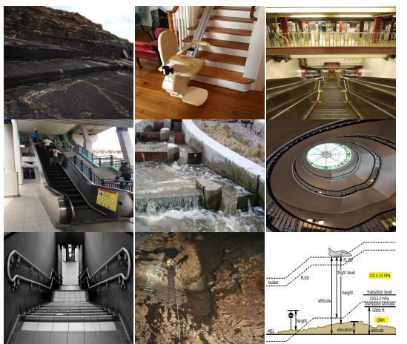
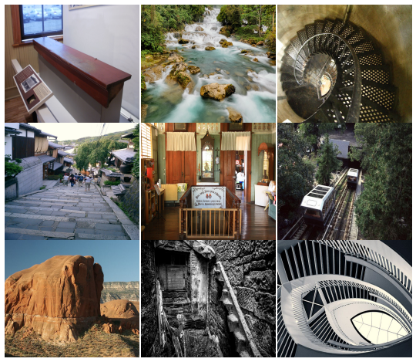
Experiments

Slide 6
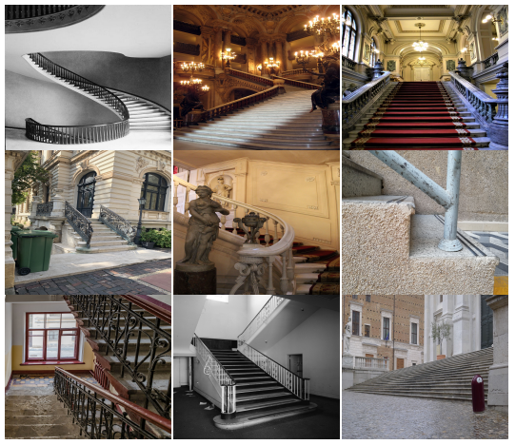
Experiments

Slide 7
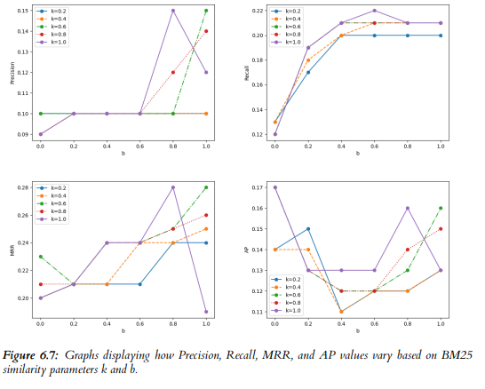

Experiments
BM25 parameters
k – document term frequency scaling
b – term weights’ scaling by document length
Percentage of Query Words

Slide 8
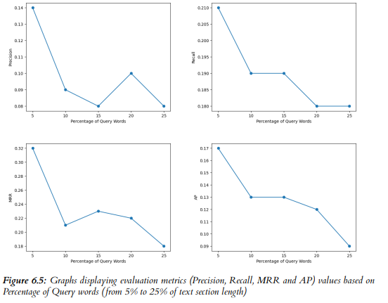
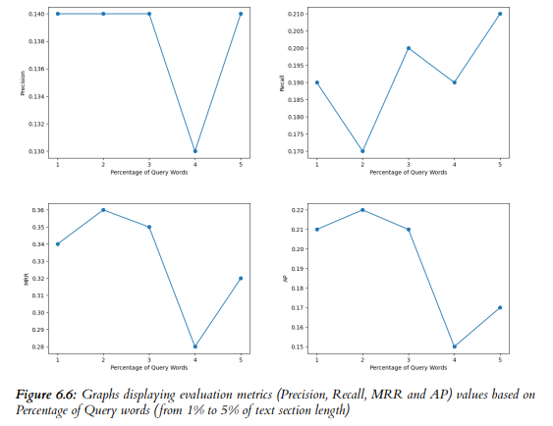
Experiments

Slide 9
Summary
Research questions
Given some context, how effectively can we extract the information need from that context?
Given the information need, how effectively can we retrieve the content of different modalities?
Future work
Multiple language implementation
Query window size
GUI
Multimodal embedding space

