Slide 1
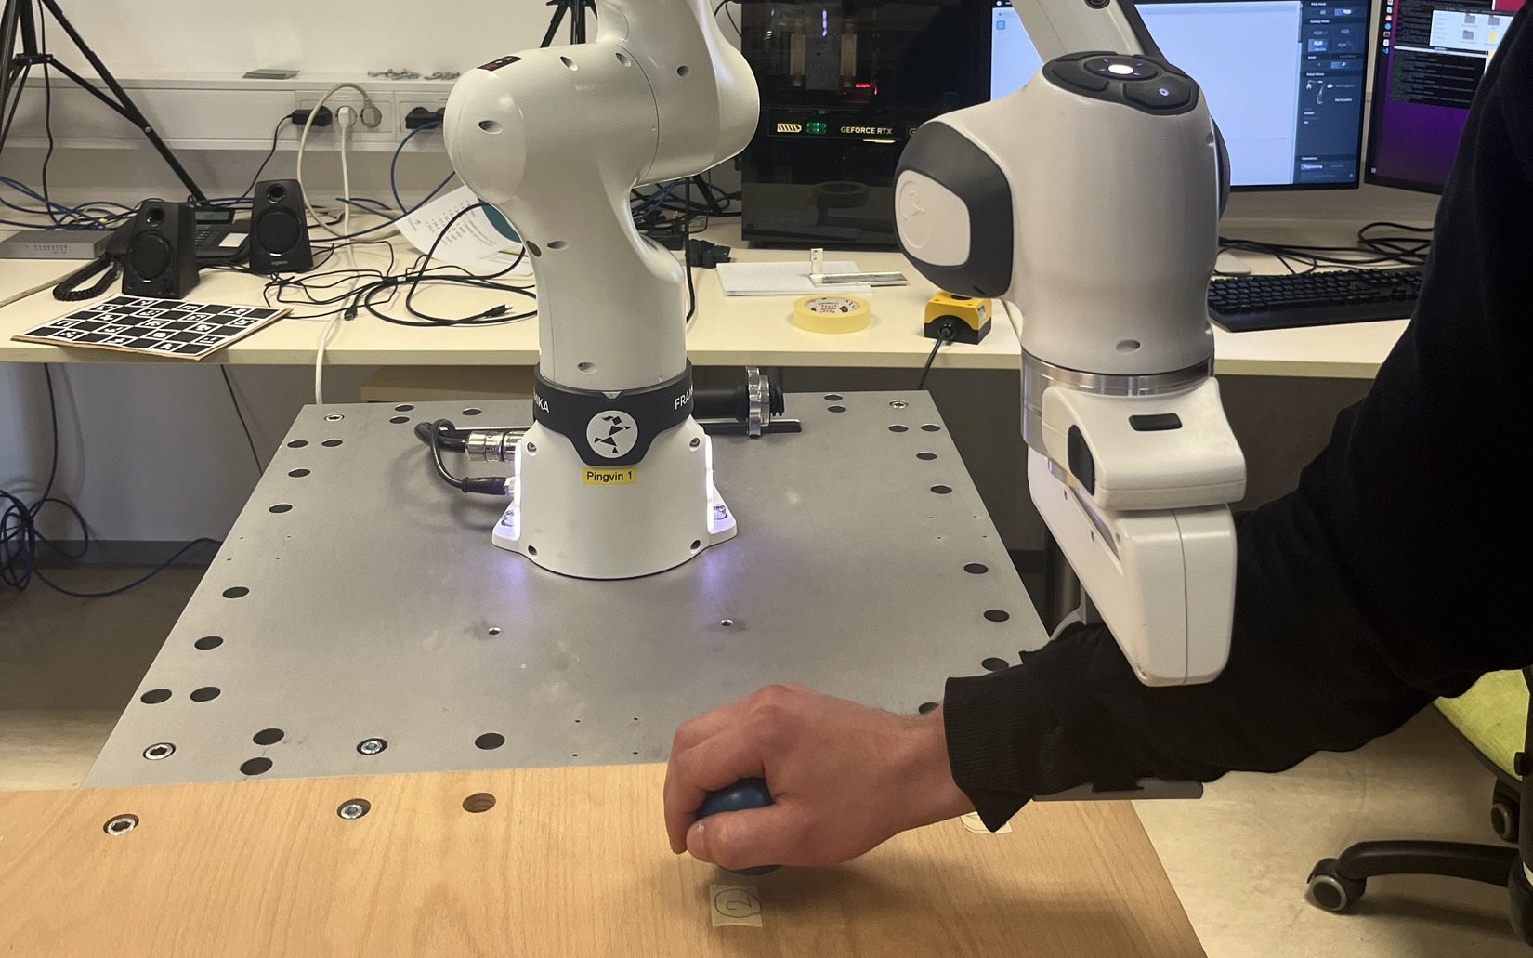
Rehabilitation Robot with Adaptive CMP Assistance
Domen Brcar, Jakob Čehovin
Robot-Human Interaction
DMP trajectories + CMP torque assistance + adjustable user support
1/8
Notes:
This presentation summarizes our laboratory rehabilitation robot project for Robot-Human Interaction.
The main idea is to combine learned movement trajectories with adaptive torque assistance.
The system is demonstrated on an upper-limb exercise with a Franka Emika Panda robot.

Slide 2
Motivation and Goal
Upper-limb rehabilitation needs repeatable, safe and adjustable assistance.
Repeatable movement
Safe interaction
Adjustable assistance
The robot can reproduce the same guided exercise many times.
Controlled, slow motions support physical human-robot contact.
The amount of help can be changed according to user ability.
Goal: develop a laboratory exercise using Franka Emika Panda.
Robot should assist the user, not fully replace active movement.
2/8
Notes:
The motivation is the need for controlled and repeatable upper-limb rehabilitation exercises.
The robot should provide support, but the user should still remain actively involved in the motion.
Our goal was to build a laboratory system where the assistance level can be adjusted.

Slide 3
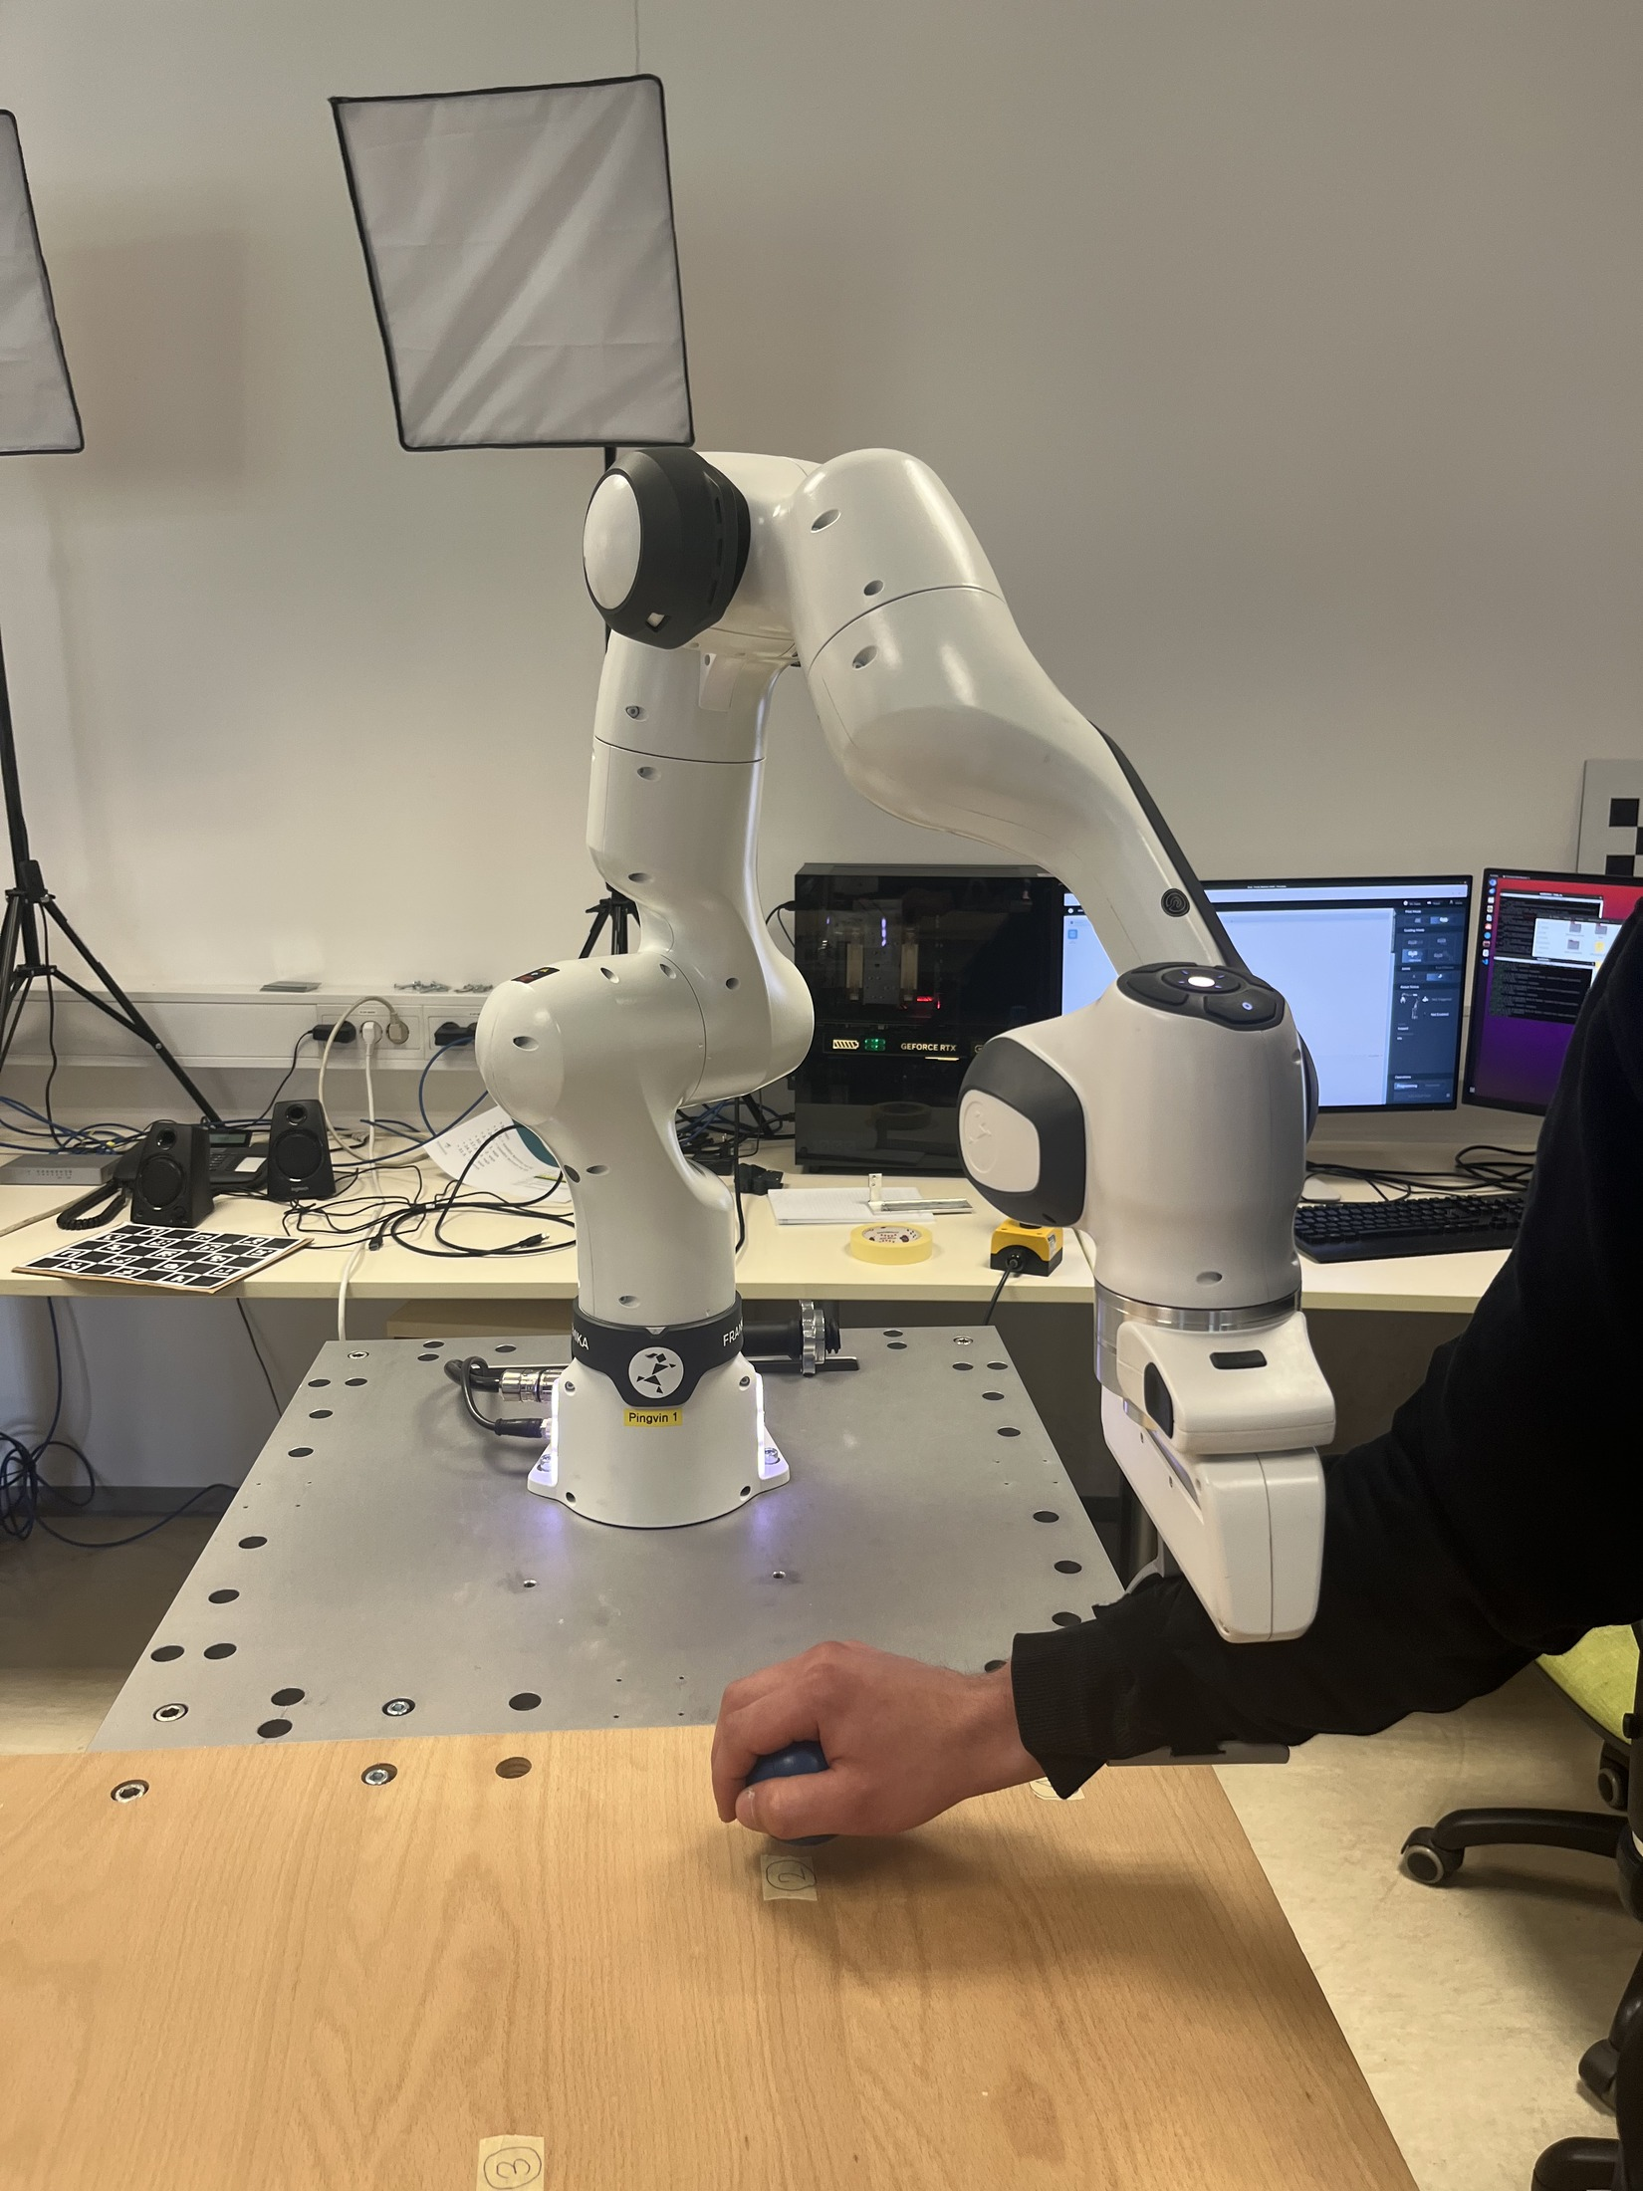
System Overview
Laboratory setup for guided reaching movements
Franka Emika Panda
7-DOF collaborative robot
3D printed hand support
Mechanical interface between hand and robot
Ball reaching exercise
The user moves the ball from the start point to three target points.
Exercise layout
T1
Start
T2
Robot-assisted ball reaching task
T3
3/8
Notes:
The system is built around the Franka Emika Panda robot.
The user interacts with the robot through a 3D printed hand support and performs a reaching task above the working surface.
The exercise uses one start point and three target points, represented by the ball positions.

Slide 4
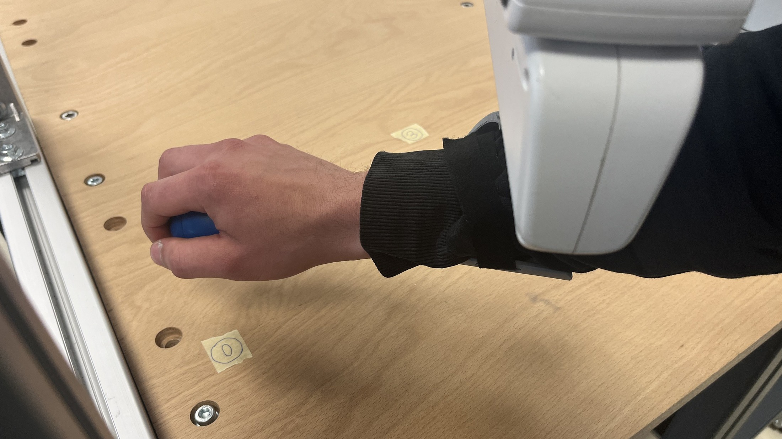
Mechanical Hand Support
Designed in Fusion 360
Modeled as a controlled hand-robot interface.
3D printed
Fast fabrication for a task-specific support.
Adapted to the hand
Supports stable, comfortable contact.
Guided arm movement
Enables controlled motion above the surface.
Hand support during guided motion
4/8
Notes:
The mechanical hand support is important because it defines how the user physically interacts with the robot.
It was designed in Fusion 360 and manufactured with 3D printing.
The goal is to provide stable, repeatable and comfortable contact while the robot guides the arm.

Slide 5
Methodology
From demonstration to adaptive assistance
Manual demonstration
DMP learning
DMP reproduction
CMP learning
Assistance scaling
Robot-assisted exercise
DMP
CMP
Ability S
Stores the demonstrated joint trajectory.
Stores the learned torque assistance profile.
0 = more assistance 100 = less assistance
Assistance scaling:
α = (100 − S) / 100
5/8
Notes:
The workflow starts with a manual demonstration of the movement.
DMP learning stores the desired joint trajectory, while CMP learning stores the torque assistance profile.
During execution, the CMP assistance is scaled using the ability parameter S from 0 to 100.

Slide 6
Development Path
A gradual path toward the final rehabilitation exercise
1
Additional weight tests
2
Direct hand interaction
3
Three target exercise
load
Observe load influence on duration, speed and torque.
Introduce physical user-robot cooperation.
Final ball-reaching rehabilitation task.
6/8
Notes:
The development was gradual.
We first used a simpler additional-weight task to observe how load affects motion and torque.
Then we moved to direct hand interaction, and finally to the more meaningful three-target ball exercise.

Slide 7
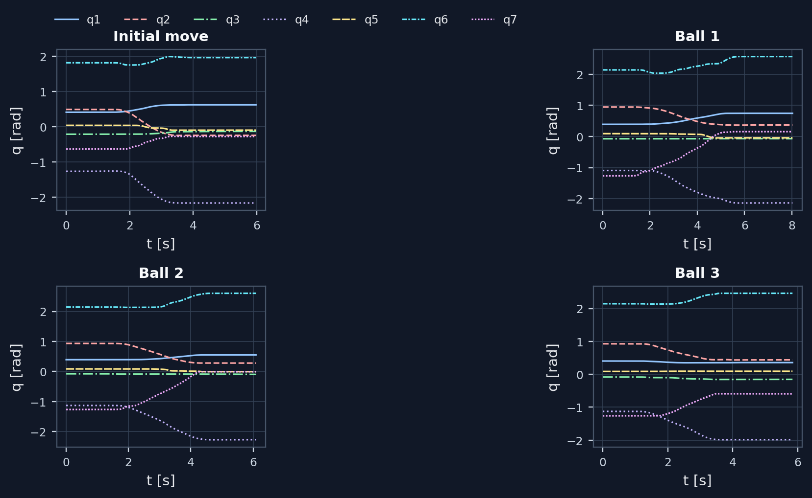
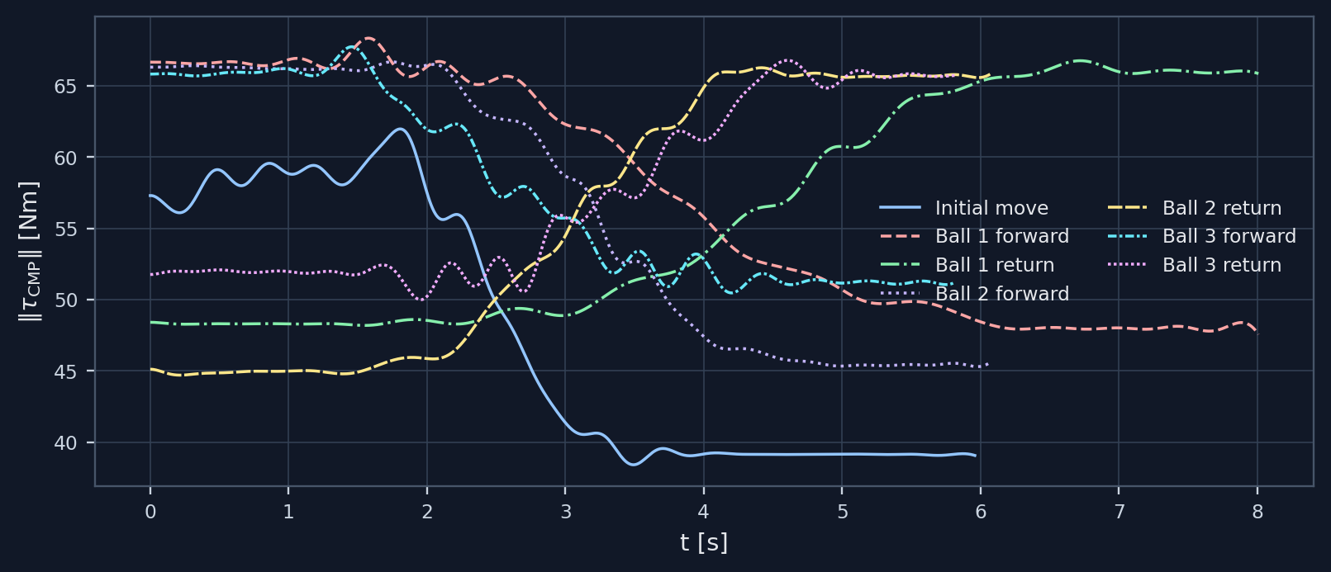
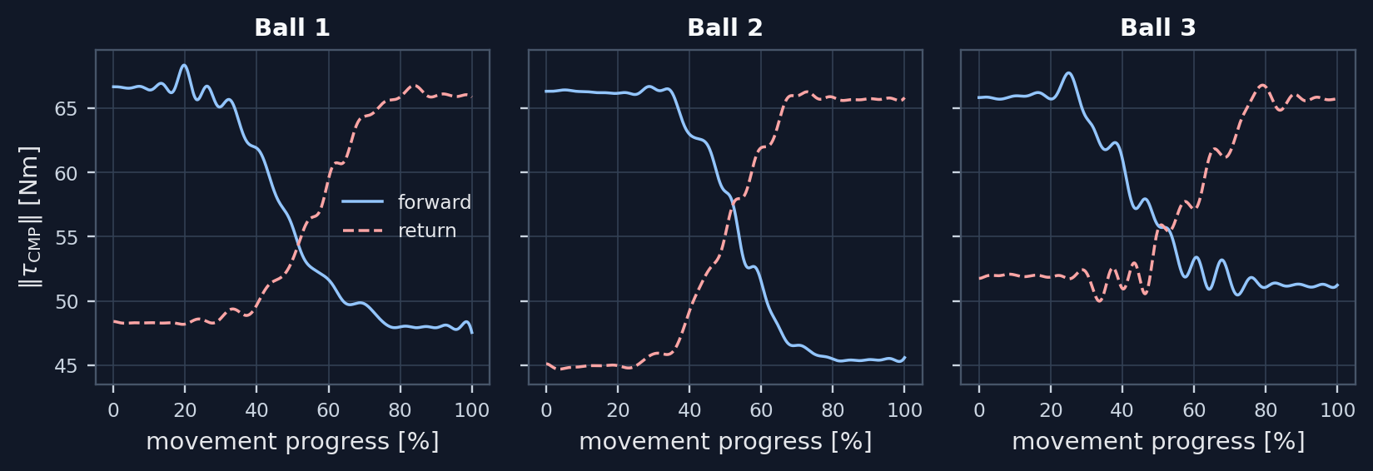
Results
Recorded trajectories and learned CMP assistance profiles
CMP torque profile norms
Joint trajectories
Forward / return CMP comparison
Smooth recorded trajectories
Separate CMP profiles
Adjustable assistance
7/8
Notes:
The recorded joint trajectories are smooth and suitable for DMP reproduction.
CMP profiles provide learned torque assistance that can be scaled during execution.
Forward and return movements are treated separately because their assistance profiles are not identical.

Slide 8
Conclusion and Future Work
Complete laboratory setup for robot-assisted upper-limb rehabilitation
Future work
More repetitions
Different assistance levels
User evaluation
Improved ergonomic support
DMP trajectories
CMP assistance
repeatable motion
torque support
Ability parameter
Hand support
0 to 100 scaling
stable contact
Demo
DMP
CMP
8/8
Notes:
The final system combines DMP movement reproduction, CMP torque assistance, an adjustable assistance parameter and a 3D printed hand support.
Together these elements form a complete laboratory demonstration for robot-assisted upper-limb rehabilitation.
Future work should include more repetitions, different assistance settings, user evaluation and further ergonomic improvements.

