Slide 1
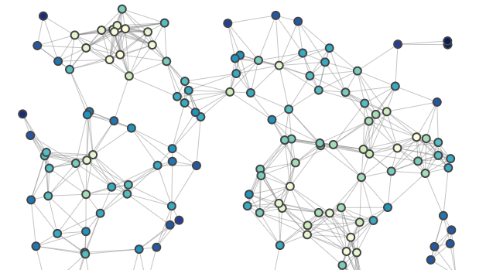
Find competitors
Similar websites
Here you enter the website name
Here you enter number of iterations
Get results
Build graphs
AlternativeTo
Download CSV
Delete

