Slide 1
ES6 is Nigh
A Presentation on the future of JavaScript
http://es6isnigh.com

Slide 2
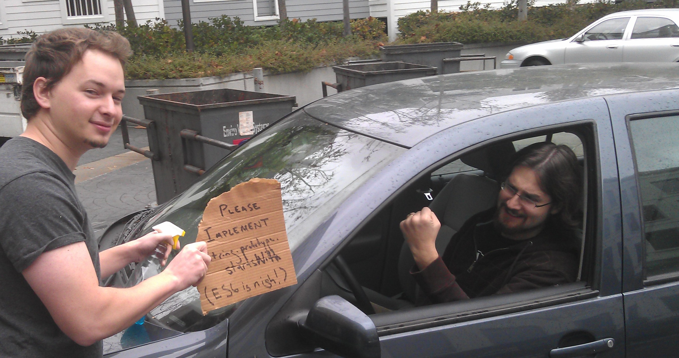

Slide 3

Domenic Denicola
https://github.com/domenic
https://npmjs.org/~domenic
@esdiscuss

Slide 4
History
ES1 → ES3: try/catch, do/while, switch, regular expressions, …
ES3 → ES5: accessors, strict mode (static scoping), object reflection, JSON, array extras, …
Now, ES5 → ES6
Notes:
Mention “comfort” (do/while, switch) vs. “magic” (try/catch, regular expressions).

Slide 5
Why?
“Stagnation on the web is a social ill.”
—Brendan Eich
http://news.ycombinator.com/item?id=4634735
Notes:
Intro with Michael’s concerns
Brendan’s argument:
Stagnation costs: IE6, Android 2.x. Developers get unhappy. CoffeeScript!
Some parties might use such a crisis, plus their large browser marketshare, to force proprietary solutions: Silverlight (“WPF Everywhere”), Dart, NaCl. People will start using them because they can move faster than this language from 1998.
This is not acceptable. What we’ve built is beautiful, and starting over means re-learning all those lessons. Too much code and developer brainpower gets thrown away.
Skate where the puck will be.

Slide 6
Why?
Say what you mean!
Notes:
Classes, modules, callbacks, Object.keys(array).forEach(function () { }), arg = arg || default

Slide 7
One JavaScript
All ES5 code is ES6 code and has the same meaning
No modes
No backwards incompatibility
No “fixes”
ES6 is purely additive

Slide 8


Slide 9

Parameter defaults
Arrow functions
Classes
Modules

Slide 10


Slide 11

Better object literals
Spread
Const
Sets and maps
Rest
Block scoping
Destructuring
Iteration

Slide 12


Slide 13

Proper tail calls
Template strings
Binary data
Unicode
Symbols
Weak sets and maps
Generators
Proxies

Slide 14
Comfort
Better object literals
Rest and spread
Block scoping
Const
Destructuring
Iteration

Slide 15
Better Object Literals
var empireJS = { attendees: "many", preParty() { console.log(this.attendees + " attendees are partying!"); } }; var conferences = { empireJS, cascadiaJS };
Notes:
FAST

Slide 16
Rest and Spread
function sprintf(format, ...params) { assert(Array.isArray(params)); } Math.max(...array); Math.max(0, ...array, 5, ...array2); new Date(...dateFields); array.push(...array2);
Notes:
FAST

Slide 17
More Spread
var prequels = ["tpm", "aotc", "rots"]; var movies = [...prequels, "anh", "tesb", "rotj"]; var nodeList = document.querySelectorAll("div"); [...nodeList].forEach(function (node) { // finally! });

Slide 18
Block Scoping
let log = console.log.bind(console); function f(x) { if (Math.random() > 0.5) { let log = Math.log; x = log(x); } log("result: " + x); }

Slide 19
Block Scoping
let log = console.log; function f(x) { // 5 refactorings later if (Math.random() > 0.5) { x = log(x); // error! used a `let` before declaration. let log = Math.log; } log("result: " + x); } f(Math.E); // but, the error doesn’t occur until here: runtime, not static.

Slide 20
Block Scoping
function f(x) { // 10 refactorings later let log = console.log; let log = Math.log; // `SyntaxError`! No double `let`s. if (Math.random() > 0.5) { x = log(x); } log("result: " + x); }

Slide 21
Block Scoping
for (let i = 0; i < a.length; ++i) { els[i].onclick = function () { return a[i]; }; } assert(typeof i === "undefined"); assert(els[0].onclick() === a[0]);

Slide 22
Block Scoping
if (Math.random() > 0.5) { function go() { console.log("gone!"); } el.onmousedown = go; el.ontouchstart = go; } assert(typeof go === "undefined");

Slide 23
Const
const PI = Math.PI; PI = 22/7; // error! cannot reassign const E; // SyntaxError! need initializer // plus all the yummy `let` semantics

Slide 24
Destructuring
[a, b] = [b, a]; let [x, y] = f(); let re = /([a-z]+)(\s)(.*)([^a-z])/; let [, hello, space, world, bang] = re.exec("hello world!"); let [first, ...allButFirst] = document.querySelectorAll("p");
Notes:
FAST

Slide 25
Destructuring
let { tagName, textContent } = el; let { viewModel, bindings } = doDataBinding(); let { firstElementChild: first, lastElementChild: last } = el; let { firstElementChild: { tagName: firstTag } } = document.body; let { children: [first, ...others] } = document.body;
Notes:
FAST

Slide 26
Destructuring
function runTests({ reporter, ui }, [firstFile, ...others]) { // ... } try { runTests({ reporter: "spec", ui: "tdd" }, ["test1", "test2"]); } catch ({ message }) { console.error(message); }
Notes:
FAST

Slide 27
Iteration
for (let x of ["one", "two", "three"]) { } for (let value of set) { } for (let [key, value] of map) { } // customizing iteration requires some magic
Notes:
Iterate over data, not properties.

Slide 28
Magic
Template strings
Symbols
Generators
Proxies

Slide 29
Template Strings
let x = 1; let y = 2; let s = `${x} + ${y} = ${x + y}`; let multiline = `<html> <body> Hello world! </body> </html>`;

Slide 30
Template Strings
let url = "http://example.com/"; let query = "Hello & Goodbye"; let s = safehtml` <a href="${url}?q=${query}“ onclick="alert('${query}')"> ${query} </a>`; assert(s === `<a href="http://example.com/?q=Hello%20%26%20Goodbye" onclick="alert('Hello&#32;\x26&#32;Goodbye')"> Hello &amp; Goodbye </a>`);

Slide 31
Symbols
function S3Bucket(apiKey, apiSecret) { this._apiKey = apiKey; this._apiSecret = apiSecret; } S3Bucket.prototype.request = function (url) { let signature = calculateSignature(this._apiKey, this._apiSecret); this._sendRequest(url, signature); }; S3Bucket.prototype._sendRequest = function () { };

Slide 32
Symbols
function S3Bucket(apiKey, apiSecret) { this.request = function (url) { let signature = calculateSignature(apiKey, apiSecret); sendRequest(url, signature); }; function sendRequest() { } }

Slide 33
Symbols
let apiKey = new Symbol(), apiSecret = new Symbol(), sendRequest = new Symbol(); function S3Bucket(theApiKey, theApiSecret) { this[apiKey] = theApiKey; this[apiSecret] = theApiSecret; } S3Bucket.prototype.request = function (url) { let signature = calculateSignature(this[apiKey], this[apiSecret]); this[sendRequest](url, signature); }; S3Bucket.prototype[sendRequest] = function () { };

Slide 34
Symbols
private @apiKey, @apiSecret, @sendRequest; function S3Bucket(theApiKey, theApiSecret) { this.@apiKey = theApiKey; this.@apiSecret = theApiSecret; } S3Bucket.prototype.request = function (url) { let signature = calculateSignature(this.@apiKey, this.@apiSecret); this.@sendRequest(url, signature); }; S3Bucket.prototype.@sendRequest = function () { };

Slide 35
Symbols Again
let checksum = new Symbol(); function calculateChecksum(httpResponse) { if (!(checksum in httpResponse)) { httpResponse[checksum] = calculateChecksum(httpResponse); } return httpResponse[checksum]; }

Slide 36
Back to Iterators
import { iterator } from "@iter"; // a symbol in the standard library let obj = {}; obj[iterator] = function () { return { next() { return 5; } }; }; for (n of obj) { assert(n === 5); }

Slide 37
Generators
function* naturalNumbers() { let current = 0; while (true) { yield current++; } } let seq = naturalNumbers(); assert(seq.next() === 0); assert(seq.next() === 1); assert(seq.next() === 2);

Slide 38
Generators Return Iterators
// Generator functions return iterators for (let n of naturalNumbers()) { console.log(n); } // Use them to create your own iterators obj[iterator] = function* () { yield 5; };

Slide 39
Generators Are Shallow Coroutines
function* demo() { console.log("a"); yield; console.log("b"); yield; console.log("c"); } let seq = demo(); // “paused,” with no code executed seq.next(); // execution resumes; logs "a"; then pause seq.next(); // execution resumes; logs "b"; then pause seq.next(); // execution resumes; logs "c"; enters “done” state seq.next(); // throws `StopIteration`

Slide 40
Shallow Coroutines for Async
spawn(function* () { try { let post = yield getJSON("/post/1.json"); let comments = yield getJSON(post.commentURL); yield fadeInCommentUI(); comments.innerHTML = template(comments); } catch (e) { comments.innerText = e.message; } });
http://taskjs.org/

Slide 41
Proxies
let handler = { getOwnPropertyDescriptor(target, name) { }, getOwnPropertyNames(target) { }, getPrototypeOf(target) { }, defineProperty(target, name, desc) { }, deleteProperty(target, name) { }, freeze(target) { }, seal(target) { }, preventExtensions(target) { }, isFrozen(target) { }, isSealed(target) { }, isExtensible(target) { }, ⋮

Slide 42
Proxies
⋮ has(target, name) { }, hasOwn(target, name) { }, get(target, name, receiver) { }, set(target, name, val, receiver) { }, enumerate*(target) { }, keys(target) { }, apply(target, thisArg, args) { }, construct(target, args) { } }); let theTarget = {}; let virtualObject = new Proxy(theTarget, handler);

Slide 43
The Future Now
The future of JS: it’s important!
Follow @esdiscuss.
Stay tuned for more on es6isnigh.com.
Be adventurous; use a transpiler!
Skate where the puck will be.

