Slide 1
ES6 is Nigh
A Presentation on the future of JavaScript
http://es6isnigh.com

Slide 2
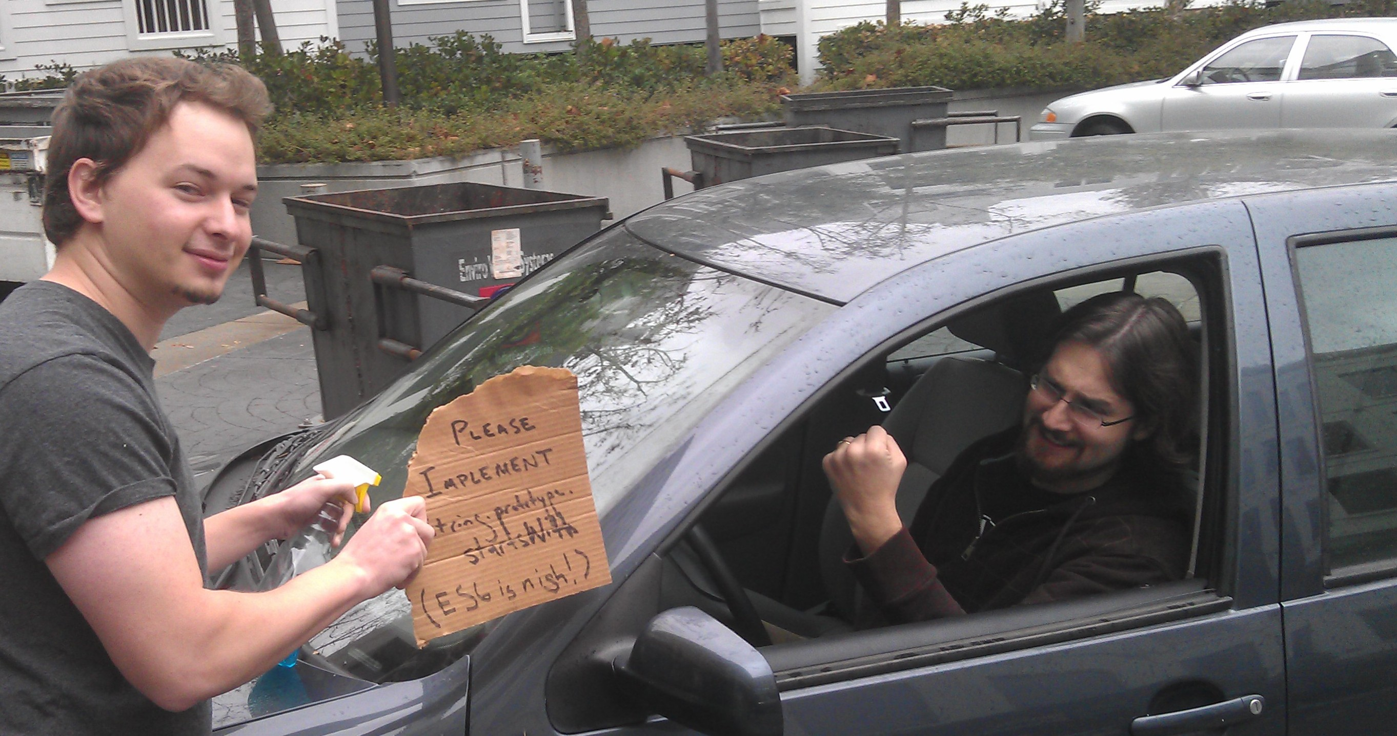

Slide 3

Domenic Denicola
https://github.com/domenic
https://npmjs.org/~domenic
@esdiscuss

Slide 4
History
ES1 → ES3: try/catch, do/while, switch, regular expressions, …
ES3 → ES5: accessors, strict mode (static scoping), object reflection, JSON, array extras, …
Now, ES5 → ES6

Slide 5
Why?
“Stagnation on the web is a social ill.”
—Brendan Eich
http://news.ycombinator.com/item?id=4634735
Notes:
Intro with Michael’s concerns
Brendan’s argument:
Stagnation costs: IE6, Android 2.x. Developers get unhappy. CoffeeScript!
Some parties might use such a crisis, plus their large browser marketshare, to force proprietary solutions: Silverlight (“WPF Everywhere”), Dart, NaCl. People will start using them because they can move faster than this language from 1998.
This is not acceptable. What we’ve built is beautiful, and starting over means re-learning all those lessons. Too much code and developer brainpower gets thrown away.
Skate where the puck will be.

Slide 6
Why?
Say what you mean!
Notes:
Classes, modules, callbacks, Object.keys(array).forEach(function () { }), arg = arg || default

Slide 7


























How?

Slide 8
One JavaScript
All ES5 code is ES6 code and has the same meaning
No modes
No backwards incompatibility
No “fixes”
ES6 is purely additive

Slide 9


Slide 10

Better object literals
Spread
Const
Sets and maps
Rest
Block scoping
Destructuring
Iteration

Slide 11


Slide 12
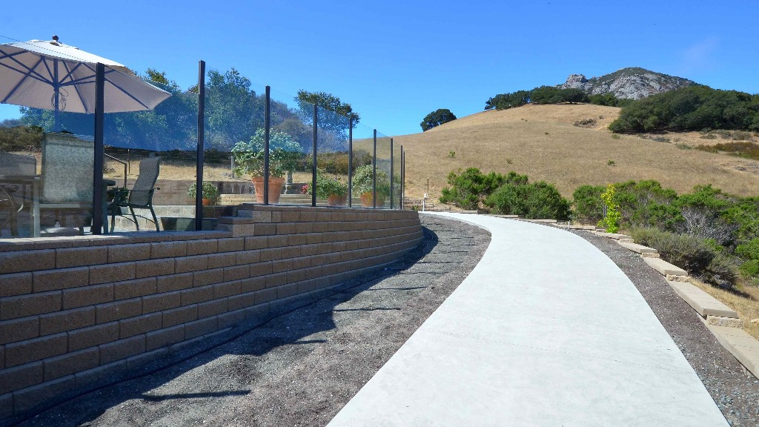
Parameter defaults
Arrow functions
Classes
Modules

Slide 13


Slide 14

Tail calls
Template strings
Binary data
Unicode
Symbols
Weak maps and sets
Generators
Proxies

Slide 15
Comfort
Better object literals
Rest and spread
Block scoping
Const
Destructuring
Sets and maps
Iteration

Slide 16
Better Object Literals
var empireJS = { attendees: "many", preParty() { console.log(this.attendees + " attendees are partying!"); } }; var conferences = { empireJS, cascadiaJS };

Slide 17
Rest and Spread
function sprintf(format, ...params) { assert(Array.isArray(params)); } Math.max(...array); Math.max(0, ...array, 5, ...array2); new Date(...dateFields); array.push(...array2);

Slide 18
More Spread
var prequels = ["tpm", "aotc", "rots"]; var movies = [...prequels, "anh", "tesb", "rotj"]; var nodeList = document.querySelectorAll("div"); [...nodeList].forEach(function (node) { // finally! });

Slide 19
Block Scoping
let log = console.log.bind(console); function f(x) { if (Math.random() > 0.5) { let log = Math.log; x = log(x); } log("result: " + x); }

Slide 20
Block Scoping
let log = console.log; function f(x) { // 5 refactorings later if (Math.random() > 0.5) { x = log(x); // error! used a `let` before declaration. let log = Math.log; } log("result: " + x); } f(Math.E); // but, the error doesn’t occur until here: runtime, not static.

Slide 21
Block Scoping
function f(x) { // 10 refactorings later let log = console.log; let log = Math.log; // `SyntaxError`! No double `let`s. if (Math.random() > 0.5) { x = log(x); } log("result: " + x); }

Slide 22
Block Scoping
for (let i = 0; i < a.length; ++i) { els[i].onclick = function () { return a[i]; }; } assert(typeof i === "undefined"); assert(els[0].onclick() === a[0]);

Slide 23
Block Scoping
if (Math.random() > 0.5) { function go() { console.log("gone!"); } el.onmousedown = go; el.ontouchstart = go; } assert(typeof go === "undefined");

Slide 24
Const
const PI = Math.PI; PI = 22/7; // error! cannot reassign const E; // SyntaxError! need initializer // plus all the yummy `let` semantics

Slide 25
Destructuring
[a, b] = [b, a]; let [x, y] = f(); let re = /([a-z]+)(\s)(.*)([^a-z])/; let [, hello, space, world, bang] = re.exec("hello world!"); let [first, ...allButFirst] = document.querySelectorAll("p");

Slide 26
Destructuring
let { tagName, textContent } = el; let { viewModel, bindings } = doDataBinding(); let { firstElementChild: first, lastElementChild: last } = el; let { firstElementChild: { tagName: firstTag } } = document.body; let { children: [first, ...others] } = document.body;

Slide 27
Destructuring
function runTests({ reporter, ui }, [firstFile, ...others]) { // ... } try { runTests({ reporter: "spec", ui: "tdd" }, ["test1", "test2"]); } catch ({ message }) { console.error(message); }

Slide 28
Sets and Maps
let s = new Set([...document.body.children]); // `s.has`, `s.add`, `s.delete` — too obvious // let's do something cool instead: function unique(array) { return [...new Set(array)]; // O(n)! } let m = new Map(); m.add(model, new ViewModel(model)); // objects as keys! // otherwise obvious — `m.has`, `m.get`, `m.add`, `m.delete`

Slide 29
Iteration
for (let x of ["one", "two", "three"]) { } for (let value of set) { } for (let [key, value] of map) { } // customizing iteration requires some magic
Notes:
Iterate over data, not properties.

Slide 30
Cowpaths
Parameter defaults
Arrow functions
Classes
Modules

Slide 31
Parameter Defaults
function fill(mug, liquid = "coffee") { // … } function pour(person, mug1 = person.mug, mug2 = new Mug()) { // … } pour(domenic, undefined, you.mug);

Slide 32
Arrow Functions
array.map(x => x * x); array.filter(x => x === this.target); [...$("p")].forEach((el, i) => { el.textContent = "The #" + i + " <p>"; });

Slide 33
Classes
class EventEmitter { constructor() { this.domain = domain.active; } emit(type, ...args) { /* ... */ } // ... } class Stream extends EventEmitter { pipe(dest, options) { /* ... */ } }

Slide 34
Modules
import http from "http"; import { read, write } from "fs"; import { draw: drawShape } from "graphics"; import { draw: drawGun } from "cowboy"; export sprintf; export function $(selector) { return [...document.querySelectorAll(selector)]; }; // what about `module.exports = aFunction`?

Slide 35
Magic
Proper tail calls
Template strings
Binary data
Unicode
Symbols
Weak sets and maps
Generators
Proxies

Slide 36
Proper Tail Calls
"use strict"; // for its effect on arguments/caller. function sumTo(n, accumulator = 0) { return n === 0 ? accumulator : sumTo(n - 1, accumulator); } sumTo(123456); // no “too much recursion error”; no stack usage at all in fact!

Slide 37
Template Strings
let x = 1; let y = 2; let s = `${x} + ${y} = ${x + y}`; let multiline = `<html> <body> Hello world! </body> </html>`;

Slide 38
Template Strings
let url = "http://example.com/"; let query = "Hello & Goodbye"; let s = safehtml` <a href="${url}?q=${query}“ onclick="alert('${query}')"> ${query} </a>`; assert(s === `<a href="http://example.com/?q=Hello%20%26%20Goodbye" onclick="alert('Hello&#32;\x26&#32;Goodbye')"> Hello &amp; Goodbye </a>`);

Slide 39
Binary Data
const Point2D = new StructType({ x: uint32, y: uint32 }); const Color = new StructType({ r: uint8, g: uint8, b: uint8 }); const Pixel = new StructType({ point: Point2D, color: Color }); const Triangle = new ArrayType(Pixel, 3); let t = new Triangle([ { point: { x: 0, y: 0 }, color: { r: 255, g: 255, b: 255 } }, { point: { x: 5, y: 5 }, color: { r: 128, g: 0, b: 0 } }, { point: { x: 10, y: 0 }, color: { r: 0, g: 0, b: 128 } } ]);

Slide 40
Unicode
// Emoji take more than two bytes: one code *point*, two code *units*. let x = "😁"; let y = "\uD83D\uDE01"; // ES5 let z = "\u{1F638}"; // ES6 assert(x === y && y === z); assert(x.charCodeAt(0) === 0xD83D); // ES5 assert(x.charCodeAt(1) === 0xDE01); // ES5 assert(x.codePointAt(0) === 0x1F638); // ES6
https://gist.github.com/1850768

Slide 41
Unicode
// iterator goes over code *points*, yay. for (let c of "😁") { assert(c === "😁"); } assert("😁".length === 2); // can't break the web, still code units :-/ // The "u" flag on regexes adds lots of Unicode fixes, e.g.: assert(/^.$/.test("😁") === false); assert(/^.$/u.test("😁") === true);

Slide 42
Symbols
function S3Bucket(apiKey, apiSecret) { this._apiKey = apiKey; this._apiSecret = apiSecret; } S3Bucket.prototype.request = function (url) { let signature = calculateSignature(this._apiKey, this._apiSecret); this._sendRequest(url, signature); }; S3Bucket.prototype._sendRequest = function () { };

Slide 43
Symbols
function S3Bucket(apiKey, apiSecret) { this.request = function (url) { let signature = calculateSignature(apiKey, apiSecret); sendRequest(url, signature); }; function sendRequest() { } }

Slide 44
Symbols
let apiKey = new Symbol(), apiSecret = new Symbol(), sendRequest = new Symbol(); function S3Bucket(theApiKey, theApiSecret) { this[apiKey] = theApiKey; this[apiSecret] = theApiSecret; } S3Bucket.prototype.request = function (url) { let signature = calculateSignature(this[apiKey], this[apiSecret]); this[sendRequest](url, signature); }; S3Bucket.prototype[sendRequest] = function () { };

Slide 45
Symbols
private @apiKey, @apiSecret, @sendRequest; function S3Bucket(theApiKey, theApiSecret) { this.@apiKey = theApiKey; this.@apiSecret = theApiSecret; } S3Bucket.prototype.request = function (url) { let signature = calculateSignature(this.@apiKey, this.@apiSecret); this.@sendRequest(url, signature); }; S3Bucket.prototype.@sendRequest = function () { };

Slide 46
Weak Sets
let trustedObjects = new WeakSet(); function createTrustedObject() { let trusted = { /* ... */ }; trustedObjects.add(trusted); return trusted; } function isTrusted(obj) { return trustedObjects.has(obj); }

Slide 47
Weak Maps
let cache = new WeakMap();
function calculateChecksum(httpResponse) { if (cache.has(httpResponse)) { return cache.get(httpResponse); } let checksum = calculateChecksum(httpResponse); cache.set(httpResponse, checksum); return checksum; }

Slide 48
Symbols Again
let checksum = new Symbol(); function calculateChecksum(httpResponse) { if (!(checksum in httpResponse)) { httpResponse[checksum] = calculateChecksum(httpResponse); } return httpResponse[checksum]; }

Slide 49
Back to Iterators
import { iterator } from "@iter"; // a symbol in the standard library let obj = {}; obj[iterator] = function () { return { next() { return 5; } }; }; for (n of obj) { assert(n === 5); }

Slide 50
Generators
function* naturalNumbers() { let current = 0; while (true) { yield current++; } } let seq = naturalNumbers(); assert(seq.next() === 0); assert(seq.next() === 1); assert(seq.next() === 2);

Slide 51
Generators Return Iterators
// Generator functions return iterators for (let n of naturalNumbers()) { console.log(n); } // Use them to create your own iterators obj[iterator] = function* () { yield 5; };

Slide 52
Generators Are Shallow Coroutines
function* demo() { console.log("a"); yield; console.log("b"); yield; console.log("c"); } let seq = demo(); // “paused,” with no code executed seq.next(); // execution resumes; logs "a"; then pause seq.next(); // execution resumes; logs "b"; then pause seq.next(); // execution resumes; logs "c"; enters “done” state seq.next(); // throws `StopIteration`

Slide 53
Shallow Coroutines for Async
spawn(function* () { try { let post = yield getJSON("/post/1.json"); let comments = yield getJSON(post.commentURL); yield fadeInCommentUI(); comments.innerHTML = template(comments); } catch (e) { comments.innerText = e.message; } });
http://taskjs.org/

Slide 54
Proxies
let handler = { getOwnPropertyDescriptor(target, name) { }, getOwnPropertyNames(target) { }, getPrototypeOf(target) { }, defineProperty(target, name, desc) { }, deleteProperty(target, name) { }, freeze(target) { }, seal(target) { }, preventExtensions(target) { }, isFrozen(target) { }, isSealed(target) { }, isExtensible(target) { }, ⋮

Slide 55
Proxies
⋮ has(target, name) { }, hasOwn(target, name) { }, get(target, name, receiver) { }, set(target, name, val, receiver) { }, enumerate*(target) { }, keys(target) { }, apply(target, thisArg, args) { }, construct(target, args) { } }); let theTarget = {}; let virtualObject = new Proxy(theTarget, handler);

Slide 56
The Future Now
The future of JS: it’s important!
Follow @esdiscuss.
Stay tuned for more on es6isnigh.com.
Be adventurous; use a transpiler!
Skate where the puck will be.

