Slide 1
understanding the platform

Slide 2
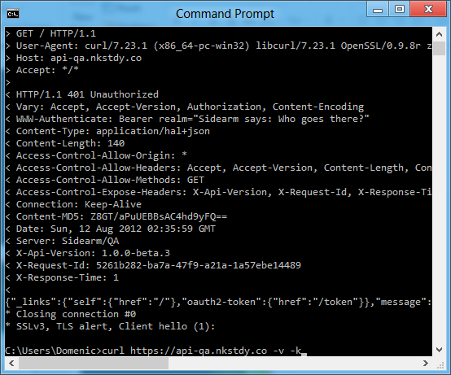
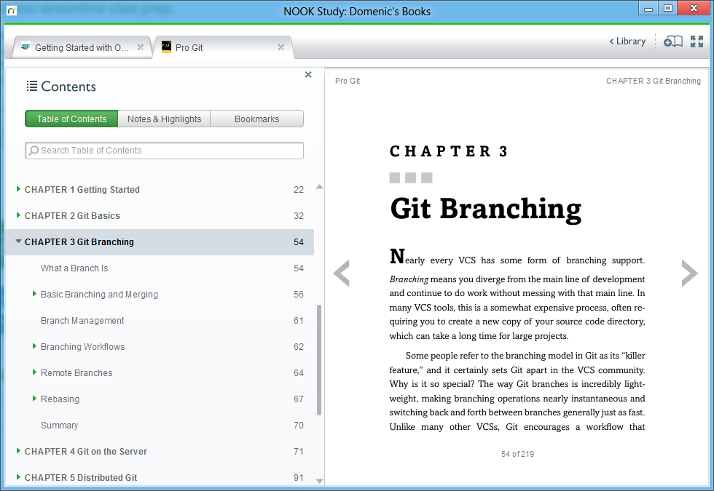
story time

Slide 3
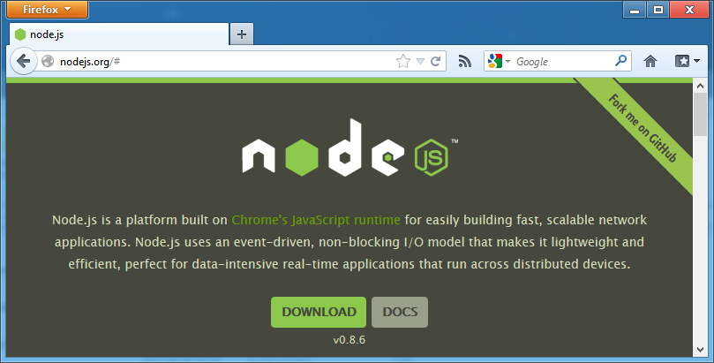
how to node

Slide 4
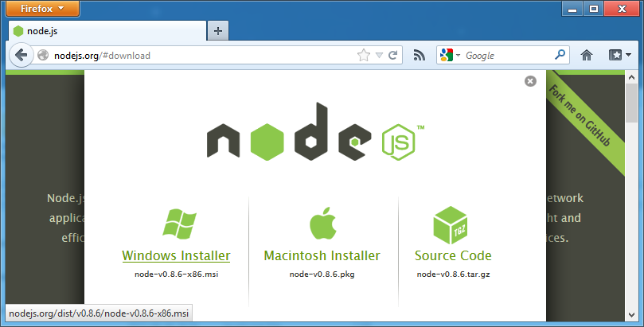
how to node

Slide 5
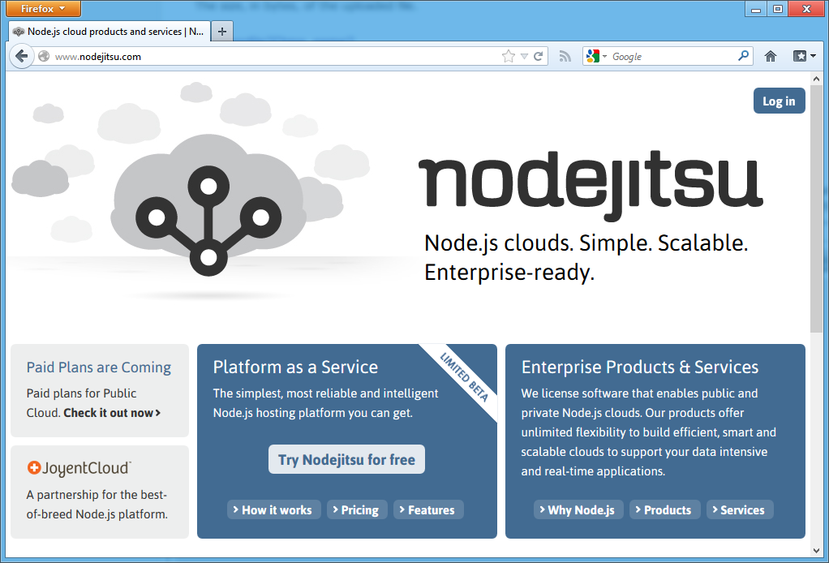
how to node

Slide 6
why to node
new and shiny
fast
scalable
low-level
modern
community

Slide 7
fast

Slide 8


Slide 9
New HTTP Parser
I've implemented a new HTTP/1.1 request and response parser by hand. (My previous parser was written with the help of Ragel.) It requires 124 bytes per HTTP connection, makes zero allocations, has no dependencies, is nearly optimal in its use of CPU instructions, interruptible on any character, has extensive tests, and is MIT licensed. README http_parser.h http_parser.c (Only one user at the moment: I've just merged it into Node.)
http://four.livejournal.com/1033160.html

Slide 10
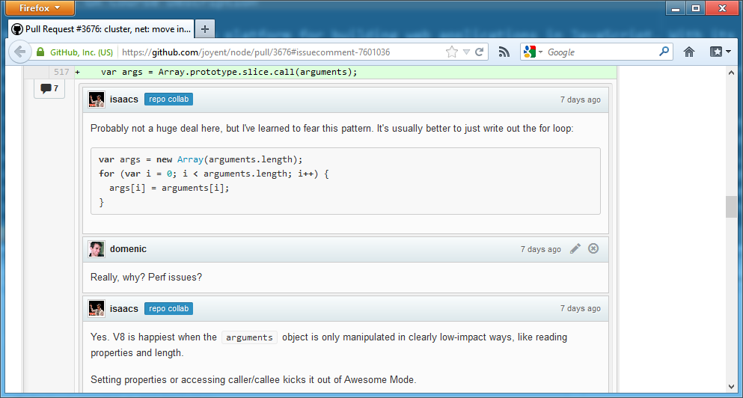

Slide 11
scalable

Slide 12
q: what do web servers actually do?
a: i/o
Notes:
Ask the audience what their webservers do

Slide 13
Response.Write("hello, world!");

Slide 14
move_uploaded_file(
$_FILES['userphoto']['tmp_name'],
"/var/www/userphotos/" . $_POST['username']
);

Slide 15
import memcache
mc = memcache.Client(['127.0.0.1:11211'])
mc.set("heavily_used_data", "data")
value = mc.get("more_data")

Slide 16
class Post < ActiveRecord::Base
attr_accessible :content, :name, :title
validates :name, :presence => true
validates :title, :presence => true
end

Slide 17
move this stuff out of the context of the web for a moment

Slide 18
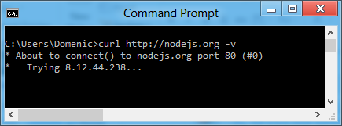
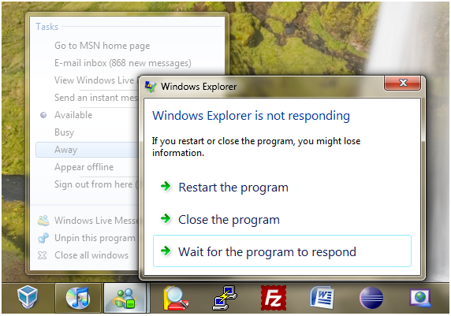


Slide 19
q: how do last-generation web servers fix this problem?
a: threads
Notes:
Ask the audience what their webservers do

Slide 20
let’s talk about threads.

Slide 21
they suck.
the end.

Slide 22
q: how does node solve this problem?
a: javascript
Notes:
Ask the audience what their webservers do

Slide 23
My next project
I'm going to write a special thin web server tied to the V8 javascript interpreter
The web server will execute javascripts in response to requests in real-time.
The beautiful thing about this is that I can lock the users in an evented box where they have no choice but to be fast. They cannot touch the disk. They cannot access a database with some stupid library that blocks because they have no access to blocking I/O. They cannot resize an image by linking imagemagick into the web server process (and thus slowing down/blocking the entire thing). They cannot crash it because they are very limited in what they can do. Why javascript?
because its bare and does not come with I/O APIs
web developers use it already
DOM API is event-based. Everyone is already used to running without threads and on an event loop already.
I think this design will be extremely efficient and support very high loads. Web requests are transformed into mysql, memcached, AMQP requests and then return to the event loop. Web developers need this sort of environment where it is not possible for them to do stupid things. Ruby, python, C++, PHP are all terrible languages for web development because they allow too much freedom.
http://four.livejournal.com/963421.html

Slide 24
javascript has never had blocking i/o

Slide 25
javascript has never had more than one thread

Slide 26
instead we use callbacks and events

Slide 27
$.get("http://nodejs.org", function (data) {
document.body.innerHTML = data;
});

Slide 28
var dbReq = indexedDB.open("my-database");
dbReq.addEventListener("success", function () {
var dbConnection = dbReq.result;
});

Slide 29
it’s the same in node

Slide 30
fs.readFile("/etc/passwd", function (err, data) {
console.log(data);
});

Slide 31
request.on("data", function (chunk) {
response.write(chunk);
});

Slide 32
db.users.find({ name: "domenic" }, function(err, users) {
users.forEach(function (user) {
response.write(user);
});
});

Slide 33
io.sockets.on("connection", function (socket) {
socket.emit("news", { hello: "world" });
socket.on("my other event", function (data) {
console.log(data);
});
});

Slide 34
low-level

Slide 35
u STDIO u Timers u Process u Utilities u Events u Domain u Buffer u Stream u Crypto u TLS/SSL u String Decoder u File System u Path u Net u UDP/Datagram u DNS u HTTP u HTTPS u URL u Query Strings u Punycode u Readline u REPL u VM u Child Processes u Assertion Testing u TTY u ZLIB u OS u Cluster
http://nodejs.org/docs/latest/api/

Slide 36
that’s it.
that’s all you get.
Notes:
Why is this a good thing? Well that leads us to our next point, which is that Node.js is…

Slide 37
modern
Notes:
“Solving modern problems.”

Slide 38
let’s look at the most-used node.js packages.

Slide 39
socket.io: used by 306 other packages
redis: 259 (hiredis: 70)
stylus: 148 (less: 134)
mongodb: 144 (mongoose: 135)

Slide 40
who builds these?

Slide 41
community

Slide 42


Slide 43
codingTime();
https://github.com/domenic/understanding-node

