Slide 1
understanding the platform

Slide 2
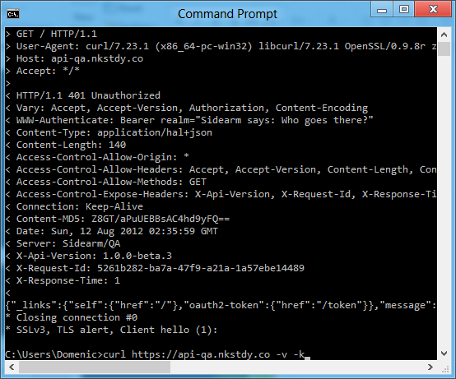
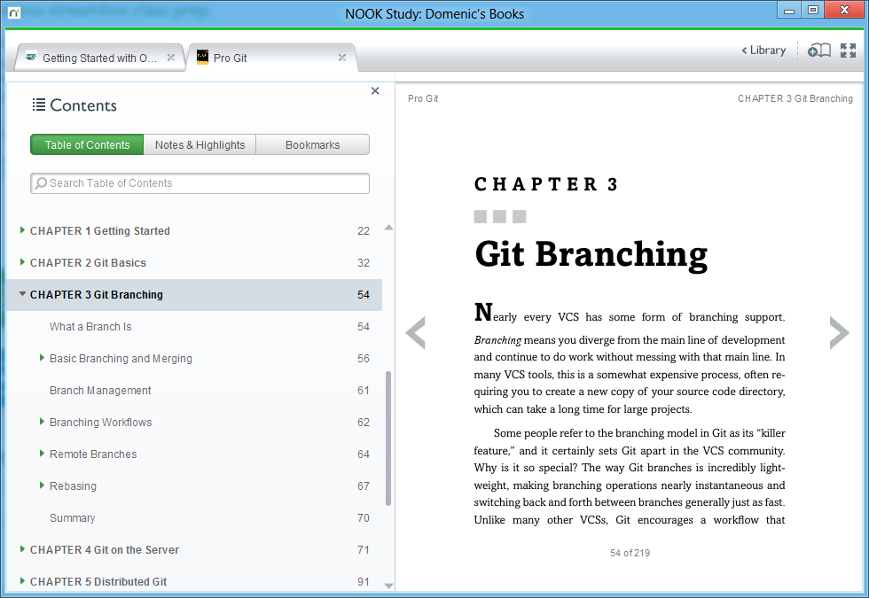
story time

Slide 3

Domenic Denicola
@domenic
https://npmjs.org/profile/domenicdenicola http://github.com/domenic http://github.com/NobleJS

Slide 4
agenda
how to node
why to node
coding time

Slide 5
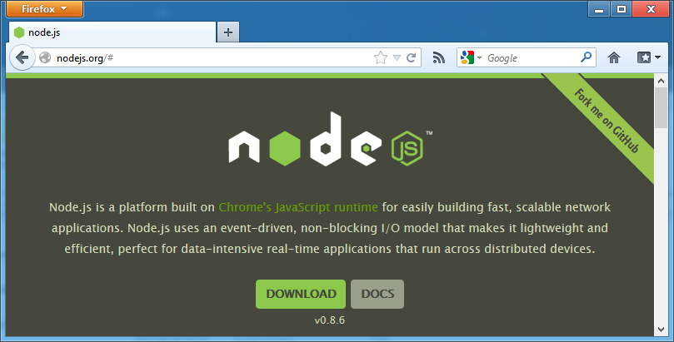
how to node

Slide 6
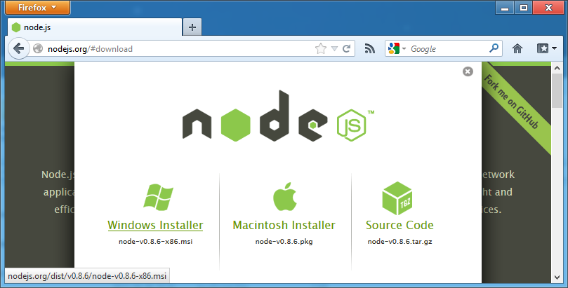
how to node

Slide 7
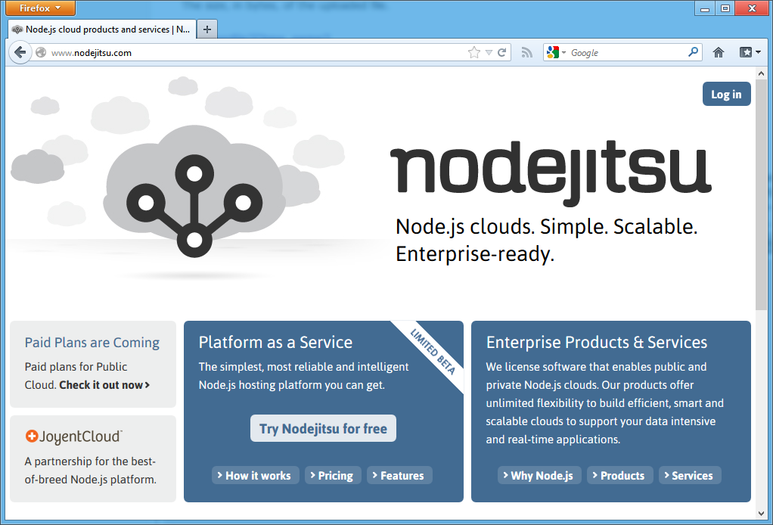
how to node

Slide 8
why to node
new and shiny
fast
scalable
low-level
community
Notes:
Don’t expand on each point yet

Slide 9
new and shiny
Notes:
“Solving modern problems.”

Slide 10
let’s look at the most-used node.js packages.

Slide 11
socket.io: used by 306 other packages
redis: 259 (hiredis: 70)
stylus: 148 (less: 134)
mongodb: 144 (mongoose: 135)

Slide 12
who builds these?

Slide 13
fast

Slide 14


Slide 15
New HTTP Parser
I've implemented a new HTTP/1.1 request and response parser by hand. (My previous parser was written with the help of Ragel.) It requires 124 bytes per HTTP connection, makes zero allocations, has no dependencies, is nearly optimal in its use of CPU instructions, interruptible on any character, has extensive tests, and is MIT licensed. README http_parser.h http_parser.c (Only one user at the moment: I've just merged it into Node.)
http://four.livejournal.com/1033160.html

Slide 16
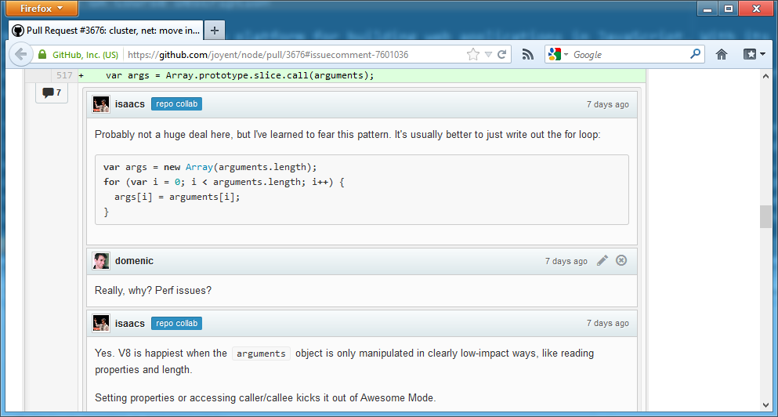

Slide 17
scalable

Slide 18
q: what do web servers actually do?
a: i/o
Notes:
Ask the audience what their webservers do Lead in to next slide is “let’s look at some examples of this in our usual web frameworks”

Slide 19
Response.Write("hello, world!");

Slide 20
move_uploaded_file(
$_FILES['userphoto']['tmp_name'],
"/var/www/userphotos/" . $_POST['username']
);

Slide 21
import memcache
mc = memcache.Client(['127.0.0.1:11211'])
mc.set("heavily_used_data", "data")
value = mc.get("more_data")

Slide 22
class Post < ActiveRecord::Base
attr_accessible :content, :name, :title
validates :name, :presence => true
validates :title, :presence => true
end

Slide 23
move this stuff out of the context of the web for a moment

Slide 24
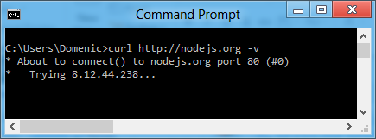
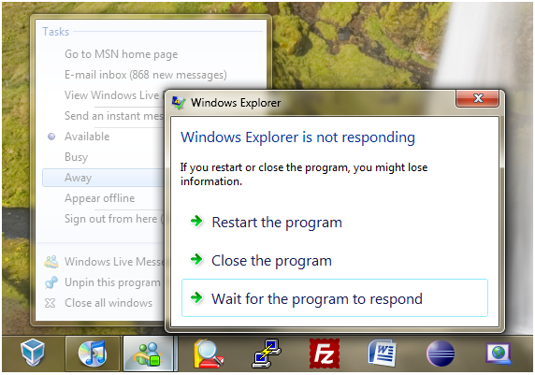


Slide 25
q: how do last-generation web servers fix this problem?
a: threads
Notes:
Ask the audience what their webservers do

Slide 26
let’s talk about threads.

Slide 27
they suck.
the end.

Slide 28
q: how does node solve this problem?
a: javascript
Notes:
Ask the audience what their webservers do

Slide 29
My next project
I'm going to write a special thin web server tied to the V8 javascript interpreter
The web server will execute javascripts in response to requests in real-time.
The beautiful thing about this is that I can lock the users in an evented box where they have no choice but to be fast. They cannot touch the disk. They cannot access a database with some stupid library that blocks because they have no access to blocking I/O. They cannot resize an image by linking imagemagick into the web server process (and thus slowing down/blocking the entire thing). They cannot crash it because they are very limited in what they can do. Why javascript?
because its bare and does not come with I/O APIs
web developers use it already
DOM API is event-based. Everyone is already used to running without threads and on an event loop already.
I think this design will be extremely efficient and support very high loads. Web requests are transformed into mysql, memcached, AMQP requests and then return to the event loop. Web developers need this sort of environment where it is not possible for them to do stupid things. Ruby, python, C++, PHP are all terrible languages for web development because they allow too much freedom.
http://four.livejournal.com/963421.html
Notes:
Don’t explain this, just read it---explanation is on upcoming slides.

Slide 30
javascript has never had blocking i/o

Slide 31
javascript has never had more than one thread

Slide 32
instead we use callbacks and events

Slide 33
$.get("http://nodejs.org", function (data) {
document.body.innerHTML = data;
});

Slide 34
var dbReq = indexedDB.open("my-database");
dbReq.addEventListener("success", function () {
var dbConnection = dbReq.result;
});

Slide 35
it’s the same in node

Slide 36
fs.readFile("/etc/passwd", function (err, data) {
console.log(data);
});

Slide 37
request.on("data", function (chunk) {
response.write(chunk);
});

Slide 38
db.users.find({ name: "domenic" }, function (err, users) {
users.forEach(function (user) {
response.write(user);
});
});

Slide 39
io.sockets.on("connection", function (socket) {
socket.emit("news", { hello: "world" });
socket.on("my other event", function (data) {
console.log(data);
});
});

Slide 40
low-level

Slide 41
u STDIO u Timers u Process u Utilities u Events u Domain u Buffer u Stream u Crypto u TLS/SSL u String Decoder u File System u Path u Net u UDP/Datagram u DNS u HTTP u HTTPS u URL u Query Strings u Punycode u Readline u REPL u VM u Child Processes u Assertion Testing u TTY u ZLIB u OS u Cluster
http://nodejs.org/docs/latest/api/

Slide 42
that’s it.
that’s all you get.
Notes:
Why is this a good thing? Well that leads us to our next point, which is that Node.js is…

Slide 43
community

Slide 44

Notes:
Don’t forget Knox and Q stories

Slide 45
codingTime();
https://github.com/domenic/understanding-node

