Slide 1

Optimized matrix multiplication and inversion
Advanced Computer Architecture project
A.Y. 2020/2021
Docenti:
Prof. Marco Ferretti
Prof. Mirto Musci
Membri del team:
Domenico Ragusa
Danilo Modica
Notes:
SLIDE 1 - DOMENICO
Good afternoon to everyone, I am Domenico Ragusa and with my colleague Danilo Modica we have chosen the optimized matrix multiplication and inversion project.
As framework for parallelization we used both OpenMP and CUDA to try to get the lowest possible execution times, as we will present next.
*CAMBIO*

Slide 2
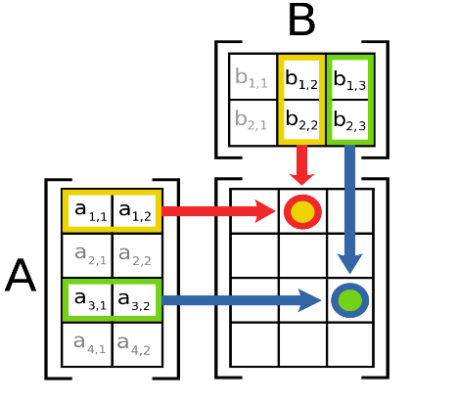
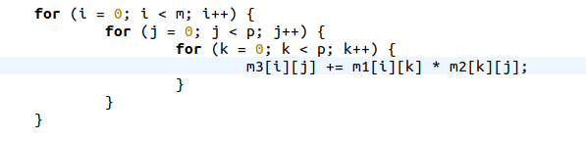
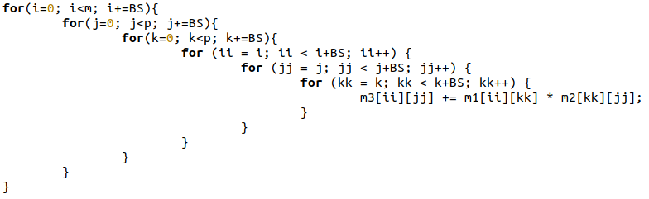
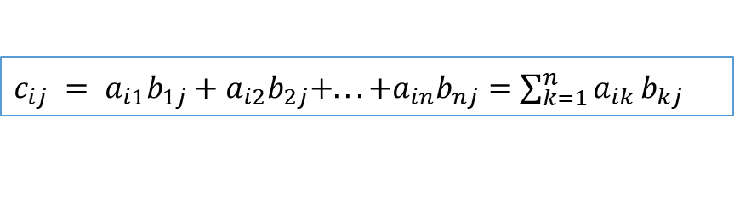
Serial algorithms - Multiplication
n x m n x p
A x B = C
m x p
$c_{ij} = a_{i1}b_{1j}+a_{i2}b_{2j}+...+a_{in}b_{nj}=$ $\sum_{k=1}^{n}{a_{ik}}b_{kj}$
Simplest Algorithm
Program structure
Initialization with memory allocation
Reading of two matrices
Multiplication
Writing the resulting matrix
Matrices subdivision in tiles
Notes:
SLIDE 2 - DOMENICO
Let's start with the multiplication problem. As shown in the figure, given a matrix A whose dimensions are n x m and B whose dimensions are m x p, with multiplication we obtain a matrix C n x p whose elements are calculated as a summation of products between each element in a row of A with the corresponding one in the corresponding column of the matrix B. So, to calculate each element the above summation is calculated each time.
*CAMBIO*
The serial program from which we started was written as a training exercise during the writing of my bachelor thesis and it is structured in such a way as to allocate the necessary memory, then read the two matrices, perform the multiplication and finally write the results to a file.
*CAMBIO*
The multiplication function has been obtained by means of three nested for loops designed to implement the above summation using indices i, j, k.
*CAMBIO*
Another possibility that was evaluated was to divide the calculation of the matrix result in tiles, as seen in the lab, to obtain some improvements due to the exploitation of cache and principle of locality. Here we report the serial in which a single thread iterates between multiple tiles and in each tile calculates the known summation.
*CAMBIO*

Slide 3
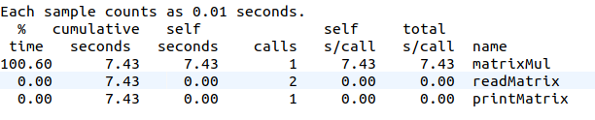
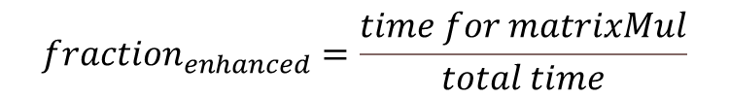
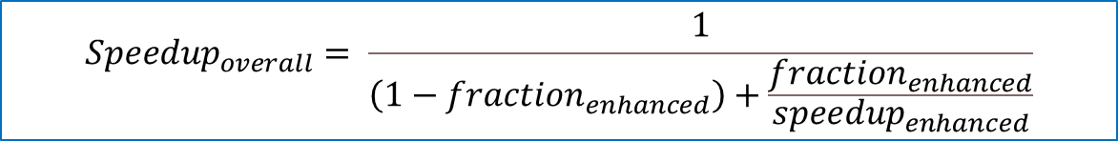
A-priori parallelism study - Multiplication
Gprof profiling
Amdahl’s law
$${Speedup}_{overall}= \frac{1}{\left(1−{fraction}_{enhanced}\right)+\frac{{fraction}_{enhanced}}{{speedup}_{enhanced}}}$$
$${fraction}_{enhanced}=\frac{time for matrixMul}{total time}$$
Theoretical speedups
OpenMP (max 24 thread) -> theoretical speedup = 24
CUDA (640 CUDA cores) -> theoretical speedup = 640
Notes:
SLIDE 3 - DOMENICO
To study the a-prior parallelism and to understand on which parts of the program we needed to act we used the Gprof profiler, on two 1024 order matrices, that, as shown in the figure, indicates in the matrixMul the function that occupies most of the time and this is why we deciced to parallelize only it, while the others, being I/O functions with low occupation of time, have not been optimized.
*CAMBIO*
Instead, to assess the maximum speedup that could be obtained we used the Amdahl's law whose formula is given in the picture and which we used as seen in lectures.
Here the fraction_enhanced was calculated as the ratio between the time of the function parallelizable divided by the total time while, since it was thought that increasing the number of threads you get a proportional speedup, then we took as speedup_enhanced 24 which is the maximum number of threads used to obtain data with OpenMP and 640 for CUDA.
*CAMBIO*
Substituting in the formula we obtained a theoretical speedup of 24 for OpenMP and 640 for the CUDA implementation.
*CAMBIO*

Slide 4
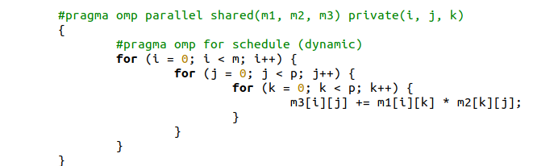
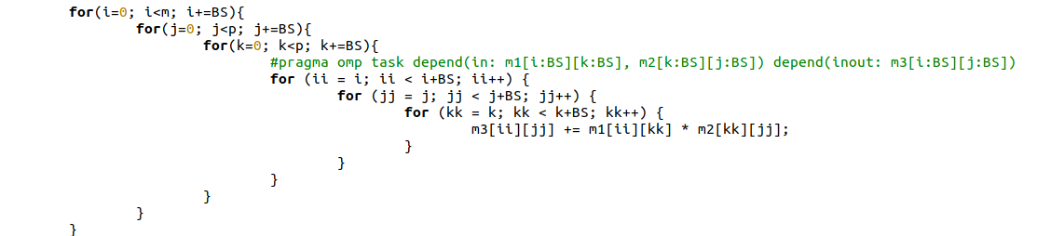
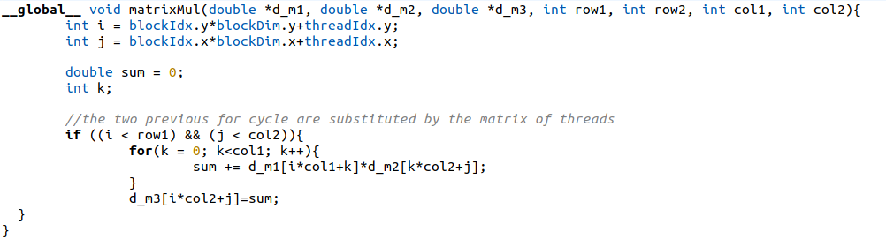
Parallelization - Multiplication
Parallelization by rows (OpenMP)
Result matrix
Parallelization per tiles (OpenMP)
Result matrix
Parallelization per elements (CUDA)
Result matrix
Notes:
SLIDE 4 - DANILO
To speedup the multiplication function we tried three different approaches using both OpenMP and CUDA:
- We called the first approach parallelization by rows, in fact since each element in the result matrix can be calculated independently from the others, we assigned to each thread a row of that matrix , as illustrated in the figure on the right. As shown on the left, for OpenMP implementation we simply used the pragma omp for directive on the outermost loop to assign to each thread an iteration of the loop at a time with a dynamic scheduling. The result matrix m3 was declared shared in order to be filled in simultaneously by all threads.
*CAMBIO*
- The second approach is the parallelization per tiles, in fact we subdivided the result matrix into tiles and each thread works with a tile, as illustrated in the figure on the right. The size of the block is 64, since it is a power of 2 and it allows to have at least one block per thread with matrices greater than 512. Here for the implementation, we call the matrix_mul function on the main after opening a parallel region and using pragma omp single directive, because within the function, as shown on the left, we used tasks on the three innermost loops, so that each tile, who can be tought as a "work package", is associated to a single thread. With depend clauses we ensured the synchronization of threads, so to avoid writings on the same memory locations.
*CAMBIO*
- The third approach is the parallelization per elements, in fact we assigned to each thread the concurrent computation of a single element of the result matrix, as depicted in the figure on the right.
To achieve this, we used CUDA exploiting the huge number of cores of the NVIDIA graphic card. Here the two outer loops were substituted by the GPU grid of threads and since it is not possible to store complex data structures, in the GPU memory, we used 1D array to linearize matrices so that each thread accesses to one element depending on its coordinates in the grid according to ThreadId and BlockId. The threads grid is subdivided into blocks of 32x32.
*CAMBIO*

Slide 5
Performance analysis - Multiplication
Comparison between execution times
 | Serial - rows | Serial - tiles | OpenMP - rows | OpenMP - tiles
2048 | 73.47 s | 10.59 s | 5.80 s | 0.69 s
3072 | 263.58 s | 35.89 s | 20.78 s | 2.29 s
Virtual machine configuration
Ubuntu 20.04
N1 Platform
24 vCPU
22 GB RAM
Notes:
SLIDE 5 - DOMENICO
To carry out our test we used a virtual machine on Google Cloud Platform equipped with an N1 CPU platform with 24 vCPU and 22 GB of RAM running Ubuntu operating system.
As you can see with the first parallelization you get almost linear speedups up to the maximum of about 13 which is reached using 16 threads.
*CAMBIO*
A similar behavior of the speedup is obtained with the parallelization per tiles as can be seen in the graph below but the main difference is the measure times which are significantly lower for the greater exploitation of the cache and the principle of locality, *CAMBIO* as reported in the table on the right where we compare rows and tiles approaches. As you can see, for example, with OpenMP we pass from about 20 s to 2 s with a matrix order of 3072.
In both cases speedups are lower than the calculated theoretical one due to the continuous memory accesses.
*CAMBIO*
For CUDA instead we obtain much higher speedups but still lower than expected due to the kernel calls overhead and data transfers between CPU and GPU memory and vice-versa.

Slide 6
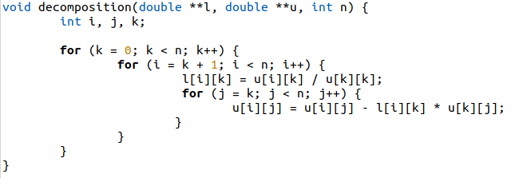
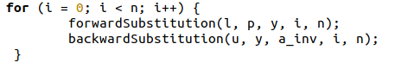


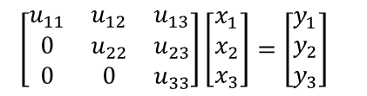

Serial algorithm - Inversion
1. $AA^{−1}=I$
$$\left[\begin{matrix}A_{11} & A_{12} & A_{13} \\ A_{21} & A_{22} & A_{23} \\ A_{31} & A_{32} & A_{33}\end{matrix}\right]\left[\begin{matrix}a_{11}′ & a_{12}′ & a_{13}′ \\ a_{21}′ & a_{22}′ & a_{23}′ \\ a_{31}′ & a_{32}′ & a_{33}′\end{matrix}\right]=\left[\begin{matrix}1 & 0 & 0 \\ 0 & 1 & 0 \\ 0 & 0 & 1\end{matrix}\right]$$
Program structure
Memory allocations with malloc
Reading matrix
Computing inversion
Pivoting
LU decomposition
Computing determinant and checks
Forward and Backward substitutions
Writing the resulting matrix
2. LU decomposition
$$\left[\begin{matrix}l_{11} & 0 & 0 \\ l_{21} & l_{22} & 0 \\ l_{31} & l_{32} & l_{33}\end{matrix}\right]\left[\begin{matrix}y_{1} \\ y_{2} \\ y_{3}\end{matrix}\right]=\left[\begin{matrix}b_{1} \\ b_{2} \\ b_{3}\end{matrix}\right]$$
$\left[\begin{matrix}u_{11} & u_{12} & u_{13} \\ 0 & u_{22} & u_{23} \\ 0 & 0 & u_{33}\end{matrix}\right]\left[\begin{matrix}x_{1} \\ x_{2} \\ x_{3}\end{matrix}\right]=\left[\begin{matrix}y_{1} \\ y_{2} \\ y_{3}\end{matrix}\right]$
3. Forward substitution
4. Backward substitution
Notes:
SLIDE 6 - DANILO
Now, let’s see the matrix inversion problem.
To compute the inverse of a matrix we used the LU algorithm, since we studied it in the Numerical Methods course.
The inverse of a matrix A is a matrix such that the product between A and itself gives the Identity matrix. Using LU decomposition matrix A is splitted into two matrices L (lower triangular) and U (upper triangular). So, the original system can be divided into two sub-systems. The first one can be solved with the forward substitution method and the result vector is used to solve the second with the backward substitution method.
*CAMBIO*
Here, on the right, it is indicated our program structure where the core phase is the computation of the inverse matrix, that is divided into four parts:
- first the pivoting to avoid divisions by zero;
- then we apply the LU decomposition;
- we compute the determinant of the matrix to check if it can be inverted (determinant must be not equal to 0) by multiplying the determinant of L with determinant of U;
- finally, forward and backward substitutions are used to get the inverse matrix.
*CAMBIO*
Now let’s have a brief look at the two most important parts of the serial code that affect most performances:
- The code on the left reports the function to perform LU decomposition, where three nested loops are used to fill in the matrices L and U.
- On the right, the other code indicates the for loop where forward and backward substitution functions are called. In each iteration a single column of the inverse matrix is computed. Forward function fills in the y vector that then is used by the backward function to fill in the a_inv matrix.
*CAMBIO*

Slide 7
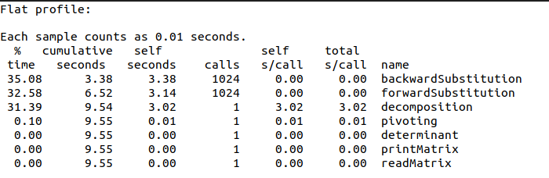
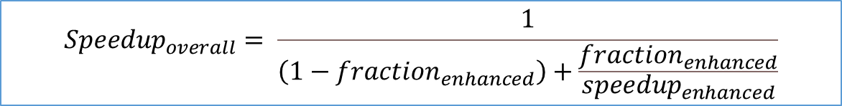
A-priori parallelism study - Inversion
Gprof profiling
Amdahl’s law
$${Speedup}_{overall}= \frac{1}{\left(1−{fraction}_{enhanced}\right)+\frac{{fraction}_{enhanced}}{{speedup}_{enhanced}}}$$
$${fraction}_{enhanced}= \frac{backward time + forward time +decomposition time + determinant time}{total time}$$
Theoretical speedups
OpenMP (max 24 thread) -> theoretical speedup = 19.51
CUDA (640 CUDA cores) -> theoretical speedup = 86.60
Notes:
SLIDE 7 - DANILO
Again, to make a-priori study of available parallelism we used Gprof and we stated that the most part of the execution time was taken by the forward and backward functions as well as
the decomposition, as you can see in this flat profile obtained with a matrix whose size is 1024. However, determinant function is highlighted because we decided to parallelize it,
even if not necessary, as Domenico will explain.
*CAMBIO*
To compute the a-priori speedup we used again the Amdahl’s law. Here we compute the fraction enhanced by considering the times of the backward, forward, decomposition and
determinant functions over the execution time of the whole program. As Domenico already said, the speedup enhanced is expressed in terms of number of cores.
*CAMBIO*
So, as theoretical speedups we obtained 19.51 for openmp and 86.60 for CUDA.
*CAMBIO*

Slide 8
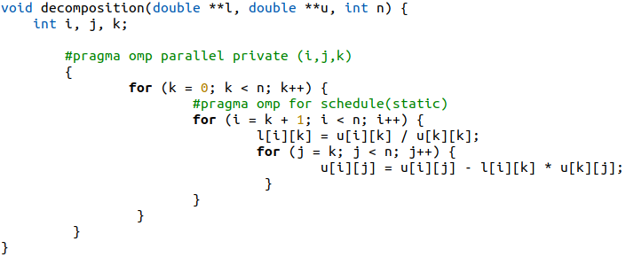
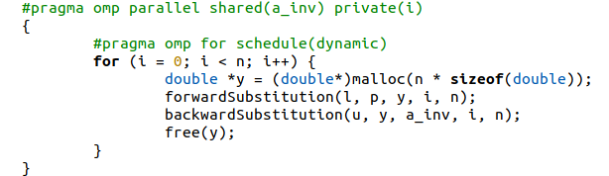
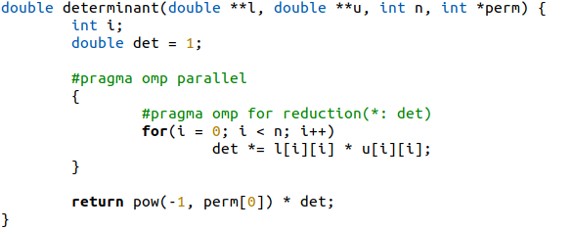
Parallelization - Inversion
Same parallelization reasoning was applied exploiting a GPU through the CUDA framework
Notes:
SLIDE 8 - DOMENICO
In order to parallelize the decomposition, the rows of matrix A were divided into several pieces and each processed by a thread with static scheduling. It has not been possible to do differently because otherwise we had concurrent accesses on the U matrix with consequent data races.
*CAMBIO*
For the determinant we performed a simple reduction on the variable det while *CAMBIO* for the forward and backward, being difficult to parallel the algorithm, we calculated each column of the inverse matrix separately between multiple threads using the #pragma omp for.
*CAMBIO*
CUDA parallelization instead was done in the same way, following the same reasoning, switching from functions to kernels, simply with the aim to test the improvements due to the greater number of cores in use. But due to its complexity we did not parallelize the decomposition function otherwise data races would have been arised.
*CAMBIO*

Slide 9
Performance analysis - Inversion
Virtual machine configuration
Ubuntu 20.04
N1 Platform
24 vCPU
22 GB RAM
Notes:
SLIDE 9 - DANILO
Now let’s look the results we obtained.
The configuration of the virtual machine on GCP is the same as the one used for the multiplication problem.
With OpenMP we initially have a linear speedup, and then as you can see with small matrices, an upper bound with 8 threads is reached due to the limits of the parallelism scalablity. With big matrices instead, we get higher speedups as the sizes and number of threads increases up to a maximum of about 13, so it is pretty below the theoretical speedup, since not all the code has been parallelized. Furthermore, there is still an overhead due to the concurrency and memory accesses as can be noticed on small matrices, where speedups decrease.
*CAMBIO*
With CUDA, we can see that the speedup increases by increasing the size of the matrices, until reaching a speedup of 13. Here maximum speedup is much lower than the a-priori speedup, but this could be explained with the many data transfers, from CPU to GPU, and with the multiple kernel calls that introduce overhead. Furthermore, as Domenico said, with CUDA we did not parallelize the decomposition. So, compared with the multiplication, the inversion problem with CUDA does not provide surprising results.
*CAMBIO*

Slide 10
Thank you for your attention
Repository: https://github.com/domenico-rgs/ACA-Project.git
Notes:
SLIDE 10 - DANILO
We have concluded and we thank you for your attention.

