Slide 1
EFSA-Project
Statistical Learning Theory
UNIPV
A.Y. 2020/2021
Professor: Giuseppe De Nicolao
Team members:
Andrea Vergine
Domenico Ragusa

Slide 2
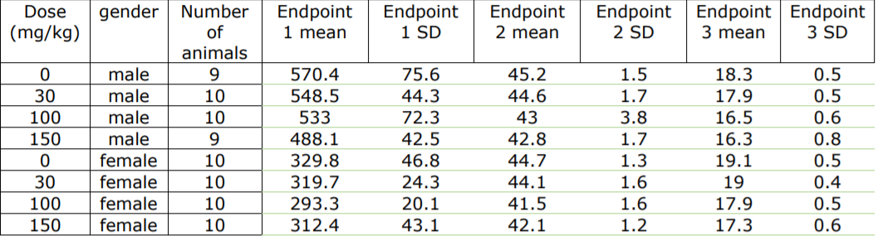
Data table

Slide 3
Goals
1. Plot dose-response data for each pair endpoint-gender (6 plots) with error bars reflecting error size on response measurements.
2. Use subset selection to estimate separate models for the 3 endpoints using gender as categorical variable.
3. Use subset selection to estimate a unique model using gender and endpoint as categorical variables.
4. In points 2. and 3., heteroscedasticity of the data should be taken into account.

Slide 4
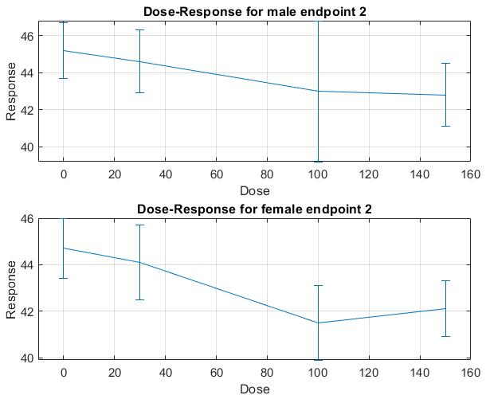
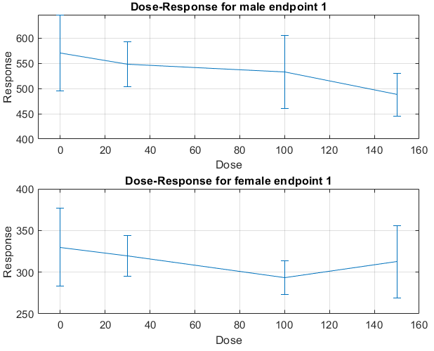
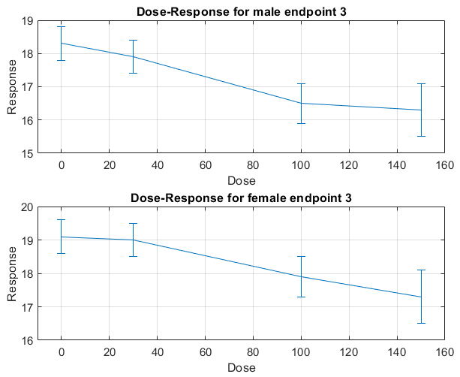
Dose - response data plot

Slide 5
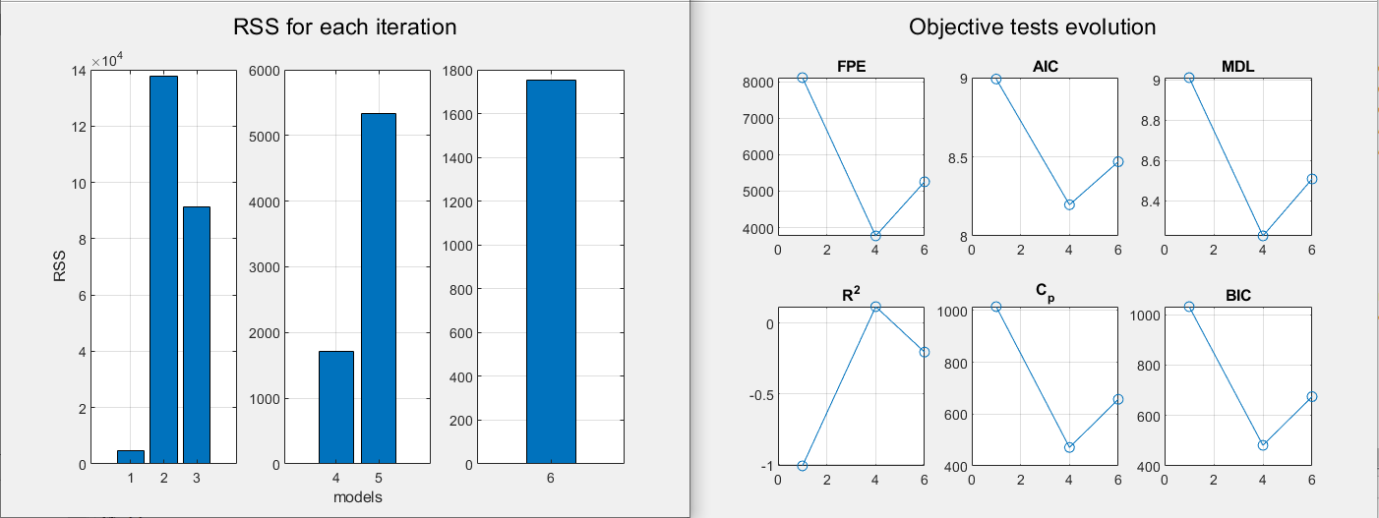

Linear model – forward selection – endpoint 1
$$f_{y}=θ_{1}+θ_{2}∗sex+θ_{3}∗dose$$

Slide 6
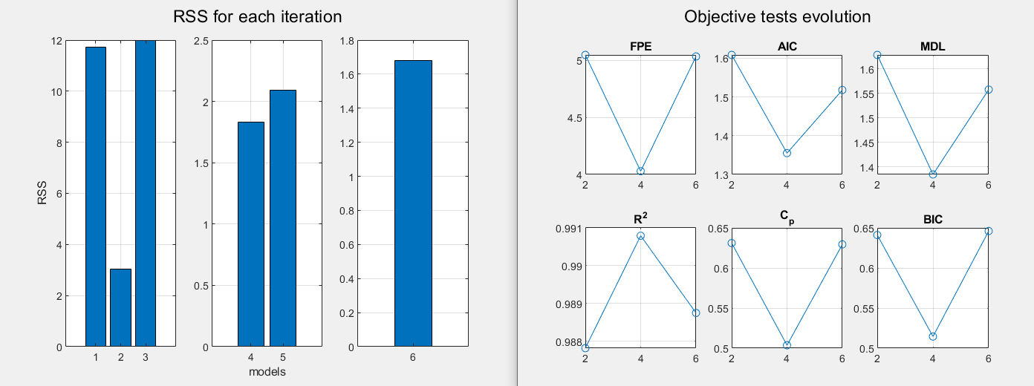

Linear model – forward selection – endpoint 2
$$f_{y}=θ_{1}+θ_{2}∗dose+θ_{3}∗sex$$

Slide 7
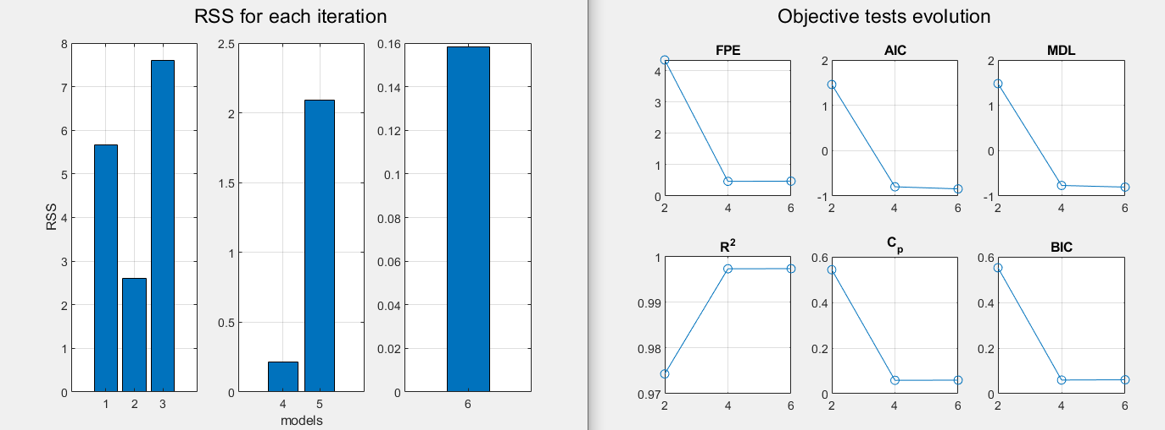
Linear model – forward selection – endpoint 3
$$f_{y}=θ_{1}+θ_{2}∗dose+θ_{3}∗sex$$

Slide 8
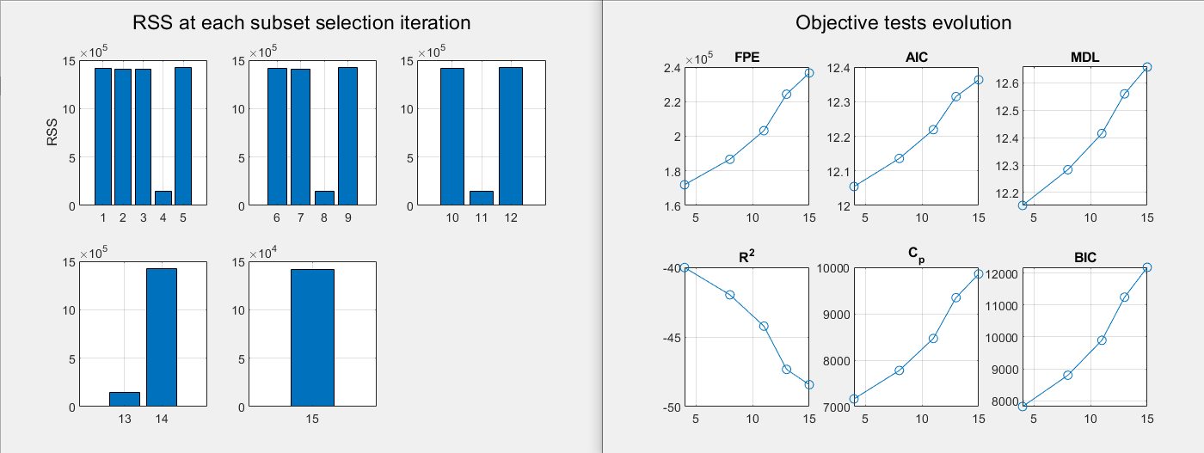

Linear model – forward selection – unique model
$$f_{y}=θ_{1}+θ_{2}∗endpoint$$

Slide 9
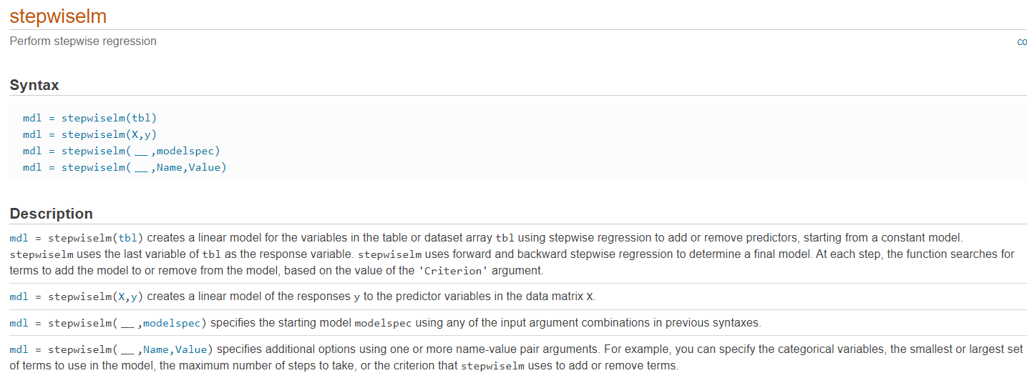
Function: stepwiselm
http://it.mathworks.com/help/stats/stepwiselm.html

Slide 10
Grazie per l’attenzione
Repository: https://github.com/domenico-rgs/EFSA-Project

Slide 23
SlidesCarnival icons are editable shapes. This means that you can:
Resize them without losing quality.
Change fill color and opacity.
Change line color, width and style.
Isn’t that nice? :) Examples:
Find more icons at slidescarnival.com/extra-free-resources-icons-and-maps

Slide 24
Diagrams and infographics

