Slide 1
EFSA-Project
Statistical Learning Theory
UNIPV
A.Y. 2020/2021
Professor: Giuseppe De Nicolao
Team members:
Andrea Vergine
Domenico Ragusa

Slide 2
Goals
1. Plot dose-response data for each pair endpoint-gender (6 plots) with error bars reflecting error size on response measurements.
2. Use subset selection to estimate separate models for the 3 endpoints using gender as categorical variable.
3. Use subset selection to estimate a unique model using gender and endpoint as categorical variables.
4. In points 2. and 3., heteroscedasticity of the data should be taken into account.

Slide 3
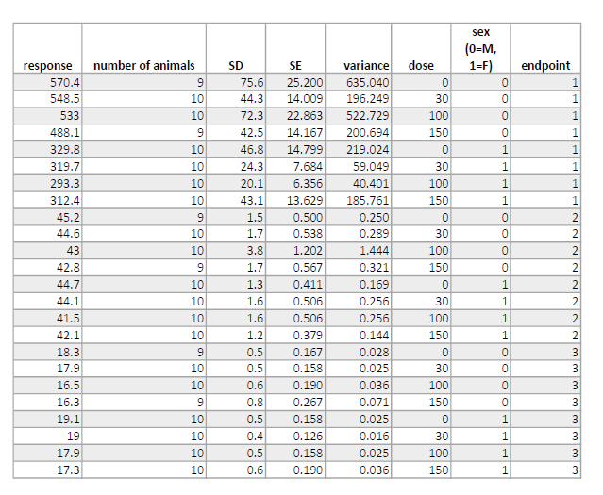
Data table

Slide 4
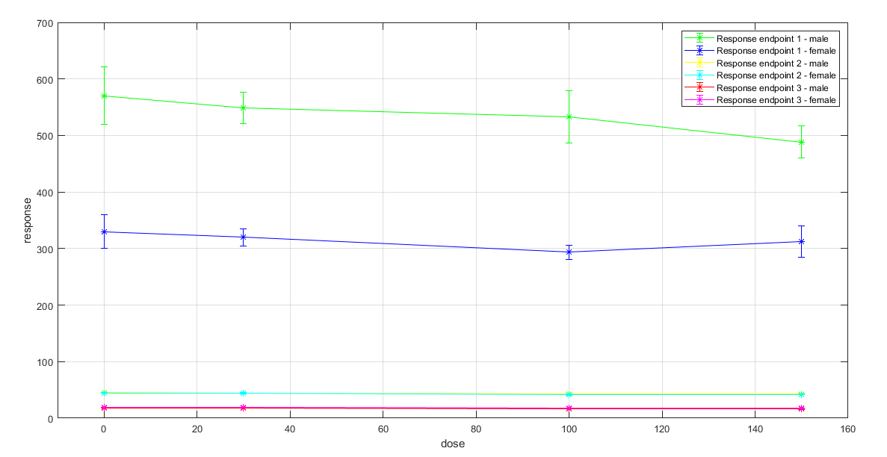
Data plot

Slide 5
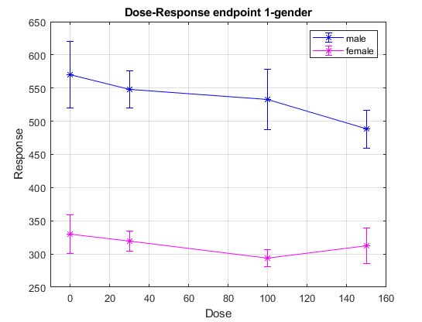
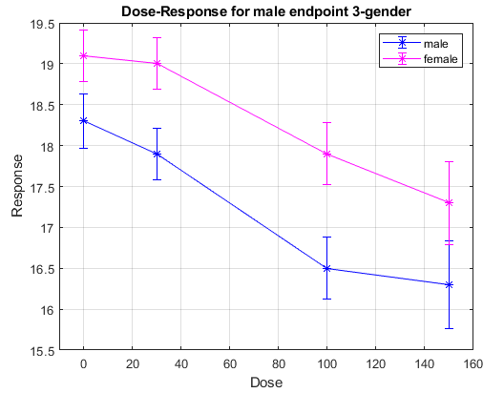
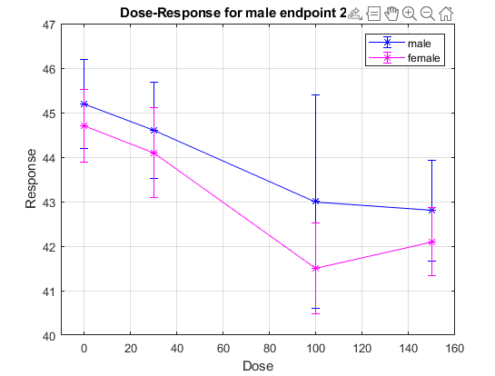
Dose - response data plot

Slide 6
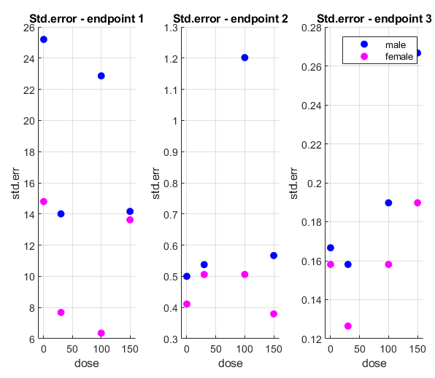
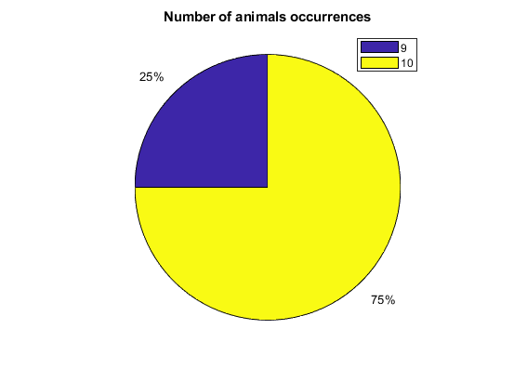
Looking at the data in advance

Slide 7

How to work
Alternatives:
Linear models ->
Fourier series -> No period, few data
Polynomial models -> few data (not beyond 2° degree)
Approaches:
Forward stepwise selection
Backward stepwise selection
Forward-Backward stepwise selection (stepwiselm)
Take into account heteroscedasticity:
$$w_{ii}=\frac{1}{{std.error}^{2}},{ std.error}^{2}=\frac{σ_{i}^{2}}{n}$$

Slide 8
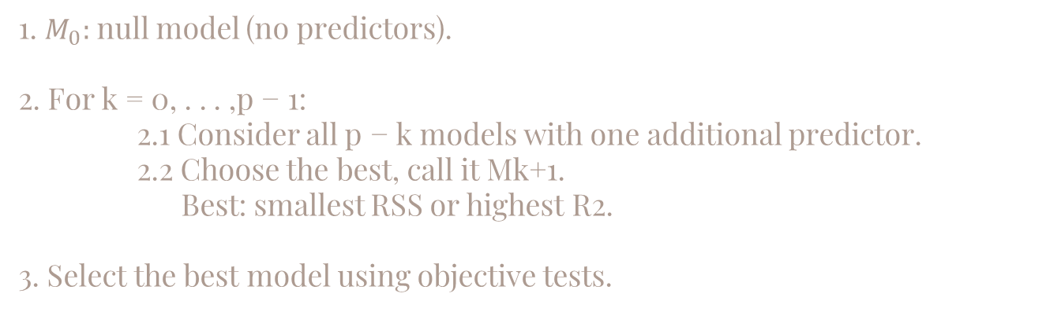
Forward stepwise selection
1. $M_{0}:$null model (no predictors).
2. For k = 0, . . . ,p − 1:
2.1 Consider all p − k models with one additional predictor.
2.2 Choose the best, call it Mk+1.
Best: smallest RSS or highest R2.
3. Select the best model using objective tests.

Slide 9
Backward Stepwise Selection
1. Mp: full model (all p predictors).
2. For k = p, p-1,..., 1:
2.1 Consider all k.
2.2 Choose the best among these k models and call it Mk1. (smallest RSS or highest R^2).
3. Select the best model using objective tests.

Slide 10
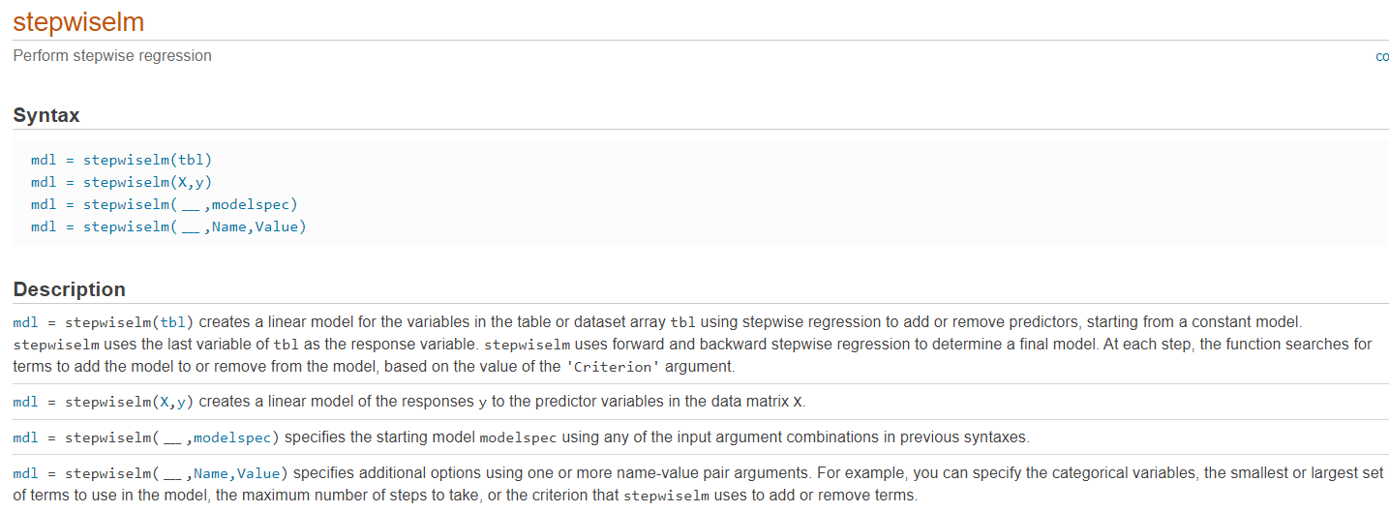
Function: stepwiselm
http://it.mathworks.com/help/stats/stepwiselm.html

Slide 11
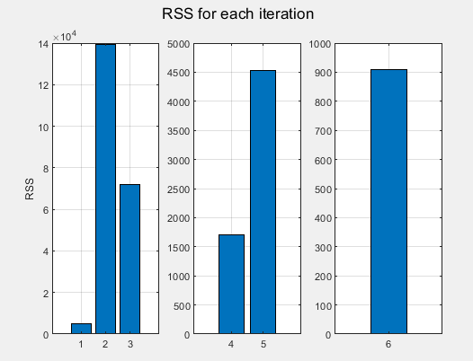
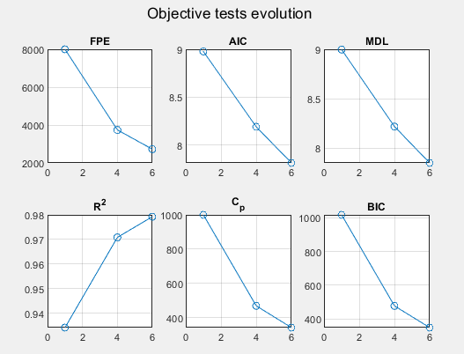
Forward (Backward) Selection – endpoint 1
$$response=567.3801−243.6787∗sex−0.5059∗dose+0.2808∗sex∗dose$$

Slide 12
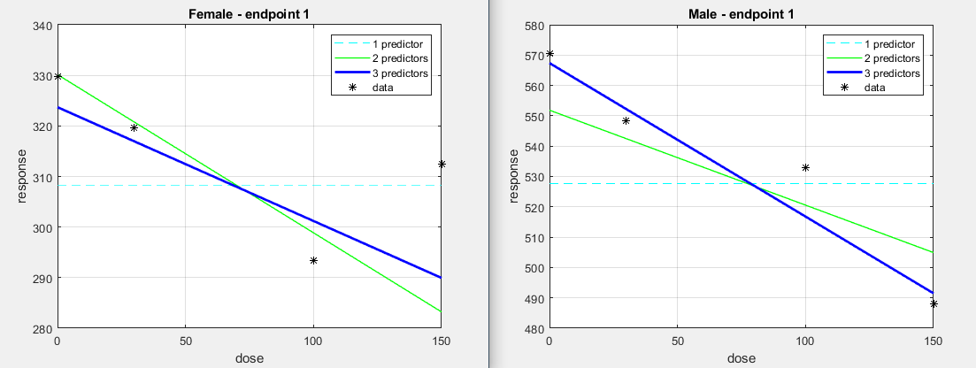
Forward (Backward) Selection – endpoint 1

Slide 13
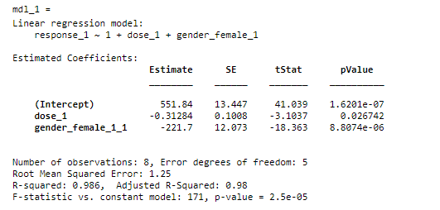
StepwiseLM (forward-backward) – endpoint 1
Confidence intervals
517.2787 | 586.4103
-0.5720 | -0.0537
-252.7355 | -190.6660

Slide 14
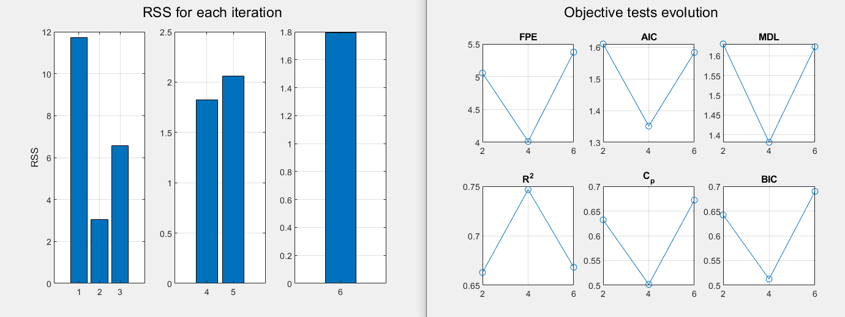
Forward (Backward) Selection – endpoint 2
$$response=45.2371−0.0180∗dose−0.7831∗sex$$

Slide 15
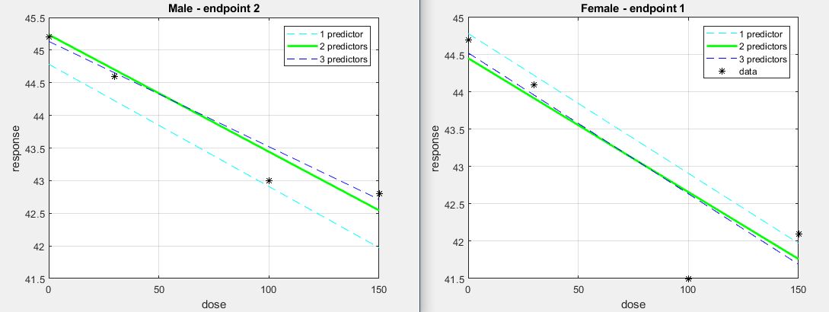
Forward (Backward) Selection – endpoint 2

Slide 16
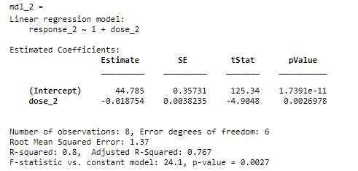
StepwiseLM (forward-backward) – endpoint 2
Confidence intervals
43.991 | 45.6596
-0.0281 | -0.0094

Slide 17
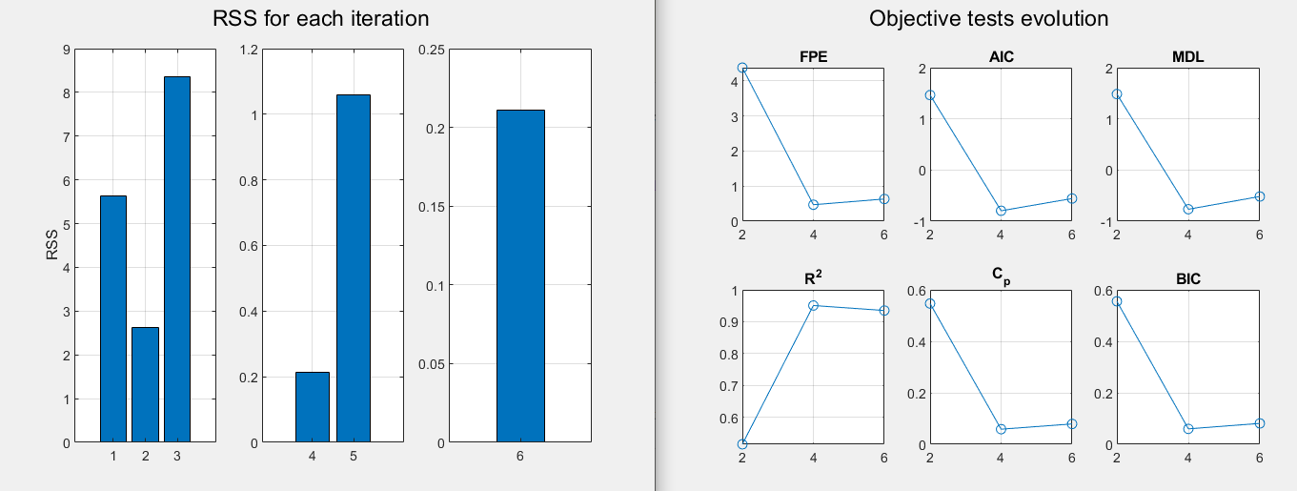
Forward (Backward) Selection – endpoint 3
$$response=18.2186−0.0139∗sex+1.0881∗dose$$

Slide 18
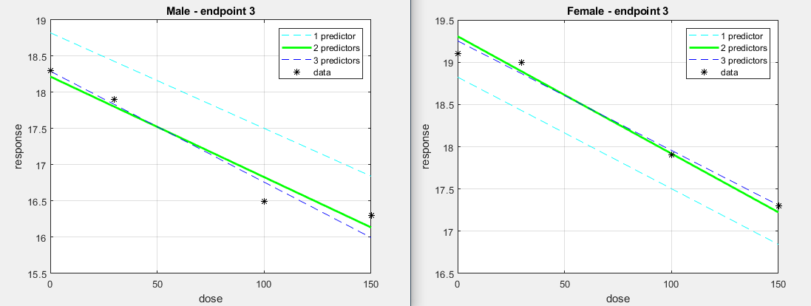
Forward (Backward) Selection – endpoint 3

Slide 19
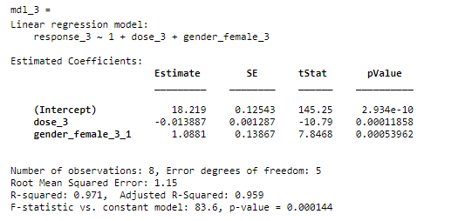
StepwiseLM (forward-backward) – endpoint 3
Confidence intervals
17.8962 | 18.5410
-0.0172 | -0.0106
0.7317 | 1.4446

Slide 20
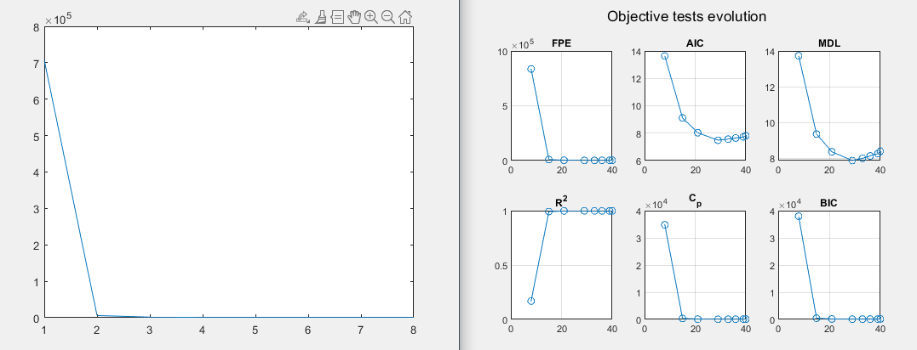
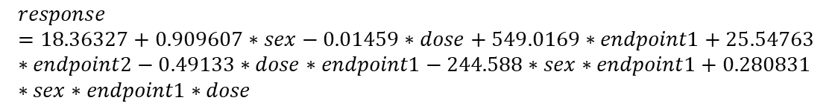
Forward (backward) selection – unique model
$$response=18.36327+0.909607∗sex−0.01459∗dose+549.0169∗endpoint1+25.54763∗endpoint2−0.49133∗dose∗endpoint1−244.588∗sex∗endpoint1+0.280831∗sex∗endpoint1∗dose$$

Slide 21
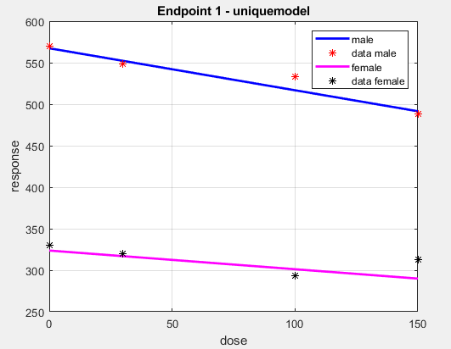
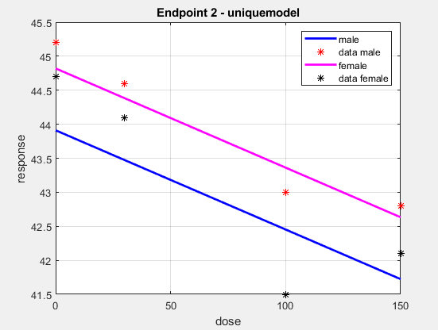
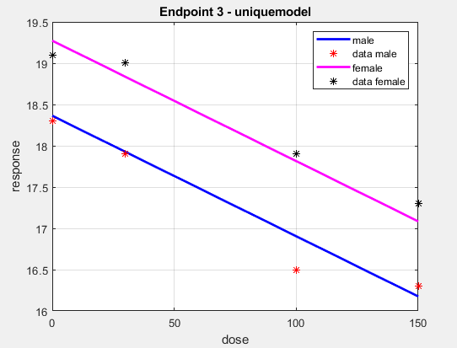
Forward (Backward) selection – unique model

Slide 22
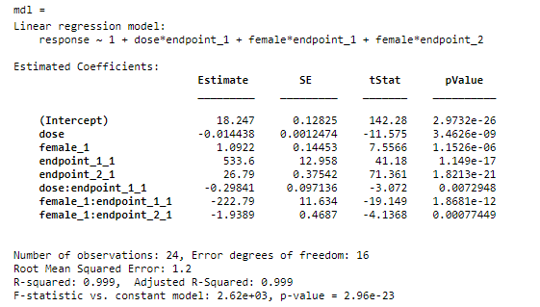
StepwiseLM (forward-backward) – unique model
Confidence intervals
17.9752 | 18.5190
-0.0171 | -0.0118
0.7858 | 1.3985
506.1281 | 561.0667
25.9946 | 27.5863
-0.5043 | -0.0925
-247.4567 | -198.1291
-2.9325 | -0.9453

Slide 23
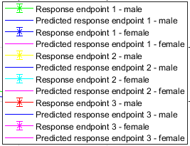
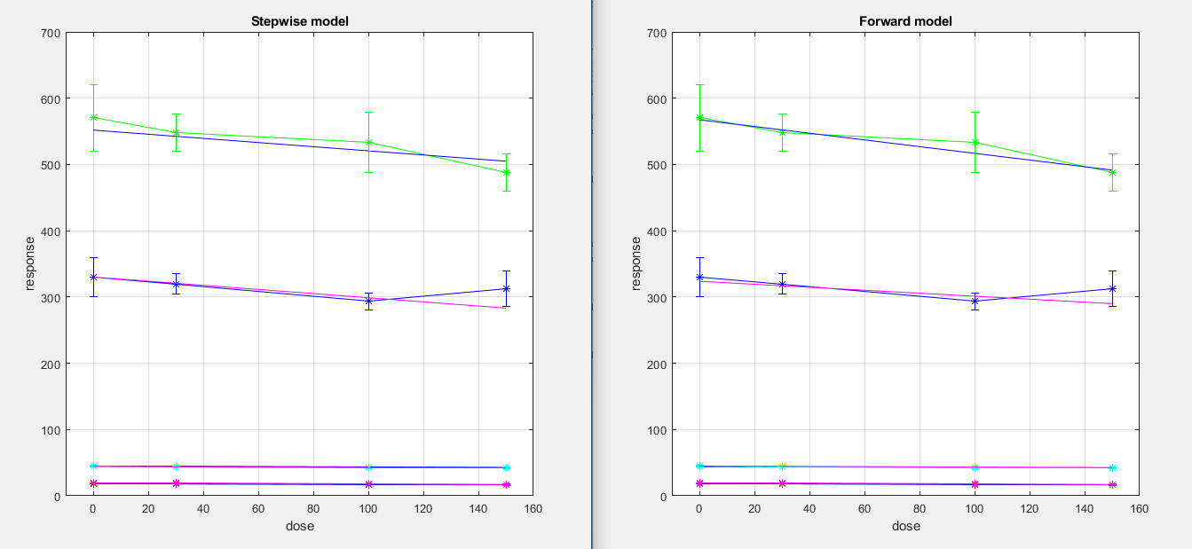
Jump to the conclusions

Slide 24
Thanks for
your attention!
Repository: https://github.com/domenico-rgs/EFSA-Project

