Slide 1
EFSA-Project
Statistical Learning Theory
UNIPV
A.Y. 2020/2021
Professor: Giuseppe De Nicolao
Team members:
Andrea Vergine
Domenico Ragusa

Slide 2
Goals
1. Plot dose-response data for each pair endpoint-gender (6 plots) with error bars reflecting error size on response measurements.
2. Use subset selection to estimate separate models for the 3 endpoints using gender as categorical variable.
3. Use subset selection to estimate a unique model using gender and endpoint as categorical variables.
4. In points 2. and 3., heteroscedasticity of the data should be taken into account.

Slide 3
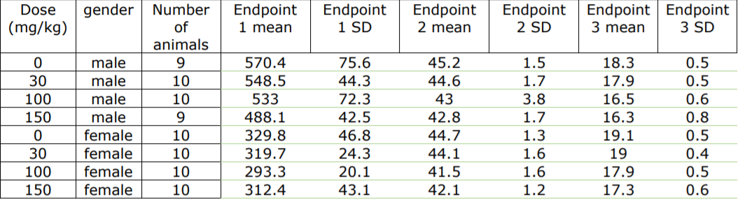
Data table

Slide 4
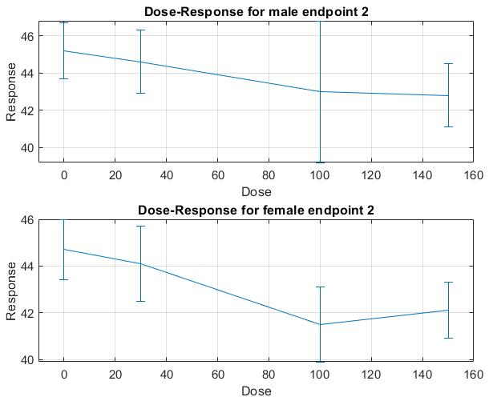
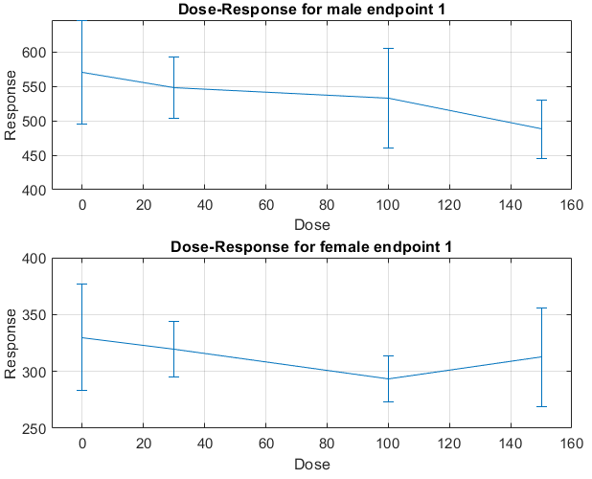
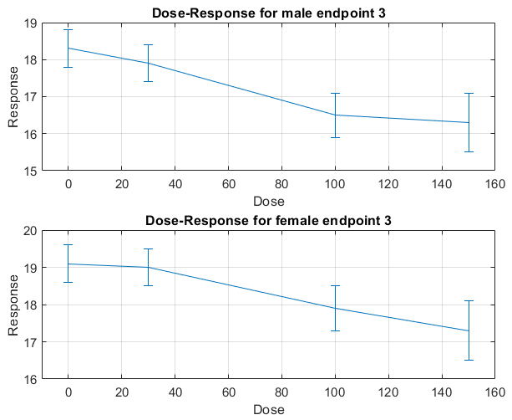
Dose - response data plot

Slide 5
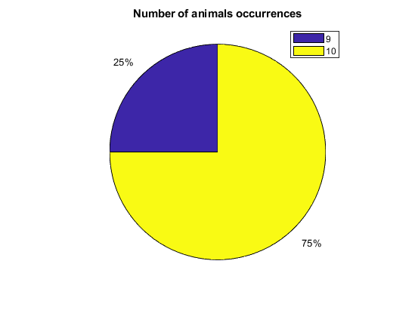
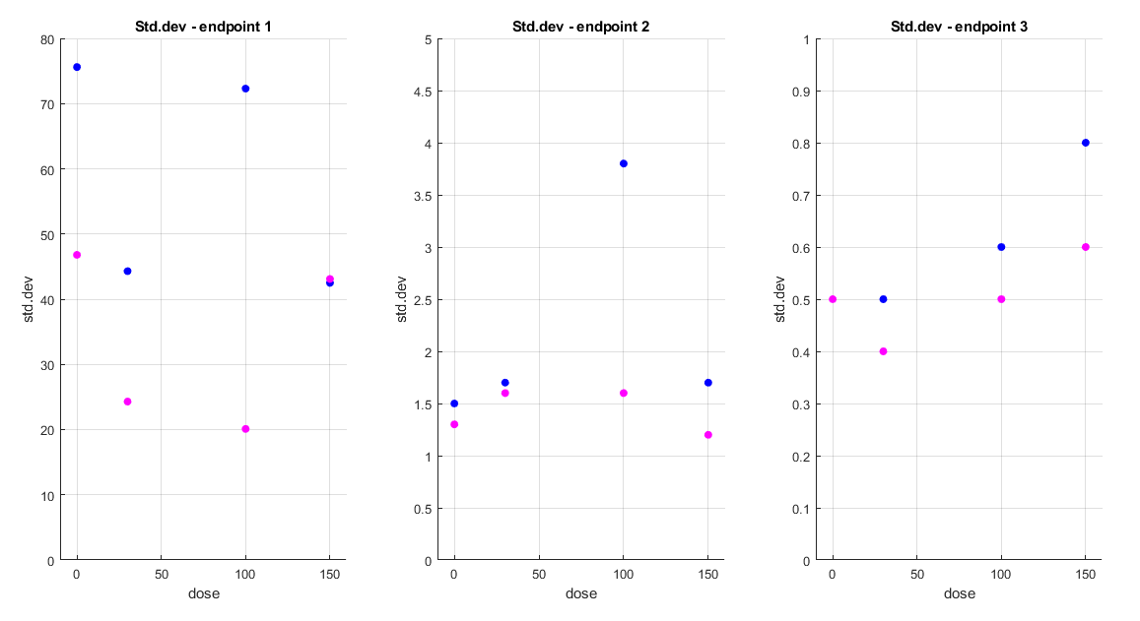
Looking at the data in advance

Slide 6

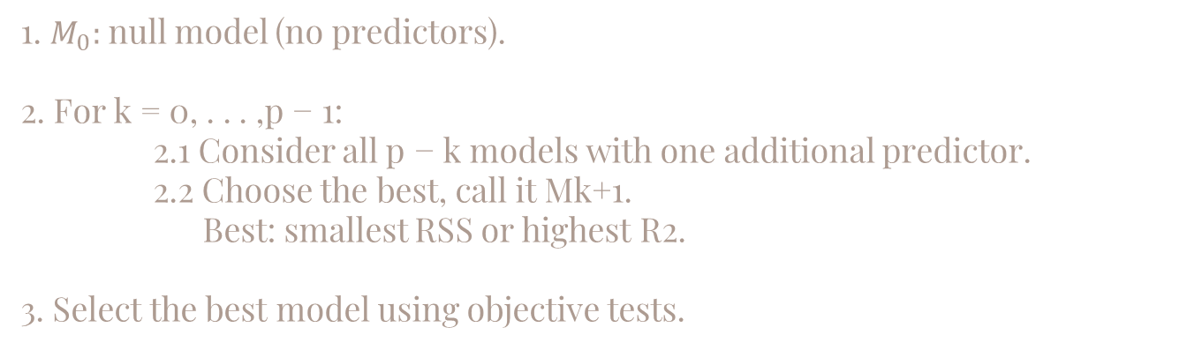
Forward stepwise selection
1. $M_{0}:$null model (no predictors).
2. For k = 0, . . . ,p − 1:
2.1 Consider all p − k models with one additional predictor.
2.2 Choose the best, call it Mk+1.
Best: smallest RSS or highest R2.
3. Select the best model using objective tests.
Take into account heteroscedasticity

Slide 7
Type of models
Alternatives:
Linear models ->
Fourier series -> No period, no graphic visualisation
Polynomial models -> data < parameters -> overfitting

Slide 8
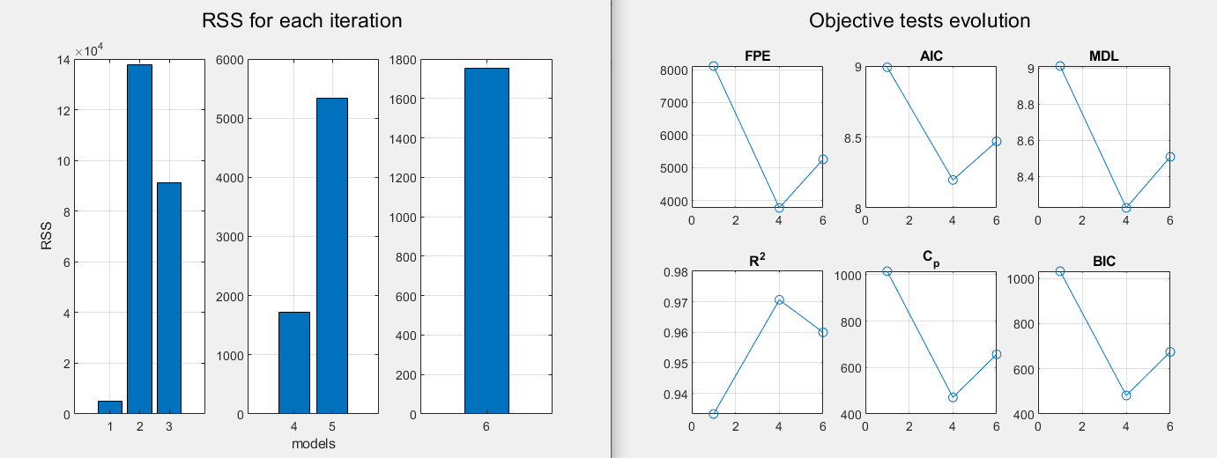
Linear model – forward selection – endpoint 1

Slide 9
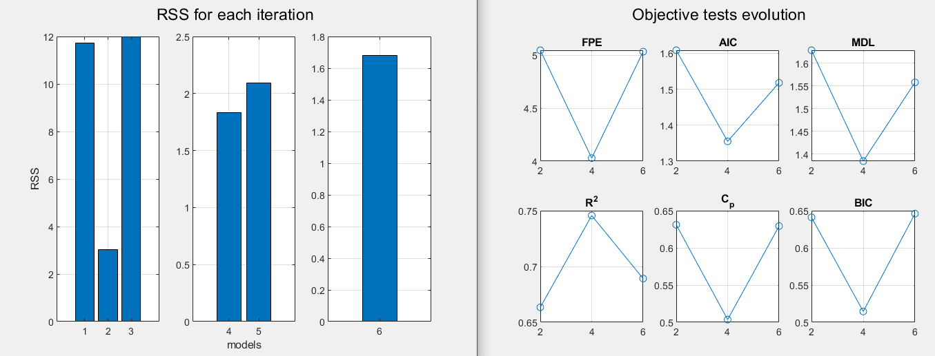
Linear model – forward selection – endpoint 2

Slide 10
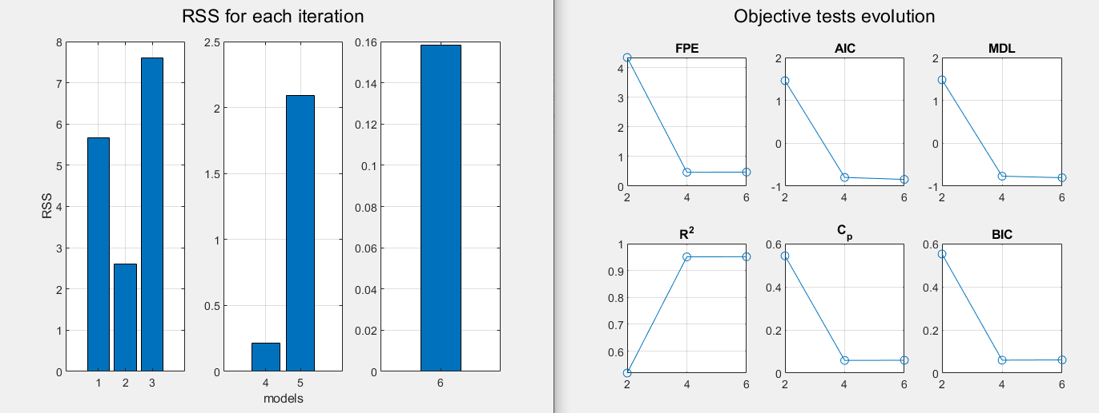
Linear model – forward selection – endpoint 3

Slide 11
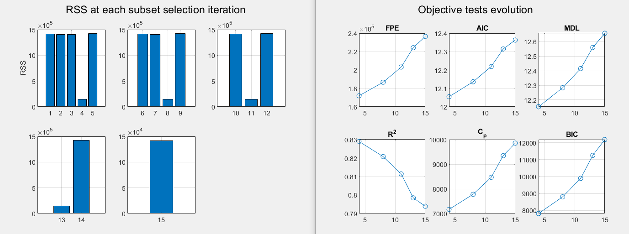
Linear model – forward selection – unique model

Slide 12
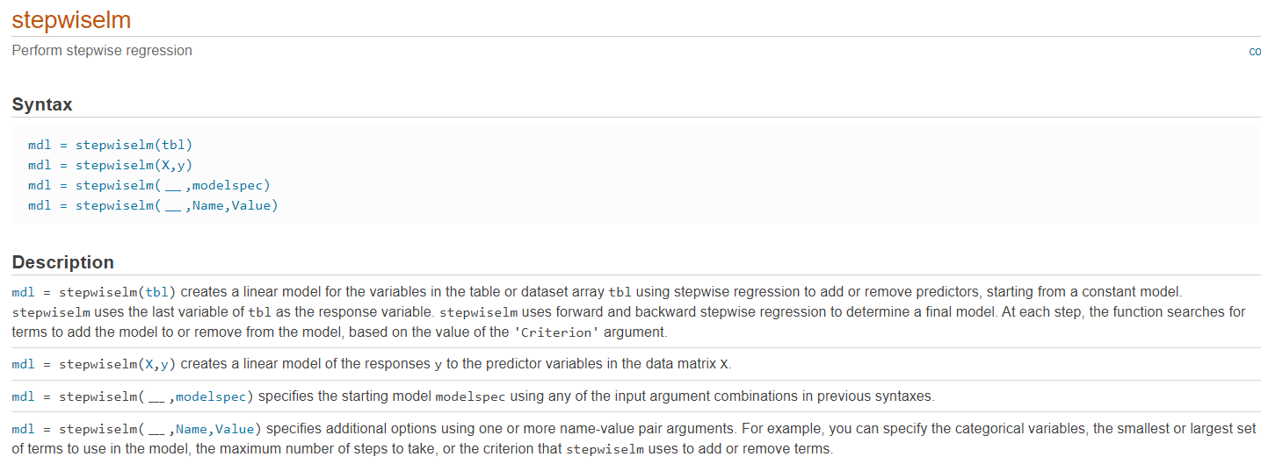
Function: stepwiselm
http://it.mathworks.com/help/stats/stepwiselm.html

Slide 13
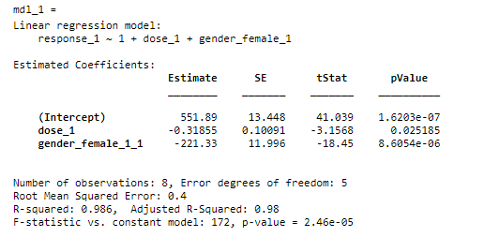
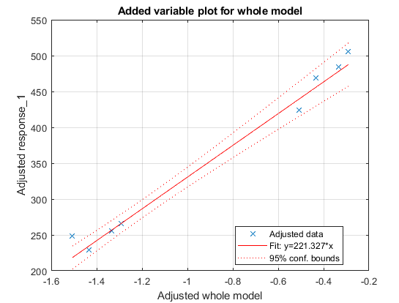
Endpoint1 model with stepwiselm
Confidence intervals
517.3200 | 586.4587
-0.5779 | -0.0592
-252.1636 | -190.4895

Slide 14
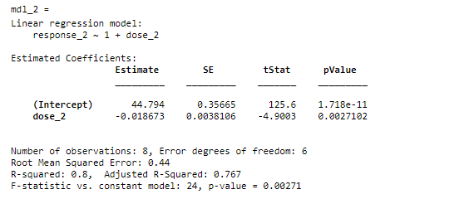
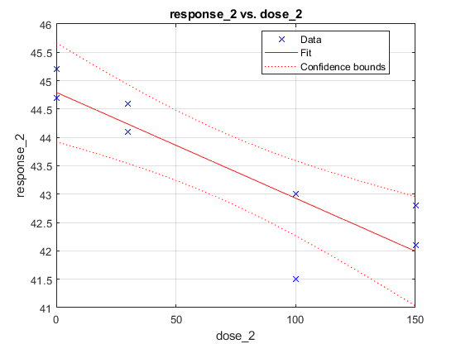
Endpoint2 model with stepwiselm
Confidence intervals
43.9215 | 45.6669
-0.0280 | -0.0093

Slide 15
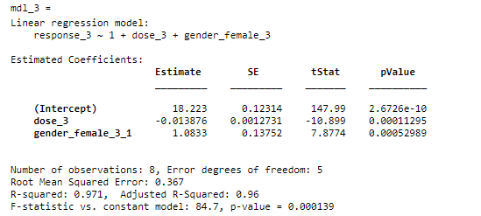
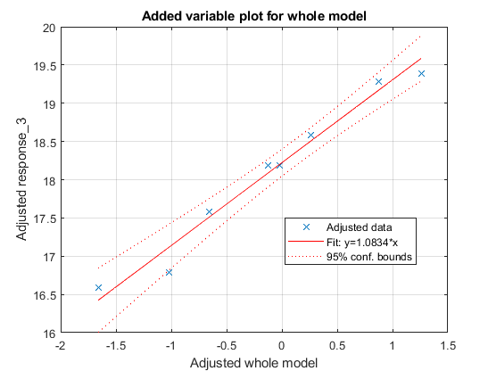
Endpoint3 model with stepwiselm
Confidence intervals
17.9062 | 18.5393
-0.0171 | -0.0106
0.7298 | 1.4368

Slide 16
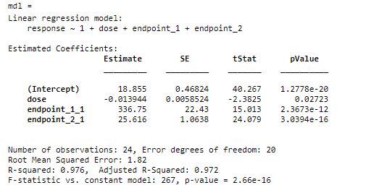
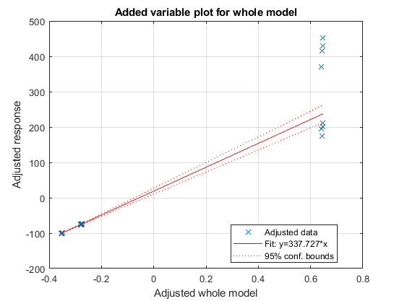
Unique model with stepwiselm
17.8779 | 19.8314
-0.0262 | -0.0017
289.9654 | 383.5427
23.3966 | 27.8347
Confidence intervals

Slide 17
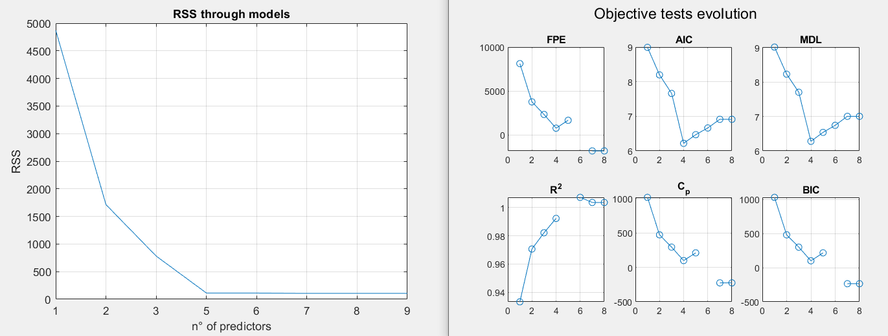
Polynomial model – forward selection – endpoint 1
$$response=$$
$$554.5197 −234.2800∗sex −4.4461∗Dose+1.7645∗NumberofAnimals+0.3559∗Dose∗NumberofAnimals+0.0046∗{Dose}^{2}$$

Slide 18
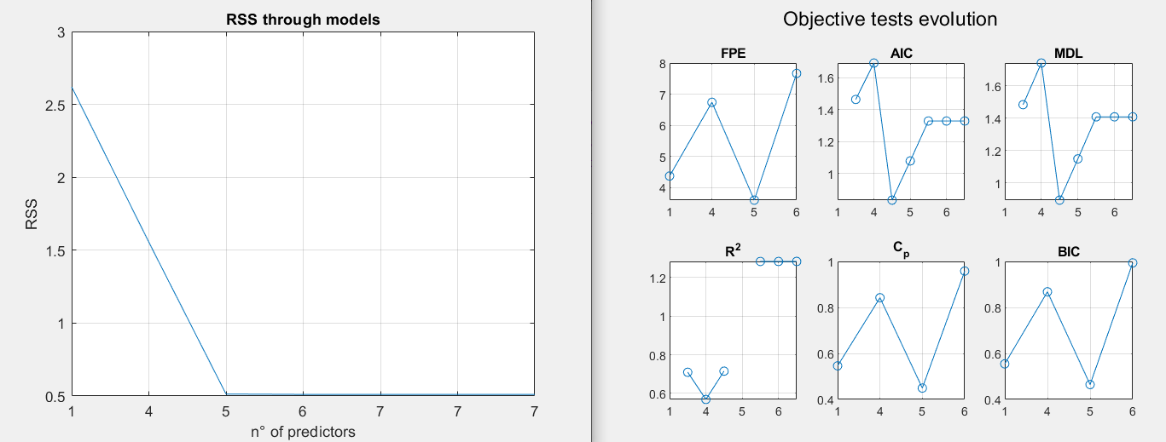
Polynomial model – forward selection – endpoint 2
$$response=$$
$$38,5987 −1,0296∗sex −0,0255∗dose+0,7335∗NumberofAnimals −0,0025∗dose∗NumberofAnimals+2,1592∗{10}^{−4}∗{dose}^{2} −7,3309∗{10}^{−4}∗sex∗dose$$

Slide 19
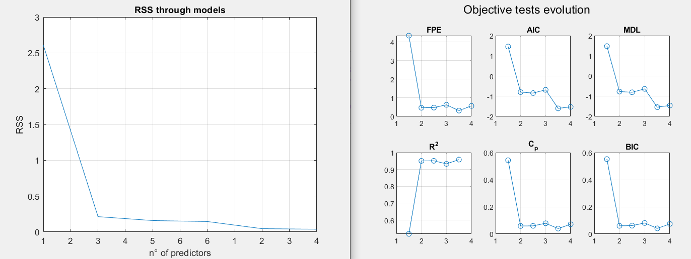
Polynomial model – forward selection – endpoint 3
$$response=$$
$$19,8496+1,0491∗sex−0,0149∗dose−0,1646∗NumberofAnimals+0,0020sex∗dose$$

Slide 20
Polynomial model – forward selection – unique model

Slide 21
Problems
Due to the elevated grade, we observe problem with the invertibility matrix -> rank deficient
We solve our problema using the more reliable linear models.

Slide 22
Jump to the conclusions

Slide 23
Grazie per l’attenzione
Repository: https://github.com/domenico-rgs/EFSA-Project

Slide 33
SlidesCarnival icons are editable shapes. This means that you can:
Resize them without losing quality.
Change fill color and opacity.
Change line color, width and style.
Isn’t that nice? :) Examples:
Find more icons at slidescarnival.com/extra-free-resources-icons-and-maps

Slide 34
Diagrams and infographics

