Slide 1
EFSA-Project
Statistical Learning Theory
UNIPV
A.Y. 2020/2021
Professor: Giuseppe De Nicolao
Team members:
Andrea Vergine
Domenico Ragusa

Slide 2
Goals
1. Plot dose-response data for each pair endpoint-gender (6 plots) with error bars reflecting error size on response measurements.
2. Use subset selection to estimate separate models for the 3 endpoints using gender as categorical variable.
3. Use subset selection to estimate a unique model using gender and endpoint as categorical variables.
4. In points 2. and 3., heteroscedasticity of the data should be taken into account.

Slide 3
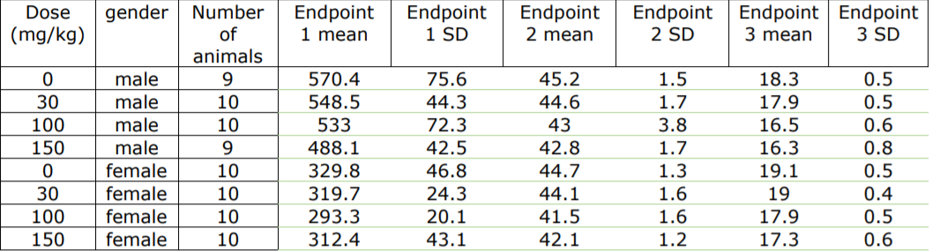
Data table

Slide 4
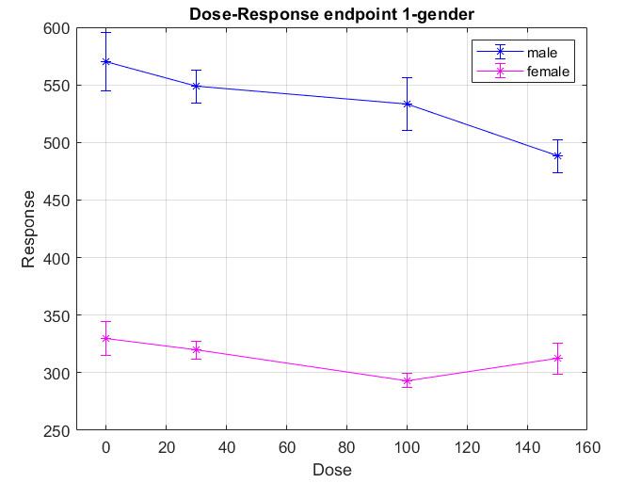
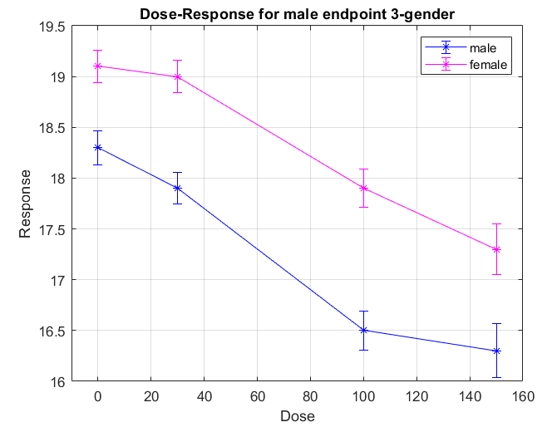
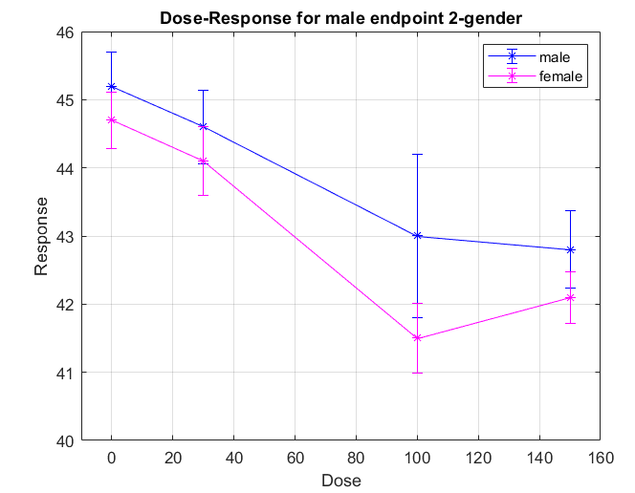
Dose - response data plot

Slide 5
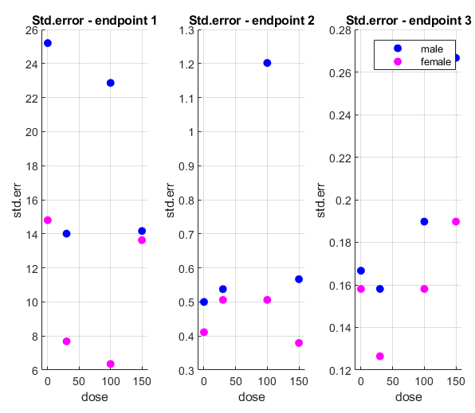
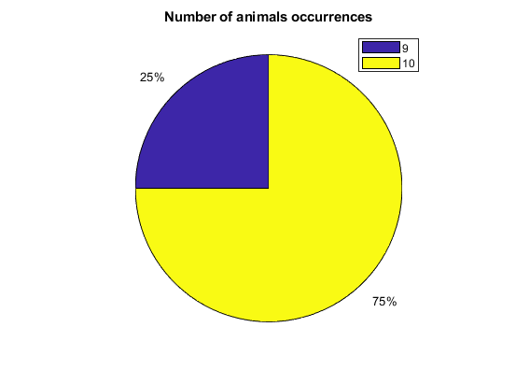
Looking at the data in advance

Slide 6
How to work
Alternatives:
Linear models ->
Fourier series -> No period
Polynomial models -> few data

Slide 7
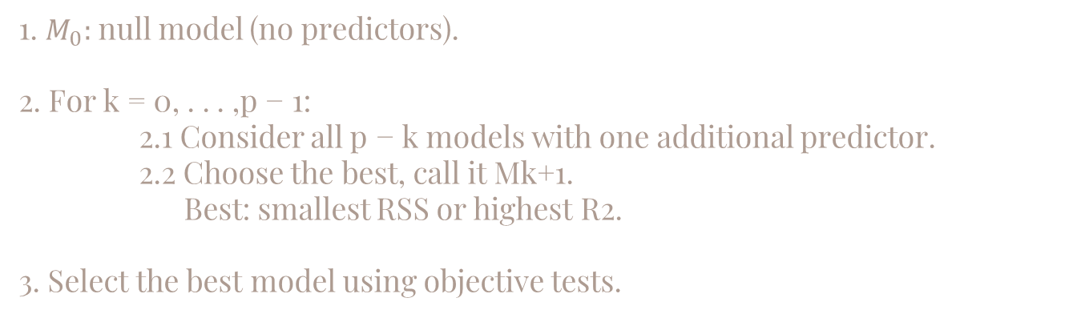

Forward stepwise selection
1. $M_{0}:$null model (no predictors).
2. For k = 0, . . . ,p − 1:
2.1 Consider all p − k models with one additional predictor.
2.2 Choose the best, call it Mk+1.
Best: smallest RSS or highest R2.
3. Select the best model using objective tests.
Take into account heteroscedasticity
$$w_{ii}=\frac{1}{{std.error}^{2}},{ std.error}^{2}=\frac{σ_{i}^{2}}{n}$$

Slide 8
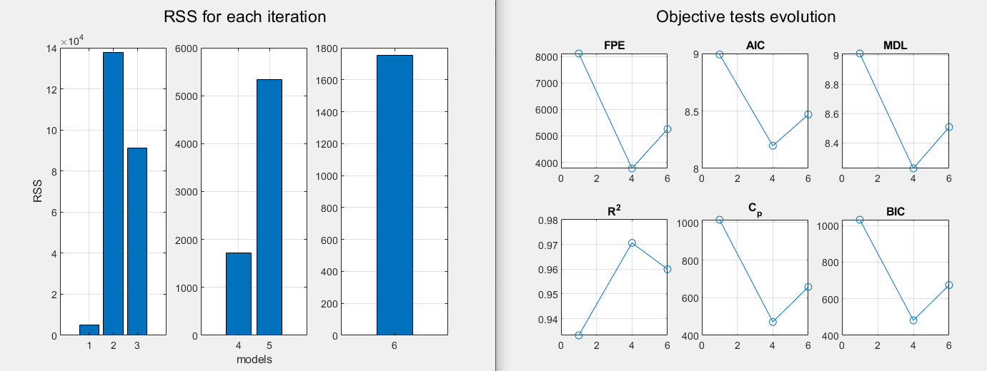
Linear model – forward selection – endpoint 1

Slide 9
Linear model – forward selection – endpoint 1

Slide 10
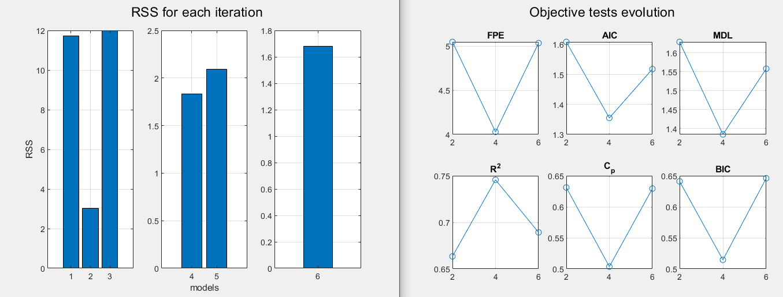
Linear model – forward selection – endpoint 2

Slide 11
Linear model – forward selection – endpoint 2

Slide 12
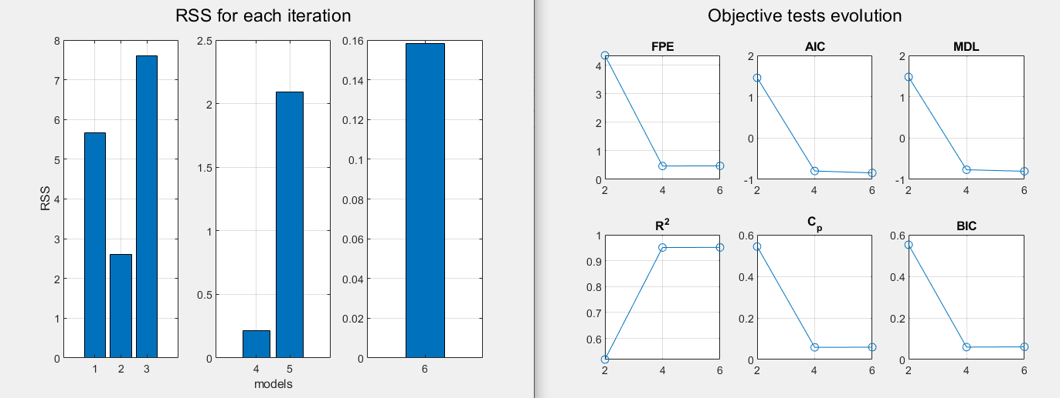
Linear model – forward selection – endpoint 3

Slide 13
Linear model – forward selection – endpoint 3

Slide 14
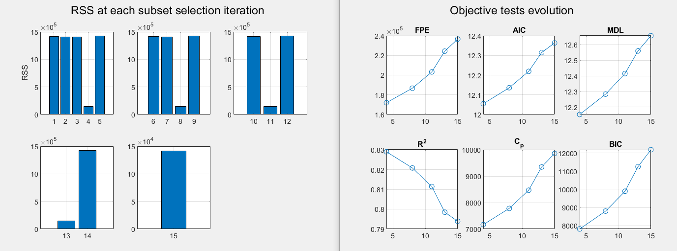
Linear model – forward selection – unique model

Slide 15
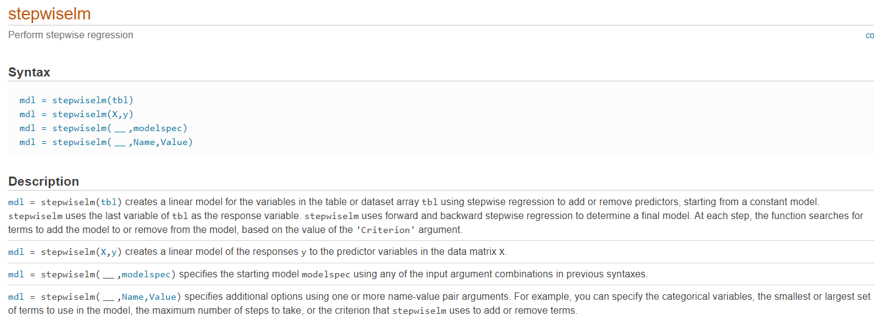
Function: stepwiselm
http://it.mathworks.com/help/stats/stepwiselm.html

Slide 16
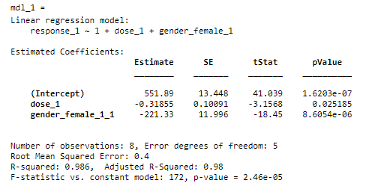
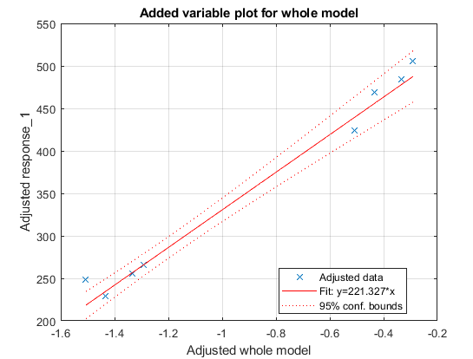
Endpoint1 model with stepwiselm
Confidence intervals
517.3200 | 586.4587
-0.5779 | -0.0592
-252.1636 | -190.4895

Slide 17
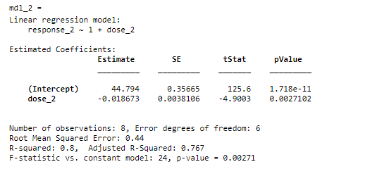
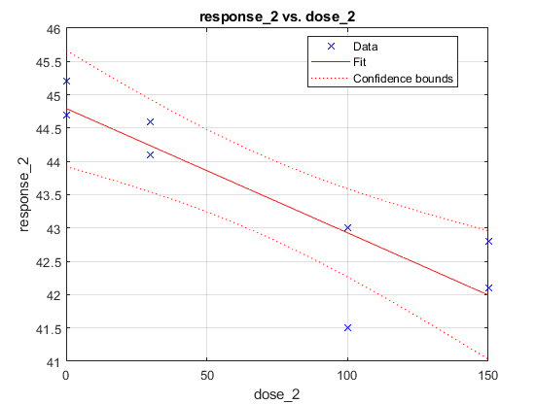
Endpoint2 model with stepwiselm
Confidence intervals
43.9215 | 45.6669
-0.0280 | -0.0093

Slide 18
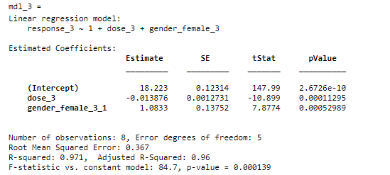
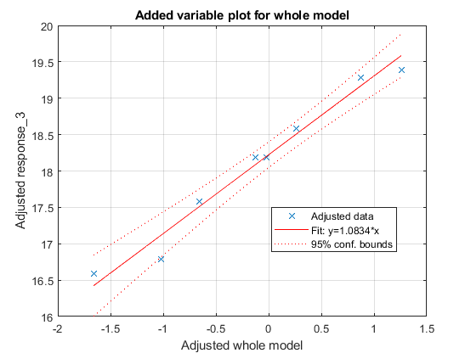
Endpoint3 model with stepwiselm
Confidence intervals
17.9062 | 18.5393
-0.0171 | -0.0106
0.7298 | 1.4368

Slide 19
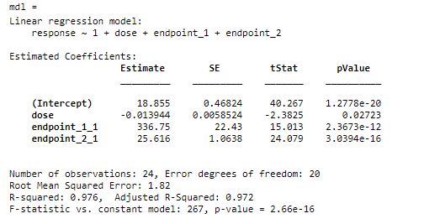
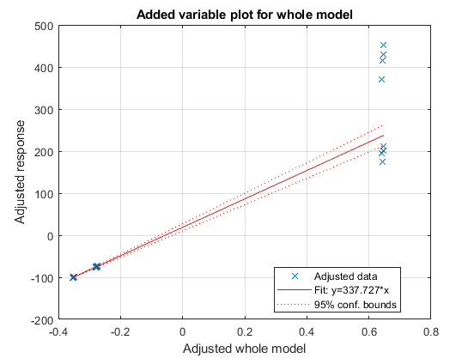
Unique model with stepwiselm
17.8779 | 19.8314
-0.0262 | -0.0017
289.9654 | 383.5427
23.3966 | 27.8347
Confidence intervals

Slide 20
Jump to the conclusions

Slide 21
Grazie per l’attenzione
Repository: https://github.com/domenico-rgs/EFSA-Project

Slide 31
SlidesCarnival icons are editable shapes. This means that you can:
Resize them without losing quality.
Change fill color and opacity.
Change line color, width and style.
Isn’t that nice? :) Examples:
Find more icons at slidescarnival.com/extra-free-resources-icons-and-maps

Slide 32
Diagrams and infographics

