Slide 1
Mechanisms to Protect Intellectual Properties: the Physically Unclonable Functions Technology Approach
tesi di laurea magistrale
Anno Accademico 2014/2015
relatore
Ch.mo prof. Antonino Mazzeo
correlatore
Ing. Mario Barbareschi
candidato
Pierpaolo Bagnasco
Matr. M63/354

Slide 2
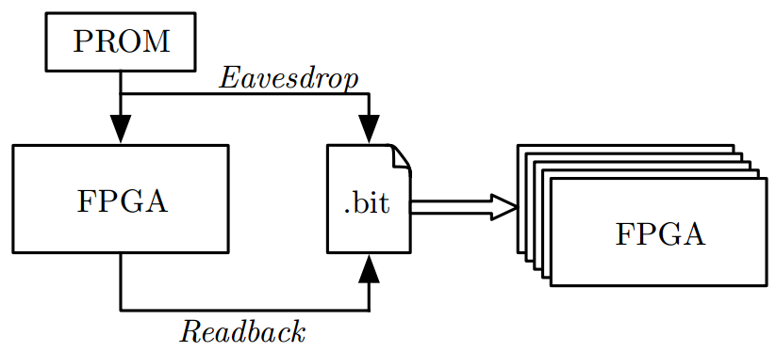

Introduction
Problems:
  Theft of Intellectual Property (IP)
  Production of counterfeits components
Threats to hardware design:
  Reverse engineering
  Cloning
  Overbuilding
  Tampering

Slide 3
Physically Unclonable Functions
Physical(ly) Unclonable Functions (PUFs) exploit physical properties of imperfections which are randomly introduced by the manufacturing processes
The function maps a set of inputs (challenges) to a set of outputs (responses), defining an unclonable and unique challenge/response pairs (CRPs) set
The PUF concept can be used also in Integrated Circuits (ICs), with the introduction of Silicon PUFs
  the process is the photolithography;
  challenges are the applied electrical stimuli;
  responses are the PUF's outputs.

Slide 4
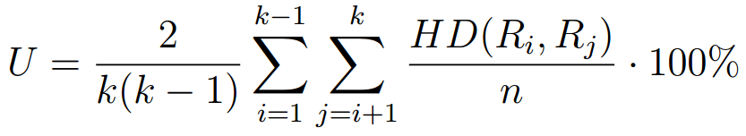
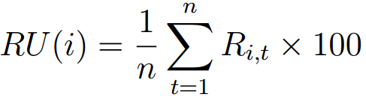
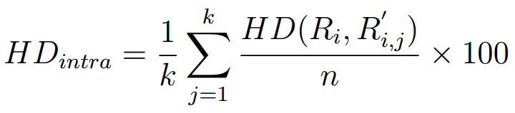
PUF Quality Factors
Uniqueness:
Uniformity:
Reliability:
Notes:
Uniqueness: within a PUF population, the Hamming Distance distance between two PUFs responses should be as high as possible
Uniformity: PUFs’ responses have to be characterized by a uniform distribution of logic-0 and logic-1
Reliability: as the PUF relies on measurement of electrical phenomena, the responses may change during time due to external conditions, such as temperature and voltage

Slide 5
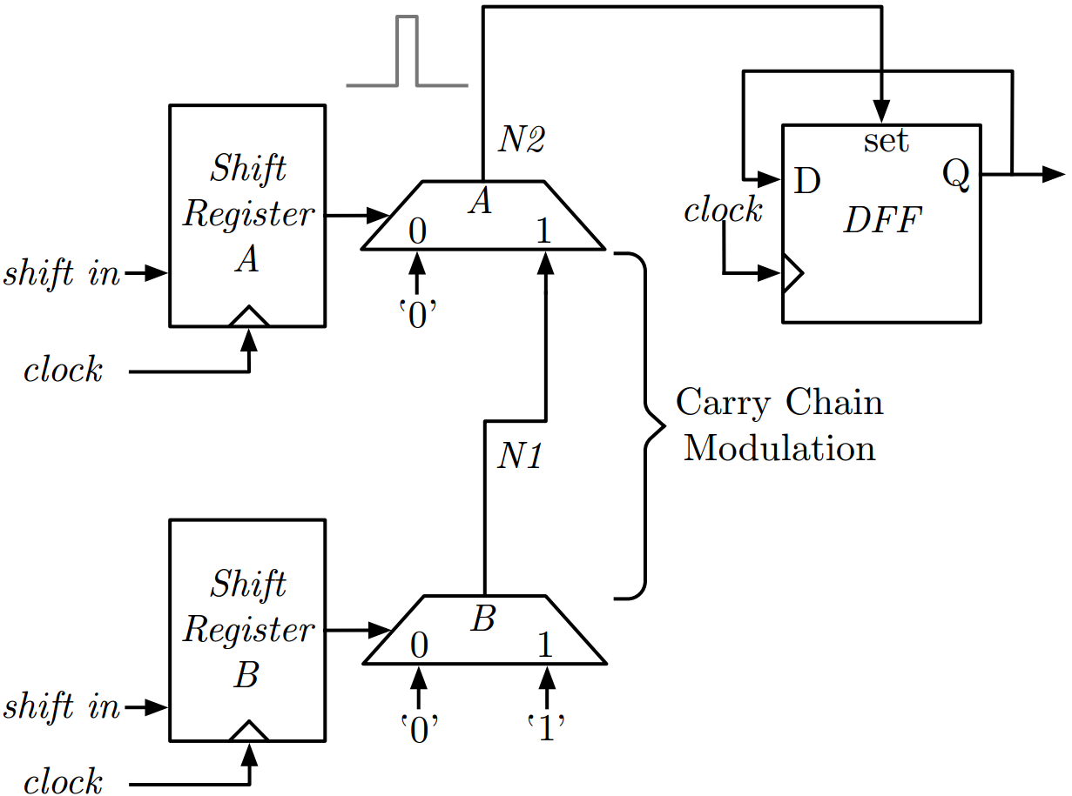
Anderson PUF Cell
A glitch is generated trough 2 alternating sequences in counter-phase
Due to manufacturing imperfections, the glitch has a different width for each cell
The cell design perfectly matches the Xilinx Virtex-5 FPGA structure
We ported the Anderson PUF on the Spartan-3E FPGA, enabling protection mechanisms even on low-cost devices

Slide 6
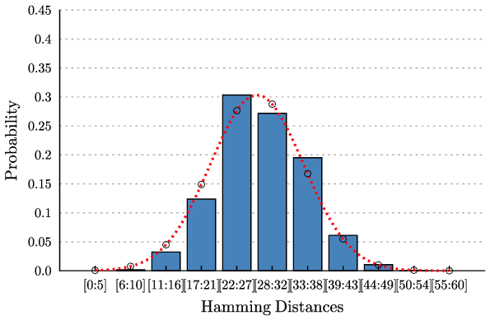
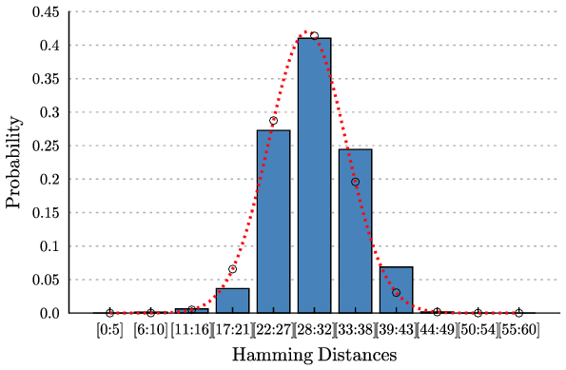
Anderson PUF Qualities
15 different FPGAs (XC3S1200E)
Anderson PUF
Average Uniqueness value: 47.18%
Average Uniformity Value: 50.59%
Enhanced Anderson PUF
Average Uniqueness value: 49.37%
Average Uniformity Value: 50.99%

Slide 7
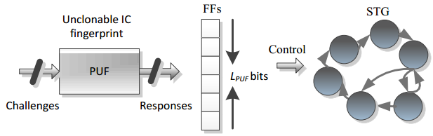
FSM-Based IP Licensing Mechanism
Enables a protection mechanism for low-cost FPGAs
A secure FSM is added into the original IP core design
The FSM enables the IP core only if the PUF response and the license are valid
FPGA | Slices | Flip-flops
XC3S1200E | 1.25% | 0.43%
XC7Z020 | 0.26% | 0.07%
60 bits case of study

Slide 8
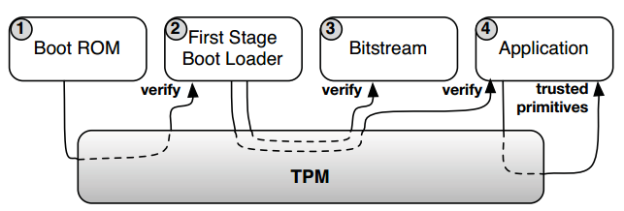
Dynamic Hardware-IP Protection
A Security Module (SM) is programmed into the device exploiting a secure boot procedure based on Trusted Platform Module (TPM)
The SM includes the Anderson PUF and a SW decryption engine
(Chain of trust)
The SM decrypts an encrypted partial bitstream (HWIP) using as key a specific PUF response, then partially re-configures the FPGA with the decrypted bitstream
Primitive | Bitstream size (150 kBytes) | Bitstream size (600 kBytes)
AES-CBC | 170 ms | 682 ms
AES-GCM | 280 ms | 1122 ms

Slide 9
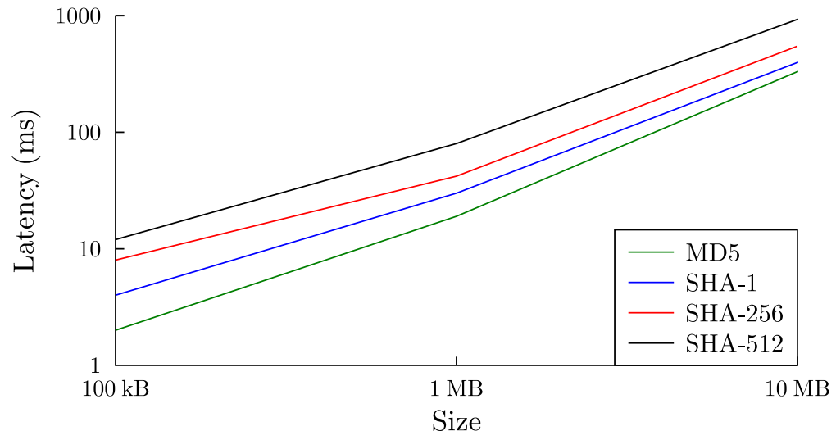
Implementation of a Trusted Platform Exploiting Android OS
We developed a customized version of Android OS which checks and installs only valid applications (apks)
The TPM boot procedure is exploited in order to build a secure and trusted platform
The validity check is based on the XML manifest of an Android app, which comprises the enciphered digest of the application executable

Slide 13
Future Work
Defining a model for the glitch generation of the Anderson PUF by varying the supply voltage
Analyzing the impact on responses of the logic surrounding a PUF in order to mitigate its effect
Implementing low-weight mechanisms to enhance PUFs reliability
Implementing the Android check mechanism on the most recent Android version and on other operating systems

