Slide 1
Prototype of Domeo new plugin
DDI plugin for : “dikbD2R:inhibits” and “dikbD2R:maximum_concentration”
Presenter: Yifan Ning

Slide 2
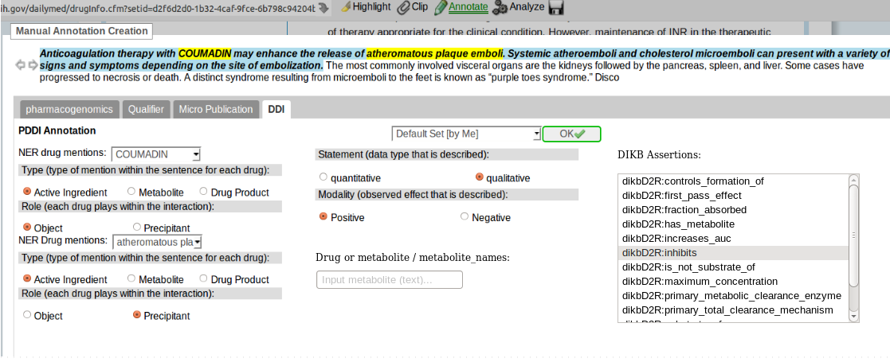
Assertion inhibits

Slide 3
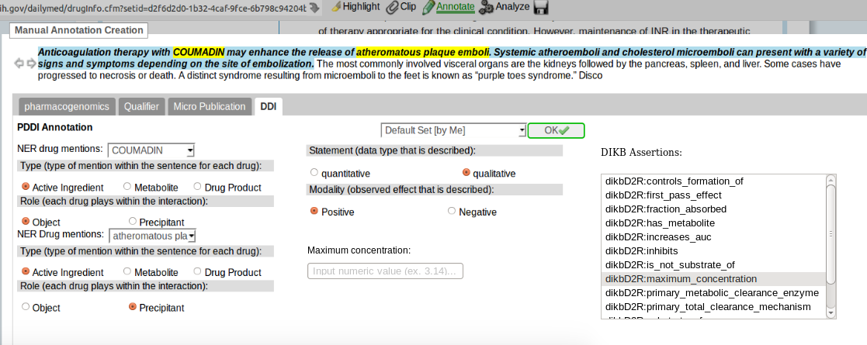
Assertion maximum concentration

