Slide 1
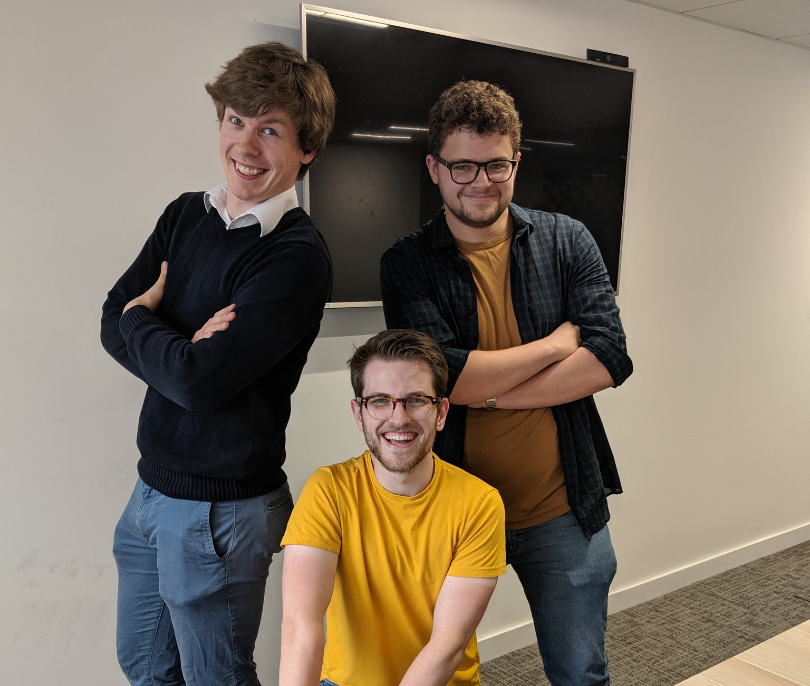

In the loop
Henri Williams, Dom Goodwin, Ben Farley
Article summarization and question answering (BERT)

Slide 2
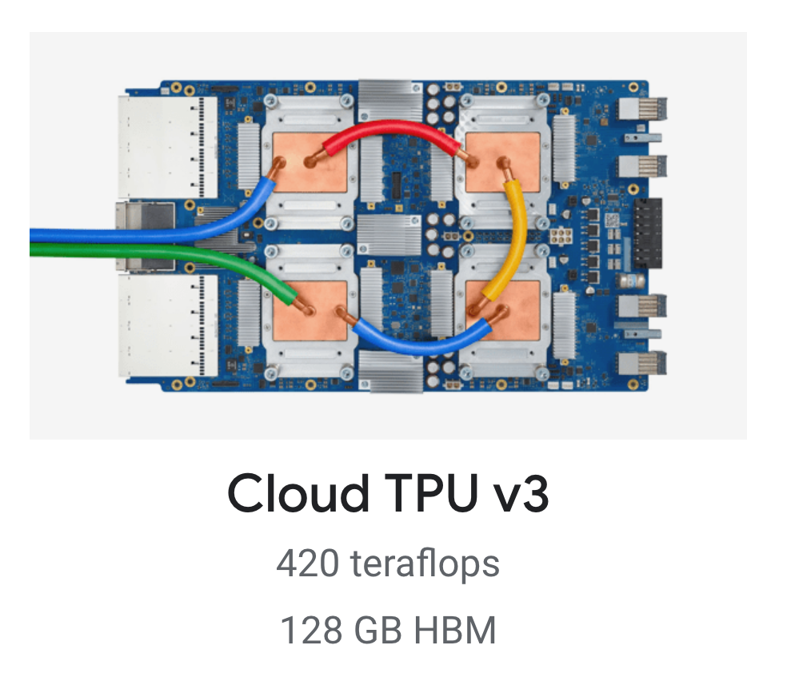
Training the model
Finetuning of BERT Base model
Trained on a v3-8 TPU
64GB of memory
SQuAD 2.0 dataset
Took < 1hour
BERT Base Model
QA Model
Summary Model
Other NLP Model…

Slide 3








How we got here
Training
Took BERT Base model
Finetuned into summary model
Developing
Summary backend
QA Backend
Deploying
Dockerised applications
Finetuned into QA model
Front end
Put into CUDA focused images
Deployed onto Kubernetes cluster (CaaS)
SQuAD2.0
BERT

Slide 4
Use cases
Document guidance (Gift aid)
News summaries and briefings
Content filtering
Can be trained for multi-lingual cases

Slide 5
Demo
Summary
Question answer

Slide 6
Further reading
https://rajpurkar.github.io/SQuAD-explorer/
https://github.com/google-research/bert

