Slide 1
Next steps in HTML and CSS
Data Studio – Lede Program
July 20, 2019
Ashlyn Still
@ashlynstill
as5962@columbia.edu

Slide 2
How many different CSS style properties are there?
https://www.w3.org/Style/CSS/all-properties.en.html
Notes:
We can only cover a fraction of these, but I’ve been writing CSS for 8+ years and I still google CSS properties every single day
The best approach is to understand the basic structure and style properties you use the most frequently, and then google the rest. There are so many cool CSS tutorials and code snippets out there to explore

Slide 3
Quick review!
CSS stands for Cascading Style Sheets because the computer reads it top to bottom and inherits the most recent reference OR the most specific reference to a selector.
CSS describes how the HTML content should look on the page
You attach CSS to your HTML elements via CSS selectors referencing tags, classes, and ids on your HTML elements.

Slide 4
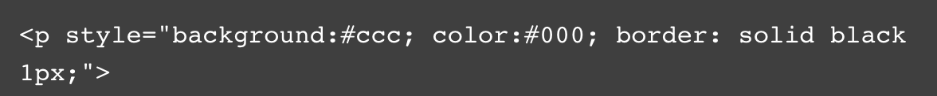
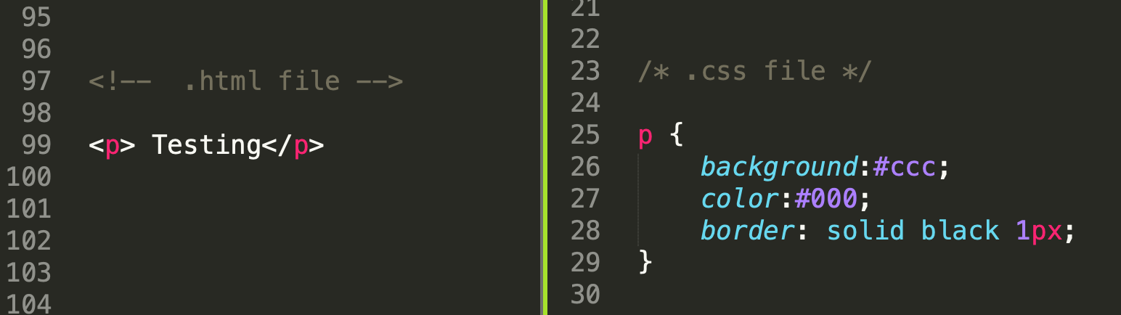
Inline styles vs separate CSS
Notes:
Almost all web pages require a lot of CSS, and using inline styles can get really messy really quick!
It’s a lot easier to manage your styles and page consistency using CSS, especially when you add in classes and ids to your elements.

Slide 5
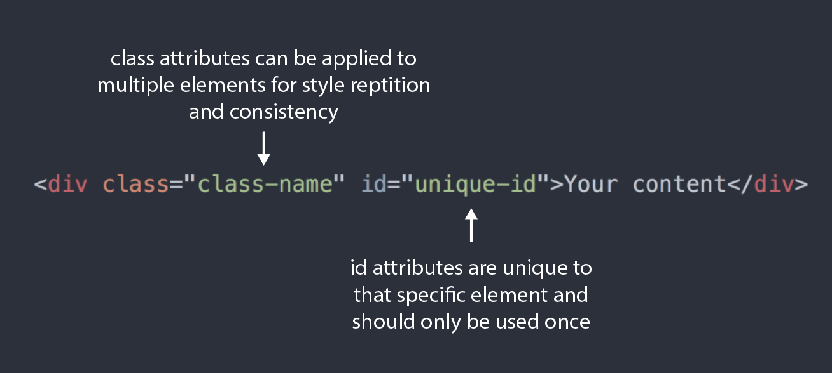

Slide 6
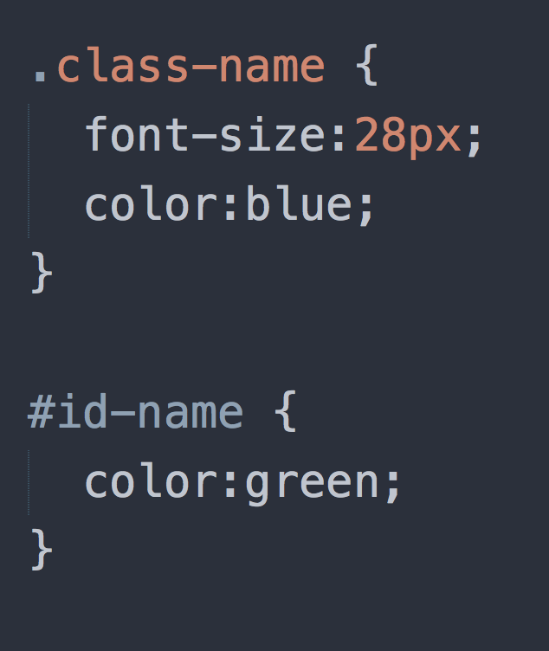
Class selectors in CSS are referenced with a period
ID selectors in CSS are referenced with a hash (#)
Notes:
This is the format for how css looks

Slide 7
CSS units of measurement
Numeric values
Length values for specifying e.g. element width, border thickness, or font size, and unitless integers for specifying e.g. relative line width or number of times to run an animation.
Percentages:
Specifying size or length — relative to a parent container's width or height for example, or the default font-size. These are often to facilitate responsive design (e.g. creating "liquid layouts", which automatically adjust to fit on different screen sizes).
Colors
Specifying background colors, text colors, etc.
Functions
Specifying e.g. background images or background image gradients.
Notes:
https://www.w3.org/Style/Examples/007/units.en.html
https://developer.mozilla.org/en-US/docs/Learn/CSS/Introduction_to_CSS/Values_and_units

Slide 8
What can CSS do?
A pure CSS mona lisa
How to parallel park
The Avengers
Notes:
Just a few crazy ways people have used CSS

Slide 9
Download the source file
https://github.com/ashlynstill/data-studio-learning-css

Slide 10
Typography: How do we style our text in CSS?

Slide 11
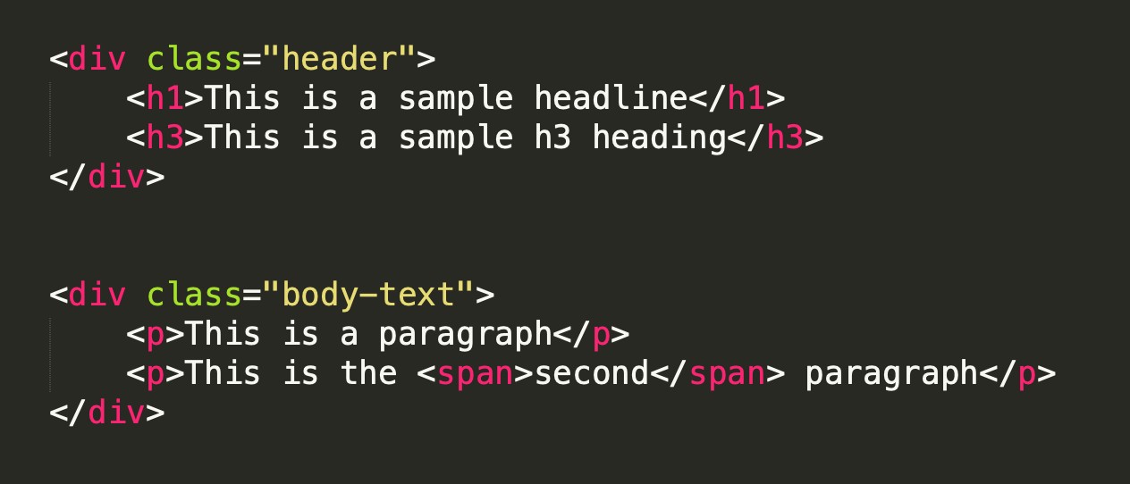

Slide 12
Layout: Styling our block elements with CSS

Slide 13
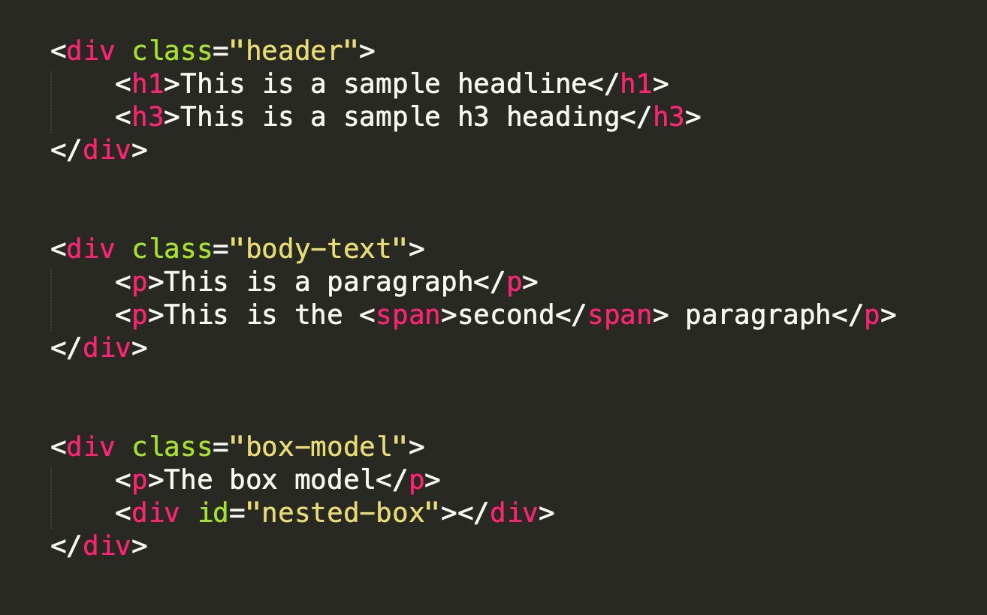

Slide 14
The Box Model
The browser renders every element on the page as a box
The box model is how we style that box
The box is made of four parts: content, padding, border, margin

Slide 15
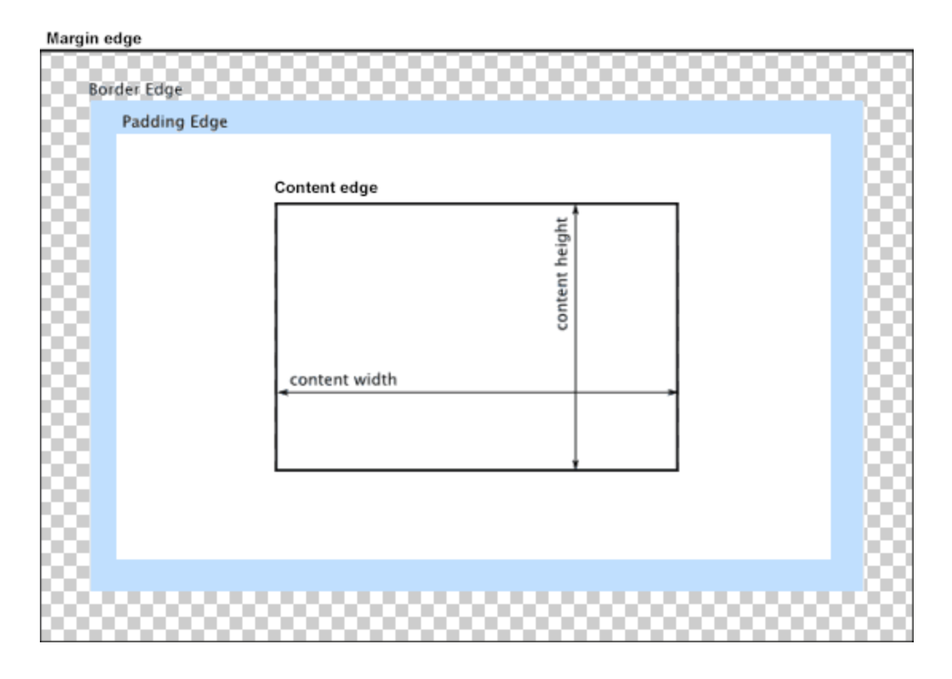
Notes:
The box model

Slide 16
Nesting and positioning within the box model
We can use what we know about the box model to position elements inside each other
Each “box” is relative to the other “boxes” on the page
We can use the css `position` attribute to made adjustments to how the boxes relate to each other

Slide 17
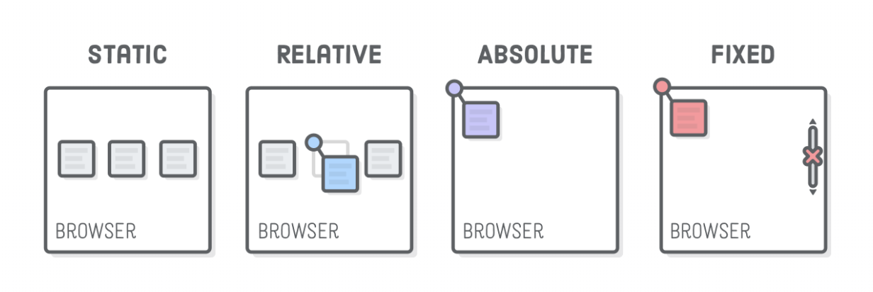
Notes:
https://internetingishard.com/html-and-css/advanced-positioning/

Slide 18
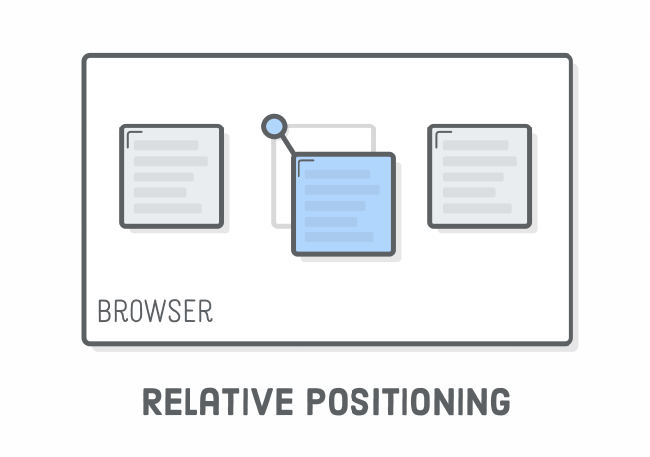
Notes:
“Relative positioning” moves elements around relative to where they would normally appear in the static flow of the page. This is useful for nudging boxes around when the default flow is just a little bit off.
The position: relative; line makes it a positioned element, and the topand left properties let you define how far it’s offset from its static position. This is sort of like setting an (x, y) coordinate for the element.

Slide 19
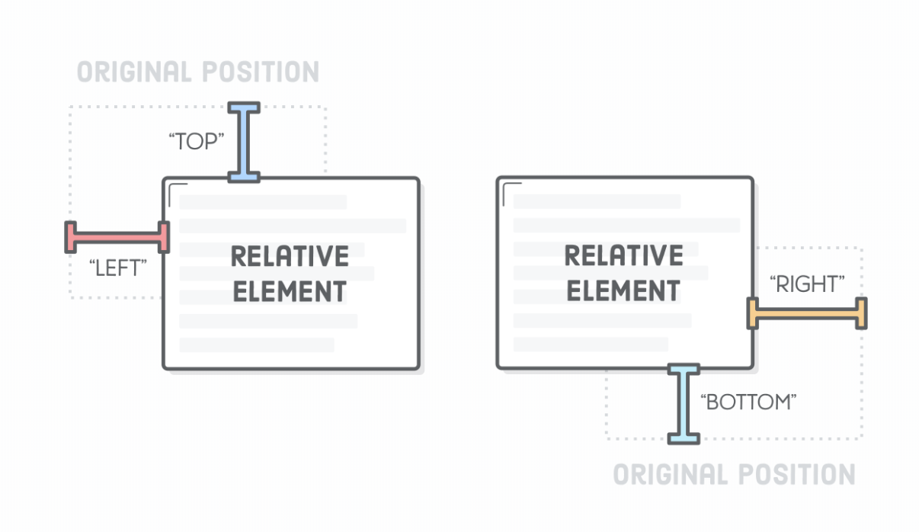
Notes:
Relative positioning works similarly to margins, with one very important difference: neither the surrounding elements or parent element are affected by the top and left values. Everything else renders as if .item-relativewas in its original position. Think of the offsets as being applied after the browser finishes laying out the page.
The top and left properties measure from the original box’s top and left edges, respectively. We can offset relative to the other edges with the bottom and right properties.

Slide 20
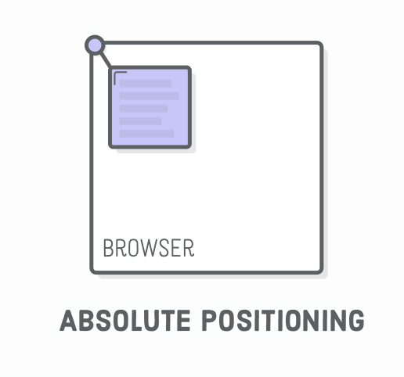
Notes:
“Absolute positioning” is just like relative positioning, but the offset is relative to the entire browser window instead of the original position of the element. Since there’s no longer any relationship with the static flow of the page, consider this the most manual way to lay out an element
The other interesting effect of absolute is that it completely removes an element from the normal flow of the page.

Slide 21
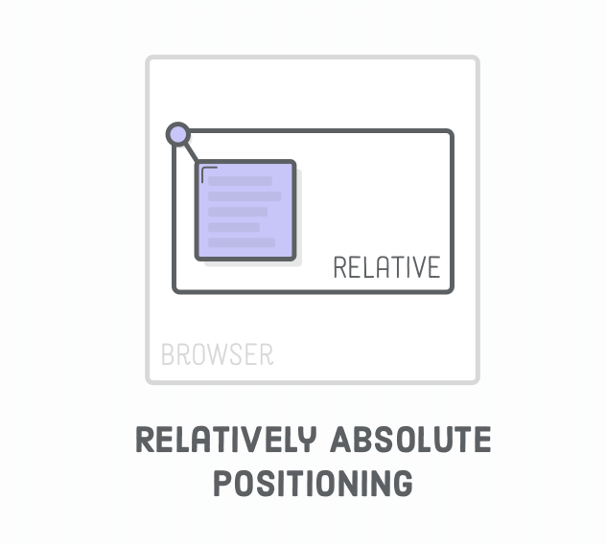
Notes:
Absolute positioning becomes much more practical when it’s relative to some other element that is in the static flow of the page. Fortunately, there’s a way to change the coordinate system of an absolutely positioned element.
Coordinates for absolute elements are always relative to the closest container that is a positioned element. It only falls back to being relative to the browser when none of its ancestors are positioned.

Slide 22
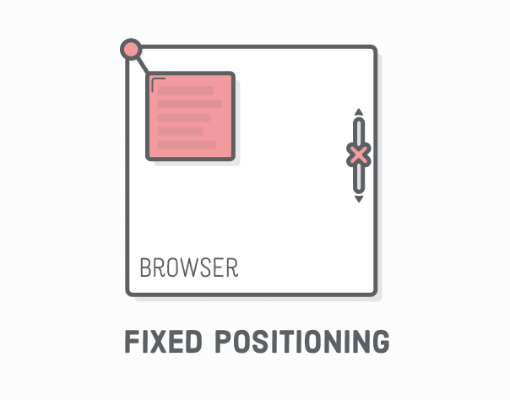
Notes:
“Fixed positioning” has a lot in common with absolute positioning: it’s very manual, the element is removed from the normal flow of the page, and the coordinate system is relative to the entire browser window. The key difference is that fixed elements don’t scroll with the rest of the page.

Slide 23
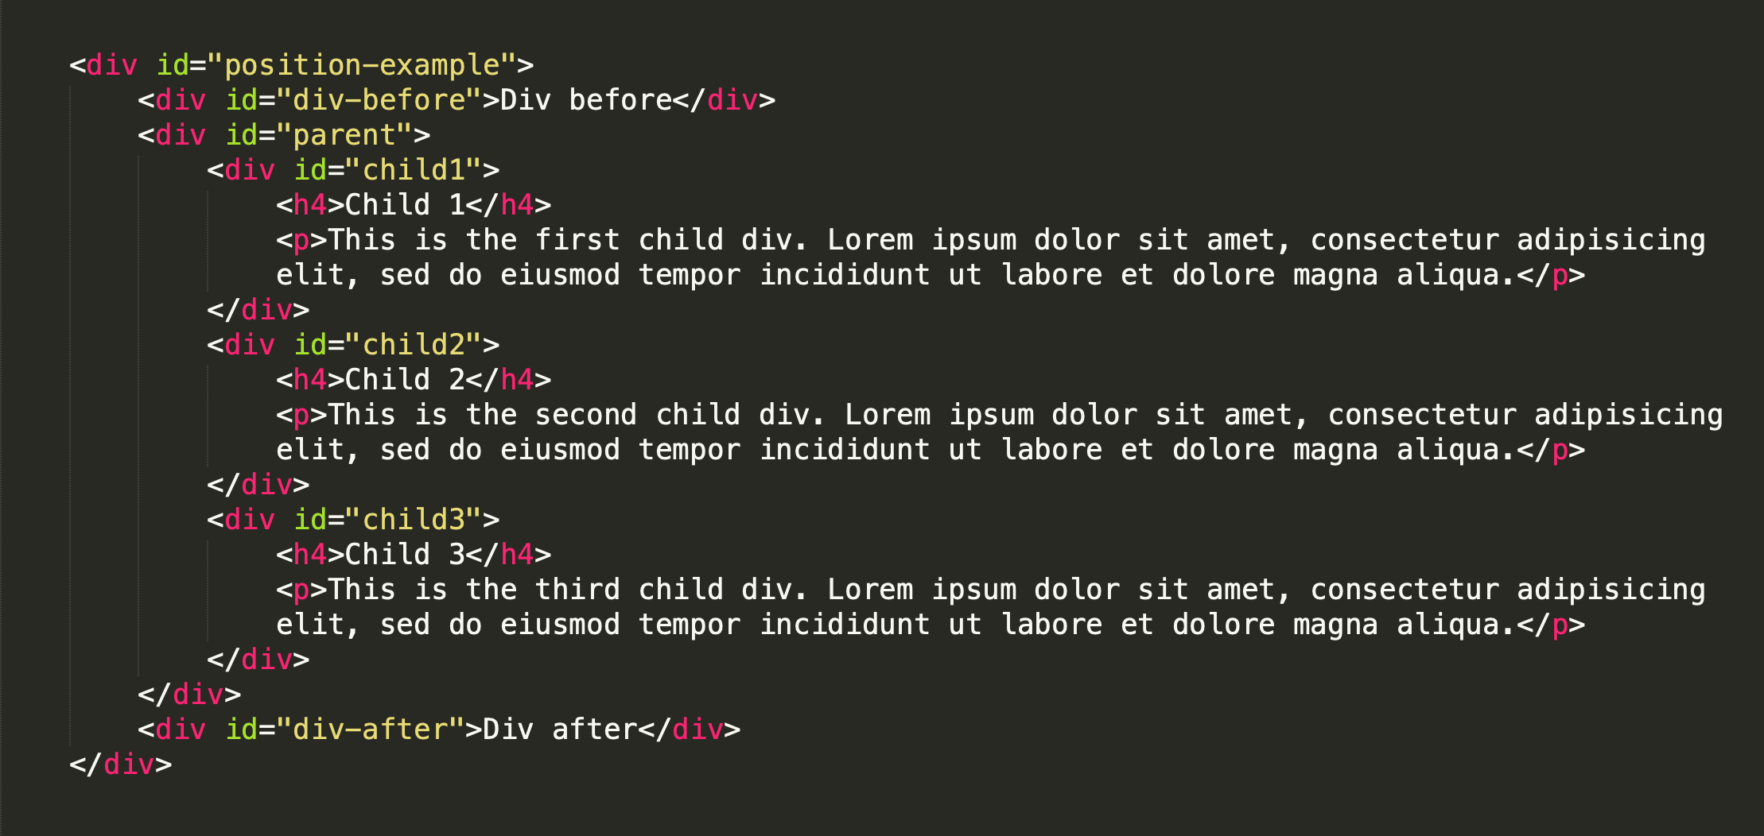
Notes:
Line 39 in index.html
Ashlyn: use list in your guide for tasks to do

Slide 24
Today’s activity:
We’re making restaurant menus again, but this time we’re going to make them as web pages using HTML and CSS!
You can re-clone the learning-css repo and empty out the HTML to write your own, or you can duplicate the directory we worked on today and clear out the work we did

Slide 25
Requirements
Nested divs
Styled inline and block elements
Side-by-side divs
An image
Proof you used the box model: Make some adjustments to margins and padding
Use the elements of design we talked about on Wednesday!

Slide 26
display: flex;
Notes:
Another great way to lay out your page: Flexbox!
https://developer.mozilla.org/en-US/docs/Web/CSS/CSS_Flexible_Box_Layout/Basic_Concepts_of_Flexbox
Flexbox froggy game: https://flexboxfroggy.com/

