Slide 1
Development of a Reference Application for the OWASP Mobile Application Security Testing Guide (MASTG)
BA Thesis Presentation
Dominic Kronig, Software Engineering Group
10.02.2026 Engehalde Bern

Slide 2
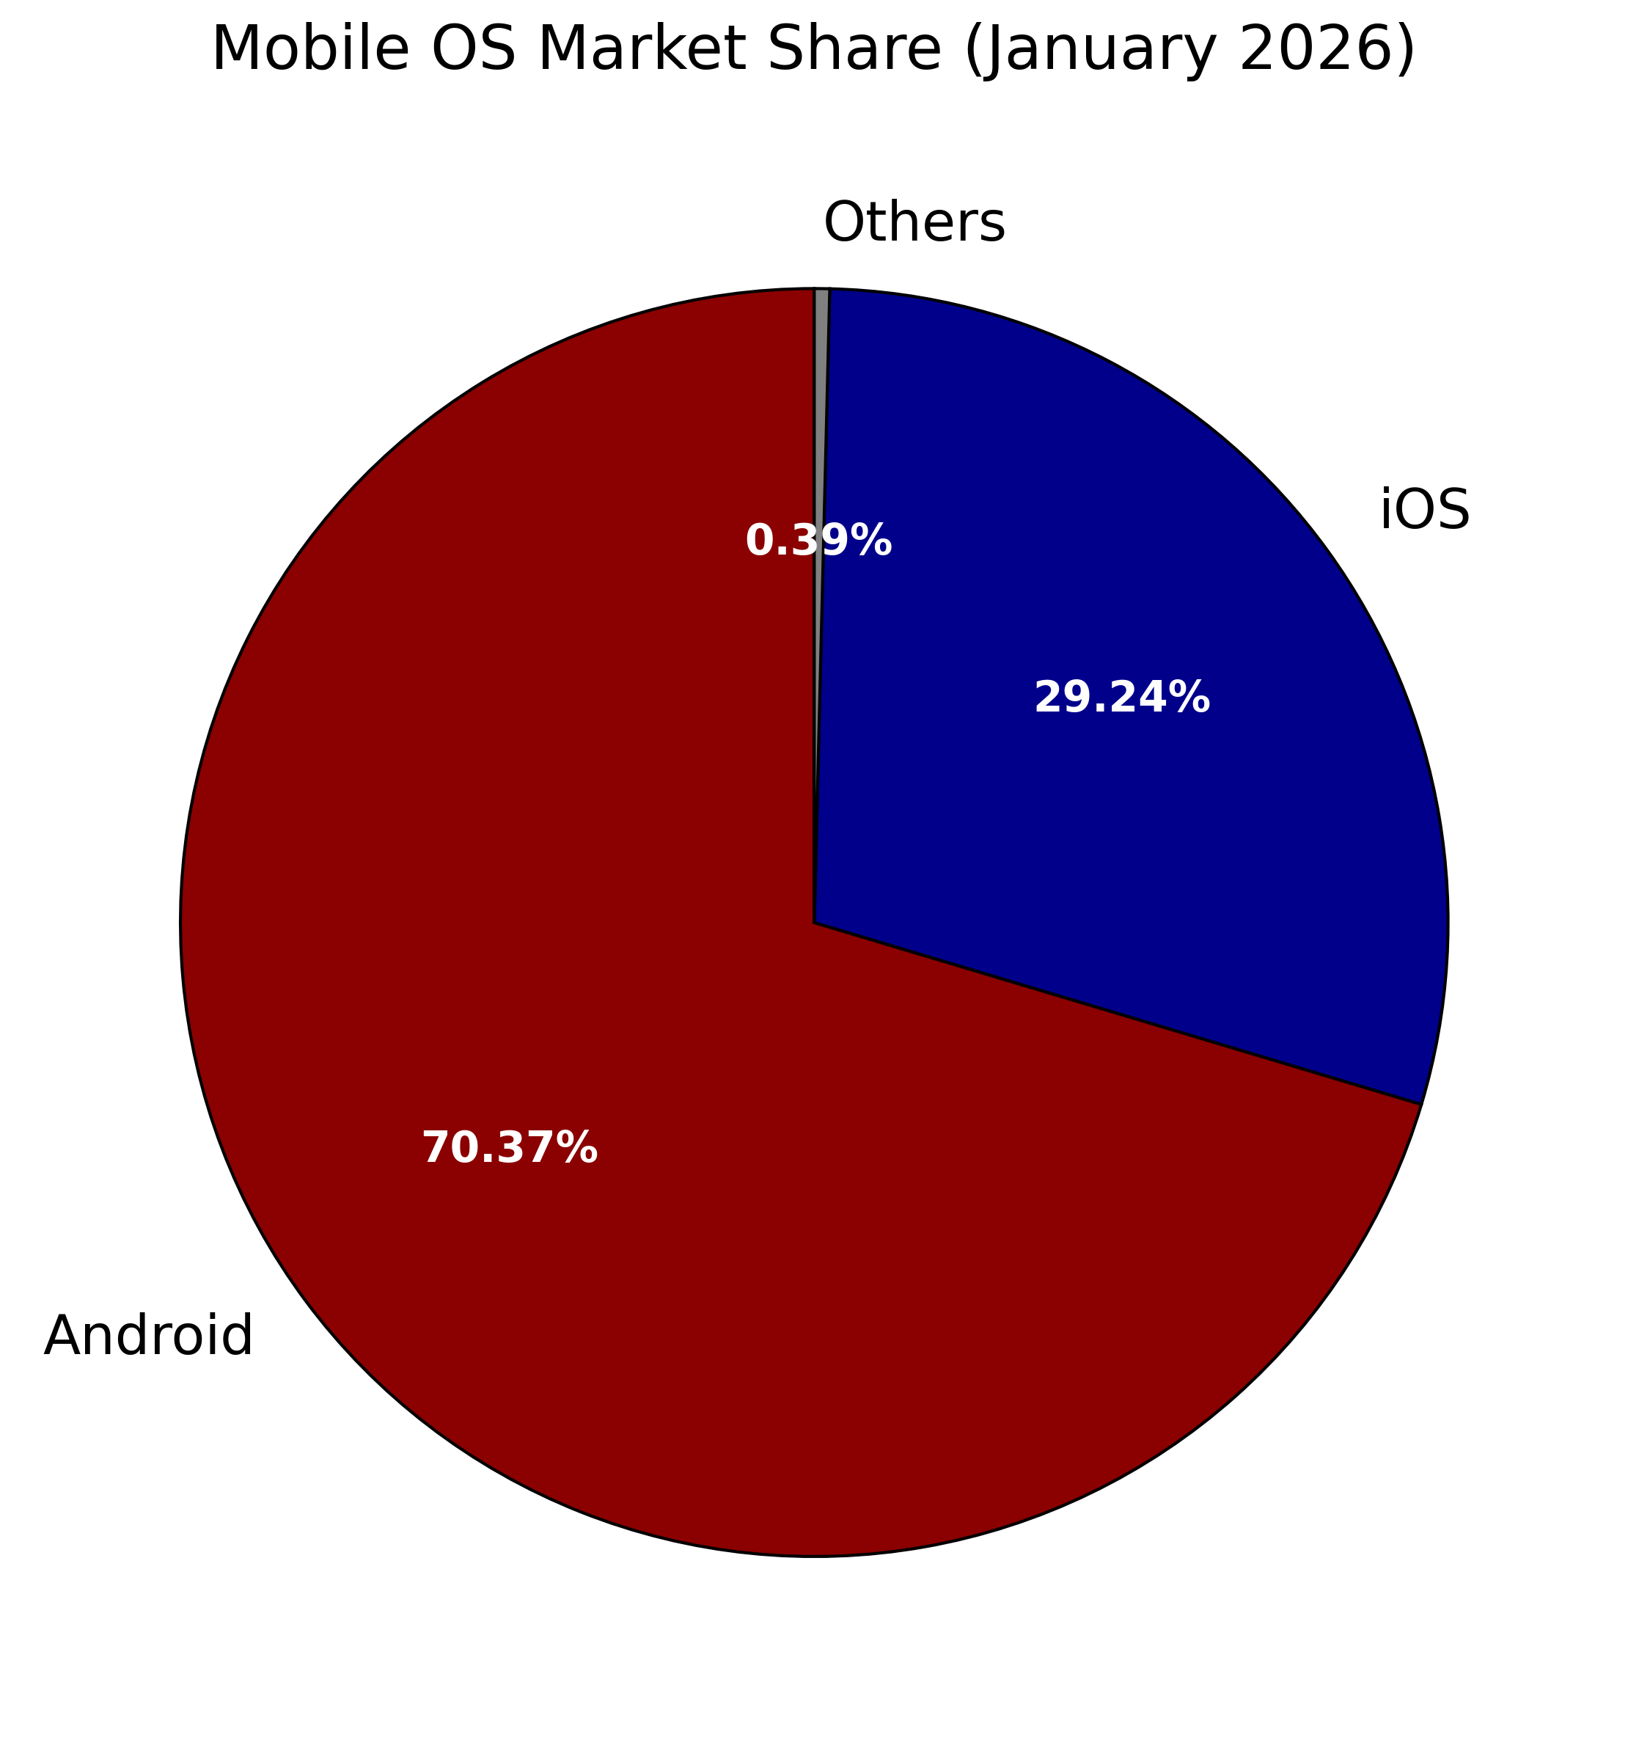
State of Android App Security
Android Dominance
Android most dominant mobile market
Sideloading of apps
Automated security review
Prone to vulnerabilities
(StatCounter Global Stats, 2026)

Slide 3
State of Android App Security
The Problem in Numbers
How many security vulnerabilities per app?
Around 5?
Around 15?
More than 30?

Slide 4
State of Android App Security
The Problem in Numbers
Across the 18 most popular Android categories:
39
vulnerabilities per app
63%
apps show vulnerabilities
(Ferrari et al., 2025; Tech Inside Out 2021)

Slide 5
State of Android App Security
The Problem in Numbers
In terms of financial apps:
88%
of banking apps
84%
of budgeting apps
80%
of payment apps
(Tech Inside Out, 2021)

Slide 6
State of Android App Security
The Problem in Numbers
Of 272 mobile health apps in the US:
50%
use deprecated cryptography
25%
access GPS data
42
transmit unencrypted data
(Stevenson & Das, 2025 )

Slide 7
State of Android App Security
The Causes
What can be done about this?
☐ Find existing vulnerabilities
☐ Prevent new vulnerabilities

Slide 8
State of Android App Security
The Causes
Of interviewed developers:
78%
lacked
security knowledge
63%
cited security
as too complex and expensive
(Chiboora et al., 2023)

Slide 9
Understanding the Challenge
The Goals
Lack of knowledge…
…make mobile security knowledge more accessible
Too complex and expensive…
…promote the best security testing tools

Slide 10
State of Android App Security
The Causes
What can be done about this?
🗹 Find existing vulnerabilities
☐ Prevent new vulnerabilities

Slide 11
State of Android App Security
The Causes
What can be done about this?
🗹 Find existing vulnerabilities
🗹 Prevent new vulnerabilities

Slide 12
Understanding the Challenge
Making Mobile Security More Accessible
OWASP MAS(TG)
MASTG reference apps
Challenge: Lack of coverage

Slide 13
Understanding the Challenge
Promoting the Best Security Testing Tools
Tools for vulnerability detection
Static & Dynamic Application Security Testing (SAST, DAST)
Abundance of such tools
Challenge: How to know which ones are good?

Slide 14
Understanding the Challenge
Our Purpose
By developing well documented MASTG apps we…
…improve educational value of OWASP MASTG
...create a benchmark for evaluating SAST & DAST tools
…solve both challenges!

Slide 15
Presentation Outline
Background Knowledge
Connection to Academia
State of the Art in MASTG Reference Apps
Design of Our Apps
Results
Outlook

Slide 16
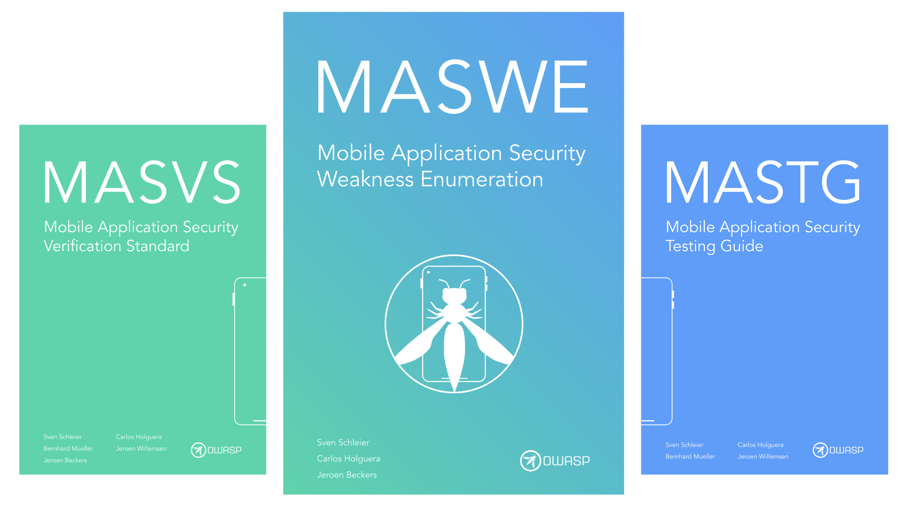
Background Knowledge
OWASP Ecosystem
Mobile Application Security project (MAS)
Assess security standards through tests
MASVS: What to test against
MASWE: What to test for
MASTG: How to test for it
(OWASP MAS, 2026)

Slide 17
Connection to Academia
Why do we care?

Slide 18
Connection to Academia
Methodology
Literature Review
“OWASP” & “MASTG” on Google Scholar
Written in English
Published after 2023
15 Papers

Slide 19
Connection to Academia
Findings
MAS used for evaluating real-world apps
Strong presence of cryptography vulnerabilities
Storage and platform

Slide 20
Connection to Academia
Findings
MASTG reference apps used for:
Developing & testing tools

Slide 21
Connection to Academia
Findings
Take-away points:
Significant use-case for academia
Evaluating real-world apps
Developing & testing tools

Slide 22
State of the Art in MASTG Reference Apps
Understanding the Challenge
Our goal is clear: develop MASTG reference apps
What makes a good reference app?

Slide 23
State of the Art in MASTG Reference Apps
Methodology
Analyze source code and documentation
Map vulnerabilities to MASWE
Explore data
Challenge: Missing source code and documentation

Slide 24
State of the Art in MASTG Reference Apps
Methodology
Of 25 unique apps hosted by OWASP MASTG...
…18 are Android apps…
…with 12 having source code…
…and 8 have vulnerability documentation available.
(OWASP MASTG, 2025)

Slide 25
State of the Art in MASTG Reference Apps
Results Overview
163 implemented vulnerabilities
Of 117 MASWE vulnerability types…
…42 (35.9%) covered
…75 (64.1%) with no reference implementations

Slide 26
State of the Art in MASTG Reference Apps
Results Overview
Most vulnerability types without reference implementation
Small group is completely overrepresented
Reflected in coverage by category as well

Slide 27
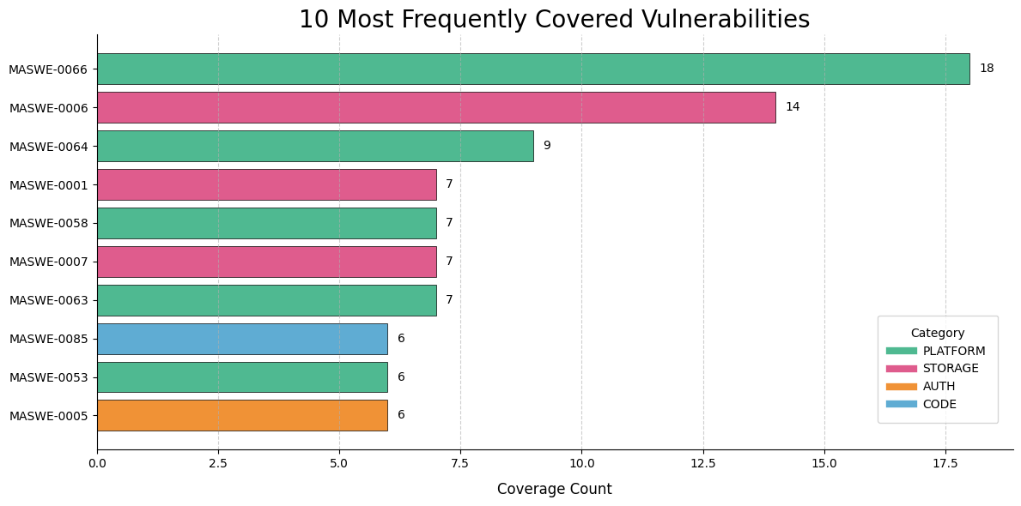
State of the Art in MASTG Reference Apps
Skewered Coverage of Vulnerability Types
Top 10 vulnerability types account for 53.4% of all implementations
5 of category Platform
3 of category Storage
Reflects study results

Slide 28
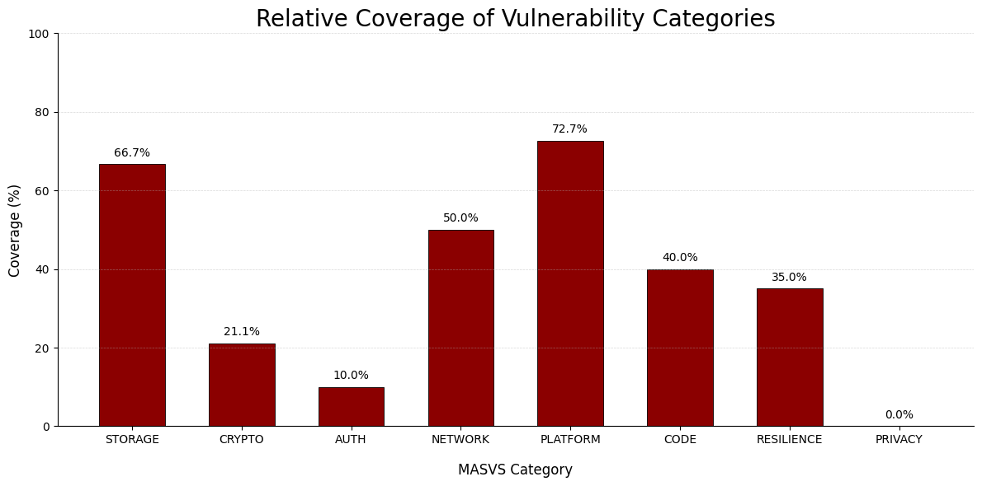
State of the Art in MASTG Reference Apps
Skewered Coverage of Vulnerability Categories
Favoring of Storage and Platform vulnerability types
Lack of Privacy

Slide 29
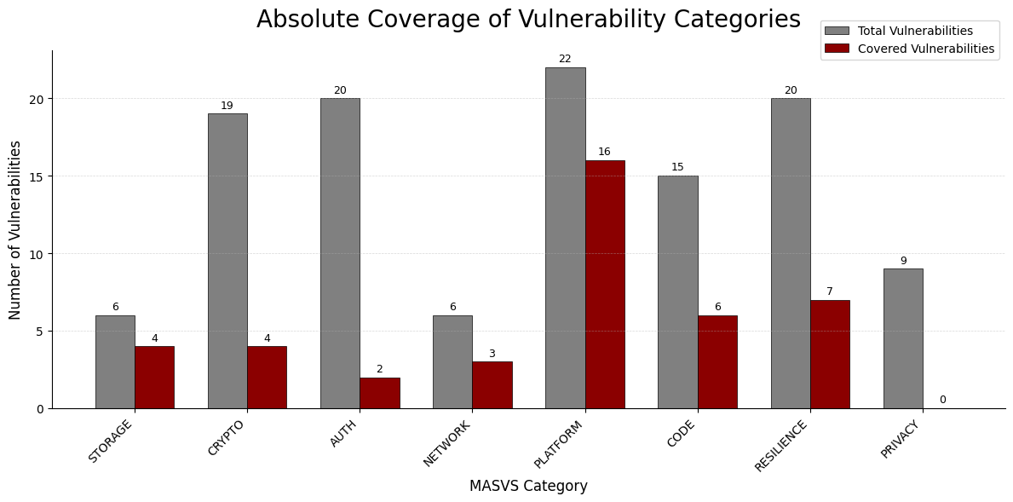
State of the Art in MASTG Reference Apps
Skewered Coverage of Vulnerability Categories
Auth and Crypto have most unrepresented vulnerabilities
Dominance of Platform

Slide 30
State of the Art in MASTG Reference Apps
Take-Away Points
Uneven coverage
Many without any implementation
Most implementations cover the same types

Slide 31
State of the Art in MASTG Reference Apps
Significance for Our Apps
Completely open-source
Extensive documentation
Vulnerabilities with no coverage

Slide 32
State of the Art in MASTG Reference Apps
Significance for Our Apps
One category at a time
Focus on MASVS-CRYPTO
Start with MASVS-STORAGE

Slide 33
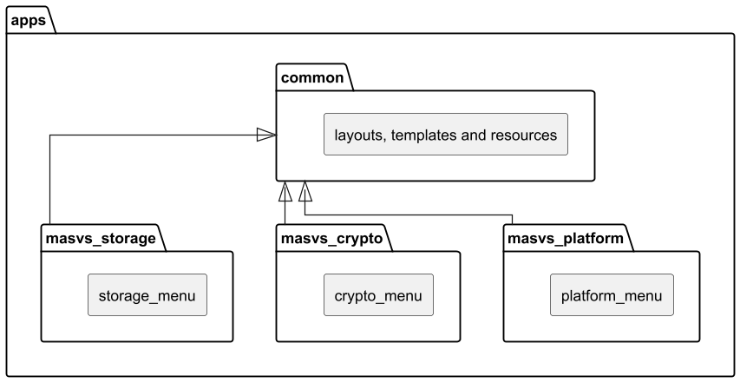
Designing Our Apps
Modular Architecture
Multiple, modular apps design
One app per MASVS category
Shared resources in “common”

Slide 34
Designing Our Apps
Modular Architecture
Advantages:
Limited effect of vulnerabilities
Standalone units
Isolated app development & testing

Slide 35
Designing Our Apps
Modular Architecture
Advantages:
Uniform formatting
Limit boilerplate code
Limit scaling costs

Slide 36
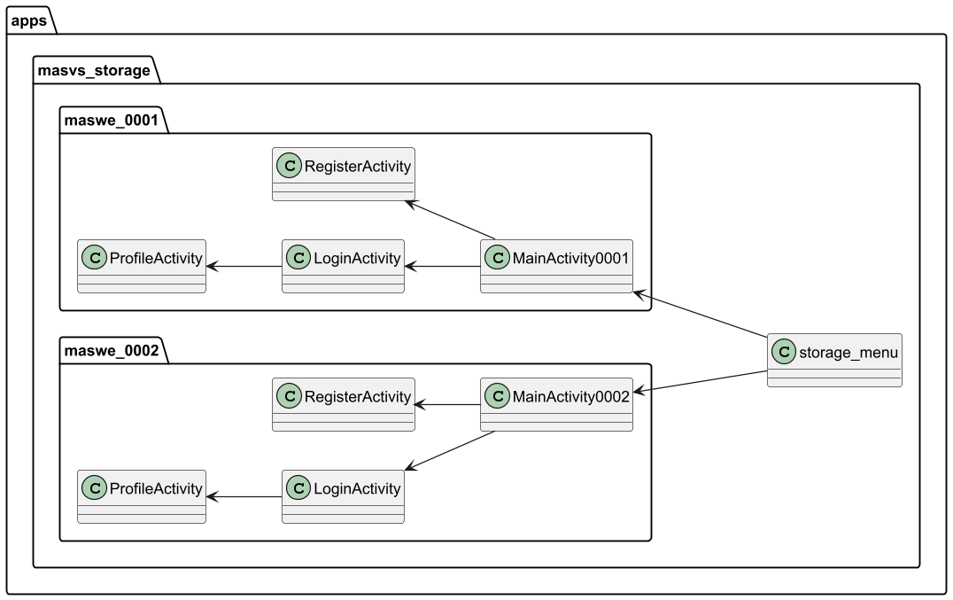
Designing Our Apps
Feature-Oriented Design
Feature-oriented app structure
Menu as launcher
One app package per vulnerability
Extendable with additional logic

Slide 37
Designing Our Apps
Feature-Oriented Design
Advantages:
Separation of vulnerabilities
Clean project structure
Isolated vulnerability development
Minimal scaling costs

Slide 38
Designing Our Apps
Inheritance
All vulnerabilities (packages) share:
Login logic
Registration logic
Mostly differ in encryption and storage
-> Abstract classes for login & registration

Slide 39
Designing Our Apps
Inheritance
Advantages:
Reduce boilerplate code
Minimal scaling costs

Slide 40
Designing Our Apps
Architecture Summary
One app per vulnerability category
One app package per vulnerability type
Shared resources in “common”
All apps are independent modules of the project
Custom templates reduce boiler plate code

Slide 41
Results
Overview of Our Apps
Three apps
28 vulnerabilities
Complete coverage of MASVS-STORAGE and CRYPTO

Slide 42
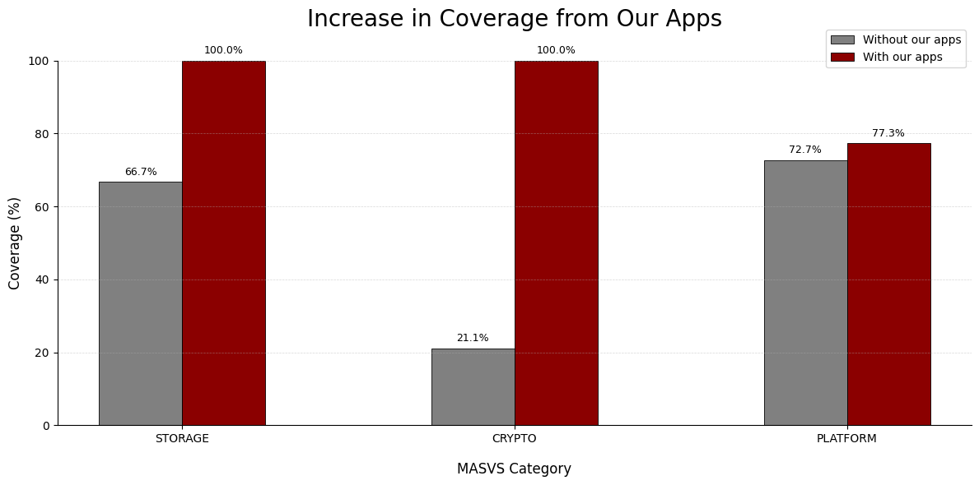
Results
Contribution to Vulnerability Coverage
25% MASWE coverage
18/28 vulnerability types without previous coverage
MASWE coverage from 35.9% to 51.3%
Largest contribution to Crypto

Slide 43
Results
MobSF Static Scan
Surprisingly high security scores
Storage and crypto apps deemed “low risk”
Inconsistent vulnerability detection
Many false positives

Slide 44
Results
Semgrep Static Scan
Slightly better than MobSF
Found 8 of 28 vulnerabilities
Failed to flag deprecated cryptographic algorithms

Slide 45
Outlook
Benchmarking Security Testing Tools
Natural next step
Combine our apps with others
Compare with existing benchmarks

Slide 46
Outlook
Moving on to new Categories
Only 60/117 (51.3%) of MASWE vulnerabilities implemented
Privacy and Auth still neglected
Important for both educational and benchmarking reasons

Slide 47
Conclusion
Summary
Developed MASTG reference apps
Identified weaknesses of MASTG reference apps
Designed a clean and scalable apps architecture
Increased coverage of MASVS categories
Built basis of MASTG tool testing benchmark

Slide 48
Questions?

Slide 49
References
StatCounter Global Stats. (2026). Mobile operating system market share worldwide. Retrieved February 3, 2026, from https://gs.statcounter.com/os-market-share/mobile/worldwide
Tech Inside Out. (2021, August 2). Security vulnerabilities found in over 60% of Android apps. https://www.techinsideout.co/inside/security-vulnerabilities-found-in-over-60-of-android-apps
Stevenson, L., & Das, S. (2025). “Your doctor is spying on you”: An analysis of data practices in mobile healthcare applications (arXiv:2510.06015). arXiv. https://doi.org/10.48550/arXiv.2510.06015

Slide 50
References
Chiboora, T. H., Chacha, L., Byagutangaza, T., & Gueye, A. (2023). Evaluating mobile banking application security posture using the OWASP’s MASVS framework. In Proceedings of the 6th ACM SIGCAS/SIGCHI Conference on Computing and Sustainable Societies (COMPASS 2023) (pp. 99–106). ACM. https://doi.org/10.1145/3588001.3609367
OWASP Mobile Application Security. (2025). Home page. The OWASP Foundation. https://mas.owasp.org/
OWASP Mobile Application Security Testing Guide (MASTG). (2025). Android reference apps section. The OWASP Foundation. https://github.com/OWASP/mastg/tree/ffde0bdd9bdfd375d93ddb433bd3134e3977c64d/apps/android

