Slide 1
Neck_yaw_joint
VOLUME = 1.2566371e+05 MM^3
SURFACE AREA = 1.5079645e+04 MM^2
DENSITY = 2.8000000e-06 KILOGRAM / MM^3
MASS = 3.5185838e-01 KILOGRAM
CENTER OF GRAVITY with respect to _FAKE_YAW_INERTIA coordinate frame:
X Y Z 0.0000000e+00 0.0000000e+00 1.1550000e+02 MM
INERTIA with respect to _FAKE_YAW_INERTIA coordinate frame: (KILOGRAM * MM^2)
INERTIA TENSOR:
Ixx Ixy Ixz 5.0222799e+03 0.0000000e+00 0.0000000e+00
Iyx Iyy Iyz 0.0000000e+00 4.7642504e+03 0.0000000e+00
Izx Izy Izz 0.0000000e+00 0.0000000e+00 3.2840111e+02
INERTIA at CENTER OF GRAVITY with respect to _FAKE_YAW_INERTIA coordinate frame: (KILOGRAM * MM^2)
INERTIA TENSOR:
Ixx Ixy Ixz 3.2840119e+02 0.0000000e+00 0.0000000e+00
Iyx Iyy Iyz 0.0000000e+00 7.0371675e+01 0.0000000e+00
Izx Izy Izz 0.0000000e+00 0.0000000e+00 3.2840111e+02
PRINCIPAL MOMENTS OF INERTIA: (KILOGRAM * MM^2)
I1 I2 I3 7.0371675e+01 3.2840103e+02 3.2840127e+02
ROTATION MATRIX from _FAKE_YAW_INERTIA orientation to PRINCIPAL AXES:
0.00000 0.00000 1.00000
1.00000 0.00000 0.00000
0.00000 1.00000 0.00000
ROTATION ANGLES from _FAKE_YAW_INERTIA orientation to PRINCIPAL AXES (degrees):
angles about x y z 0.000 90.000 90.000
RADII OF GYRATION with respect to PRINCIPAL AXES:
R1 R2 R3 1.4142136e+01 3.0550499e+01 3.0550510e+01 MM

Slide 2
Neck_pitch_joint( com-express)
VOLUME = 2.3000000e+05 MM^3
SURFACE AREA = 2.9200000e+04 MM^2
DENSITY = 2.7100000e-06 KILOGRAM / MM^3
MASS = 6.2330000e-01 KILOGRAM
CENTER OF GRAVITY with respect to _FAKE_PITCHCOMEXPRESS_INERTIA coordinate frame:
X Y Z -1.0200000e+02 0.0000000e+00 2.6575000e+02 MM
INERTIA with respect to _FAKE_PITCHCOMEXPRESS_INERTIA coordinate frame: (KILOGRAM * MM^2)
INERTIA TENSOR:
Ixx Ixy Ixz 4.5058188e+04 0.0000000e+00 1.6895481e+04
Iyx Iyy Iyz 0.0000000e+00 5.1051062e+04 0.0000000e+00
Izx Izy Izz 1.6895481e+04 0.0000000e+00 7.0317070e+03
INERTIA at CENTER OF GRAVITY with respect to _FAKE_PITCHCOMEXPRESS_INERTIA coordinate frame: (KILOGRAM * MM^2)
INERTIA TENSOR:
Ixx Ixy Ixz 1.0388333e+03 0.0000000e+00 0.0000000e+00
Iyx Iyy Iyz 0.0000000e+00 5.4689381e+02 0.0000000e+00
Izx Izy Izz 0.0000000e+00 0.0000000e+00 5.4689381e+02
PRINCIPAL MOMENTS OF INERTIA: (KILOGRAM * MM^2)
I1 I2 I3 5.4689381e+02 5.4689381e+02 1.0388333e+03
ROTATION MATRIX from _FAKE_PITCHCOMEXPRESS_INERTIA orientation to PRINCIPAL AXES:
0.00000 0.00000 1.00000
1.00000 0.00000 0.00000
0.00000 1.00000 0.00000
ROTATION ANGLES from _FAKE_PITCHCOMEXPRESS_INERTIA orientation to PRINCIPAL AXES (degrees):
angles about x y z 0.000 90.000 90.000
RADII OF GYRATION with respect to PRINCIPAL AXES:
R1 R2 R3 2.9621220e+01 2.9621220e+01 4.0824829e+01 MM

Slide 3
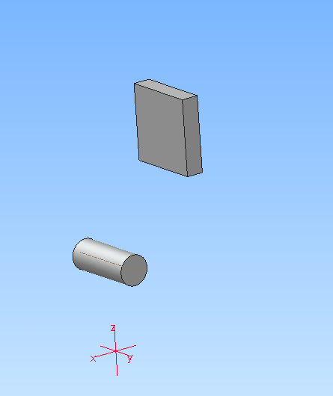
3d model

