Slide 1
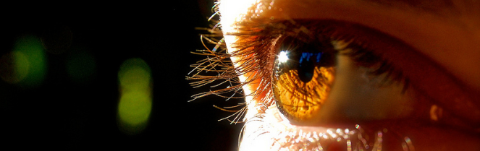
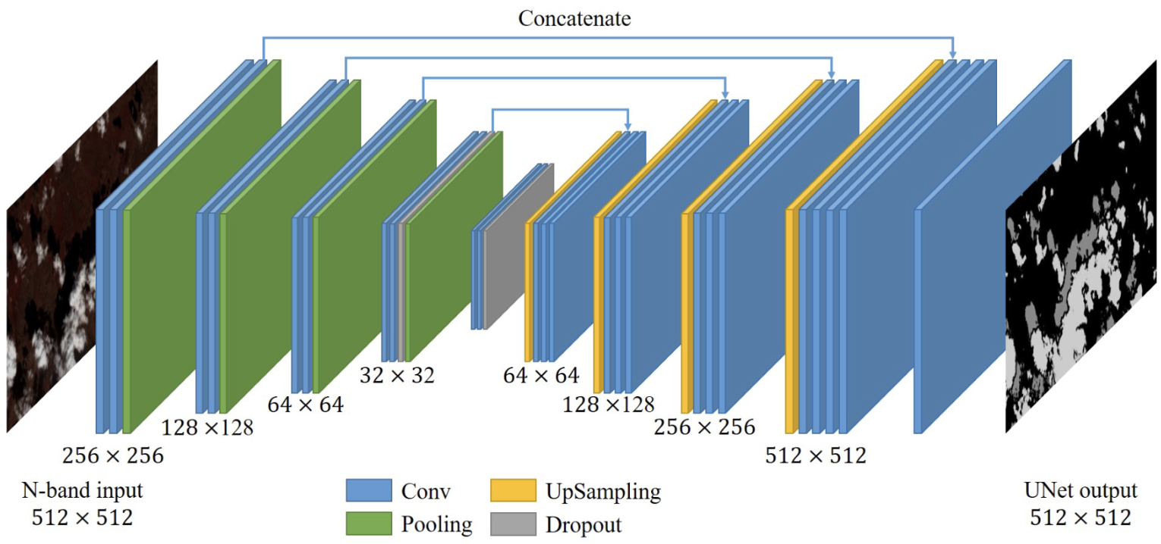

Visión por Computador
Versión 2026
UNet
(CAPÍTULO 3 – CV03E )
Domingo Mery
Ciencia de la Computación
Universidad Católica – Chile
http://domingomery.ing.uc.cl

Slide 2
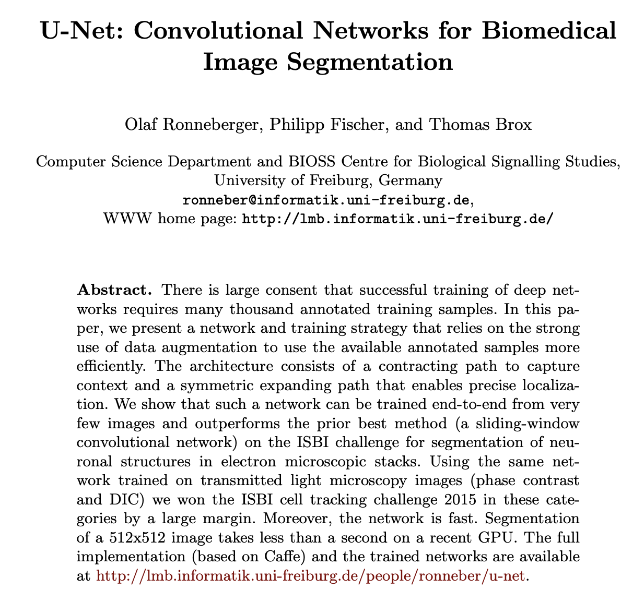

Slide 3
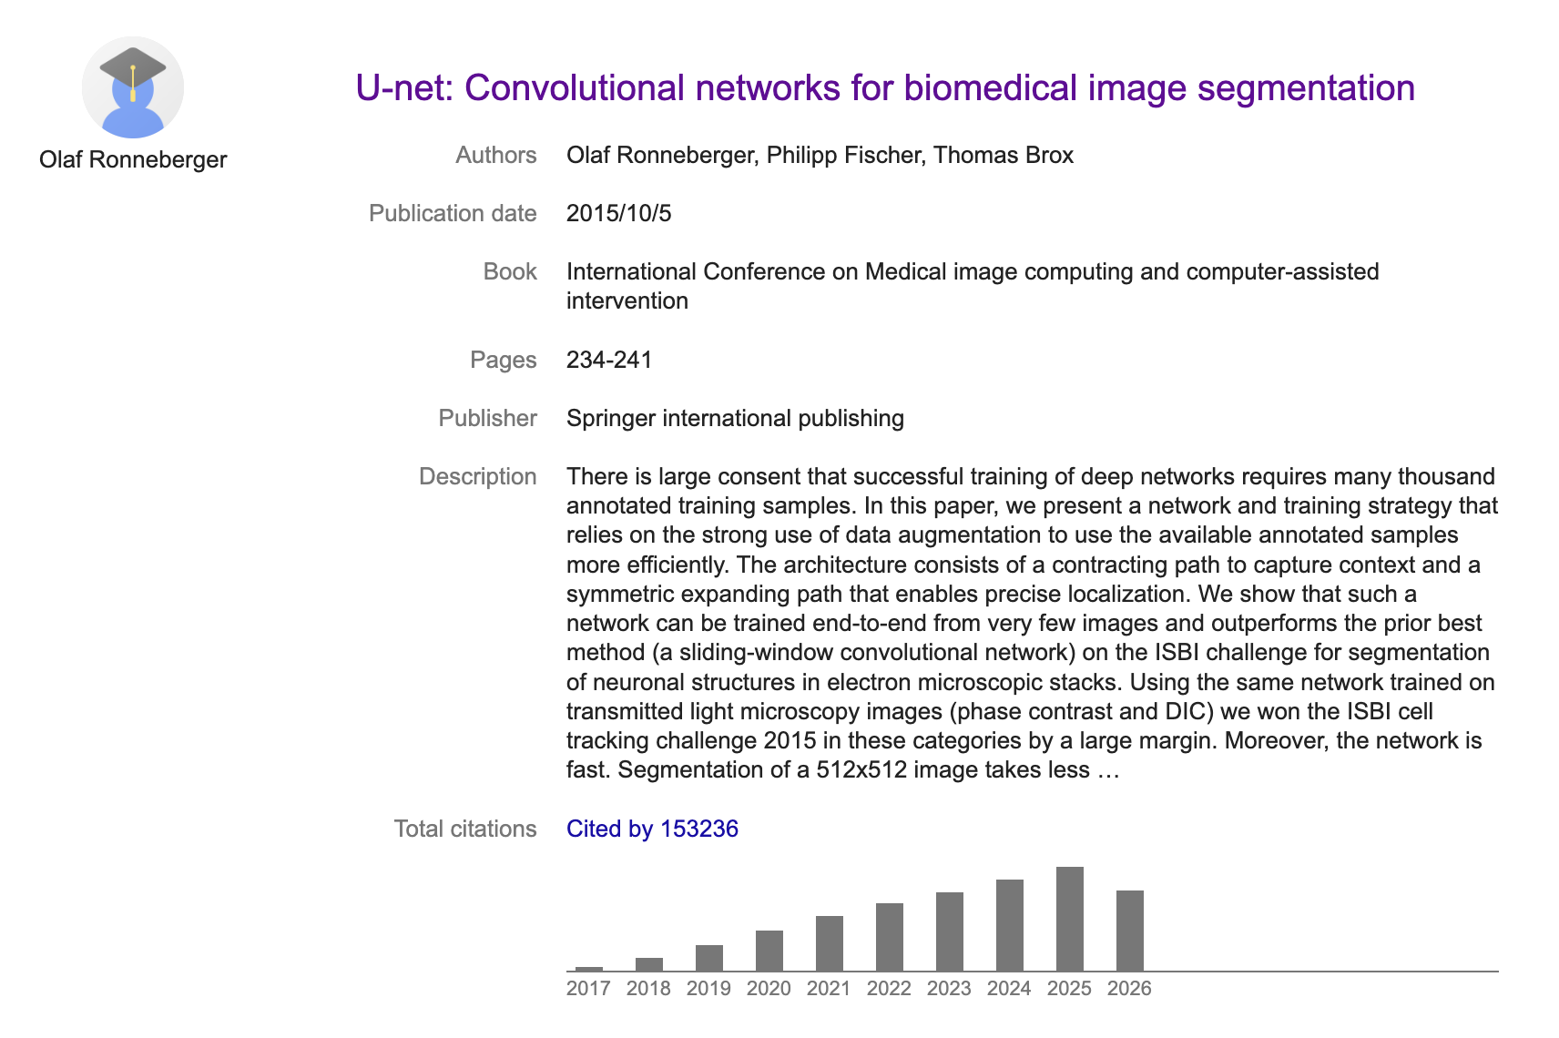

Slide 4
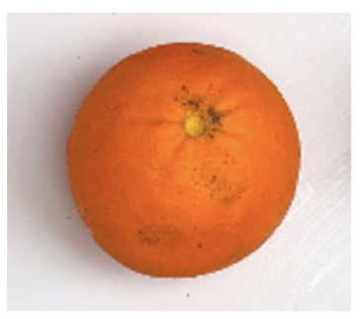

Image Processing – Problem
> Get a target output image from an input image
Image Segmentation
Input: image
Output: Segmentation

Slide 5
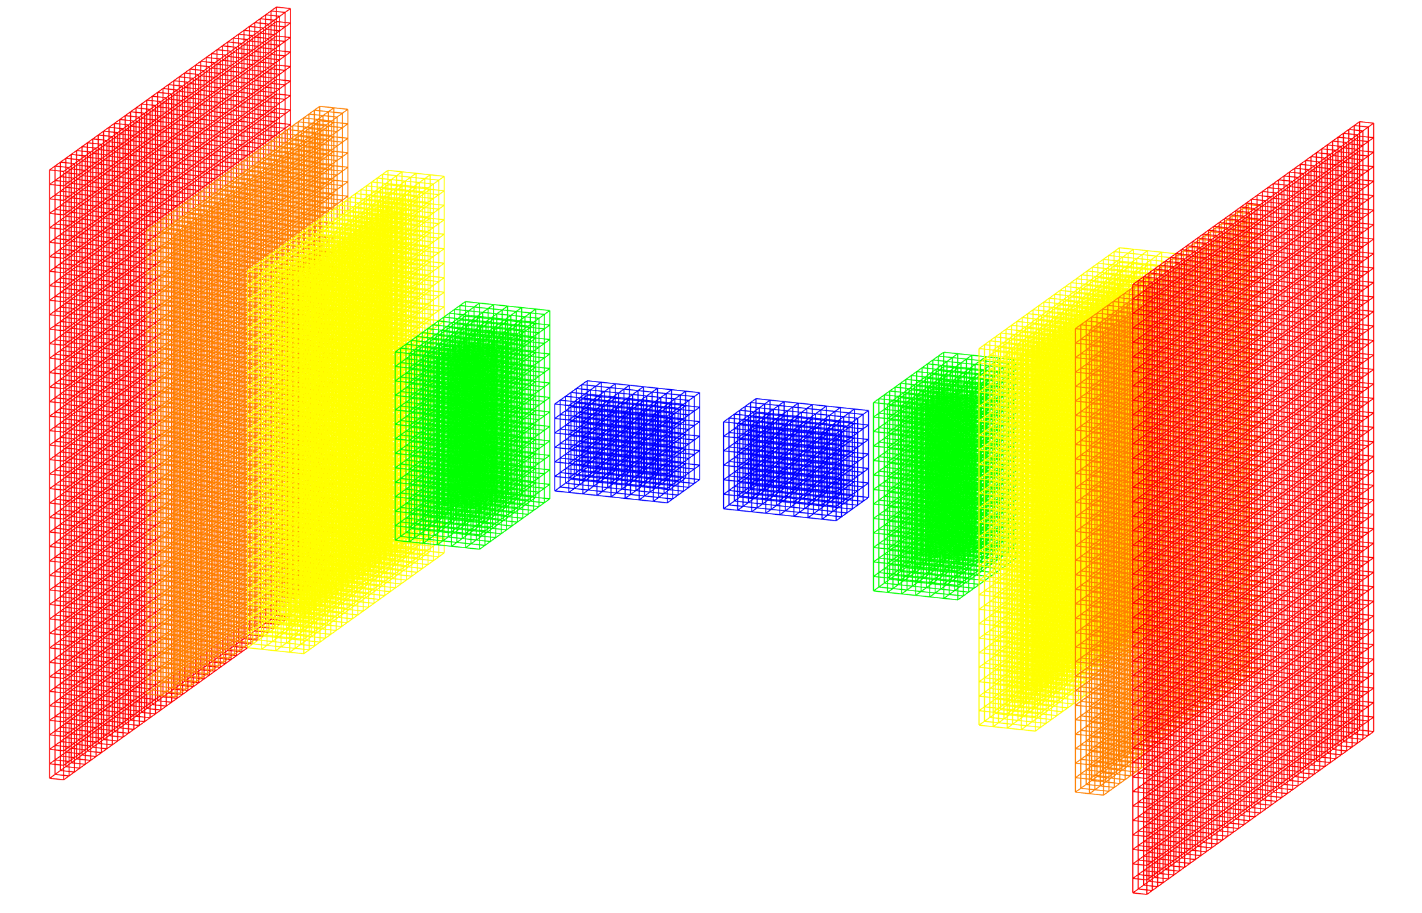
Image Processing – Solution
Deep Learning Model: U-Net
Training Data
Training
Data
Encoder
Decoder
Target
image
Output
image
errors
Back-propagation
Input image

Slide 6
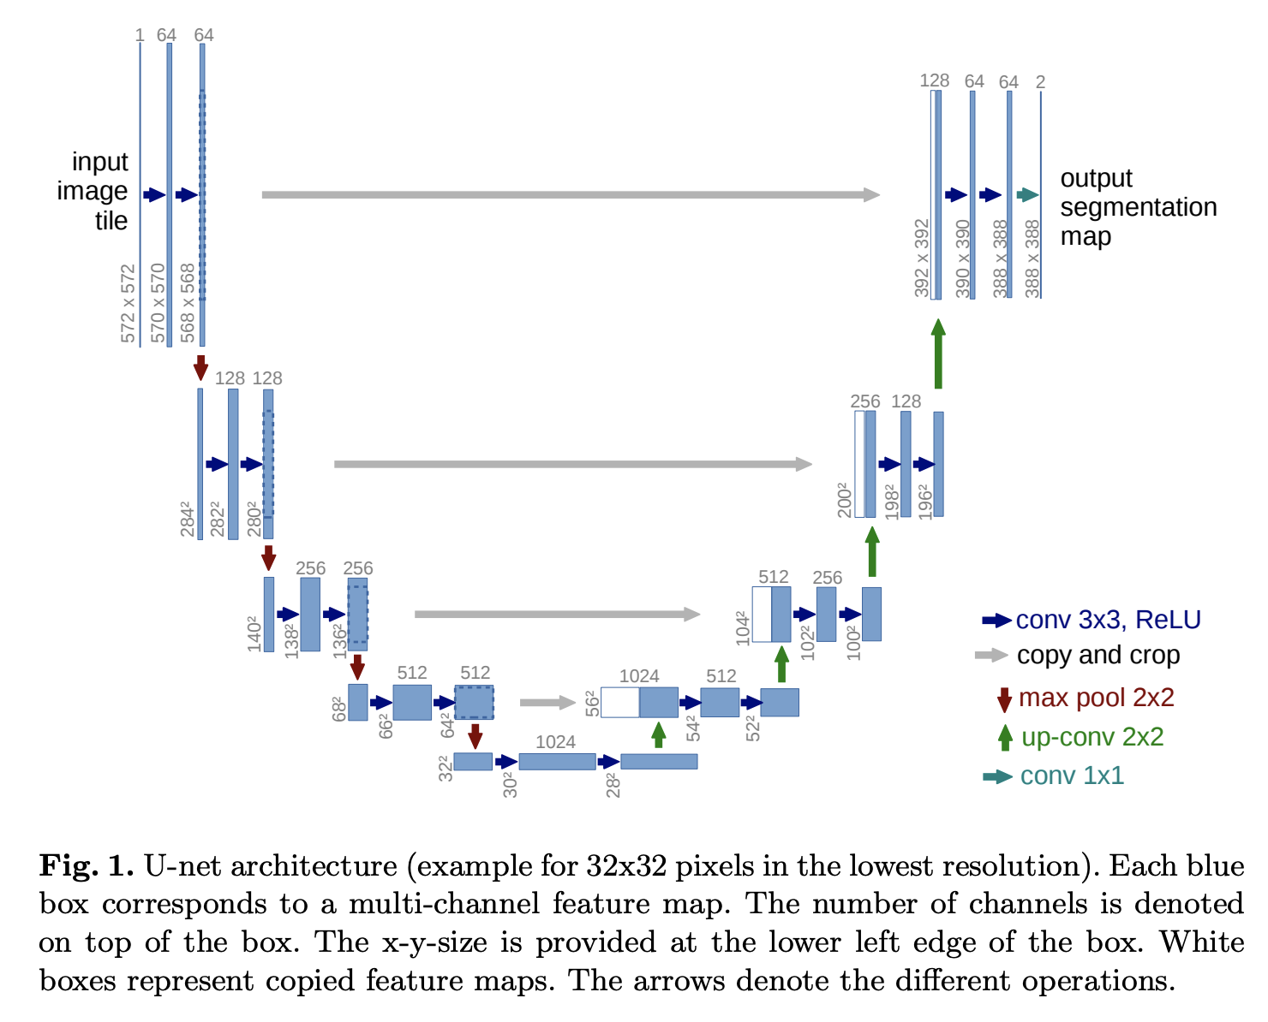

Slide 7
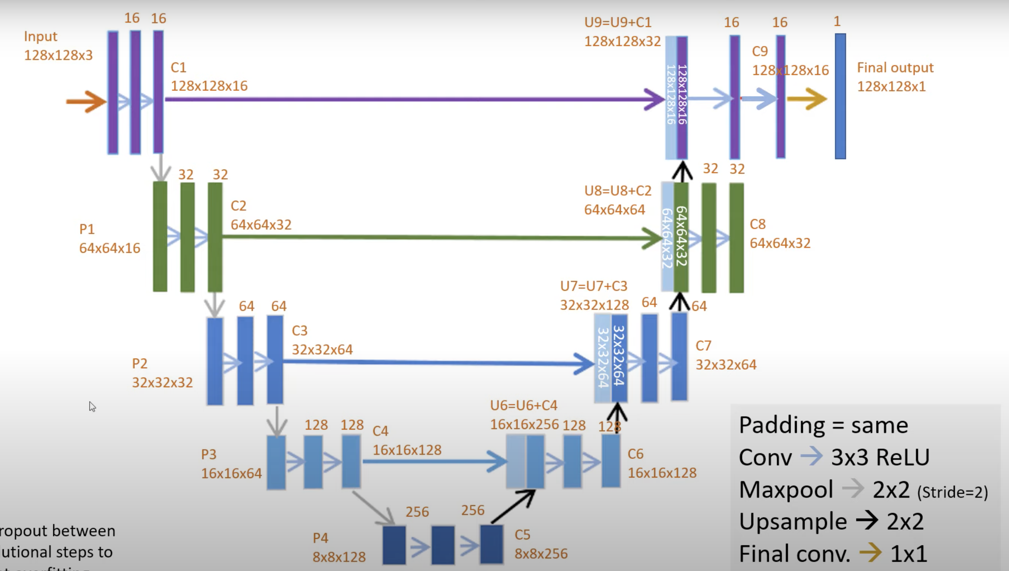
https://youtu.be/azM57JuQpQI

Slide 8
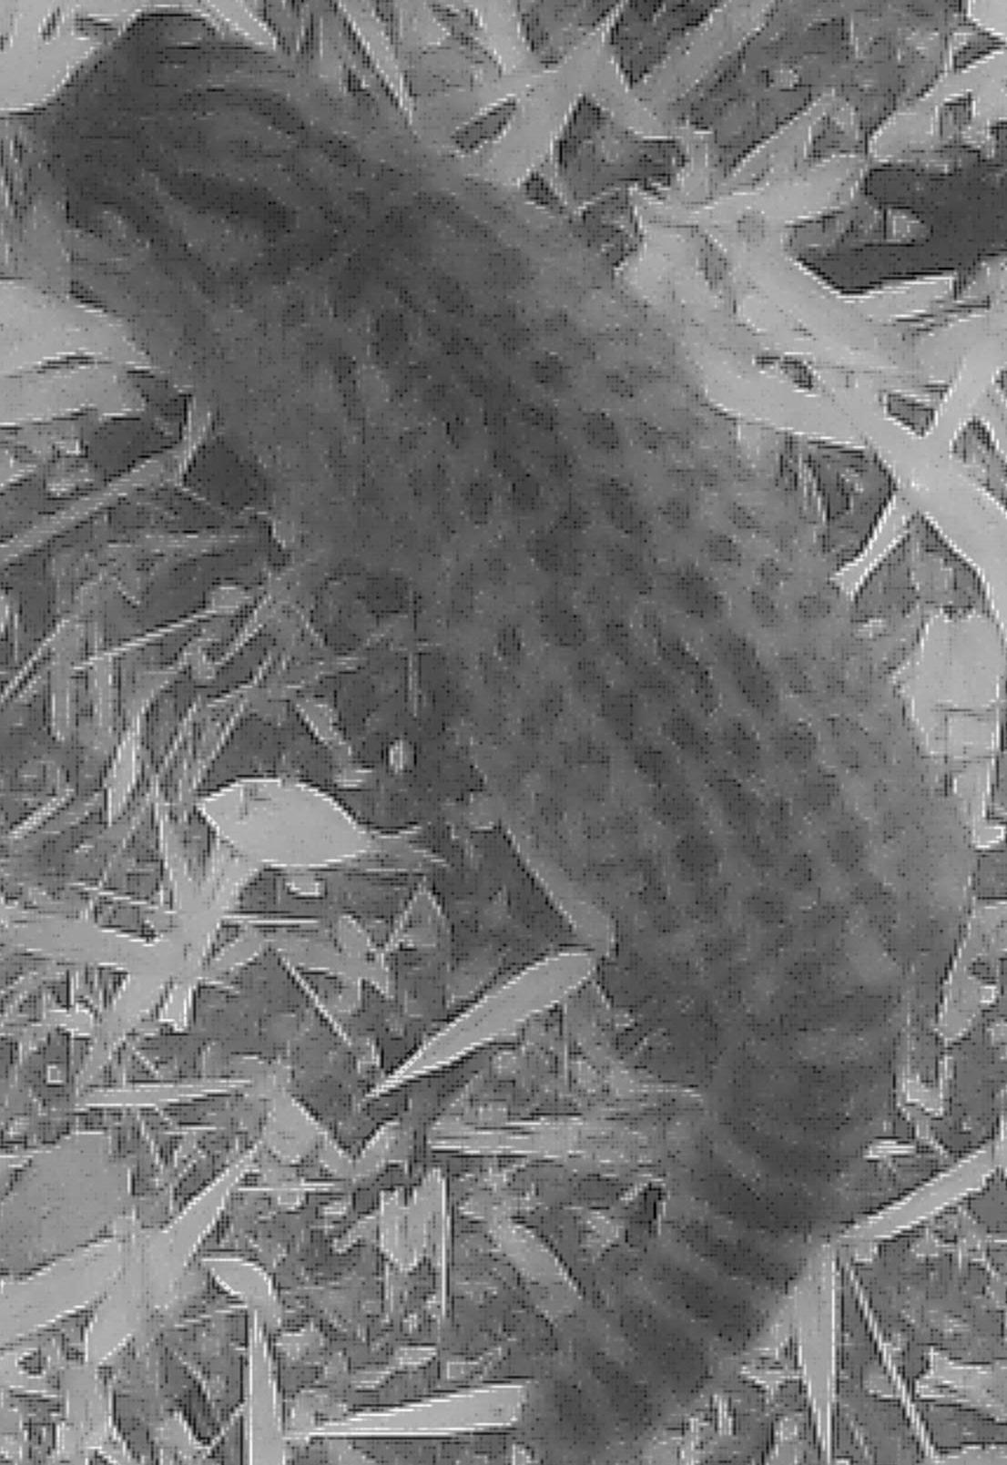
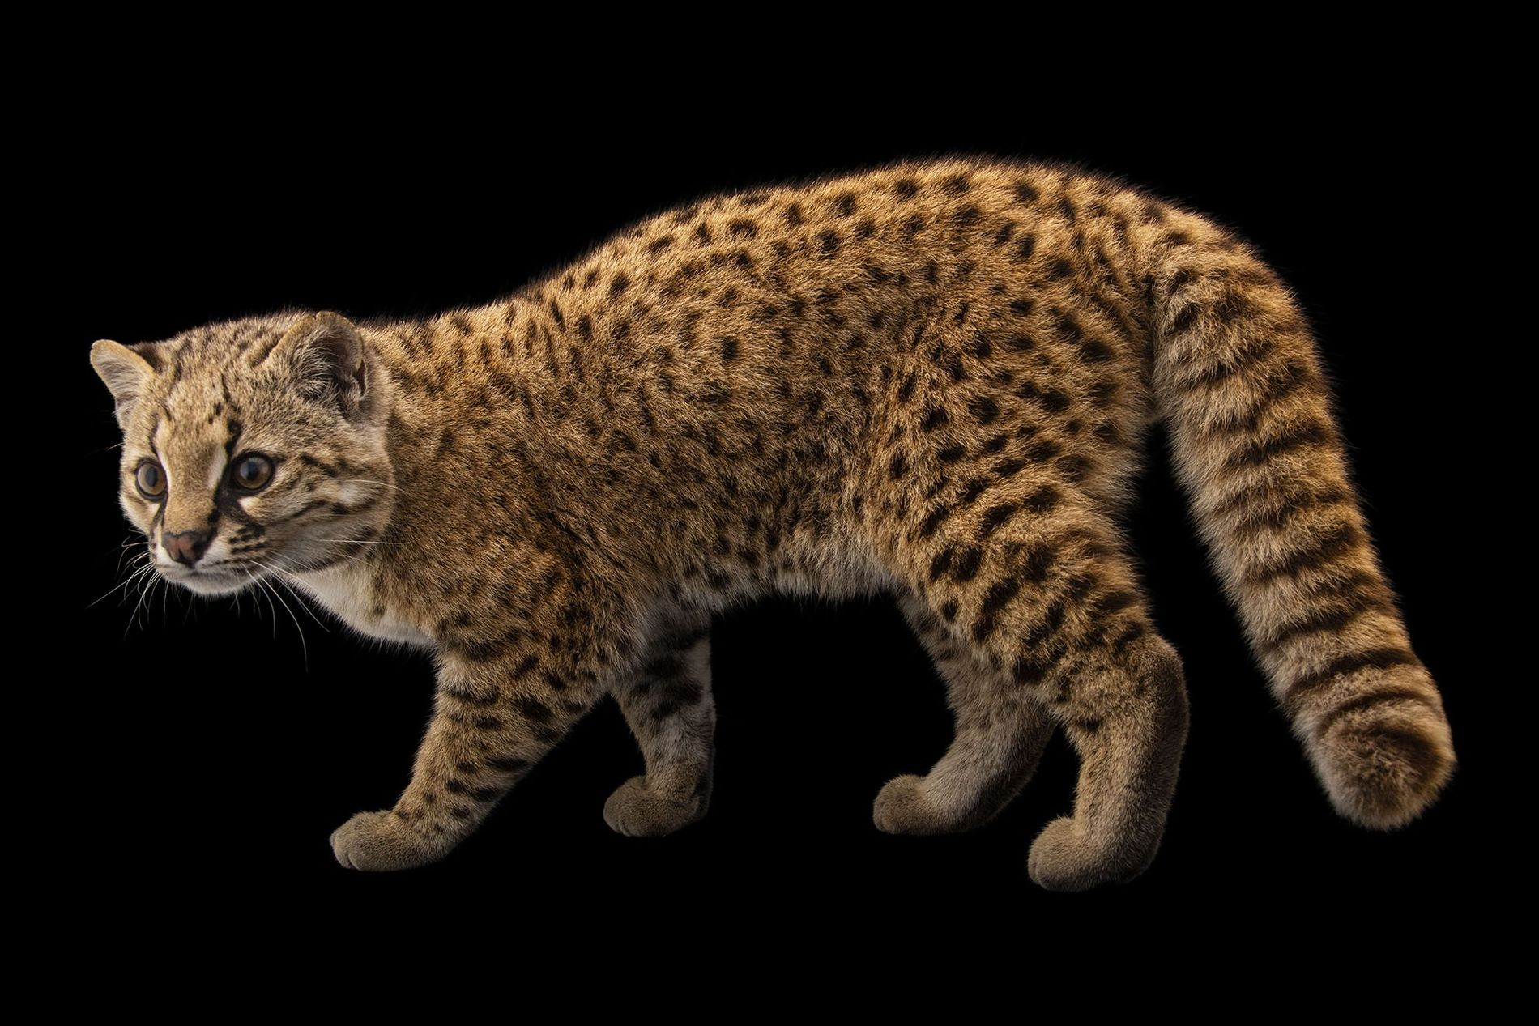
Image Segmentation
Example
Trap Camera
Segmentation
Güiñas
Segmentation

Slide 9
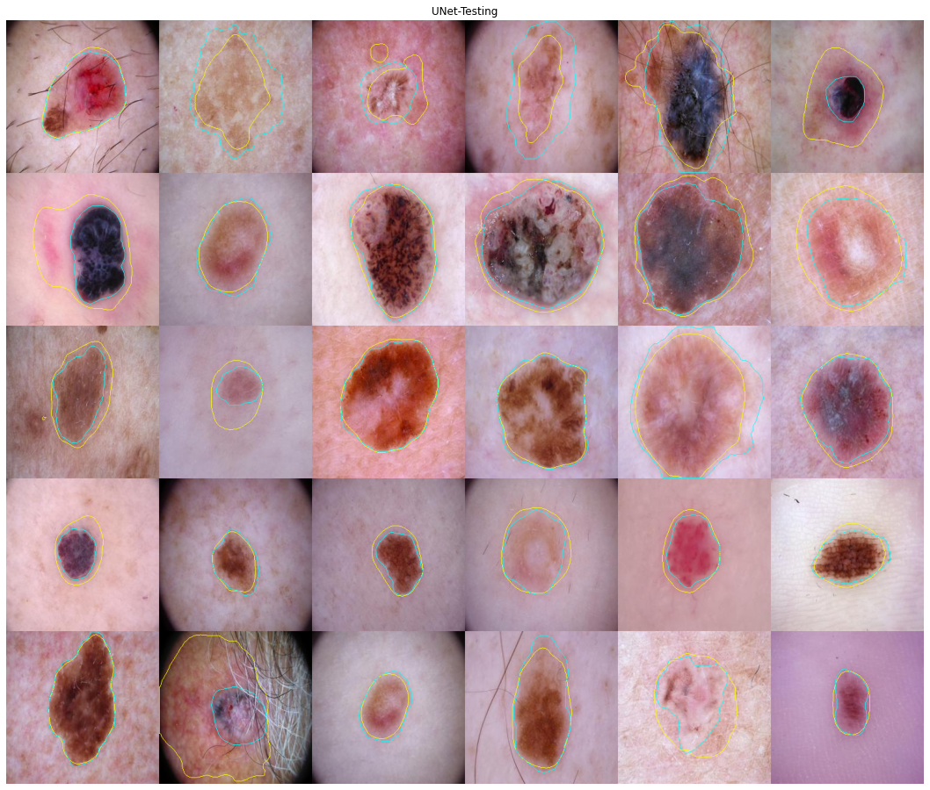
Image Segmentation
Example
Skin Lesion
Segmentation

Slide 10
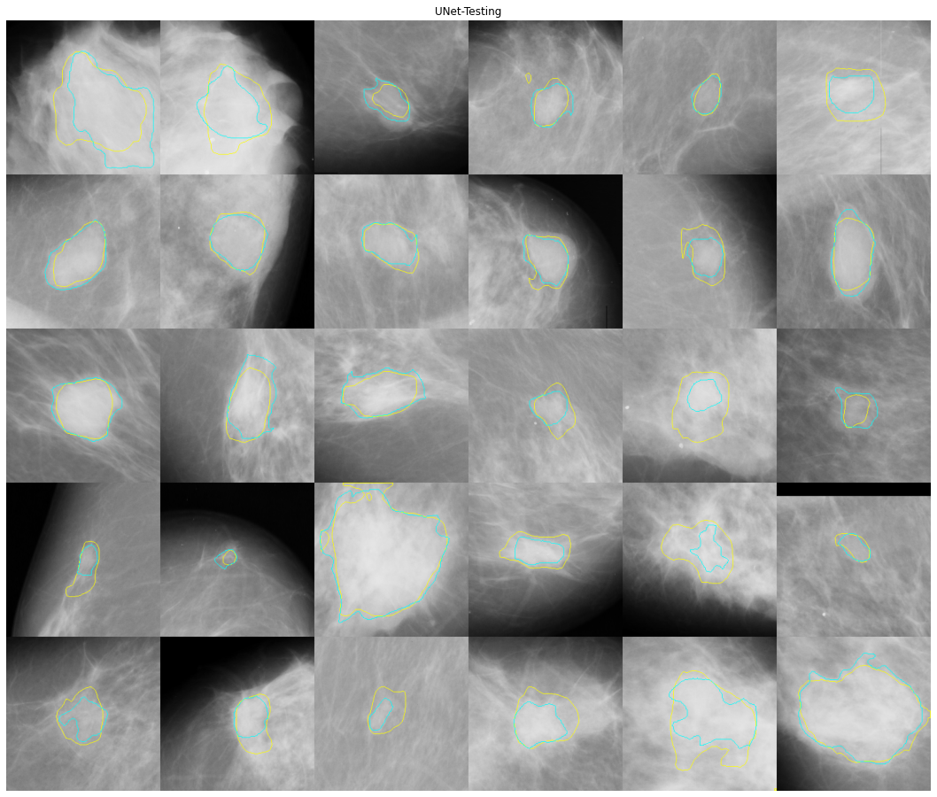
Image Segmentation
Example
Breast Tumor
Segmentation

Slide 11
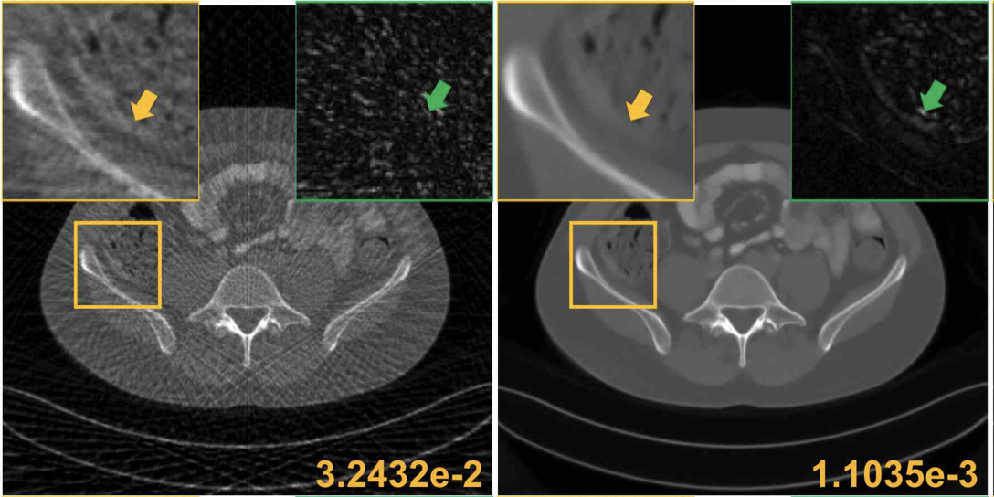
Image Denoising
Example
Input Output
MRI reconstruction
Han, Yoseob, and Jong Chul Ye. "Framing U-Net via deep convolutional framelets: Application to sparse-view CT." IEEE transactions on medical imaging 37.6 (2018): 1418-1429.

Slide 12
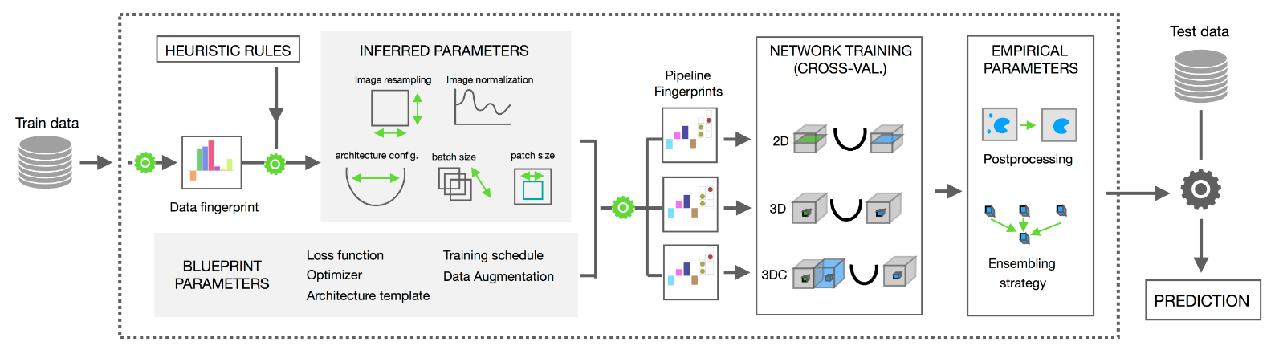
Automated Design of Unet: nnUNet
References:
https://youtu.be/fc2nGJC3mUY
https://medium.com/miccai-educational-initiative/nnu-net-the-no-new-unet-for-automatic-segmentation-8d655f3f6d2a
https://github.com/MIC-DKFZ/nnUNet

Slide 13
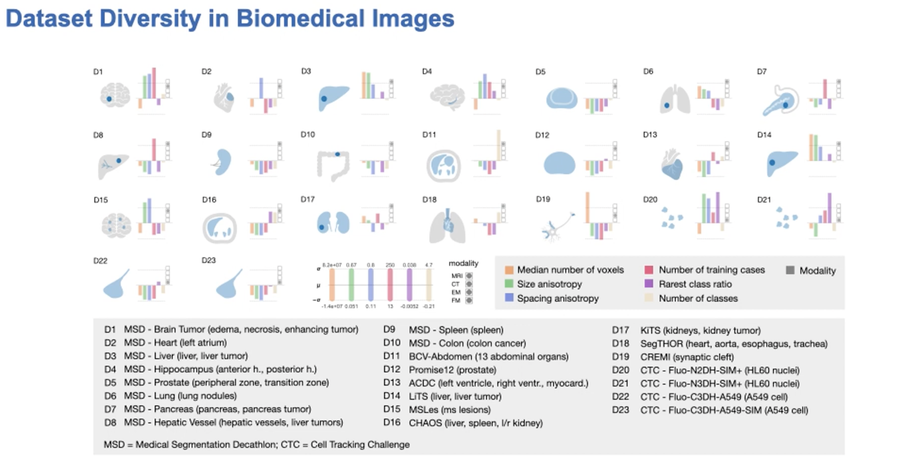

Slide 14
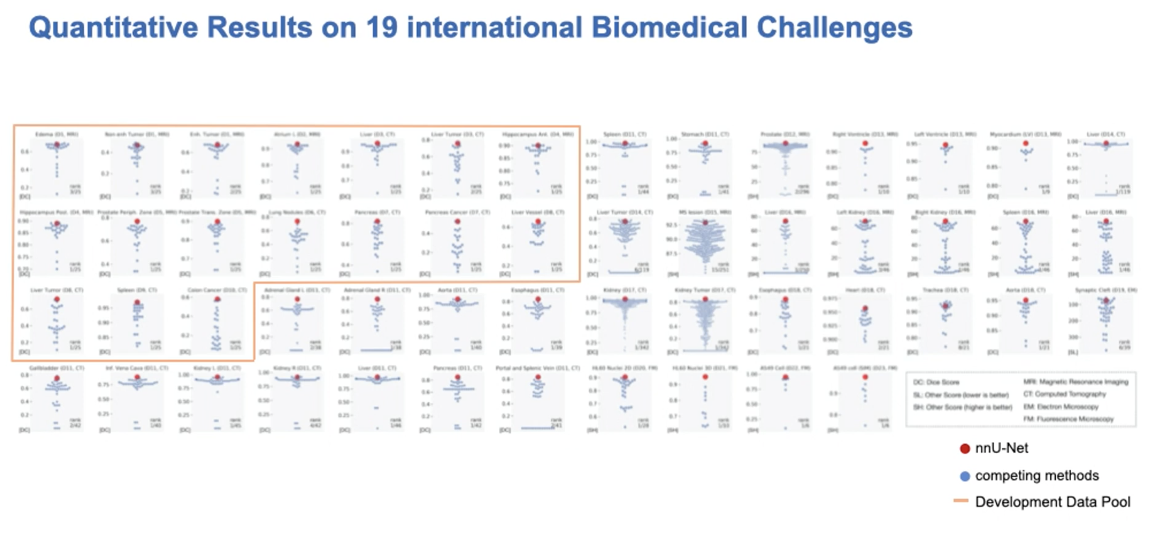
nnUNet: configuracion automatica de UNet
video: https://youtu.be/fc2nGJC3mUY
explicacion: https://medium.com/miccai-educational-initiative/nnu-net-the-no-new-unet-for-automatic-segmentation-8d655f3f6d2a
github: https://github.com/MIC-DKFZ/nnUNet

