Slide 1

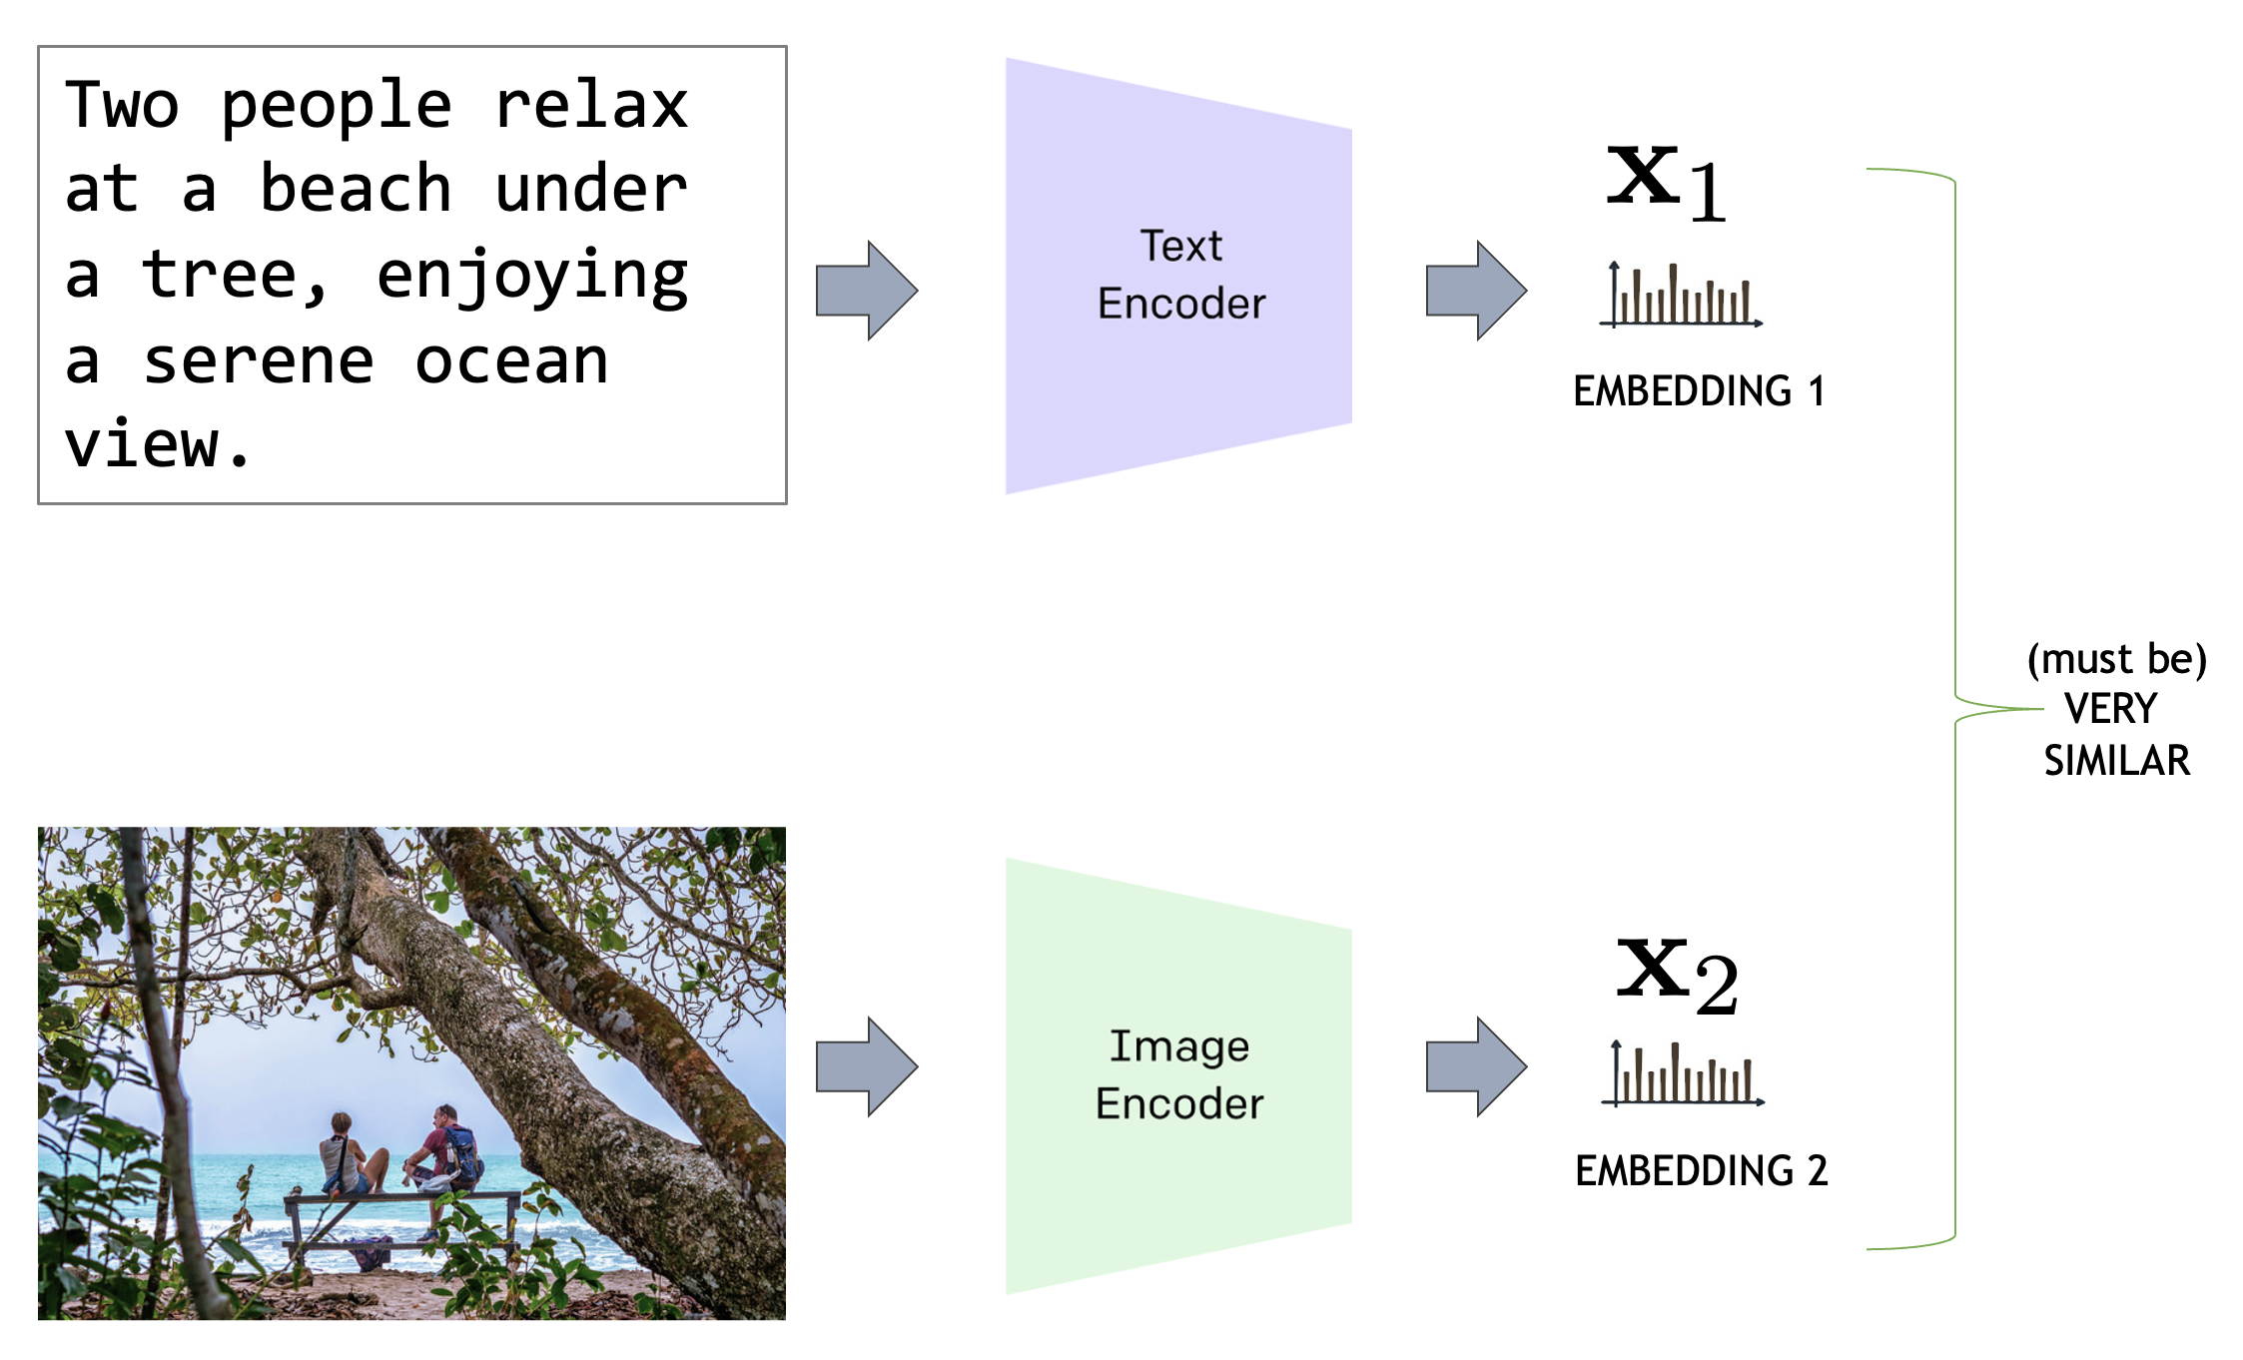

Visión por Computador
Versión 2026
CLIP
(CAPÍTULO 3 – CV03G )
Domingo Mery
Ciencia de la Computación
Universidad Católica – Chile
http://domingomery.ing.uc.cl

Slide 2
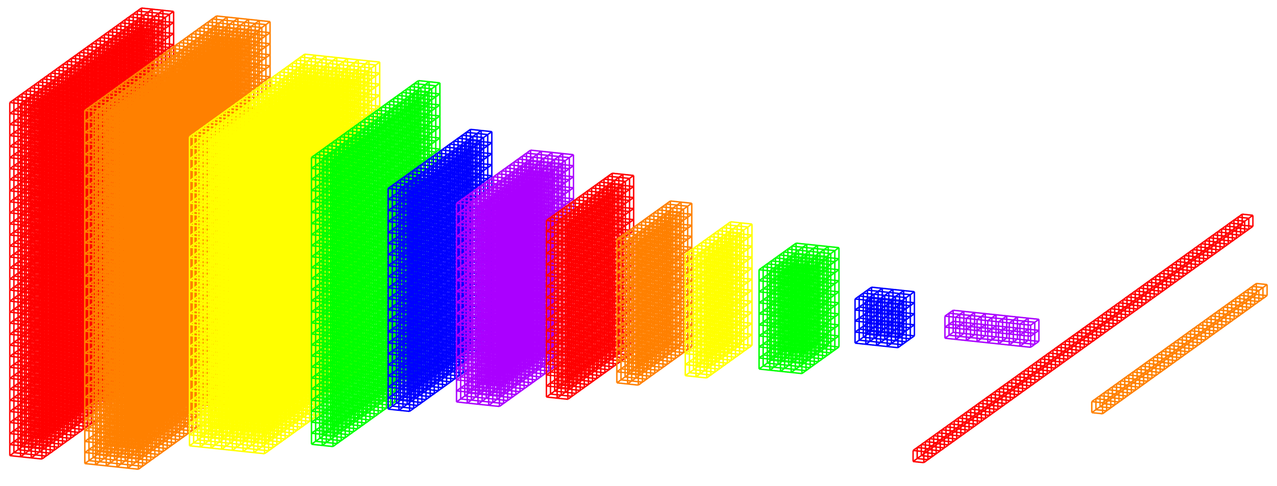
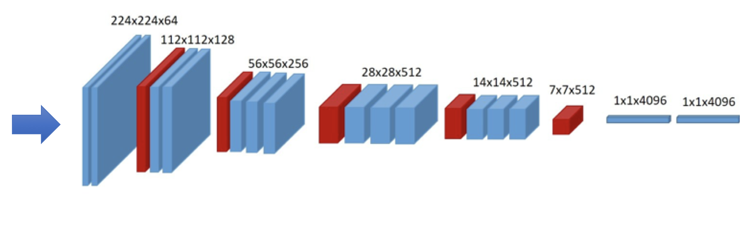



Embeddings
EMBEDDINGS: vectors of n elements that describe the input. Typically, they have a norm equal to 1, and n=512.
INPUT 1
EMBEDDING 1
sc
SCORE: It measures how similar the embeddings are
HIGH → similar
LOW → different
INPUT 2
EMBEDDING 2

Slide 3
Embeddings
sc

Slide 4
Embeddings
HOW SIMILAR ARE TWO VECTORS?
DON'T FORGET: in our case the vectors have 512 elements and have a norm equal to 1
DOT PRODUCT
SCORE
If the vectors are very similar, the angle between them is small and the SCORE is close to 1.

Slide 5
Embeddings
HOW SIMILAR ARE TWO VECTORS?
DON'T FORGET: in our case the vectors have 512 elements and have a norm equal to 1
DOT PRODUCT
SCORE
If the vectors are very similar, the angle between them is small and the SCORE is close to 1.
If the vectors are very different, the angle between them is large and the SCORE decreases significantly.

Slide 6
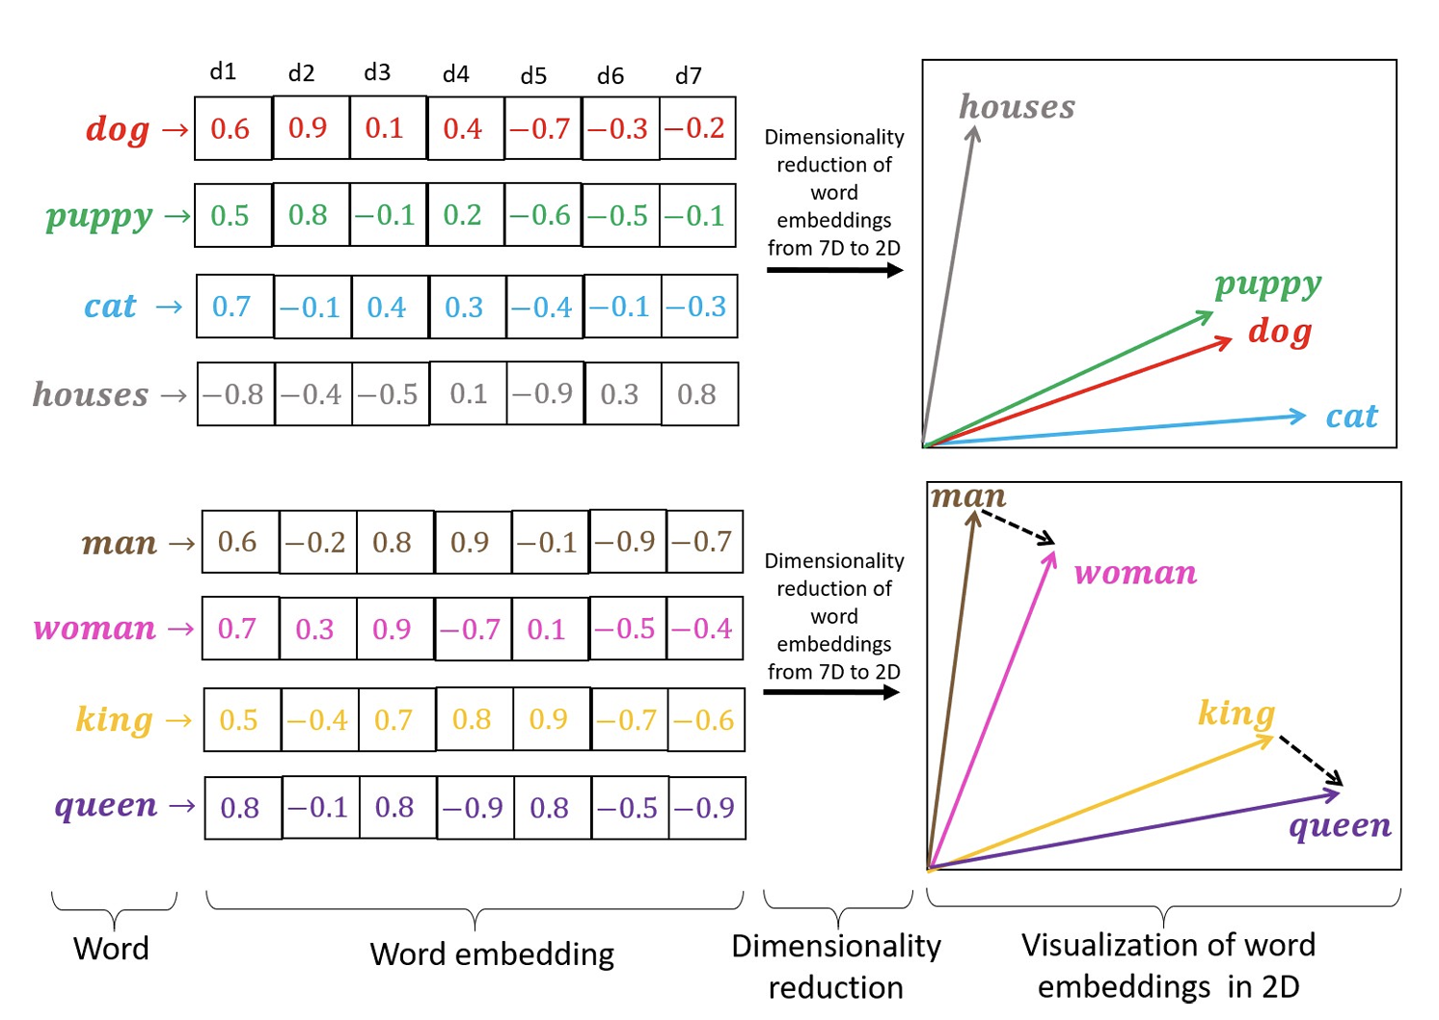


Embeddings in NLP
Token
Token embedding
token
Adapted from: Rozado, D. (2020). Wide range screening of algorithmic bias in word embedding models using large sentiment lexicons reveals underreported bias types. PloS one, 15(4), e0231189.

Slide 7
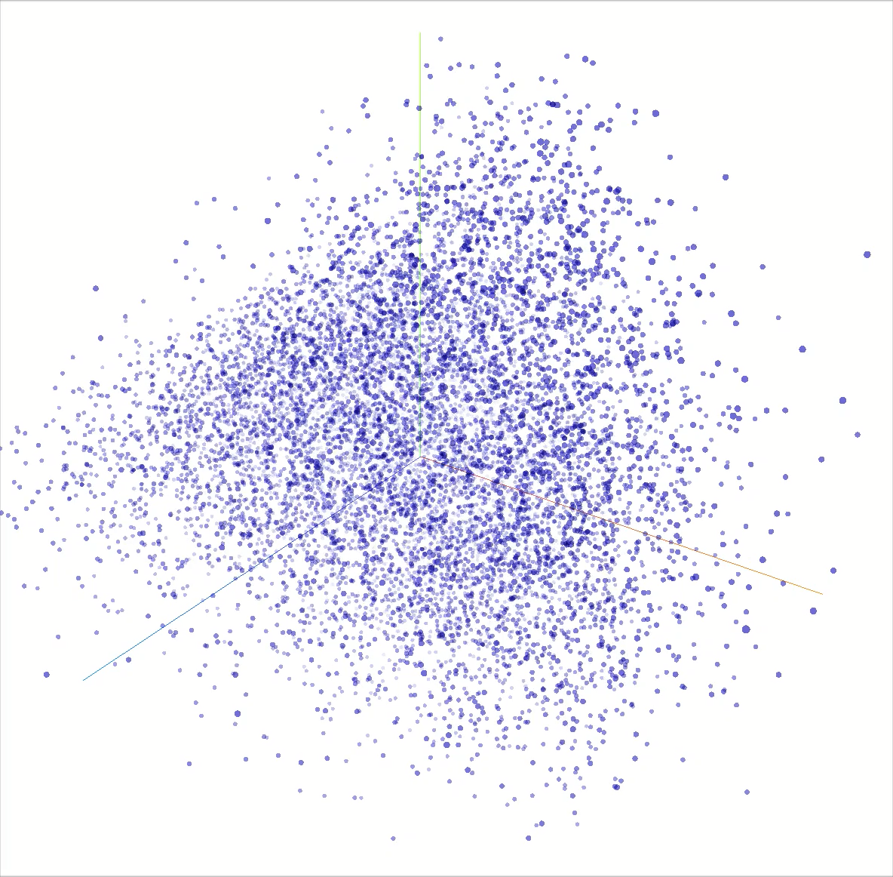
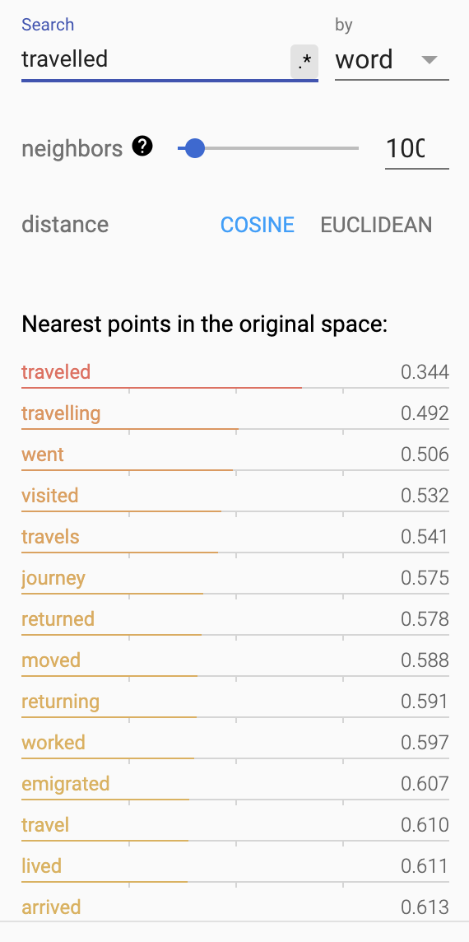
Embedding Projector
https://projector.tensorflow.org/

Slide 8

Key Idea of CLIP
Image
Encoder
EMBEDDING 1
VERY
SIMILAR
Two people relax at a beach under a tree, enjoying a serene ocean view.
Text
Encoder
EMBEDDING 2
→ HIGH

Slide 9

Key Idea of CLIP
Two people relax at a beach under a tree, enjoying a serene ocean view.
EMBEDDING 1
(must be)
VERY
SIMILAR
→ HIGH
EMBEDDING 2
HOW TO TRAIN THEM?

Slide 10
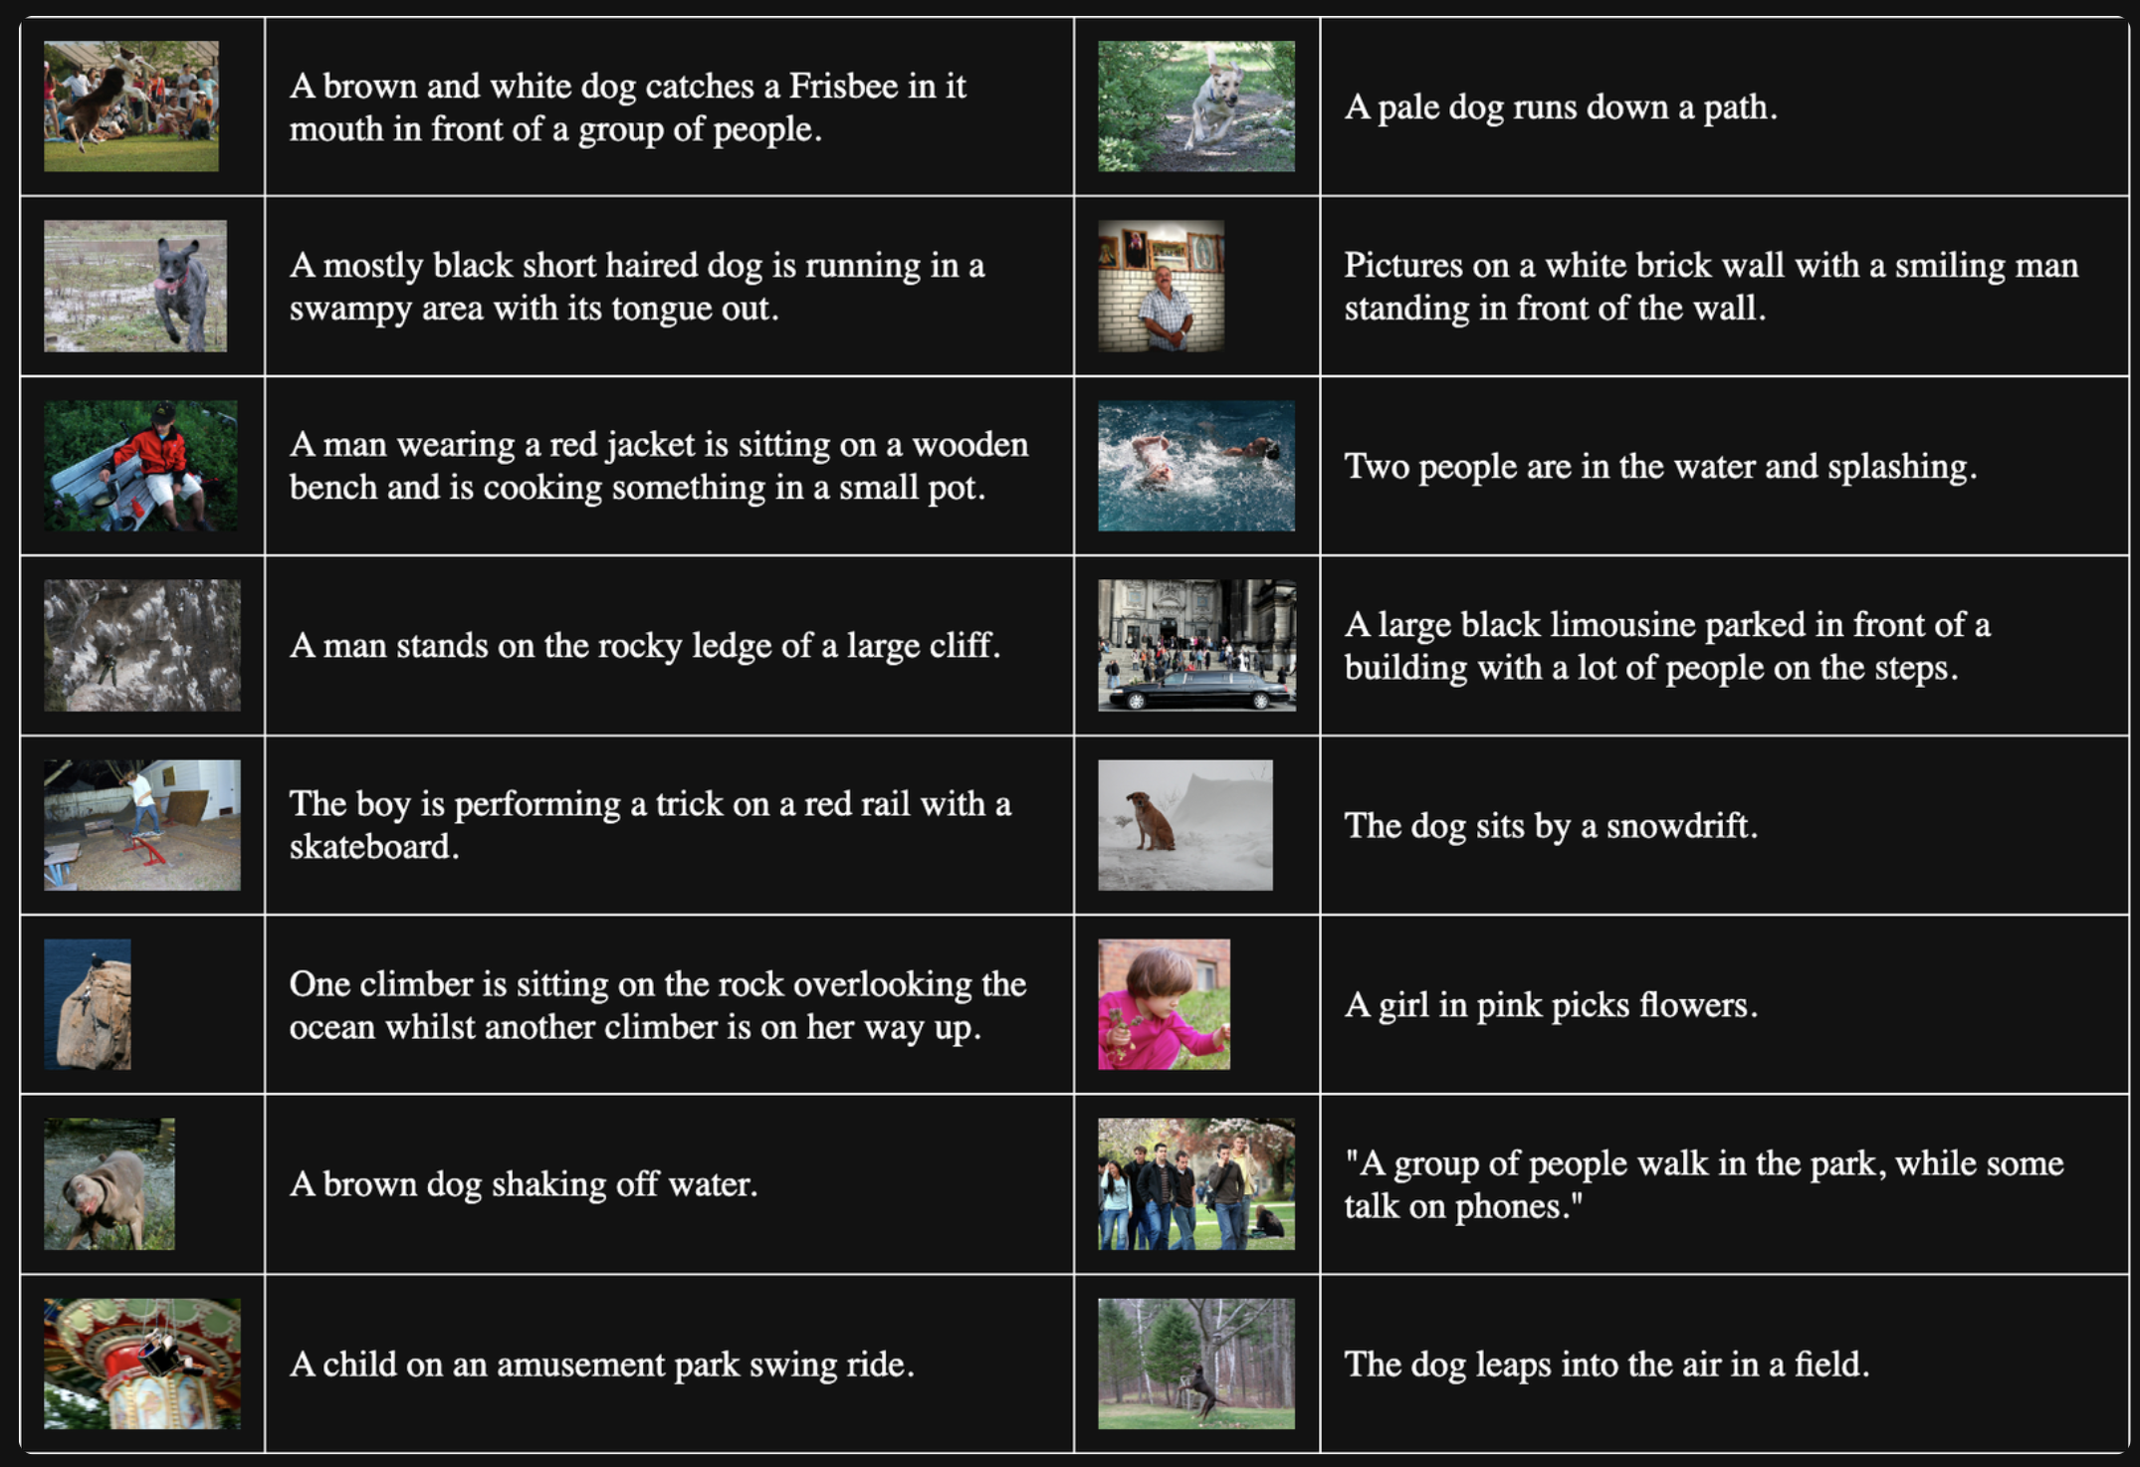
Data Collection: (Image , Text) 400M pairs

Slide 11
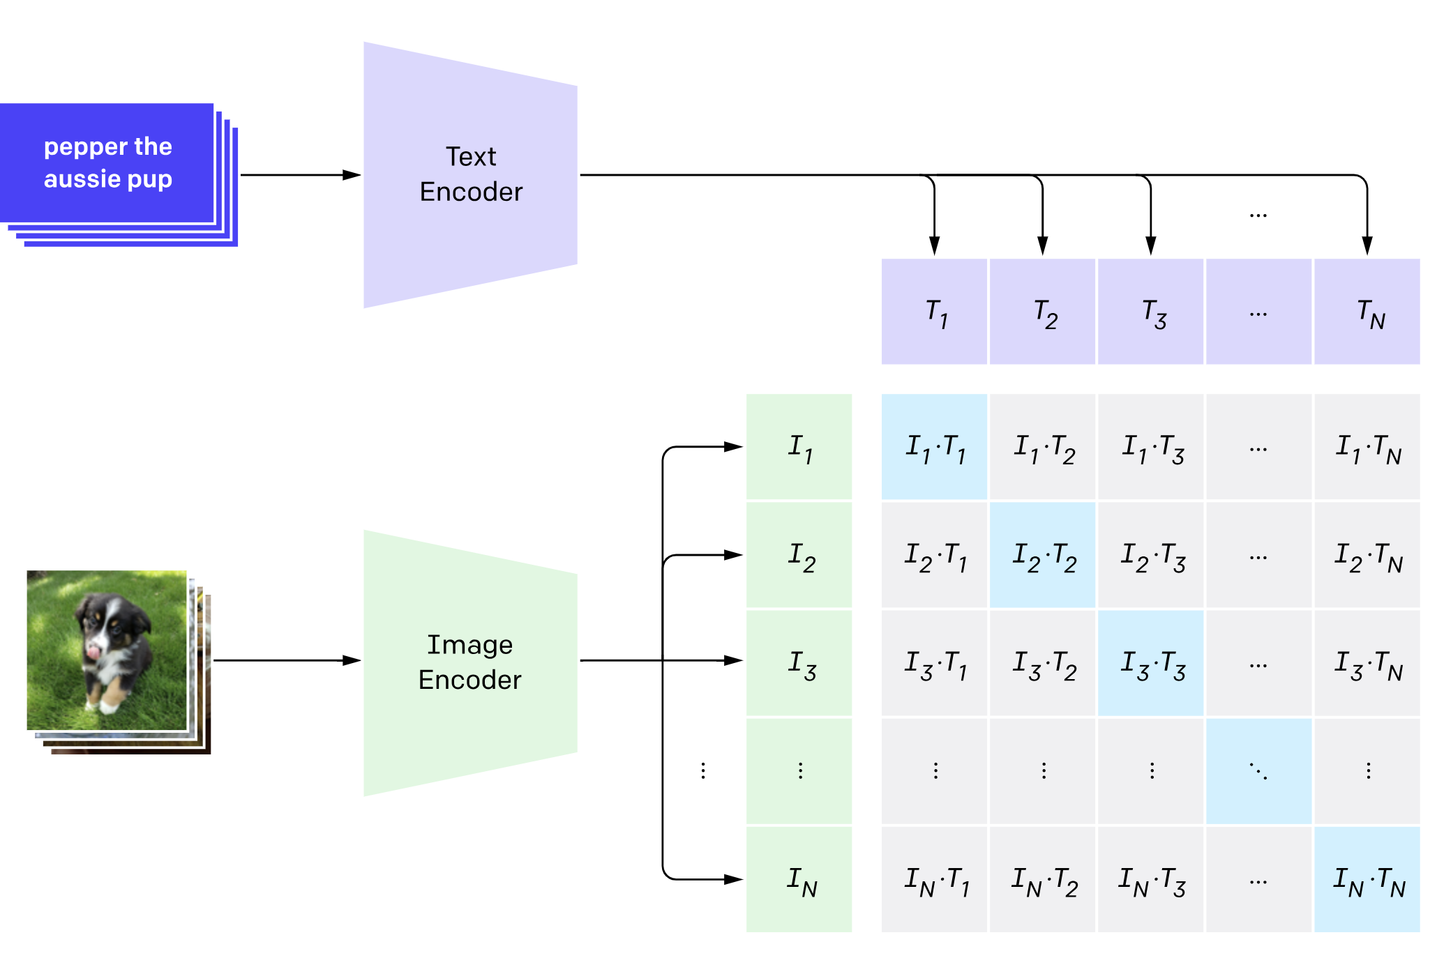
Contrastive Pre-Training

Slide 12
Contrastive Pre-Training
Maximize the diagonal

Slide 13
Contrastive Pre-Training
Contrastive loss: minimizes distance between correct pairs, maximizes for incorrect pairs.
Maximize the diagonal,
and minimize the non-diagonal

Slide 14
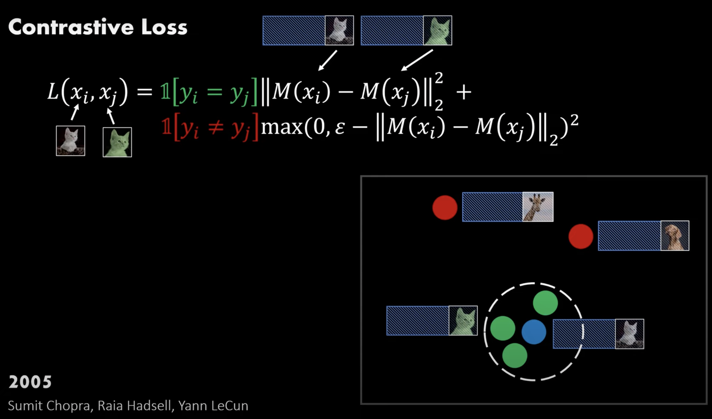
Max Margin Loss
https://youtu.be/u-X_nZRsn5M?si=hVAEmak-y7D7yqms

Slide 15


Max Margin Loss
https://youtu.be/u-X_nZRsn5M?si=hVAEmak-y7D7yqms

Slide 16
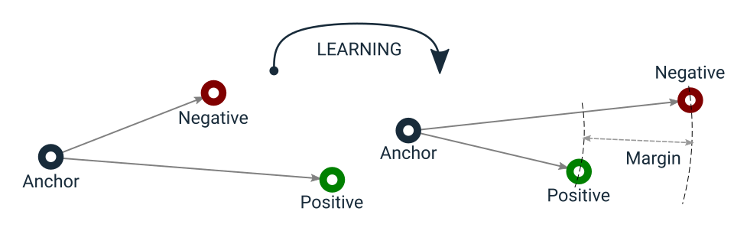
Triplet Loss

Slide 17
Triplet Loss

Slide 18
Triplet Loss

Slide 19
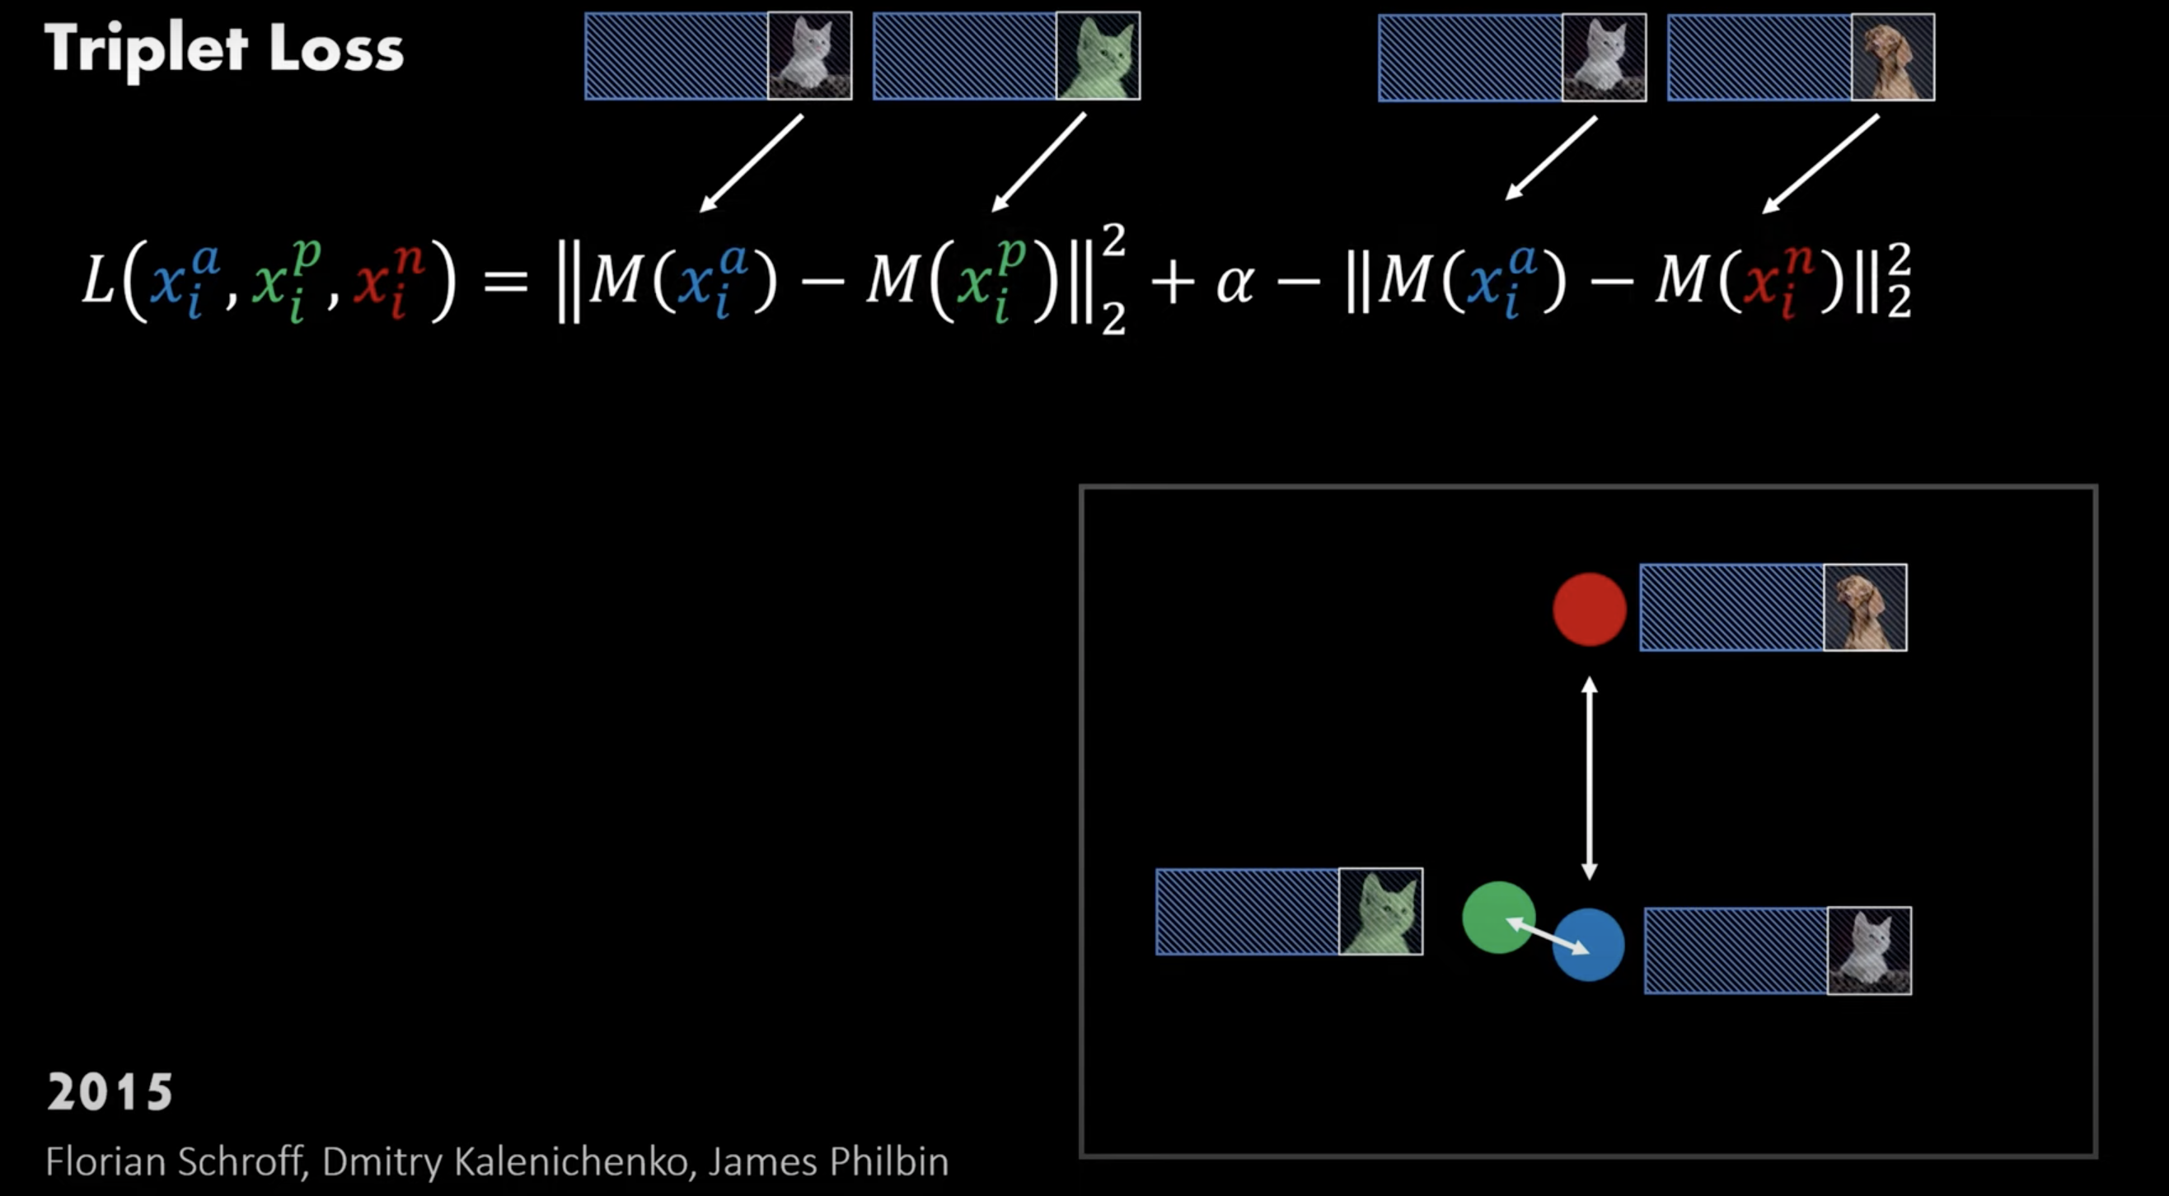

Triplet Loss
https://youtu.be/u-X_nZRsn5M?si=hVAEmak-y7D7yqms

Slide 20
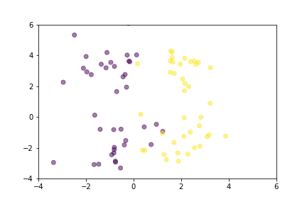
Triplet Loss

Slide 21
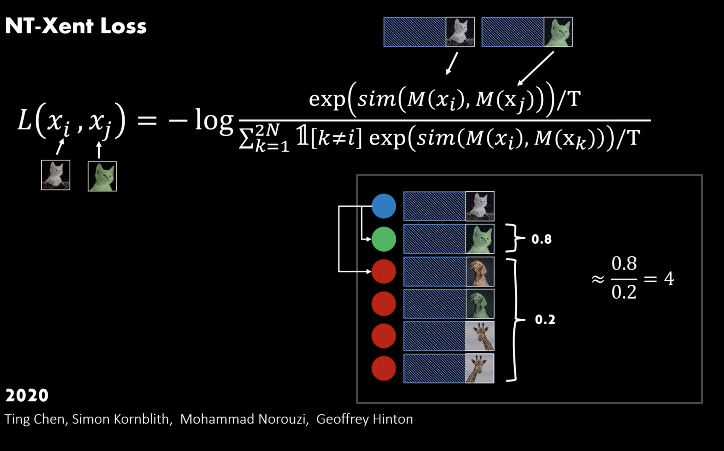
NT-Xent Loss
https://youtu.be/u-X_nZRsn5M?si=hVAEmak-y7D7yqms

Slide 22
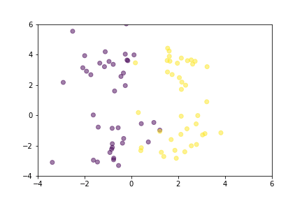
Contrastive Loss

Slide 23
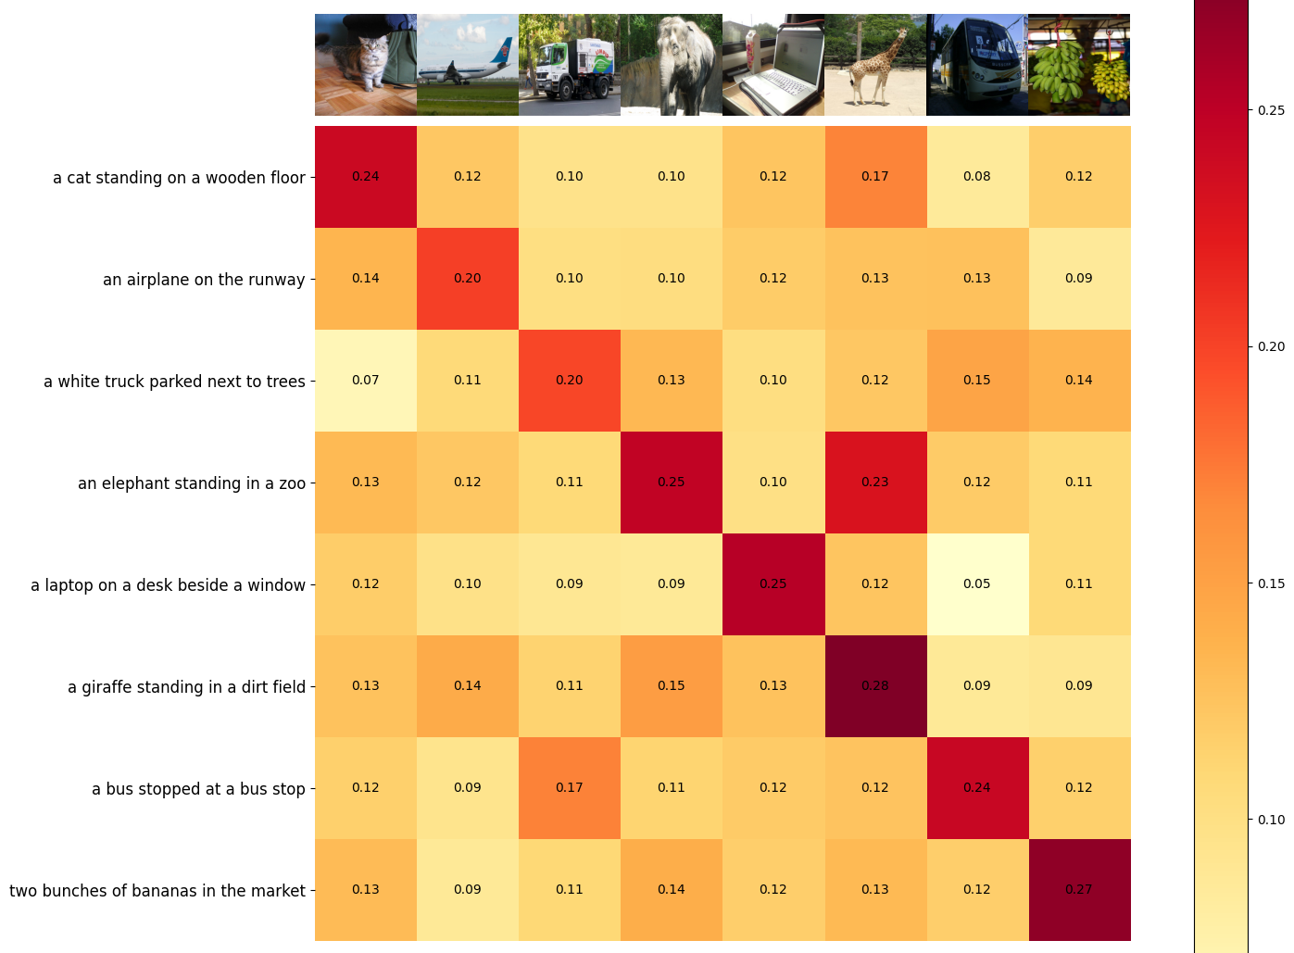
Contrastive Pre-Training

Slide 24
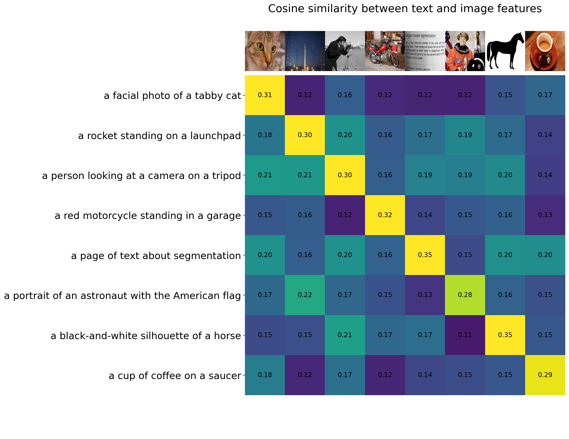
Contrastive Pre-Training

Slide 25
Applications: Zero-Shot Classification
CLIP can classify images into categories that were not included during its training. This is possible because it generates image and text embeddings that are directly comparable, enabling the model to predict categories based solely on textual descriptions provided at runtime.

Slide 26
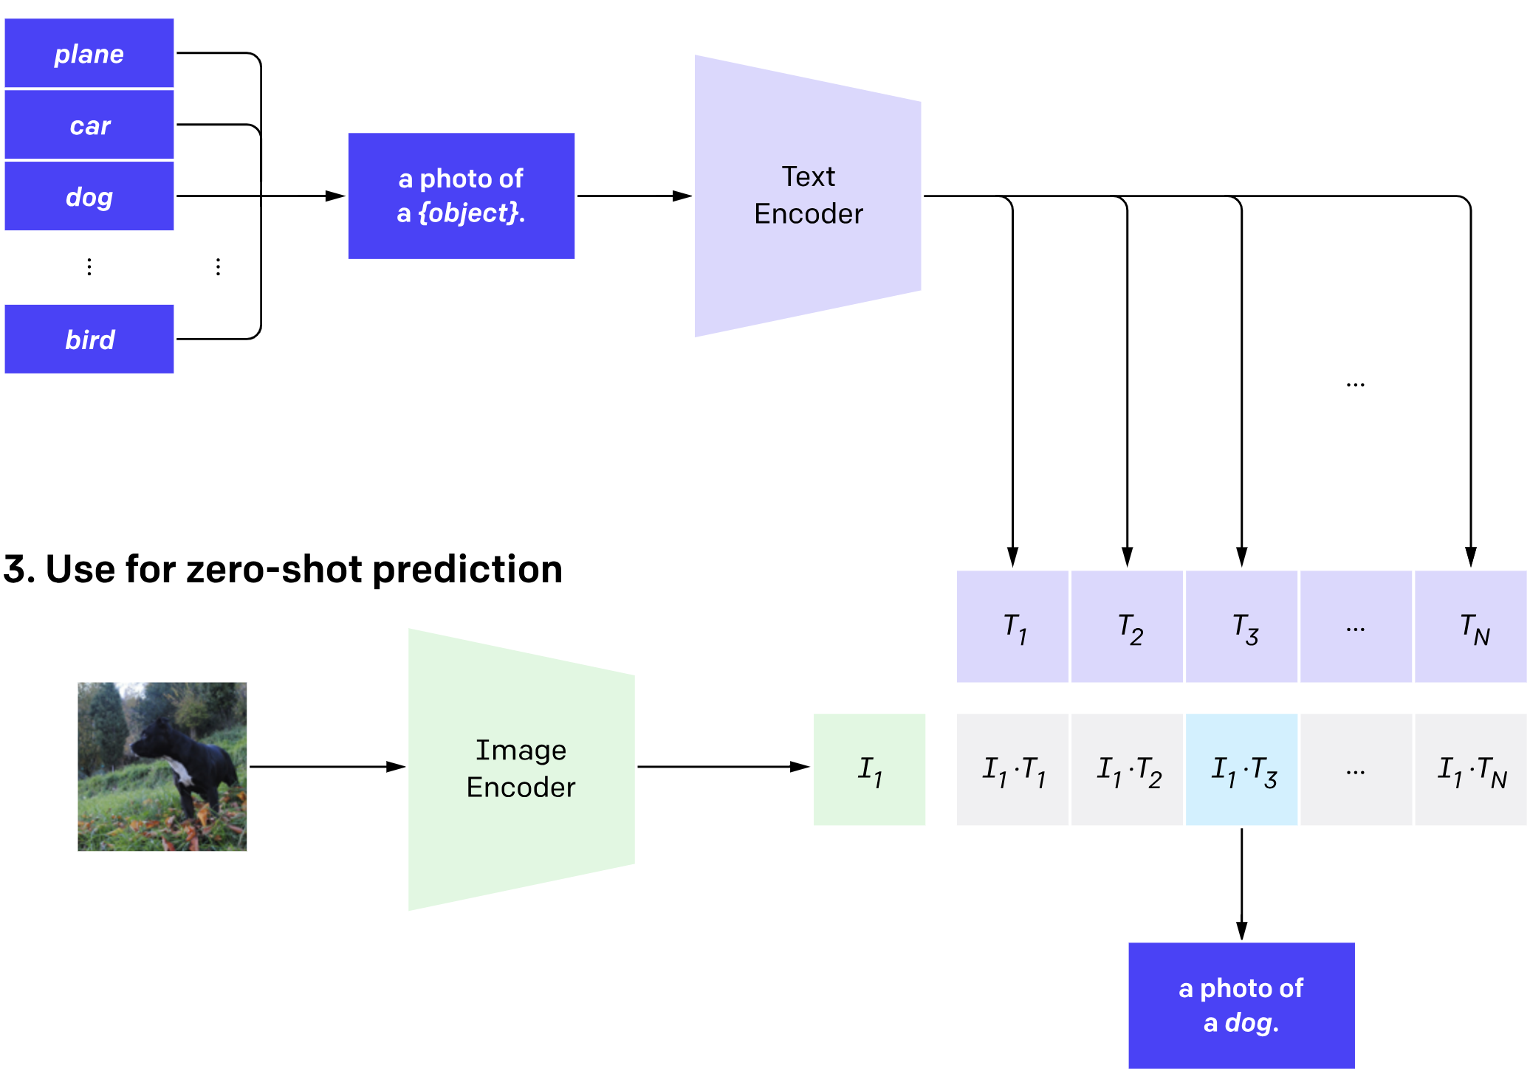
Create Dataset Classifier from label Text
Zero-shot prediction

Slide 27
Create Dataset Classifier from label Text
Zero-shot prediction

Slide 28
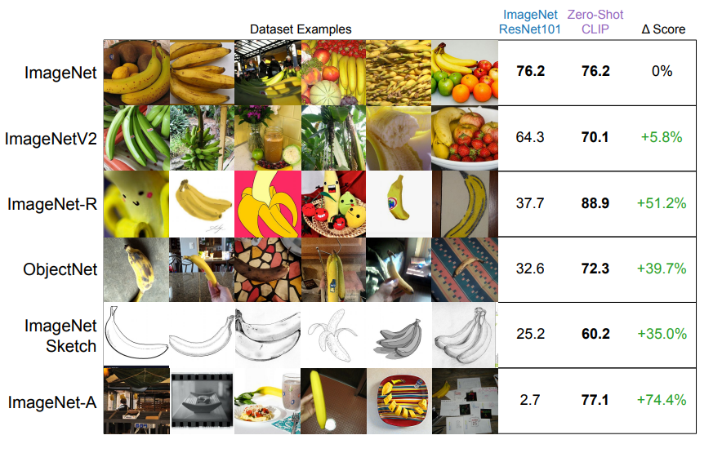
Comparison

Slide 29
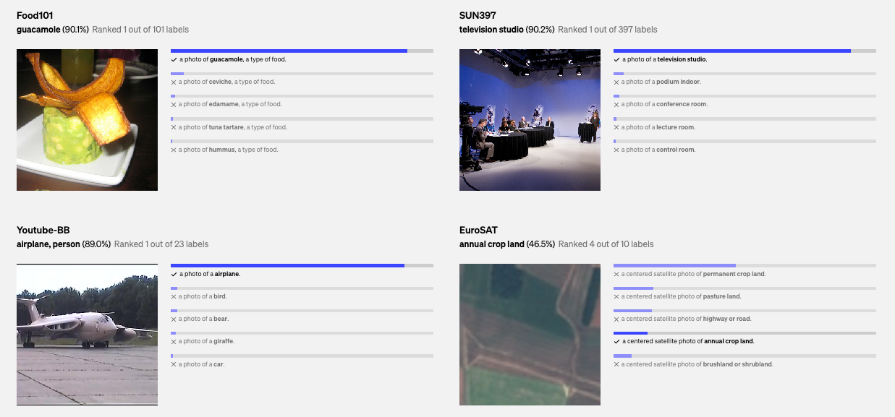
Results

Slide 30
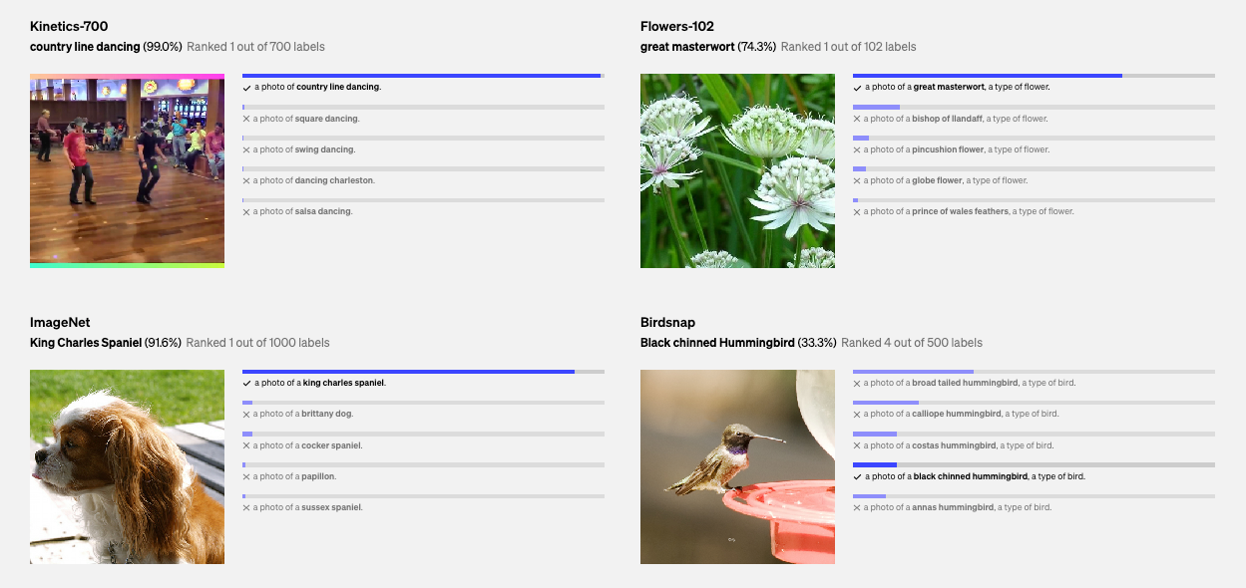
Results

Slide 31
Applications: Image Retrieval
By converting both text queries and images into a common embedding space, CLIP can efficiently retrieve images that are semantically related to textual queries, enhancing search functionalities in databases and online.

Slide 32
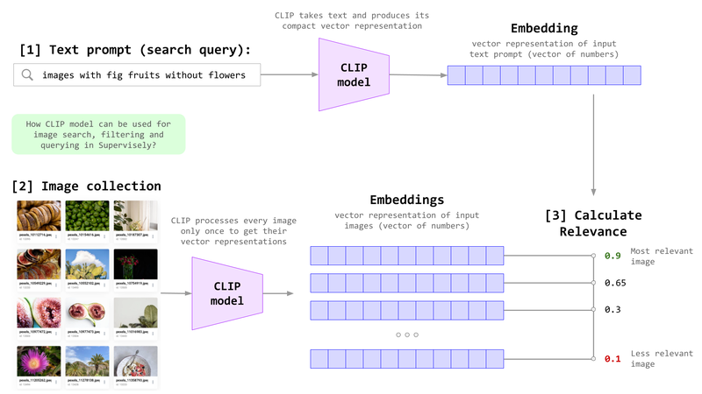
Applications: Image Retrieval

Slide 33
Applications: Image Caption
CLIP can assist in generating descriptive captions for images or even help generate images from textual descriptions by linking the textual content with visual representations.
Two people relax at a beach under a tree, enjoying a serene ocean view.

Slide 34
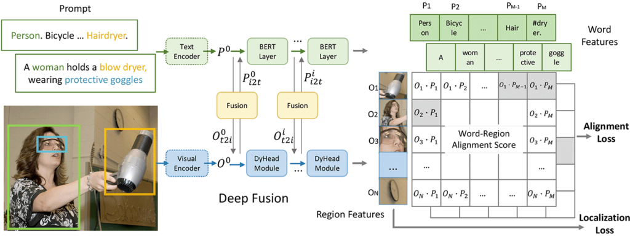
Applications: Object Detection
Although not primarily designed for this, CLIP can be adapted for object detection tasks where objects are detected based on their descriptions rather than traditional bounding box annotations.

Slide 35
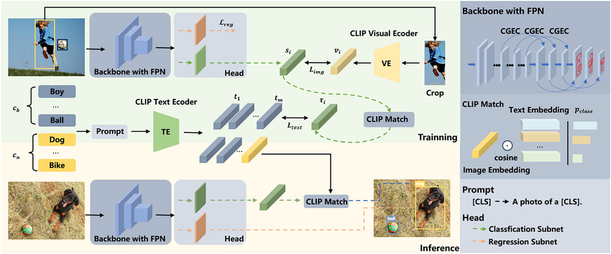
Applications: Object Detection
Although not primarily designed for this, CLIP can be adapted for object detection tasks where objects are detected based on their descriptions rather than traditional bounding box annotations.

Slide 36
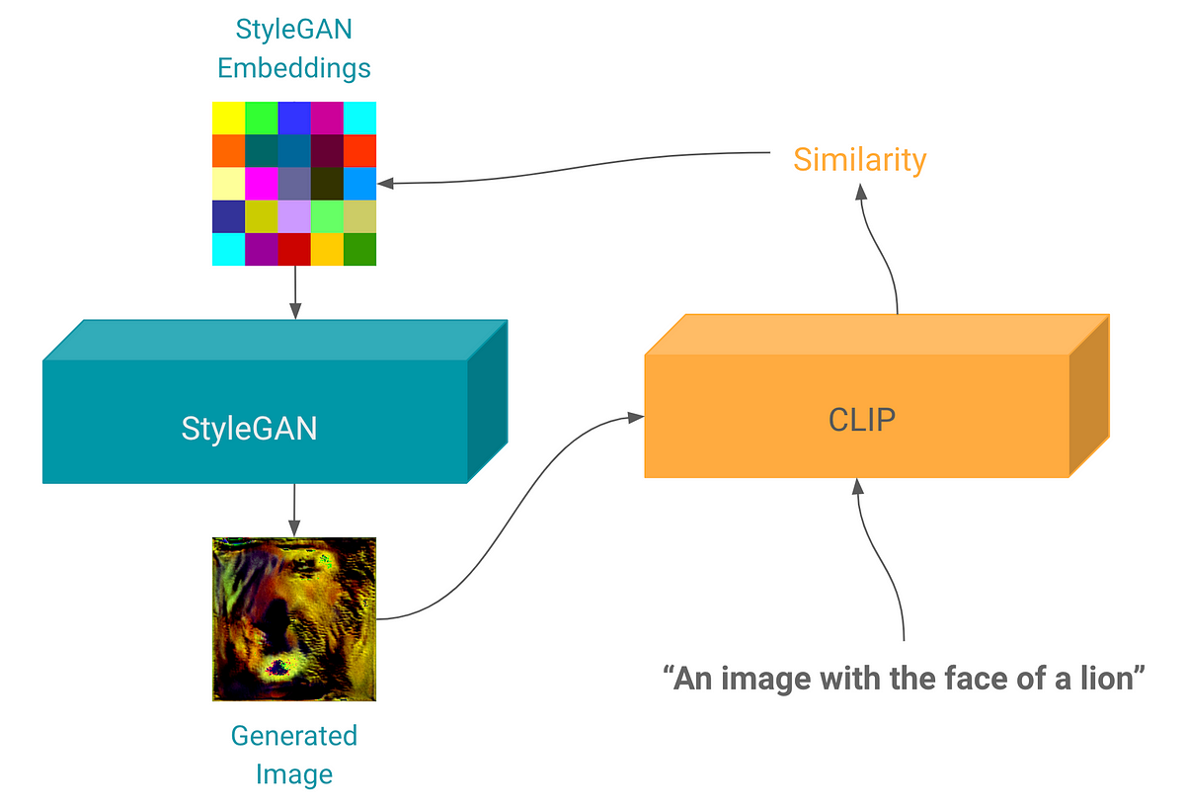
Applications: Image Generation
Although not primarily designed for this, CLIP can be adapted for image generation.

