Slide 1

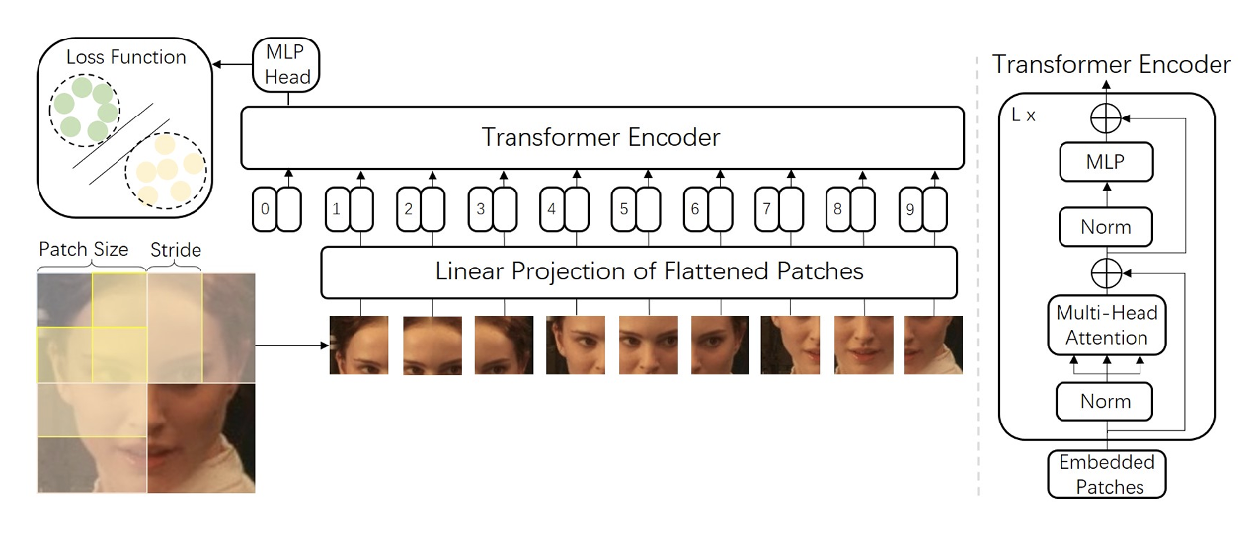

Visión por Computador
Versión 2026
ViT
(CAPÍTULO 3 – CV03I )
Domingo Mery
Ciencia de la Computación
Universidad Católica – Chile
http://domingomery.ing.uc.cl

Slide 2
Visual Transformer (ViT)

Slide 3
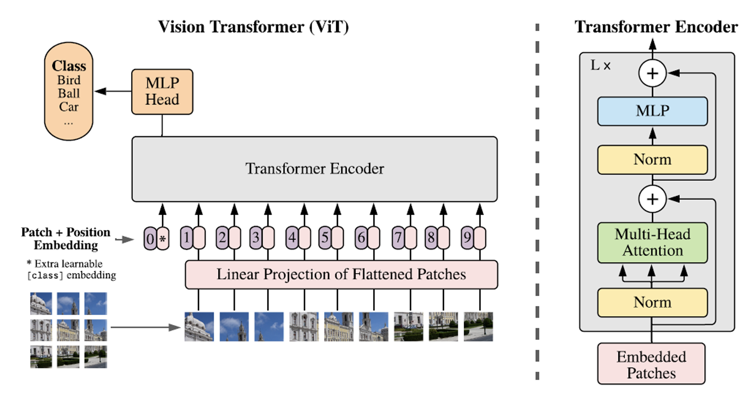
Visual Transformer (ViT)
Dosovitskiy, Alexey, Lucas Beyer, Alexander Kolesnikov, Dirk Weissenborn, Xiaohua Zhai, Thomas Unterthiner, Mostafa Dehghani et al. "An image is worth 16x16 words: Transformers for image recognition at scale." arXiv preprint arXiv:2010.11929 (2020).

Slide 4


Visual Transformer (ViT)
Example: ViT in Face Recognition

Slide 5

Visual Transformer (ViT)
48x48

Slide 6
Visual Transformer (ViT)
16x16

Slide 7
Visual Transformer (ViT)
16x16

Slide 8
Visual Transformer (ViT)

Slide 9
Visual Transformer (ViT)

Slide 10
Visual Transformer (ViT)

Slide 11
Visual Transformer (ViT)

Slide 12
Visual Transformer (ViT)

Slide 13
Visual Transformer (ViT)

Slide 14
Visual Transformer (ViT)
256x1x3

Slide 15
Visual Transformer (ViT)
256x1x3

Slide 16
Visual Transformer (ViT)
Red
256x1
Green
256x1
Blue
256x1
256x1x3
768x1

Slide 17
Visual Transformer (ViT)
768x1
256x1x3

Slide 18
Visual Transformer (ViT)
768x1
256x1x3

Slide 19
Visual Transformer (ViT)
16x16x3
768x1
256x1x3

Slide 20









Visual Transformer (ViT)

Slide 21
Visual Transformer (ViT)

Slide 22
Visual Transformer (ViT)
768x9

Slide 23

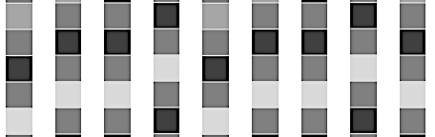


Visual Transformer (ViT)
Class
MLP
Transformer Encoder
PE
. . .
PE
+
+

Slide 24
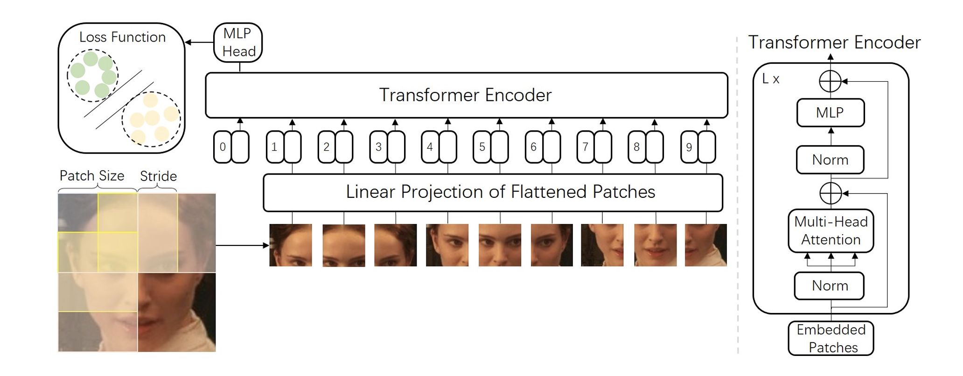
Visual Transformer (ViT)
Zhong, Y., & Deng, W. (2021). Face transformer for recognition. arXiv preprint arXiv:2103.14803.

Slide 25
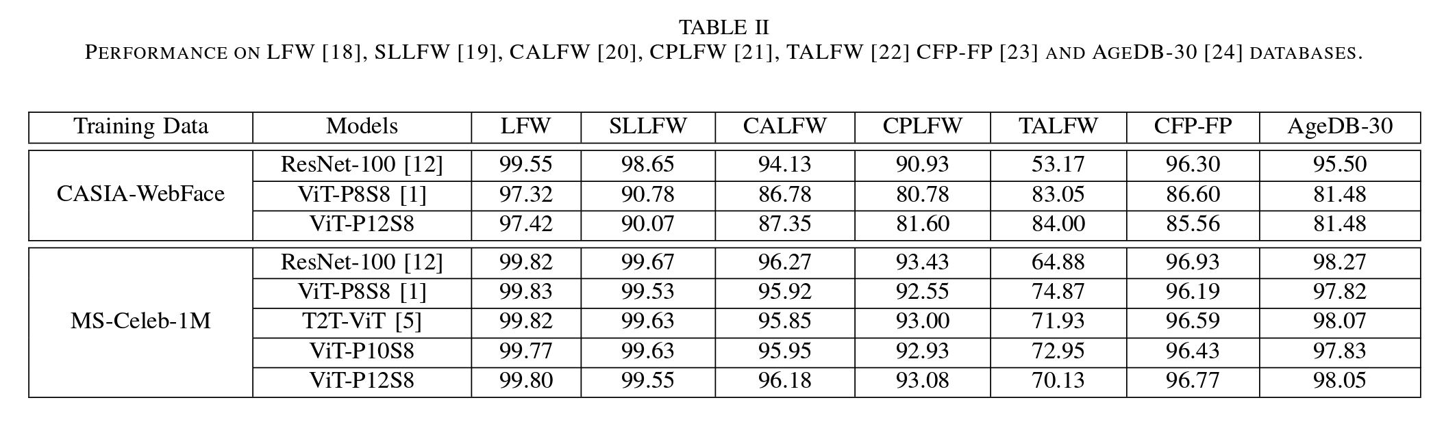
Visual Transformer (ViT)
Zhong, Y., & Deng, W. (2021). Face transformer for recognition. arXiv preprint arXiv:2103.14803.

Slide 26
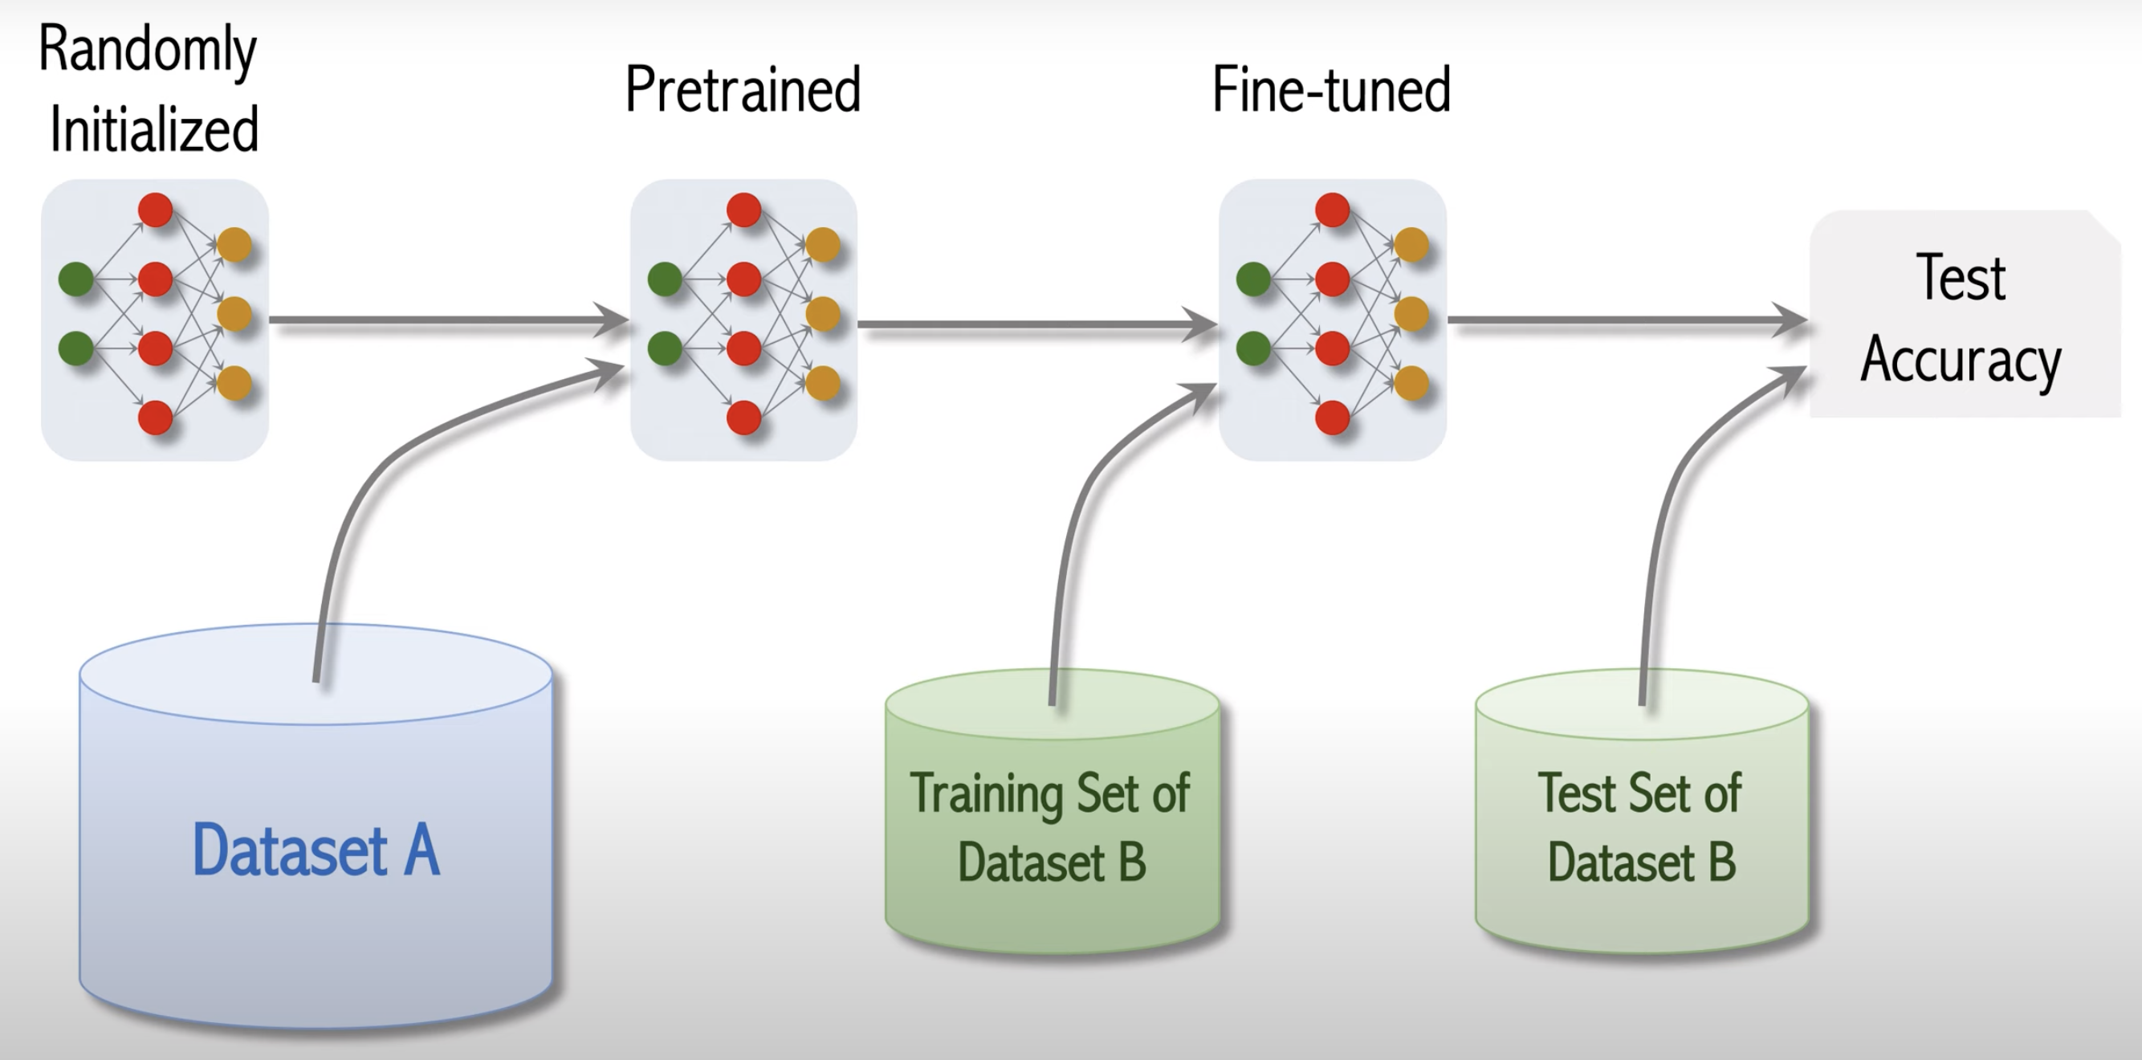
Visual Transformer (ViT)
Shusen Wang: Vision Transformer for Image Classification. https://youtu.be/HZ4j_U3FC94?si=plI9zvAIxx2eIYgq

Slide 27
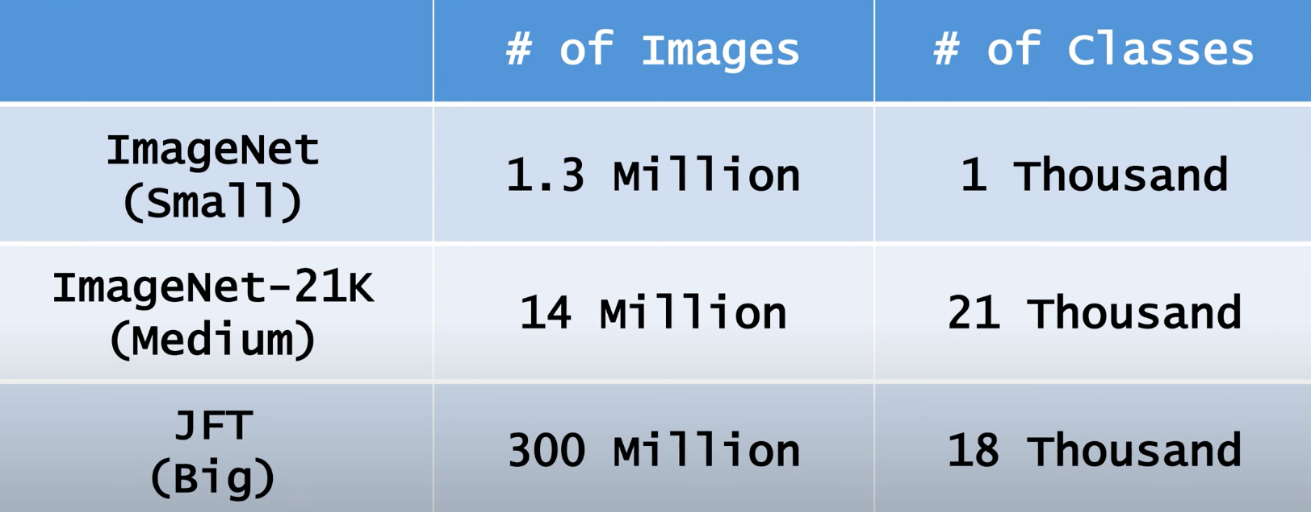
Visual Transformer (ViT)
Shusen Wang: Vision Transformer for Image Classification. https://youtu.be/HZ4j_U3FC94?si=plI9zvAIxx2eIYgq

Slide 28
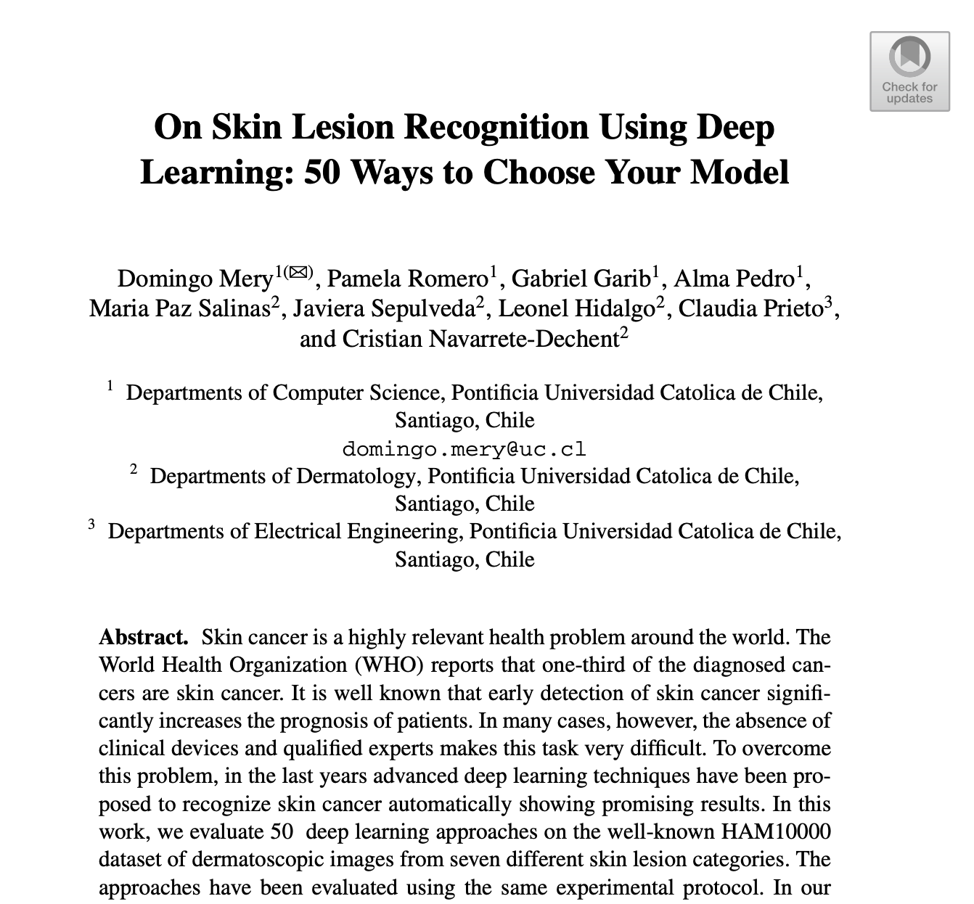
Visual Transformer (ViT): Example
Mery, Domingo, Pamela Romero, Gabriel Garib, Alma Pedro, Maria Paz Salinas, Javiera Sepulveda, Leonel Hidalgo, Claudia Prieto, and Cristian Navarrete-Dechent. "On Skin Lesion Recognition Using Deep Learning: 50 Ways to Choose Your Model." In Pacific-Rim Symposium on Image and Video Technology, pp. 103-116. Cham: Springer International Publishing, 2022.

Slide 29
Evaluated Methods
AlexNet
GoogleNet
ConvNet
VGG
ResNet
ResNeXt
DenseNet
SqueezNet
ShuffleNet
MobileNet
MnasNet
EfficientNet
ARLNET
ViT
Wide ResNet
50 models from
15 different architectures

Slide 30
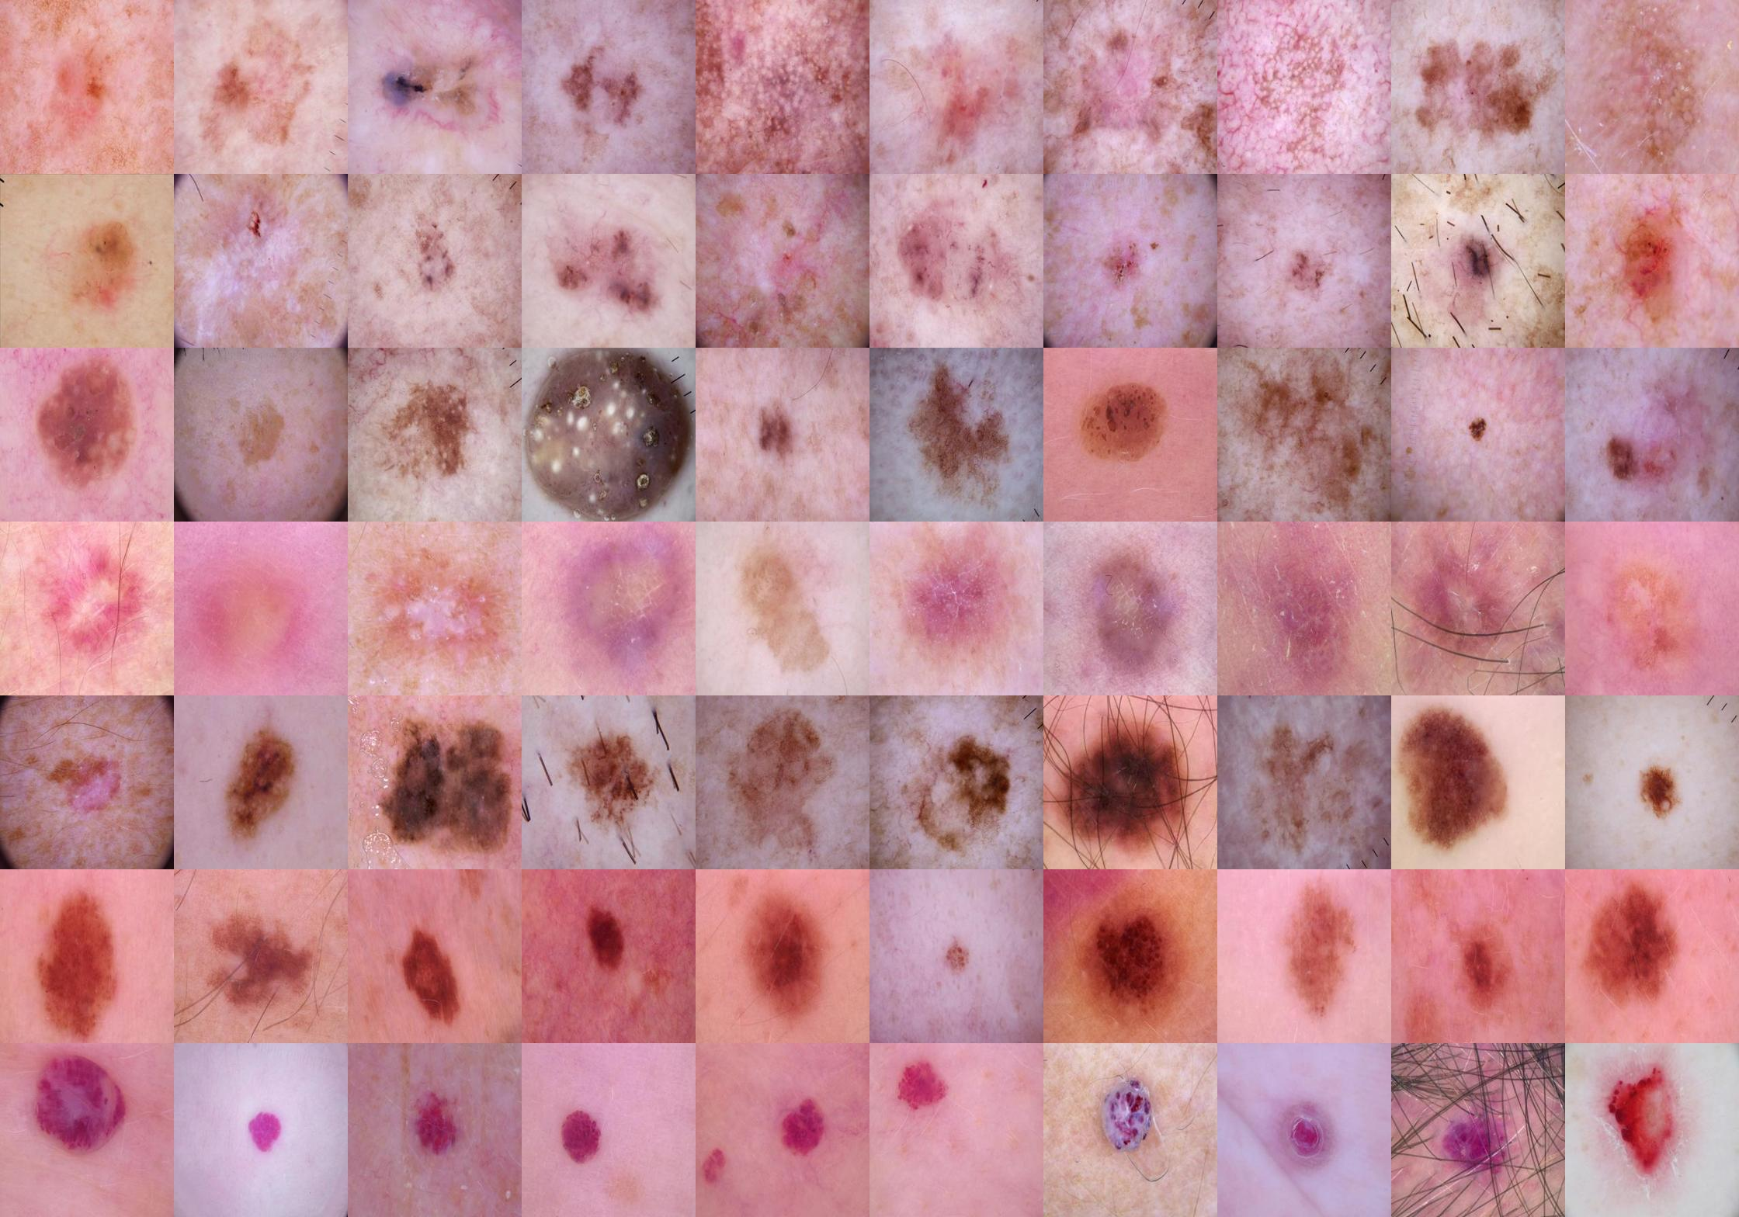
Class | Acronym | Name
0 | akiec | Actinic Keratosis
1 | bcc | Basal Cell Carcinoma
2 | bkl | Benign Keratosis
3 | df | Dermatofibroma
4 | mel | Melanoma
5 | nv | Melanocytic Nevus
6 | vasc | Vascular Lesion
Database
ISIC Dataset – HAM 10000

Slide 31
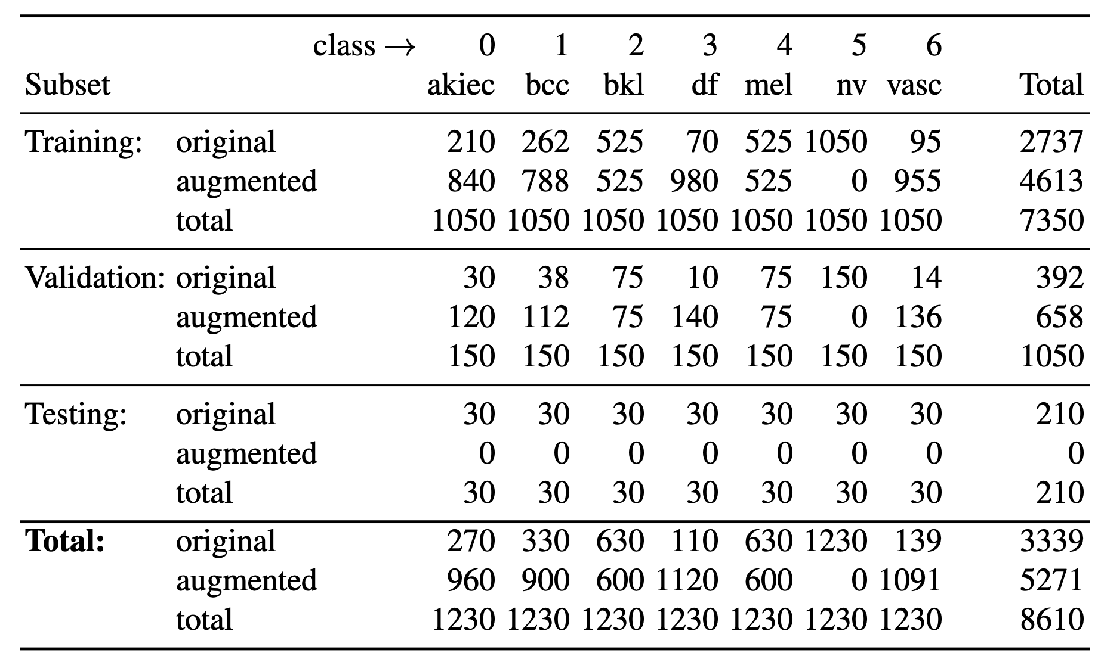
Number of images for training, validation and testing of each class

Slide 32
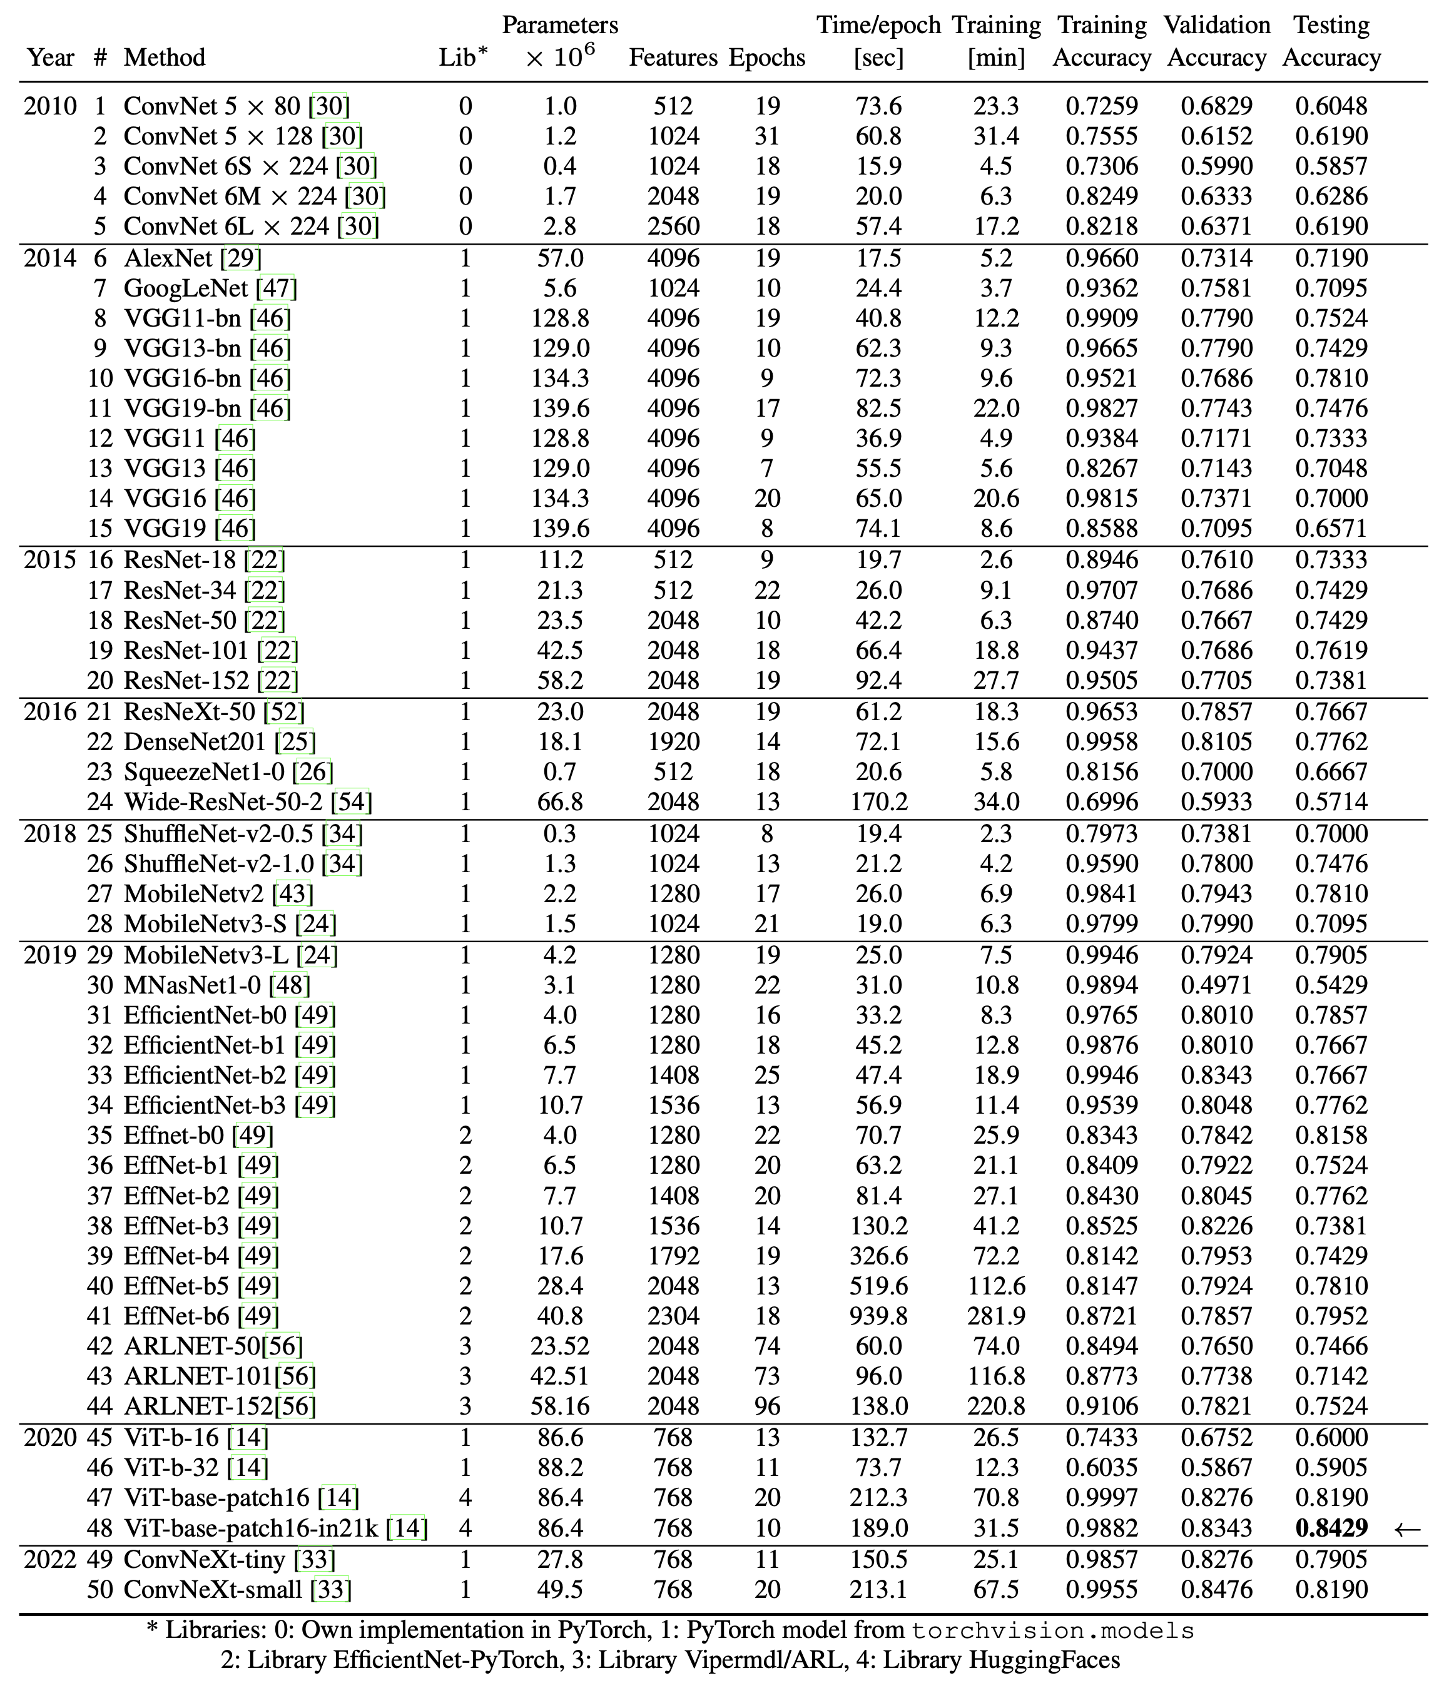
Results
for the
50 models

Slide 33
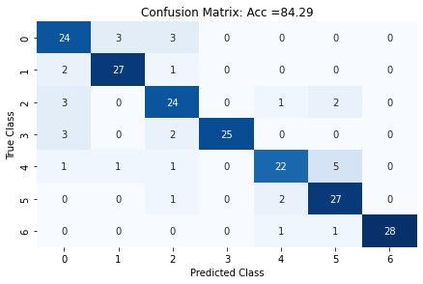
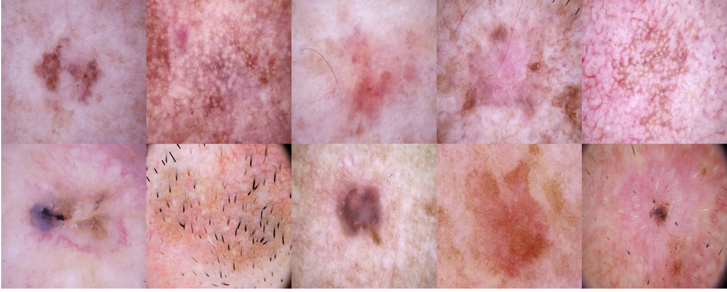
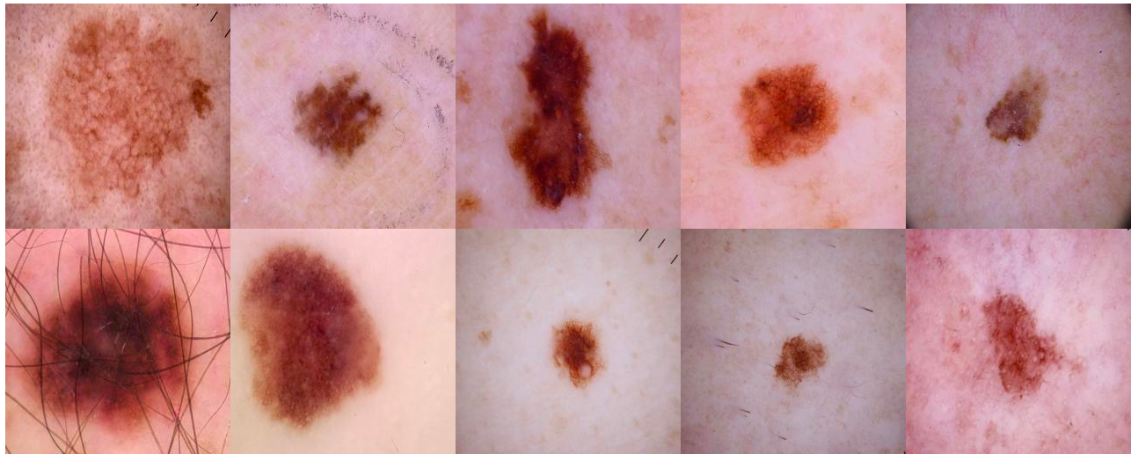
Confusion Matrix for Best Model (ViT)
Images classified as Class 0
correctly
classified
wrongly
classified
Images classified as Class 4
correctly
classified
wrongly
classified

Slide 34
Images classified as Class 0
correctly
classified
wrongly
classified
Images classified as Class 4
correctly
classified
wrongly
classified

Slide 35
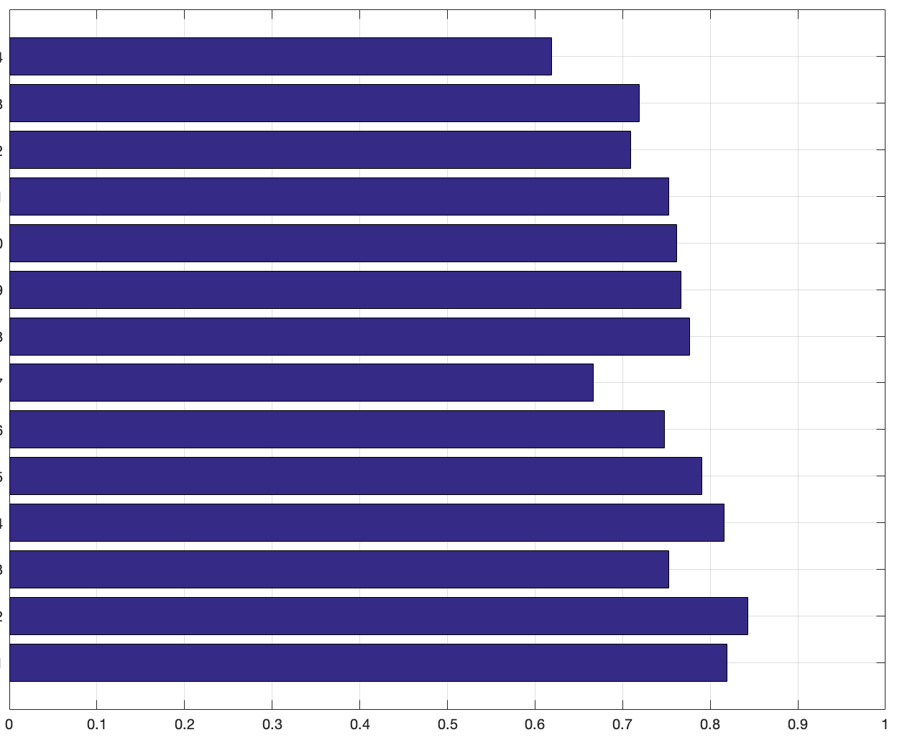
Accuracy on testing subset for each architecture
ConvNet
AlexNet
GoogLeNet
VGG
ResNet
ResNeXt
DenseNet
SqueezeNet
ShuffleNet
MobileNet
EfficientNet
ARLNET
ViT
ConvNeXt
0.6286
0.7190
0.7095
0.7524
0.7619
0.7667
0.7762
0.6667
0.7476
0.7905
0.8158
0.7524
0.8429
0.8190
2010
2014
2015
2016
2018
2019
2020
2022

