Slide 1
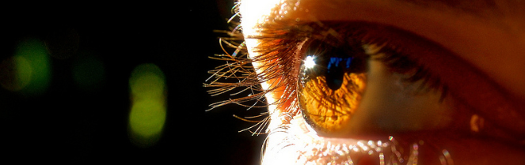
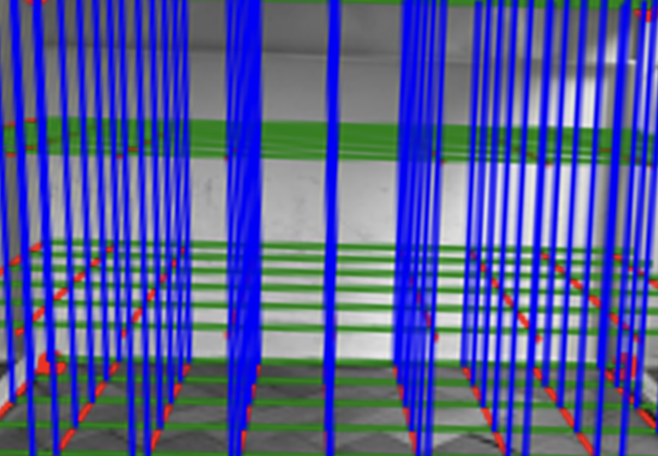

Visión por Computador
Versión 2026
Calibración
(CAPÍTULO 2 – CV02D)
Domingo Mery
Ciencia de la Computación
Universidad Católica – Chile
http://domingomery.ing.uc.cl

Slide 2
[ Calibration ]

Slide 3
Calibration: Estimation of the parameters of the projection model
m
M
C
[3x1] [3x4][4x1]

Slide 4
[ Calibration ]
Calibration is the process that estimates the parameters of the camera given corresponding points 3D – 2D
INPUT: 3D points M₁, M₂, M₃, M₄, ... M_{n}
2D points m₁, m₂, m₃, m₄, ... m_{n} m_{i} is the projection of M_{i}.
OUTPUT:
Parameters of the Model
Notes:
\lambda \begin{bmatrix}
u\\
v\\
1
\end{bmatrix}
=
\begin{bmatrix}
\alpha_x & s & u_0\\
0 & \alpha_s & v_0 \\
0 & 0 & 1
\end{bmatrix}
\begin{bmatrix}
f & 0 & 0 & 0\\
0 & f & 0 & 0 \\
0 & 0 & 0 & 1
\end{bmatrix}
\begin{bmatrix}
{\bf R}' & {\bf t}'\\
{\bf 0} & 1
\end{bmatrix}
\begin{bmatrix}
X'\\
Y'\\
Z'\\
1
\end{bmatrix}

Slide 5
[ Calibration ]
Calibration is the process that estimates the parameters of the camera given corresponding points 3D – 2D
Measurements:
INPUT: 3D points M₁, M₂, M₃, M₄, ... M_{n}
2D points m₁, m₂, m₃, m₄, ... m_{n} m_{i} is the projection of M_{i}.
OUTPUT:
Parameters of the Model
parameter
model
Notes:
\lambda \begin{bmatrix}
u\\
v\\
1
\end{bmatrix}
=
\begin{bmatrix}
\alpha_x & s & u_0\\
0 & \alpha_s & v_0 \\
0 & 0 & 1
\end{bmatrix}
\begin{bmatrix}
f & 0 & 0 & 0\\
0 & f & 0 & 0 \\
0 & 0 & 0 & 1
\end{bmatrix}
\begin{bmatrix}
{\bf R}' & {\bf t}'\\
{\bf 0} & 1
\end{bmatrix}
\begin{bmatrix}
X'\\
Y'\\
Z'\\
1
\end{bmatrix}

Slide 6
[ Simple Calibration ]

Slide 7
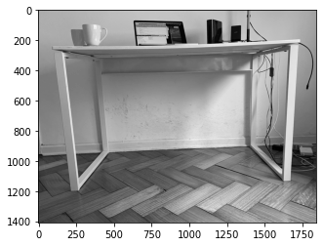

Slide 8
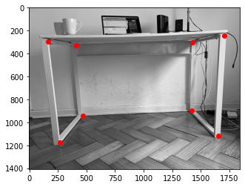
Selection
of Points

Slide 9

2D Points
(measurement)
5: (1704, 246)
1: (166,294)
2: (412,328)
6: (1426, 304)
3: (470,940)
7: (1420,900)
0: (268,1178)
4: (1654,1118)

Slide 10

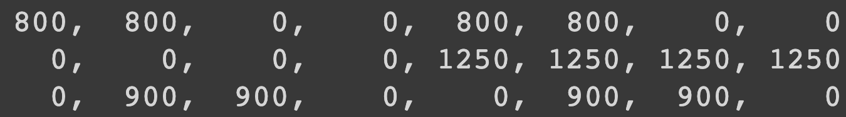
3D Points
(measurement)
5
1
2
6
3
7
0
4
0 1 2 3 4 5 6 7
3D POINTS
(in mm)

Slide 11
Selection
of Points
5: (1704, 246)
1: (166,294)
(measurement)
2: (412,328)
6: (1426, 304)
3: (470,940)
7: (1420,900)
0: (268,1178)
4: (1654,1118)
0 1 2 3 4 5 6 7
3D POINTS
(in mm)

Slide 12
For each point

Slide 16

LEAST SQUARES

Slide 17
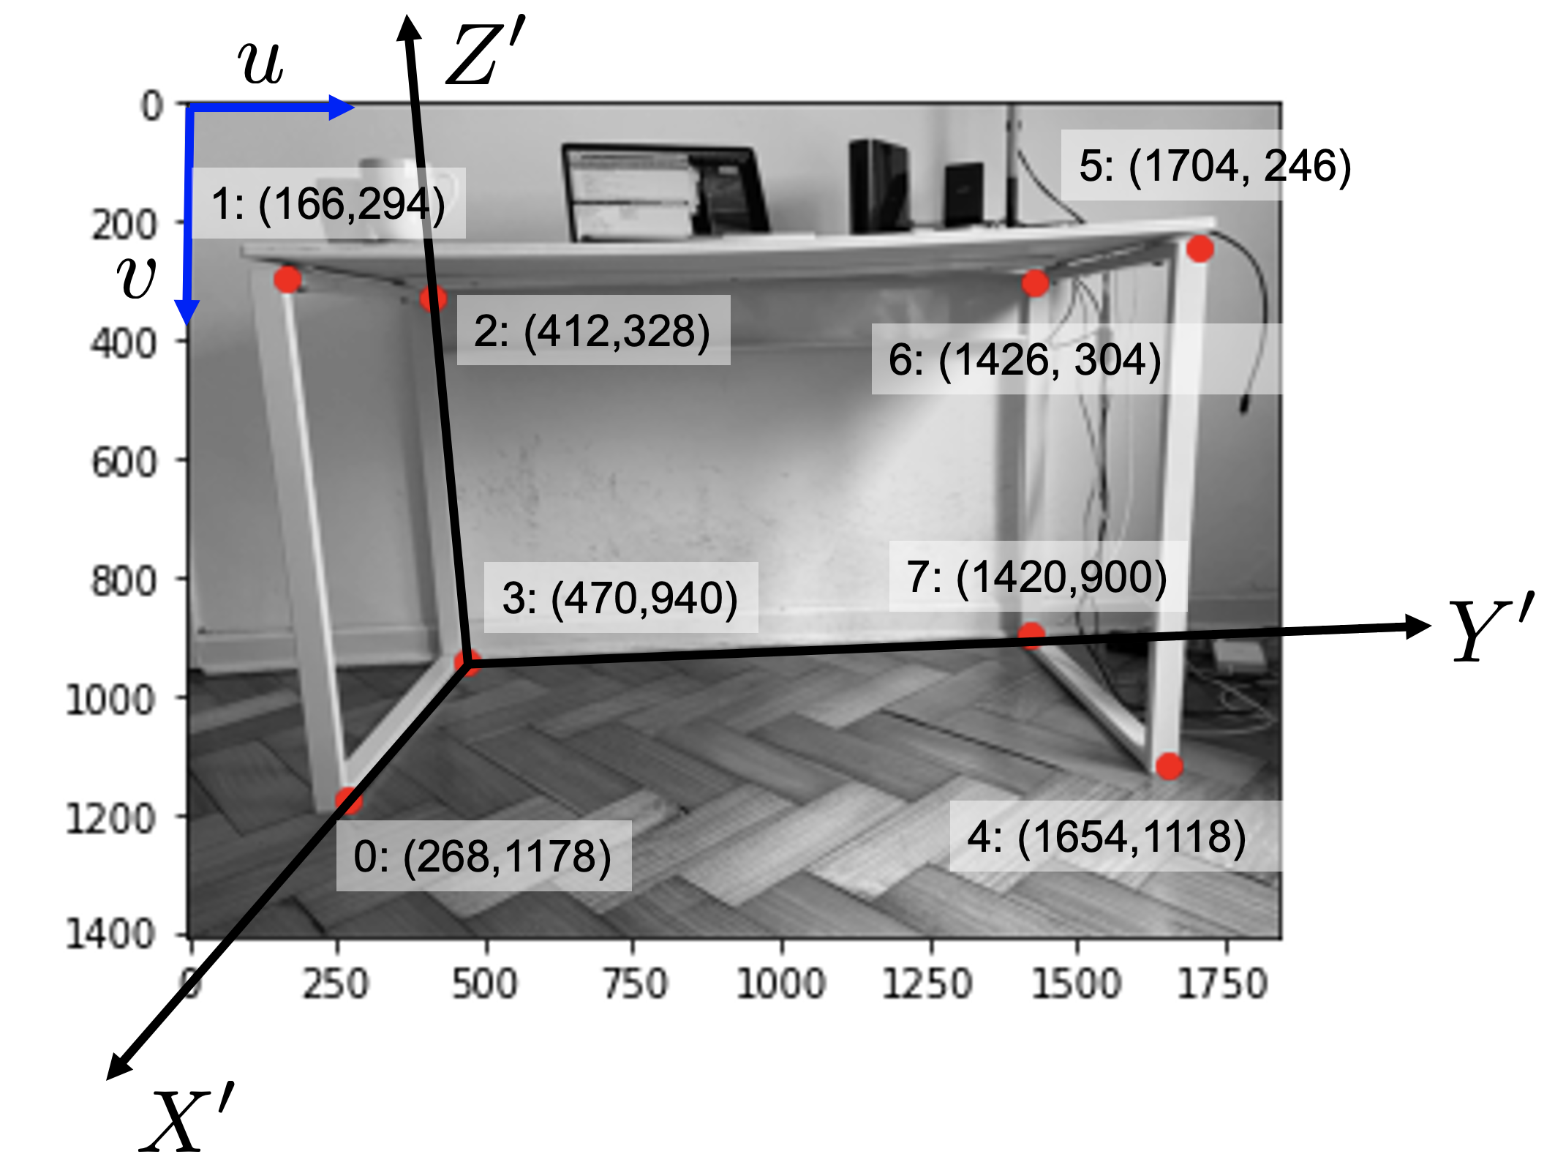
2D POINTS
Calibration
3D POINTS
u = 268 166 412 470 1654 1704 1426 1420
= 271 164 412 468 1656 1699 1429 1417
v = 1178 294 328 940 1118 246 304 900
= 1180 289 331 937 1119 246 302 899

Slide 18
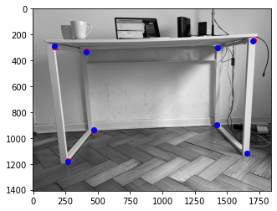



Slide 19
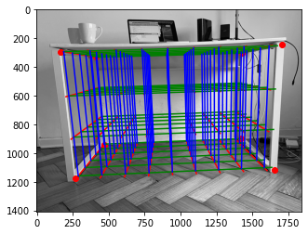

Slide 20
[ Non-Linear Calibration ]

Slide 21

[ Camera Model ] (see explanation in CV02C_Transformaciones3D.pptx)
f
v
m
Y
Z'
M
Y'
(u,v)
y
(X',Y',Z')
Z
C
u
X'
x
X

Slide 22
[ Camera Model ]
Notes:
\lambda \begin{bmatrix}
u\\
v\\
1
\end{bmatrix}
=
\begin{bmatrix}
\alpha_x & s & u_0\\
0 & \alpha_s & v_0 \\
0 & 0 & 1
\end{bmatrix}
\begin{bmatrix}
f & 0 & 0 & 0\\
0 & f & 0 & 0 \\
0 & 0 & 0 & 1
\end{bmatrix}
\begin{bmatrix}
{\bf R}' & {\bf t}'\\
{\bf 0} & 1
\end{bmatrix}
\begin{bmatrix}
X'\\
Y'\\
Z'\\
1
\end{bmatrix}

Slide 23
[ Camera Model ]
Notes:
\lambda \begin{bmatrix}
u\\
v\\
1
\end{bmatrix}
=
\begin{bmatrix}
\alpha_x & s & u_0\\
0 & \alpha_s & v_0 \\
0 & 0 & 1
\end{bmatrix}
\begin{bmatrix}
f & 0 & 0 & 0\\
0 & f & 0 & 0 \\
0 & 0 & 0 & 1
\end{bmatrix}
\begin{bmatrix}
{\bf R}' & {\bf t}'\\
{\bf 0} & 1
\end{bmatrix}
\begin{bmatrix}
X'\\
Y'\\
Z'\\
1
\end{bmatrix}

Slide 24
[ Camera Model ]
11 DoF:
5 intrinsec parameters
6 extrinsec parameters
Notes:
\lambda \begin{bmatrix}
u\\
v\\
1
\end{bmatrix}
=
\begin{bmatrix}
\alpha_x & s & u_0\\
0 & \alpha_s & v_0 \\
0 & 0 & 1
\end{bmatrix}
\begin{bmatrix}
f & 0 & 0 & 0\\
0 & f & 0 & 0 \\
0 & 0 & 0 & 1
\end{bmatrix}
\begin{bmatrix}
{\bf R}' & {\bf t}'\\
{\bf 0} & 1
\end{bmatrix}
\begin{bmatrix}
X'\\
Y'\\
Z'\\
1
\end{bmatrix}

Slide 25
[ Calibration ]
Calibration is the process that estimates the parameters of the camera given corresponding points 3D – 2D
11 DoF:
5 intrinsec parameters
6 extrinsec parameters
Notes:
\lambda \begin{bmatrix}
u\\
v\\
1
\end{bmatrix}
=
\begin{bmatrix}
\alpha_x & s & u_0\\
0 & \alpha_s & v_0 \\
0 & 0 & 1
\end{bmatrix}
\begin{bmatrix}
f & 0 & 0 & 0\\
0 & f & 0 & 0 \\
0 & 0 & 0 & 1
\end{bmatrix}
\begin{bmatrix}
{\bf R}' & {\bf t}'\\
{\bf 0} & 1
\end{bmatrix}
\begin{bmatrix}
X'\\
Y'\\
Z'\\
1
\end{bmatrix}

Slide 26
[ Calibration ]
Calibration is the process that estimates the parameters of the camera given corresponding points 3D – 2D
INPUT: 3D points M₁, M₂, M₃, M₄, ... M_{n}
2D points m₁, m₂, m₃, m₄, ... m_{n} m_{i} is the projection of M_{i}.
OUTPUT:
Notes:
\lambda \begin{bmatrix}
u\\
v\\
1
\end{bmatrix}
=
\begin{bmatrix}
\alpha_x & s & u_0\\
0 & \alpha_s & v_0 \\
0 & 0 & 1
\end{bmatrix}
\begin{bmatrix}
f & 0 & 0 & 0\\
0 & f & 0 & 0 \\
0 & 0 & 0 & 1
\end{bmatrix}
\begin{bmatrix}
{\bf R}' & {\bf t}'\\
{\bf 0} & 1
\end{bmatrix}
\begin{bmatrix}
X'\\
Y'\\
Z'\\
1
\end{bmatrix}

Slide 27
[ Camera Model ]
f
v
m₁
Y
Z'
M₁
Y'
m₂
y
M₂
Z
C
M_{n}
u
X'
m_{n}
x
X

Slide 28
[ Calibration ]
Calibration is the process that estimates the parameters of the camera given corresponding points 3D – 2D
Measurements:
INPUT: 3D points M₁, M₂, M₃, M₄, ... M_{n}
2D points m₁, m₂, m₃, m₄, ... m_{n} m_{i} is the projection of M_{i}.
OUTPUT:
parameter
model
Notes:
\lambda \begin{bmatrix}
u\\
v\\
1
\end{bmatrix}
=
\begin{bmatrix}
\alpha_x & s & u_0\\
0 & \alpha_s & v_0 \\
0 & 0 & 1
\end{bmatrix}
\begin{bmatrix}
f & 0 & 0 & 0\\
0 & f & 0 & 0 \\
0 & 0 & 0 & 1
\end{bmatrix}
\begin{bmatrix}
{\bf R}' & {\bf t}'\\
{\bf 0} & 1
\end{bmatrix}
\begin{bmatrix}
X'\\
Y'\\
Z'\\
1
\end{bmatrix}

Slide 29
[ Calibration ]
Calibration is the process that estimates the parameters of the camera given corresponding points 3D – 2D
For each corresponding pair of points m_{i} – M_{i}:
Error:
Objective Function to be minimized:
model
Notes:
\lambda \begin{bmatrix}
u\\
v\\
1
\end{bmatrix}
=
\begin{bmatrix}
\alpha_x & s & u_0\\
0 & \alpha_s & v_0 \\
0 & 0 & 1
\end{bmatrix}
\begin{bmatrix}
f & 0 & 0 & 0\\
0 & f & 0 & 0 \\
0 & 0 & 0 & 1
\end{bmatrix}
\begin{bmatrix}
{\bf R}' & {\bf t}'\\
{\bf 0} & 1
\end{bmatrix}
\begin{bmatrix}
X'\\
Y'\\
Z'\\
1
\end{bmatrix}

Slide 30
Estimación de Parametros

Slide 31
[ Example ]

Slide 32
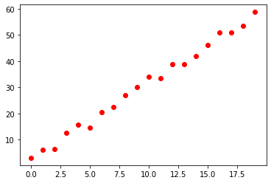
[ Example: Estimation of a line ]
MODEL
(for each point: 1 equation)

Slide 33
[ Solution ]

Slide 34
[ Solution 1 ]

Slide 35
[ Solution 1 ]

Slide 36
[ Solution 1 ]
a_prime = np.linalg.lstsq(Q, r, rcond=None)[0]

Slide 37
[ Solution 2 ]
(last column of V)
[U,S,V] = np.linalg.svd(X)
a_hat = V[-1,:]

Slide 38
[ Example: Estimation of a line ]
MODEL
(for each point: 1 equation)
SOLUTION

Slide 39
[ In Computer Vision ]
Homography
Camera Calibration
Fundamental Matrix

Slide 40
[ In Computer Vision ]
Homography
Camera Calibration
Fundamental Matrix

Slide 41
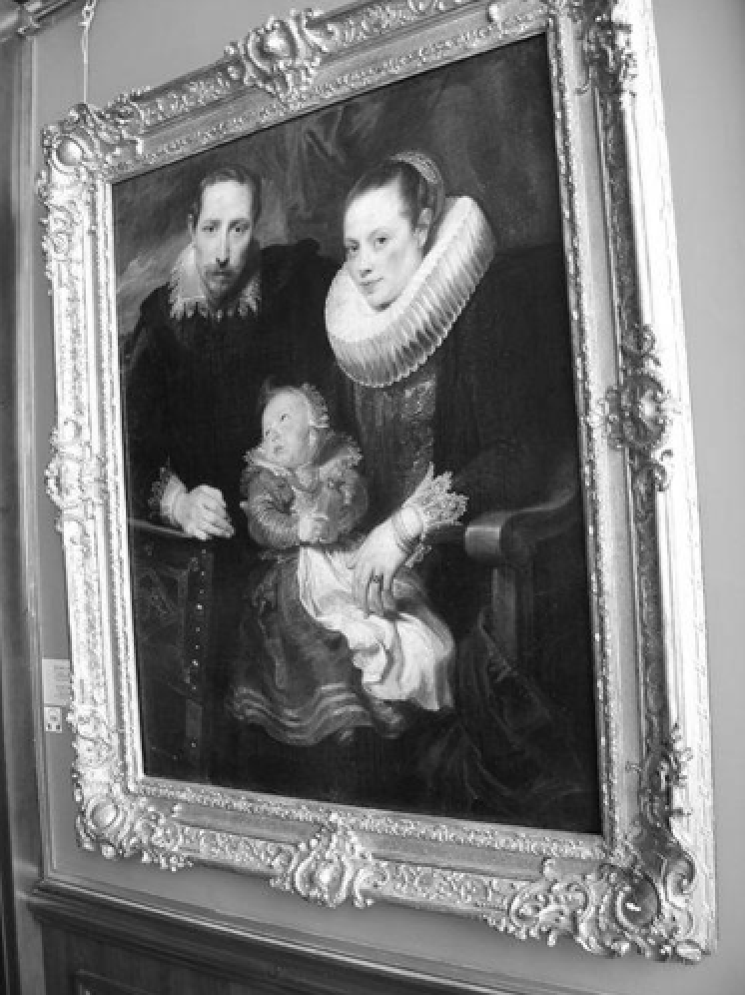
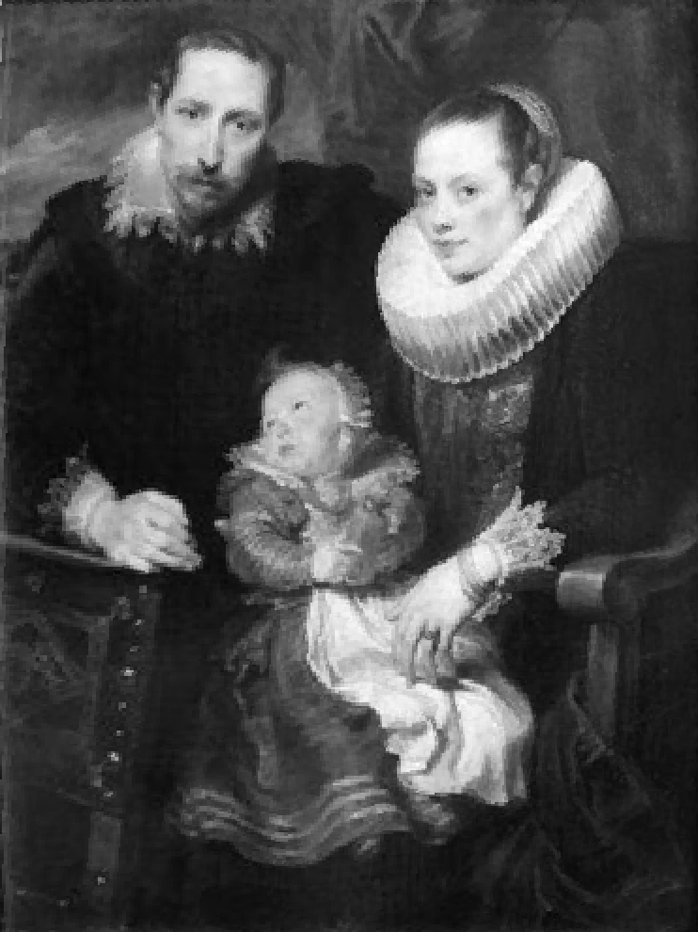
[ Homography ]
y’
y
m
m’
x
x’
MODEL

Slide 42
[ Homography ]
CORRESPONDENCE:
(for each correspondence: 2 equations)

Slide 43
[ Homography ]

Slide 44
[ In Computer Vision ]
Homography
Camera Calibration
Fundamental Matrix

Slide 45
[ Camera Calibration ]
m
M
C
MODEL

Slide 46
[ Camera Calibration ]
CORRESPONDENCE:
(for each correspondence: 2 equations)

Slide 47
[ Solution 1 ]

Slide 48
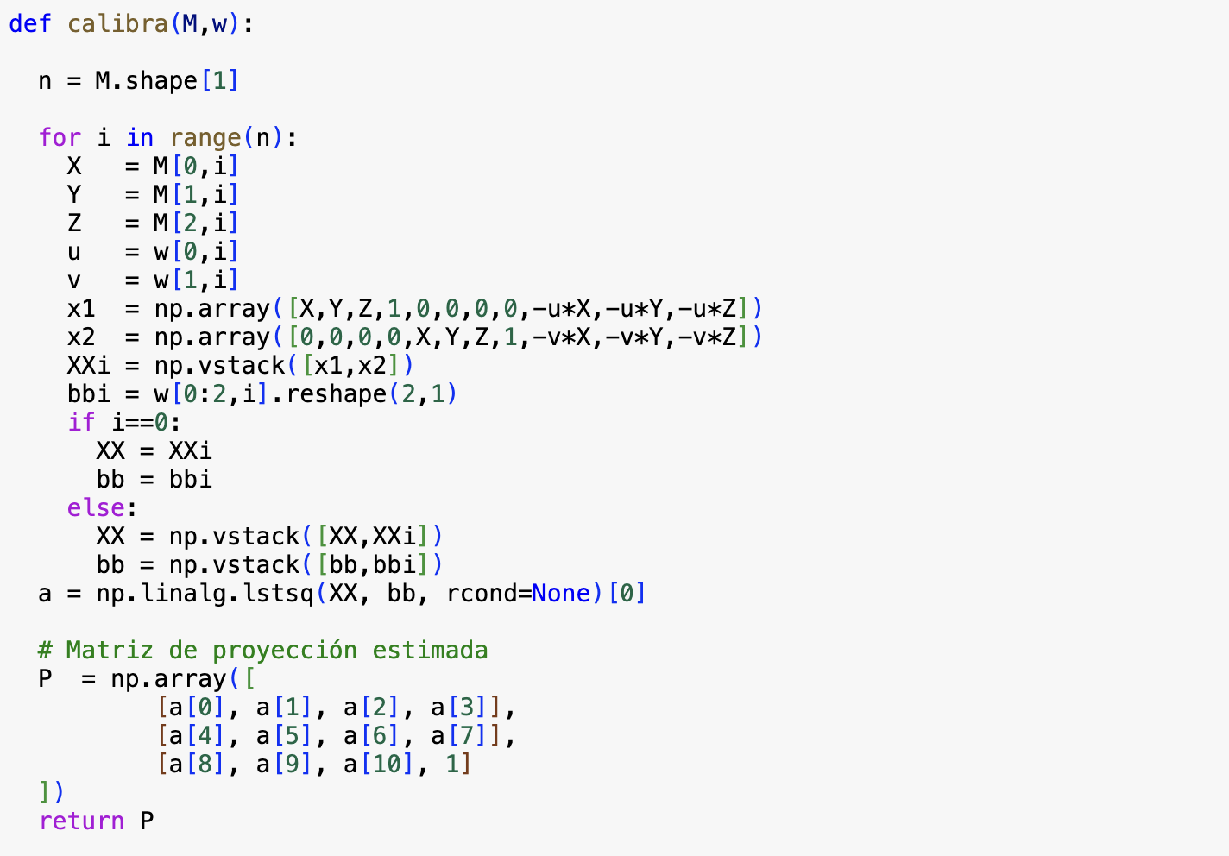
[ Solution 1 ]

Slide 49
[ Solution 1 ]

Slide 50
[ Camera Calibration ]

Slide 51
[ In Computer Vision ]
Homography
Camera Calibration
Fundamental Matrix

Slide 52


[ Fundamental Matrix: Epipolar Geometry ]
2
3
2
3
1
4
1
4
5
9
5
9
6
8
6
8
7
I₁
7
I₂
Epipolar
Line
MODEL

Slide 53
[ Fundamental Matrix: Epipolar Geometry ]
CORRESPONDENCE:
(for each correspondence: 1 equation)

Slide 54
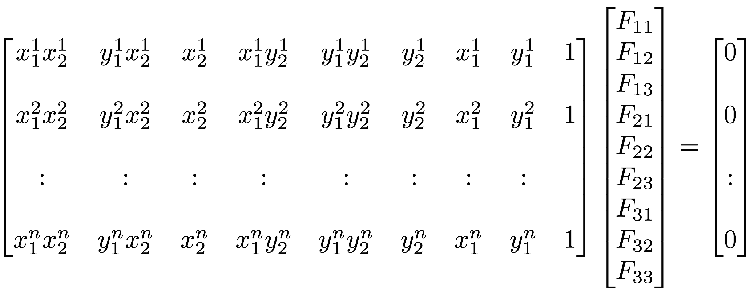
[ Fundamental Matrix: Epipolar Geometry ]

Slide 55
[ Outliers ]

Slide 56
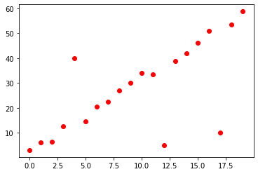
[ Example: Estimation of a line - OUTLIERS ]
MODEL
(for each point: 1 equation)
SOLUTION

Slide 57
RANSAC
[ How to remove the OUTLIERS ]

Slide 58
RANSAC
[ How to remove the OUTLIERS ]
1. Select random 2 points

Slide 59
RANSAC
[ How to remove the OUTLIERS ]
1. Select random 2 points
2. Estimate the line

Slide 60
RANSAC
[ How to remove the OUTLIERS ]
1. Select random 2 points
2. Estimate the line
3. Define a tolerance range

Slide 61
RANSAC
[ How to remove the OUTLIERS ]
1. Select random 2 points
2. Estimate the line
3. Define a tolerance range
4. Count the outliers

Slide 62
RANSAC
[ How to remove the OUTLIERS ]
1. Select random 2 points
2. Estimate the line
3. Define a tolerance range
4. Count the outliers
5. Repeat N times and select
the line that minimizes the number of outliers

Slide 63
RANSAC
[ How to remove the OUTLIERS ]
1. Select random 2 points^{(*)}
2. Estimate the line
3. Define a tolerance range
4. Count the outliers
5. Repeat N times and select
the line that minimizes the number of outliers
^{(*)}
Minimal number of points to estimate the parameters of the model

Slide 64
SIFT matching points
[ In Computer Vision ]
Homography
Camera Calibration
Fundamental Matrix
Corner detection (Chess)
Corresponding points can be found automatically…
Outliers can be removed using RANSAC

