Slide 1

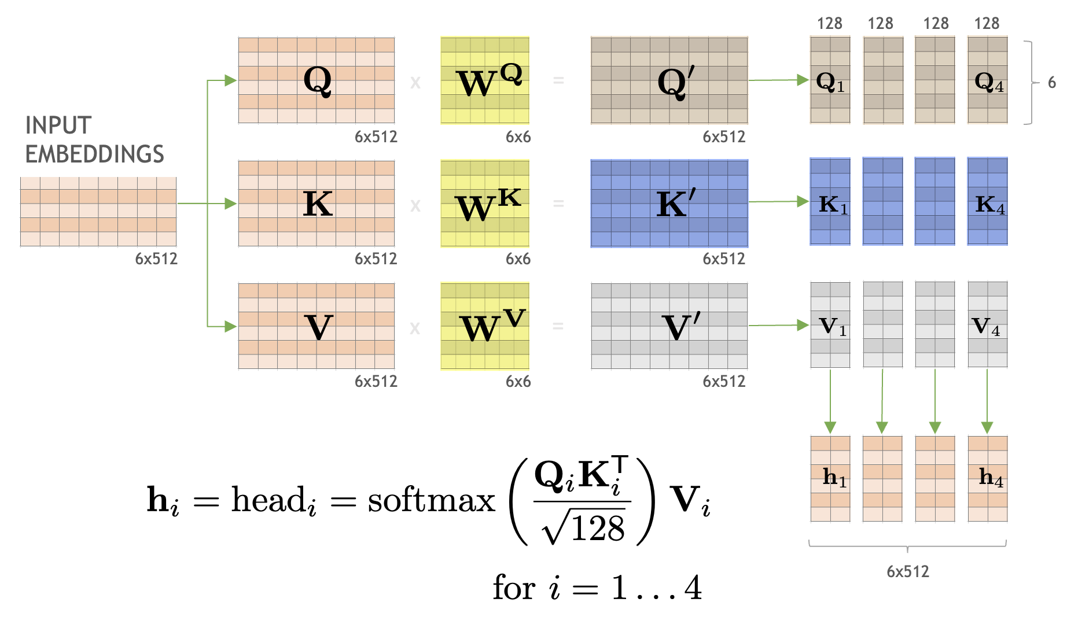

Visión por Computador
Versión 2026
Transformers
(CAPÍTULO 3 – CV03F )
Domingo Mery
Ciencia de la Computación
Universidad Católica – Chile
http://domingomery.ing.uc.cl

Slide 2
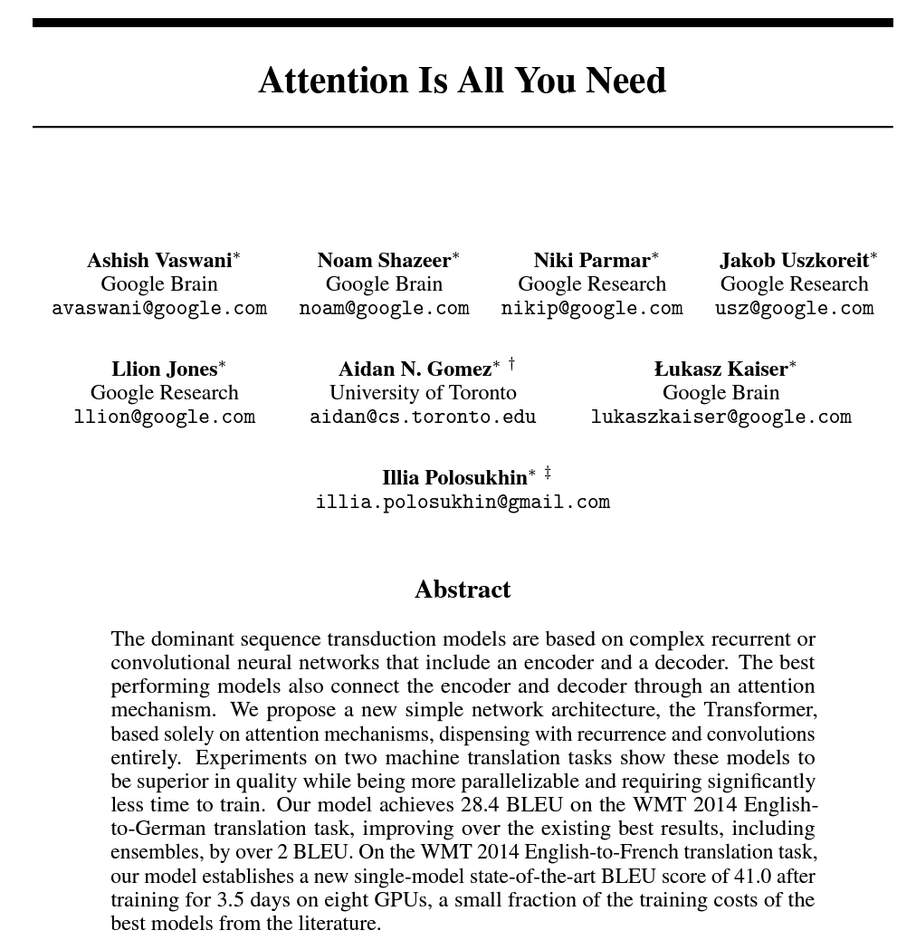
Vaswani, Ashish, Noam Shazeer, Niki Parmar, Jakob Uszkoreit, Llion Jones, Aidan N. Gomez, Łukasz Kaiser, and Illia Polosukhin. "Attention is all you need." Advances in neural information processing systems 30 (2017).

Slide 3
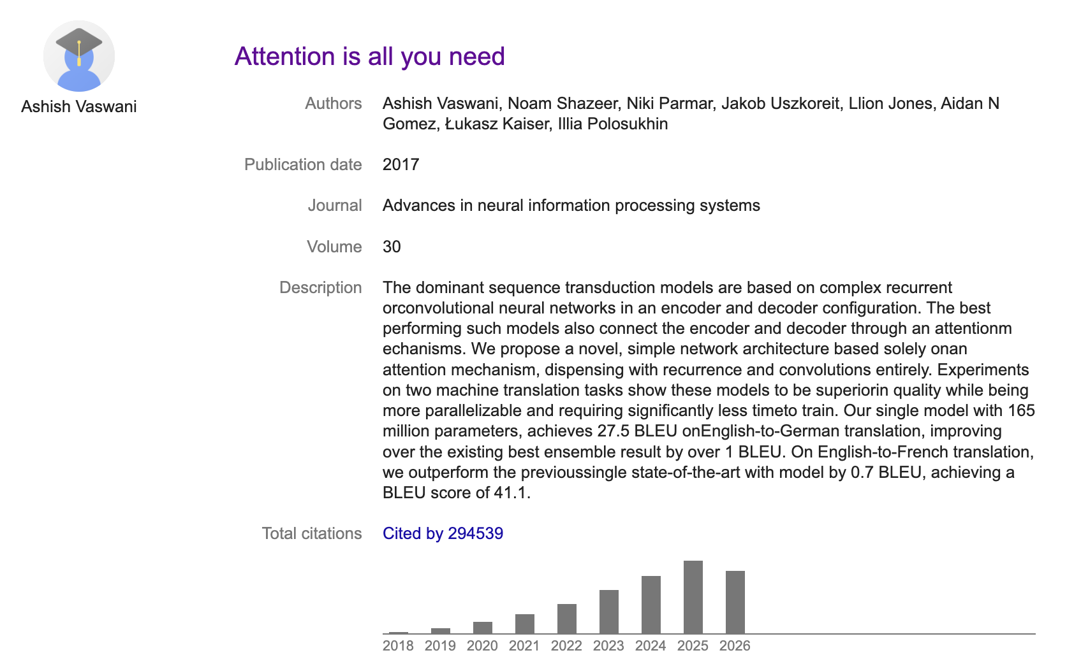
Vaswani, Ashish, Noam Shazeer, Niki Parmar, Jakob Uszkoreit, Llion Jones, Aidan N. Gomez, Łukasz Kaiser, and Illia Polosukhin. "Attention is all you need." Advances in neural information processing systems 30 (2017).

Slide 4
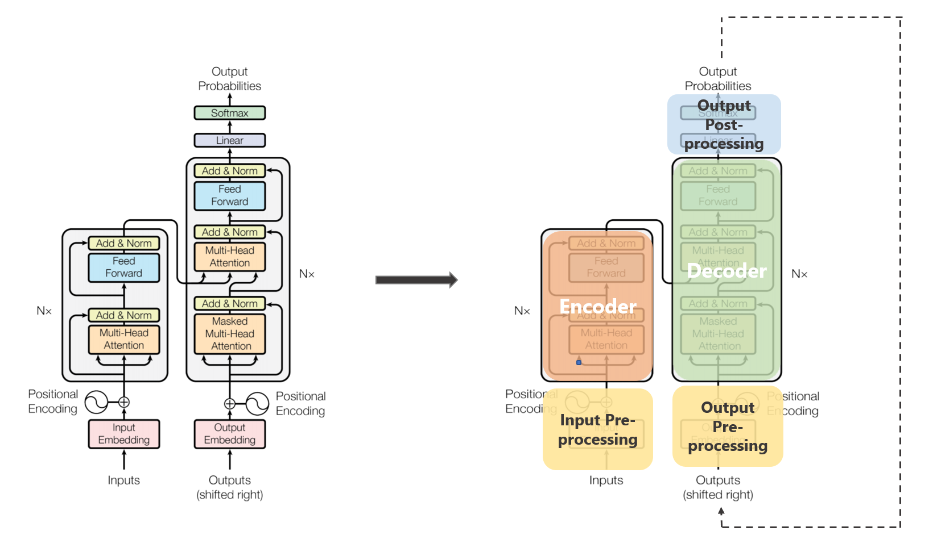
Transformers
Vaswani, Ashish, Noam Shazeer, Niki Parmar, Jakob Uszkoreit, Llion Jones, Aidan N. Gomez, Łukasz Kaiser, and Illia Polosukhin. "Attention is all you need." Advances in neural information processing systems 30 (2017).

Slide 5
Transformers
From https://towardsdatascience.com/transformers-89034557de14

Slide 6
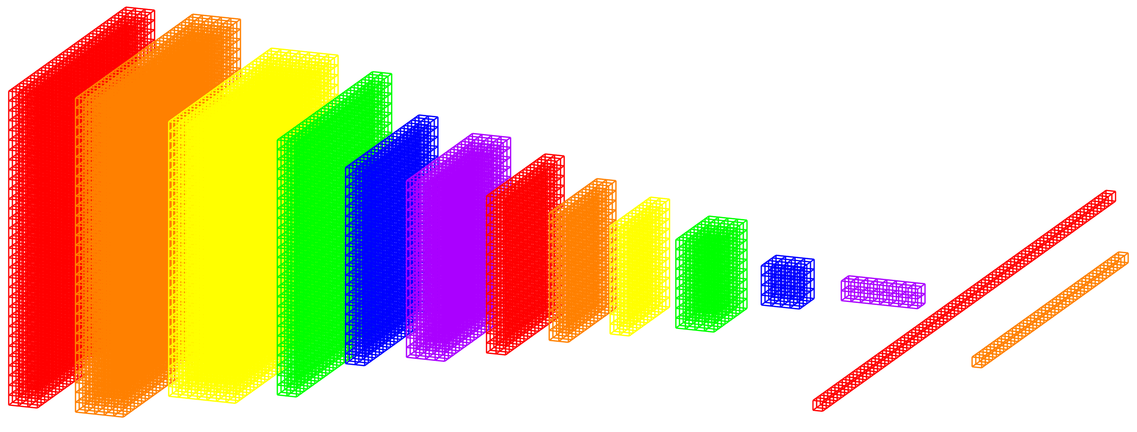
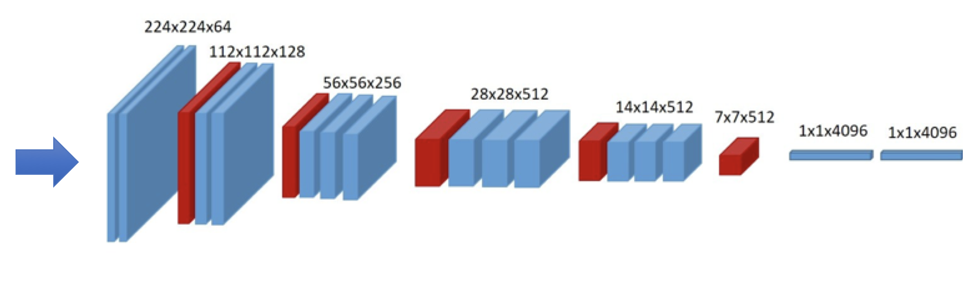



Embeddings
EMBEDDINGS: vectors of n elements that describe the input. Typically, they have a norm equal to 1, and n=512.
INPUT 1
EMBEDDING 1
sc
SCORE: It measures how similar the embeddings are
HIGH → similar
LOW → different
INPUT 2
EMBEDDING 2

Slide 7
Embeddings
sc

Slide 8
Embeddings
HOW SIMILAR ARE TWO VECTORS?
DON'T FORGET: in our case the vectors have 512 elements and have a norm equal to 1
DOT PRODUCT
SCORE
If the vectors are very similar, the angle between them is small and the SCORE is close to 1.

Slide 9
Embeddings
HOW SIMILAR ARE TWO VECTORS?
DON'T FORGET: in our case the vectors have 512 elements and have a norm equal to 1
DOT PRODUCT
SCORE
If the vectors are very similar, the angle between them is small and the SCORE is close to 1.
If the vectors are very different, the angle between them is large and the SCORE decreases significantly.

Slide 10
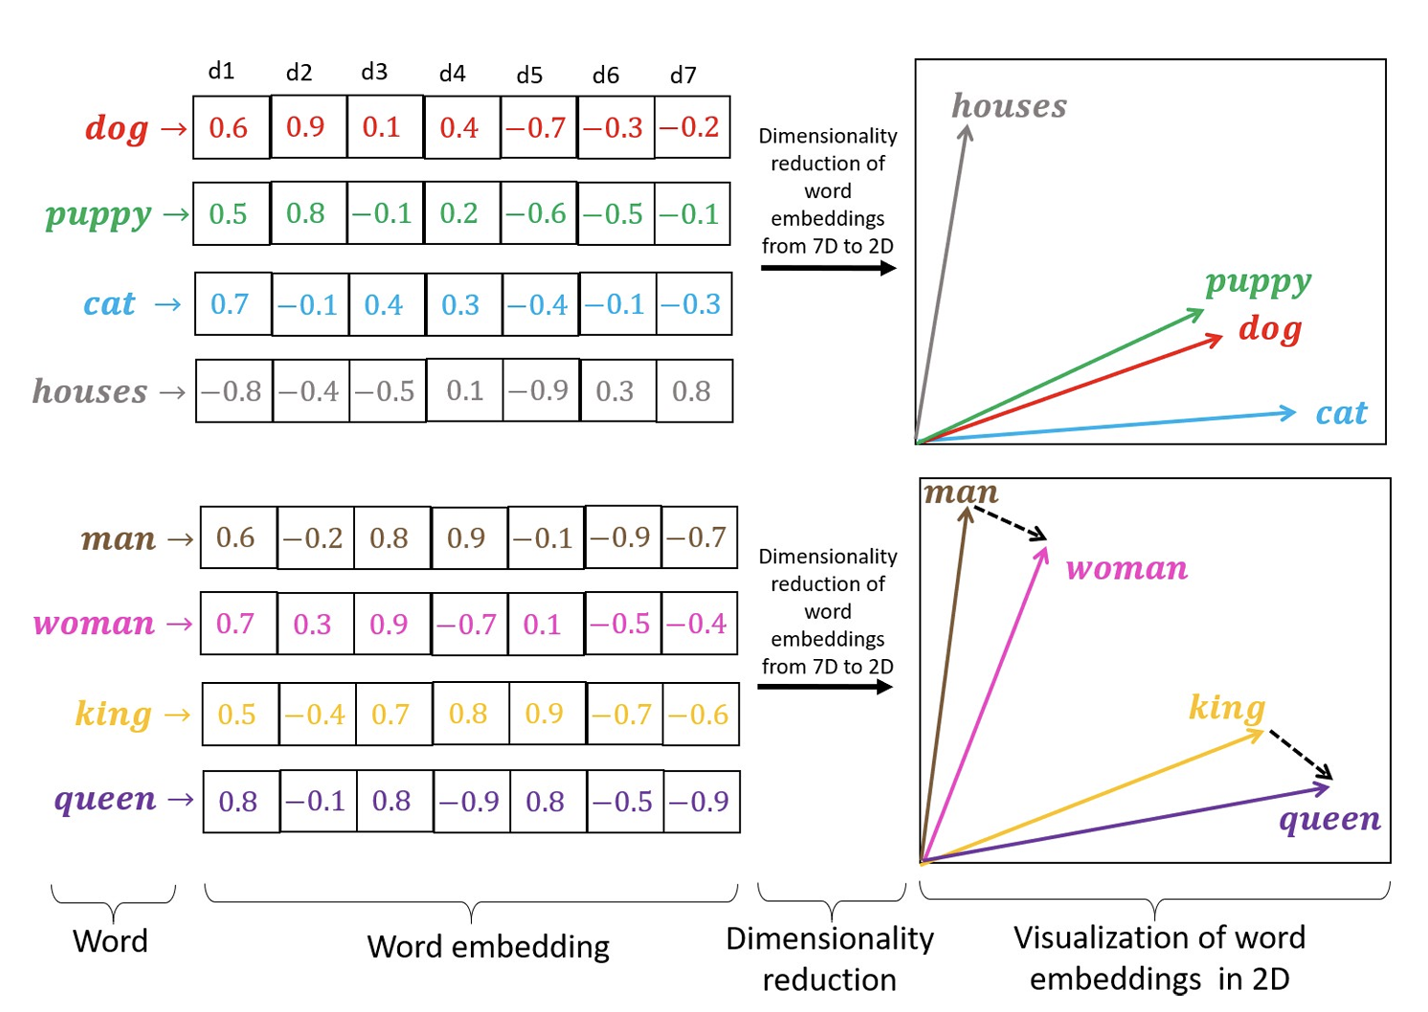


Embeddings in NLP
Token
Token embedding
token
Adapted from: Rozado, D. (2020). Wide range screening of algorithmic bias in word embedding models using large sentiment lexicons reveals underreported bias types. PloS one, 15(4), e0231189.

Slide 11
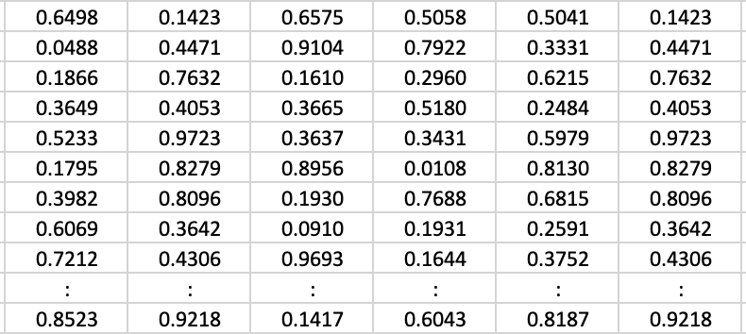
Embeddings in NLP
YOUR CAT IS A LOVELY CAT
Embeddings de las palabras
Adapted from: Umar Jamil: Attention is all you need (Transformer) – Model explanation.
https://github.com/hkproj/transformer-from-scratch-notes

Slide 12
Transformers
From https://towardsdatascience.com/transformers-89034557de14

Slide 13
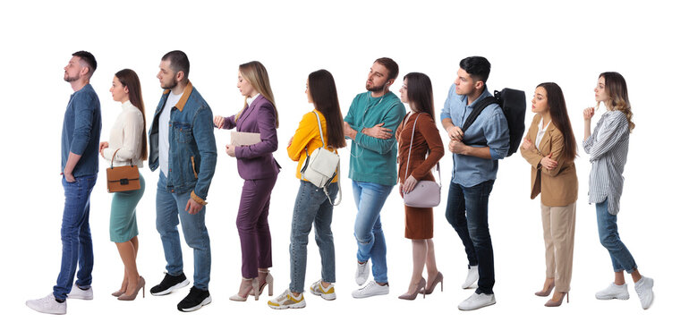
Positional Encoding (PE)
i =
1 2 3 4 5 6 7 8 9 10
d_{i} =
1 2 3 4 5 6 7 8 9 10
if for persons

Slide 14
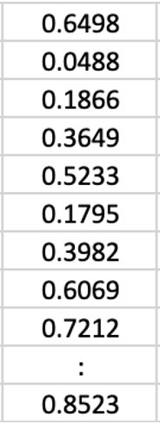
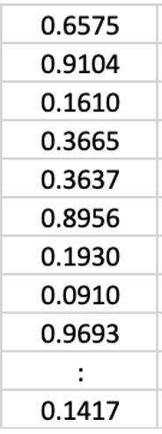
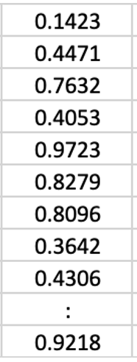
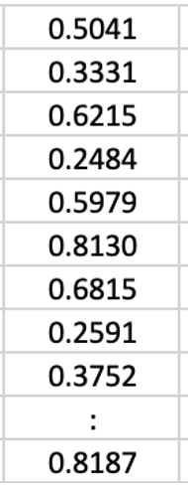
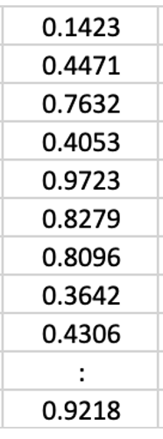
Positional Encoding (PE)
i =
1 2 3 4 5 6 7 8 9 10
d_{i} =
if for persons

Slide 15


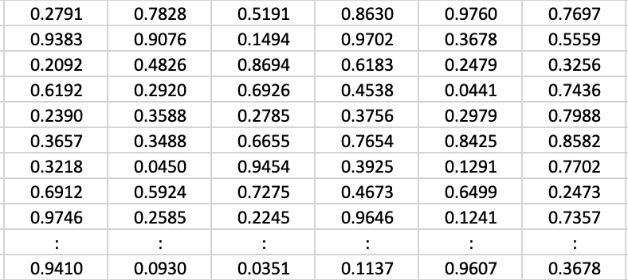
Positional Encoding (PE)
YOUR CAT IS A LOVELY CAT
PE
+
PE
+
PE
+
PE
+
PE
+
PE
+
Embeddings de las palabras
+
Embeddings de las posiciones

Slide 16



Positional Encoding
Each token has information about the position in the sentence.
Tokens that are close to each other should be close in the embedding’s space
Tokens that are distant/different should be distant in the embedding’s space
TOKEN
ORIGINAL
EMBEDDING
POSITIONAL
ENCODING
+
NEW
EMBEDDING
if for persons

Slide 17
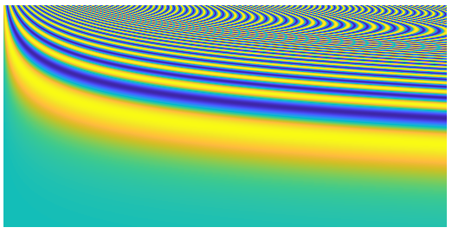

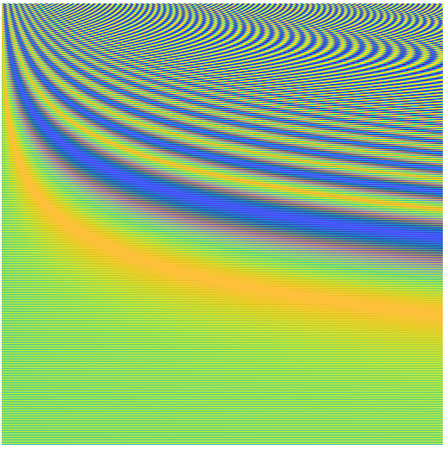
Positional Encoding
For i even
For i odd
i: element index of the embedding
p: token position
d: embedding size (512 for example)

Slide 18
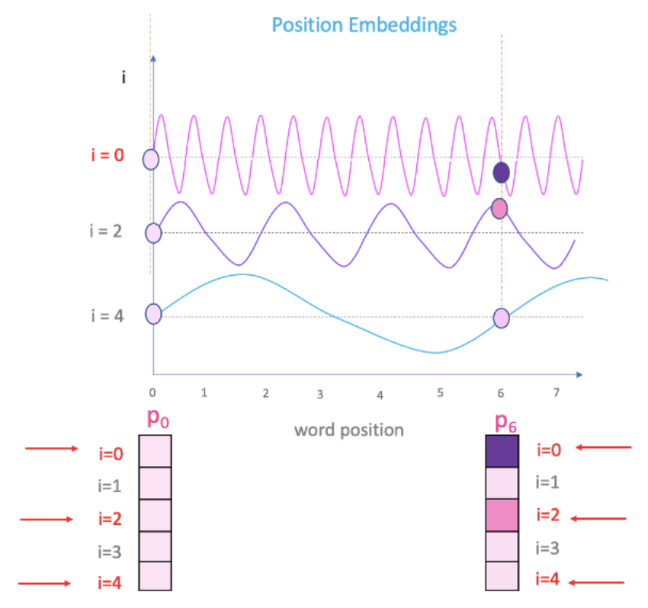
Positional Encoding
For i even
For i odd
i: element index of the embedding
p: token position
d: embedding size (512 for example)
PE₀
PE₆
Positional Encoding
Adapted from: https://datascience.stackexchange.com/questions/51065/what-is-the-positional-encoding-in-the-transformer-model

Slide 19
Transformers
From https://towardsdatascience.com/transformers-89034557de14

Slide 20
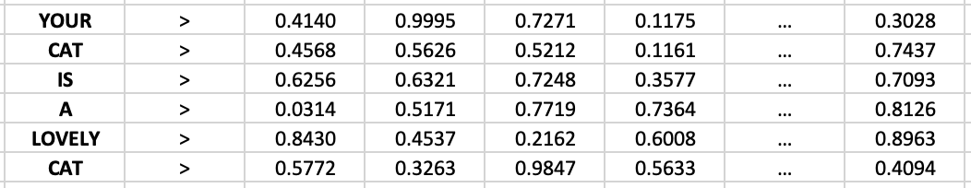

Self-Attention
It allows the model to relate tokens to each other
For 6 tokens with embeddings of 512 elements:
Tokens
Token embeddings
6x512
Matrix of embeddings
6 x 512 elements

Slide 21
Self-Attention

Slide 22
Self-Attention

Slide 23

Self-Attention
x
6x512
512x6
6x6
REMEMBER!
Element (i,j) means how similar is the embedding of token i with the embedding of token j
SCORE: It measures how similar the embeddings are
HIGH → similar
LOW → different

Slide 24

Self-Attention
The sum of each row of the matrix is 1 (like the probabilities).
x
softmax
‘Probability’ of how similar is word i to word j (related to all words)

Slide 25
Self-Attention
The sum of each row of the matrix is 1 (like the probabilities).
x
softmax
‘Probability’ of how similar is word i to word j

Slide 26

Self-Attention
x
softmax
x

Slide 27
Self-Attention
new
embedding
i
row i
x

Slide 28

Self-Attention
1
2
6
new
embedding
i
row i
1
2
6
x

Slide 29


Self-Attention
1
x
1
2
x
2
. . .
6
x
6
1
new
embedding
i
row i
1
2
6
2
x
6

Slide 30

Self-Attention
1
x
1
2
x
2
. . .
x
+
6
6
1
new
embedding
i
row i
1
2
6
2
x
6

Slide 31
Self-Attention
1
x
1
2
x
2
. . .
x
+
6
6
weighted sum of
original embeddings
1
new
embedding
i
row i
1
2
6
2
x
6
weights
original embeddings

Slide 32
Self-Attention
x
softmax
x

Slide 33

Self-Attention
x
softmax
6x512
512x6
6x6
x
6x6
6x512
6x512

Slide 34
Self-Attention
KEYS
QUERIES
VALUES
x
softmax
6x512
512x6
x
6x512
6x512
Each row of the Attention Matrix captures:
The meaning of the word (token).
The position of the word.
The interaction with the other words.
In the Self-Attention Q = K = V are the embeddings of the word of the sentence.

Slide 35
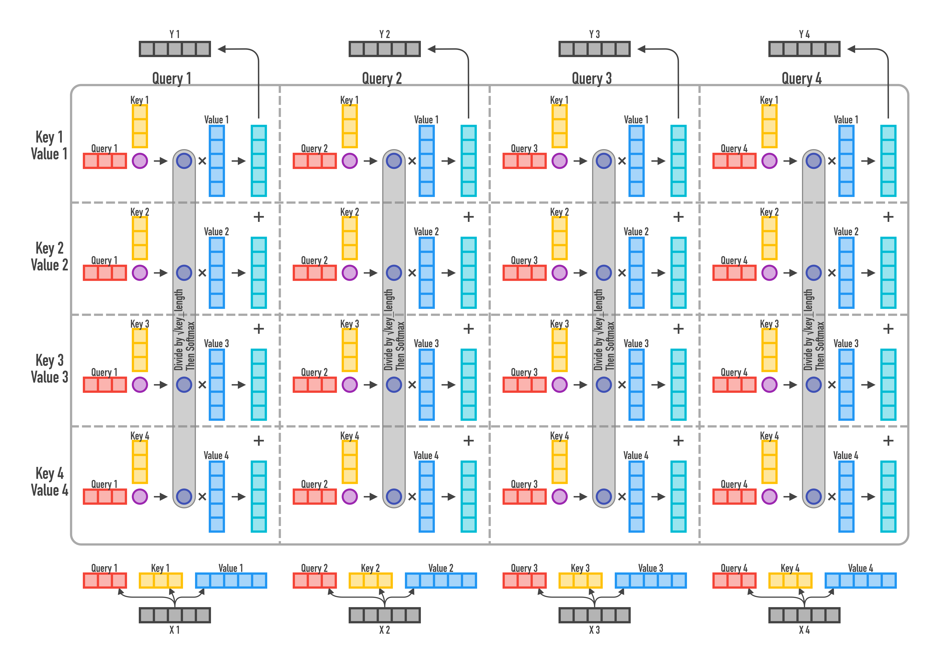
Self-Attention
https://jalammar.github.io/illustrated-transformer/ https://imgur.com/gallery/FBQqrxw

Slide 36
Transformers
From https://towardsdatascience.com/transformers-89034557de14

Slide 37
Multi-Head Attention (MHA)
Notes:
{\bf h}_i = \text{head}_i = \text{softmax}\left(\frac{{\bf Q}_i{\bf K}^{\sf T}_i}{\sqrt{128}}\right) {\bf V}_i

Slide 38
Multi-Head Attention (MHA)
INPUT
EMBEDDINGS
6x512
Notes:
{\bf h}_i = \text{head}_i = \text{softmax}\left(\frac{{\bf Q}_i{\bf K}^{\sf T}_i}{\sqrt{128}}\right) {\bf V}_i

Slide 39
Multi-Head Attention (MHA)
cloning
INPUT
EMBEDDINGS
6x512
6x512 6x512
6x512
Notes:
{\bf h}_i = \text{head}_i = \text{softmax}\left(\frac{{\bf Q}_i{\bf K}^{\sf T}_i}{\sqrt{128}}\right) {\bf V}_i

Slide 40
Multi-Head Attention (MHA)
x
=
INPUT
EMBEDDINGS
6x512 6x6 6x512
x
=
6x512 6x512 6x6 6x512
x
=
6x512 6x6 6x512
Notes:
{\bf h}_i = \text{head}_i = \text{softmax}\left(\frac{{\bf Q}_i{\bf K}^{\sf T}_i}{\sqrt{128}}\right) {\bf V}_i

Slide 41
Multi-Head Attention (MHA)
128 128 128 128
x
=
6
INPUT
EMBEDDINGS
6x512 6x6 6x512
x
=
6x512 6x512 6x6 6x512
x
=
6x512 6x6 6x512
Notes:
{\bf h}_i = \text{head}_i = \text{softmax}\left(\frac{{\bf Q}_i{\bf K}^{\sf T}_i}{\sqrt{128}}\right) {\bf V}_i

Slide 42
Multi-Head Attention (MHA)
128 128 128 128
x
=
6
INPUT
EMBEDDINGS
6x512 6x6 6x512
x
=
6x512 6x512 6x6 6x512
x
=
6x512 6x6 6x512
6x512
Notes:
{\bf h}_i = \text{head}_i = \text{softmax}\left(\frac{{\bf Q}_i{\bf K}^{\sf T}_i}{\sqrt{128}}\right) {\bf V}_i

Slide 43

Multi-Head Attention (MHA)
128 128 128 128
x
=
6
INPUT
EMBEDDINGS
6x512 6x6 6x512
x
=
6x512 6x512 6x6 6x512
x
=
6x512 6x6 6x512
x
=
6x512
6x512
512x512
Notes:
{\bf h}_i = \text{head}_i = \text{softmax}\left(\frac{{\bf Q}_i{\bf K}^{\sf T}_i}{\sqrt{128}}\right) {\bf V}_i

Slide 44
Multi-Head Attention (MHA)
*
128 128 128 128
x
=
6
INPUT
EMBEDDINGS
6x512 6x6 6x512
*
x
=
6x512 6x512 6x6 6x512
*
x
=
6x512 6x6 6x512
*
x
=
6x512
6x512
512x512
* Learnable in a training process
Notes:
{\bf h}_i = \text{head}_i = \text{softmax}\left(\frac{{\bf Q}_i{\bf K}^{\sf T}_i}{\sqrt{128}}\right) {\bf V}_i

Slide 45
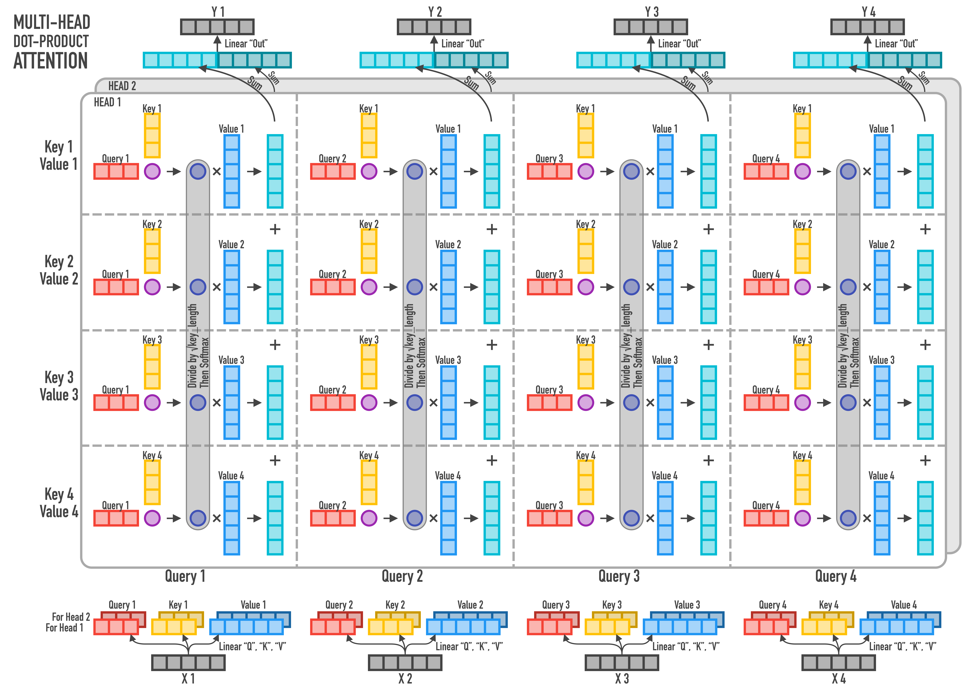
Multi-Head Attention (MHA)
https://jalammar.github.io/illustrated-transformer/ https://imgur.com/gallery/FBQqrxw
Notes:
{\bf h}_i = \text{head}_i = \text{softmax}\left(\frac{{\bf Q}_i{\bf K}^{\sf T}_i}{\sqrt{128}}\right) {\bf V}_i

Slide 46
Query, Key and Value
QUERY
KEYS
VALUES
Love
0.8
Romantic
Action
SciFi
Horror
Comedy
Titanic
The dark night
Inception
The shining
The intouchables
0.2
0.2
0.1
0.6
Notes:
{\bf h}_i = \text{head}_i = \text{softmax}\left(\frac{{\bf Q}_i{\bf K}^{\sf T}_i}{\sqrt{128}}\right) {\bf V}_i

Slide 47
Transformers
From https://towardsdatascience.com/transformers-89034557de14

Slide 48
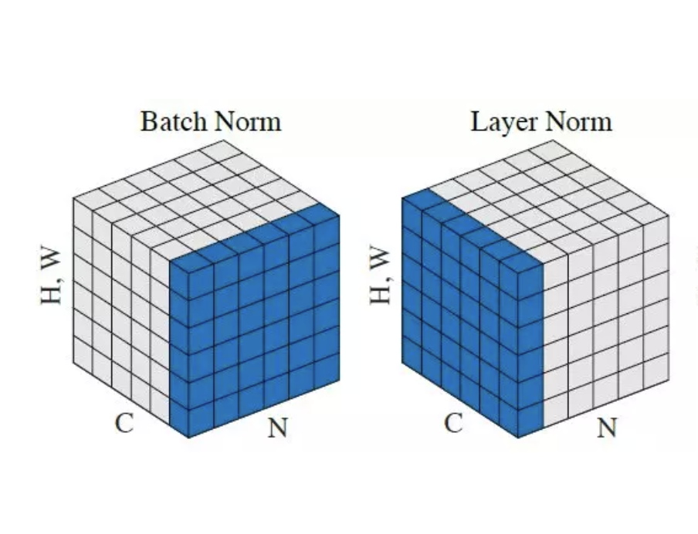
Layer Normalization
For images of HxW pixels and C channels
From https://paperswithcode.com/method/layer-normalization
Notes:
{\bf h}_i = \text{head}_i = \text{softmax}\left(\frac{{\bf Q}_i{\bf K}^{\sf T}_i}{\sqrt{128}}\right) {\bf V}_i

Slide 49
Transformers
From https://towardsdatascience.com/transformers-89034557de14

Slide 50
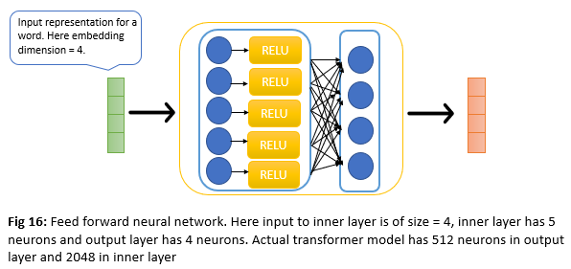
Feed Forward – Neural Network
https://raviteja-ganta.github.io/attention-is-all-you-need-transformers
Notes:
{\bf h}_i = \text{head}_i = \text{softmax}\left(\frac{{\bf Q}_i{\bf K}^{\sf T}_i}{\sqrt{128}}\right) {\bf V}_i

Slide 51
Transformers
From https://towardsdatascience.com/transformers-89034557de14

Slide 52
Masked Multi-Head Attention
KEYS
QUERIES
CAUSALITY: The model must not be able to see future words.
When word i arrives, we will only have attention values with i, i-1, … 1
It is applied in the softmax’s of the heads
6x512
512x6
6x6
* * * * *
BEFORE SOFTMAX!
Replace with
so, AFTER SOFTMAX
it will be zero.
* * * *
* * *
* *
*
6x6
SOFTMAX
o o o o o
o o o o
o o o
o o
o
6x6

Slide 53
The Whole Model (for translation)
From https://towardsdatascience.com/transformers-89034557de14

Slide 54
Training
Te amo mucho <EOS>
Softmax
_
Error
TIME STEP = 1
Linear
Backpropagation
Encoder
Output
Decoder
Output
Encoder
Decoder
Encoder
Input
Decoder
Input
<SOS> I love you
very much <EOS>
<SOS> Te amo mucho
Adapted from: Umar Jamil: Attention is all you need (Transformer) – Model explanation.
https://github.com/hkproj/transformer-from-scratch-notes

Slide 55
Testing
Softmax
Te
TIME STEP = 1
Linear
Encoder
Output
Decoder
Output
Encoder
Decoder
Encoder
Input
Decoder
Input
<SOS> I love you
very much <EOS>
<SOS>
Adapted from: Umar Jamil: Attention is all you need (Transformer) – Model explanation.
https://github.com/hkproj/transformer-from-scratch-notes

Slide 56
Testing
Softmax
amo
TIME STEP = 2
Linear
Encoder
Output
Decoder
Output
Encoder
Decoder
Encoder
Input
Decoder
Input
Te
<SOS> I love you
very much <EOS>
<SOS>
Adapted from: Umar Jamil: Attention is all you need (Transformer) – Model explanation.
https://github.com/hkproj/transformer-from-scratch-notes

Slide 57
Testing
Softmax
mucho
TIME STEP = 3
Linear
Encoder
Output
Decoder
Output
Encoder
Decoder
Encoder
Input
Decoder
Input
amo
Te
<SOS> I love you
very much <EOS>
<SOS>
Adapted from: Umar Jamil: Attention is all you need (Transformer) – Model explanation.
https://github.com/hkproj/transformer-from-scratch-notes

Slide 58
Testing
Softmax
<EOS>
TIME STEP = 4
Linear
Encoder
Output
Decoder
Output
Encoder
Decoder
Encoder
Input
Decoder
Input
amo
mucho
Te
<SOS> I love you
very much <EOS>
<SOS>
Adapted from: Umar Jamil: Attention is all you need (Transformer) – Model explanation.
https://github.com/hkproj/transformer-from-scratch-notes

Slide 59
Visual Transformer (ViT)

Slide 60
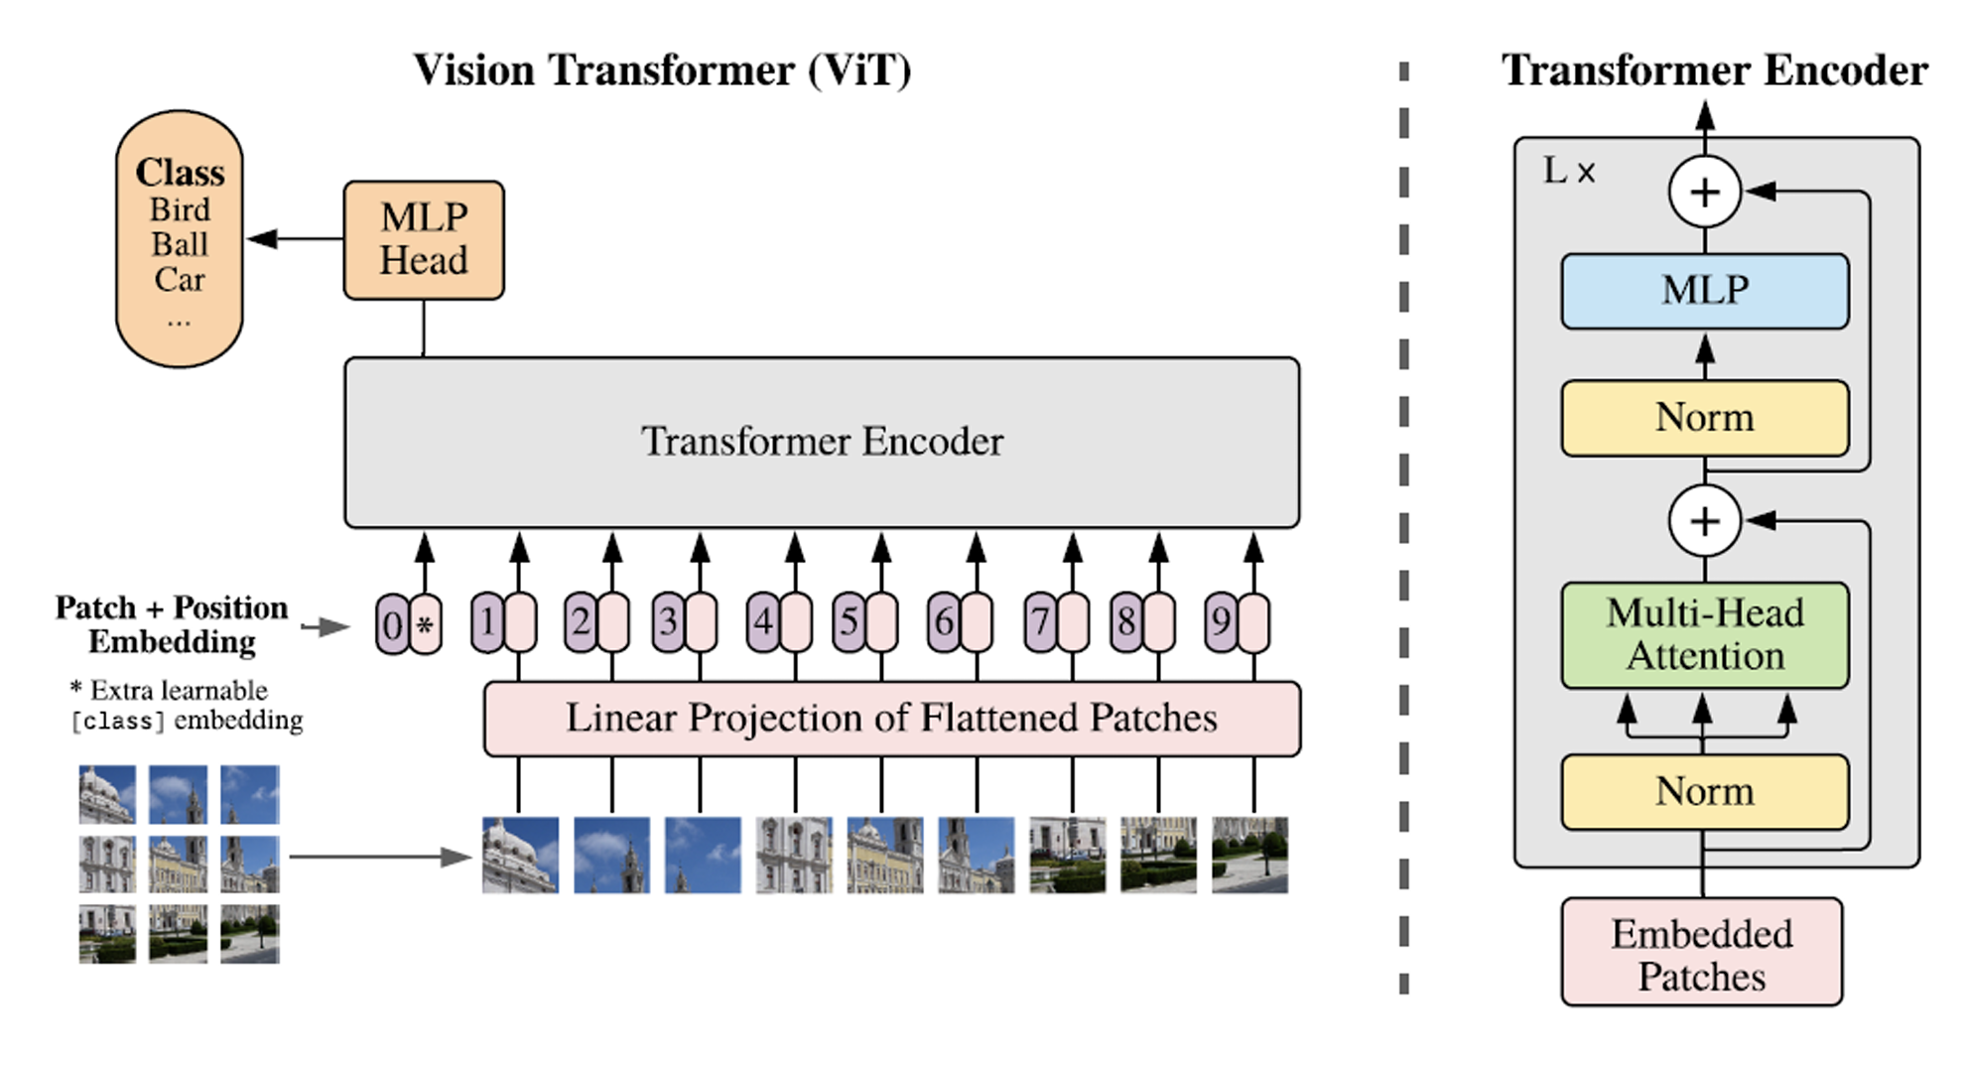
Visual Transformer (ViT)
Dosovitskiy, Alexey, Lucas Beyer, Alexander Kolesnikov, Dirk Weissenborn, Xiaohua Zhai, Thomas Unterthiner, Mostafa Dehghani et al. "An image is worth 16x16 words: Transformers for image recognition at scale." arXiv preprint arXiv:2010.11929 (2020).

Slide 61


Visual Transformer (ViT)
Example: ViT in Face Recognition

Slide 62

Visual Transformer (ViT)
48x48

Slide 63
Visual Transformer (ViT)
16x16

Slide 64
Visual Transformer (ViT)
16x16

Slide 65
Visual Transformer (ViT)

Slide 66
Visual Transformer (ViT)

Slide 67
Visual Transformer (ViT)

Slide 68
Visual Transformer (ViT)

Slide 69
Visual Transformer (ViT)

Slide 70
Visual Transformer (ViT)

Slide 71
Visual Transformer (ViT)
256x1x3

Slide 72
Visual Transformer (ViT)
256x1x3

Slide 73
Visual Transformer (ViT)
Red
256x1
Green
256x1
Blue
256x1
256x1x3
768x1

Slide 74
Visual Transformer (ViT)
768x1
256x1x3

Slide 75
Visual Transformer (ViT)
768x1
256x1x3

Slide 76
Visual Transformer (ViT)
16x16x3
768x1
256x1x3

Slide 77









Visual Transformer (ViT)

Slide 78
Visual Transformer (ViT)

Slide 79
Visual Transformer (ViT)
768x9

Slide 80

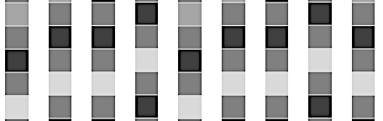
Visual Transformer (ViT)
Class
MLP
Transformer Encoder
PE
. . .
PE
+
+

Slide 81
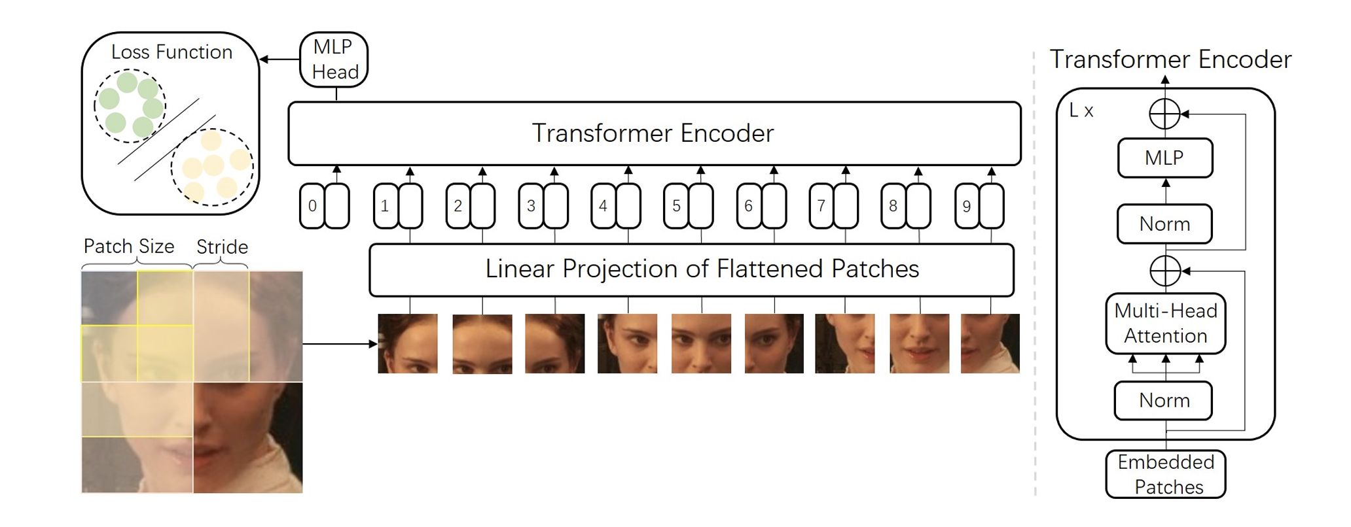
Visual Transformer (ViT)
Zhong, Y., & Deng, W. (2021). Face transformer for recognition. arXiv preprint arXiv:2103.14803.

Slide 82
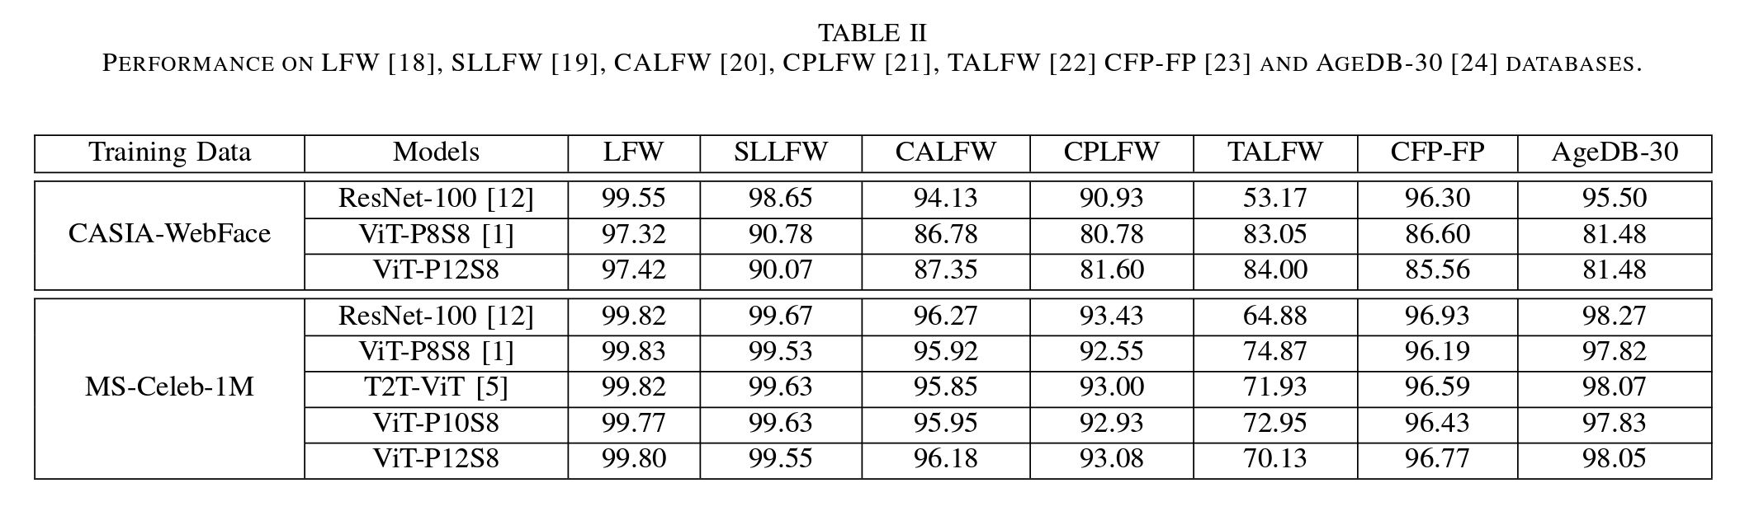
Visual Transformer (ViT)
Zhong, Y., & Deng, W. (2021). Face transformer for recognition. arXiv preprint arXiv:2103.14803.

Slide 83
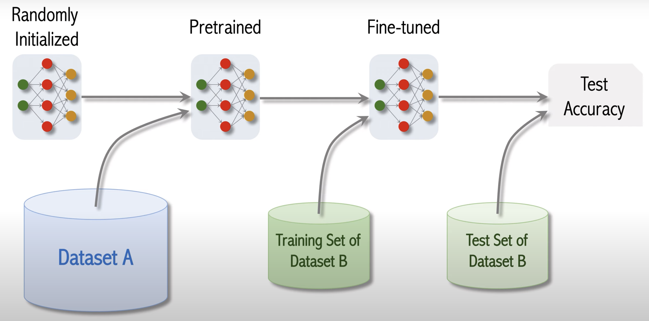
Visual Transformer (ViT)
Shusen Wang: Vision Transformer for Image Classification. https://youtu.be/HZ4j_U3FC94?si=plI9zvAIxx2eIYgq

Slide 84
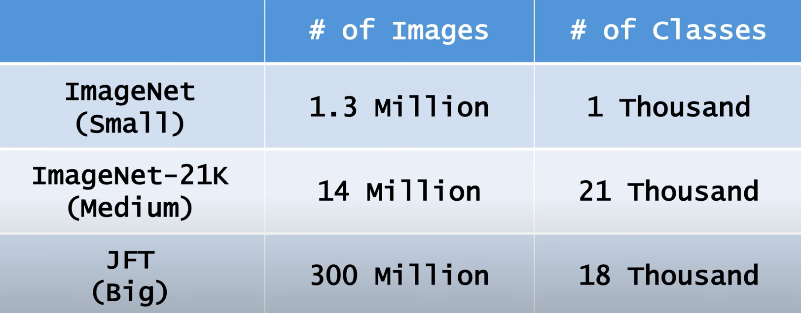
Visual Transformer (ViT)
Shusen Wang: Vision Transformer for Image Classification. https://youtu.be/HZ4j_U3FC94?si=plI9zvAIxx2eIYgq

Slide 85
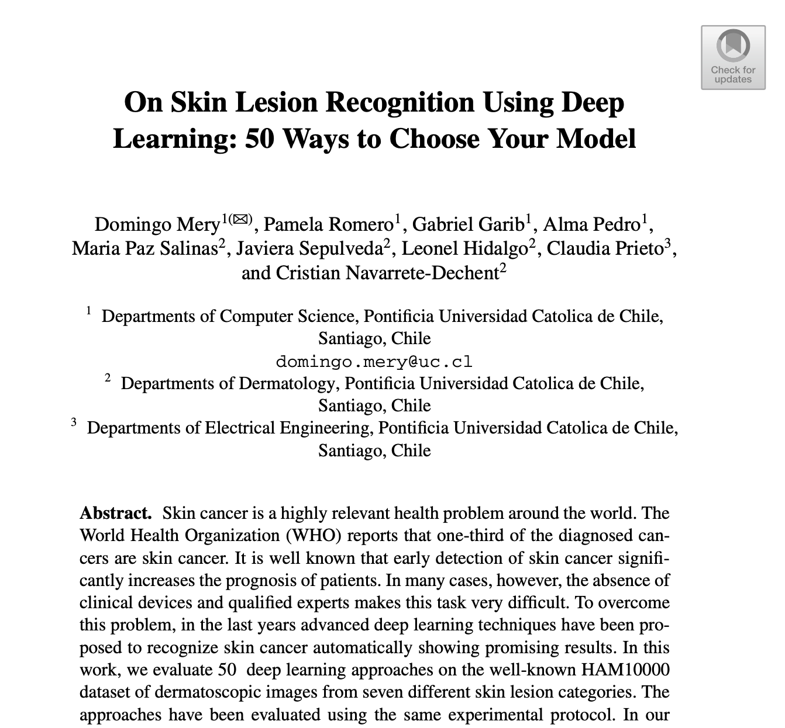
Visual Transformer (ViT): Example
Mery, Domingo, Pamela Romero, Gabriel Garib, Alma Pedro, Maria Paz Salinas, Javiera Sepulveda, Leonel Hidalgo, Claudia Prieto, and Cristian Navarrete-Dechent. "On Skin Lesion Recognition Using Deep Learning: 50 Ways to Choose Your Model." In Pacific-Rim Symposium on Image and Video Technology, pp. 103-116. Cham: Springer International Publishing, 2022.

Slide 86
Evaluated Methods
AlexNet
GoogleNet
ConvNet
VGG
ResNet
ResNeXt
DenseNet
SqueezNet
ShuffleNet
MobileNet
MnasNet
EfficientNet
ARLNET
ViT
Wide ResNet
50 models from
15 different architectures

Slide 87
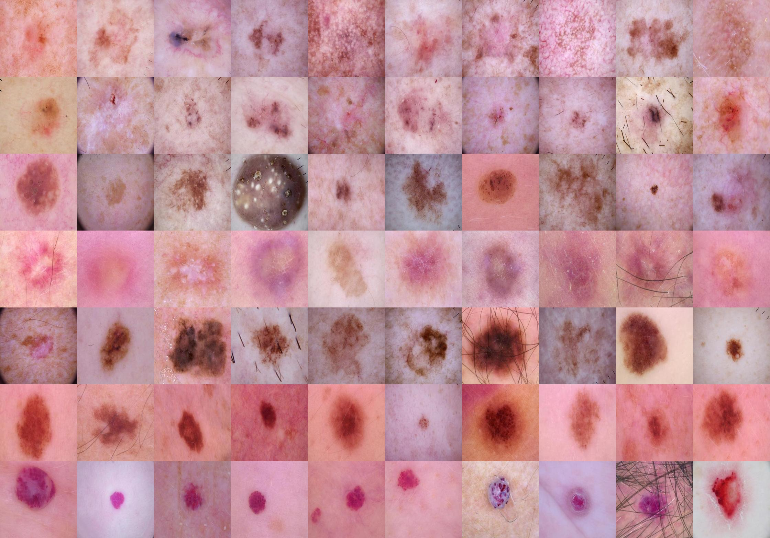
Class | Acronym | Name
0 | akiec | Actinic Keratosis
1 | bcc | Basal Cell Carcinoma
2 | bkl | Benign Keratosis
3 | df | Dermatofibroma
4 | mel | Melanoma
5 | nv | Melanocytic Nevus
6 | vasc | Vascular Lesion
Database
ISIC Dataset – HAM 10000

Slide 88
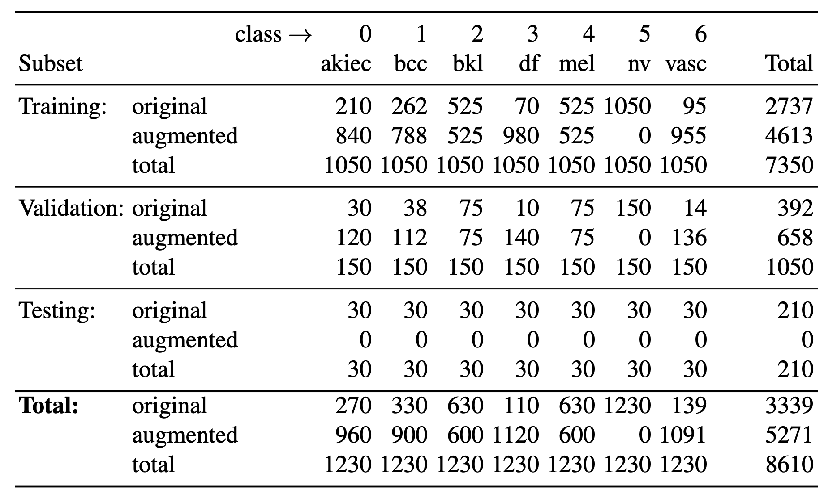
Number of images for training, validation and testing of each class

Slide 89
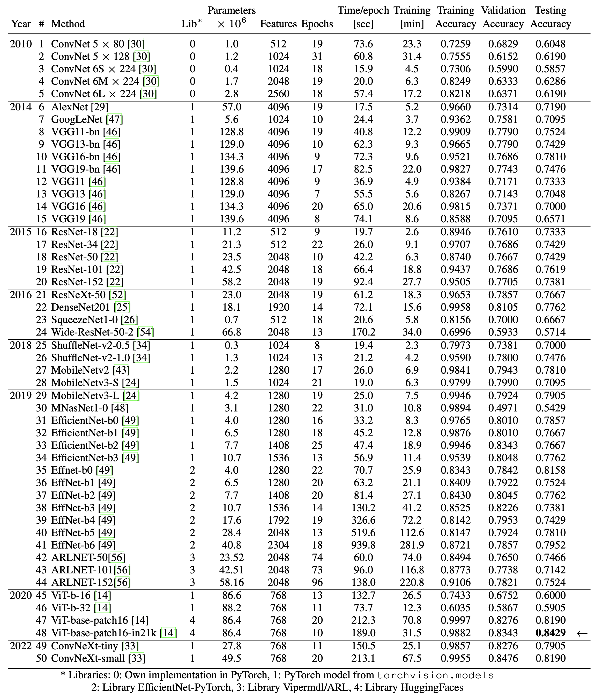
Results
for the
50 models

Slide 90
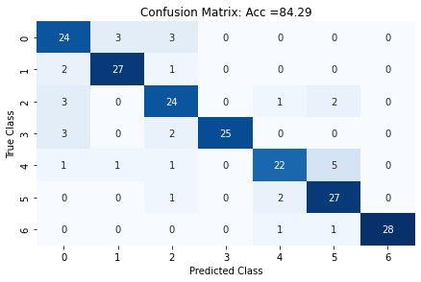
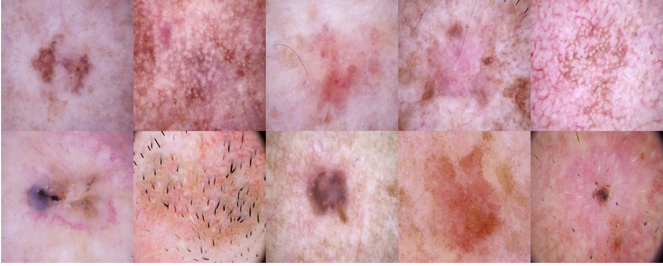
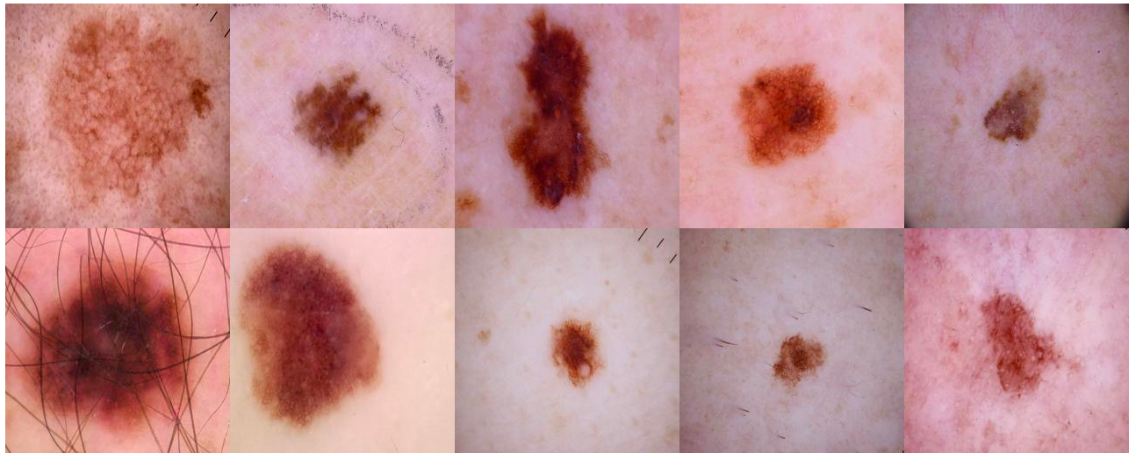
Confusion Matrix for Best Model (ViT)
Images classified as Class 0
correctly
classified
wrongly
classified
Images classified as Class 4
correctly
classified
wrongly
classified

Slide 91
Images classified as Class 0
correctly
classified
wrongly
classified
Images classified as Class 4
correctly
classified
wrongly
classified

Slide 92
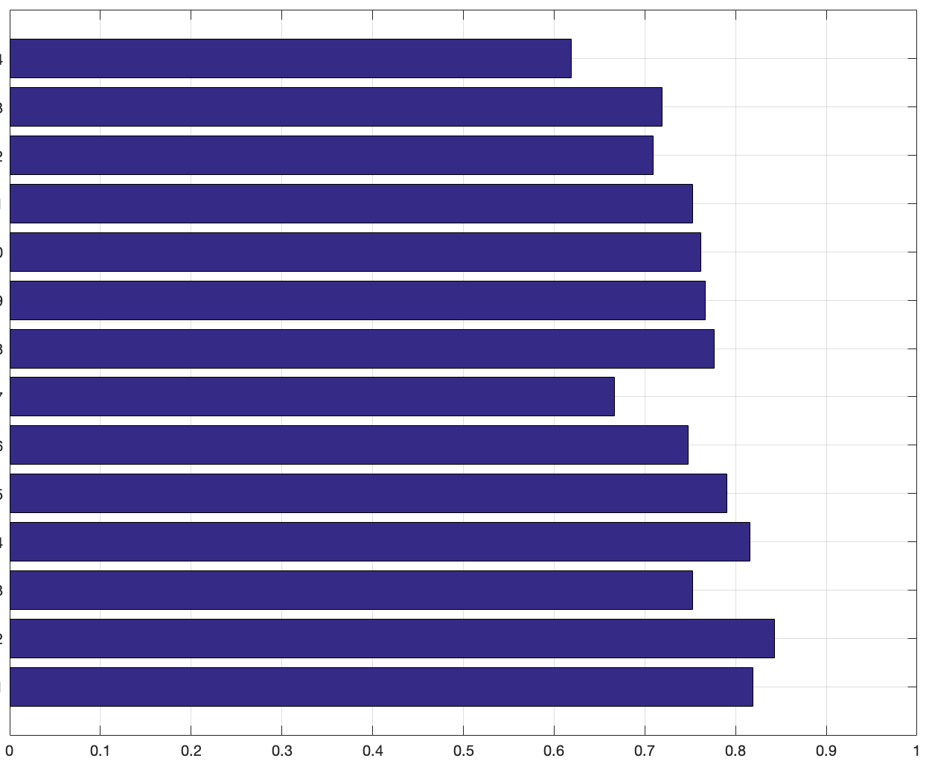
Accuracy on testing subset for each architecture
ConvNet
AlexNet
GoogLeNet
VGG
ResNet
ResNeXt
DenseNet
SqueezeNet
ShuffleNet
MobileNet
EfficientNet
ARLNET
ViT
ConvNeXt
0.6286
0.7190
0.7095
0.7524
0.7619
0.7667
0.7762
0.6667
0.7476
0.7905
0.8158
0.7524
0.8429
0.8190
2010
2014
2015
2016
2018
2019
2020
2022

