Slide 1
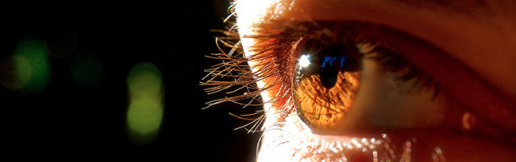
Procesamiento de Imágenes
Domingo Mery
Departamento de Ciencia de la Computación
Escuela de Ingeniería
Universidad Católica de Chile
Métricas de Desempeño de Segmetación
[ Capítulo 8 ]

Slide 2
[ EXAMPLE ]
x₂
* : class 1
x₁
PAT05_ConfisionMatrix.pptx

Slide 3
[ EXAMPLE ]
Red pixels: Positive instances (P)
White pixels: Negative instances (N)
Ground Truth
Target
PAT05_ConfisionMatrix.pptx

Slide 4
[ EXAMPLE ]
Detection (D)
Ground Truth
Detection using a classifier
PAT05_ConfisionMatrix.pptx

Slide 5
[ EXAMPLE ]
Detection (D)
Ground Truth
Detection using a classifier
PAT05_ConfisionMatrix.pptx

Slide 6
Magenta pixels: True positives (TP)
Blue pixels: False positives (FP)
Red pixels: False negatives (FN)
White pixels: True negatives (TN)
[ EXAMPLE ]
Detection (D)
Ground Truth
PAT05_ConfisionMatrix.pptx

Slide 7
Magenta pixels: True positives (TP)
Blue pixels: False positives (FP)
Red pixels: False negatives (FN)
White pixels: True negatives (TN)
[ EXAMPLE ]
Detection (D)
FN
Ground Truth
TP
FP
TN
PAT05_ConfisionMatrix.pptx

Slide 8
IDEAL
TPR = 100%
FPR = 0%
Magenta pixels: True positives (TP)
Blue pixels: False positives (FP)
Red pixels: False negatives (FN)
White pixels: True negatives (TN)
Extreme
Extreme
All positive samples
are detected
No false positive
No false alarm
Reality:
Trade-off between
FPR and TPR
All targets detected
PAT05_ConfisionMatrix.pptx

Slide 9
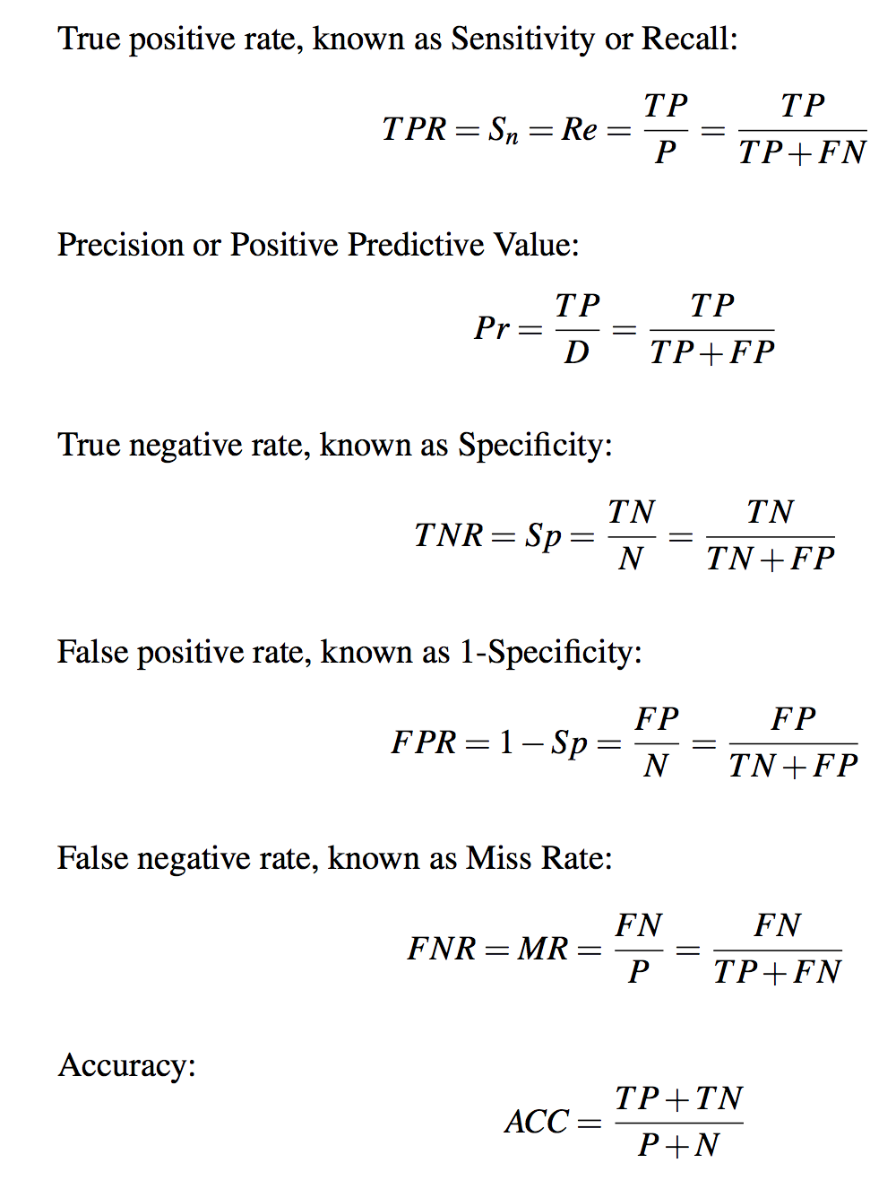
[ DEFINITIONS ]
PAT05_ConfisionMatrix.pptx

Slide 10
Curve
Precision – Recall
PAT05_ConfisionMatrix.pptx

Slide 11
Magenta pixels: True positives (TP)
Blue pixels: False positives (FP)
Red pixels: False negatives (FN)
White pixels: True negatives (TN)
[ EXAMPLE ]
FN
TP
FP
TN
PAT05_ConfisionMatrix.pptx

Slide 12
Magenta pixels: True positives (TP)
Blue pixels: False positives (FP)
Red pixels: False negatives (FN)
White pixels: True negatives (TN)
[ EXAMPLE ]
Pr
Pr = TP/(TP+FP)
Re = TP/(TP+FN)
1
Re
FN
0
1
TP
Precision-Recall curve
FP
TN
PAT05_ConfisionMatrix.pptx

Slide 13
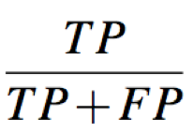
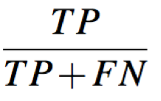
Precision = =
Recall = =
+
+
1
AREA UNDER CURVE:
mPA
(mean Precision Average)
Precision
0 1
Recall
PAT05_ConfisionMatrix.pptx

