Slide 1
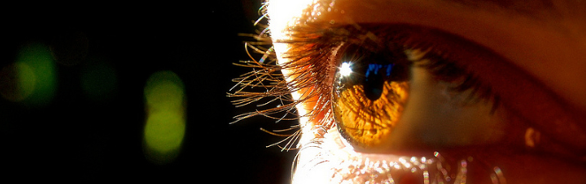
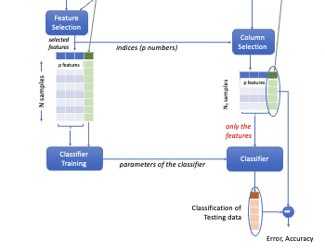

Reconocimiento de Patrones
Versión 2026
Esquema General
(CAPÍTULO V )
Domingo Mery
Ciencia de la Computación
Universidad Católica – Chile
http://domingomery.ing.uc.cl

Slide 2
Esquema General para Reconocimiento de Patrones:
0. Colección de datos originales (ejemplo: imágenes)
1. Extracción de Características
2. Definición de set de datos de Training / Testing
3. Cleaning: eliminar características correlacionadas o constantes
4. Normalización de Características (ejemplo: MinMax)
5. Selección de Características (ejemplo: SFS)
6. Diseño del Clasificador con datos de Training (ejemplo: KNN)
7. Prueba del Clasificador con datos de Testing
8. Medición de desempeño (ejemplo: Accuracy)

Slide 3
DATASET
Training Subset
m features
Feature Matrix of N x m elements
N samples
Label Vector of N x 1 elements
Clean
Remove correlated and constant features
Clone q features of m features
cleaned
features
q features
N samples
Normalization
Linear Transformation of each column:
MinMax: Max(column) = 1 Var1: Std(column) = 1
Min(column) = 0 Mean(column) = 0
normalized
features
q features
N samples
Feature
Selection
Feature Selection algorithm (like SFS, B&B, etc.)
Clone p features of q features
selected
features
p features
N samples
Classifier
Training
Classifier (like KNN, SVM, Neural Network, etc.)

Slide 4
DATASET
Training Subset
Testing Subset
m features
N_{t} samples
m features
N samples
Clean
Column
Selection
cleaned
features
indices (q numbers)
q features
q features
N samples
N_{t} samples
Normalization
Yj = a_{j} X_{j} + b_{j}
normalized
features
a , b
For each column j
q features
N samples
N_{t} samples
q features
Feature
Selection
selected
features
indices (p numbers)
Column
Selection
p features
N samples
N_{t} samples
p features
only the
features
Classifier
Training
parameters of the classifier
Classifier
Classification of
Testing data
-
Error, Accuracy, etc.

