Slide 1

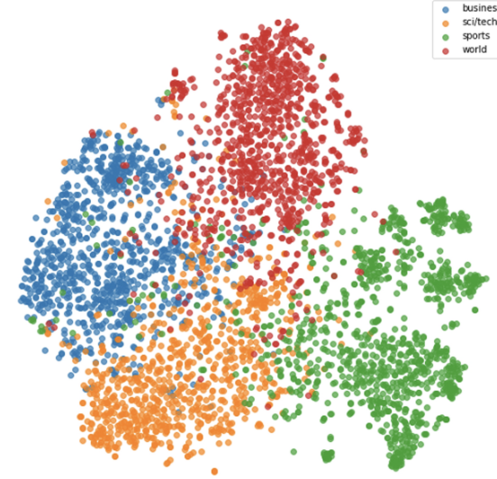

Reconocimiento de Patrones
Versión 2026
Clustering y Bag of Words
(CAPÍTULO IV )
Domingo Mery
Ciencia de la Computación
Universidad Católica – Chile
http://domingomery.ing.uc.cl

Slide 2
Clustering usando k-Means

Slide 3
Algorithm:
Input Data X = {x₁, x₂, ... x_{N}} and number of clusters K
Centroids {c₁, c₂, ... c_{K}} = random K points of X
For each data point x_{i}
Compute distance d_{ij} = d(x_{i},c_{j}) i=1,...,N, j=1,...K
Assign x_{i} to the nearest centroid: y_{i} = argmin_{j}{d_{ij}}
Compute the new centroids of each cluster
c*_{j} = mean(x_{i}) for y_{i} = j
if c*_{j} c_{j} then c_{j} = c*_{j} go to step 3
Output: {c*₁, c*₂, ... c*_{K}} and y_{i} for i=1,...,N

Slide 5
Choose random K=2 points (centroids)

Slide 6
Assign to the nearest centroid

Slide 7
Assign to the nearest centroid

Slide 8
Assign to the nearest centroid

Slide 10
Compute new centroids

Slide 11
Assign to the nearest centroid

Slide 12
Assign to the nearest centroid

Slide 13
Repeat until convergence

Slide 14
Algorithm:
Input Data X = {x₁, x₂, ... x_{N}} and number of clusters K
Centroids {c₁, c₂, ... c_{K}} = random K points of X
For each data point x_{i}
Compute distance d_{ij} = d(x_{i},c_{j}) i=1,...,N, j=1,...K
Assign x_{i} to the nearest centroid: y_{i} = argmin_{j}{d_{ij}}
Compute the new centroids of each cluster
c*_{j} = mean(x_{i}) for y_{i} = j
if c*_{j} c_{j} then c_{j} = c*_{j} go to step 3
Output: {c*₁, c*₂, ... c*_{K}} and y_{i} for i=1,...,N

Slide 15
Example: Two Clouds of Points

Slide 16
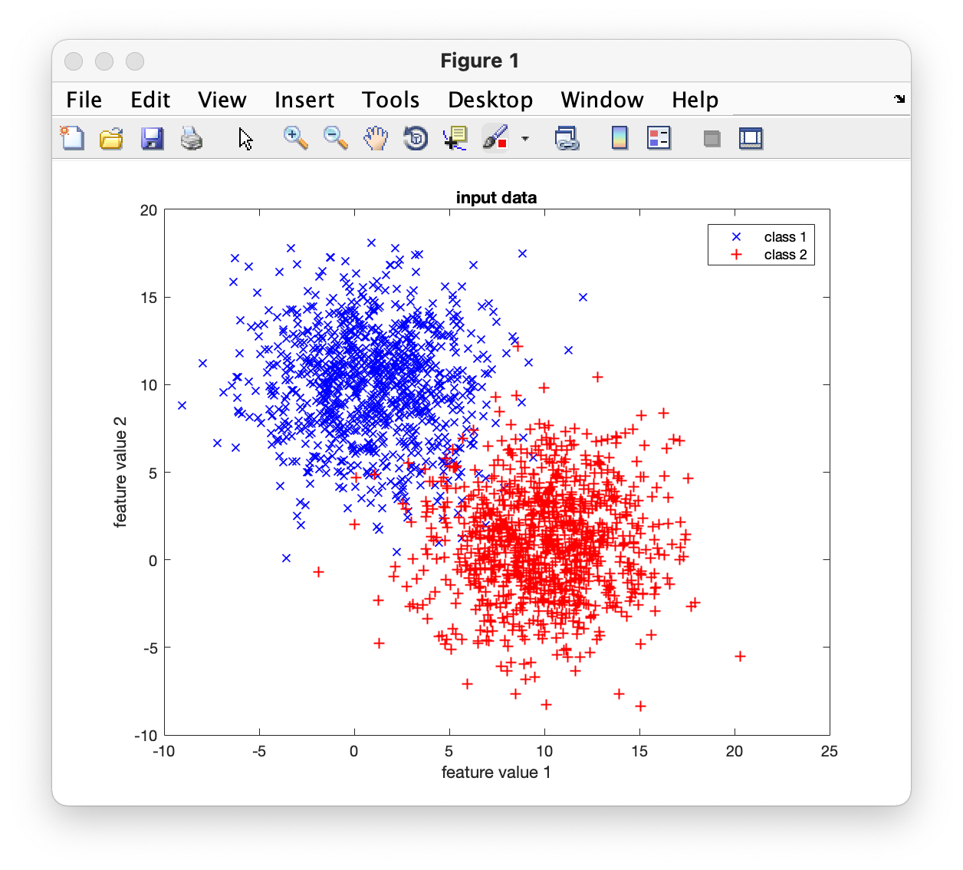
Input Data

Slide 17
Iteration 0:

Slide 18
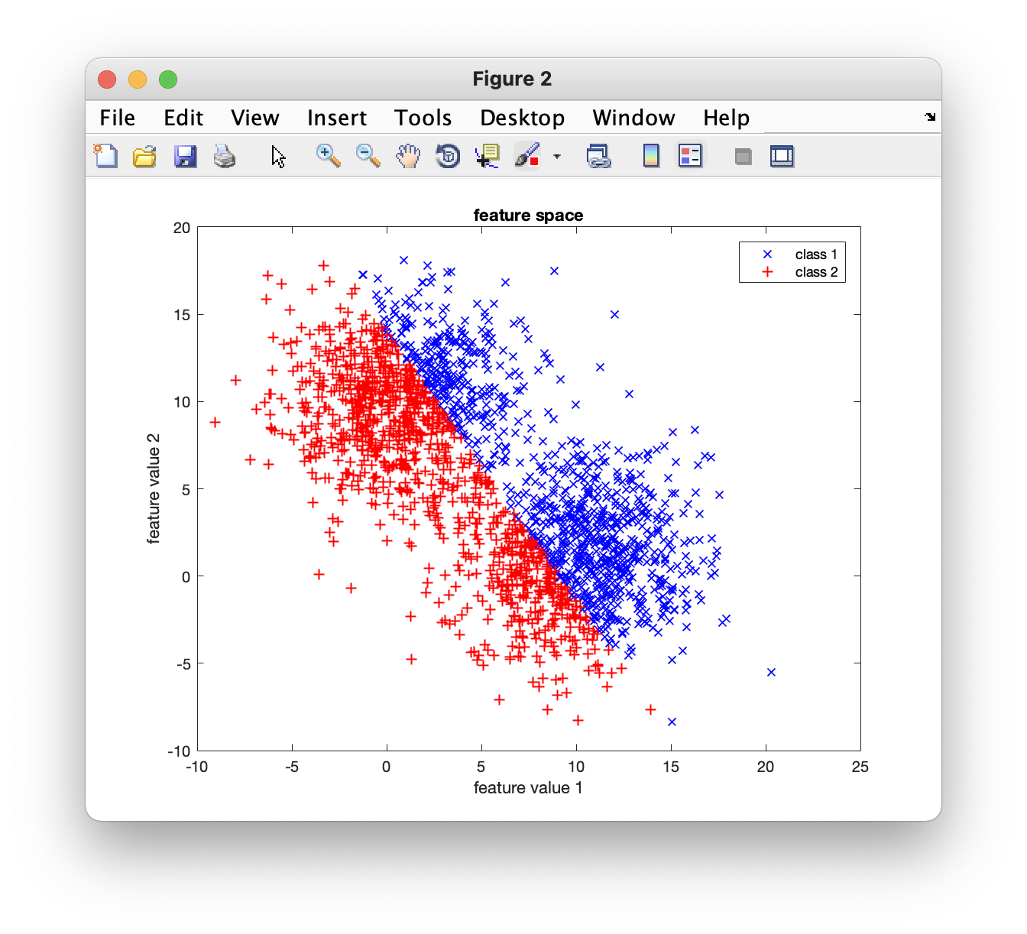
Iteration 1:
Random
points
Separation
line

Slide 19
Iteration 1:

Slide 20
Iteration 2:
Centroids
Separation
line

Slide 21
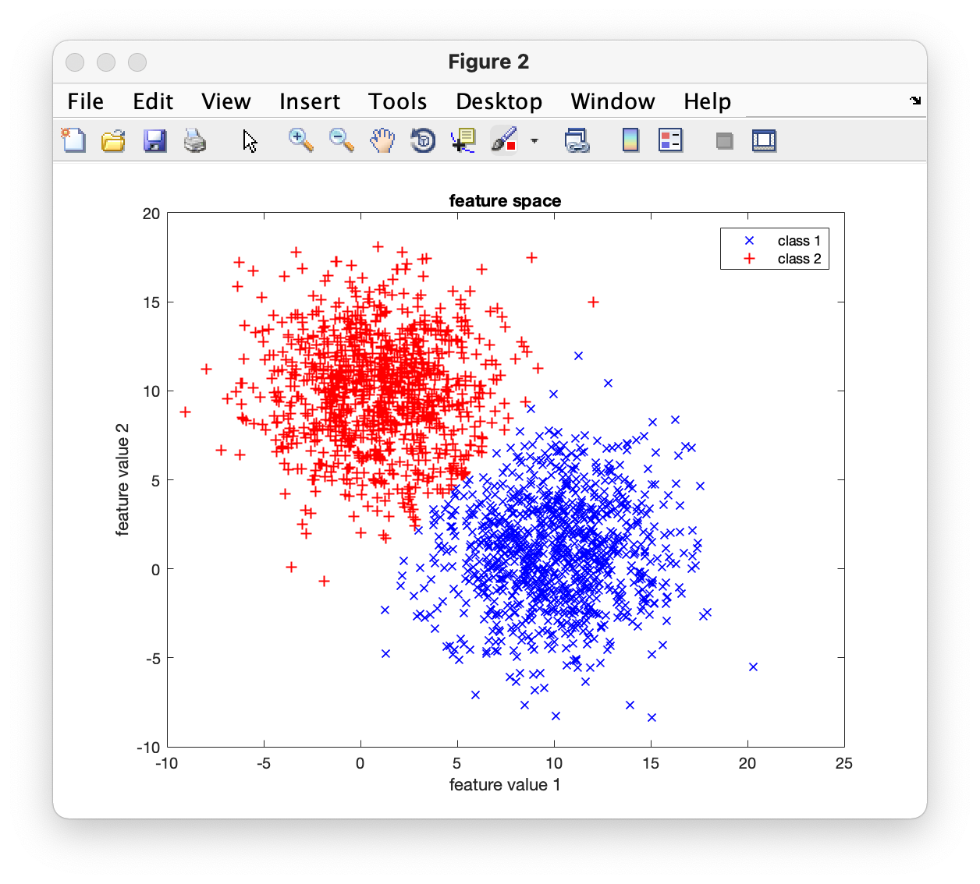
Iteration 3:

Slide 22

Iteration 4:

Slide 23

Iteration 5:

Slide 24
Found Clusters

Slide 25
Input Data

Slide 26
Example: Color Segmentation

Slide 27


Slide 28

Segmentación por Clustering
B
(47,97,168)
G
(192,201,216)
R

Slide 29
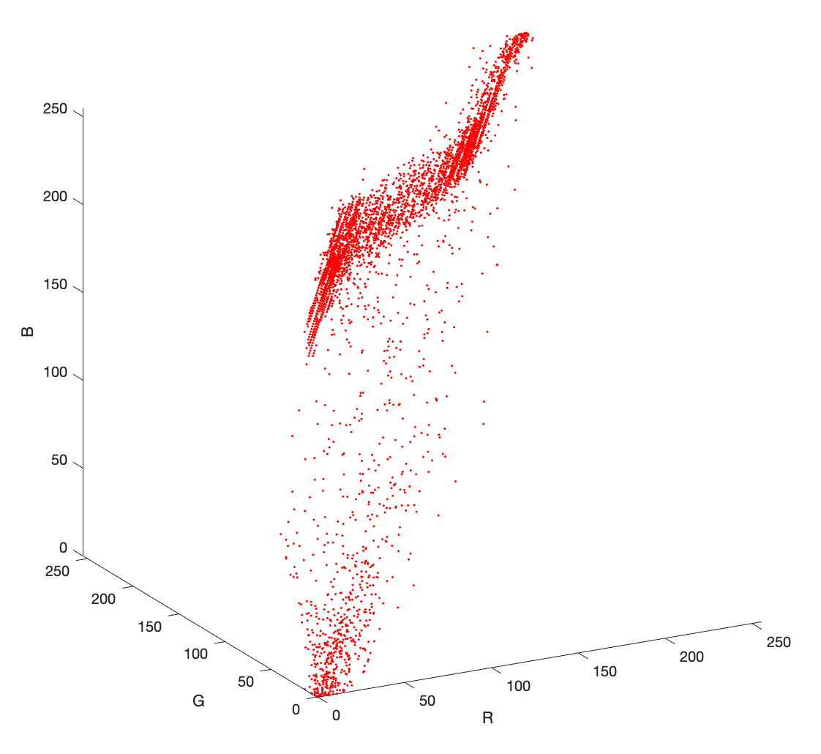
Segmentación por Clustering
B
G
R

Slide 30
Segmentación por Clustering

Slide 31
Segmentación por Clustering
cielo
nubes
palmera

Slide 32
Descomposición de Colores
Algoritmo
INPUT
R G B
Clustering
Clusters
OUTPUT

Slide 33
Clustering usando k-means

Slide 34
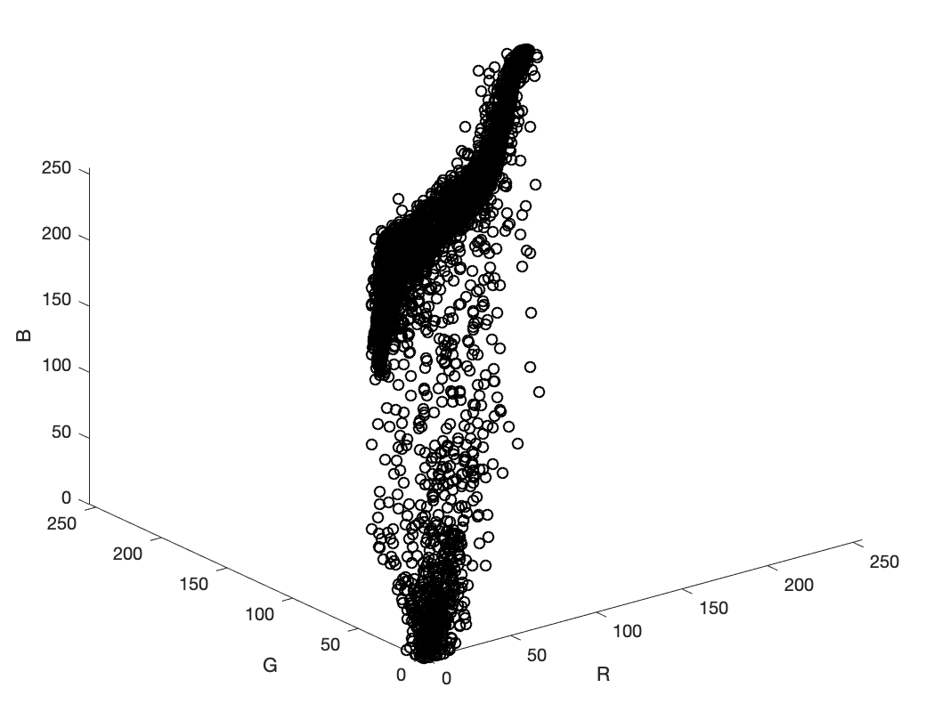

Slide 35

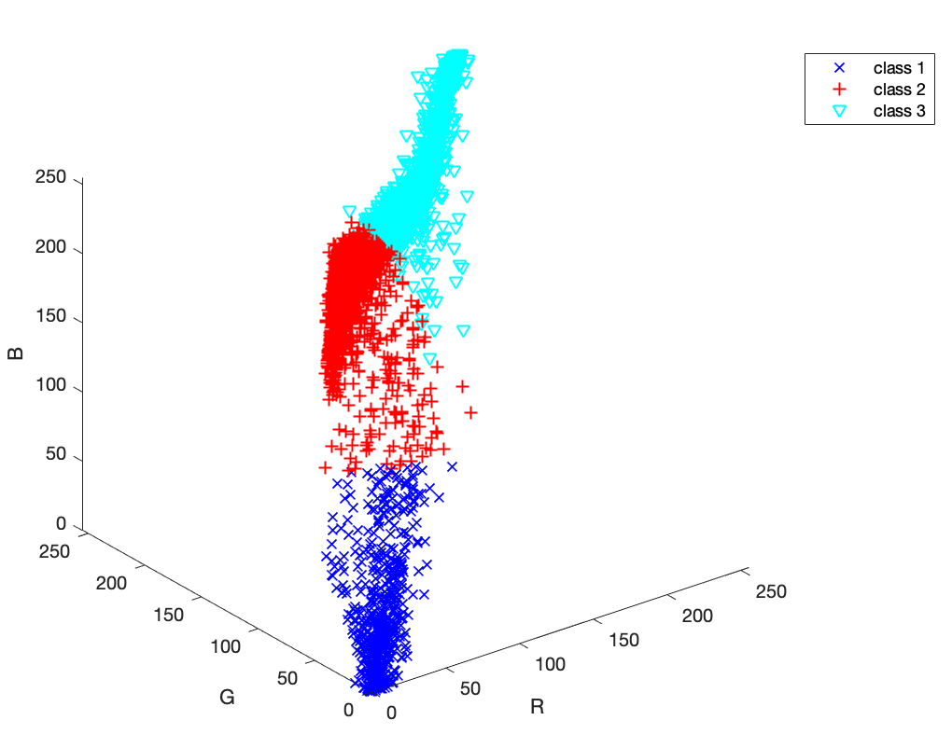

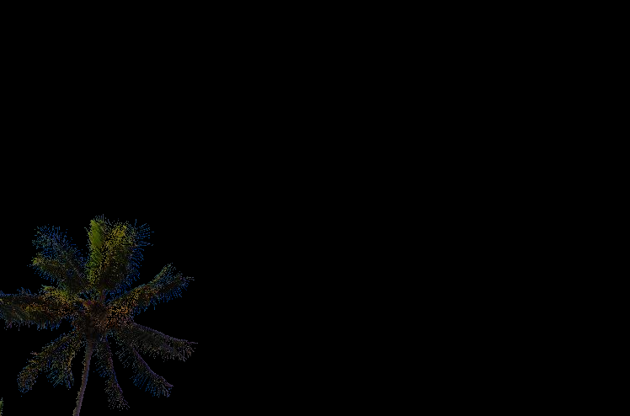

Slide 36

INPUT
OUTPUT

Slide 37
INPUT

Slide 38
OUTPUT

Slide 39
Bag of Visual Words

Slide 40


Slide 42
descriptor

Slide 43
10 | 30 | 11 | 12 | 13 | 29 | 22 | 12 | 13 | 30
descriptor

Slide 44
10 | 30 | 11 | 12 | 13 | 29 | 22 | 12 | 13 | 30
10 | 10 | 12 | 34 | 12 | 10 | 12 | 34 | 12 | 9
12 | 29 | 11 | 10 | 12 | 10 | 12 | 34 | 12 | 14
3 | 10 | 12 | 34 | 12 | 10 | 12 | 34 | 12 | 14
12 | 12 | 3 | 10 | 12 | 12 | 3 | 10 | 12
12 | 10 | 12 | 34 | 12 | 10 | 12 | 34 | 12 | 14
11 | 10 | 12 | 34 | 12 | 10 | 12 | 34 | 12 | 14
12 | 29 | 11 | 10 | 12 | 10 | 12 | 34 | 12 | 14
3 | 10 | 12 | 34 | 12 | 12 | 12 | 3 | 10 | 12
12 | 12 | 3 | 10 | 12 | 12 | 12 | 3 | 10 | 12
10 | 10 | 12 | 34 | 12 | 10 | 12 | 34 | 12 | 14
10 | 10 | 12 | 34 | 12 | 10 | 12 | 34 | 12 | 9
12 | 29 | 11 | 10 | 12 | 10 | 12 | 34 | 12 | 14
3 | 10 | 12 | 34 | 12 | 10 | 12 | 34 | 12 | 14
12 | 12 | 3 | 10 | 12 | 12 | 3 | 10 | 12 | 15
12 | 10 | 12 | 34 | 12 | 10 | 12 | 34 | 12 | 14
11 | 10 | 12 | 34 | 12 | 10 | 12 | 34 | 12 | 14
12 | 29 | 11 | 10 | 12 | 10 | 12 | 34 | 12 | 14
3 | 10 | 12 | 34 | 12 | 12 | 12 | 3 | 10 | 12
12 | 12 | 3 | 10 | 12 | 12 | 12 | 3 | 10 | 12
10 | 10 | 12 | 34 | 12 | 10 | 12 | 34 | 12 | 14
12 | 12 | 3 | 10 | 12 | 12 | 3 | 10 | 12 | 17
description

Slide 45
N
10 | 30 | 11 | 12 | 13 | 29 | 22 | 12 | 13 | 30
10 | 10 | 12 | 34 | 12 | 10 | 12 | 34 | 12 | 9
12 | 29 | 11 | 10 | 12 | 10 | 12 | 34 | 12 | 14
3 | 10 | 12 | 34 | 12 | 10 | 12 | 34 | 12 | 14
12 | 12 | 3 | 10 | 12 | 12 | 3 | 10 | 12
12 | 10 | 12 | 34 | 12 | 10 | 12 | 34 | 12 | 14
11 | 10 | 12 | 34 | 12 | 10 | 12 | 34 | 12 | 14
12 | 29 | 11 | 10 | 12 | 10 | 12 | 34 | 12 | 14
3 | 10 | 12 | 34 | 12 | 12 | 12 | 3 | 10 | 12
12 | 12 | 3 | 10 | 12 | 12 | 12 | 3 | 10 | 12
10 | 10 | 12 | 34 | 12 | 10 | 12 | 34 | 12 | 14
10 | 10 | 12 | 34 | 12 | 10 | 12 | 34 | 12 | 9
12 | 29 | 11 | 10 | 12 | 10 | 12 | 34 | 12 | 14
3 | 10 | 12 | 34 | 12 | 10 | 12 | 34 | 12 | 14
12 | 12 | 3 | 10 | 12 | 12 | 3 | 10 | 12 | 15
12 | 10 | 12 | 34 | 12 | 10 | 12 | 34 | 12 | 14
11 | 10 | 12 | 34 | 12 | 10 | 12 | 34 | 12 | 14
12 | 29 | 11 | 10 | 12 | 10 | 12 | 34 | 12 | 14
3 | 10 | 12 | 34 | 12 | 12 | 12 | 3 | 10 | 12
12 | 12 | 3 | 10 | 12 | 12 | 12 | 3 | 10 | 12
10 | 10 | 12 | 34 | 12 | 10 | 12 | 34 | 12 | 14
12 | 12 | 3 | 10 | 12 | 12 | 3 | 10 | 12 | 17
description
.
.
.
.
.
.
.
.
.
.
.
.
.
.
.
.
.
.
.
.
.
.
.
.

Slide 46
.
.
.
.
.
.
.
.
.
.
.
.
.
.
.
.
.
.
.
.
.
.
.
.

Slide 47

.
.
.
.
.
.
.
.
.
.
.
.
.
.
.
.
.
.
.
.
.
.
.
.
.
.
.
.
.
.
.
.
.
.
.
.
.
.
.
.
.
.
.
.
.

Slide 48

.
.
.
.
.
.
.
.
.
.
.
.
.
.
.
.
.
.
.
.
.
.
.
.
.
.
.
.
.
.
.
.
.
.
.
.
.
.
.
.
.
.
.
.
.
.
.
.
.
.
.
.
.
.
.
.
.
.
.
.
.
.
.
.
.
.

Slide 49
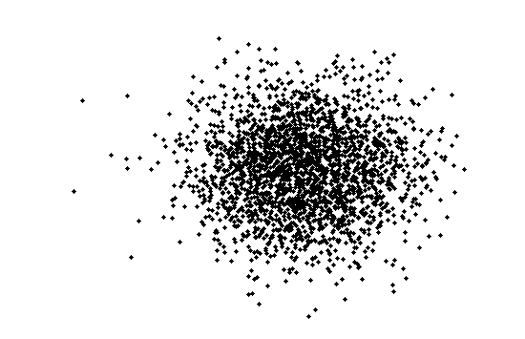
for all images

Slide 50
Description of
all parts

Slide 51
Description of
all parts
Description of
one part

Slide 52
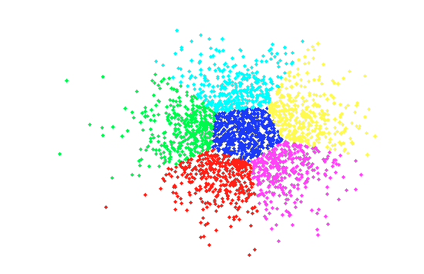
Visual Vocabulary
K-Means with K clusters

Slide 53
Visual Vocabulary
K-Means with K clusters

Slide 54
Visual Vocabulary
N
12 | 12 | 3 | 10 | 12 | 12 | 12 | 3 | 10 | 12
10 | 10 | 12 | 34 | 12 | 10 | 12 | 34 | 12 | 14
10 | 10 | 12 | 34 | 12 | 10 | 12 | 34 | 12 | 9
12 | 29 | 11 | 10 | 12 | 10 | 12 | 34 | 12 | 14
3 | 10 | 12 | 34 | 12 | 10 | 12 | 34 | 12 | 14
12 | 12 | 3 | 10 | 12 | 12 | 3 | 10 | 12 | 15
K
(coordinates of the centroids)
K-Means with K clusters

Slide 55
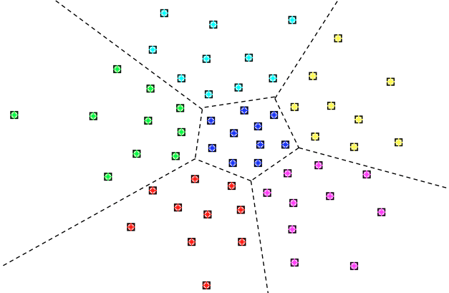


Example
John
K

Slide 56






Example: More Dictionaries
Julio
Miguel
John
Ana

Slide 57
Visual Vocabulary
N
12 | 12 | 3 | 10 | 12 | 12 | 12 | 3 | 10 | 12
10 | 10 | 12 | 34 | 12 | 10 | 12 | 34 | 12 | 14
10 | 10 | 12 | 34 | 12 | 10 | 12 | 34 | 12 | 9
12 | 29 | 11 | 10 | 12 | 10 | 12 | 34 | 12 | 14
3 | 10 | 12 | 34 | 12 | 10 | 12 | 34 | 12 | 14
12 | 12 | 3 | 10 | 12 | 12 | 3 | 10 | 12 | 15
1
2
3
4
5
6
K
2
3
1
4
5
6
Example with K=6 clusters

Slide 58

descriptor
10 | 11 | 11 | 32 | 11 | 13 | 12 | 31 | 13 | 15

Slide 59
10 | 11 | 11 | 32 | 11 | 13 | 12 | 31 | 13 | 15

Slide 60
10 | 11 | 11 | 32 | 11 | 13 | 12 | 31 | 13 | 15
2
3
1
4
5
6

Slide 61
10 | 11 | 11 | 32 | 11 | 13 | 12 | 31 | 13 | 15
2
3
1
4
5
6

Slide 62
10 | 11 | 11 | 32 | 11 | 13 | 12 | 31 | 13 | 15
2
This part is represented by word 3
3
1
4
5
6
[ Encoding ]

Slide 63
12 | 12 | 3 | 10 | 12 | 12 | 12 | 3 | 10 | 12
10 | 10 | 12 | 34 | 12 | 10 | 12 | 34 | 12 | 14
10 | 10 | 12 | 34 | 12 | 10 | 12 | 34 | 12 | 9
12 | 29 | 11 | 10 | 12 | 10 | 12 | 34 | 12 | 14
3 | 10 | 12 | 34 | 12 | 10 | 12 | 34 | 12 | 14
12 | 12 | 3 | 10 | 12 | 12 | 3 | 10 | 12 | 15
1
2
3
4
5
6
10 | 11 | 11 | 32 | 11 | 13 | 12 | 31 | 13 | 15
2
This part is represented by word 3
3
1
4
5
6
[ Encoding ]

Slide 64
3
[ Encoding ]

Slide 65
4
3
[ Encoding ]

Slide 66
4
3
1
[ Encoding ]

Slide 67
6
4
3
1
3
5
4
3
1
2
[ Encoding ]

Slide 68
6
4
3
1
3
5
4
3
1
2
How many words ‘1’ are in this image?

Slide 69
6
4
3
1
3
5
4
3
1
2
How many words ‘1’ are in this image?
Answer: 2

Slide 70
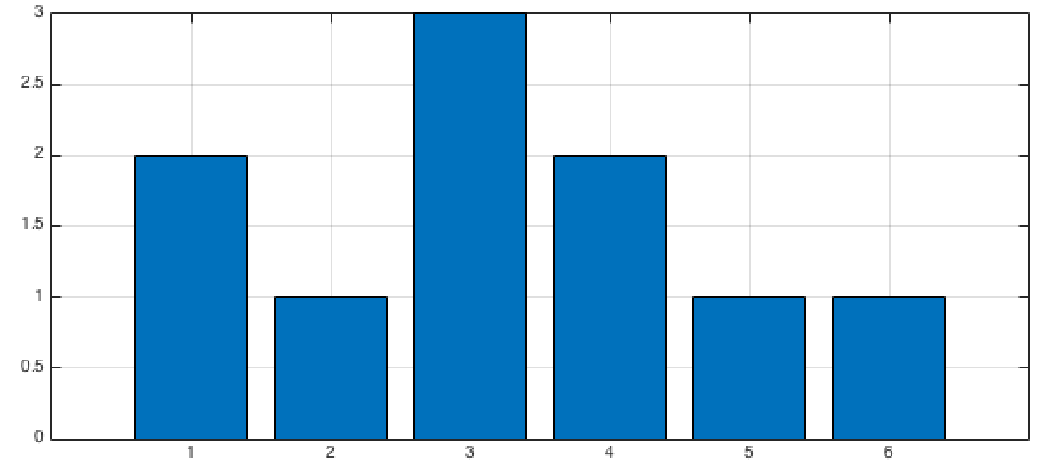
6
4
3
1
3
5
4
3
1
2
Histogram

Slide 71
6
4
3
1
3
5
4
3
1
2
Histogram

Slide 72

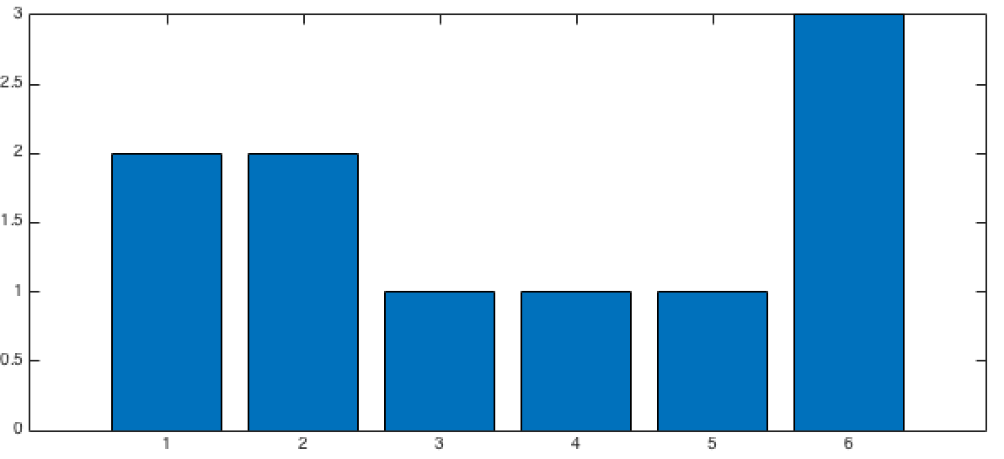
Histogram
different objects have different histograms
Histogram

Slide 73

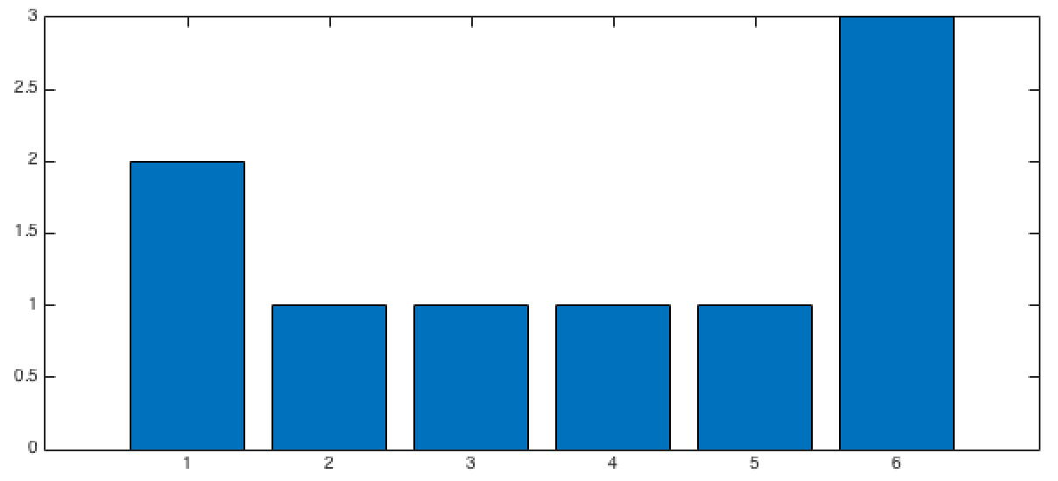
Histogram
Histogram
same objects have similar histograms
Histogram

Slide 74
Summary
PART 1: VISUAL VOCABULARY
Collect representative images
Extract descriptors (example LBP, HOG, HoG, etc.)
K-means (Visual Vocabulary of K words)

Slide 75
Summary
PART 1: VISUAL VOCABULARY
Collect representative images
Extract descriptors
K-means (Visual Vocabulary of K words)
PART 2: CLASSIFIER DESIGN
1. For each image of the training set
- Extract descriptors and encode them using the Visual Vocabulary
- Build the histogram
Train a classifier using the new representation (histogram) of each image
Repeat for testing set and test the classifier

Slide 76
Ejemplo Reconocimiento de Tigres (Biometría)

Slide 77
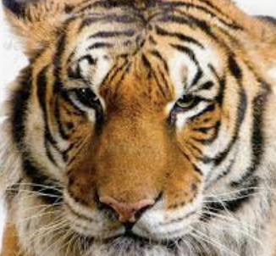
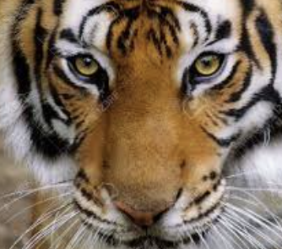
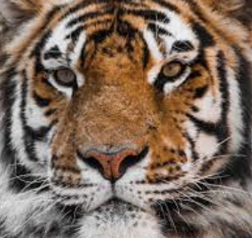
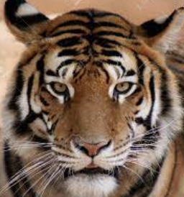
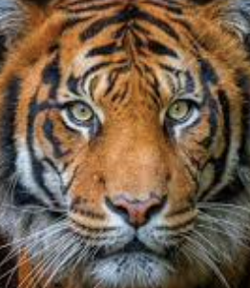
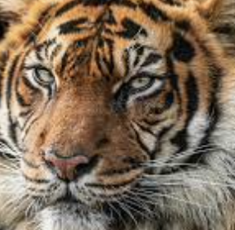
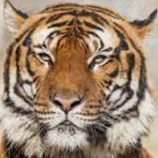
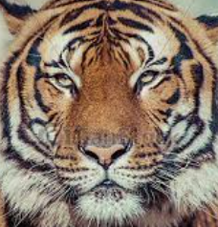
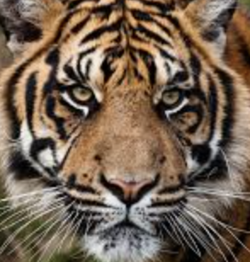
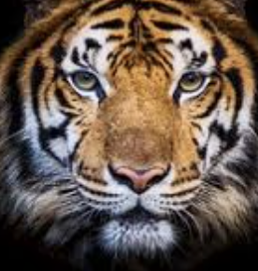
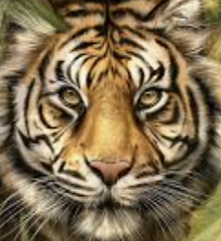
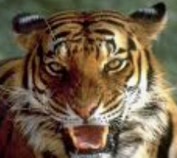
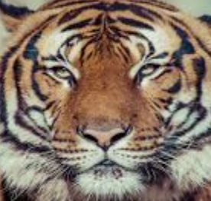
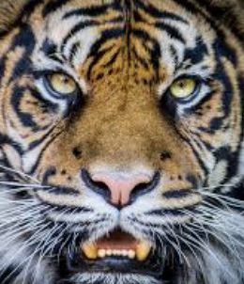
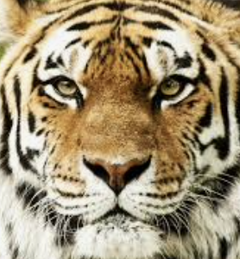
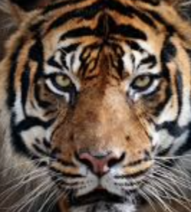
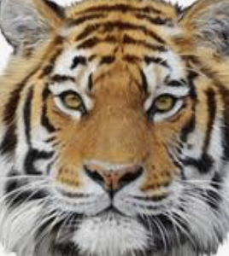


Slide 78
TRAINING

Slide 79
TRAINING
12 | 12 | 3 | 10 | 12 | 12 | 12 | 3 | 10 | 12
10 | 10 | 12 | 34 | 12 | 10 | 12 | 34 | 12 | 14
10 | 10 | 12 | 34 | 12 | 10 | 12 | 34 | 12 | 9
12 | 29 | 11 | 10 | 12 | 10 | 12 | 34 | 12 | 14
3 | 10 | 12 | 34 | 12 | 10 | 12 | 34 | 12 | 14
12 | 12 | 3 | 10 | 12 | 12 | 3 | 10 | 12 | 15
HoG de cada una
de los Tigres
K-means de todos los HoG

Slide 80
TRAINING
Coordenadas de K centroides
12 | 12 | 3 | 10 | 12 | 12 | 12 | 3 | 10 | 12
10 | 10 | 12 | 34 | 12 | 10 | 12 | 34 | 12 | 14
10 | 10 | 12 | 34 | 12 | 10 | 12 | 34 | 12 | 9
12 | 29 | 11 | 10 | 12 | 10 | 12 | 34 | 12 | 14
3 | 10 | 12 | 34 | 12 | 10 | 12 | 34 | 12 | 14
12 | 12 | 3 | 10 | 12 | 12 | 3 | 10 | 12 | 15
HoG de cada una
de los Tigres
K-means de todos los HoG
Diccionario de
K palabras
visuales
K
N

Slide 81

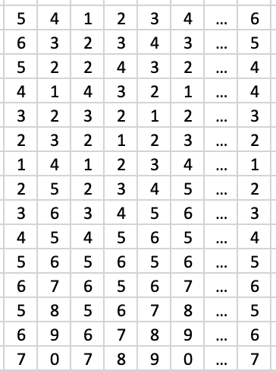

TRAINING
K
Para cada tigre del entrenamiento
HoG
Codificación
Histograma
Entrenar
Clasificador
Clasificador
Entrenado
Histogramas Labels

Slide 82
TESTING

Slide 83

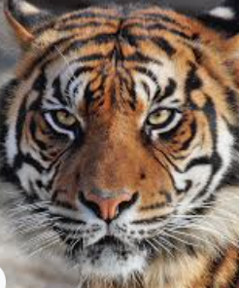
TESTING
K
Para el tigre de testing
HoG
Codificación
Histograma

Slide 84
TESTING
Para el tigre de testing
HoG
Codificación
Histograma
Clasificación
“3”

Slide 85
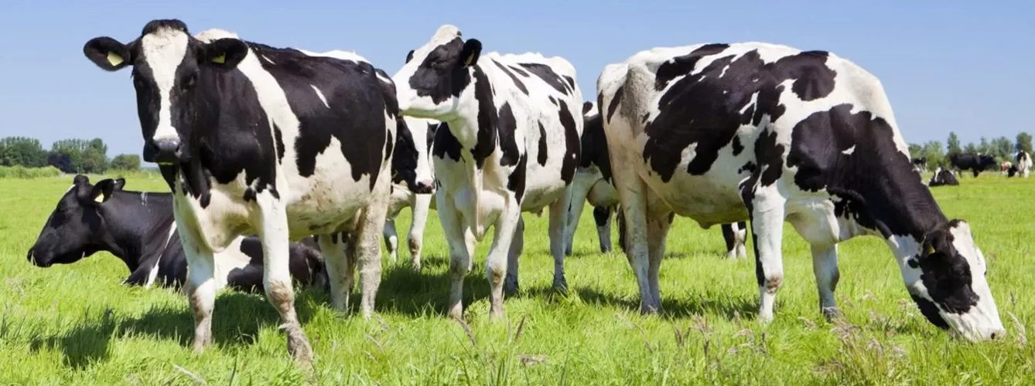
Se puede usar este método para reconocer vacas?

