Slide 1

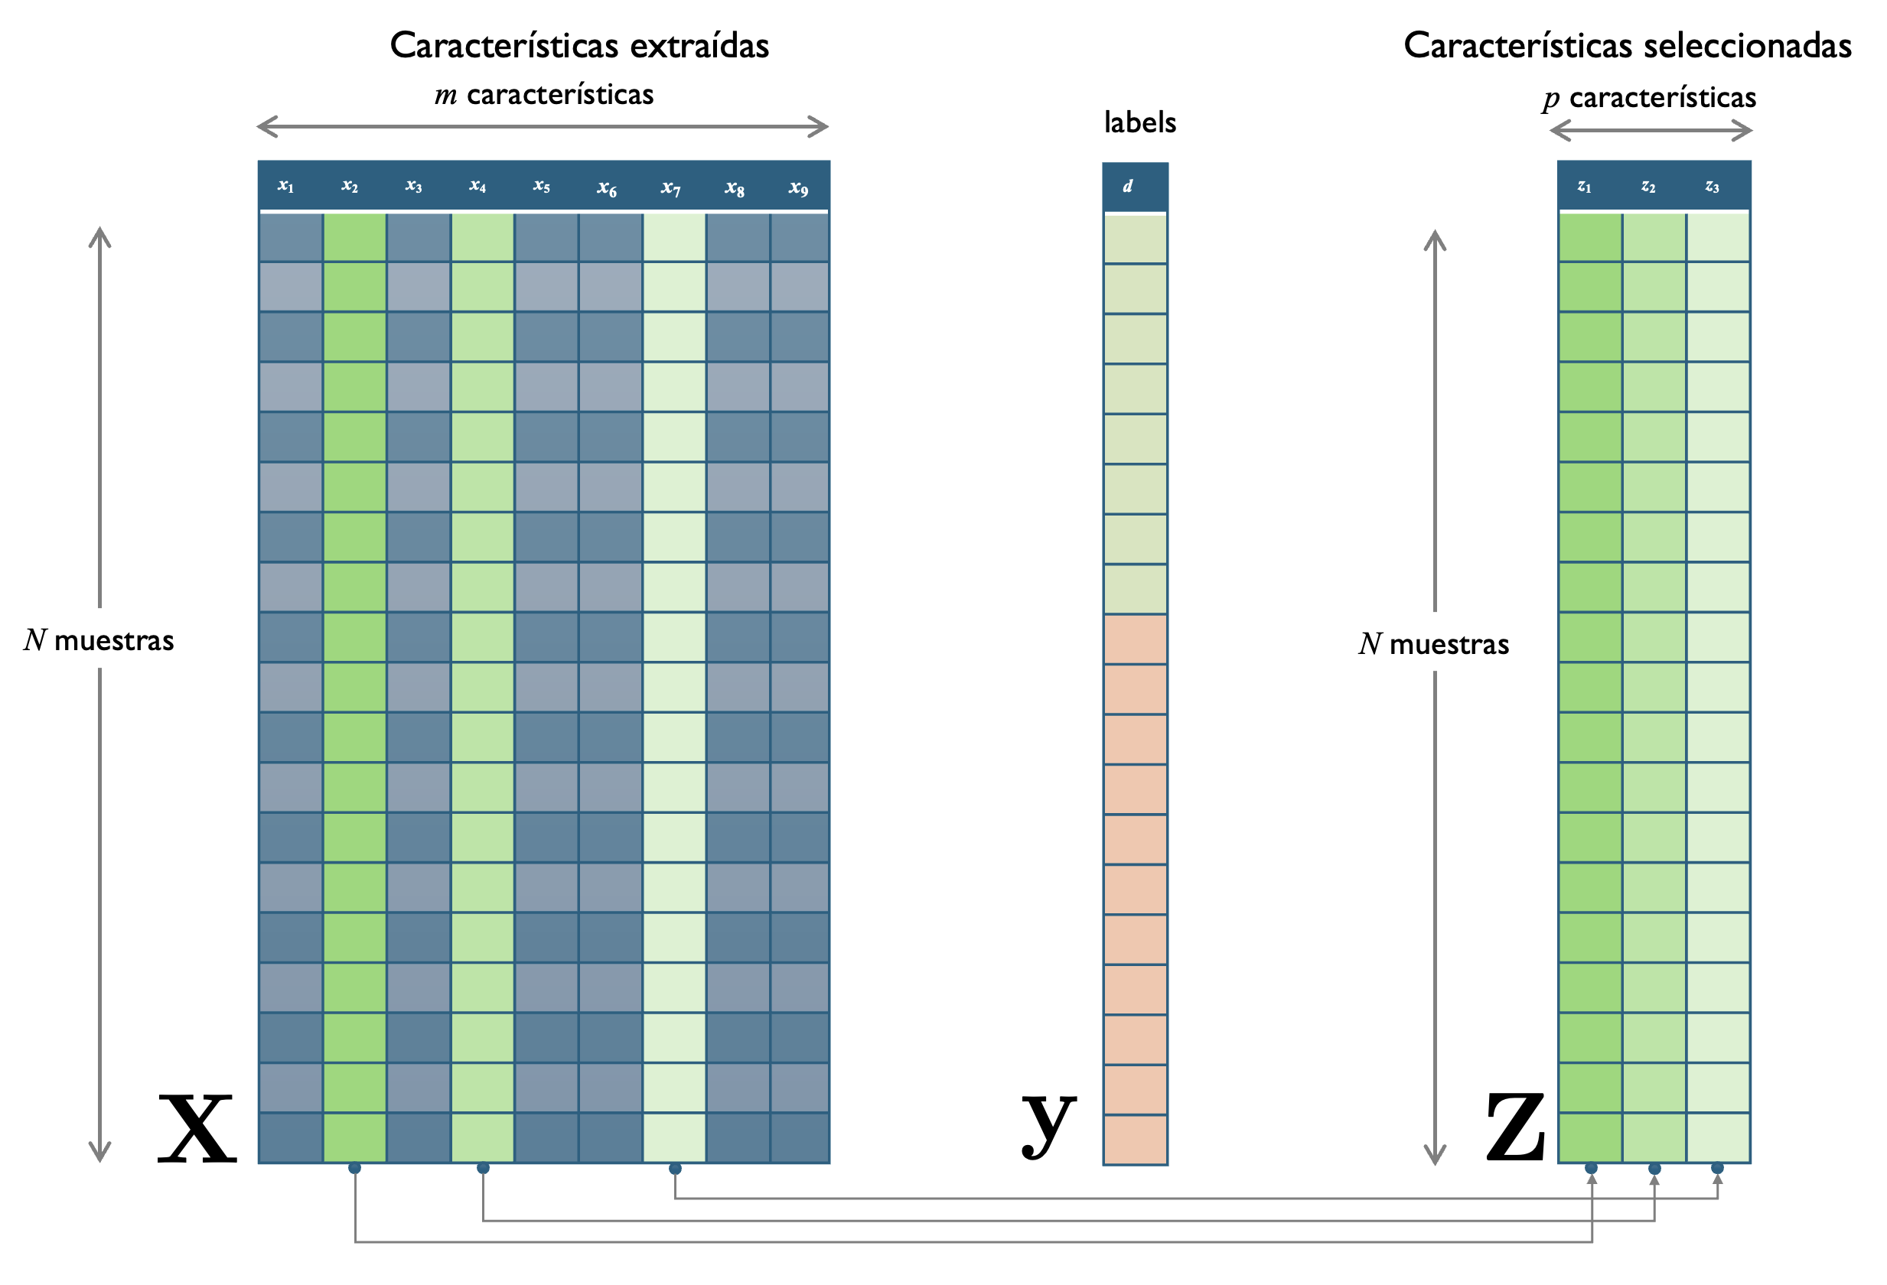

Reconocimiento de Patrones
Versión 2026
Ejercicio E06: Selección de Características
( CAPÍTULO I1I )
Domingo Mery
Ciencia de la Computación
Universidad Católica – Chile
http://domingomery.ing.uc.cl

Slide 2

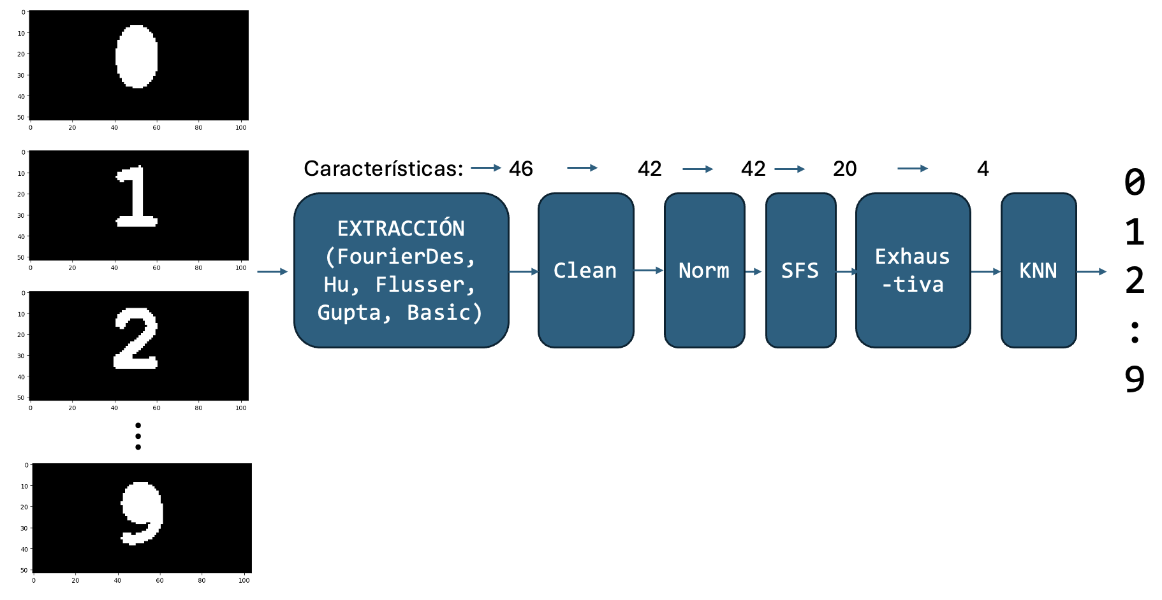
E06 > Reconocedor de 10 dígitos
Imagen X
1000 x 1000
Imagen Yk

Slide 3
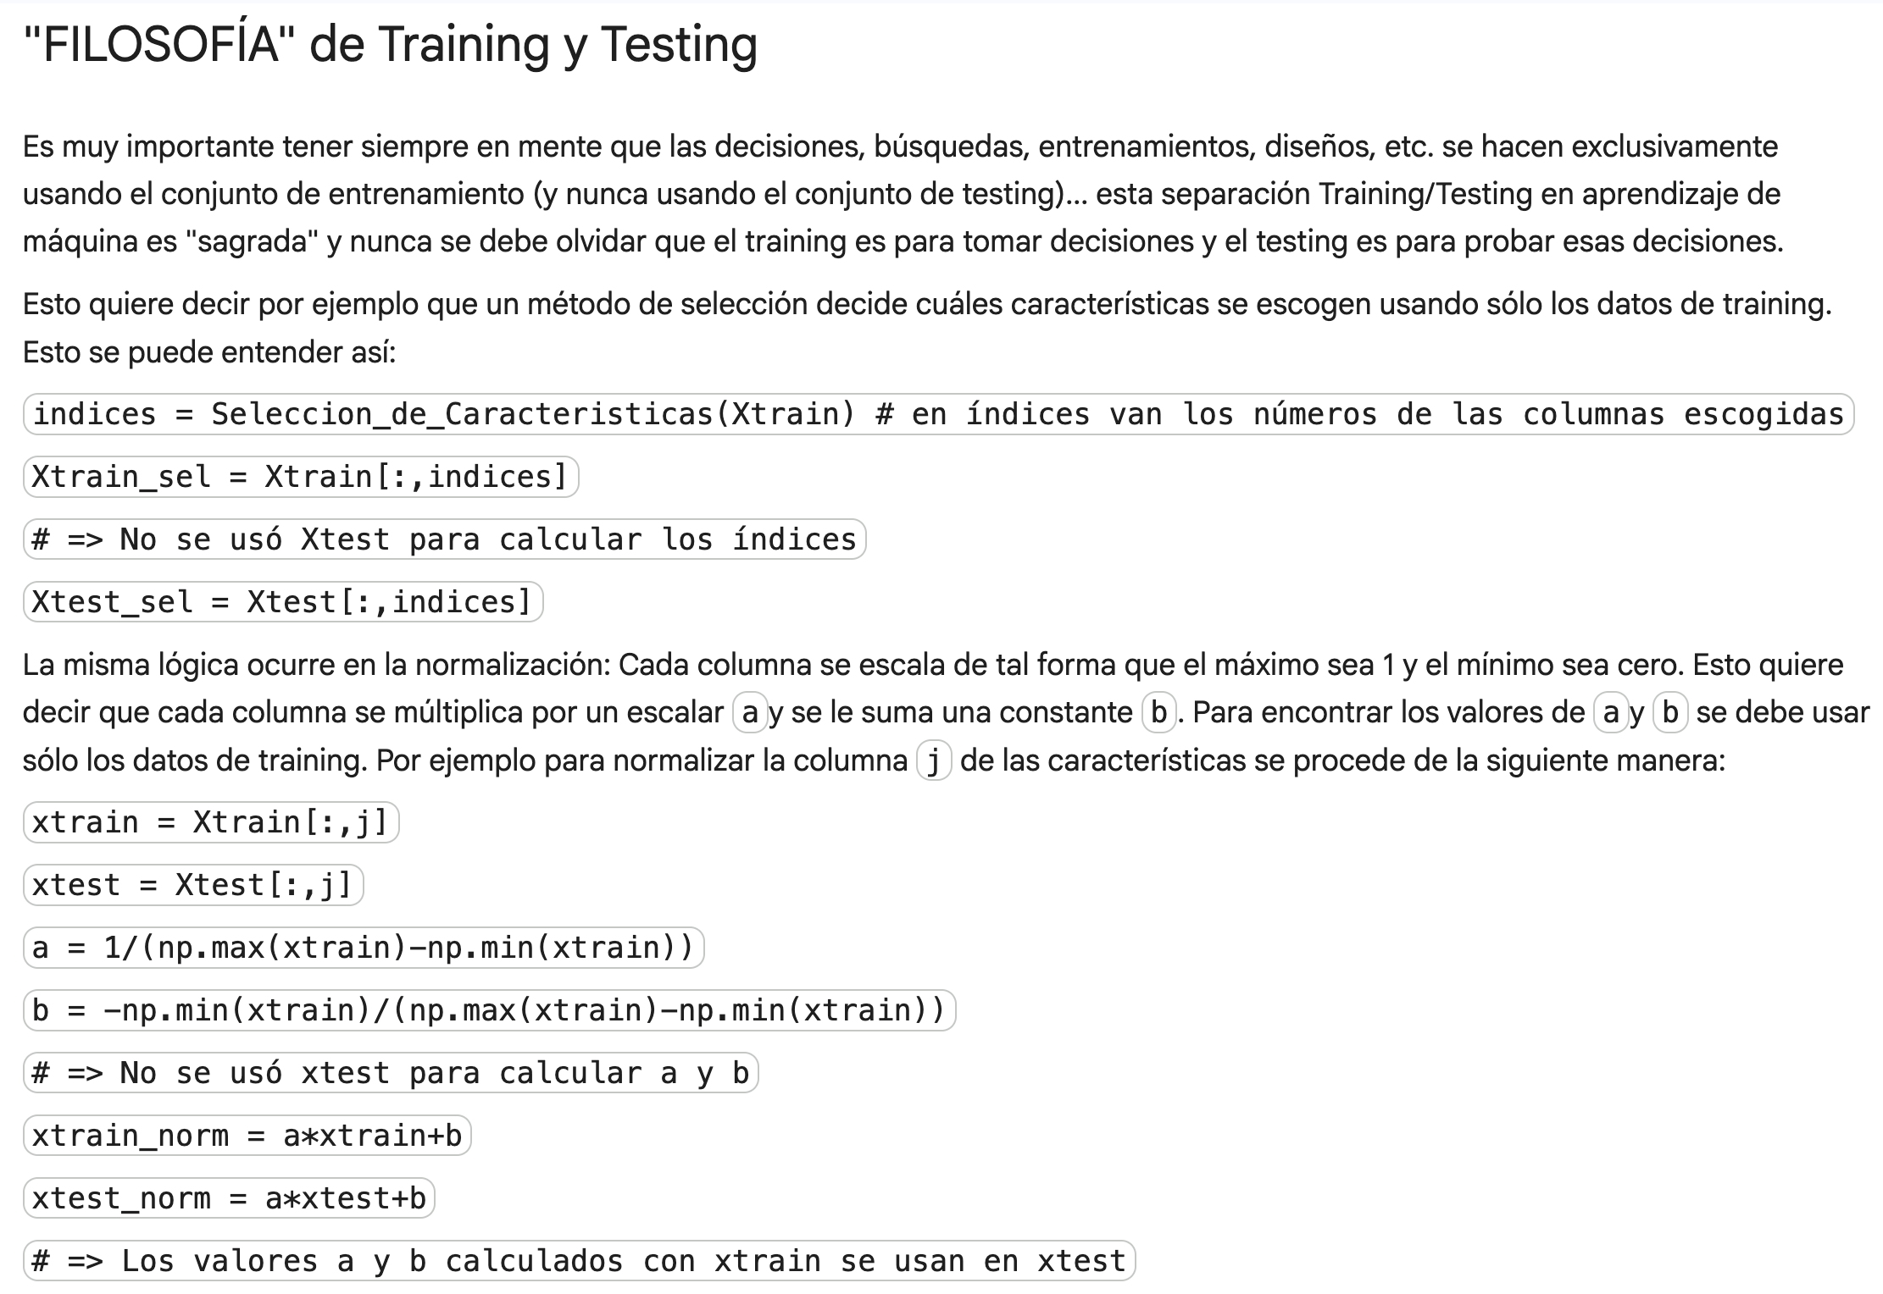

Slide 4
Xtrain_sfs
Xtrain_ex
Xtrain_clean
Xtrain_norm
Cleaning
Normalization
Selection
Training
Xtrain

Slide 5
Xtrain_sfs
Xtrain_ex
Xtrain_clean
Xtrain_norm
ytrain
Cleaning
Normalization
Selection
Training
Xtrain

Slide 6
Xtrain_sfs
Xtrain_ex
Xtrain_clean
Xtrain_norm
ytrain
Cleaning
Normalization
Selection
Training
Xtrain
sclean
a,b
sel
Learned
Model

Slide 7
Xtrain_sfs
Xtrain_ex
Xtrain_clean
Xtrain_norm
ytrain
70%
Cleaning
Normalization
Selection
Training
Xtrain
Split
Features &
Labels
sel
Learned
Model
sclean
a,b
X,y
ypred
Clean
Features
Normalize
Features
Select
Features
Classify
30%
Xtest
Xtest_clean
Xtest_norm
Xtest_sfs
Xtest_ex

Slide 8
Xtrain_sfs
Xtrain_ex
Xtrain_clean
Xtrain_norm
ytrain
70%
Cleaning
Normalization
Selection
Training
Xtrain
Split
Features &
Labels
sel
Learned
Model
sclean
a,b
X,y
ypred
Clean
Features
Normalize
Features
Select
Features
Classify
30%
Xtest
-
acc
ytest
Xtest_clean
Xtest_norm
Xtest_sfs
Xtest_ex

Slide 9
Xtrain_sfs
Xtrain_ex
PIENSA,
DECIDE,
DISEÑA
Xtrain_clean
Xtrain_norm
ytrain
70%
Cleaning
Normalization
Selection
Training
Xtrain
Split
Features &
Labels
sel
Learned
Model
sclean
a,b
X,y
ypred
Clean
Features
Normalize
Features
Select
Features
Classify
30%
Xtest
-
acc
ytest
Xtest_clean
Xtest_norm
Xtest_sfs
Xtest_ex

Slide 10
Xtrain_sfs
Xtrain_ex
PIENSA,
DECIDE,
DISEÑA
Xtrain_clean
Xtrain_norm
ytrain
70%
Cleaning
Normalization
Selection
Training
Xtrain
Split
Features &
Labels
sel
Learned
Model
sclean
a,b
X,y
ypred
Clean
Features
Normalize
Features
Select
Features
Classify
30%
Xtest
-
acc
ytest
NO PIENSA,
EJECUTA,
OBEDECE
Xtest_clean
Xtest_norm
Xtest_sfs
Xtest_ex

Slide 11
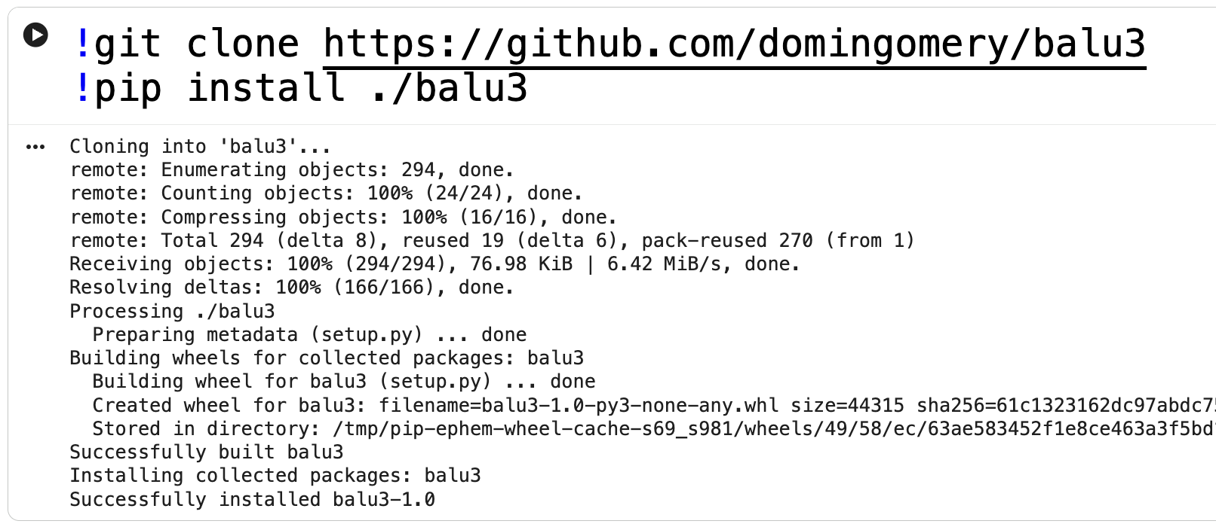
E06
PASO INICIAL : Cargar Balu

Slide 12
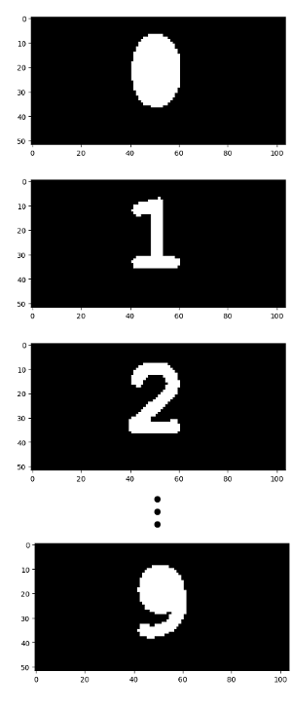
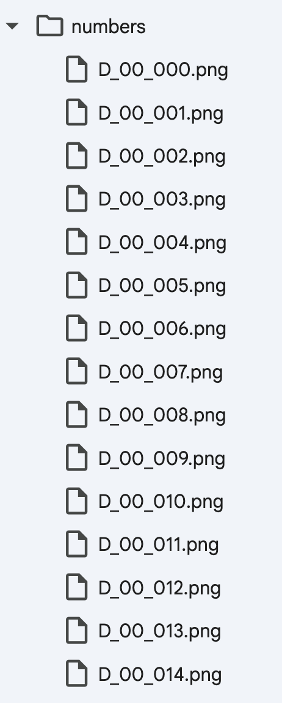
E06 > P01: Base de Datos
300 imágenes:
30 imágenes binarias por dígito
Las primeras 21 de cada dígito se usan para training
Las últimas 9 de cada dígito se usan para testing
D_xx_nnn.png
xx = 00, 01, … 09
nnn = 000, 001, … 029
Imagen X
1000 x 1000
Imagen Yk

Slide 13
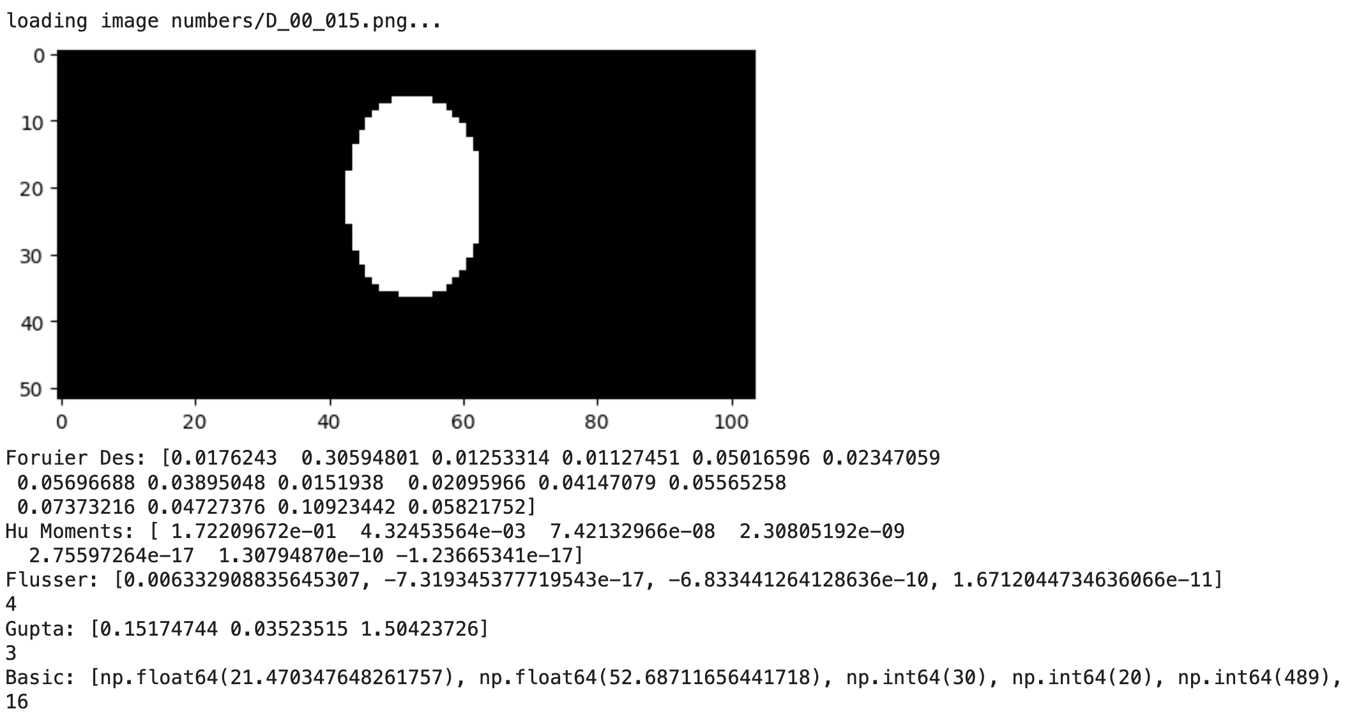
E06 > P02: Pruebas Iniciales

Slide 14
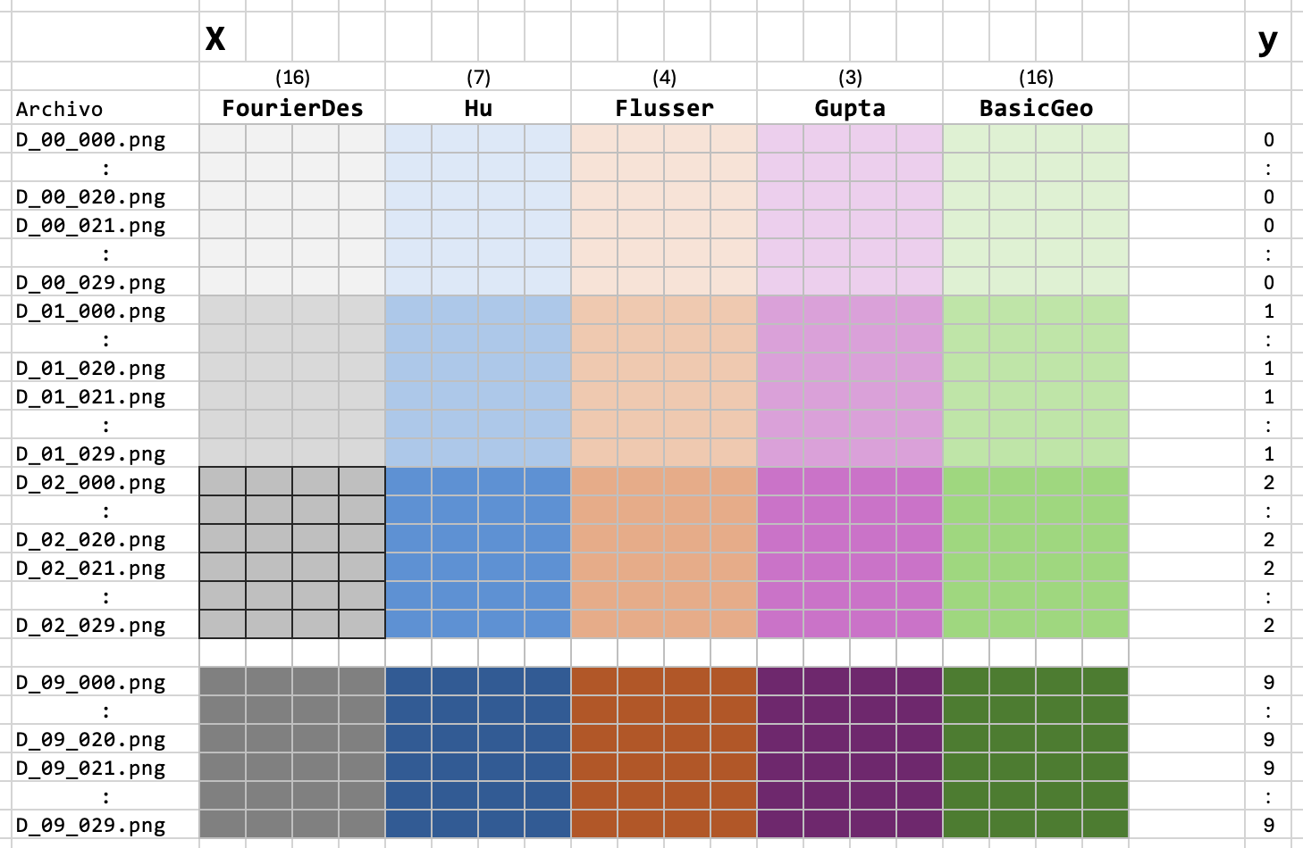
E06 > P03: Extracción de Características

Slide 15
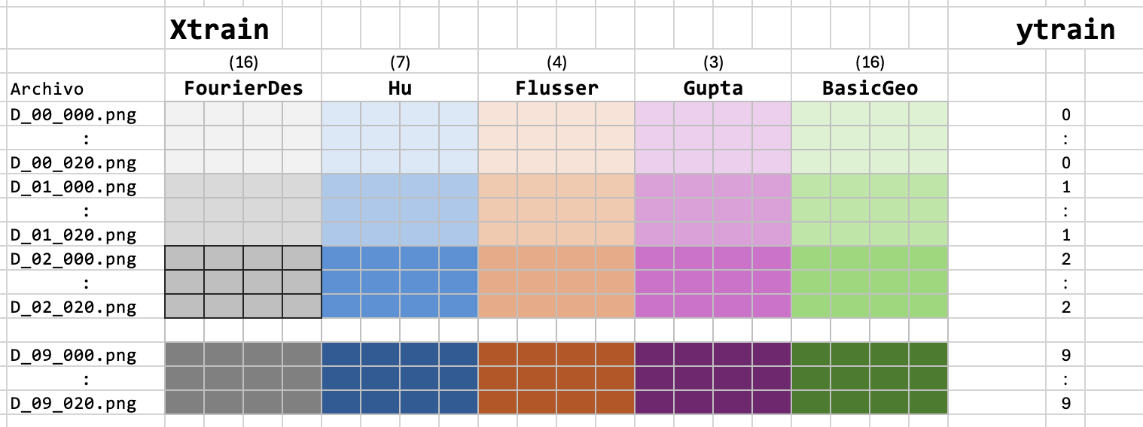
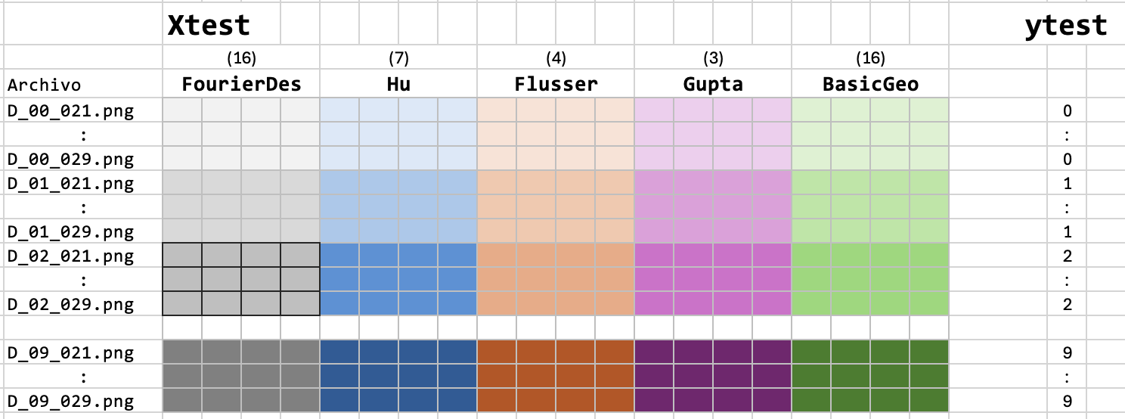
E06 > P04: Separación Training / Testing

Slide 16
E06 > P04: Separación Training / Testing

Slide 17
E06 > P05: CLEAN
Xtrain_sfs
Xtrain_ex
Xtrain_clean
Xtrain_norm
ytrain
70%
Cleaning
Normalization
Selection
Train
Xtrain
Split
Features &
Labels
sel
Learned
Model
sclean
a,b
X,y
ypred
Clean
Features
Normalize
Features
Select
Features
Classify
30%
Xtest
-
acc
ytest
Xtest_clean
Xtest_norm
Xtest_sfs
Xtest_ex

Slide 18
E06 > P06: NORMALIZATION
Xtrain_sfs
Xtrain_ex
Xtrain_clean
Xtrain_norm
ytrain
70%
Cleaning
Normalization
Selection
Train
Xtrain
Split
Features &
Labels
sel
Learned
Model
sclean
a,b
X,y
ypred
Clean
Features
Normalize
Features
Select
Features
Classify
30%
Xtest
-
acc
ytest
Xtest_clean
Xtest_norm
Xtest_sfs
Xtest_ex

Slide 19
E06 > P07: SELECTION - SFS
Xtrain_sfs
Xtrain_ex
Xtrain_clean
Xtrain_norm
ytrain
70%
Cleaning
Normalization
Selection
Train
Xtrain
Split
Features &
Labels
sel
Learned
Model
sclean
a,b
X,y
ypred
Clean
Features
Normalize
Features
Select
Features
Classify
30%
Xtest
-
acc
ytest
Xtest_clean
Xtest_norm
Xtest_sfs
Xtest_ex

Slide 20
E06 > P08: SELECTION - Exhaustiva
Xtrain_sfs
Xtrain_ex
Xtrain_clean
Xtrain_norm
ytrain
70%
Cleaning
Normalization
Selection
Train
Xtrain
Split
Features &
Labels
sel
Learned
Model
sclean
a,b
X,y
ypred
Clean
Features
Normalize
Features
Select
Features
Classify
30%
Xtest
-
acc
ytest
Xtest_clean
Xtest_norm
Xtest_sfs
Xtest_ex

Slide 21
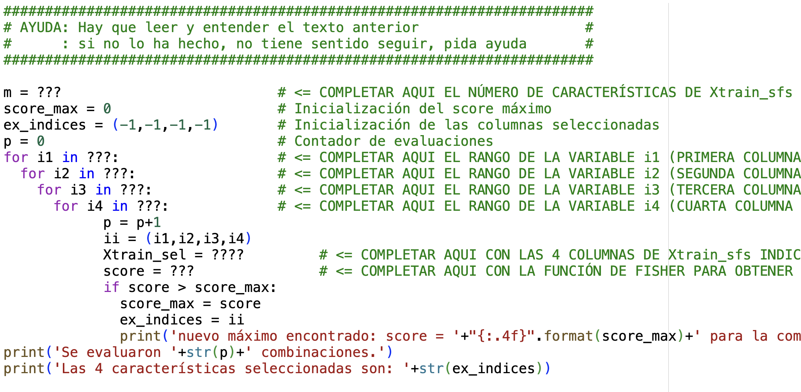
E06 > P08: SELECTION - Exhaustiva

Slide 22
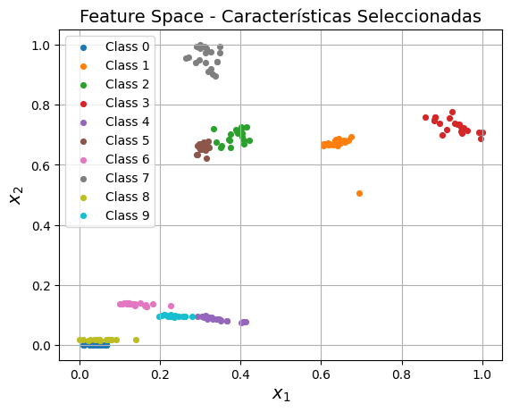
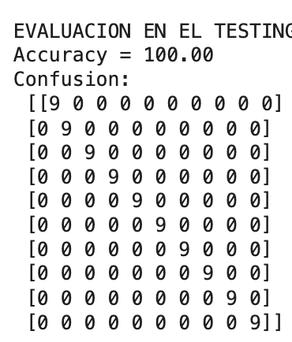
E06 > P05: KNN
Definir KNN con 1 vecino
Entrenar KNN con Xtrain_ex
Predecir ypred con Xtest_ex
Evaluar accuracy y matriz de confusión

