Slide 1

Visión por Computador
Domingo Mery
Departmento de Ciencia de la Computación
Escuela de Ingeniería
Universidad Católica de Chile
Homography

Slide 2
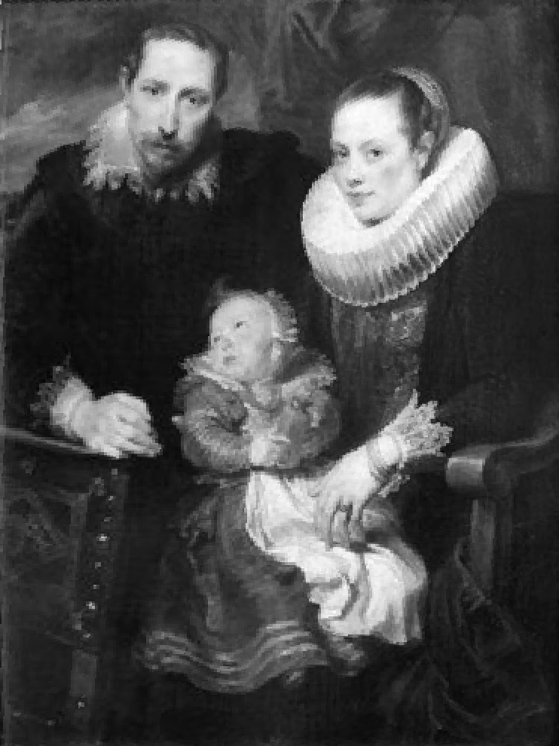
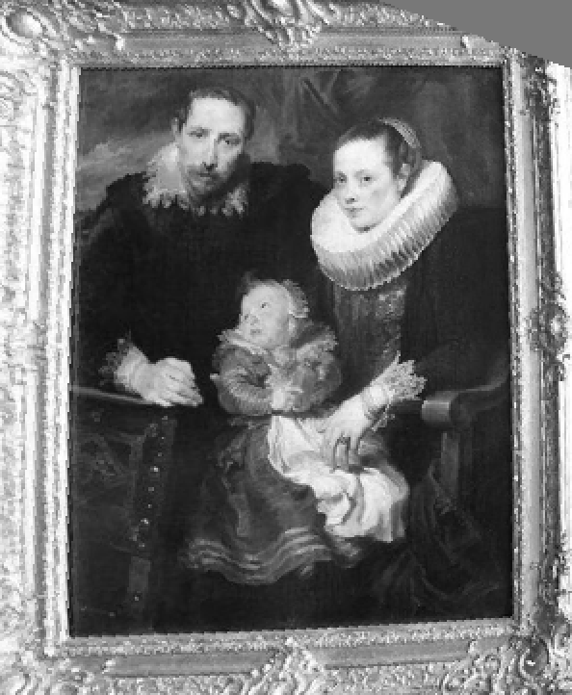
[ Homography ]
Transformation from two 2D spaces, where straight lines are transformed as straight lines.

Slide 3
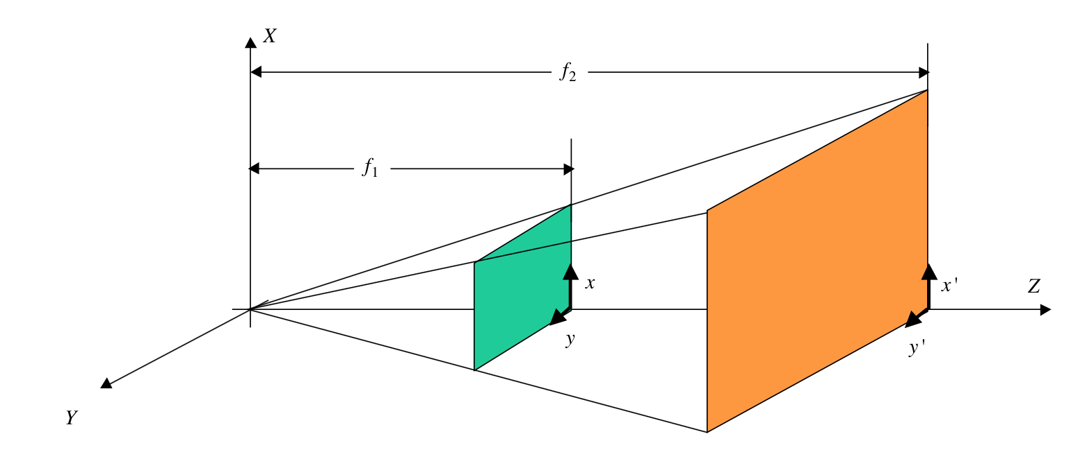
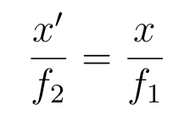
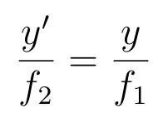
[ Homography: Example ]
Problem: Given ( x , y ), find ( x' , y' )
(planes and are parallel and perpendicular to Z).

Slide 4
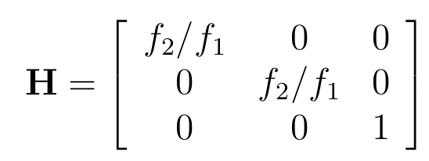

[ Homography: Example ]
Notes:
\begin{bmatrix}
x'\\ y'\\ 1
\end{bmatrix}
=
\begin{bmatrix}
f_2/f_1 & 0 & 0\\
0 & f_2/f_1 & 0 \\
0 & 0 & 1
\end{bmatrix}
\begin{bmatrix}
x\\ y\\ 1
\end{bmatrix}

Slide 5
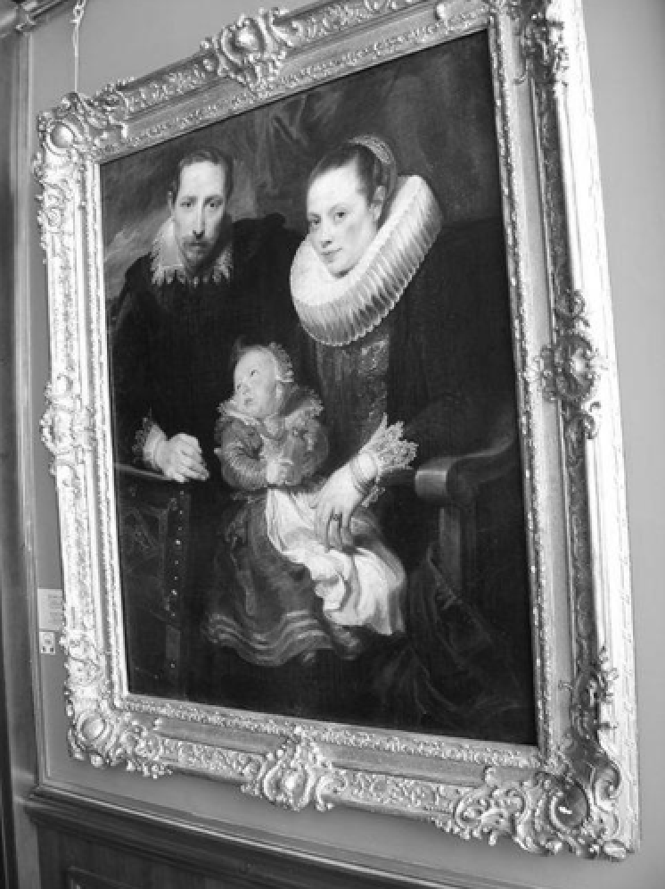
[ Homography ]
Transformation from two 2D spaces, where straight lines are transformed as straight lines.

Slide 6
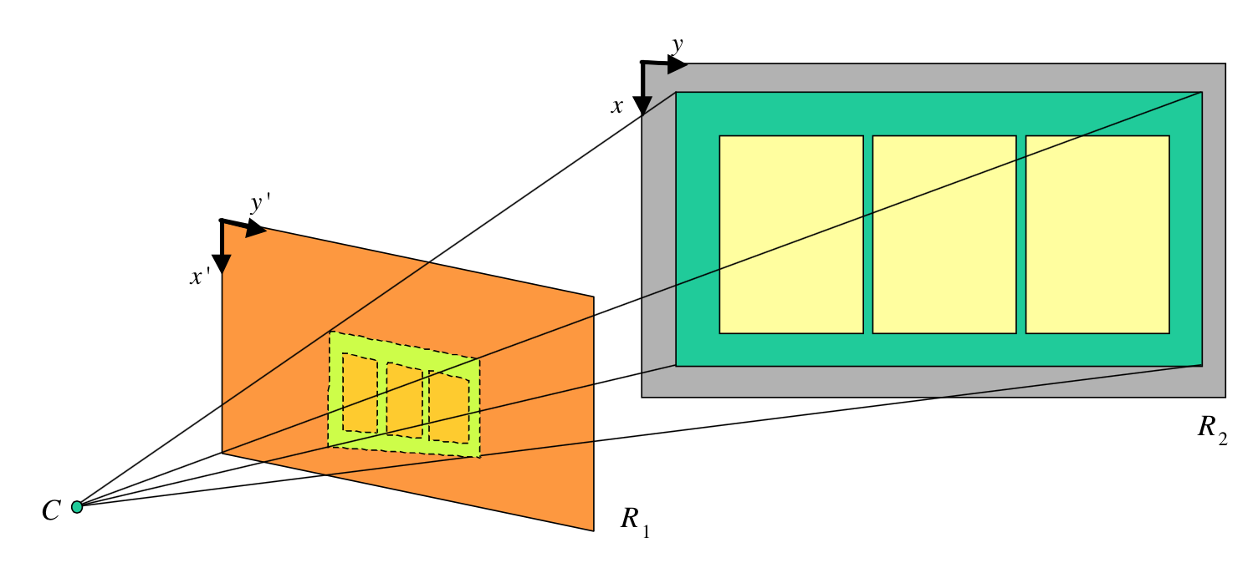
[ Homography: Planes R₁ and R₂ are not parallel ]

Slide 7
[ Homography ]
Demo: pág 21 (D.Mery: Apuntes de Visión por Computador)
y’
y
m
m’
x
x’
m’ = Hm

Slide 8
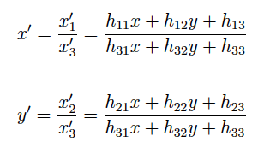
[ Homography ]

Slide 9
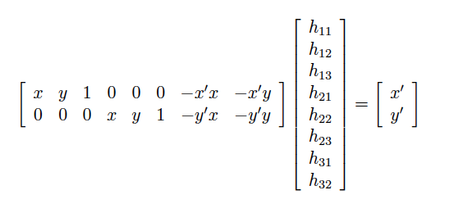
[ Homography ]
with h₃₃ = 1
b
A
h
Ah = b

Slide 10
[ Homography ]
y’
y
m₄’
m₁
m₄
m₁’
x’
x
m₂’
m₃’
m₂
m₃

Slide 11
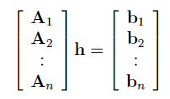



[ Homography ]
y’
y
m₁
m₄
m₄’
m₁’
x’
x
m₂’
m₃’
m₂
m₃
for n = 4
for n > 4

Slide 12
Implementation

Slide 13
SOURCE
TARGET
I’
I
H

Slide 14
SOURCE
TARGET
I’
I
H

Slide 15
SOURCE
TARGET
I’
I
H
ALGORITHM: For each pixel in TARGET

Slide 16

SOURCE
TARGET
I’
I
H
ALGORITHM: For each pixel in TARGET
- compute the corresponding position in SOURCE

Slide 17
SOURCE
TARGET
I’
I
H
ALGORITHM: For each pixel in TARGET
- compute the corresponding position in SOURCE
- interpolate the grayvalue using SOURCE pixels.

Slide 18
I’
I
x
x´
y'
y
H

Slide 19
I’
I
x
x´
y'
y
H
Coordinate Transformation:

Slide 20
I’
I
x
x´
y'
y
H
Coordinate Transformation:

Slide 21
EXAMPLE
I’
I
x
x´
y'
y
H
Coordinate Transformation:

Slide 22
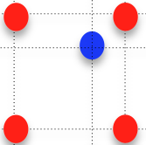
EXAMPLE
I’
I
x
x´
y'
y
H
Coordinate Transformation:

Slide 23
x´
I´₁
I´₂
Nearest pixel
I(x,y) = interpolation {I’(x’,y’)} = I₂
y'
I´₃
I´₄

Slide 24
x´
I´₁
I´₂
Nearest pixel
I(x,y) = interpolation {I’(x’,y’)} = I₂
y'
I´₃
I´₄

Slide 25
x´
I´₁
I´₂
Bilinear interpolation
I(x,y) = interpolation {I’(x’,y’)} =
AI’₄+BI’₃+CI’₂+DI’₁
A+B+C+D = 1
A B
C D
y'
I´₃
I´₄

Slide 26
x´
I´₁
I´₂
Bilinear interpolation
I(x,y) = interpolation {I’(x’,y’)} =
AI’₄+BI’₃+CI’₂+DI’₁
A+B+C+D = 1
A B
C D
y'
I´₃
I´₄

Slide 27
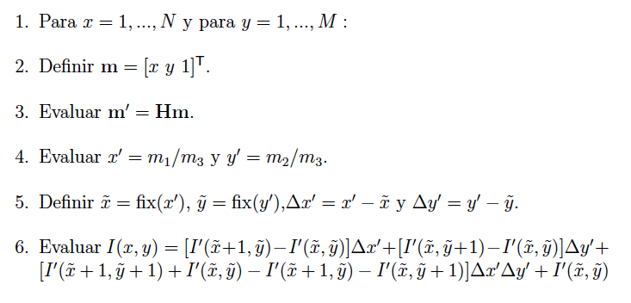
Implementation:

Slide 28
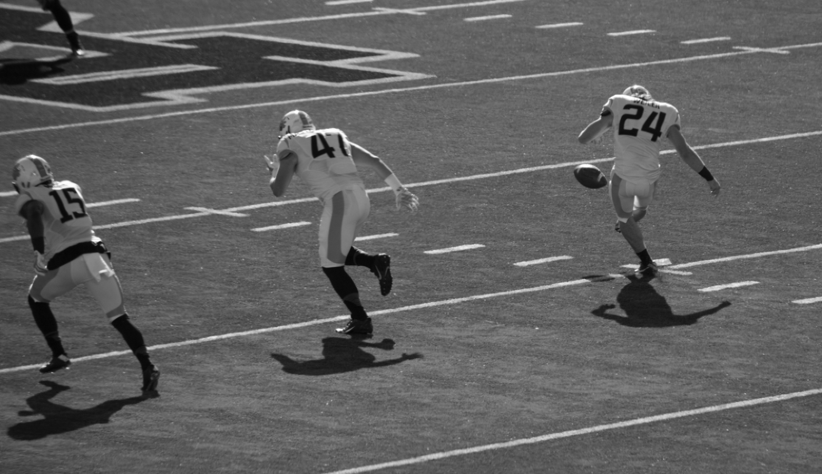
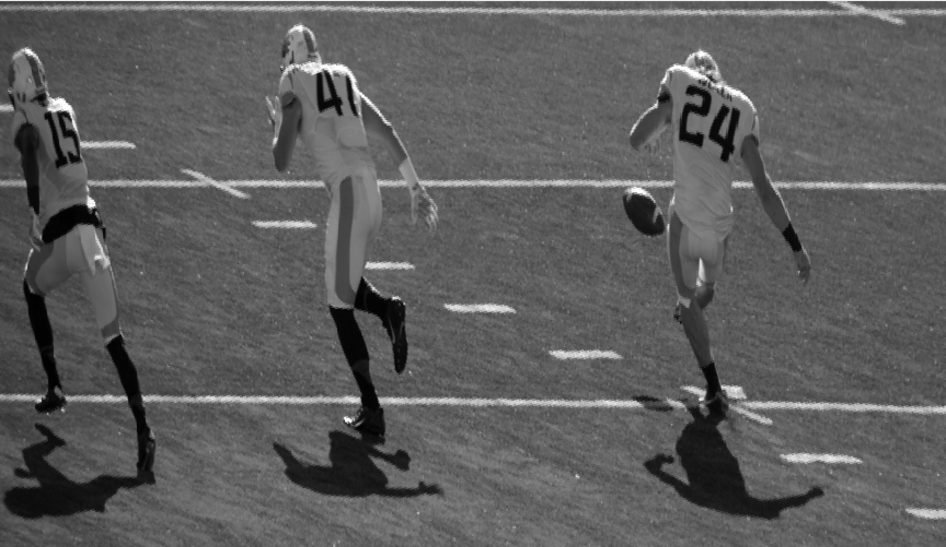
[ Homography ]
More examples.

Slide 29

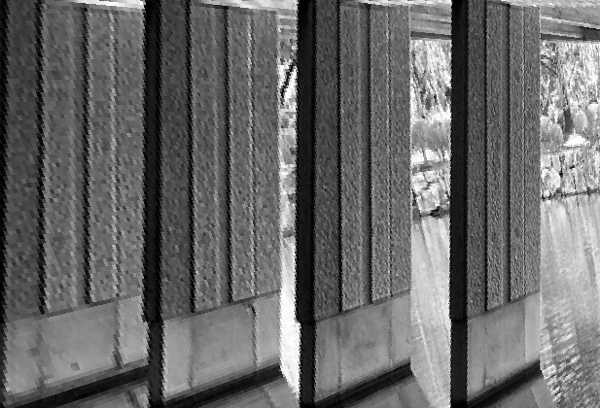
[ Homography ]
More examples.

Slide 30


