Slide 1
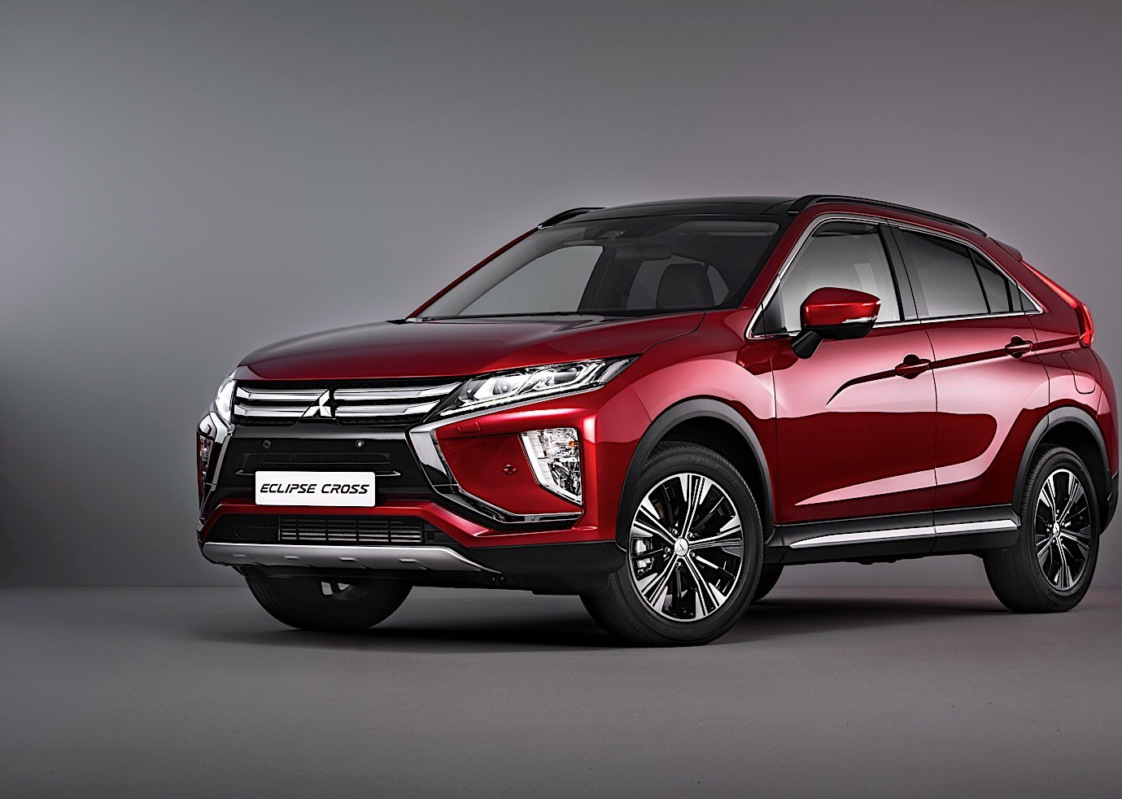
LARIAT 2018 Fleet Analysis and Strategies for 2019
Notes:
Hello my name is Domingo and I am here to go over some analysis and potential business plans for Lariat.

Slide 2

2019 Fleet Planning
Business objective
Make better decisions about vehicle inventory to help cut cost and increase revenue
4 Potential strategies
Notes:
My overall objective is to provide Lariat with strategies going into 2019 to help with decision making regarding vehicle inventory, cutting cost and increasing revenue.
I have prepared 4 potential strategies to include cutting vehicles from the fleet, adding vehicles, and increasing rental fees.

Slide 3
Where are we now?
Notes:
Where are we today?
Lariat has 50 total branches across 22 States. 22 of the branches are within airports across 14 of the states.
Each branch averages around 1M in gross revenue.
With a total of 81 thousand rental deals closed averaging $650 per rental.
Overall hitting gross revenue of 53M and net revenue of 20M

Slide 4
2018 Key Insights
Notes:
Looking through the 2018 data it shows we have 200 cars losing profit costing us almost 210 thousand in revenue. Compared to our top 20 cars bringing in 285 thousand.
This will be a focus point for the strategies I prepared going forward to cut on cost and overall increase revenue.

Slide 5
2019 Strategy 1
Remove any vehicles that are losing revenue
Cut cost of any removed vehicles
Assume rental rates, rental length and number of deals per vehicle stays the same
Notes:
That brings me into strategy 1: removing vehicles that are losing money. Assuming everything else stays the same, rental rates, length and average number of deals made.
At a quick glace dropping 200 vehicles would lower our gross revenue by about 500 thousand. However, looking at net revenue our profits increase by close to 1.5M.
It may not be possible to drop all the negative preforming vehicles instantaneously, moving towards the goal will increase profits.

Slide 6
2019 Strategy 2
Add vehicles 200 of top 20 revenue generating vehicles
Account for cost of new vehicles
Assume rental rates, rental length and number of deals per vehicle stays the same
Notes:
In strategy 2 we look at the opposite side of the spectrum. Adding 200 of our top 20 revenue generating vehicles into the rotation.
Again assuming everything else stays the same, rental rates, length and average number of deals made.
While it may take time to increase our inventory with these specific vehicles. Making moves with this strategy can increase both our gross revenue by about 5.5M and our net revenue by close to 4M.

Slide 7
2019 Strategy 3
Increase price to rent per day across all vehicles by 5%
Assume rental length and number of deals per vehicle stays the same
Notes:
Using the original 4000 car fleet, Strategy 3 runs test on what increases we may see by increasing our rental fees.
Following with the same assumptions of rental length and average number of deals staying the same.
We see an increase again by about 4M in both gross and net revenue.
Increasing rental prices seems like a simple way to increase revenue. However, the data does not test of potential loss of customers due to increased rates.
Ultimately I would advise against this strategy.

Slide 8
2019 Strategy 4
Remove any vehicles that are losing revenue
Replace with top 200 of top 20 revenue generating vehicles
Growth rate of 15%
Notes:
The most amount of changes shown in Strategy 4, combining previous strategies.
First, remove any vehicles losing revenue.
Then, add in 200 of our top 20 vehicles to replace vehicle removed.
Lastly, we are assuming a nature growth of business at 15%.
When we run test to account for these changes, the data shows a substantial increase both in gross revenue at 12.3M and net revenue at almost 12.7M

Slide 9
Suggestions Moving Forward
Notes:
My suggestions from here would be Lariat making moves towards strategy 4: to replace non-profitable vehicles with the vehicles showing the most profits.
It may not be a quick process to remove and add vehicles to our fleet. Data projections for the 2019 year would show a total of 98 thousand rental deals closed averaging $665 per rental.
Overall achieving a gross revenue of 65M and net revenue of 33M

