Slide 1
The Technology of A R T
Ashanty Dominguez• CSIT 100-37• 3/26/2024

Slide 2
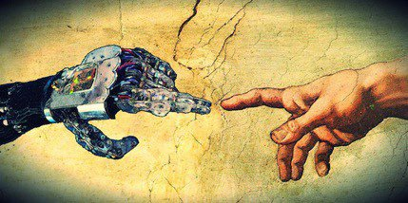
Overview
Brief History
Digital Art
Two Examples of How is used
Art/Design Programs
3D Printing
Benefits & Impact
Of Art Technology

Slide 3
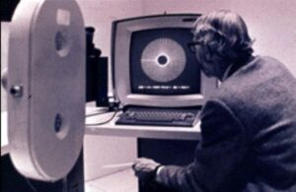
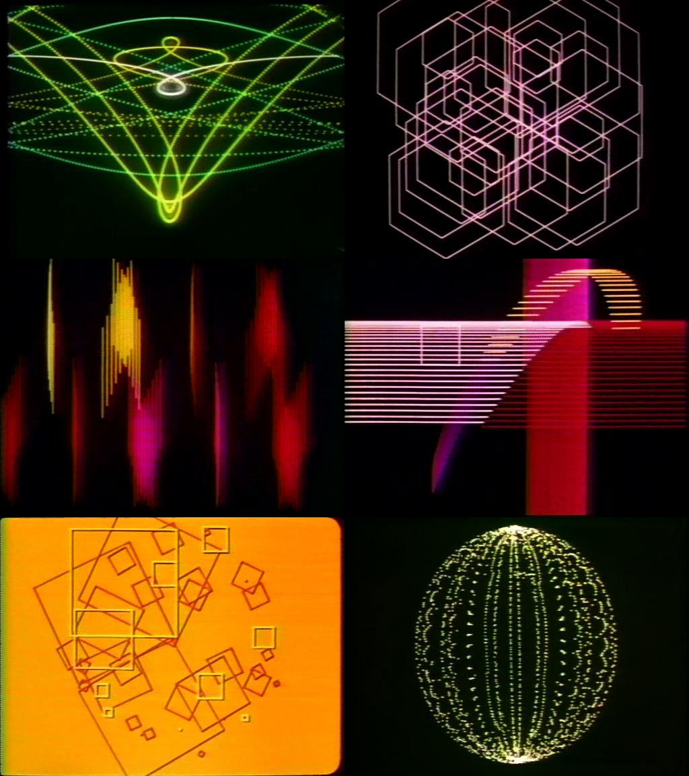
History of Digital Art
The earliest examples of digital art date back to the 1960s, when visual artists started experimenting with computers as a medium.
John Whitney was among the first artists to employ digital technology; in the 1960s, he used a computer to make abstract animations.
His creations paved the way for the advancement of digital animations
  Encouraged other artists to challenge themselves to try out the creative possibilities of computer technology.

Slide 4
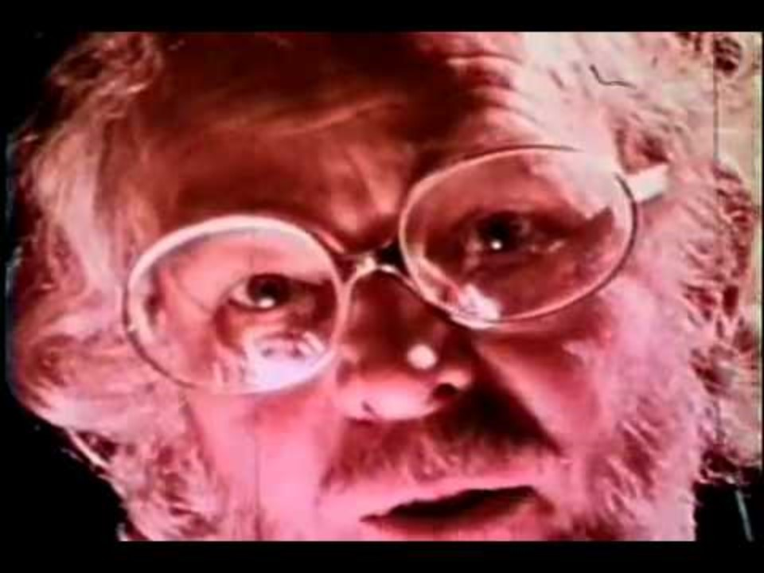
https://youtu.be/1aiIeBcKBi8

Slide 5
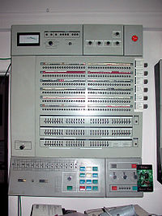
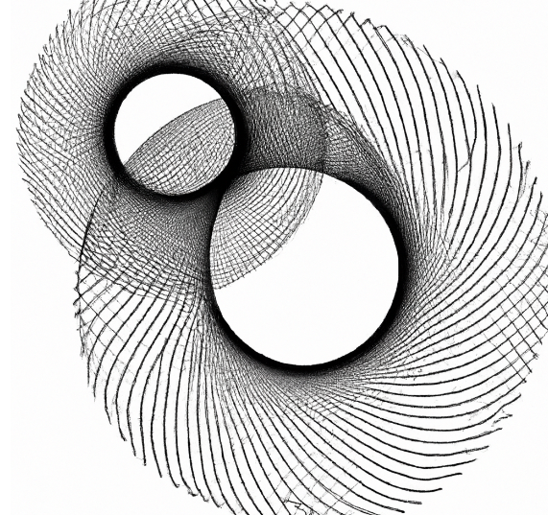
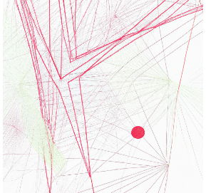
History of Digital Art
1970s: Artists like Harold Cohen and Vera Molnar started using early computer graphics software, like the Evans & Sutherland PS-1 and the IBM System/360, to create digital art
  among the first to look at the potential of utilizing mathematical codes and algorithms to create art.

Slide 6
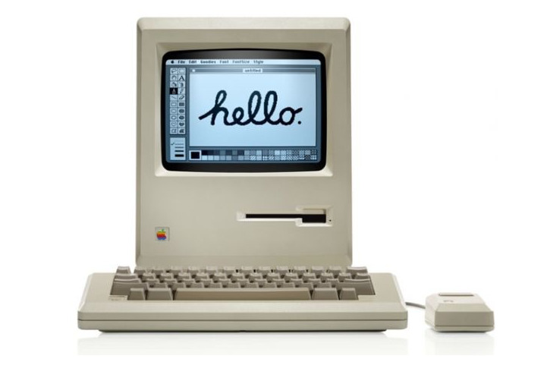
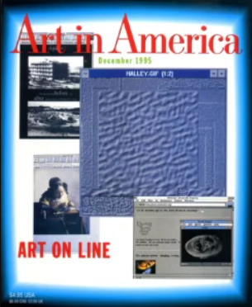

History of Digital Art
1980s: The introduction of new technology, like the Macintosh computer, which made it easier to produce digital art.
1990s:During this decade, the first virtual art galleries and cyber museums appeared.
2000s:Artists could publish their work, collaborate with others, and get criticism on websites like Behance and deviantART.
21st Cent: Digital art has become a worldwide phenomenon, with many artists producing a wide range of art forms, such as interactive art, installation art, and video art, with ever-more-powerful digital tools.

Slide 7
Types of Art Technology

Slide 8

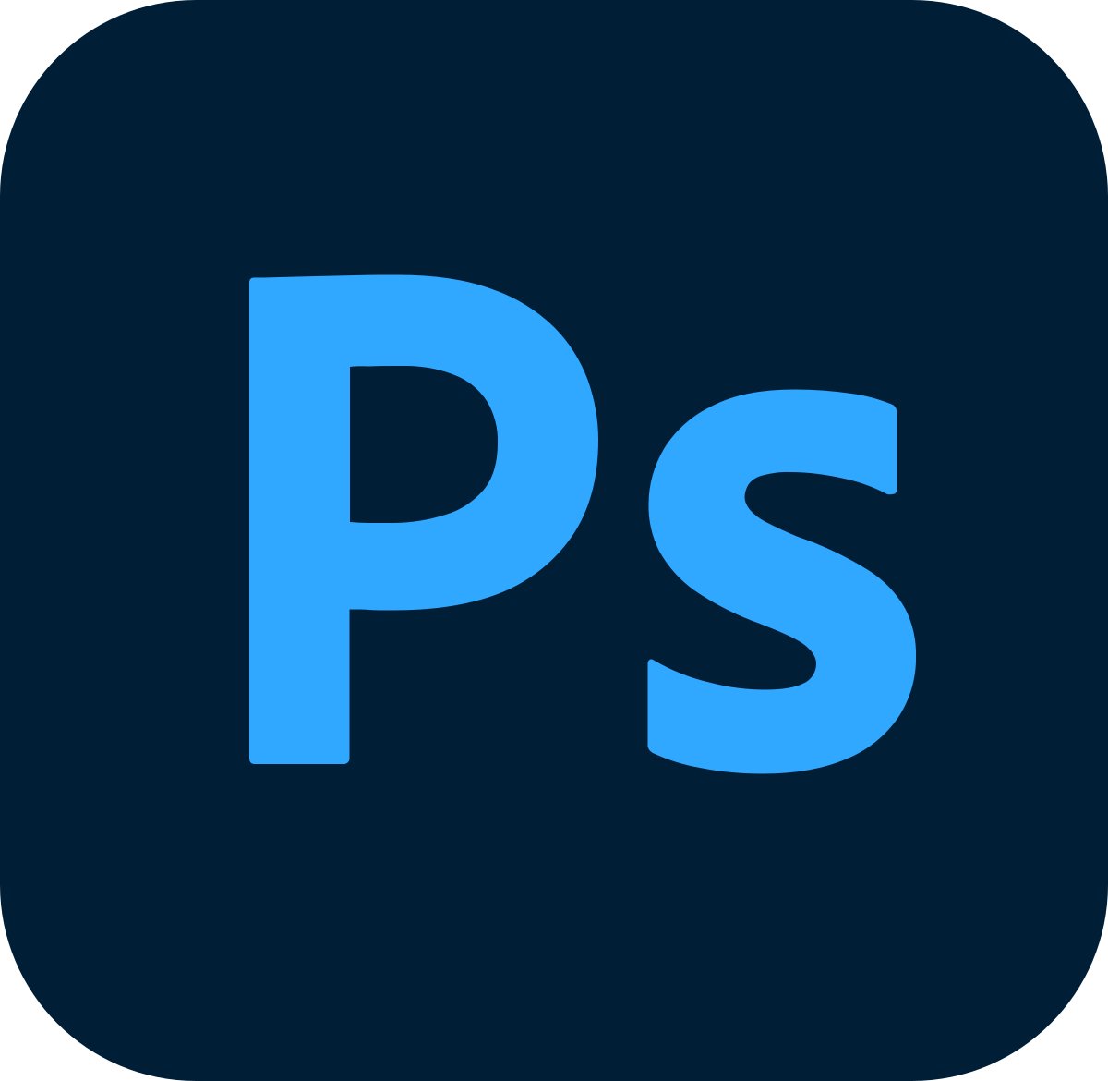

Art/Design Programs
Adobe
  Photoshop
    first released in 1988
    photo editing software
  Illustrator
    first released in 1987
    Create vector images and graphics like icons and logos
Procreate
  Founded in March 8, 2011
  a raster graphics editing application designed for digital painting
  iOS and iPadOS

Slide 9
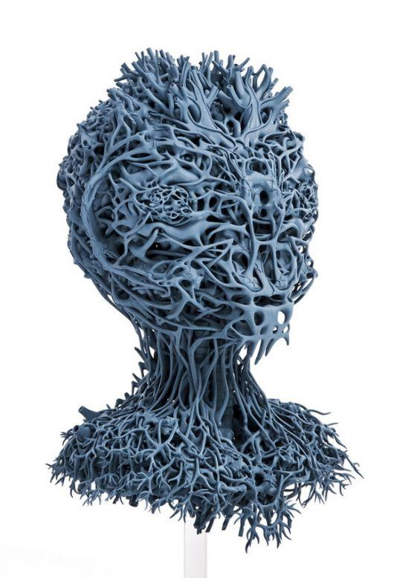
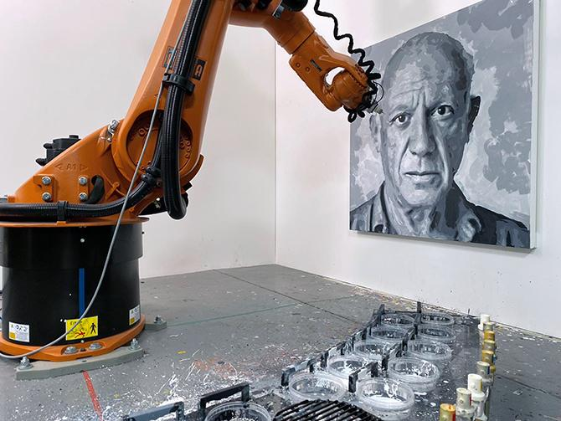
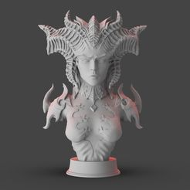
3D Printing
The earliest 3D printer originated in 1981,
a part-making technique that uses additive technology.
stacks and fuses layers of material
Mainly used in the engineering industry

Slide 10
Benefits & Impact
Of Art Technology
digital technologies provide artists unmatched power over their creations, allowing for complex editing and limitless experimentation.
open up new possibilities for creative expression.
artists can share their work with a global audience
allowing artists to experiment with an infinite range of styles, techniques, and mediums.

Slide 11
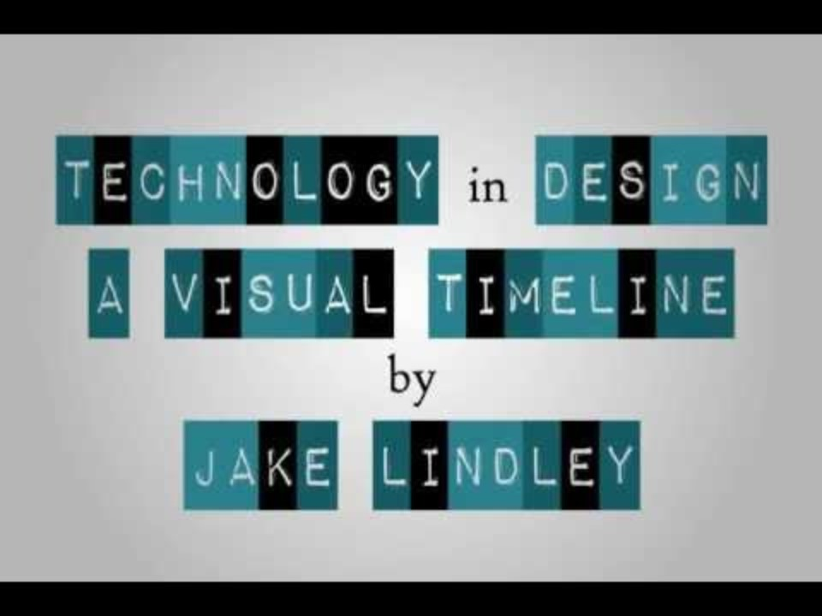
https://youtu.be/1aiIeBcKBi8

Slide 12
References
Art One Academy. “Cultivating Creativity: Benefits of Digital Art.” Art One Academy, 16 Feb. 2024, www.artoneacademy.com/cultivating-creativity-benefits-of-digital-art.
Procreate. “Procreate® – Sketch, Paint, Create.” Procreate, procreate.com.
Protolabs Network. “What Is 3D Printing? How Does 3D Printing Work? | Protolabs Network.” Protolabs Network, www.hubs.com/guides/3d-printing.
The World Art News. “Brief History of Digital Art.” World Art News, 8 Dec. 2023, worldart.news/2023/01/23/brief-history-of-digital-art.
When to Use Illustrator Vs. Photoshop | Adobe. www.adobe.com/creativecloud/design/illustrator-vs-photoshop.html#:~:text=Illustrator%20is%20a%20graphic%20design,down%20while%20maintaining%20image%20quality.

