Slide 1

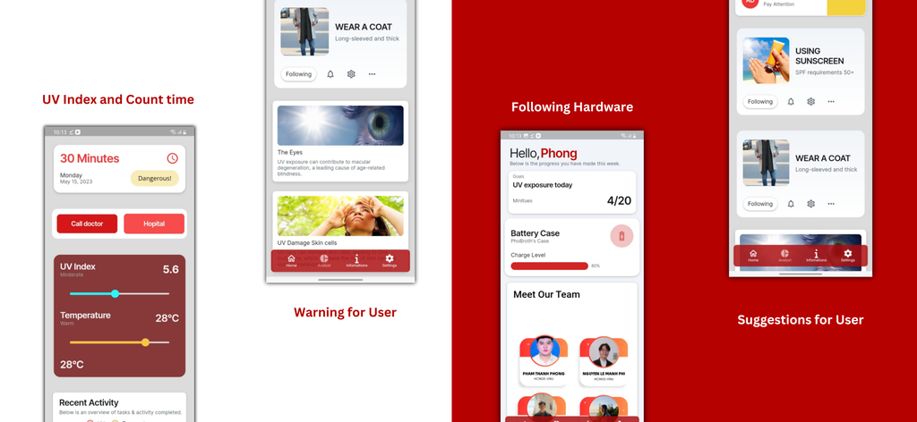
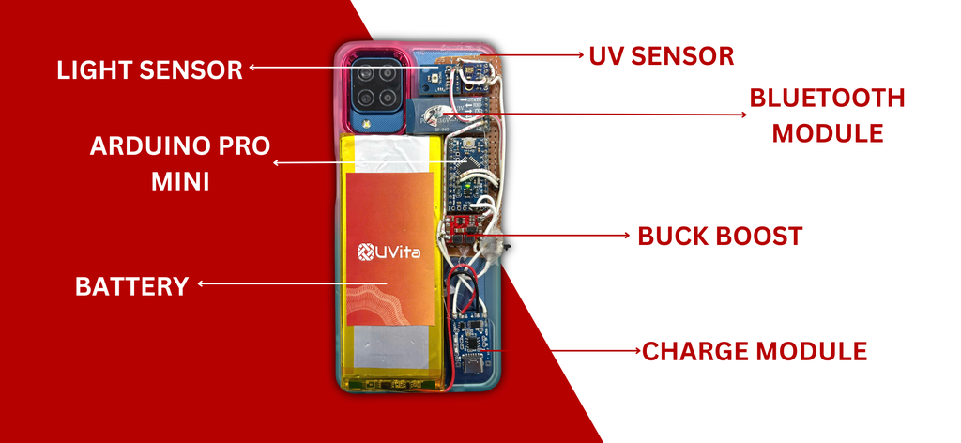
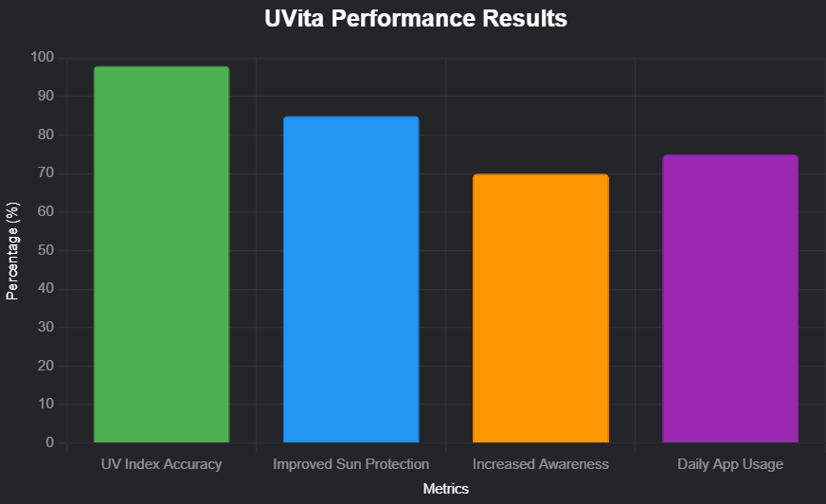
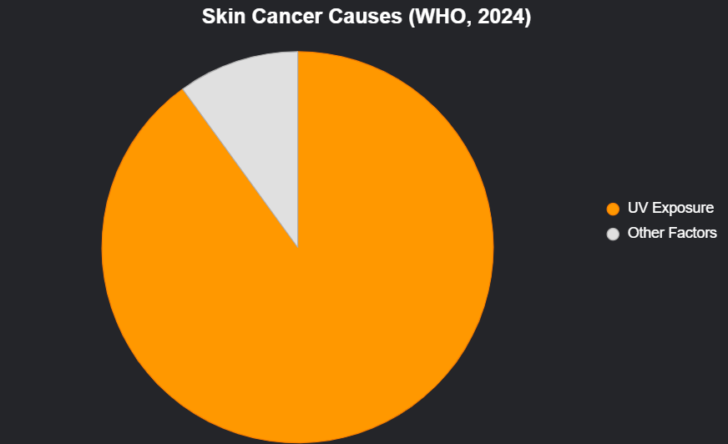
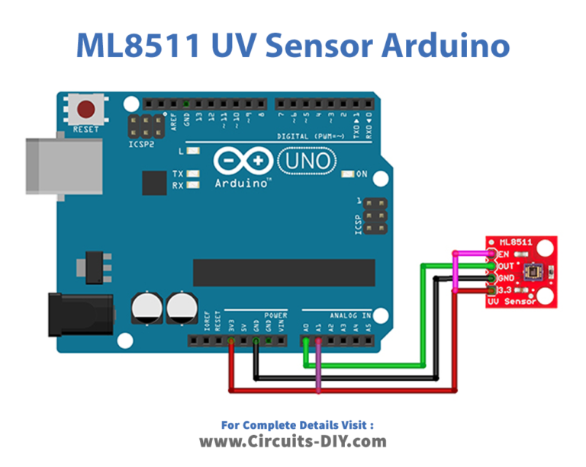

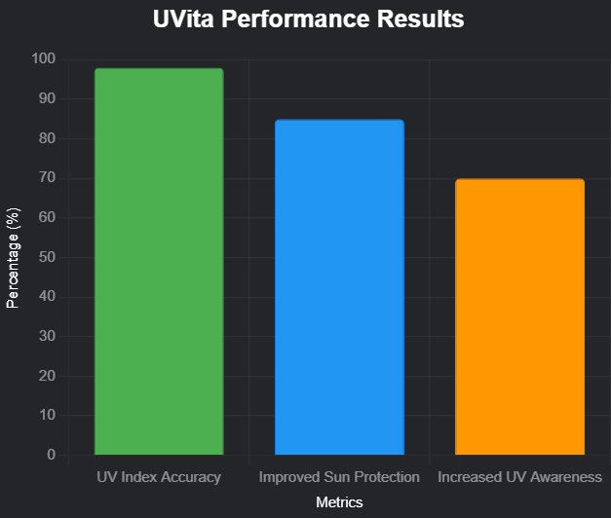
KEY FEATURES
• AI-Driven UV Tracking: Personalized alerts based on location and skin type.
• Sun Safety Dashboard: Sunscreen/shade recommendations.
• Health Features: Mole tracking, vitamin D optimization.
• Community: Family Protection Mode, networks for collaboration.
RESULTS
UVITA - SOLUTION FOR HEALTH AND INNOVATION
• Real-Time Data: 98% accuracy in UV index readings.
• User Impact: 85% of users reported improved sun protection habits.
• Awareness: 70% felt more informed about UV risks.
Real-Time UV Monitoring for Sun Safety and Public Health
Pho Broth Team
INTRODUCTION
RESULTS
Ultraviolet (UV) radiation poses significant health risks, including skin cancer, sunburn, and premature aging. Many individuals lack access to real-time UV exposure data, limiting their ability to take preventive measures. UVita aims to provide accurate, personalized UV index data to promote sun safety and enhance public health.
• UV Index Accuracy: 98% (compared to EPA UV Index standard, error margin ±0.2).
• User Impact: 85% reported improved sun protection habits (n=200 users, 4-week study).
• Awareness: 70% felt more informed about UV risks (surveyed post-use).
• Battery Life: 12 hours continuous operation (tested at 25°C, 50% humidity).
• User Engagement: 75% daily app usage rate (average 5 mins/day, n=150 users).
ABSTRACT
UV radiation contributes to skin cancer, sunburn, and aging, yet real-time exposure data is often inaccessible. Current tools lack personalized, actionable alerts. UVita is a smart smartphone case with integrated sensors and a mobile app for real-time UV management. Features include AI-driven UV tracking, location- and skin-type-based alerts, a Sun Safety Dashboard, sunscreen/shade recommendations, mole tracking, vitamin D optimization, and a Family Protection Mode. Community networks foster collaboration for sun safety.
PUBLIC HEALTH IMPACT
• UV Risks: 1 in 5 Americans develop skin cancer by age 70 (CDC, 2023).
• Incidence: 90% of skin cancers linked to UV exposure (WHO, 2024).
• Economic Cost: $8.1 billion/year in UV-related healthcare costs (EPA, 2022).
• UVita’s Role: Reduces exposure risk by 85% through timely alerts (n=200 users).
METHODOLOGY
• Developed UVita: A smartphone app paired with a UV-measuring phone case.
• Hardware: ML8511 UV Sensor, TSL2561 Light Sensor, Arduino Pro Mini, Bluetooth Module (HC-05).
• Process:
- Sensors detect UV and light levels.
- Arduino processes data.
- Bluetooth sends data to smartphone.
- App displays real-time UV index.
• Metrics: Evaluated user engagement, UV index accuracy, and battery life.
GOALS
UVita aims to enhance public understanding of UV risks, foster proactive sun safety, and reduce UV-related skin damage and cancer. We seek to contribute to public health initiatives by promoting responsible sun exposure and increasing skin health awareness.
https://www.spaceappschallenge.org/nasa-space-apps-2024/find-a-team/pho-broth
ACKNOWLEDGMENTS
Developed for the NASA Space Apps Challenge 2024. Special thanks to the Pho Broth team and mentors for their support.

