Slide 1
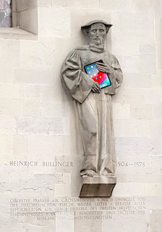
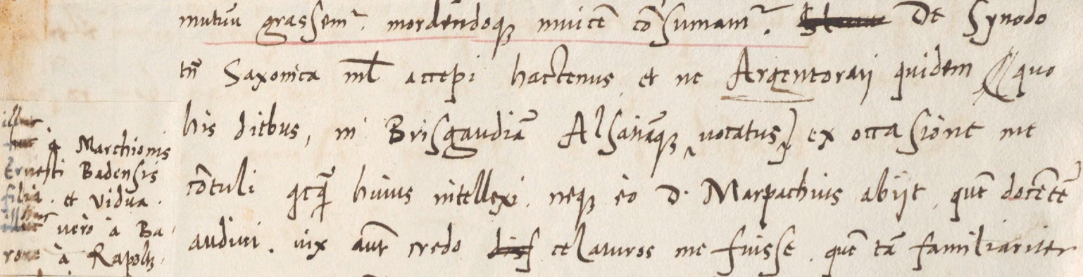
Name Consistency in LLM-based Machine Translation of Historical Texts
Dominic P. Fischer and Martin Volk

Slide 2
The Issue Simon Sulzer to Heinrich Bullinger, 26.05.1554
“De synodo tamen Saxonica nihil accepi hactenus et ne Argentorati quidem (quo hisdiebus in Brisgaudiam Alsatiamque, illuc a marchionis Ernesti Badensis filia et vidua, huc vero a barono a Rapoltzstein vocatus ex occasione me contuli) quicquam huius intellexi neque eo d. Marpachius abiit, quem docentem audivi.”
GPT-4o: “Regarding the Saxon synod, however, I have received no news so far, and even in Strasbourg (to which I recently traveled on occasion, called to Breisgau and Alsace, there by the daughter and widow of Margrave Ernest of Baden, and here by the Baron of Rapoltsweiler), I learned nothing about it. Nor has Mr. Marbach gone there, whom I heard teaching."
Notes:
split person name

Slide 3
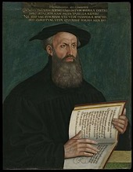
Reformers (and their letter correspondences)
Martin Luther (1483-1546): 63 years - 4300 letters
Huldrych Zwingli (1484-1531): 47 years - 1300 letters
Heinrich Bullinger (1504-1575): 71 yrs - 12’000 letters
Johannes Calvin (1509-1564): 55 yrs - 4200 letters
Notes:
Quelle: T. Schieß (1932): Der Briefwechsel Heinrich Bullingers
1369 von Calvin selbst

Slide 4
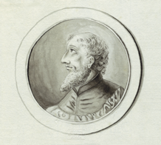
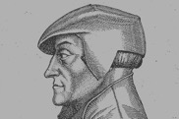

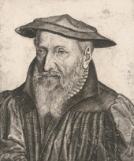

Bullinger’s Letters
2000 Letters
by Bullinger
Heinrich Bullinger
1504-1575

Slide 5
Bullinger’s Letter Collection
10’000 Letters
to Bullinger
Heinrich Bullinger
1504-1575

Slide 6
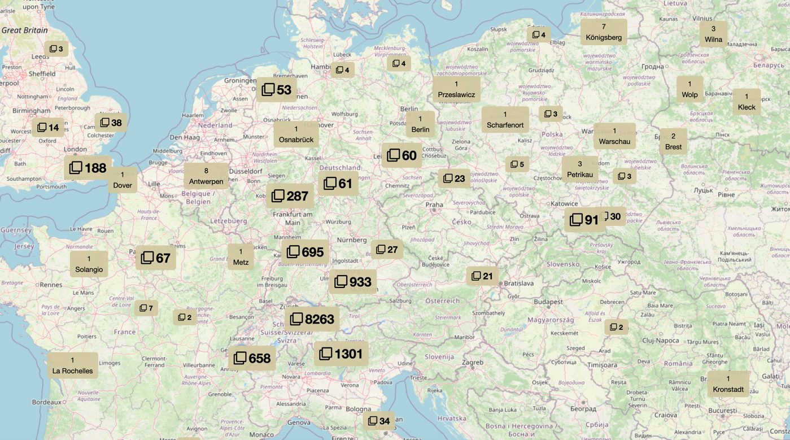
Bullinger‘s Correspondence Network

Slide 7




The Corpus and the Proper Names
12000 letters
Proper Name Index
3100 letters professionally edited
5400 letters manually transcribed
Remainder automatically transcribed
Annotate & link Names using index
Apply to the transcriptions
More than 350‘000 person and place names
Train Name recogniser and apply back to the letters
~40 proper names per letter
„Citizen Science“: Have volunteers check and add annotations

Slide 8
Experiments – Name Selection
For person and place names
10‘000 occurences
…
Sample the 10 most frequent names
Extract one sentence for each different form (max. 20) of each name
1‘000 occurences
500 occurences
…
Sample 10 random medium frequent names
+ context of three preceding and following sentences
50 occurences
20 occurences
…
Sample the 10 least frequent names (min. 10 occurences)
10 occurences
9 occurences
…

Slide 9
A Look at the Names
Genf | Genevae, Genevenses, Genevates Genff, Jenff, Jenfer Gebennę, Gebennensium, Gebennensibus …
Johannes Calvin | Calvinus, Calvini, Calvino Calphinum, Calphini, Calphino Io. Calvino, Ioannis Calvini, Joannes Calvinus …

Slide 10
A Look at the Names
- No names of dignitaries apart from emperor Karl V.
- No discontinuous names (…Ludovici nostri Lavateri uxor…)
Place Names
- No distinction between place names and place adjectives (Gallia vs. Gallus)

Slide 11
Experiments – System Selection
Proper name translation accuracy in %, random subset of 25 instances:
GPT-4o | Gemini | LLaMa
68 | 52 | 48

Slide 12
Experiments – Evaluation
Manual creation of a list of correct translations for each name
Modern canonical way(s) of writing them
Place names:
{Zürich, Zürichs,
Zürcher, Zürchers, Zürchern}
Person names:
{Heinrich, Bullinger, Heinrich Bullinger,
Heinrichs, Bullingers, Heinrich Bullingers}

Slide 13
Experiments – Setup
Default
Adapted to the task
Let‘s think step-by-step. | You are a translation expert who specializes in translating historical texts, especially from Latin and Old German into Modern German.
Translate the following sentence from language into modern German: sentence. | The following sentence is taken from a letter that is part of Swiss reformer Heinrich Bullinger’s correspondence in the 16th century. Translate it from language into modern German: sentence.
Make sure to translate proper nouns into their modern German equivalents.
Pay special attention to the target word proper noun.
– | Here is some additional context to help you guide your translation: sentence with context of +-3 sentences.
SysP
HT
Con-text
$2^{3}=8$ different settings for person and place names each

Slide 14
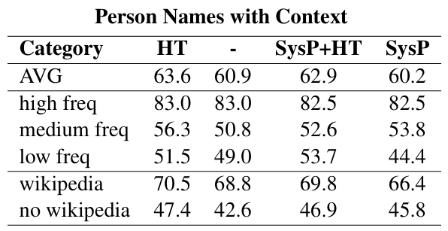
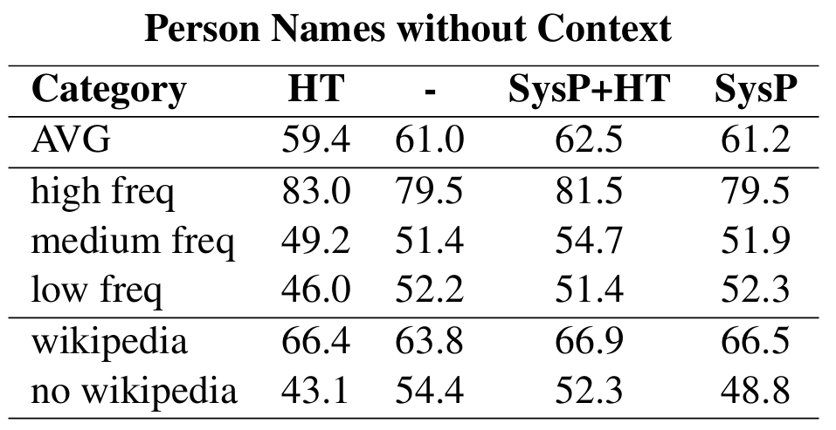
Results – Person Names
Entity importance is correlated with translation accuracy
Long tail in the domain of person names

Slide 15
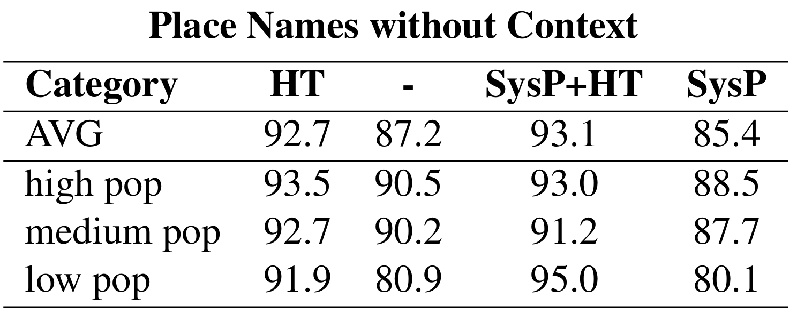
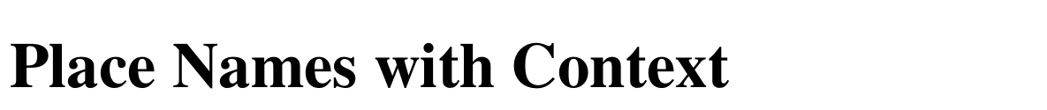
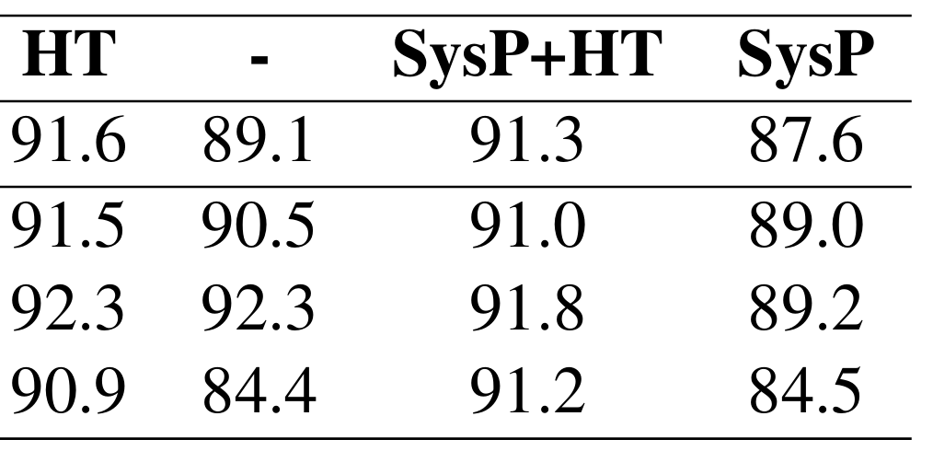
Results – Place Names
Entity importance is correlated with translation accuracy
Less of a long tail in the domain of place names

Slide 16
Results – Historical Context
Hist. Context: improvements in 7 out of 8 settings, avg. Increase of 3.0%

Slide 17
Results – Sentence Context
AVG
61.0
+0.9
AVG
61.9
AVG
89.6
+0.3
AVG
89,9
Hist. Context: improvements in 7 out of 8 settings, avg. increase of 3.0%
Sent. Context: mixed, but avg. increase of 0.6%

Slide 18
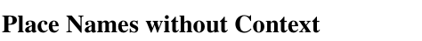
Results – System Prompt
Hist. Context: improvements in 7 out of 8 settings, avg. increase of 3.0%
Sent. Context: mixed, but avg. increase of 0.6%
Sys. Prompt: beneficial only in specific settings, avg. decrease 0.2%

Slide 19
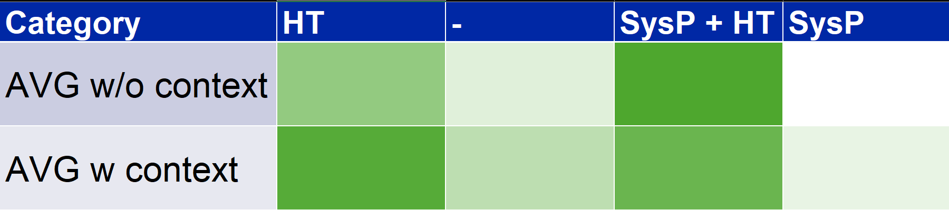
Results – Overall
False confidence!
Bottom line: Pertinent context is beneficial

Slide 20

“Regarding the Genevan matter, all pious minds and hearts must entrust it to God.”
Und des Jenffers handels halb muessend alle frome gmuͤ t und herczen das gott befelen.
Plain: Und des Teufels (the Devil‘s) Handels halber müssen alle frommen Gemüter und Herzen das Gott befehlen.
Historical Context + Sentence Context + System Prompt: Und bezüglich der Angelegenheit der Täufer (the Anabaptists) müssen alle frommen Gemüter und Herzen dies Gott anvertrauen.
Historical Context + Sentence Context: Und des Jenifers (Jennifer‘s)Handels halber müssen alle frommen Gemüter und Herzen das Gott befehlen.
Historical Context: Und des Genfer (Genevan) Handels halber müssen alle frommen Gemüter und Herzen das Gott befehlen.

Slide 21

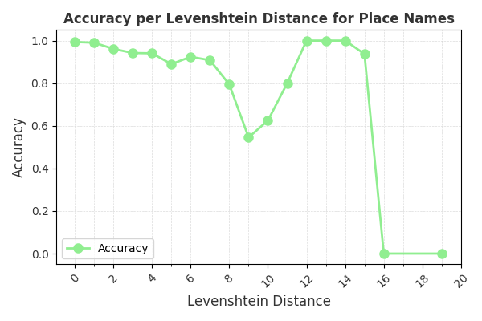
Predictors of Accuracy
Entity importance
Orthographical Proximity
Type of name
> 3000 aggregated names
Argentina:
→ Strasbourg
Augusta Vindelicorum:
→ Augsburg
Region name in CH

Slide 22
Future Directions
Providing translation suggestions in the prompt: 99%(pers) /100%(places) correct
Does Retrieval-augmented generation (RAG) make this a solved problem?
25 random sentences: Perplexity slightly outperforms GTP-4o…
…but still struggles with obscure names or spelling variations
→ Not yet: we can still do research!

Slide 23
