Slide 1
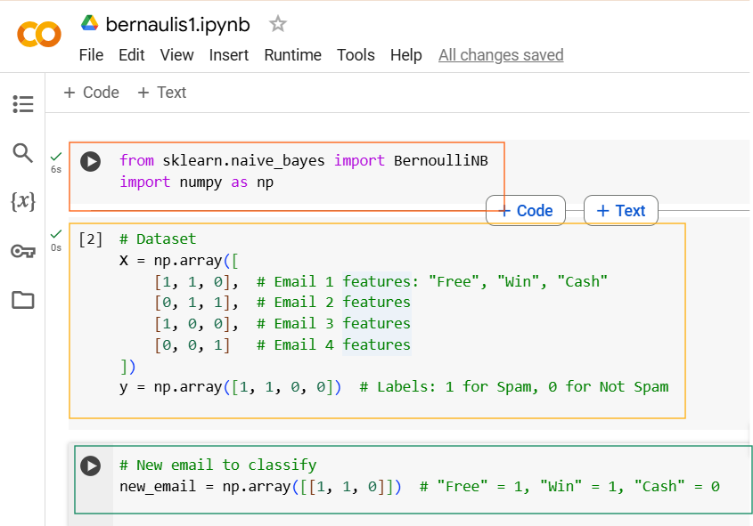

Slide 2
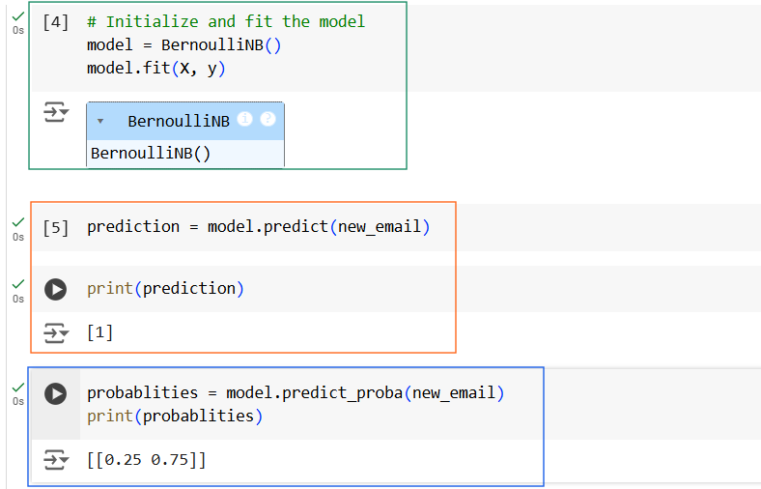
probabilities is a 2D array each column gives the probability of a specific class (column 0 = Not Spam, column 1 = Spam)

Slide 3
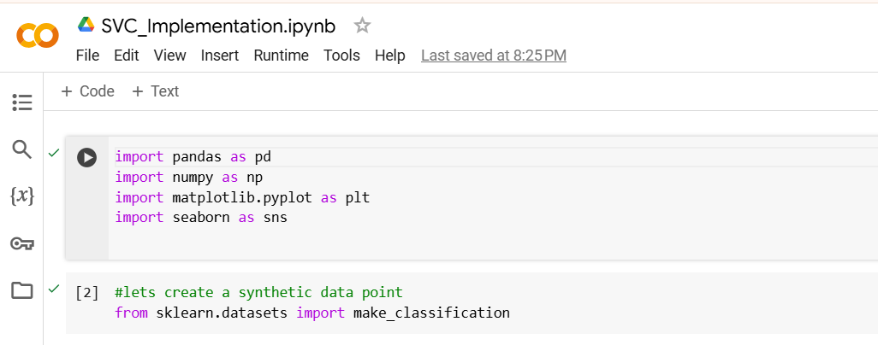

Slide 4
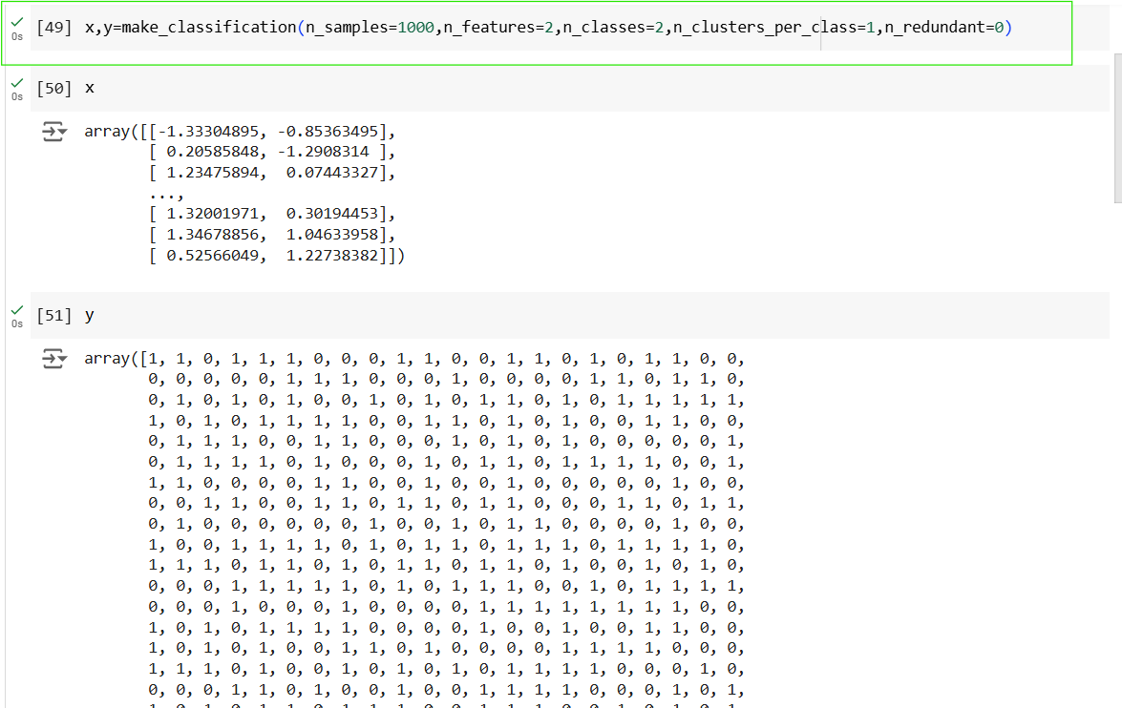

Slide 5
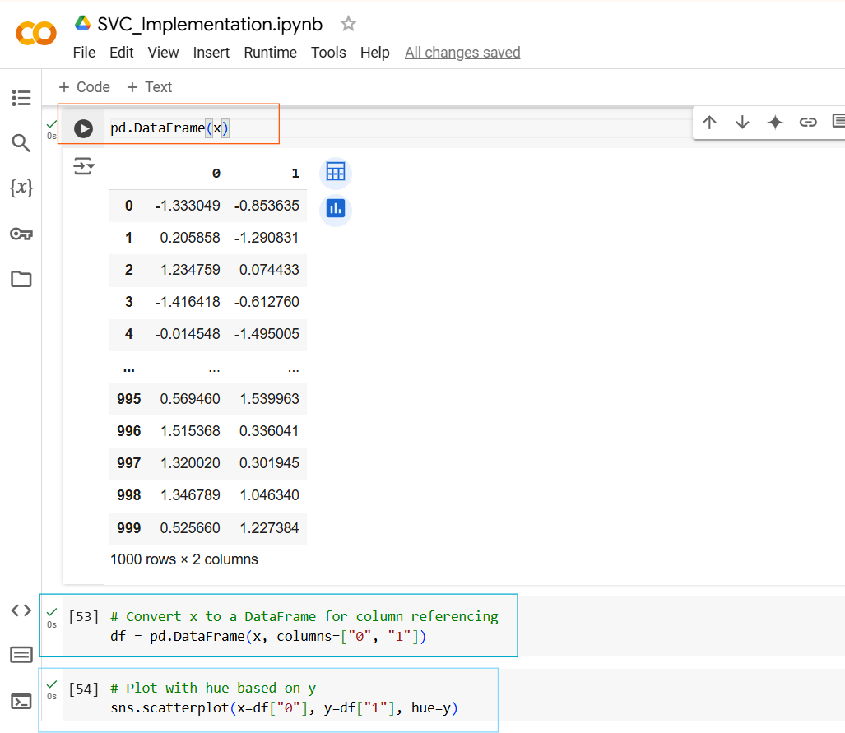
x-axis values for the scatter plot, which correspond to the values in the column "0" of the DataFrame df.
y-axis values for the scatter plot, which correspond to the values in the column "1" of the DataFrame df.
points belonging to class 0 will have one color, and points in class 1 will have another color.

Slide 6
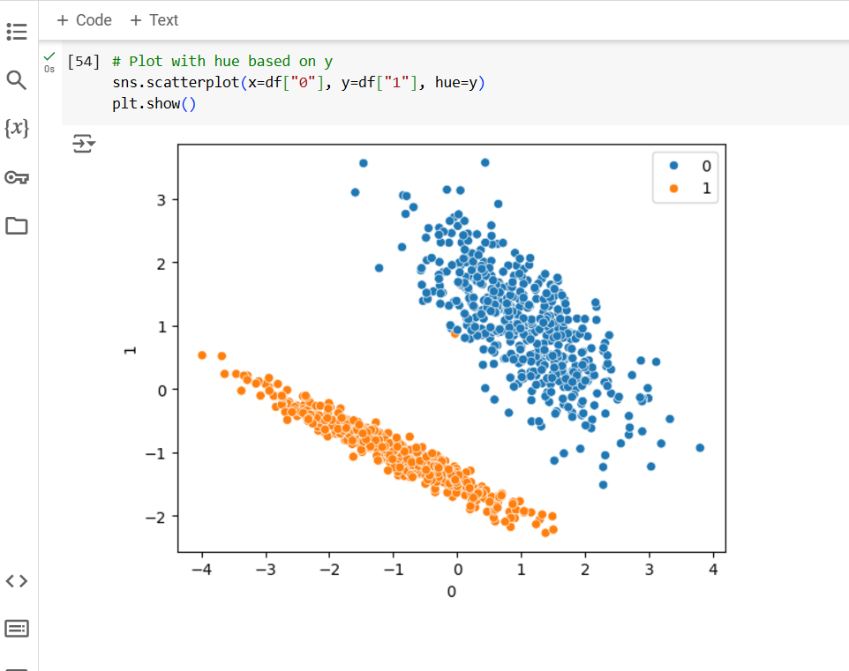
Now here you can definitely see that, uh, my data points are very clearly separable.
And obviously I can actually create a best fit line with the help of SVC.
And for this, the SVC that we will be using, it is called as linear SVC.

Slide 7
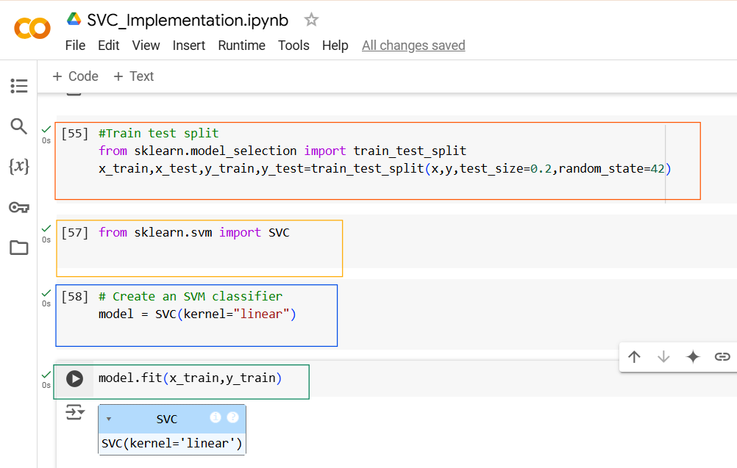

Slide 8
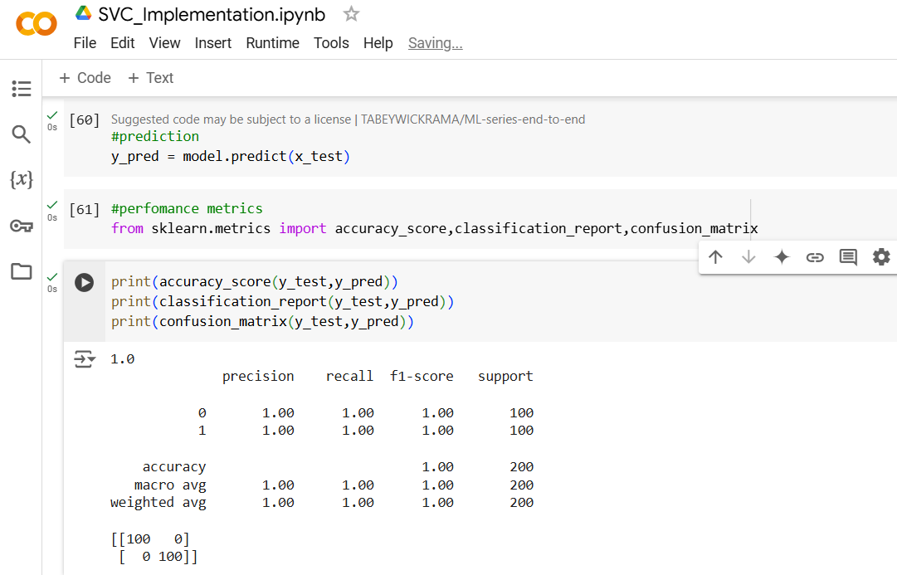
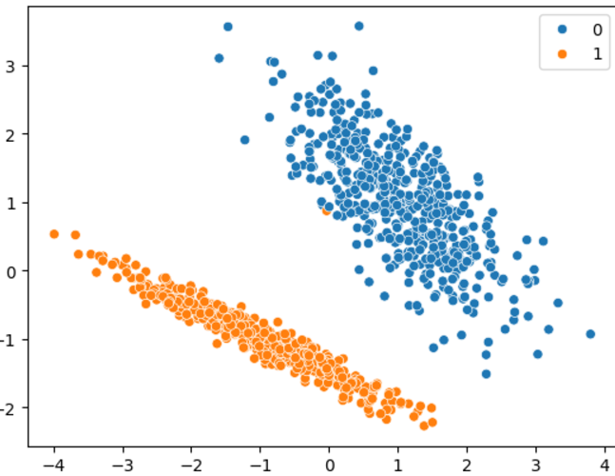
100% Accuracy because our dataset is linearly separable

Slide 9
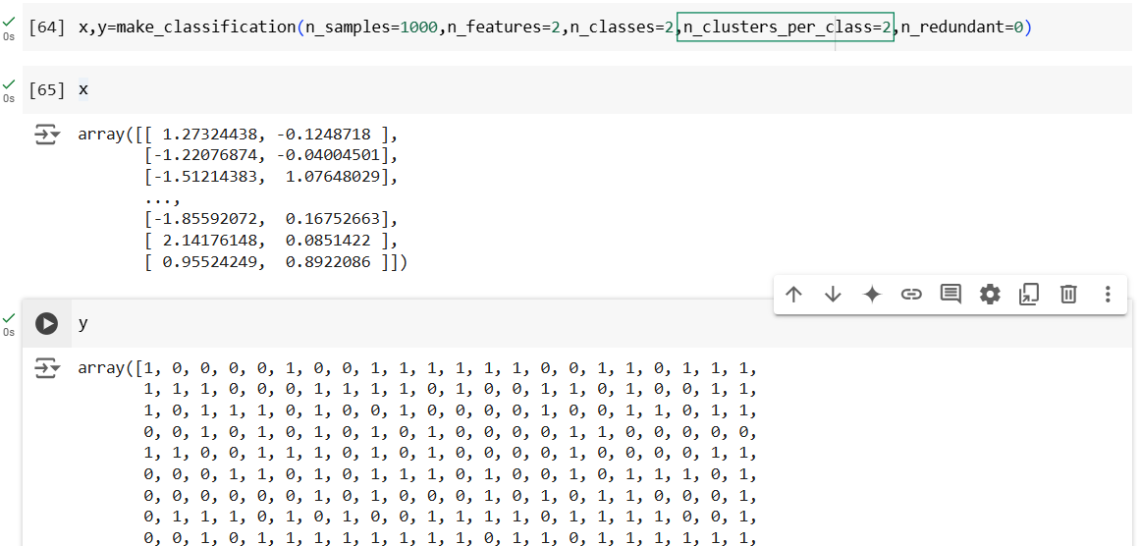
In this parameter I changed the cluster group to 2, previously we gave it as 1
Run this code again
n_clusters_per_class=1, each class class 0 and class1 will form it’s own single cluster.
n_clusters_per_class > 1 each class class 0 and class1 will form more than one cluster.

Slide 10
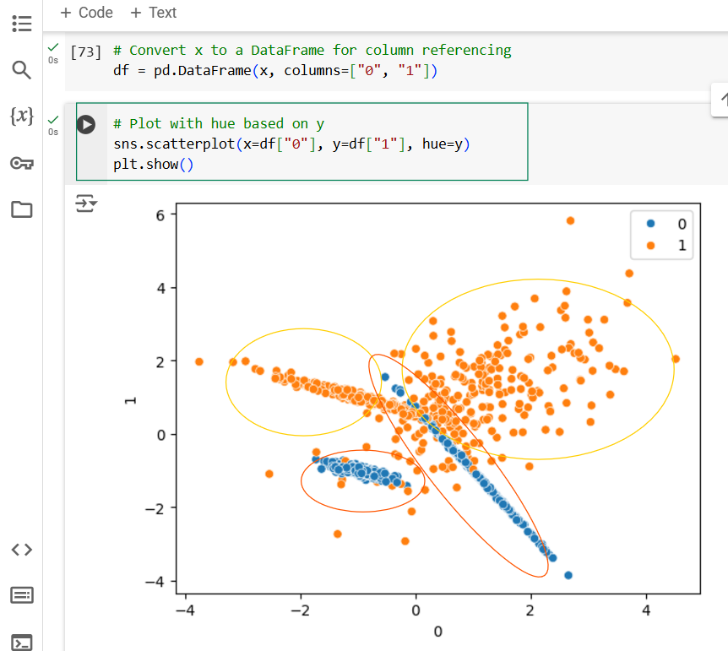
This time we can see more than 2 clusters of each class and Non linear separable data i.e. data overlapping is there

Slide 11
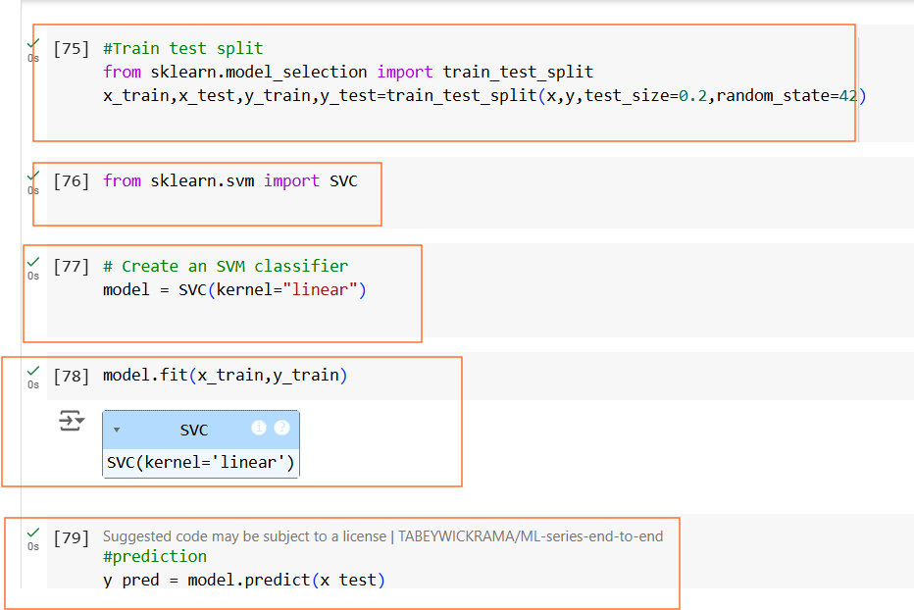
Train and Run the Model again for new dataset.

Slide 12
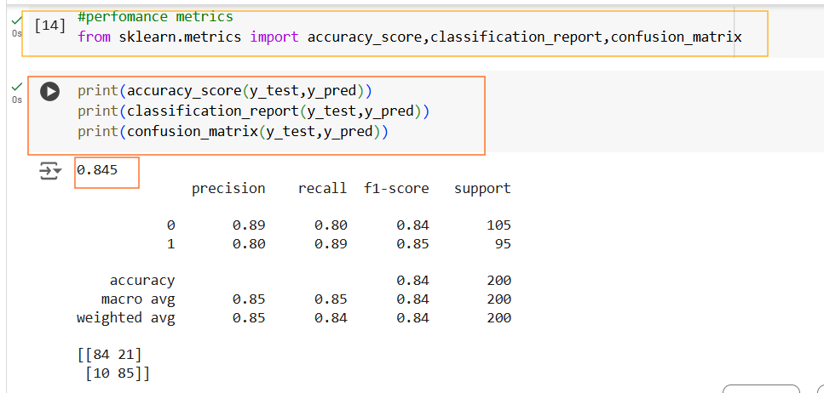
This time you can see Accuracy is reduced to 84%

Slide 13
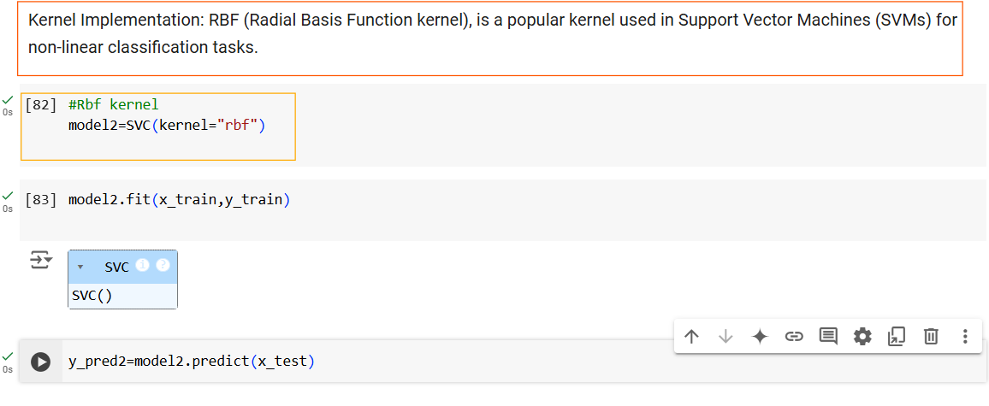

Slide 14
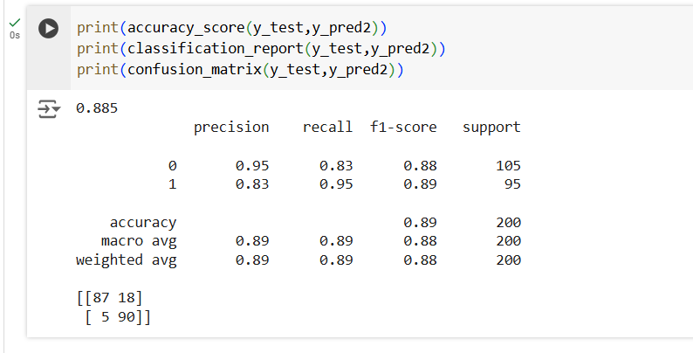
When Using Rbf , we can see a slight improvement in accuracy 89%

Slide 15
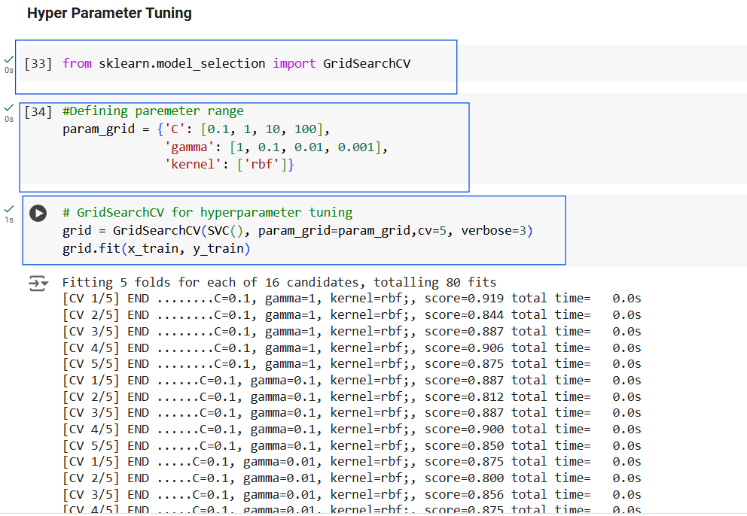
verbose=3 means detailed output, including the progress of the grid search and which parameter combination is currently being tested.

Slide 16
C:
Regularization parameter for SVM.
To achieve a low error on the training data and maintaining a large margin (generalization).
Larger values of C make the model stricter on margin violations.
Gamma:
Kernel coefficient for the RBF kernel (controls influence of individual training points).
It controls the shape of the decision boundary that the SVM tries to create to separate the classes.
High gamma Can lead to overfitting
Low gamma can lead to underfitting
Low gamma can lead to underfitting

Slide 17
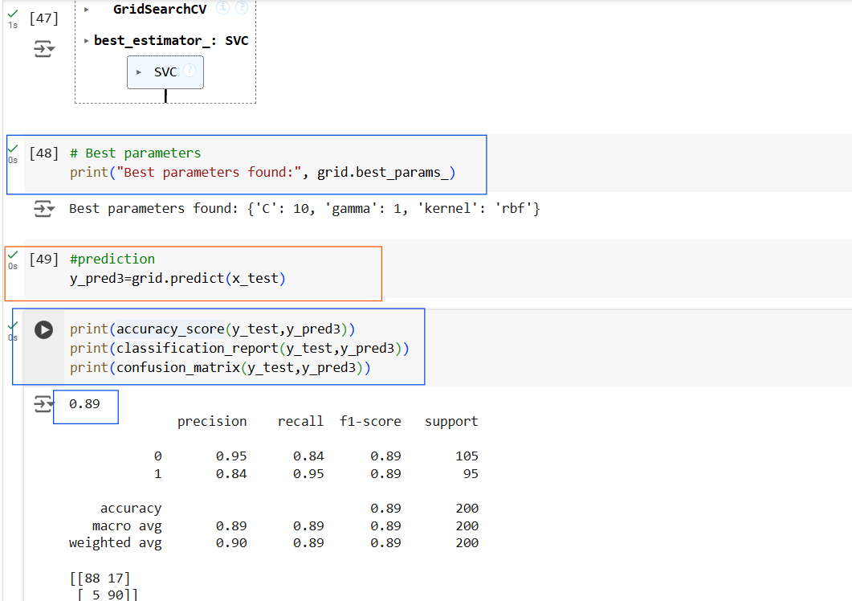
Very slight improvement in Accuracy %

