Slide 1
K-Nearest Neighbour

Slide 2
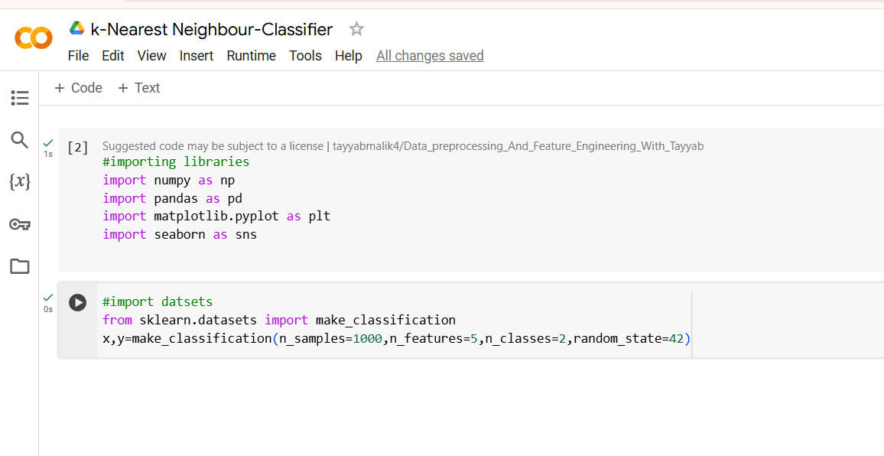

Slide 3
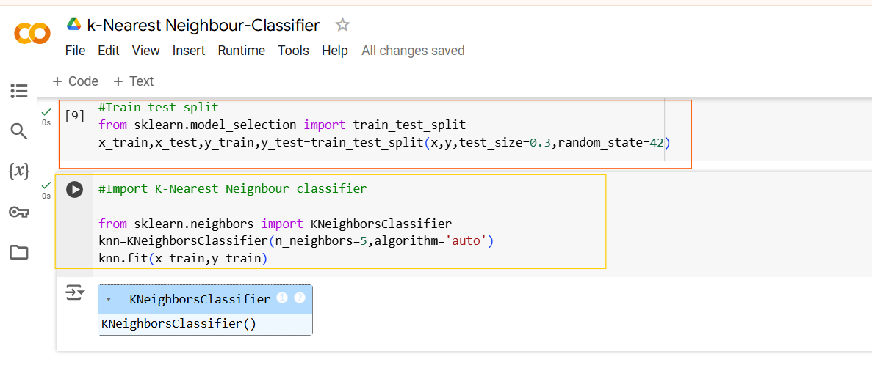
Model will consider the 5 nearest neighbors of any new data point to predict its class label.
Allows the model to select the most efficient algorithm automatically (either ball tree, kd_tree, or brute force), based on the data size and structure.

Slide 4
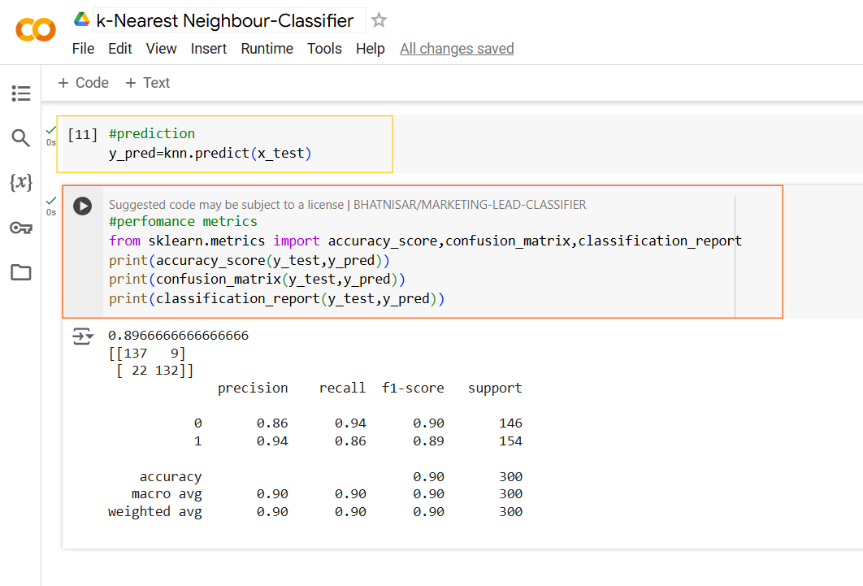
Use k-d trees for low-dimensional(<20), large datasets.
Use Ball tree for Moderate (20-30),Large dataset
Use brute-force search for high-dimensional (>30) small to moderate datasets.

Slide 5
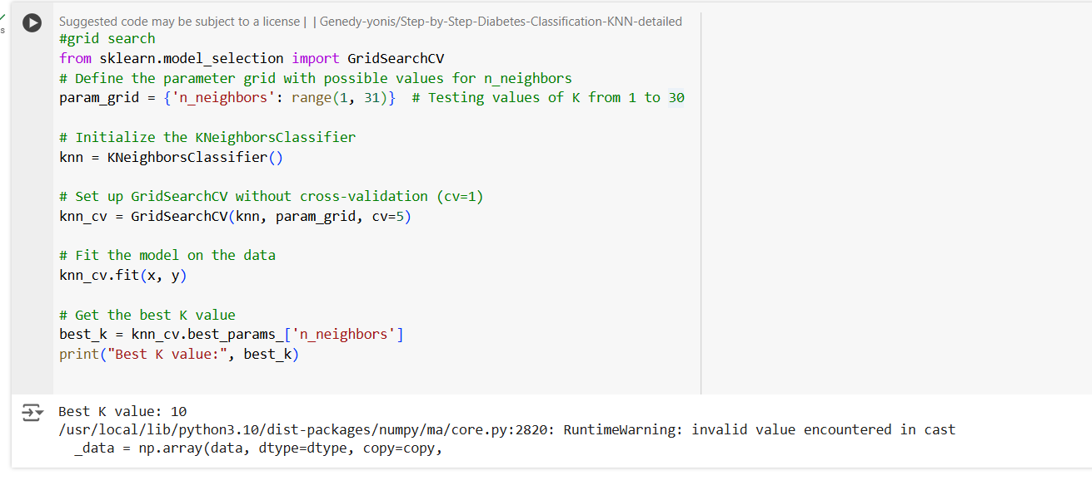
How to find the best K value?
You define a range of possible values for each hyperparameter (like n_neighbors in KNN) in a parameter grid.

Slide 6
Gaussian Naïve bayes

Slide 7
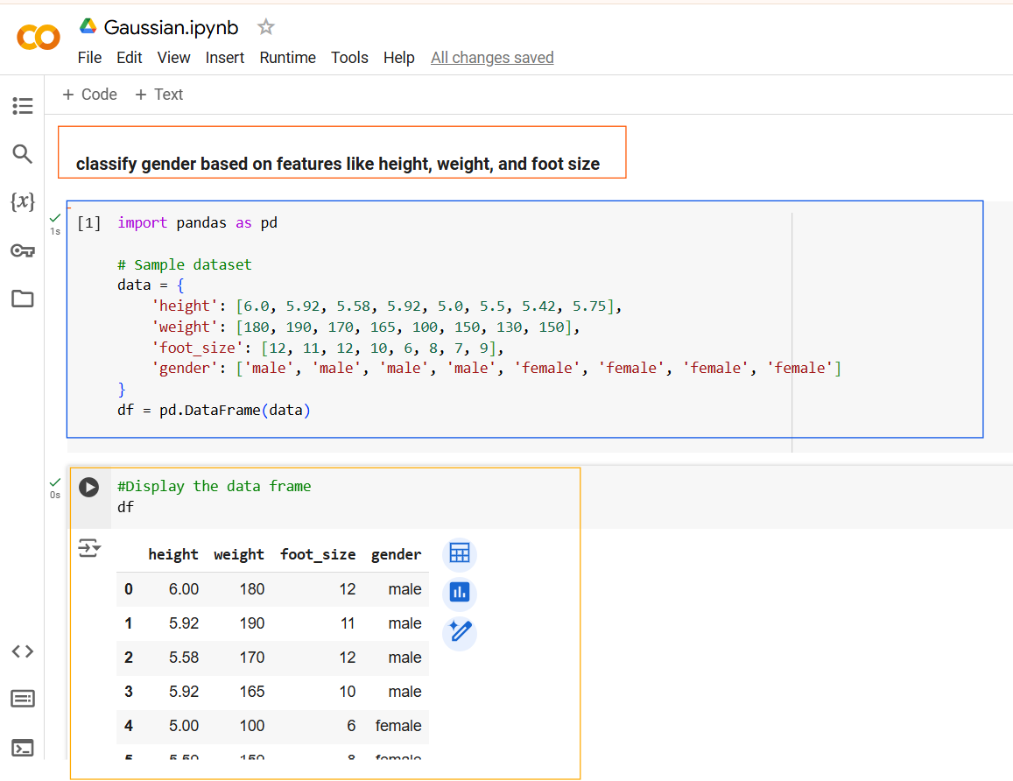

Slide 8
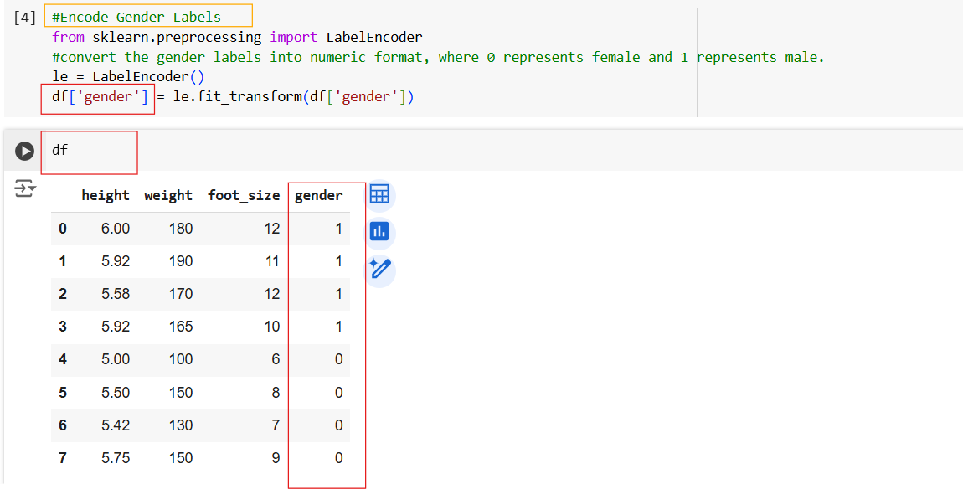

Slide 9
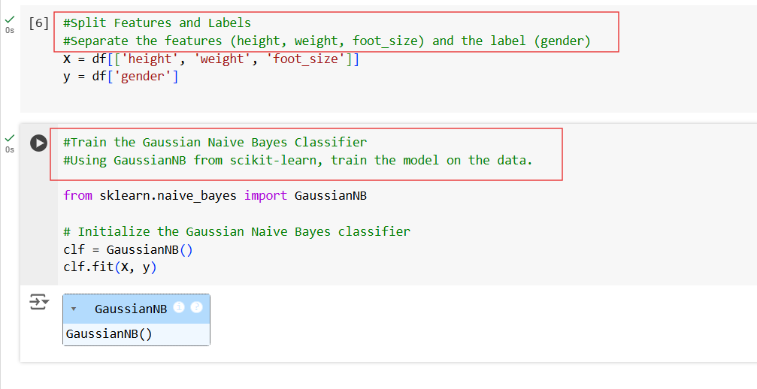

Slide 10
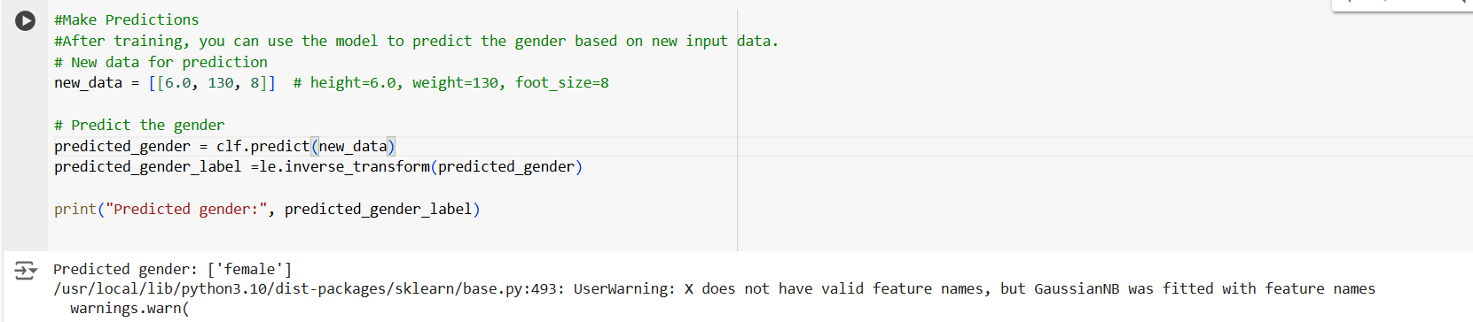

Slide 11
Bernoulli Naïve bayes

Slide 12
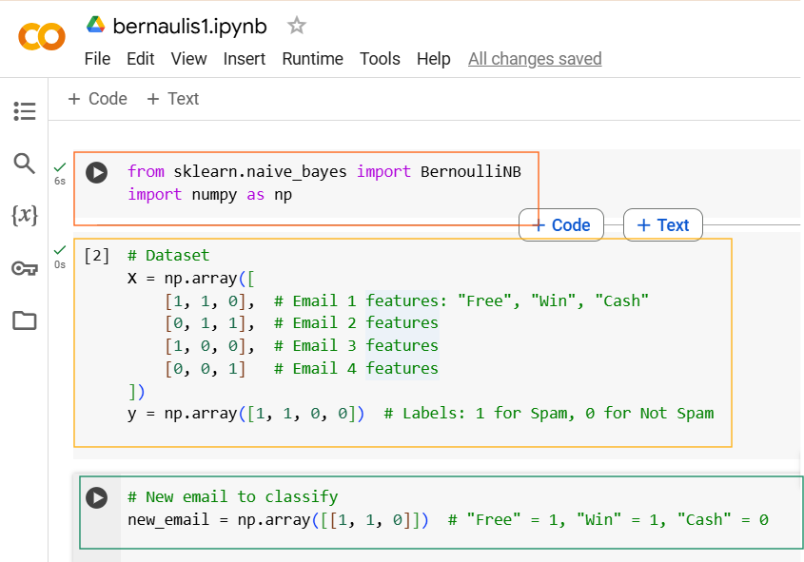

Slide 13
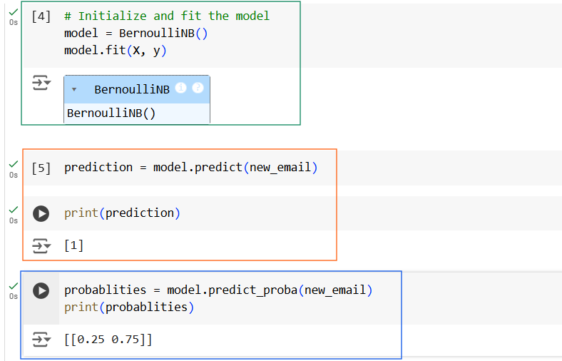
probabilities is a 2D array each column gives the probability of a specific class (column 0 = Not Spam, column 1 = Spam)

Slide 14
Multinomial Naïve bayes

Slide 15
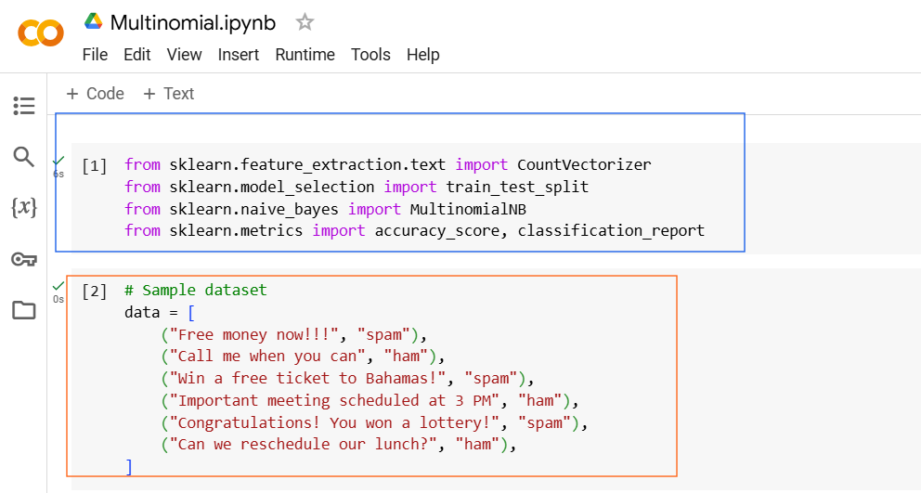

Slide 16
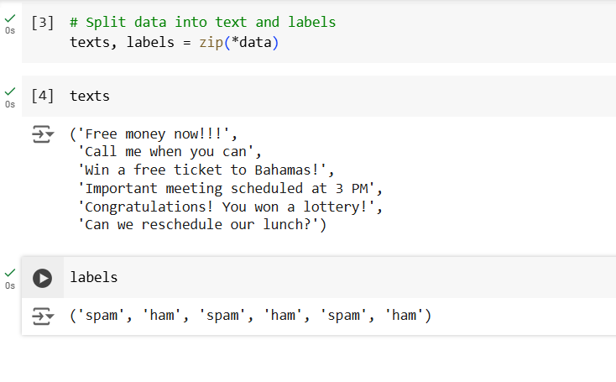
The * operator unpacks the list of tuples, so zip() can group the elements at the same positions in each tuple.
The first elements of all tuples are grouped into one sequence.
The Second elements of all tuples are grouped into one sequence

Slide 17

CountVectorizer will also extract unique features from the texts.
CountVectorizer outputs a sparse matrix, which is efficient for storing text data with many zeros.

Slide 18
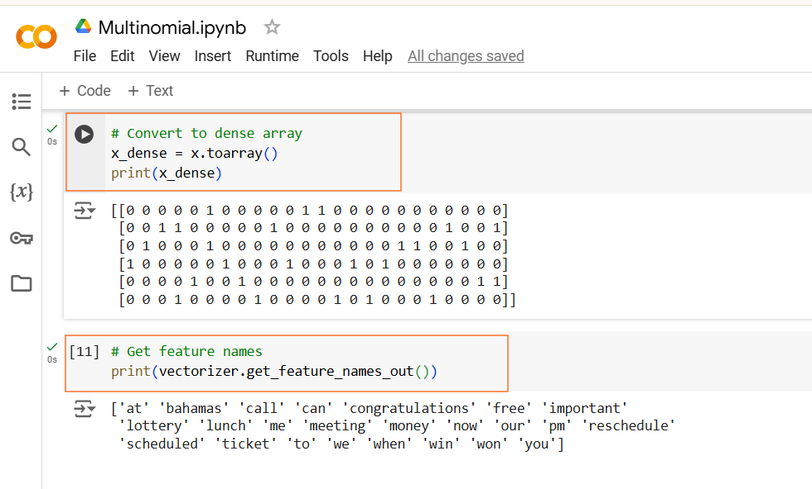
This will print a 2D array
where:
Rows correspond to the input texts.
Columns correspond to the unique words (features) in the vocabulary.
Values are the count of each word in the respective text.

Slide 19
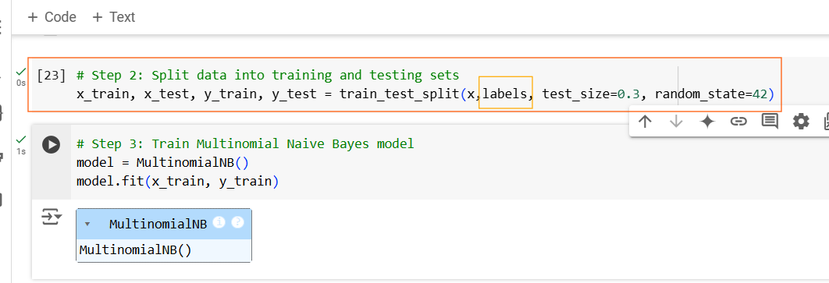

Slide 20
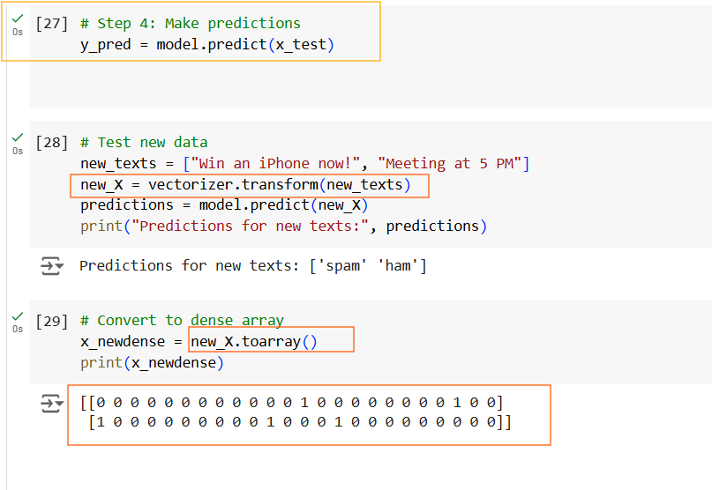
vectorizer is the previously trained CountVectorizer object.
Ensures the new text uses the same vocabulary (features) learned during training.
Predicted output
model.predict(new_X) uses the trained Multinomial Naive Bayes model to classify the transformed new data (new_X).

Slide 21
Support Vector Machine

Slide 22
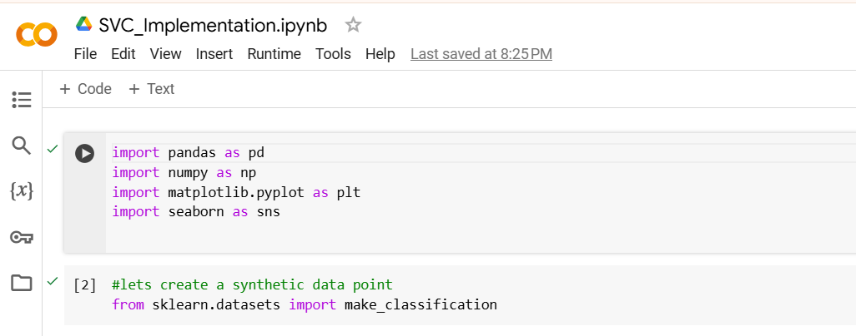

Slide 23
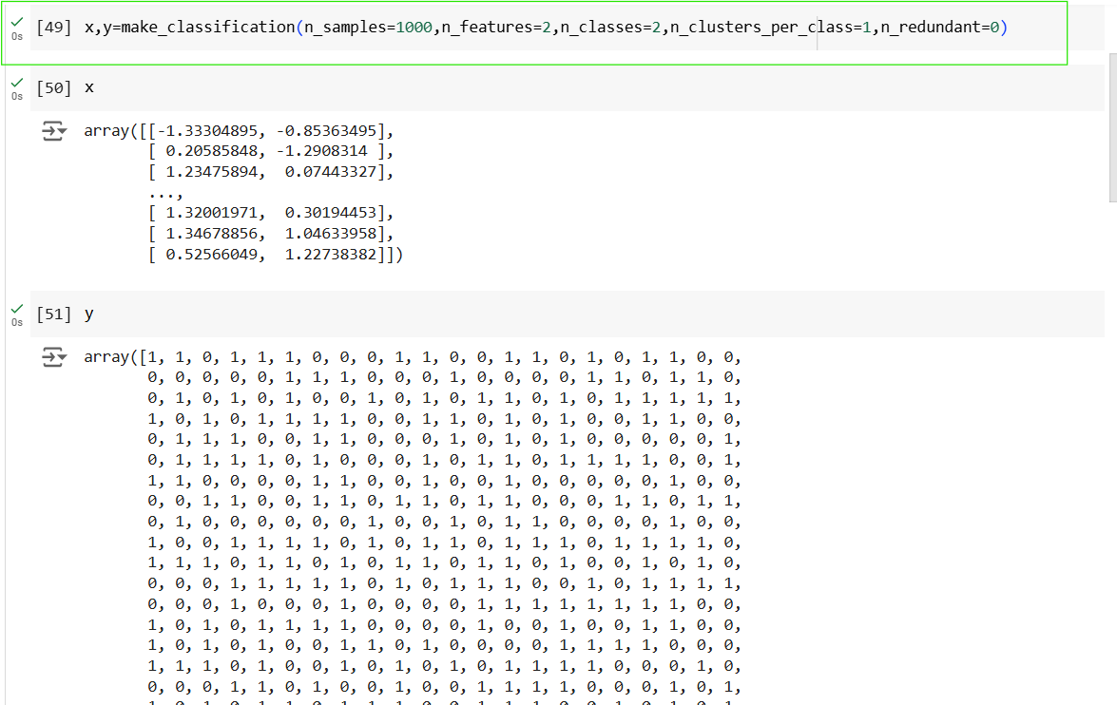

Slide 24
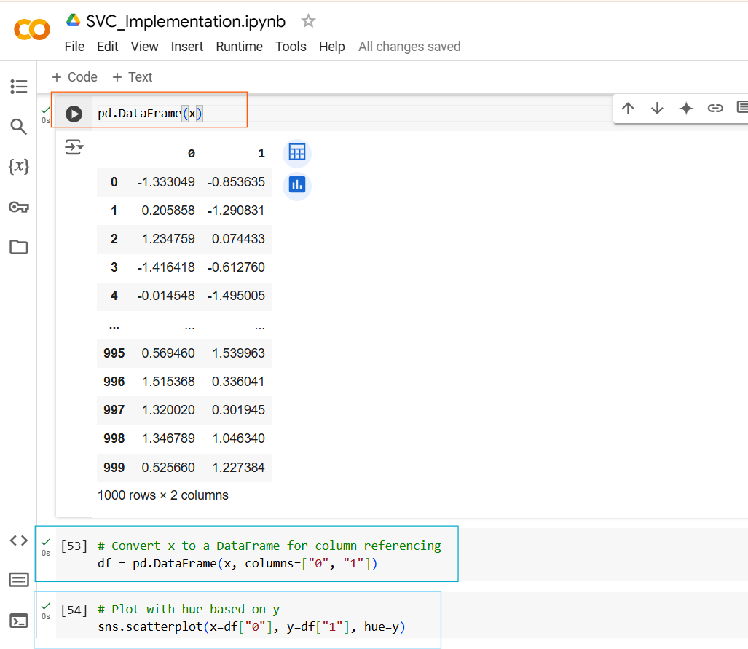
x-axis values for the scatter plot, which correspond to the values in the column "0" of the DataFrame df.
y-axis values for the scatter plot, which correspond to the values in the column "1" of the DataFrame df.
points belonging to class 0 will have one color, and points in class 1 will have another color.

Slide 25
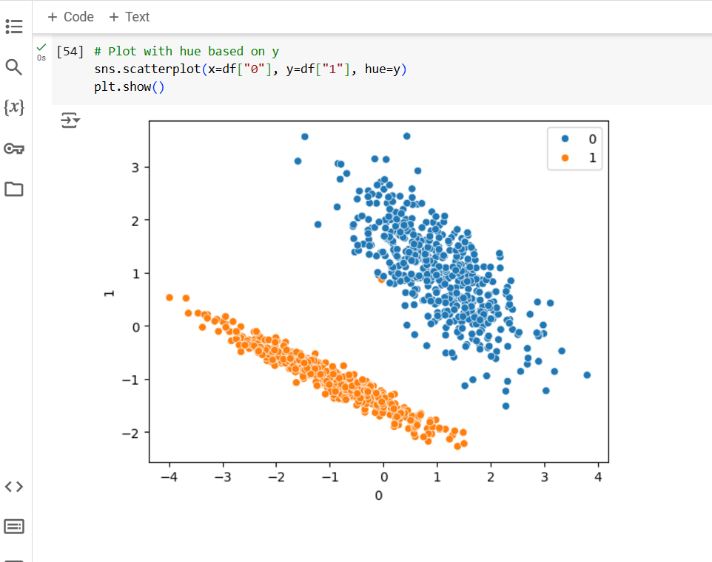
Now here you can definitely see that, uh, my data points are very clearly separable.
And obviously I can actually create a best fit line with the help of SVC.
And for this, the SVC that we will be using, it is called as linear SVC.

Slide 26
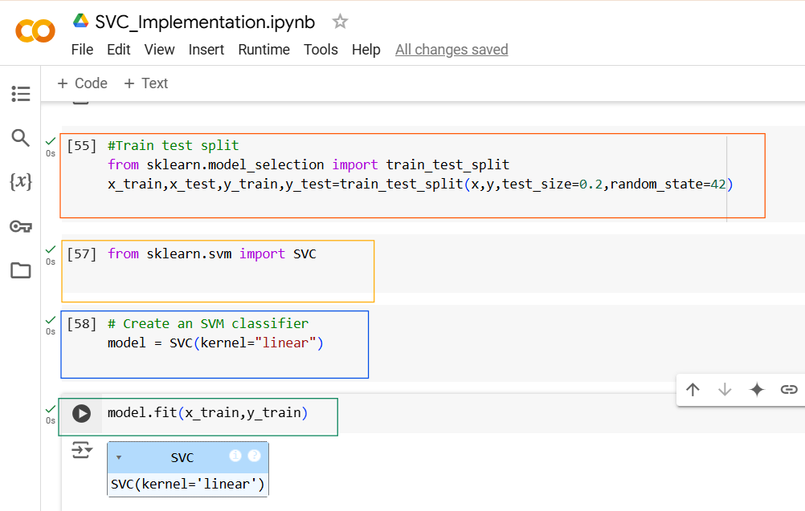

Slide 27
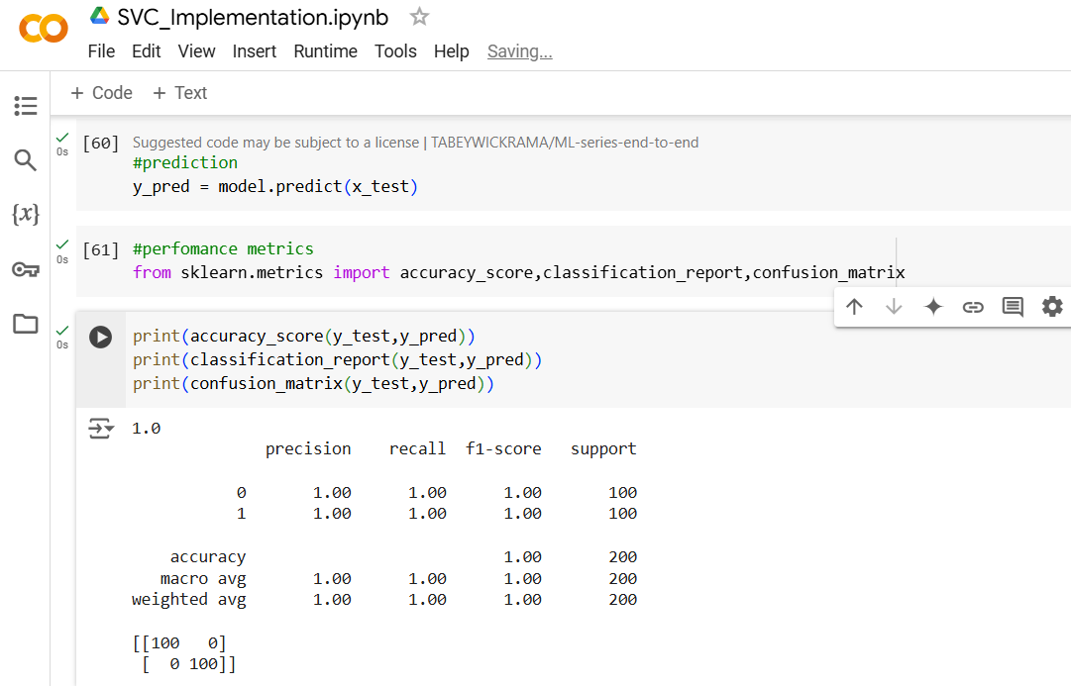
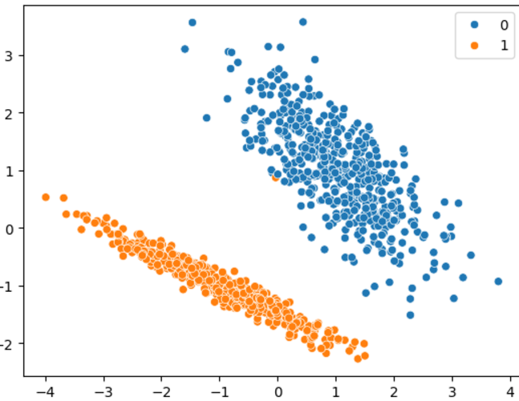
100% Accuracy because our dataset is linearly separable

Slide 28
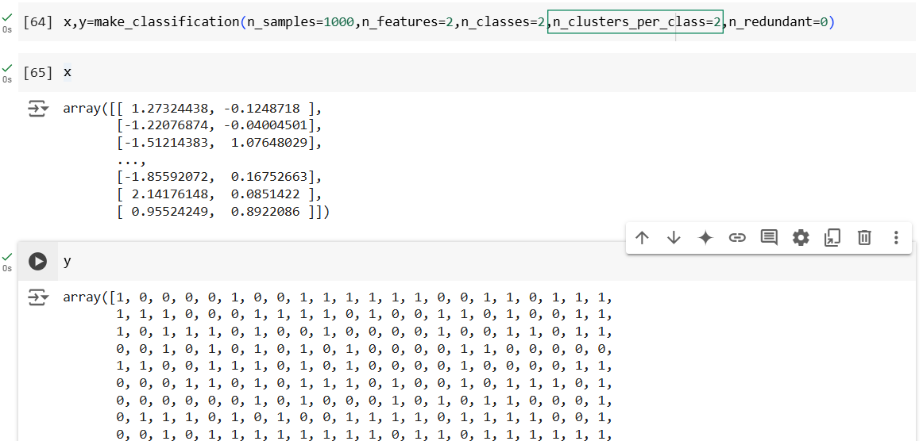
In this parameter I changed the cluster group to 2, previously we gave it as 1
Run this code again
n_clusters_per_class=1, each class class 0 and class1 will form it’s own single cluster.
n_clusters_per_class > 1 each class class 0 and class1 will form more than one cluster.

Slide 29
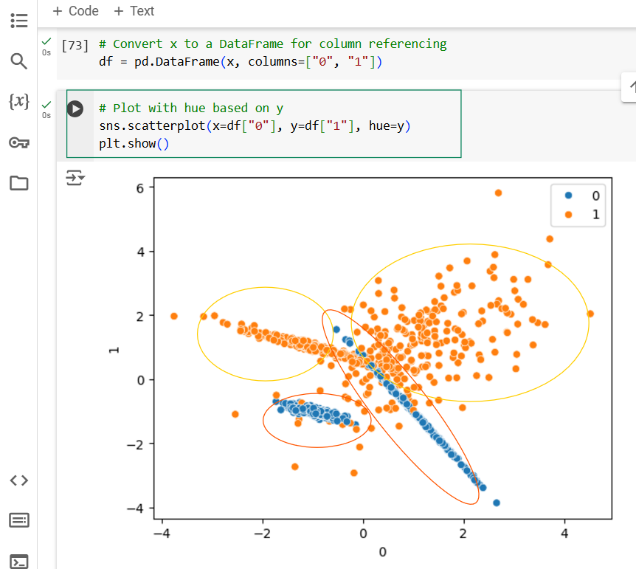
This time we can see more than 2 clusters of each class and Non linear separable data i.e. data overlapping is there

Slide 30
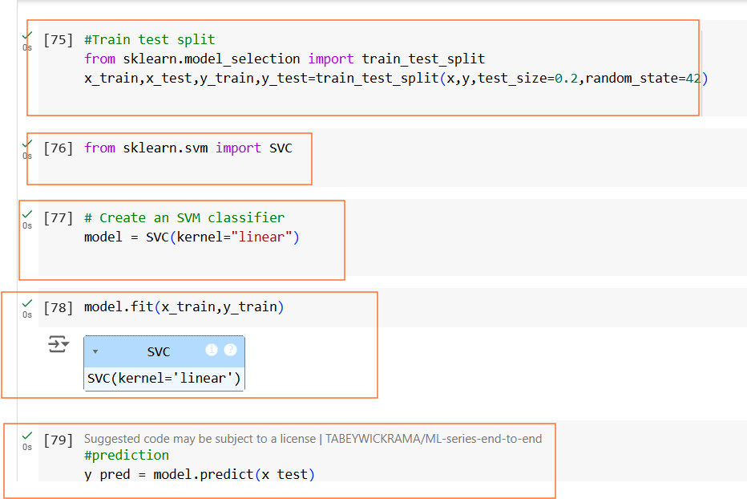
Train and Run the Model again for new dataset.

Slide 31
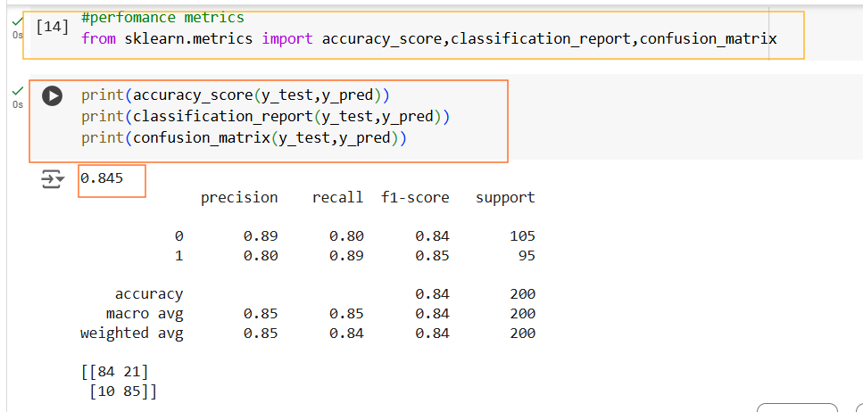
This time you can see Accuracy is reduced to 84%

Slide 32
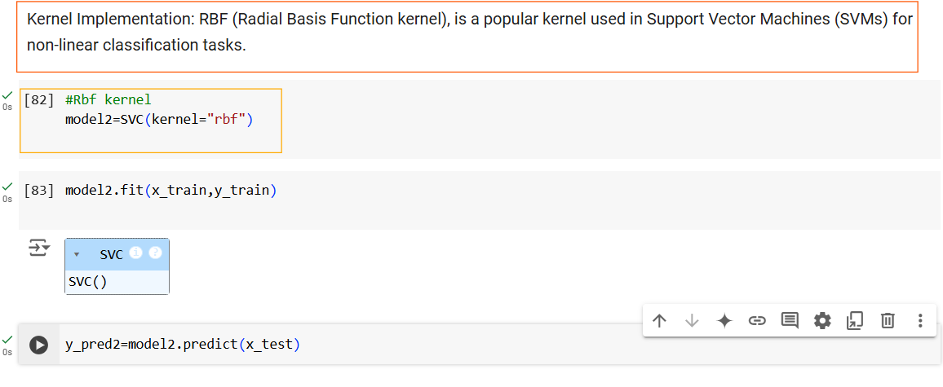

Slide 33
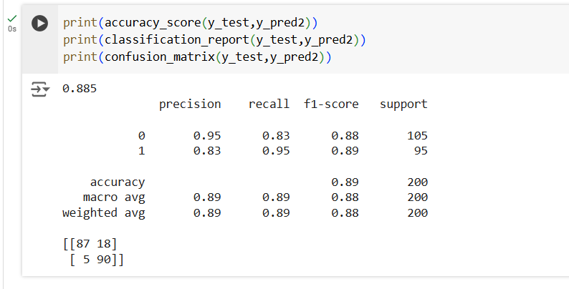
When Using Rbf , we can see a slight improvement in accuracy 89%

Slide 34
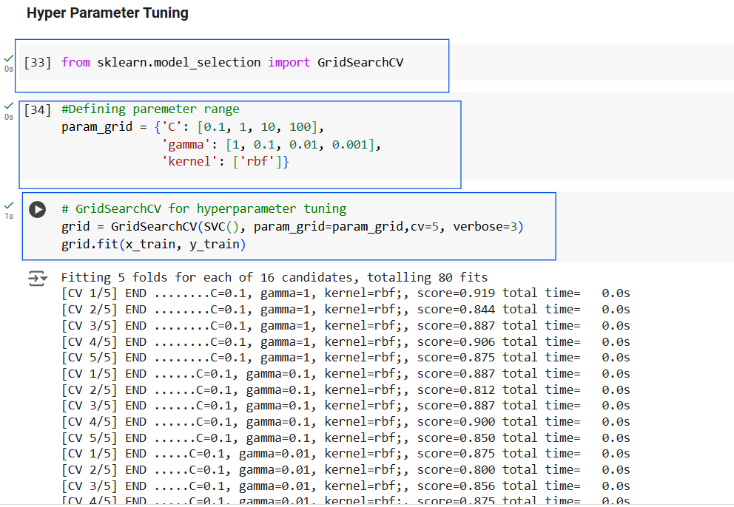
verbose=3 means detailed output, including the progress of the grid search and which parameter combination is currently being tested.

Slide 35
C:
Regularization parameter for SVM.
To achieve a low error on the training data and maintaining a large margin (generalization).
Larger values of C make the model stricter on margin violations.
Gamma:
Kernel coefficient for the RBF kernel (controls influence of individual training points).
It controls the shape of the decision boundary that the SVM tries to create to separate the classes.
High gamma Can lead to overfitting
Low gamma can lead to underfitting
Low gamma can lead to underfitting

Slide 36
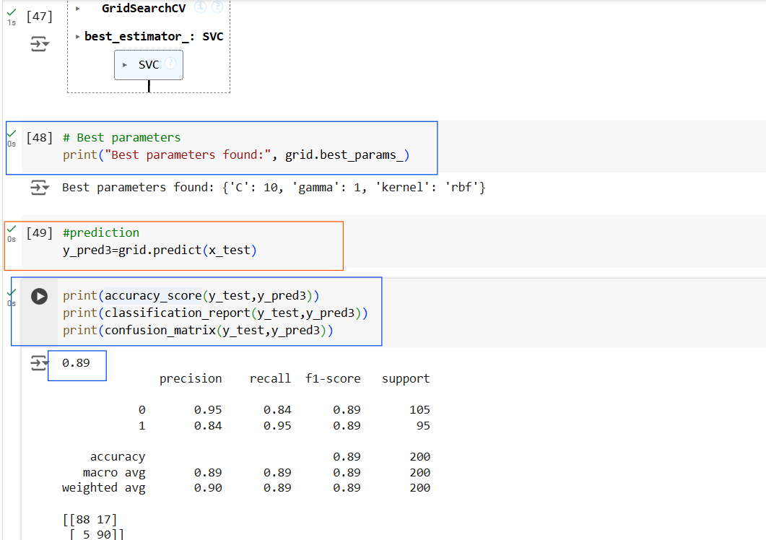
Very slight improvement in Accuracy %

