Slide 1
Lecture 14 Applications of Bayesian Analysis
Lecturer: Dr Dominic Anstey (da401)
2024
MPhil in DIS - Data Driven Radio Astronomy in the SKA era
1

Slide 2
Overview
Conjugate Priors
- Use case in radiometer calibration
Likelihood Reweighting
- Use case in RFI removal
Analytic Marginalisation of Linear Parameters
- Use case in 21cm beam modelling
Marginal Statistics and Joint Analysis
- Use case in early universe constraints
2024
MPhil in DIS - Data Driven Radio Astronomy in the SKA era
1

Slide 3
Conjugate Priors
In cases where speed of computation is critical, it may be desirable for the full posterior to have a closed-form analytical expression, making sampling unnecessary
In order to have an analytic posterior, the functional form of the likelihood and priors must be such that their product takes an analytical form
In general, these must be determined on a case-by-case basis, but there are many established cases
2024
MPhil in DIS - Data Driven Radio Astronomy in the SKA era
1

Slide 4

Conjugate Priors
Many typically used probability distributions fall into defined distribution families of a certain type:
- e.g. - normal
- multivariate normal
- uniform
- gamma distribution
distinguished by parameter values
For certain likelihoods, there exists a family of probability distributions that, when used as a prior, result in a posterior of the same family as the prior, but with different parameter values. This is called the conjugate prior of that likelihood.
2024
MPhil in DIS - Data Driven Radio Astronomy in the SKA era
1

Slide 5
Conjugate Priors
The parameters that describe the details of the prior and posterior distributions are referred to as hyperparameters.
Using the conjugate prior of the chosen likelihood makes the posterior analytic, allowing it to be evaluated without sampling
2024
MPhil in DIS - Data Driven Radio Astronomy in the SKA era
1

Slide 6


Normal Distribution Example
Consider a likelihood that is normal, with a known variance
Assume also a normal distribution prior
Prior hyperparameters:
If this is the conjugate prior, the posterior should also be normal
2024
MPhil in DIS - Data Driven Radio Astronomy in the SKA era
1

Slide 7





Normal Distribution Example
Expand
Group terms
2024
MPhil in DIS - Data Driven Radio Astronomy in the SKA era
1

Slide 8
Other Conjugate Pairs
Likelihood:
- Normal with known mean
- Normal (both mean and variance as parameters)
- Multivariate normal with known covariance
- Multivariate normal
- Uniform
- Exponential distribution
- etc.
Conjugate prior:
- Inverse gamma distribution
- Normal-inverse gamma distribution
- Multivariate normal
- Normal-inverse-Wishart distribution
- Pareto distribution
- Gamma distribution
- etc.
https://en.wikipedia.org/wiki/Conjugate_prior
2024
MPhil in DIS - Data Driven Radio Astronomy in the SKA era
1

Slide 9

Use Case – Radiometer Calibration
The output from a radiometer must be amplified , which also adds noise and reflections
Have to calibrate all these effects to recover the original temperature from the measured power
Need to solve for many unknowns
From Roque et al. (2021)
2024
MPhil in DIS - Data Driven Radio Astronomy in the SKA era
1

Slide 10

Dicke Switches
From Dicke (1946)
Known sources
Functions of the reflection coefficients
For a known calibrator, can fit for theta
From Roque et al. (2021)
2024
MPhil in DIS - Data Driven Radio Astronomy in the SKA era
1

Slide 11
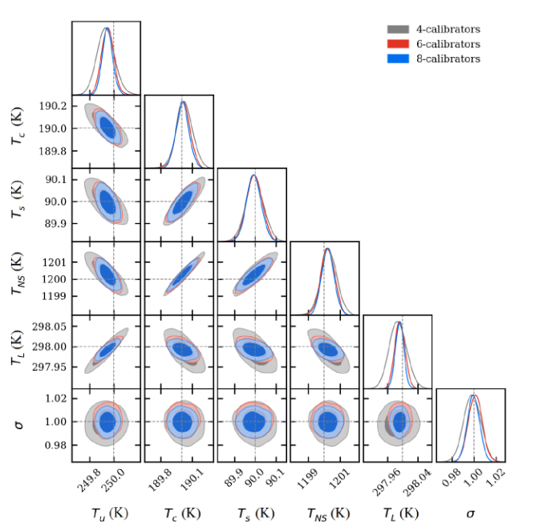
Loop Conjugate Priors
In many cases, radiometers have limits on storage and data transmission rates (e.g. due to remote locations)
Need the calibration to be performed on-site, at a rate matching the data collection
Normal likelihood with unknown mean and variance
Normal-inverse gamma distribution
Loop over all calibrators
2024
MPhil in DIS - Data Driven Radio Astronomy in the SKA era
From Roque et al. (2021)
1

Slide 12
Likelihood Reweighting
The speed of the likelihood evaluation is the limiting factor in computation time for most Bayesian algorithms
If the required likelihood is slow to evaluate, it can impede or prevent the analysis
The bulk of likelihood calls are used for exploring the parameter volume in order to isolate the region of high posterior probability
Consider the possibility of using a faster likelihood to locate the posterior peak first
2024
MPhil in DIS - Data Driven Radio Astronomy in the SKA era
1

Slide 13
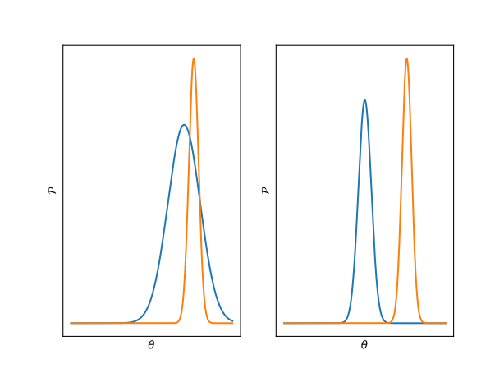


Slow and Fast Likelihoods
Assume 2 likelihoods, one of which is much faster to evaluate, can be defined, subject to the conditions:
- Both likelihoods take the same parameters with the same priors
- Both likelihoods have a posterior peak in the same location of parameter space
✓
❌
2024
MPhil in DIS - Data Driven Radio Astronomy in the SKA era
1

Slide 14




Reweighting Relation
2024
MPhil in DIS - Data Driven Radio Astronomy in the SKA era
1

Slide 15

Reweighting Relation
Process:
- Define a comparable fast likelihood with the same parameters and similar posterior to the slow
- Perform a model fit to acquire a representative set of samples from the posterior
- For each posterior sample, evaluate the fast and slow likelihoods
- Multiply the posterior sample weights by the reweight factor to convert them to samples of the slow posterior
- Slow likelihood only need to be evaluated for the few posterior samples
2024
MPhil in DIS - Data Driven Radio Astronomy in the SKA era
1

Slide 16
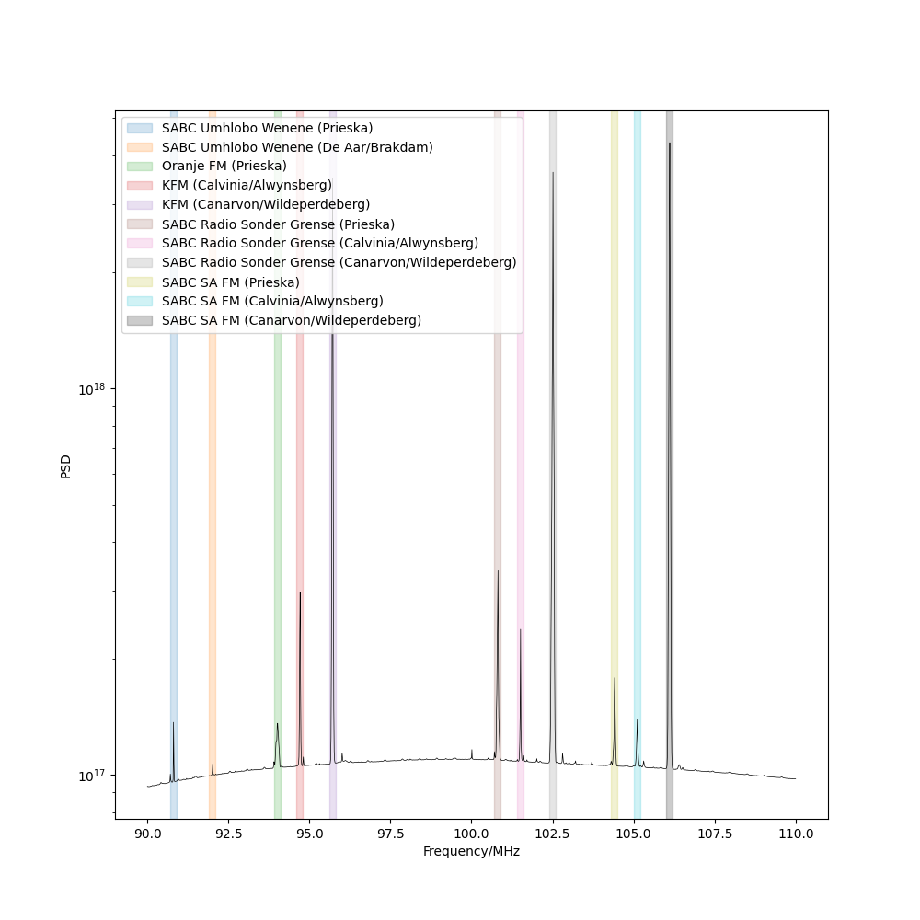
Use Case – RFI Excision
Radio Frequency Interference: Contamination of data by radio emissions from local sources
Needs flagging and removing from data
Removing entire channels of transient RFI results in the loss of useful information
2024
MPhil in DIS - Data Driven Radio Astronomy in the SKA era
1

Slide 17
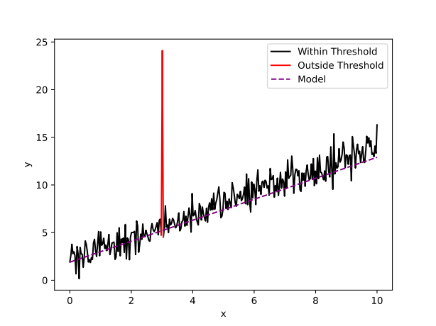
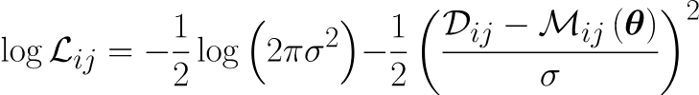





Bayesian Anomaly Flagging
if
otherwise
Probability a point is contaminated
Approximate scale of contamination
From Leeney et al. (2023)
2024
MPhil in DIS - Data Driven Radio Astronomy in the SKA era
1

Slide 18



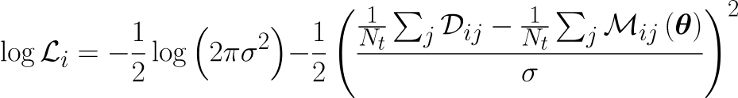
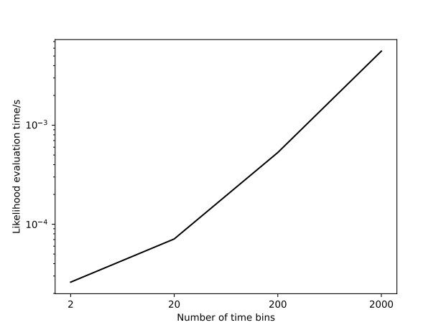
Use Case – RFI Excision
if
if
otherwise
otherwise
Full likelihood – Slow to evaluate
Averaged likelihood – Quick to evaluate
2024
MPhil in DIS - Data Driven Radio Astronomy in the SKA era
1

Slide 19
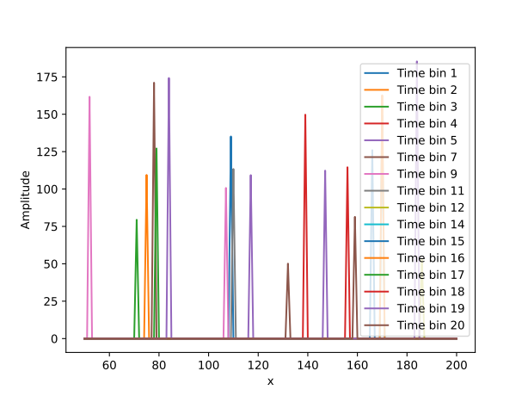

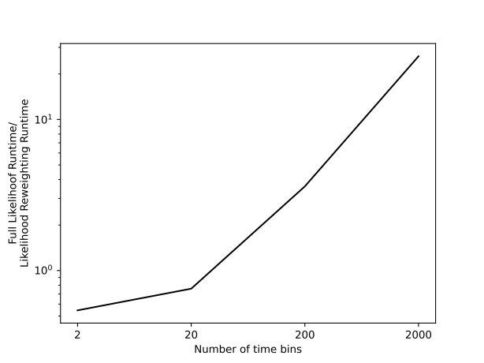
Use Case – RFI Excision
Test on simulated 21cm data with known RFI added
True
Flagged
Speed Increase
2024
MPhil in DIS - Data Driven Radio Astronomy in the SKA era
1

Slide 20


Marginalisation
Consider the circumstance where the model has too many nuisance parameters to viable fit in a reasonable time frame
Nuisance parameters can be marginalised
2024
MPhil in DIS - Data Driven Radio Astronomy in the SKA era
1

Slide 21



Marginal Likelihoods
Marginalisation can also be performed at the likelihood level
Performing an integral over the parameter space in the likelihood is normally too slow
2024
MPhil in DIS - Data Driven Radio Astronomy in the SKA era
1

Slide 22
Analytic Marginalisation
Consider the case where the model is linear in the nuisance parameters
Assume a Gaussian likelihood
2024
MPhil in DIS - Data Driven Radio Astronomy in the SKA era
1

Slide 23


Uniform Priors
Assume for now the priors are uniform
Expand out:
Make the substitutions:
2024
MPhil in DIS - Data Driven Radio Astronomy in the SKA era
1

Slide 24
Uniform Priors
All dependence on the linear nuisance parameters has been collected in this Gaussian term
If your likelihood is Gaussian and nuisance parameters are linear with uniform priors, they can be marginalised out analytically in the likelihood and do not need to be fit for
2024
MPhil in DIS - Data Driven Radio Astronomy in the SKA era
1

Slide 25

Non-Uniform Priors
Analytic marginalisation can also be performed for Gaussian priors
With the further substitutions:
2024
MPhil in DIS - Data Driven Radio Astronomy in the SKA era
1

Slide 26
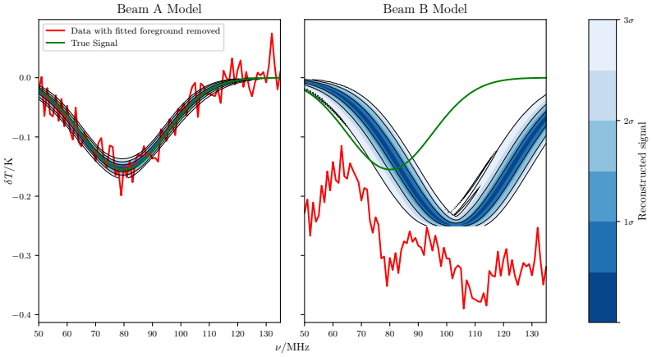
Use Case – 21cm cosmology
Recall from the previous lecture 21cm example, the model of the antenna’s directivity was assumed to be exactly known
Foreground known exactly
Beam error of <0.5%
2024
MPhil in DIS - Data Driven Radio Astronomy in the SKA era
1

Slide 27




Fitting a beam
Analytical models
Linear Models
Forward Models
Requires many large-scale EM simulations. Very slow
None exist
Parametrised coefficient functions
Basis functions
2024
MPhil in DIS - Data Driven Radio Astronomy in the SKA era
1

Slide 28
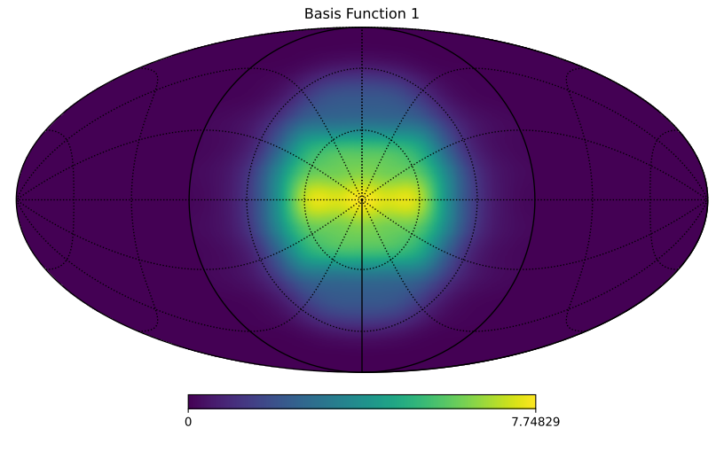
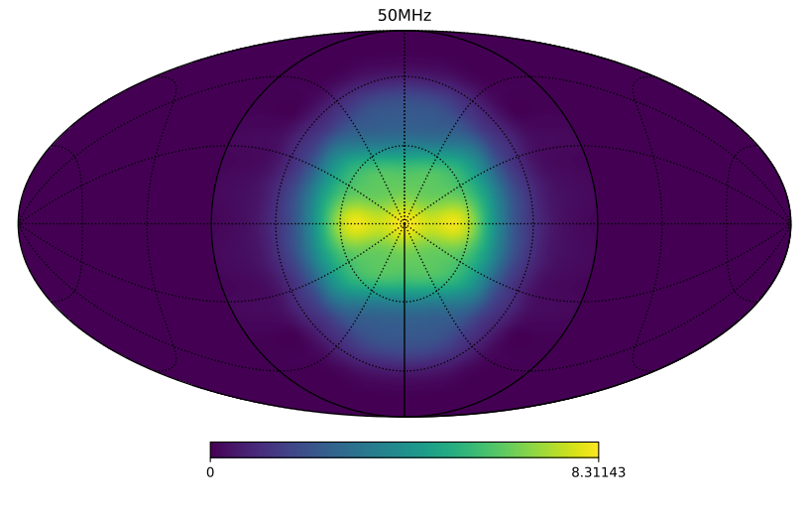
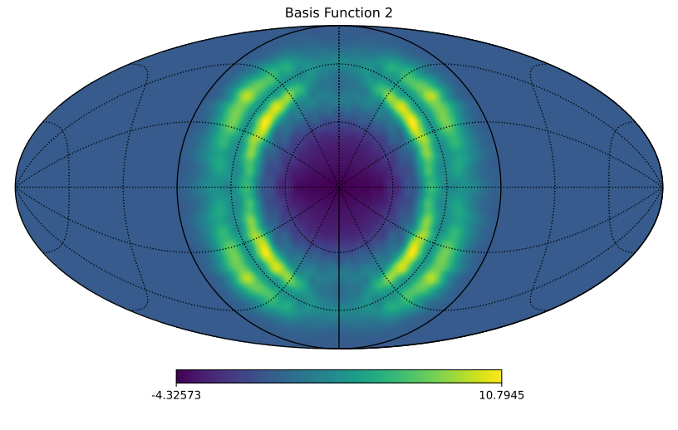
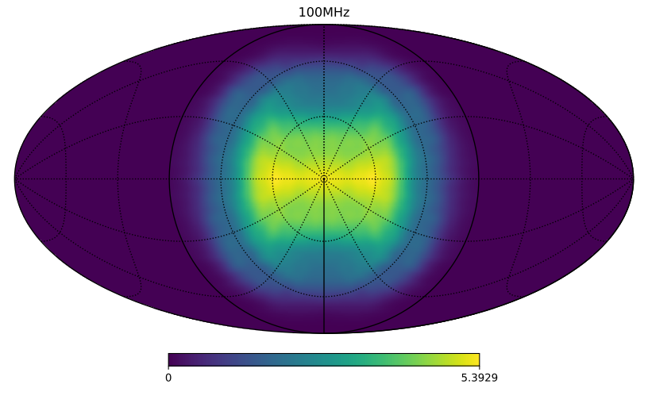
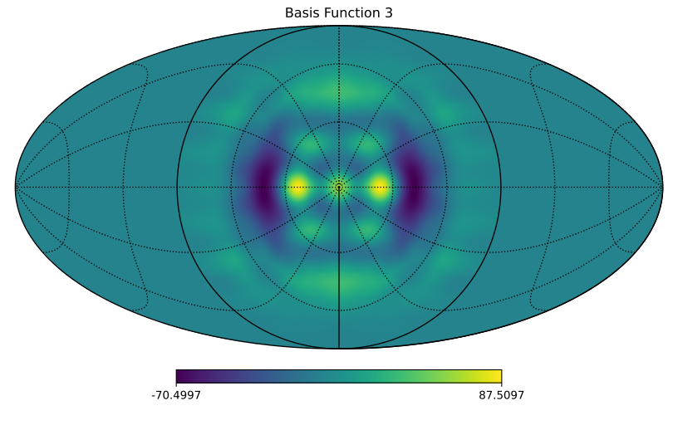
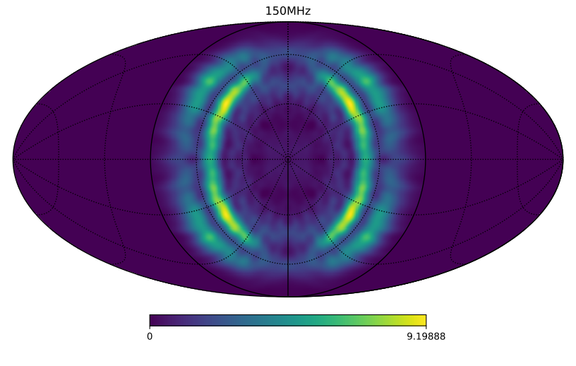
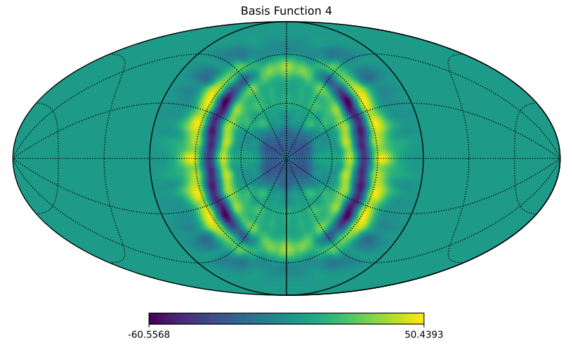
Fitting a beam
Basis functions
Beam
- Spherical Harmonics:
> 1000s of basis functions
- More sophisticated basis functions
~ 10-30
Each basis functions requires a parametrised coefficient function.
Order 5-10 parameters each.
Current best case requires of order ~50-100 parameters.
Parameters are linear by construction
2024
MPhil in DIS - Data Driven Radio Astronomy in the SKA era
1

Slide 29
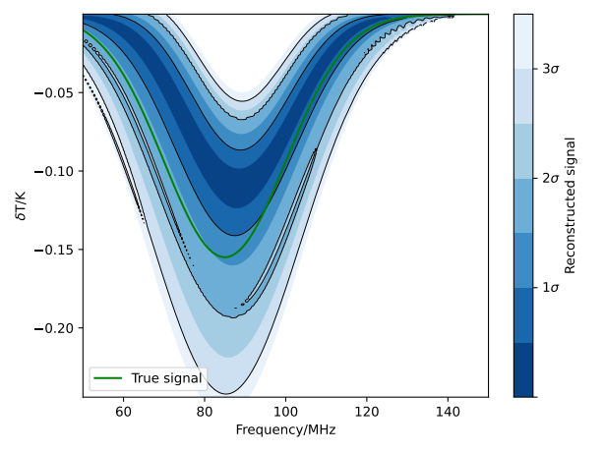
Fitting a beam
Requires inverting
2024
MPhil in DIS - Data Driven Radio Astronomy in the SKA era
1

Slide 30






Marginal Statistics
What if the marginal likelihood is needed but isn’t analytically tractable?
The marginal likelihood can be inferred from the marginal posterior
Slow to evaluate
2024
MPhil in DIS - Data Driven Radio Astronomy in the SKA era
1

Slide 31
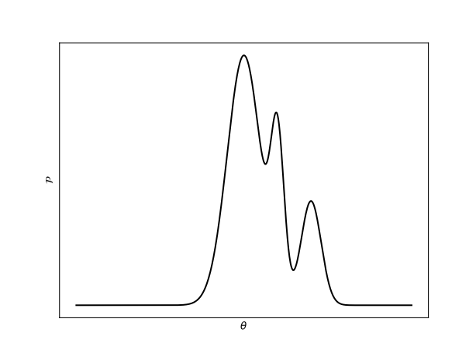
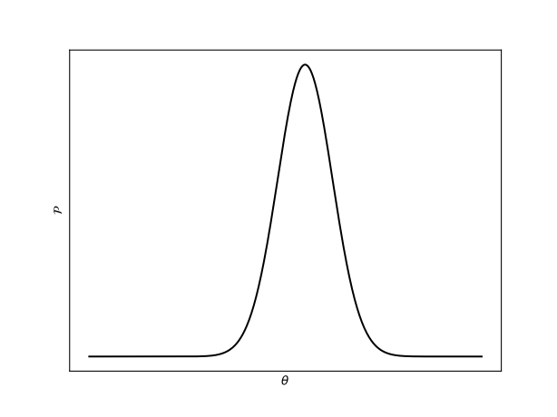
Evaluating Marginal Posteriors
Only have samples from the posterior
Learn the underlying distribution using normalising flows
Sampled distribution
Known target distribution (usually Gaussian)
Sequence of bijector neural nets
Feed known samples through and set loss function based on how well the resulting samples match the target
Can convert samples or the pdf of the target into samples or the pdf of the initial
2024
MPhil in DIS - Data Driven Radio Astronomy in the SKA era
1

Slide 32
Joint Constraints
Suppose we have two data sets with different models and nuisance parameters but with a few shared parameters of interest. Can both be used in a joint constraint?
Model 1
Model 2
3
14
3
20
17
37
23
More efficient to fit nuisance models independently, then only jointly fit the marginals
PolyChord (Handley et al.) has a runtime that scales with
2024
MPhil in DIS - Data Driven Radio Astronomy in the SKA era
1

Slide 33
Use Case – Multi-Instrument
Early Universe Constraints
Recent measurements of the upper limits on the 21cm signal:
SARAS3:
- wideband monopole radiometer
- observes in the band 55-85MHz
- based in India
Singh et al. 2022
HERA:
- dense packed interferometer
- constraints in the band ~120-190MHz
- based in South Africa
Abdurashidova et al. 2022
2024
MPhil in DIS - Data Driven Radio Astronomy in the SKA era
1

Slide 34
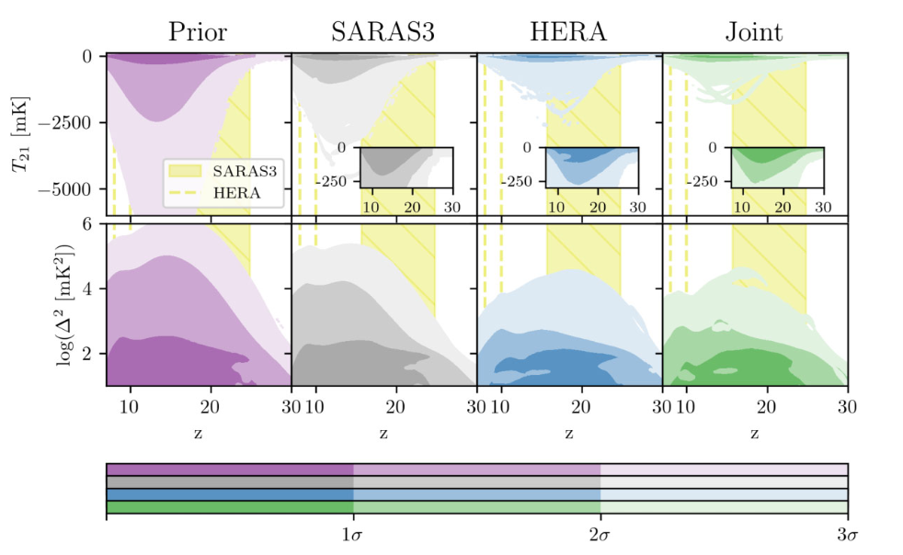
Use Case – Multi-Instrument
Early Universe Constraints
From Bevins et al. (2024)
2024
MPhil in DIS - Data Driven Radio Astronomy in the SKA era
1

Slide 35
Summary
Learned about 4 more advanced Bayesian statistical techniques and examples of appropriate circumstances for their application:
- Conjugate priors – For certain analytical likelihood, there exists a specific analytical conjugate prior, which gives a posterior in of the same family as the prior that can be evaluated quickly and analytically – e.g. in quick on-site radiometer calibration
- Likelihood reweighting – If a likelihood can be defined that takes the same parameters and has a similar posterior to another, slower likelihood, the slow posterior can be found by fitting the fast and reweighting the resultant samples – e.g. flagging transient RFI
- Analytical marginalisation – For certain likelihoods and prior pairs, linear nuisance parameters can be marginalised analytically in the likelihood, allowing the fit to avoid needing to sample those parameters – e.g. high dimensional antenna beam modelling
- Normalising flow marginal statistics – Marginal likelihoods can be derived from marginal posteriors and learnt with normalising flows, enabling efficient joint marginal fitting of multiple data sets – e.g. joint constraints on 21cm limits
2024
MPhil in DIS - Data Driven Radio Astronomy in the SKA era
<number>

